Slide 1

Network Virtualization
Lecture 8
Srinivas Narayana
http://www.cs.rutgers.edu/~sn624/553-S23

Slide 2
Virtualizing Networking in a Shared Cluster

Slide 3
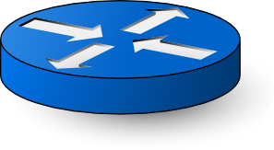
Typical network structure: Fat Trees
Spine switch
Capacities must increase as you go up the tree
Agg switch
ToR switch
…
Rack

Slide 4
Goals
Terminology:
tenant/customer and provider
Virtual NIC (vNIC): network interface exposed with SR-IOV or network namespaces
(1) Place tenant workloads on any physical machine
(2) Scale or migrate tenant workload across physical machines at any time
(3) “Simplify configuration” for everyone involved
Views of tenant addresses and interfaces
Tenant apps using load balancing, DNS-based IP discovery, etc.
Provider’s ability to plumb tenant workloads together
Migration from on-premise compute cluster to shared cloud

Slide 5
Design Choice (1): L2 or L3?
L2: zero configuration, but doesn’t scale due to broadcast
Support seamless migration within L2 network
Broadcast storms: learning switch, ARPs
Scale broadcast by isolating physical machines into VLANs. However, this requires configuring physical switch ports. Complicates migration.
L3: no broadcast, but configuration needed to run routing protocols
Configure both endpoints (e.g. gateways) and routers (IP prefixes)
Migration is not cheap but doable with a little work
e.g., with BGP, we know how to propagate reachability information changing over time in a scalable fashion

Slide 6
Design Choice (2): CA’s or PA’s?
Do VMs/pods use their own “customer addresses” (CA’s) or use the infrastructure’s “provider addresses” (PA’s)?
PA’s: supporting routing is “business as usual”
But one tenant’s ports affected by other tenants on same machine
Need static allocation of ports to tenants, or dynamic port discovery
Reduced isolation, more complex configuration, app changes
CA’s: dedicated IP per VM/pod, visible to applications
Clean and backwards compatible. e.g. DNS
If VM/pod A sees its own address to be X, any VM/pod B talking to A also thinks that A has address X. A is reachable with CA address X.
However, need to design networking to route between CA’s,
Example: migrate VMs/pods across PA’s with unchanging CA

Slide 7
Networking in a multi-tenant data center
Address virtualization: VMs/pods use own addresses (CA’s)
Physical network does not know how to route CA’s
Additional software to translate CA’s between PA’s: Tunneling
Tunneling endpoint (TEP): software tun/tap interface, NIC hardware, or software switch in a hypervisor. Overlay.
TEP encapsulates and decapsulates packet headers (VXLAN, GRE)
Topology virtualization: Tenants should be able to bring own custom network topologies or assume “one big switch”
Facilitate migration into public cloud, consistent view for tenant’s monitoring and maintenance tools, etc.
Supporting virtualized service models
e.g. rate limits and isolation across tenants sharing a physical machine

Slide 8
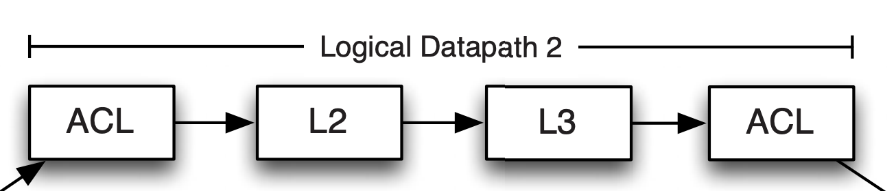
Example 1: Nicira Virtualization Platform
NVP: Motivated by migration of on-premise cloud workloads as seamlessly as possible to cloud
Address virtualization: VM’s see and use CA’s
Topology virtualization (bring your own topology)
packets processed through logical switch/router tenant topology
Tables populated by classic routing protocols (e.g. OSPF, BGP)
Edge: logical datapaths and TEPs (vNIC → hypervisor OVS)
Network core is a simple pipe that routes between TEPs

Slide 9
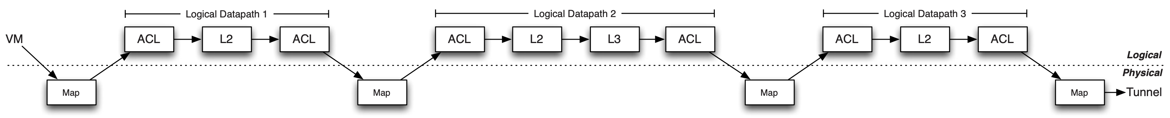
Topology and Address Virtualization
Topology virtualization
Effect: Move packets from source vNIC to dest vNIC
Address virtualization
(separation of tenant and provider addresses through tunneling)
Performance: Caching

Slide 10
SDN in NVP: Controller design
Declarative design: language to specify tuples of rules/relations
No need to implement a state machine to transition rule sets
Use a compiler to emit correct, up to date logical datapaths (tuples)
Shared-nothing parallelism to scale
Different logical datapaths easily distributed
“Template” rules output from logical datapaths may be independently specialized to specific hypervisors and VMs
Controller availability maintained using standard leader election mechanisms
Control and data paths fail independently
Existing OVS hypervisor rules can process packets even if controller fails
Fast failover through precomputed failover installed in the data path

Slide 11
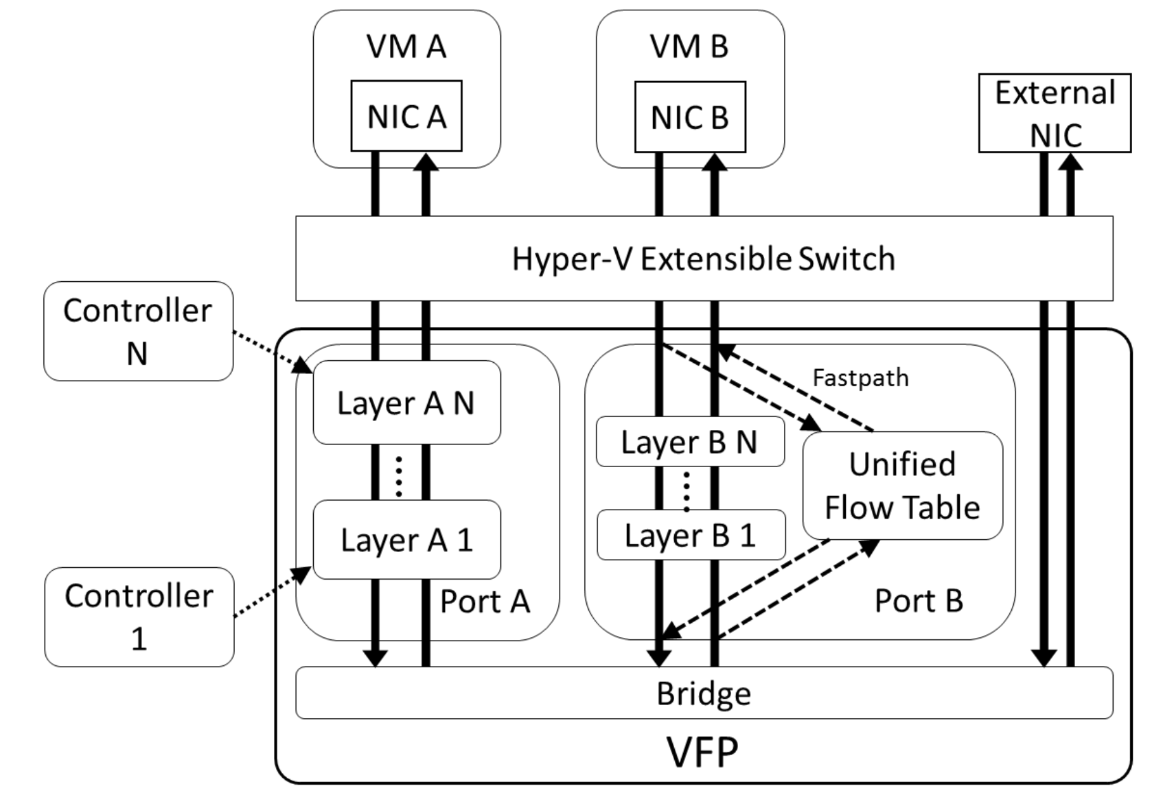
Example 2: Azure VFP
Tenants use CA-space addresses
One big switch
Multiple controllers, each programming distinct layer(s)
Layer implements a part of the policy: NAT, etc.
The TEP itself is a MAT
Stateful actions (e.g. NAT) are first-class citizens
Unified flow tables (caching)

Slide 12
Example 3: Kubernetes/CNIs
Container Network Interfaces: configuring networking for inter-pod networking
Within a pod, use loopback interface (e.g. service mesh)
Pods use CA-space addresses (overlay); but PA also possible (underlay)
Topology virtualization: If CA, TEP configured through
In-kernel forwarding (L3 forwarding tables, netfilter, iptables)
Bridging
Tun/tap software interface
eBPF
Can use either L2 or L3 networking to interconnect CAs

Slide 13
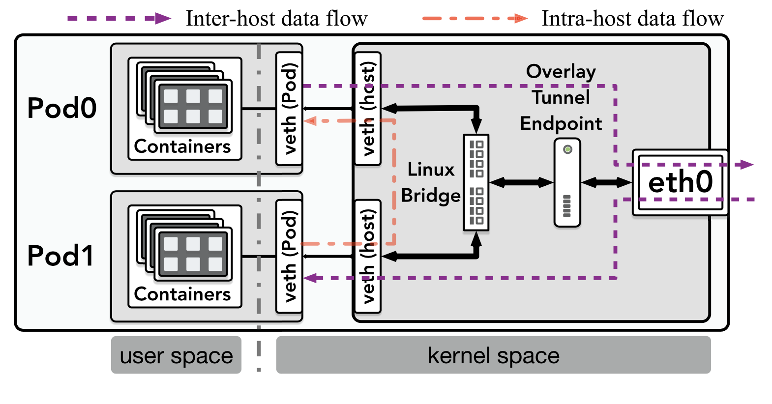
Example 3: Kubernetes/CNIs
Example with L2+L3 overlay

Slide 14
Making old software use new networks usually means making new networks behave like old ones.

Slide 15
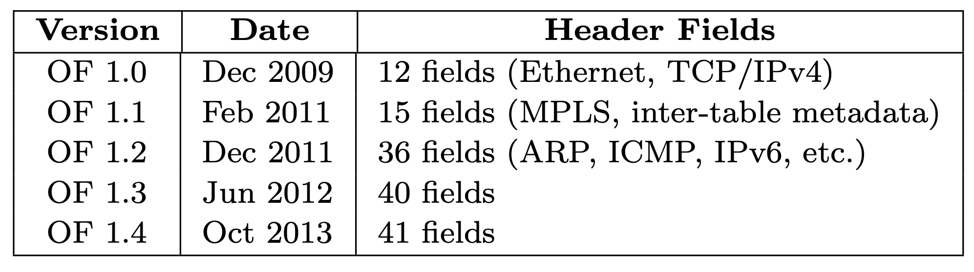
Making forwarding more programmable
Proliferation of fixed table types

Slide 16
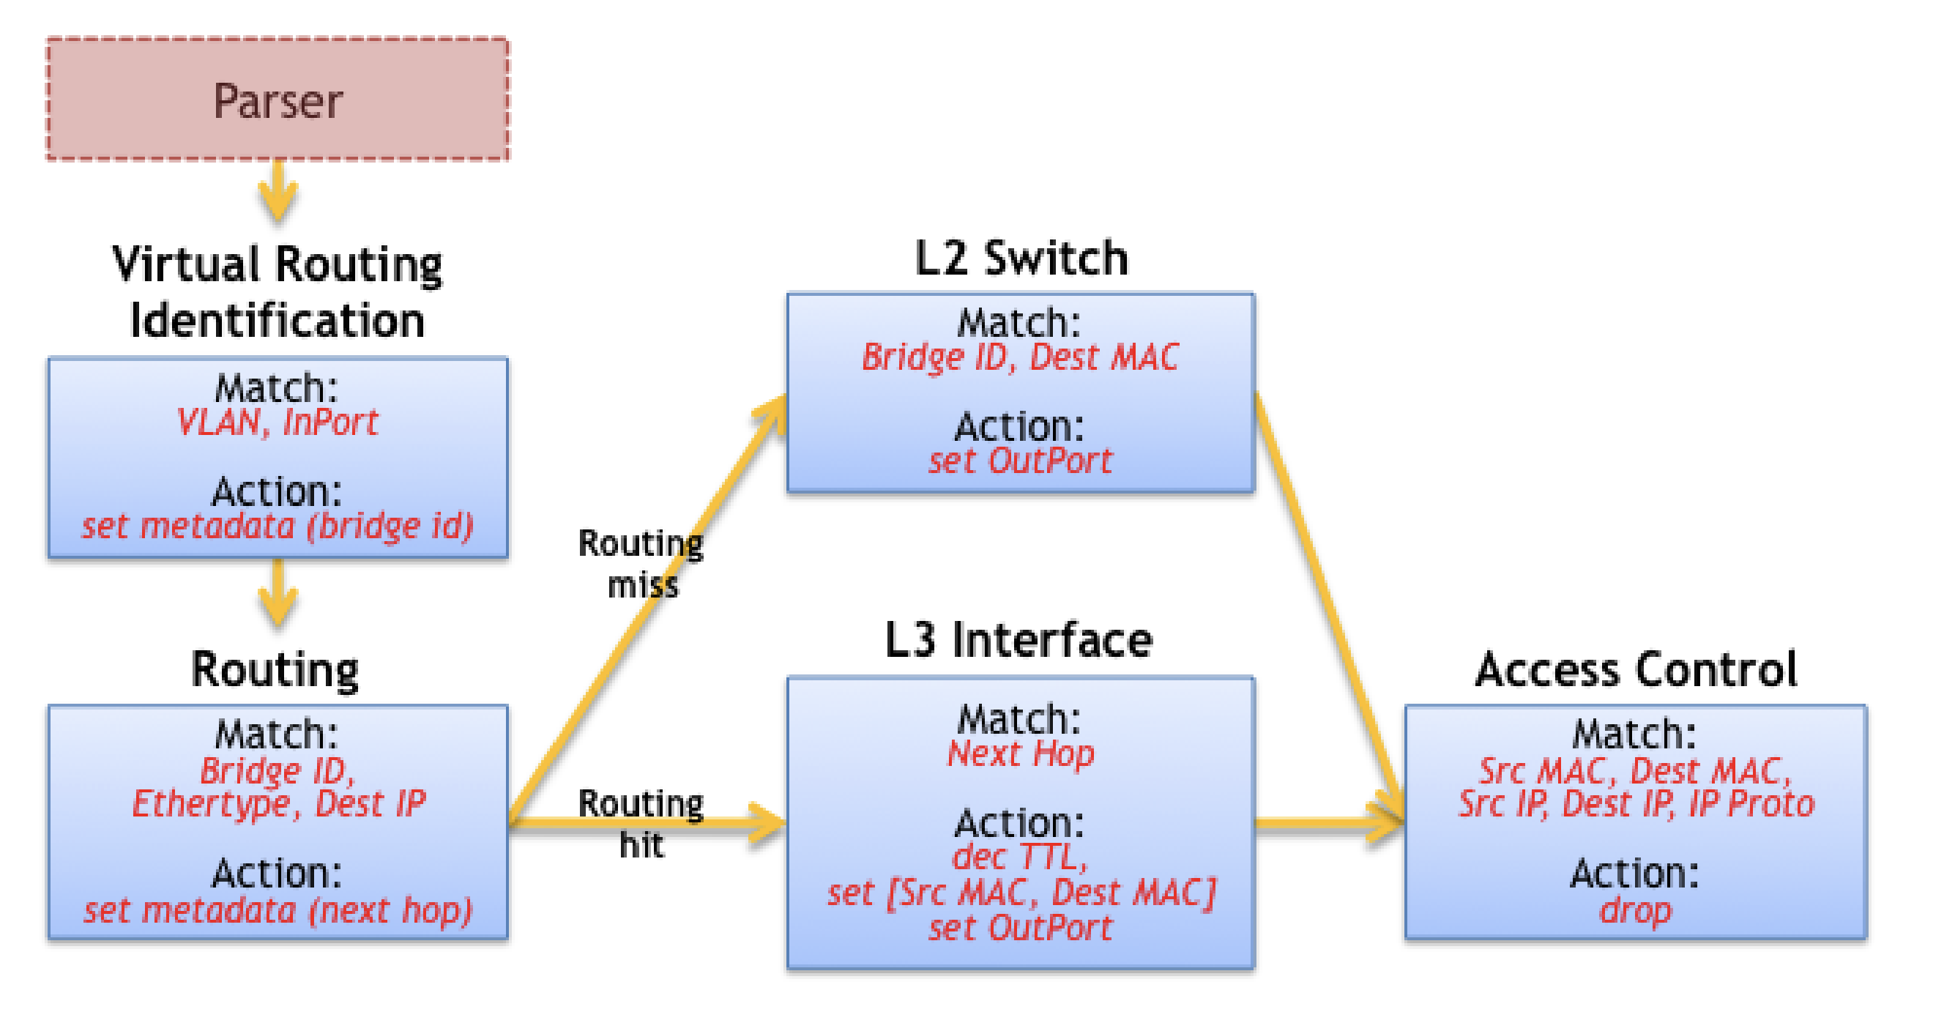
P4: Flexible Parsing & Table Dependencies

Slide 17
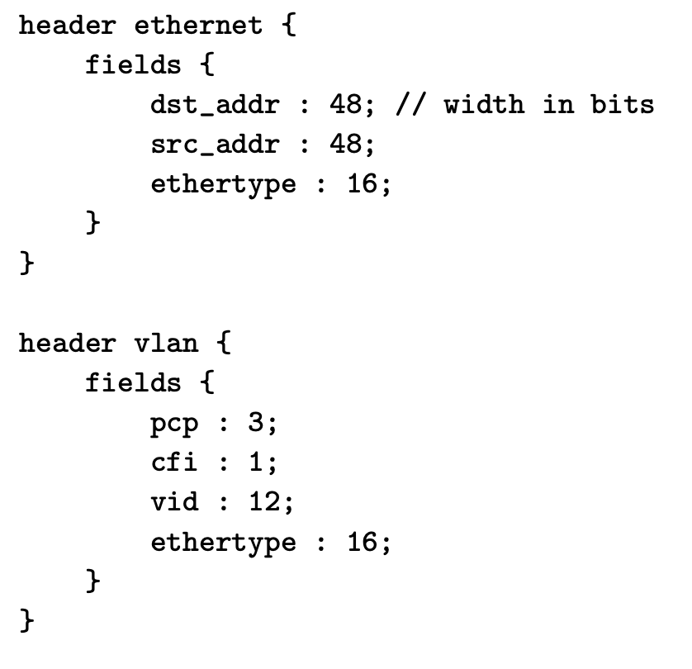
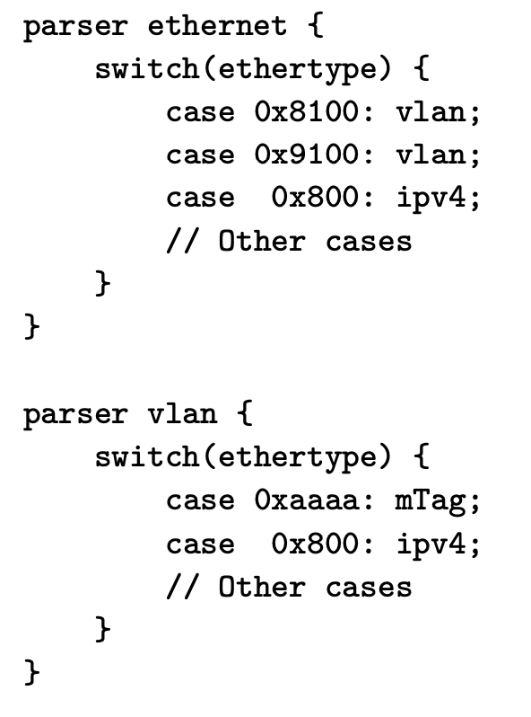
Packet Header Structure Specification

