Slide 1

Operations; Load Management
Lecture 12
Srinivas Narayana
http://www.cs.rutgers.edu/~sn624/553-S23

Slide 2
Operations
How to run and manage an Internet service?
Monitoring, security
Load management
Release engineering, canarying
Crafting and maintaining SLOs
People and processes
Incident response, postmortems
Designing and managing configurations
…

Slide 3
Load management
Global: How to direct user load across clusters?
Key: Performance considerations
Query traffic: Low latency
Data uploads: High throughput
Local: Within a cluster, how to manage the load?
Machines within a cluster are presumably similar to each other
Key: Avoiding hotspots and reducing overprovisioning

Slide 4
“Global” load balancing
Primary mechanism: DNS
DNS response sizes are bounded. Client will just choose randomly from among responses; don’t know who is closest.
Use IP anycast to talk to “nearest” (acc to BGP) authoritative DNS servers. Auth servers redirect user to closest through a single DNS response.
Problem: clients rarely talk directly to auth DNS server (go through recursive resolvers). Resolvers hide client count and geo-diversity. They also cache responses.
Mitigations: estimated users and geo-diversity behind resolvers. Issue low TTL responses (adds latency)

Slide 5
Alternative: Virtual IP address
Use a virtual IP address (VIP) to cover many real IP addresses
Hide growth, failures, maintenance in server pool from users
Use DNS with large TTL. Save latency.
Effectively decouple cluster-external from internal
Can also use IP anycast directly to get to the edge
But anycast need not be stable! BGP route flaps
Send to a different edge at any time, even in the middle of a connection

Slide 6
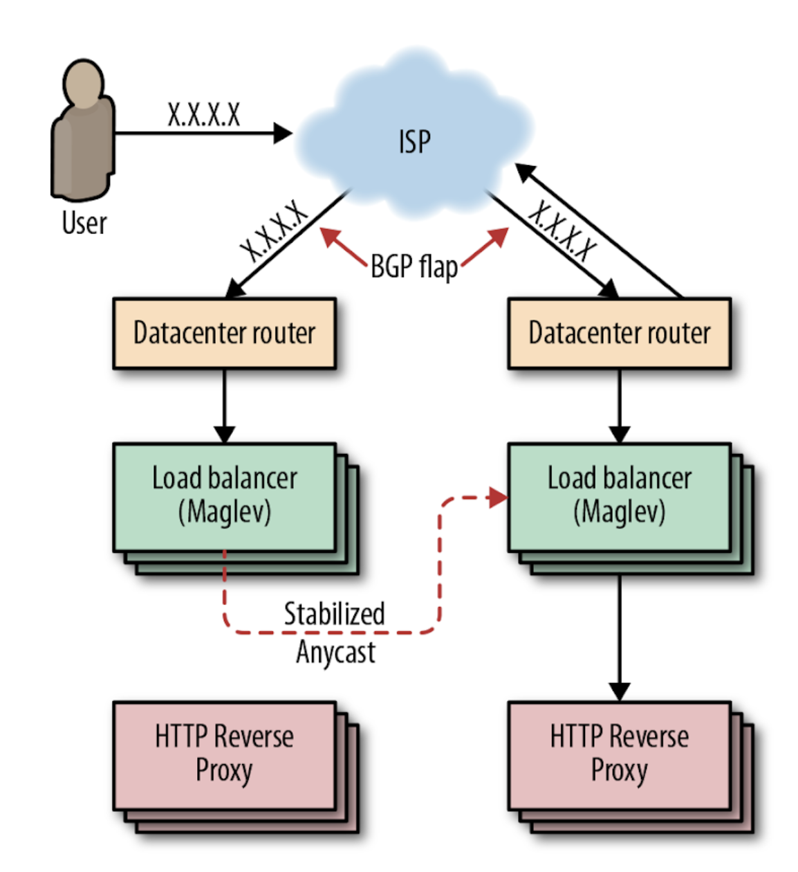
Frontend load balancing
Load balancers spray connections across HTTP reverse proxies
Reverse proxy terminates TCP/TLS and re-encrypt to backends. Maintain persistent connections to backends
Terminate TCP/TLS as close to the user as possible
ECMP: easily add more Maglev LBs to pool
Stabilize anycast through consistent hashing. Cannot rely on connection state being shared across Maglev LBs.

Slide 7
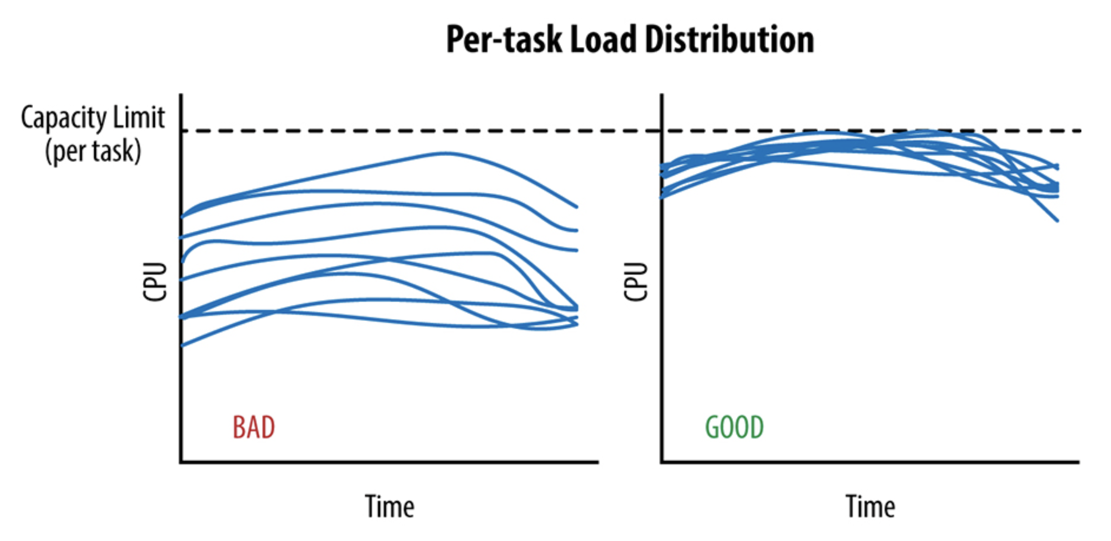
Even load is critical
Uneven load == stranded resources

Slide 8
Problem: Statefulness
A user’s TCP connection must always be sent to the same reverse proxy
Important for performance advantages of reverse proxying
If not, connection breaks!

Slide 9
Connection tracking and consistent hashing
Remembering connections by putting them in a connection tracking table: 5-tuple → backend
Not always possible
Even the load balancer forwarding a packet may change mid-connection
SYN floods and crowds may overwhelm connection tracking table
If a packet’s connection cannot be found in the connection, use a hash function h(packet) to determine the backend
Naïve choices: break connection when proxy pool changes
Need consistent hashing: even if the backends change, the backends for existing connections should be minimally disrupted

Slide 10
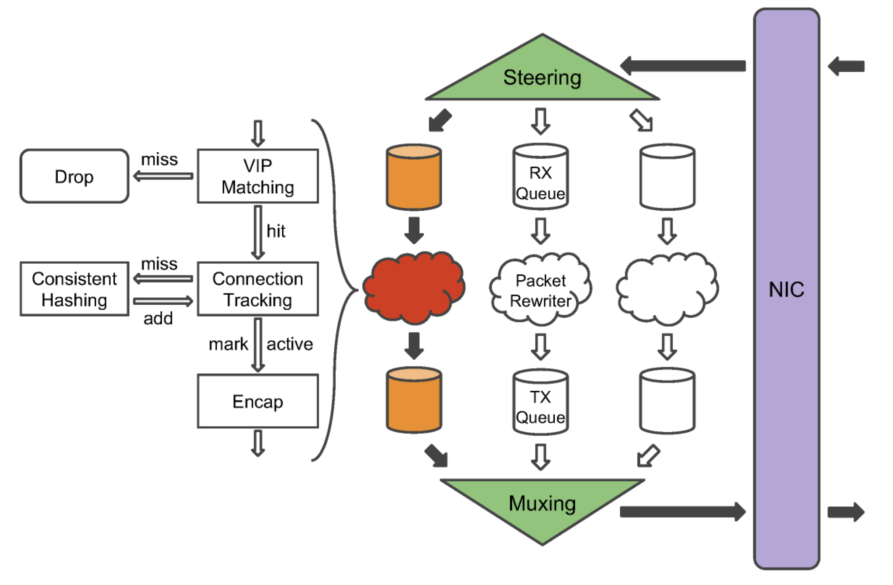
Maglev forwarder
Multi-threaded (parallelism)
Don’t share state across threads. Each 5-tuple steered to a core.
Connection tracking table is local to the core

Slide 11
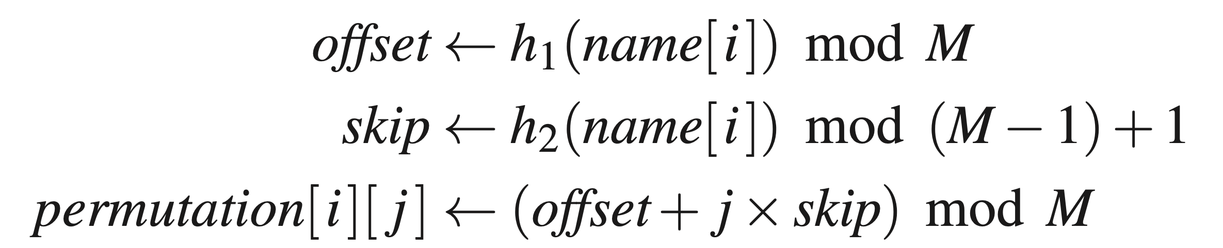
Hash table population
Backends choose slots based on permutation.

Slide 12
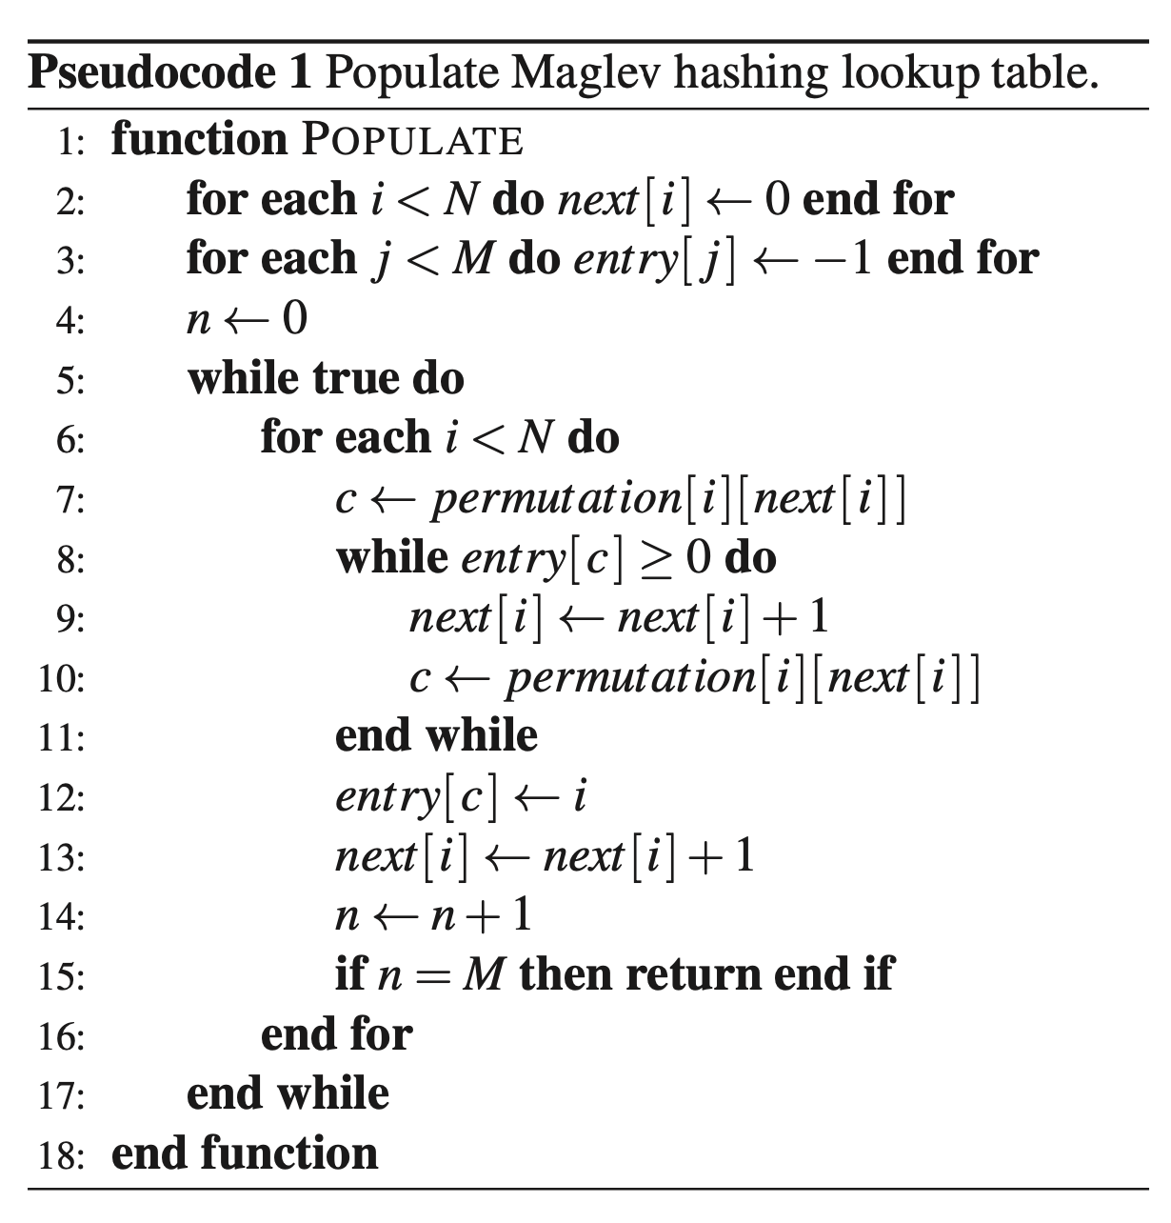

Slide 13
Actual packet forwarding
(1): NAT tables: map incoming connections to outgoing
Stateful; large tables
(2) Modify destination MAC address
Direct Server Return
But cannot have all machines in one L2 network
(3) Encapsulation (e.g. GRE). If a route exists, it works.
Server will decapsulate the packet and use DSR
Inflate packet size and possibly cause fragmentation

Slide 14
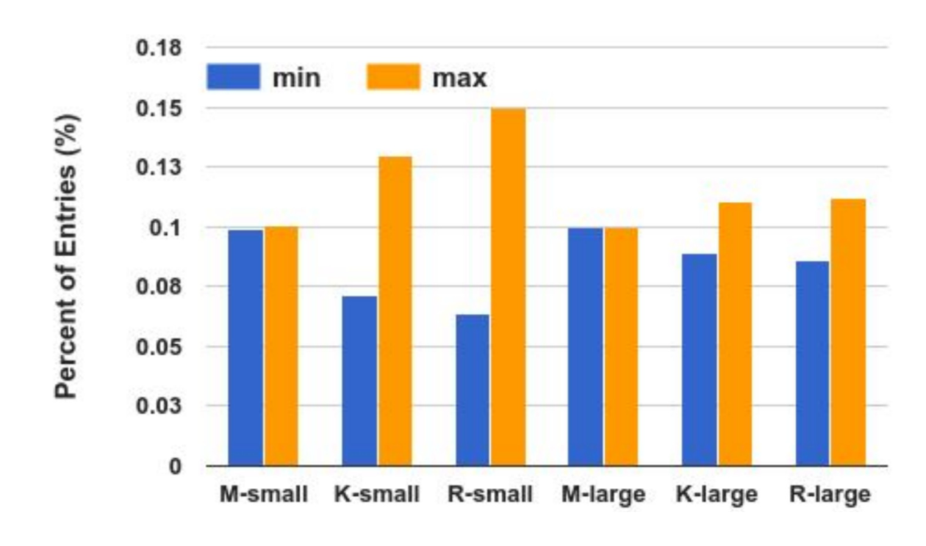
Balancing quality

Slide 15
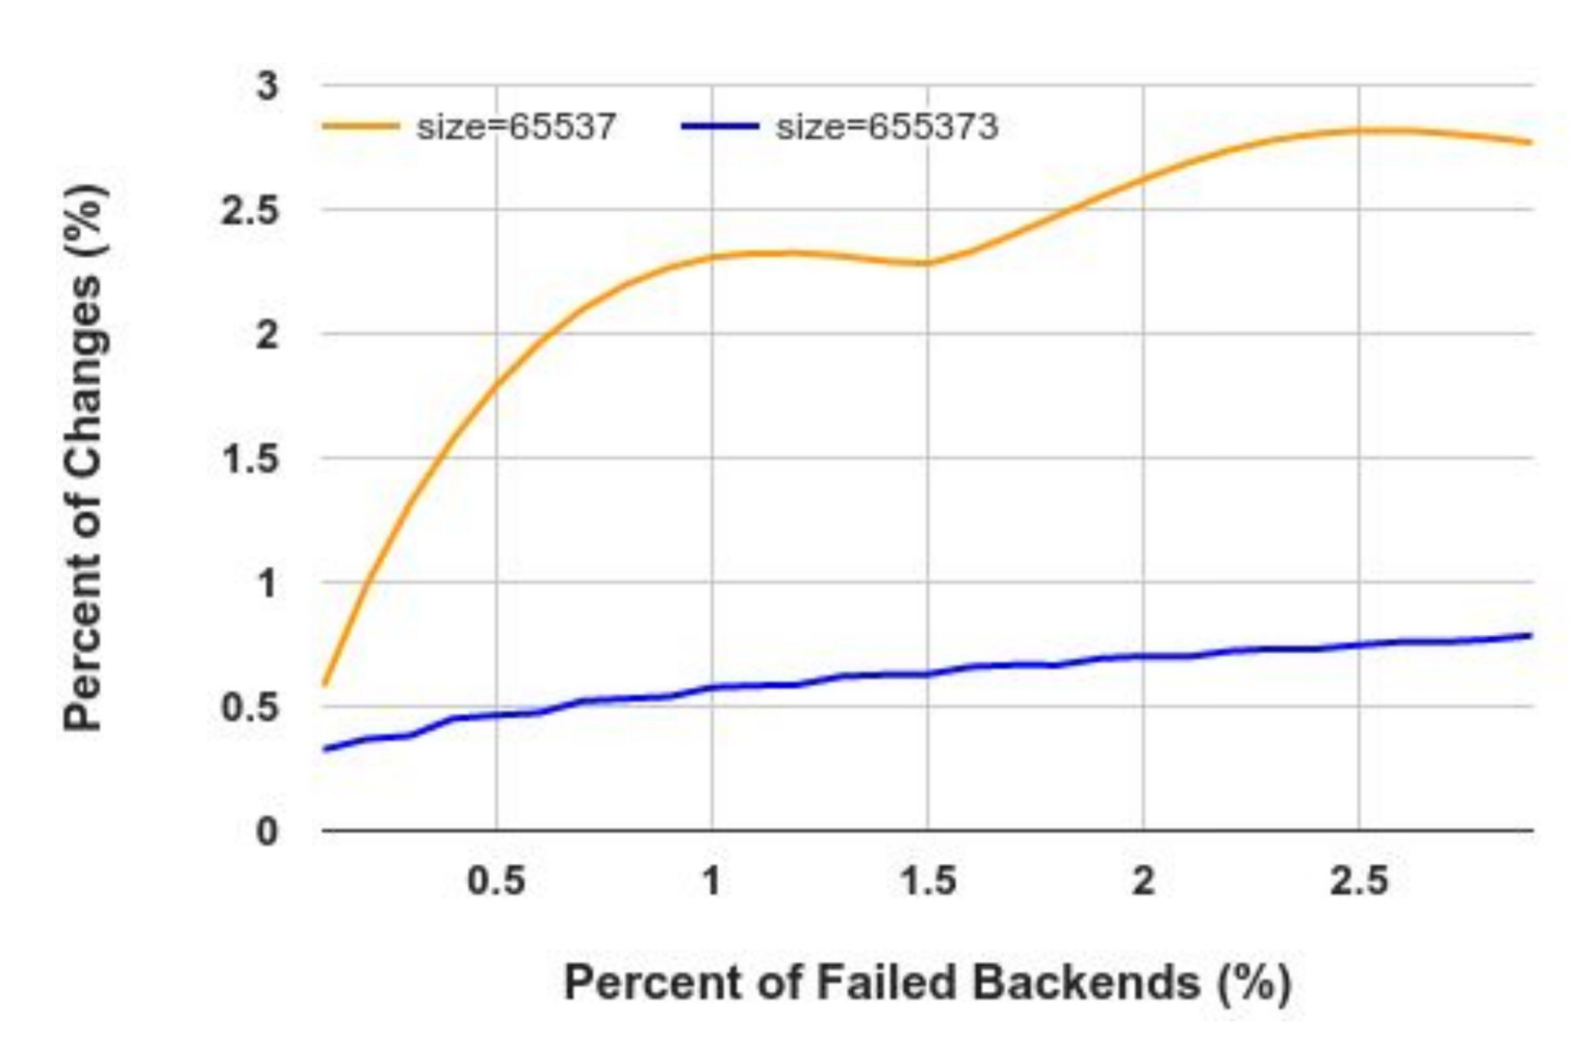
Disruptions on lookup table change

Slide 16
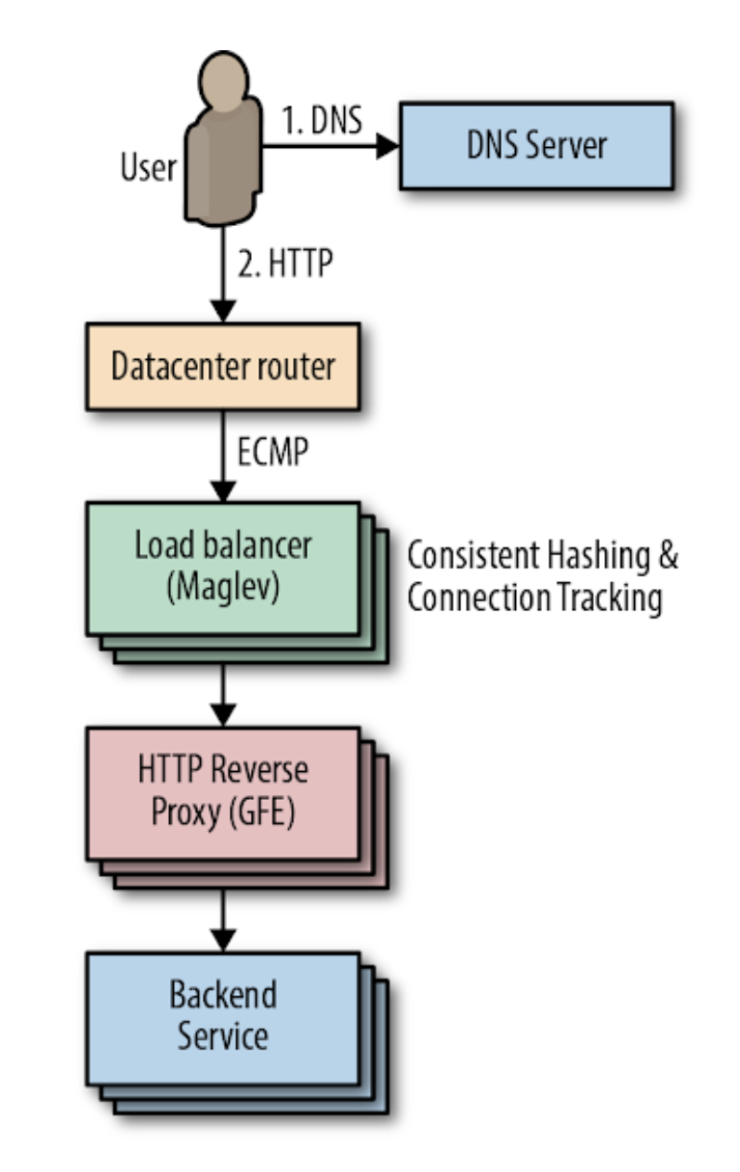
Beyond the reverse proxy
Problem 1: avoid unhealthy backends first
“Least outstanding requests”: If too many outstanding requests, avoid those backends
Only avoids extreme overload
Also, may waste capacity under diverse backend machines
“Lame duck” state: a backend can proactively signal that it is unhealthy to avoid new connections, while finishing processing requests in flight

Slide 17
Beyond the reverse proxy
Problem 2: choose among available healthy backends
Don’t maintain a connection to every backend
Connect to a subset of backends
How large?
Client load variation
# backends >> # clients
Which backends of that size?
Random subsets can be bad

Slide 18
Strategies to choose backends
Backend load and capacity agnostic: round robin. Insufficient
Small subsets: some clients heavier than others
Diversity in machine capacities (CPU architectures, speeds, cores)
Variation in work for each request (1000x). Hard to predict
Unpredictable performance changes (noisy neighbors, task restarts)
Assign to least loaded backend? (currently active load)
Good: move load away from loaded backends
Bad: Typically considers load without regard to available capacity
Bad: Long-lived requests
Bad: per-client view of load
Good approach: weighted (RR) splitting with load and error feedback from backends

Slide 19
Autoscaling
Sometimes, you just don’t have enough capacity
Vertical autoscaling
Horizontal autoscaling
Don’t just rely on server utilization metrics. For example, error codes returned very quickly have low CPU utilization
Creating new instances is never instant
Doesn’t always work:
Failure to do useful work but consuming resources
Overloading downstream dependencies by autoscaling upstream tier
Shared quotas across tiers: reason with dependencies carefully

Slide 20
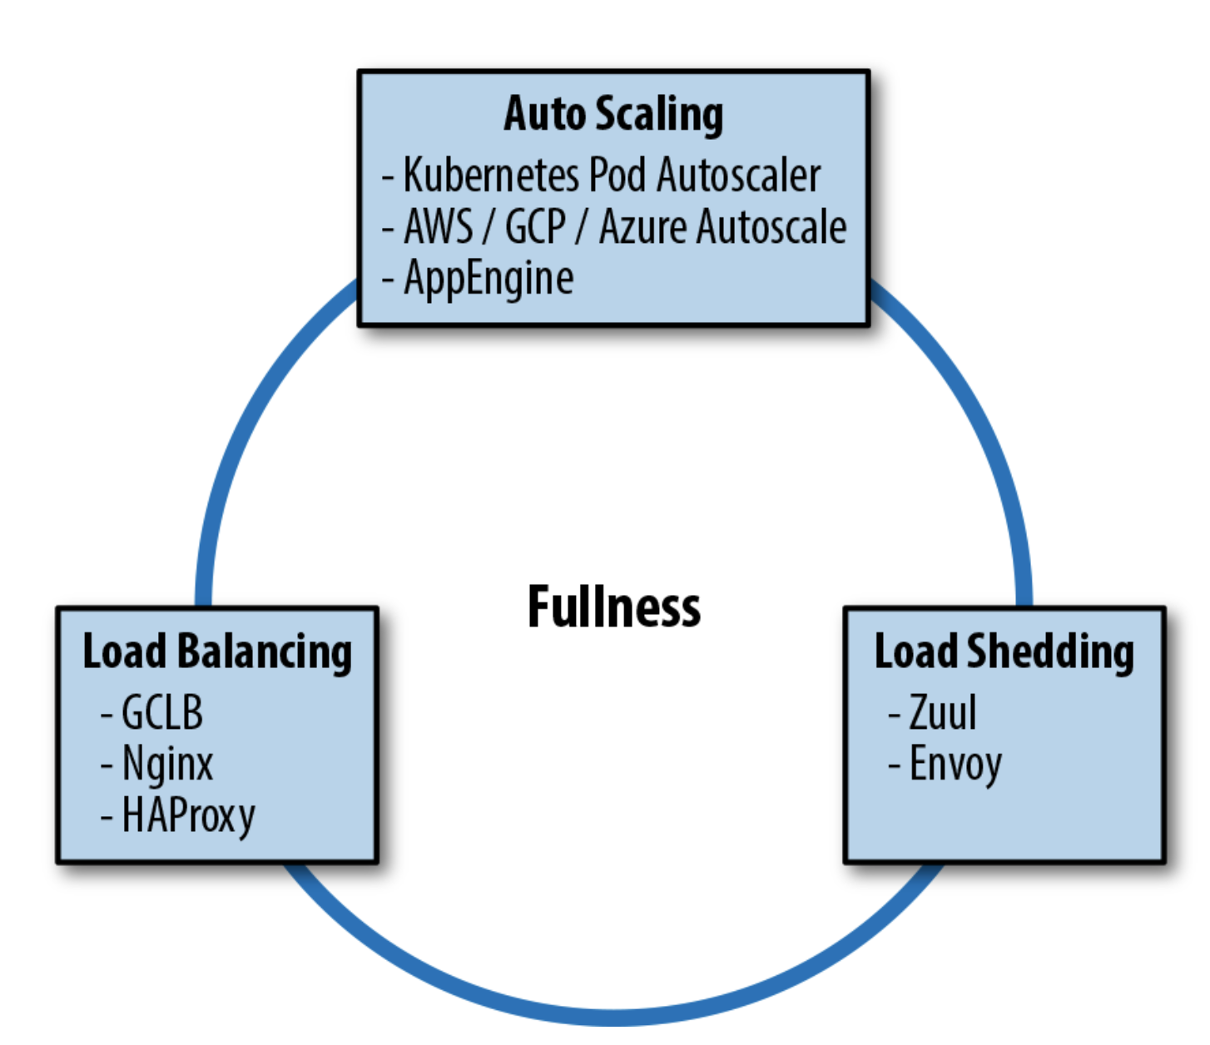
Load shedding
Return errors upon high load; process what you can
Combination of all techniques useful. But consider their interactions carefully

