Slide 1

Monitoring
Lecture 13
Srinivas Narayana
http://www.cs.rutgers.edu/~sn624/553-S23

Slide 2
Operations
How to run and manage an Internet service?
Monitoring, security
Load management
Release engineering, canarying
Crafting and maintaining SLOs
People and processes
Incident response, postmortems
Designing and managing configurations
…

Slide 3
Autoscaling
Sometimes, you just don’t have enough capacity
Vertical autoscaling
Horizontal autoscaling
Don’t just rely on server utilization metrics. For example, error codes returned very quickly have low CPU utilization
Creating new instances is never instant
Doesn’t always work:
Failure to do useful work but consuming resources
Overloading downstream dependencies by autoscaling upstream tier
Shared quotas across tiers: reason with dependencies carefully

Slide 4
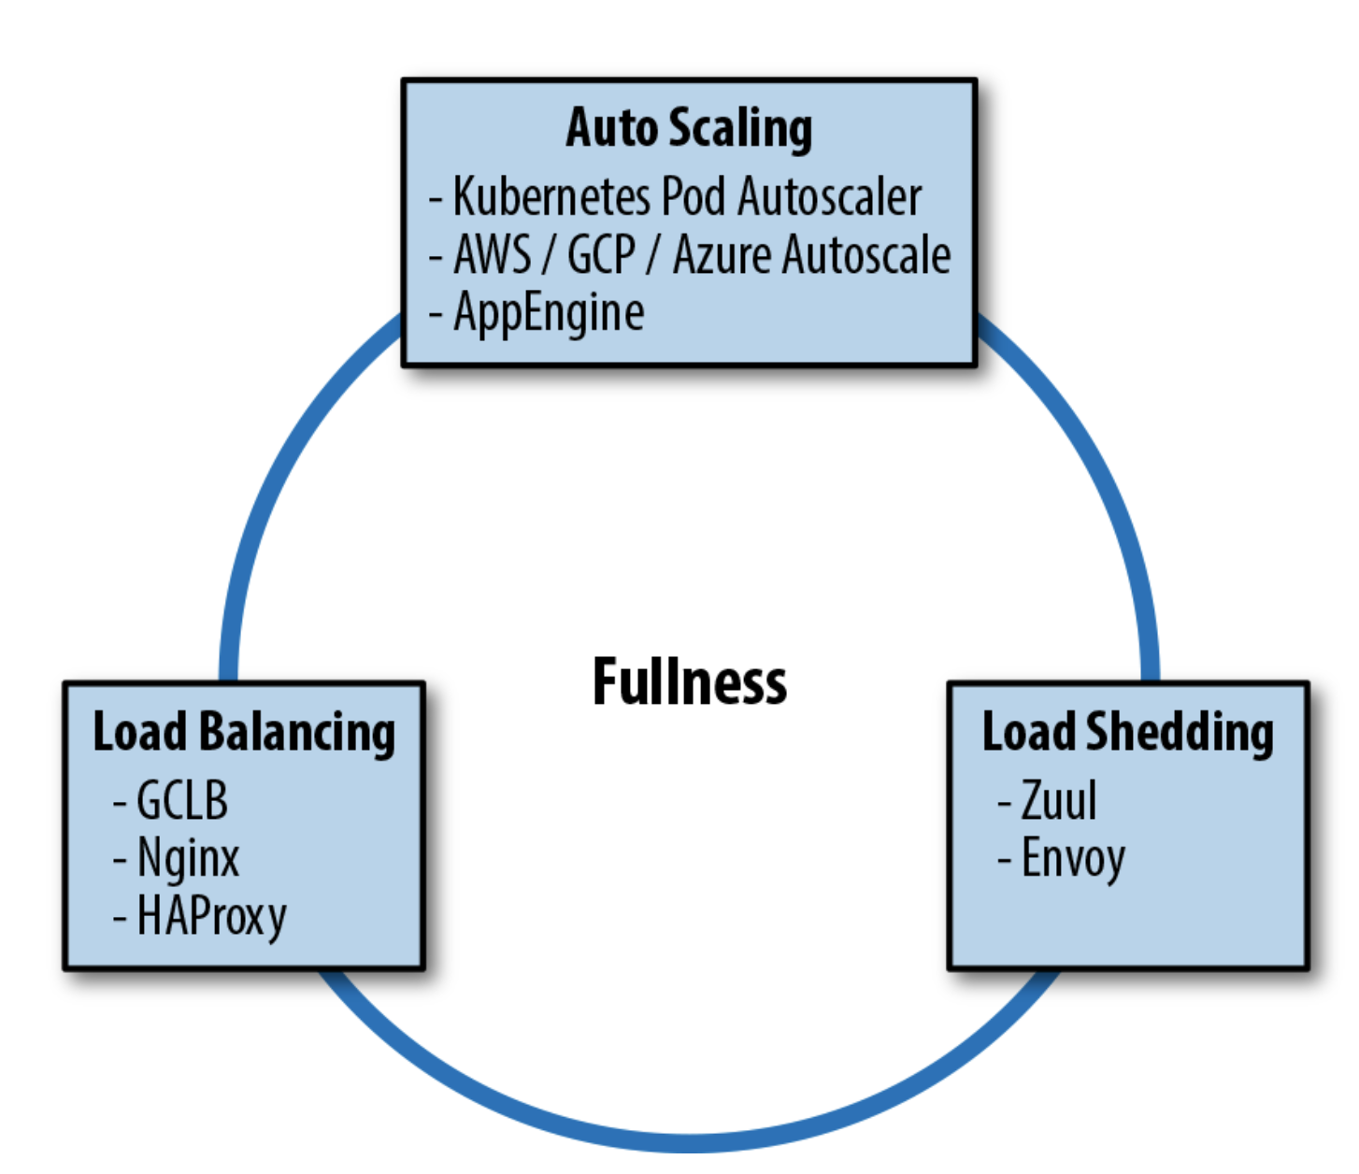
Load shedding
Return errors upon high load; process what you can
Combination of all techniques useful. But consider their interactions carefully

Slide 5
Monitoring
Distributed tracing

Slide 6
Why do we need monitoring?
Validating functionality: failures, exceptions, latencies
Understanding performance hotspots during development and after deployment
e.g. Components inducing long tail latencies
Securing user data, intellectual property, infrastructure
e.g. system calls, data exfiltration, break-ins
e.g. validating conformance to security policies: access control
Top-level view of large systems
e.g. inferring service dependencies
e.g. who is inflating the (wide-area) Internet bill?

Slide 7
Monitoring Interactive Applications
Distributed application components (microservices)
Monitoring at different levels: host, network, application
Three “pillars” of application monitoring: logs, metrics, traces
Logs: unstructured data, highly application and event specific
Metrics: aggregated data over time or requests per component
E.g. system calls, file operations within a process, etc.
Tracing: view of a single user-level request across distributed components

Slide 8
Taxonomy of tracing systems
Closed box and open box monitoring
Libraries and agents
System events and application events
Inter-process and intra-process events

Slide 9
Goals for Tracing systems
Application transparency
Low overheads
Scalability to large applications
Privacy of user data
Interpreting and annotating traces with additional metadata
Joining with other telemetry data
Today: closed box tracing using libraries to monitor inter-process application-level events

Slide 10
Spans and traces
Span: a process-level annotated event
Trace: a series of spans linked to each other by being a part of the same high-level client request
Q1. How to instrument applications to produce spans?
Q2. What should spans contain?
Q3. How are spans related to one another to produce a trace?
Q4. How to extract the data of spans from the application?
OpenTelemetry
Jaeger
Dapper

Slide 11
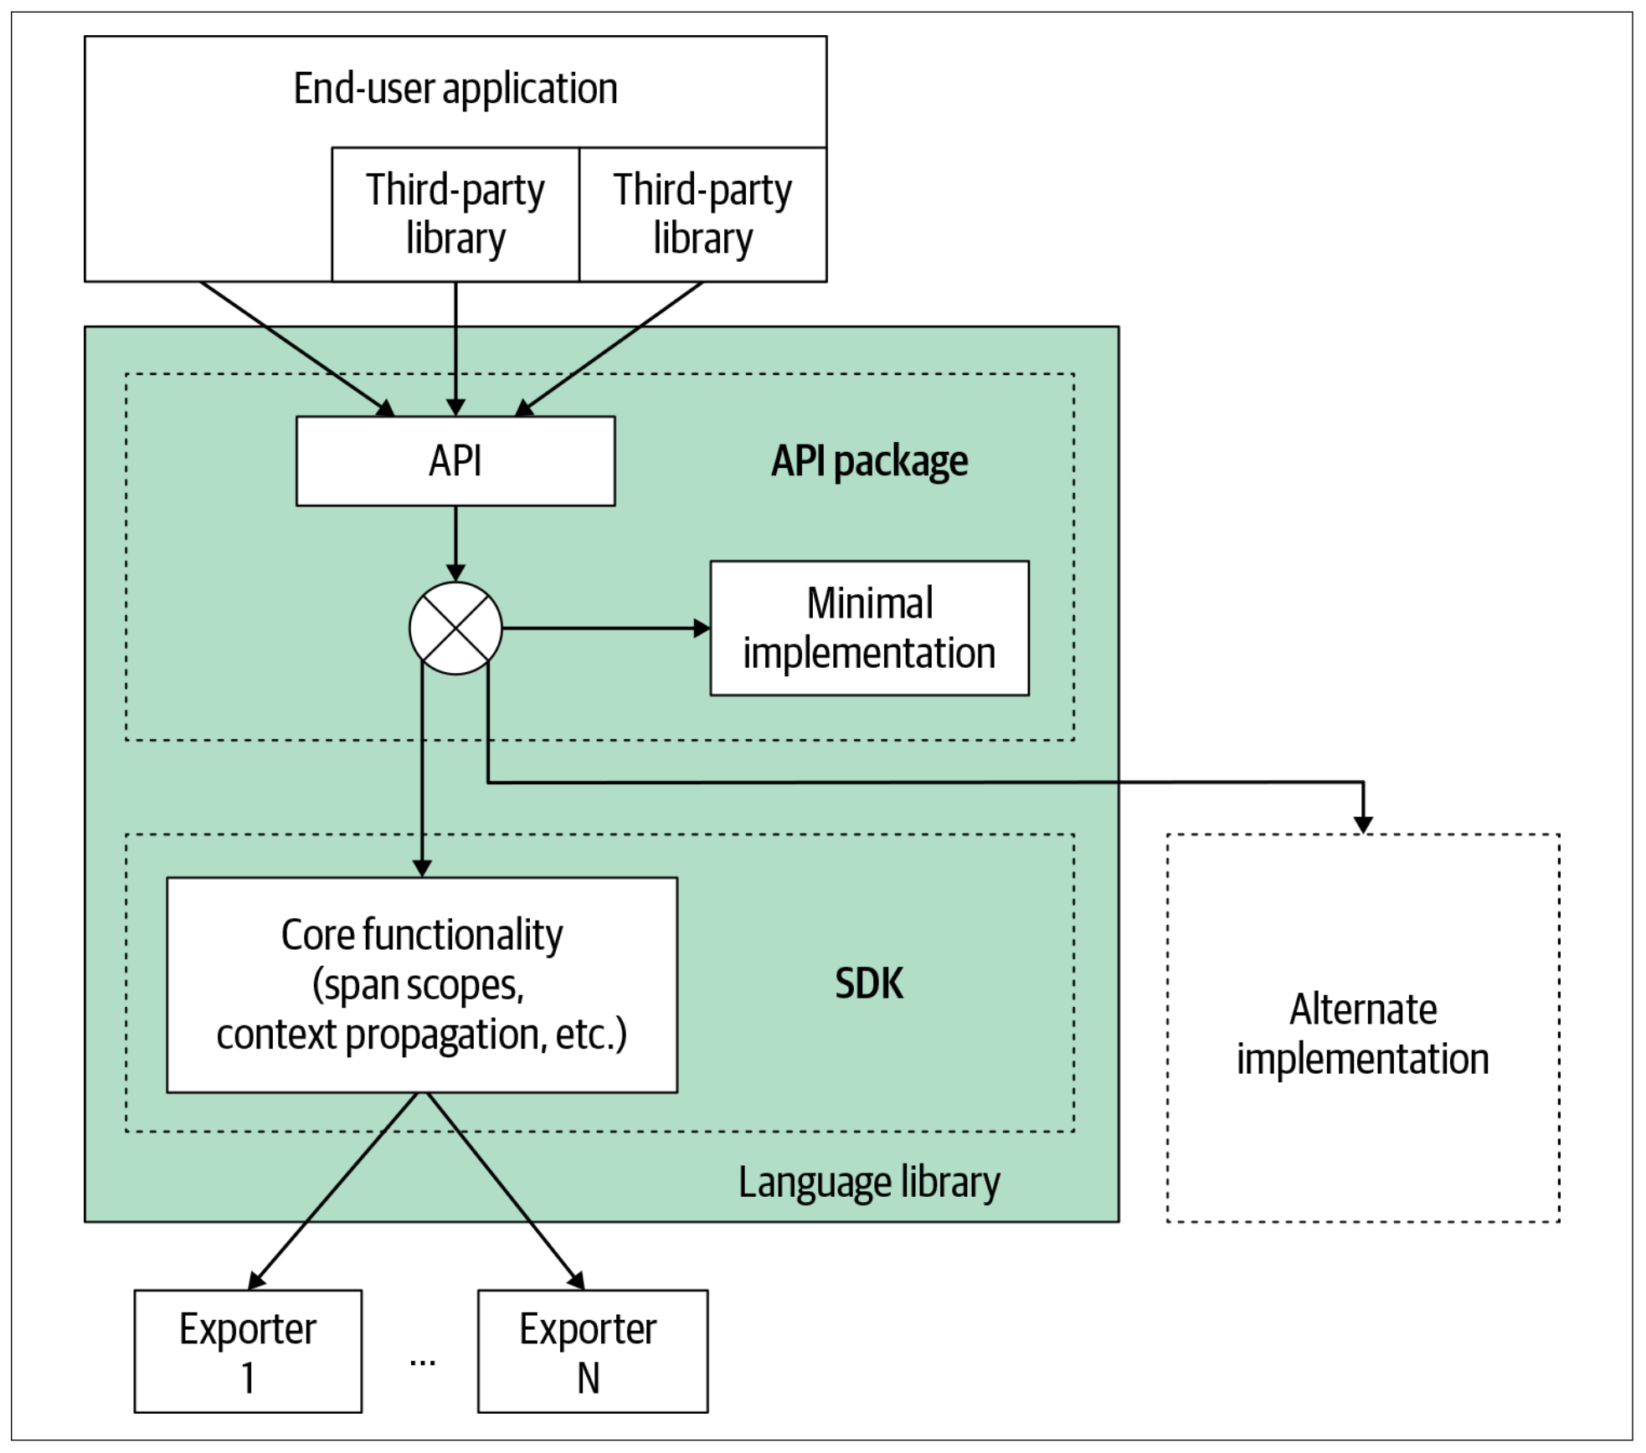
Instrumentation: OpenTelemetry
Instrument widely used libraries rather than having each app instrument itself.

Slide 12
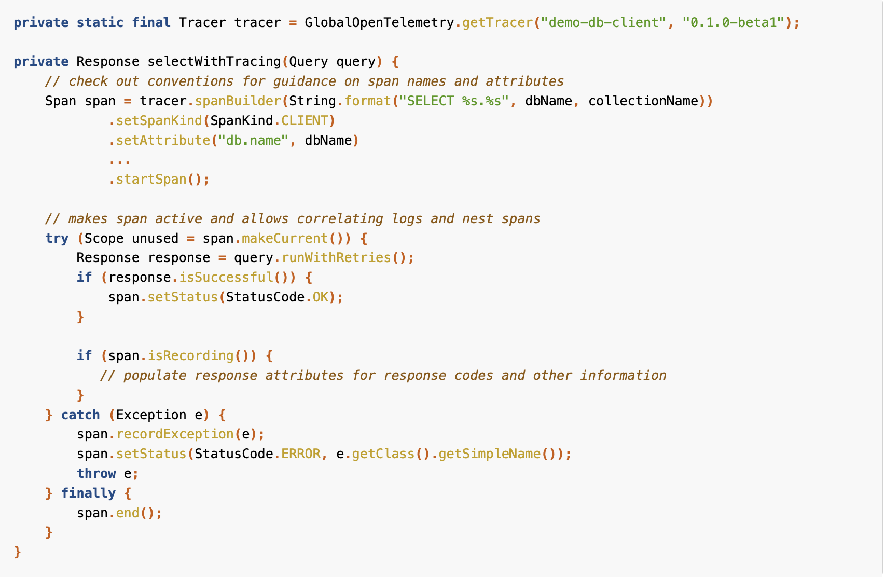
Instrumentation: OpenTelemetry

Slide 13
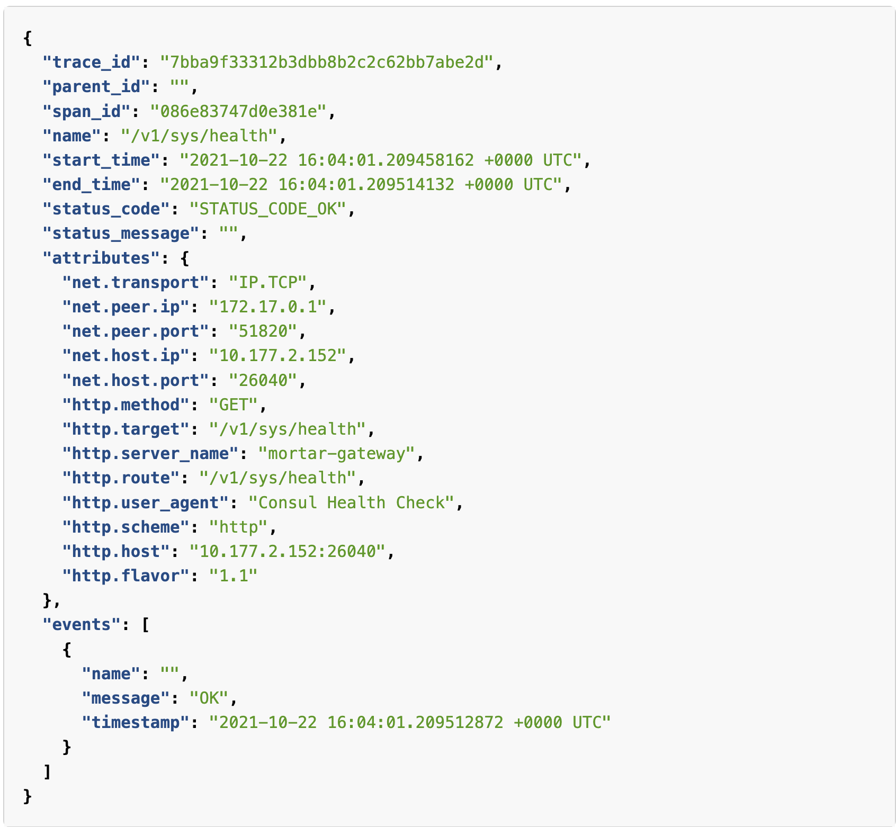
Example span: OpenTelemetry

Slide 14
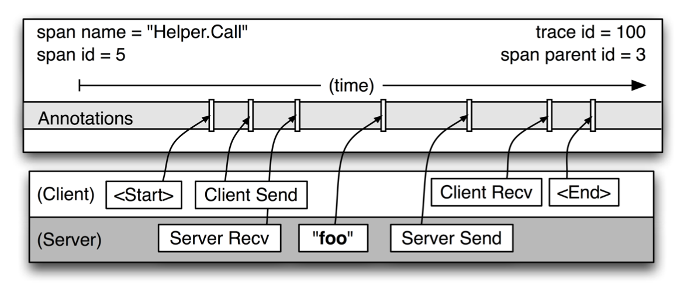
Example span: Dapper

Slide 15
Combining spans into traces
Carry all spans in headers between microservices?
Baggage: keep it small
Carry parent-child ID relationships
Trace IDs: probabilistically unique integers
Actual mechanism of propagation: HTTP/RPC protocol headers (inter-process); function call arguments (intra-process)

Slide 16
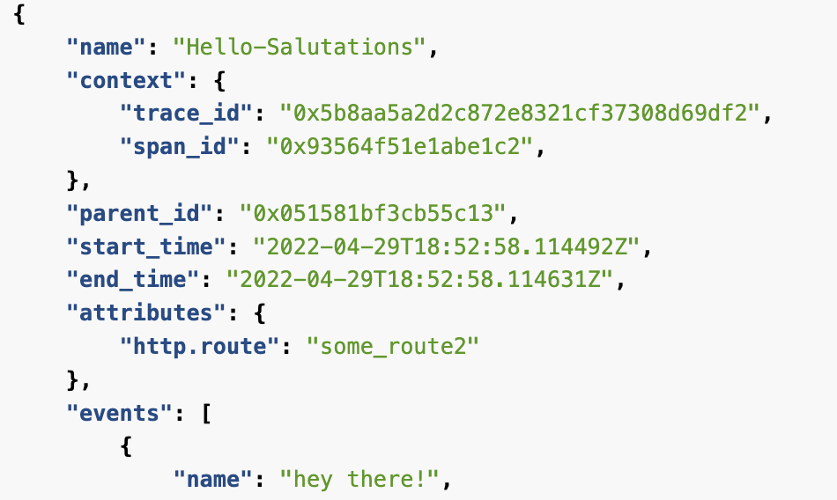
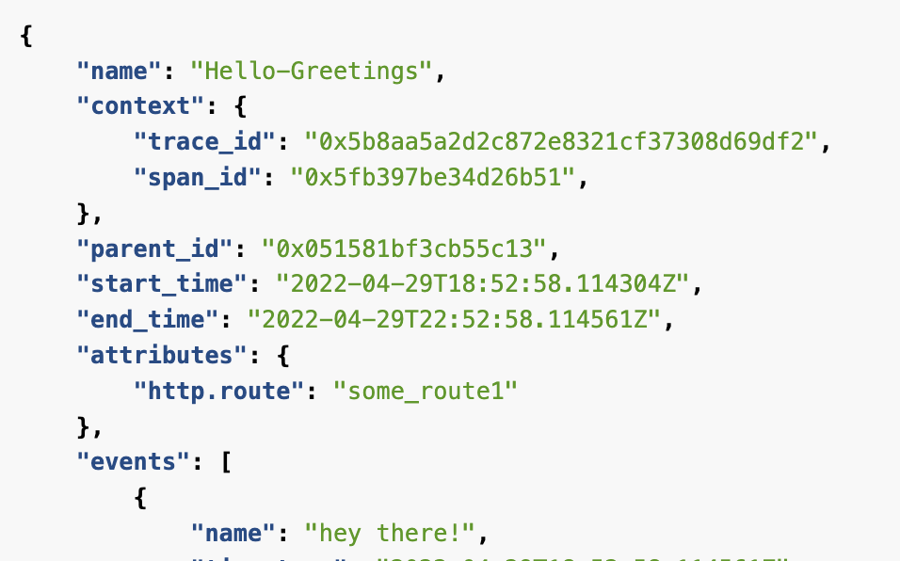
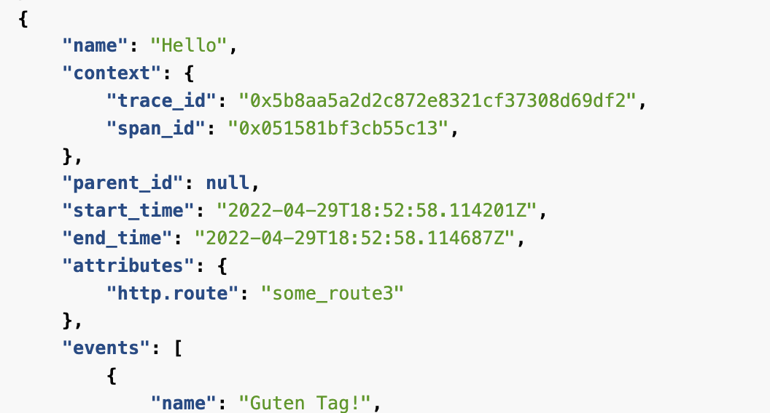
Trace: putting spans together

Slide 17
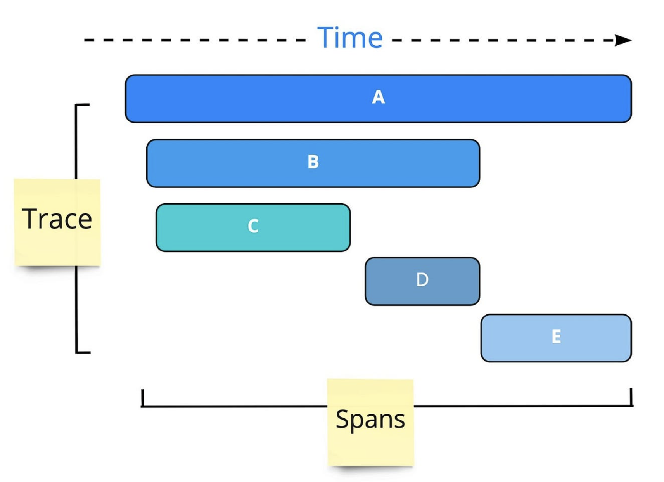
Visualizing traces

Slide 18
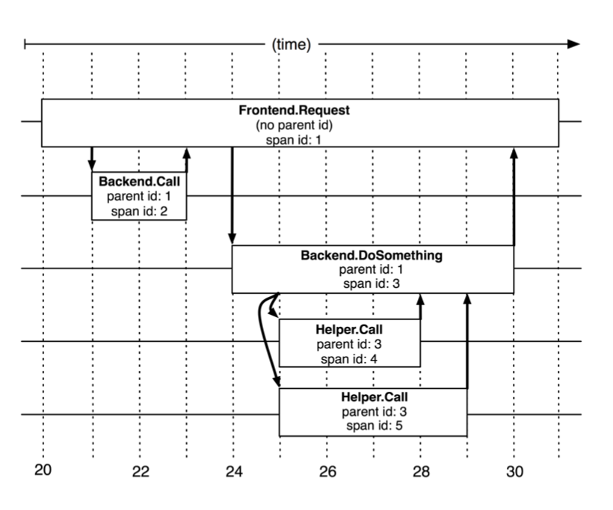
Visualizing traces

Slide 19
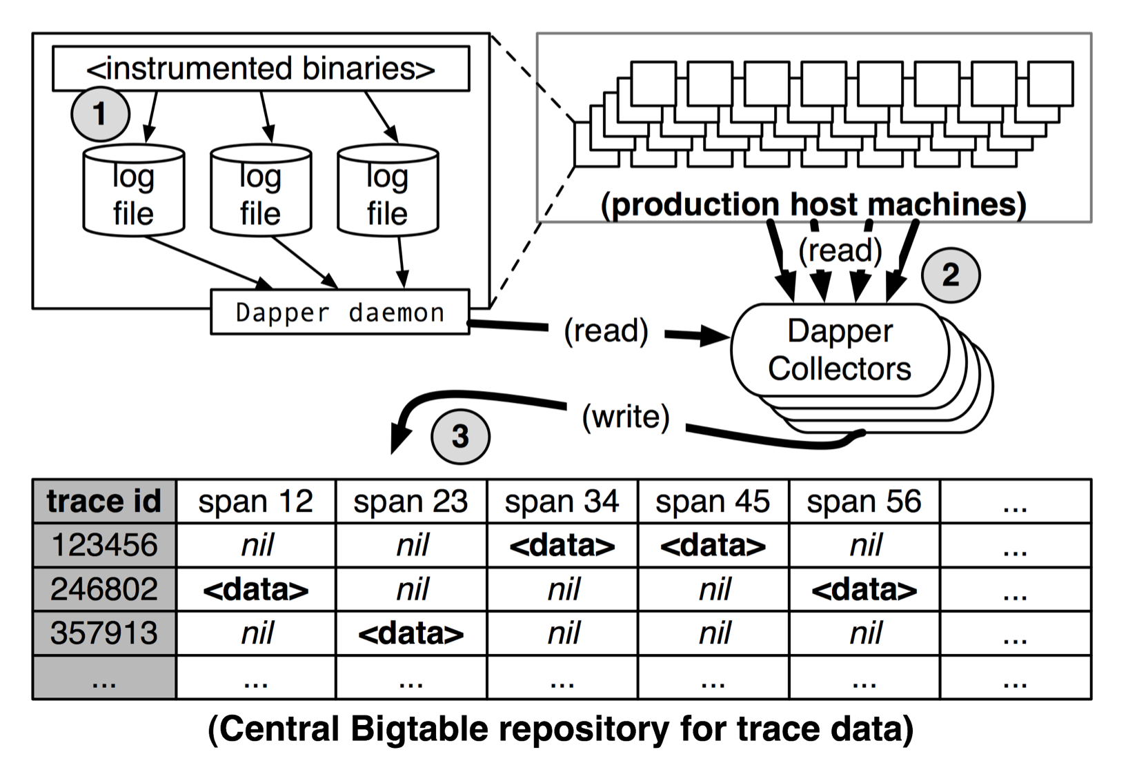
Google Dapper system

Slide 20
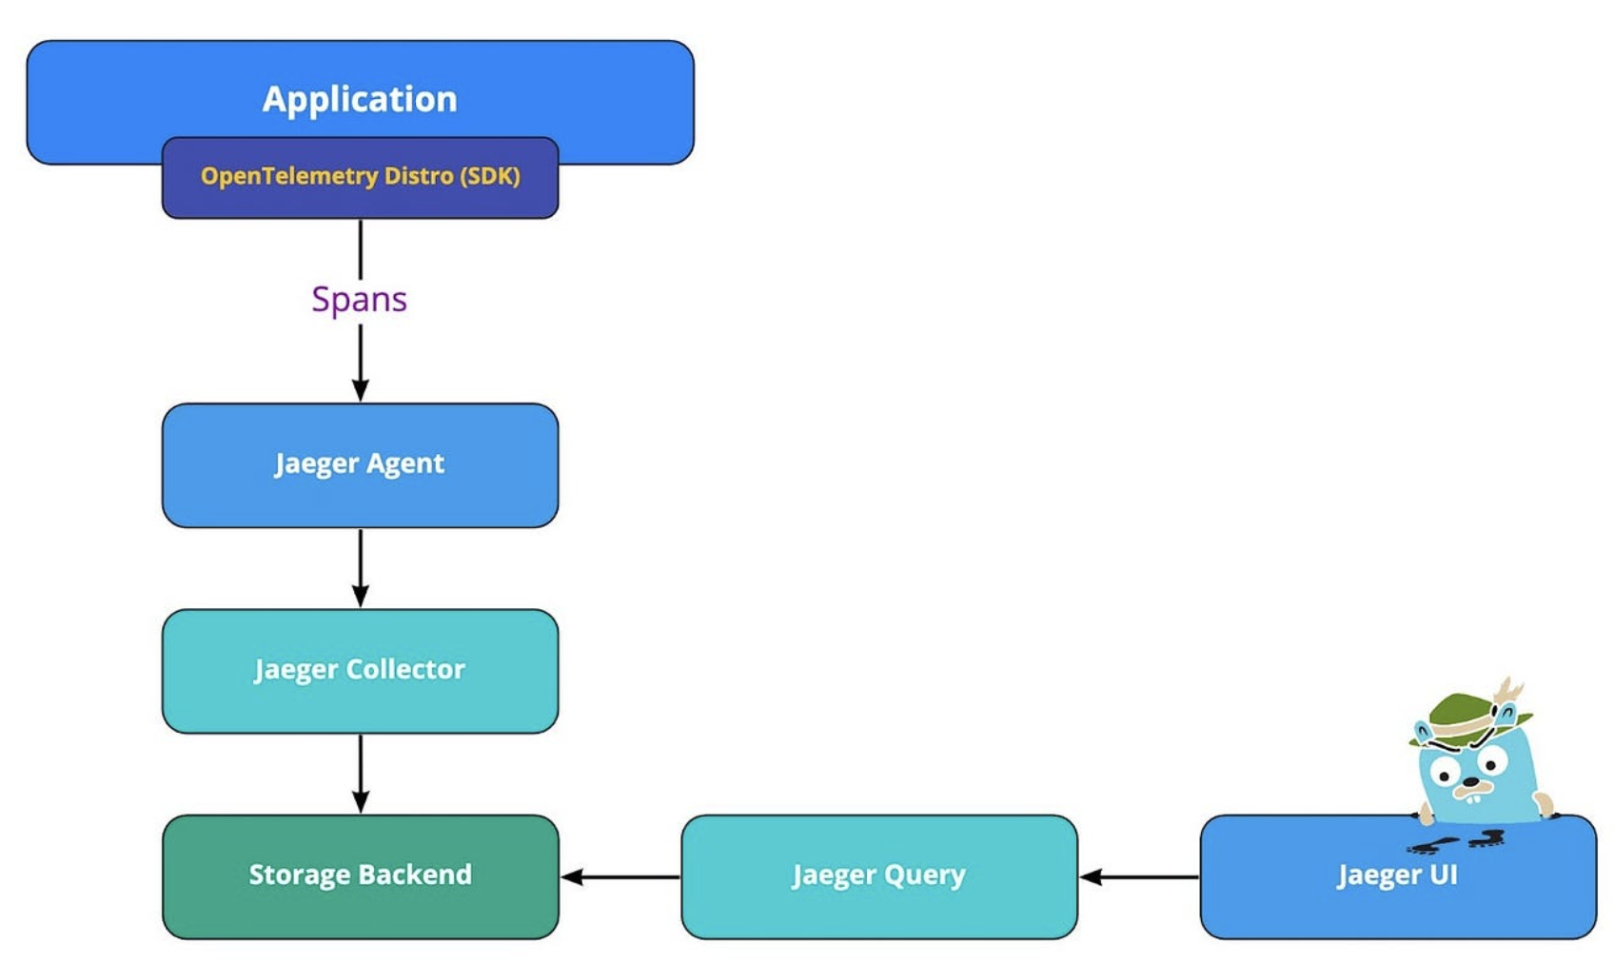
Jaeger trace collector

Slide 21
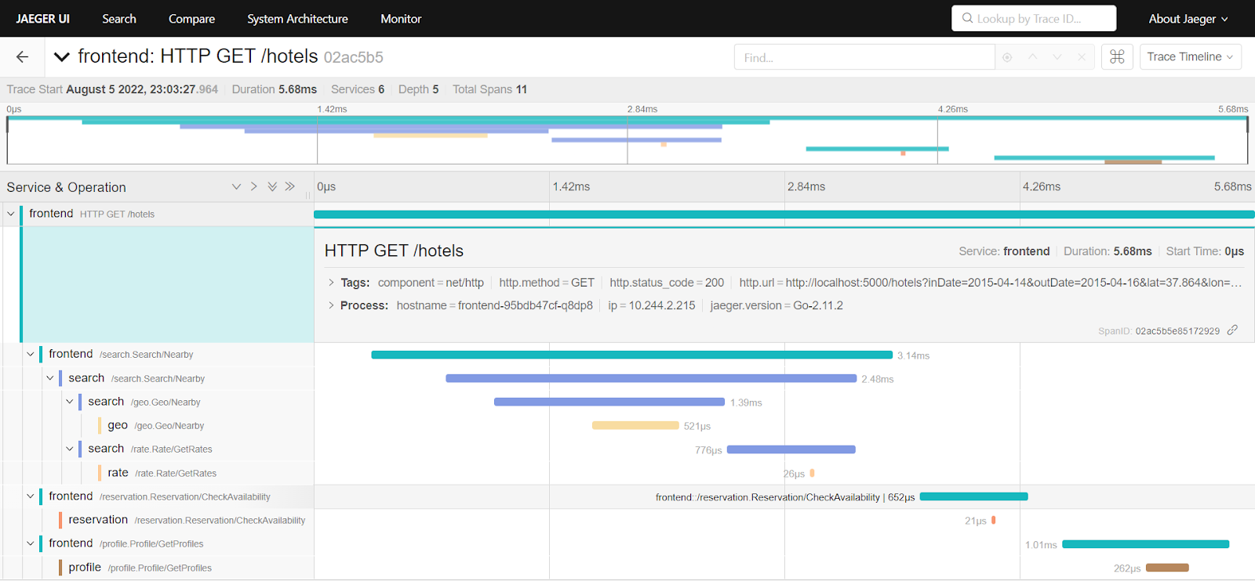
Jaeger trace example

Slide 22
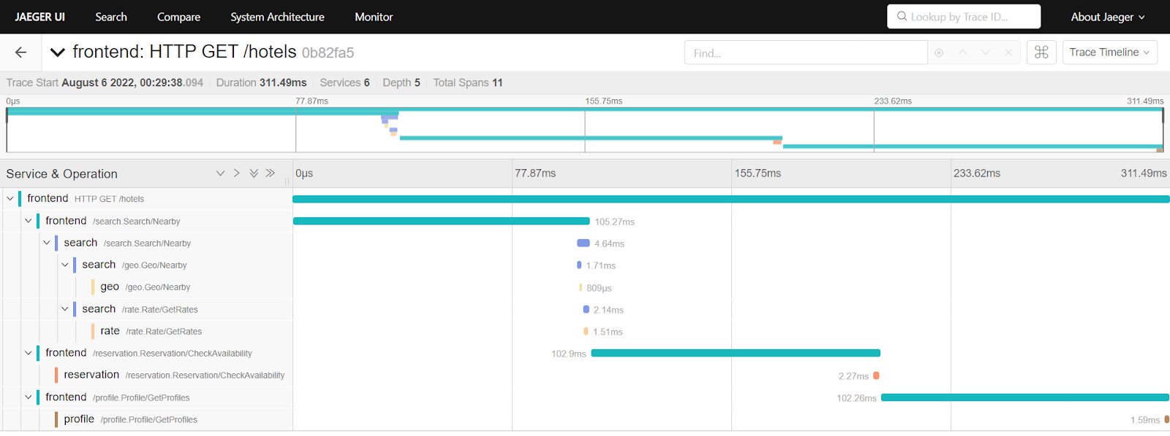
Jaeger trace example

Slide 23
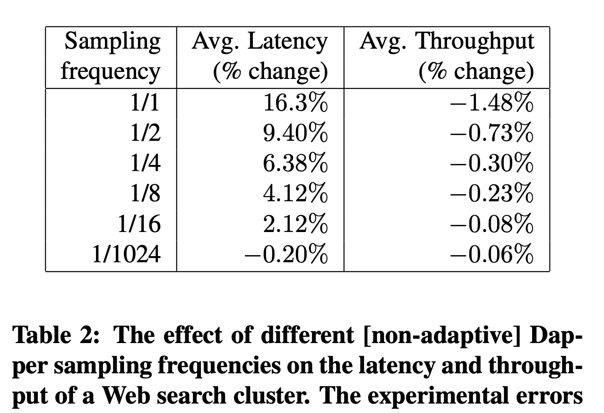
Monitoring overheads
Instrumentation in the critical path: latency and throughput issues
Sample aggressively
Tradeoff with accuracy
Head-based sampling vs. tail-based sampling
Reduce baggage

Slide 24
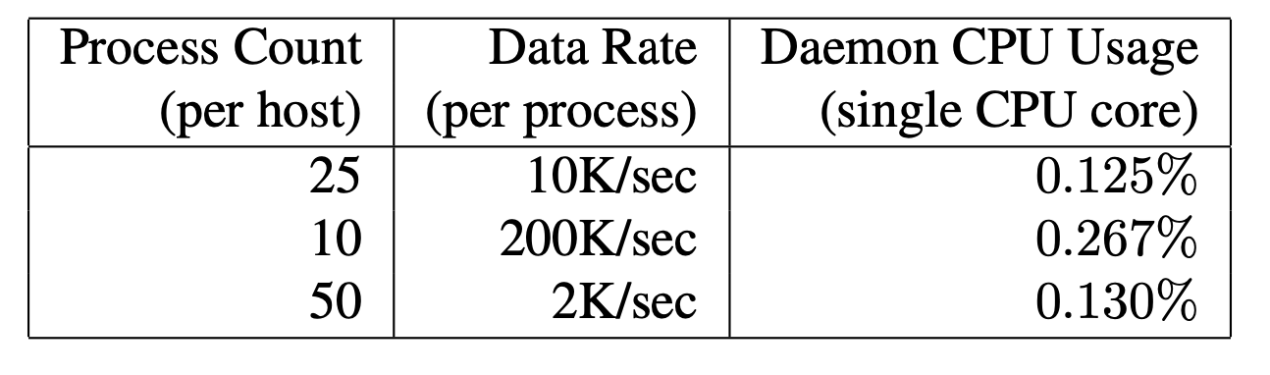
Collection overheads
Collection agents can take up resources
Sample separately at the collector as well
Sample to target # traces per unit time

Slide 25
Monitoring concerns
Teasing out interactions with shared systems
e.g., distributed storage
Integration with public cloud systems
Combining system and application visibility
Uncovering bottlenecks deeper in the stack, e.g. TCP
Batch processing applications

Slide 26
Outro

Slide 27
Summary
Internet services have many building blocks
Content delivery at the user edge
Application design patterns within the data center
Infrastructure support within the system
Networking design to achieve high performance and agility
Operational considerations

Slide 28
Where to go from here?
Carry a deeper appreciation for supporting technologies
Learn how to evaluate system designs
Understand and diagnose problems lower down the stack
Build your own better infrastructure
Research or pursue careers developing (on) these technologies

