Slide 1

Flow Control; Congestion Control
Lecture 16
http://www.cs.rutgers.edu/~sn624/352-F24
Srinivas Narayana

Slide 2
How much data to keep in flight?
= window size
Proportional to throughput
SEQ 0
SEQ 1
SEQ 2
Stop and Wait
SEQ 3
SEQ 0
RTT
ACK 1
ACK 2
ACK 3
ACK 4
RTT
ACK
SEQ 1
Pipelined Reliability
RTO
Retransmit

Slide 3



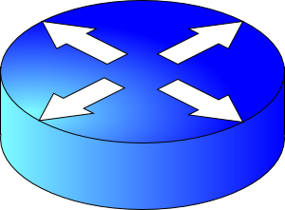
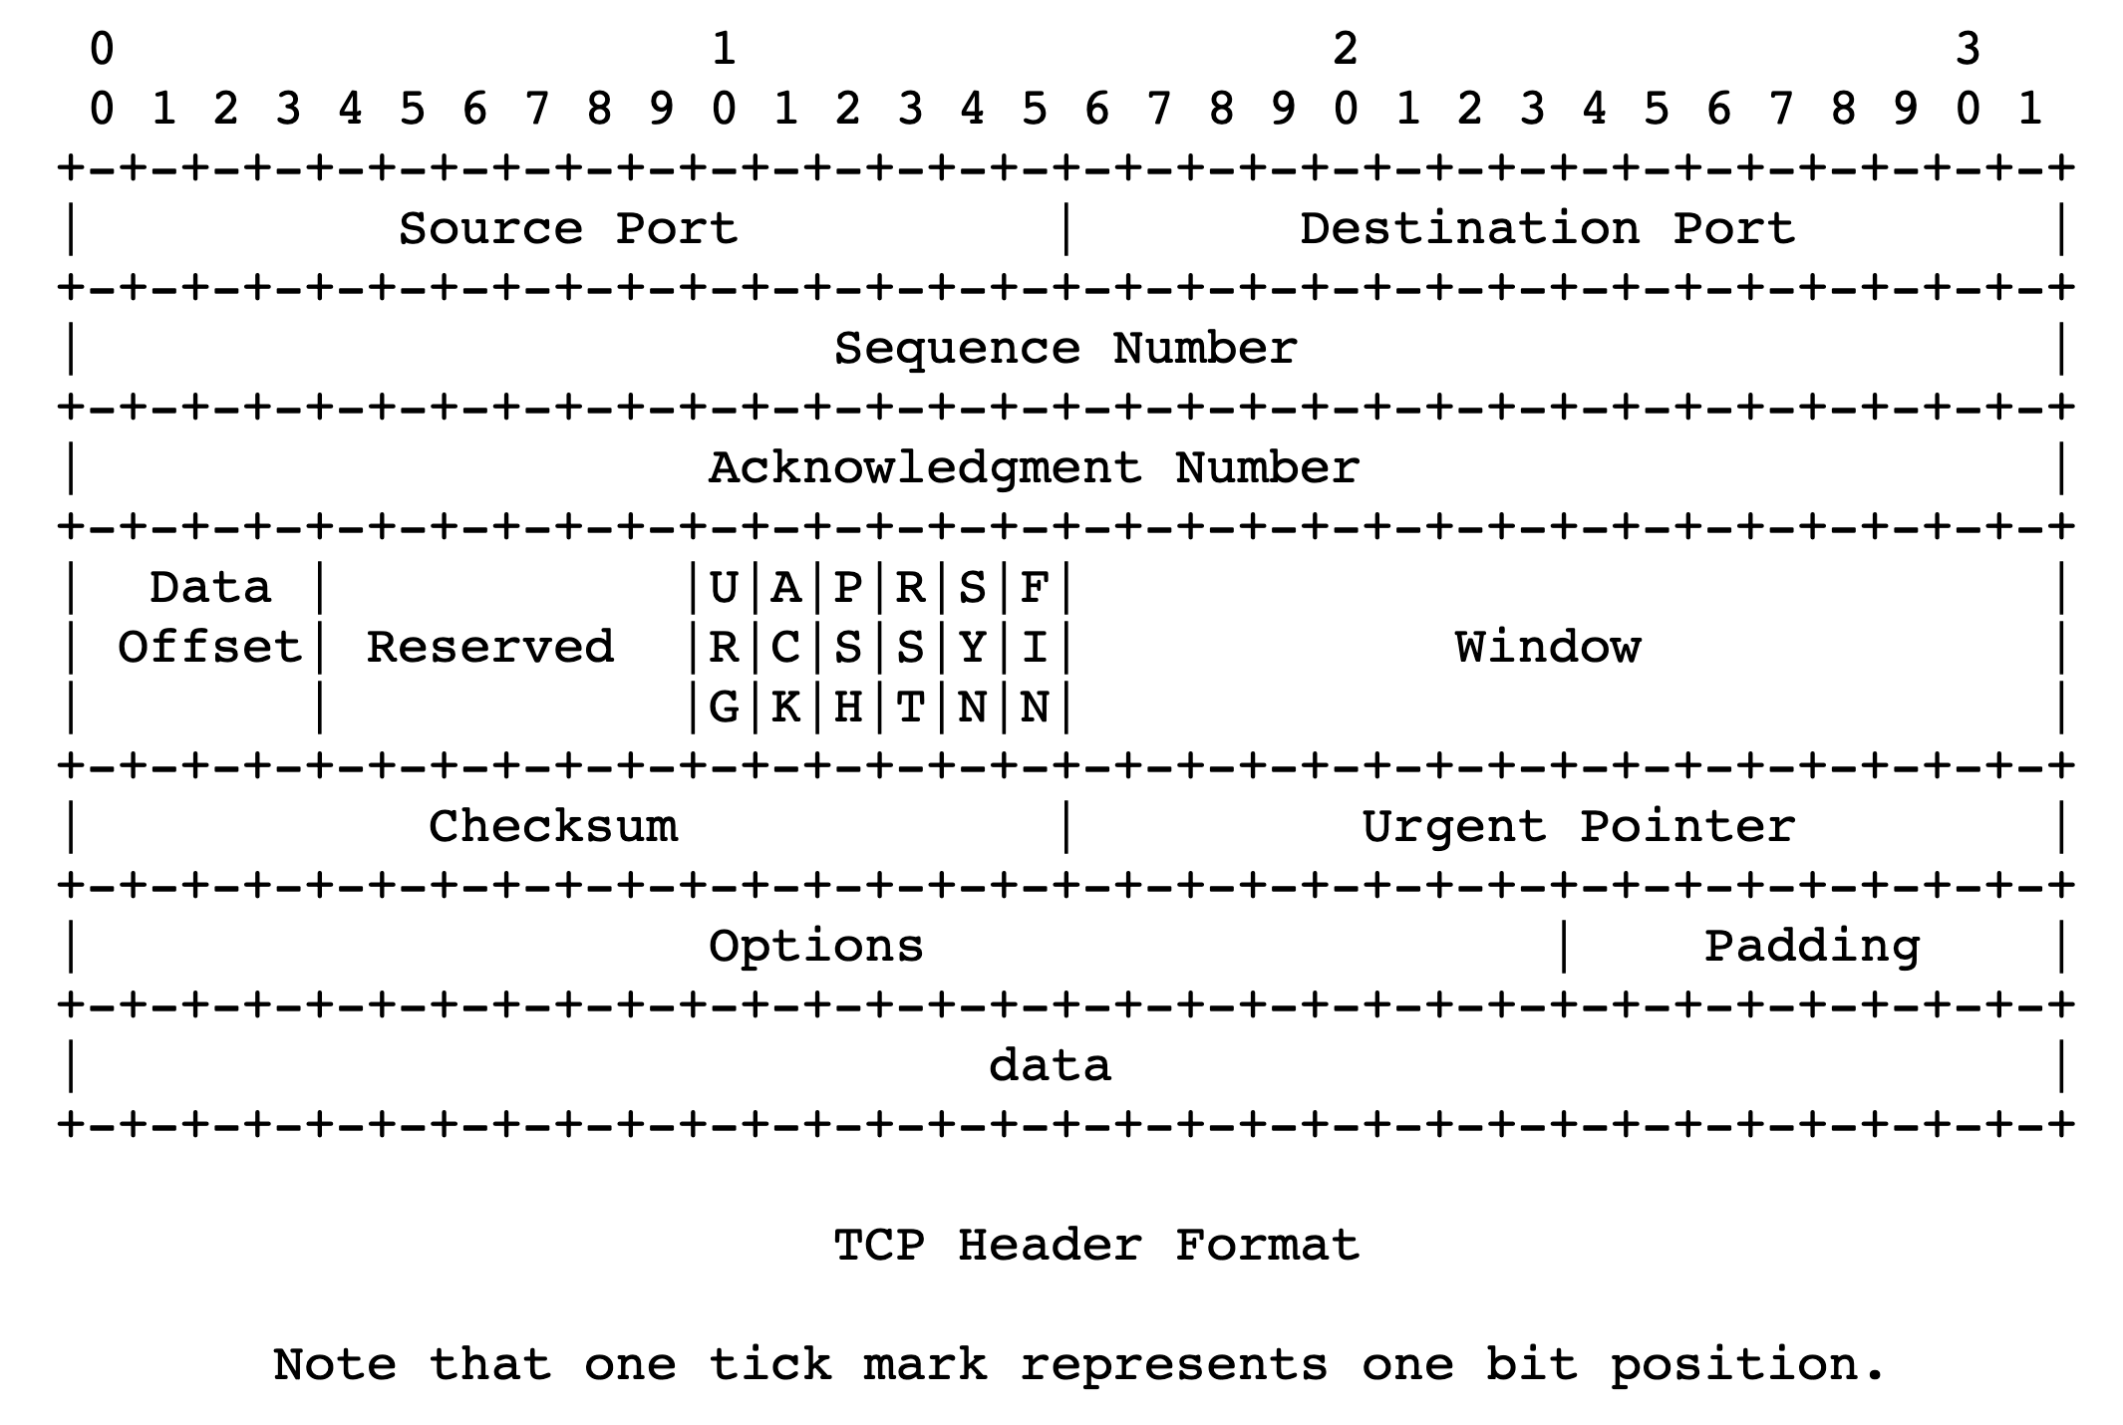
sender
Multiple locations for bottlenecks
application
process
recv()
Congestion Control
TCP socket
receiver buffers
Flow Control
What’s the bottleneck? How to adapt how much data to keep in flight?
TCP
code
from sender
Flow Control: Receiver informs sender free buffer over time
Last transmitted
seq #
receiver
Last cumulative
ACK’ed seq #
How to size this buffer?
Sender’s view:
0
1
2
3
4
5
6
7
0
1
Window <= Advertised window

Slide 4
TCP flow control
If receiver app is too slow reading data:
receiver socket buffer fills up
=> advertised window shrinks
=> sender’s window (sending rate) reduces
=> sender’s socket buffer fills up
=> sender process put to sleep upon send()
Sender
Receiver
1
2
3
4
1
2
3
Window <= Advertised window
4
5
Sender’s view:
0
1
2
3
4
5
6
7
0
1
Last cumulative
ACK’ed seq #
Last transmitted
seq #

Slide 5
TCP flow control
Flow control matches the sending process’s write speed to the receiving process’s read speed.
Sender
Receiver
1
2
3
4
1
2
3
Window <= Advertised window
4
5
Sender’s view:
0
1
2
3
4
5
6
7
0
1
Last cumulative
ACK’ed seq #
Last transmitted
seq #

Slide 6
Sizing the receiver’s socket buffer
Operating systems have a default receiver socket buffer size
Listed among sysctl –a | grep net.inet.tcp on MAC
Listed among sysctl –a | grep net.ipv4.tcp on Linux
If socket buffer is too small, sender can’t keep too many packets in flight ➔ lower throughput
If socket buffer is too large, too much memory consumed per socket
How big should the receiver socket buffer be?

Slide 7
Sizing the receiver’s socket buffer
Case 1: Suppose the receiving app is reading data too slowly:
No amount of receiver buffer can prevent low throughput (for a long-lived connection).
Flow control matches throughput to the receiving app’s (low) speed

Slide 8
Sizing the receiver’s socket buffer
Case 2: Suppose the receiving app reads sufficiently fast on average to match the sender’s writing speed.
Assume the sender desires a window of size W.
The receiver must use a buffer of size at least W. Why?
Captures two cases:
(1) When the first sequence #s in the window are dropped
Selective repeat: data in window buffered until the “hole” within the window can be filled by the sender. Advertised window reduces sender’s window
(2) When the sender sends a burst of data of size W
The receiver may not keep up with the instantaneous rate of the sender
Set receiver socket buffer size > desired window size

Slide 9
Summary of flow control
Keep memory buffers available at the receiver whenever the sender transmits data
Buffers needed to hold for selective repeat, reassembling data in order, and until applications can read data
Inform available buffer to sender on an ongoing basis, with each ACK
Function: match sender speed to receiver speed
Correct socket buffer sizing is important for TCP throughput
Throughput = window size / RTT <= receiver socket buffer / RTT

Slide 10
Info on (tuning) TCP stack parameters
https://www.ibm.com/support/knowledgecenter/linuxonibm/liaag/wkvm/wkvm_c_tune_tcpip.htm
https://cloud.google.com/solutions/tcp-optimization-for-network-performance-in-gcp-and-hybrid

Slide 11
Playing around with socket buffer sizes
iperf –s ; iperf –c localhost –i 1
ping localhost
sudo tc qdisc add dev lo root netem delay 100ms
sudo sysctl net.ipv4.tcp_rmem # min, default, max
Default buffer size 128KB; change e.g., 2.56MB by using
sudo sysctl net.ipv4.tcp_rmem=“4096 2621440 6291456”
Clean up and restore to defaults
sudo tc qdisc del dev lo root netem
If needed:
sudo sysctl net.ipv4.tcp_rmem=“4096 131072 6291456”

Slide 12
Congestion Control

Slide 13

Congestion
Routers have buffers which accommodate queued packets.
∞
Max amount of useful data that link can support, ie. link bandwidth
Packets get dropped beyond max buffer
Too many retransmissions due to packet drops!
The amount of useful (fresh) data plummets.
Congestion collapse
(occurred for real on the Internet in the last 80s)
Amount of useful data that gets across to the receiver
Queueing delay
~100%
~100%
Link load
Fraction of link used (link load)
https://en.wikipedia.org/wiki/Network_congestion#Congestive_collapse

Slide 14
How should multiple endpoints share net?
It is difficult to know where the bottleneck link is
It is difficult to know how many other endpoints are using that link
Endpoints may join and leave at any time
Network paths may change over time, leading to different bottleneck links (with different link rates) over time

