Slide 1

CS 352 The Wireless Network
CS 352, Lecture 24.1
http://www.cs.rutgers.edu/~sn624/352
Srinivas Narayana

Slide 2


Link layer
Application
HTTPS
FTP
HTTP
SMTP
DNS
Transport
TCP
UDP
Network
IP
Link
802.3
…
802.11
ATM
Ethernet
The main function of the link layer is link-local delivery:
getting packets from one side of the link to the other.

Slide 3

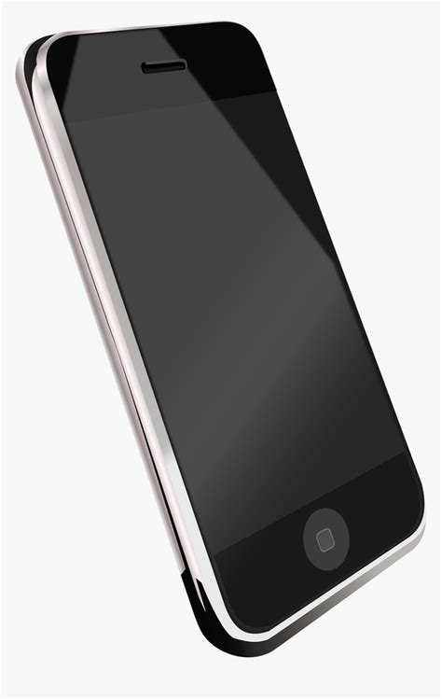
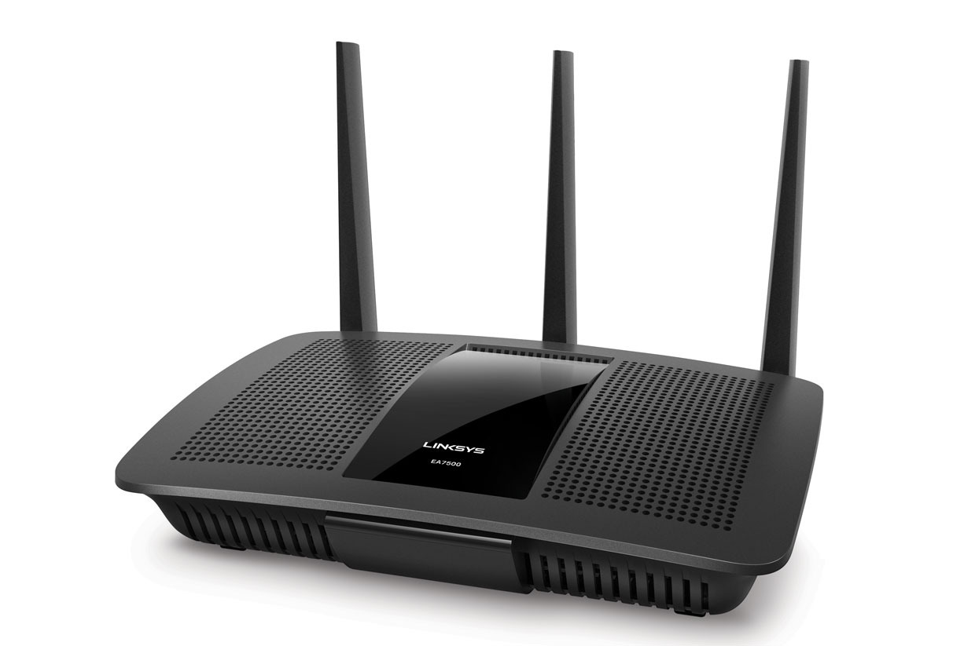
Wireless and mobile networks

Slide 4
Wireless and mobile networks
# wireless (mobile) phone subscribers now far exceeds # wired phone subscribers
# wireless Internet-connected devices far exceeds # wireline Internet-connected devices
laptops, Internet-enabled phones promise anytime untethered Internet access
Your refrigerator, microwave, and car are connected
Two important (but different) challenges
wireless: communication over wireless link
mobility: handling the mobile user who changes point of attachment to network

Slide 5



















Elements of a wireless network
network
infrastructure

Slide 6



Elements of a wireless network
wireless hosts
laptop, smartphone
run applications
may be stationary (non-mobile) or mobile
wireless does not always mean mobility
network
infrastructure

Slide 7

Elements of a wireless network
base station
typically connected to wired network
relay - responsible for sending packets between wired network and wireless host(s) in its “area”
e.g., cell towers, 802.11 (WiFi) access points
network
infrastructure

Slide 8
Elements of a wireless network
wireless link
typically used to connect mobile(s) to base station
also used as backbone link
multiple access protocol coordinates link access
various data rates, transmission distance
network
infrastructure

Slide 9
Wireless network taxonomy
single hop
multiple hops
host connects to
base station (WiFi,
cellular)
which connects to
larger Internet
host may have to
relay through several
wireless nodes to
connect to larger
Internet: mesh net
infrastructure
(e.g., APs)
no base station, no
connection to larger
Internet. May have to
relay to reach
a given wireless node
MANET, VANET
no
infrastructure
(ad-hoc)
no base station, no
connection to larger
Internet (Bluetooth,
ad hoc nets)

Slide 10
Characteristics of Wireless Networks

Slide 11
Important differences from wired links
Decreased signal strength: radio signal attenuates as it propagates (path loss)
Interference from other sources: standardized wireless network frequencies (e.g., 2.4 GHz) shared by other devices (e.g., phone); devices interfere
Multipath propagation: radio signal reflects off objects ground, arriving at destination at slightly different times
These factors make communication across (even a point to point) wireless link much more challenging

Slide 12
Error-prone channel
10⁻¹
SNR: signal-to-noise ratio influences the bit error rate (BER)
larger SNR: easier to extract signal from noise. Larger SNR is good.
Increasing signal transmission power increases SNR, decrease BER
Choose physical layer parameters (modulation technique, rate, etc.) based on least BER for a given SNR
SNR may change with mobility and over time
10⁻²
10⁻³
BER
10⁻⁴
10⁻⁵
10⁻⁶
10⁻⁷
10
20
30
40
SNR(dB)
QAM256 (8 Mbps)
QAM16 (4 Mbps)
BPSK (1 Mbps)

Slide 13

Hidden terminal problem
An obstacle
B, A hear each other
B, C hear each other
However, A and C cannot hear each other
A and C are unaware of interference at B
Distinction from, e.g., shared (wired) Ethernet: everyone can hear everyone else
C
B
A

Slide 14
Hidden terminals due to attenuation
A different version of the hidden terminals problem occurs just due to signal weakening (attenuation)
Path loss: radio frequencies weaken as they travel through space
B, A hear each other
B, C hear each other
A, C can not hear each other interfering at B
A
B
C
A’s signal
strength
C’s signal
strength
space

Slide 15
Exposed terminals
B is transmitting to A
C wants to transmit to D
However, C can hear B, and chooses not to transmit to avoid interfering
Due to signal attenuation, D won’t be affected by B’s transmission
Nor will A be affected by C’s transmission
Yet, C won’t transmit
??
A
B
C
D
C’s signal
strength
B’s signal
strength
space

Slide 16
Wireless LANs
Protocols standardized by the IEEE 802.11 standards
E.g., 802.11b, 802.11g, 802.11n, 802.11ax
Two associated frequency spectra: 2.4GHz, 5GHz.
All have infrastructure and ad-hoc versions
A host associates with an access point (AP) using beacon frames that are periodically transmitted by the AP
They all use CSMA/CA for multiple access
Subject of the next module!
Cellular networks standardized by a different body (3GPP)
We’ll see an overview later this lecture

Slide 18
CS 352 Wireless Multiple Access: CSMA/CA
CS 352, Lecture 24.2
http://www.cs.rutgers.edu/~sn624/352
Srinivas Narayana

Slide 19
Review
Medium access control
A distributed algorithm running at nodes to determine
who should transmit over a shared link
Channel Partitioning
Random access
Turn taking

Slide 20
Review: Shared Ethernet: CSMA/CD
1. NIC receives data to send (e.g., from network layer), creates a frame
2. If NIC senses channel idle, starts frame transmission. If NIC senses channel busy, waits until channel idle, then transmits (CSMA)
3. If NIC transmits entire frame without detecting another transmission, NIC is done with frame.
4. If NIC detects another transmission while transmitting (collision), the NIC aborts the transmission and sends a “jam signal” (CD)
5. The NIC attempts to retransmit after a period dictated by binary exponential backoff
After m’th collision, NIC chooses K at random from {0,1,2, …, 2^{m}-1}, and waits K*512 bit times.

Slide 21
Review: Shared Ethernet: CSMA/CD
1. NIC receives data to send (e.g., from network layer), creates a frame
2. If NIC senses channel idle, starts frame transmission. If NIC senses channel busy, waits until channel idle, then transmits (CSMA)
3. If NIC transmits entire frame without detecting another transmission, NIC is done with frame.
4. If NIC detects another transmission while transmitting (collision), the NIC aborts the transmission and sends a “jam signal” (CD)
5. The NIC attempts to retransmit after a period dictated by binary exponential backoff
After m’th collision, NIC chooses K at random from {0,1,2, …, 2^{m}-1}, and waits K*512 bit times.
This is hard to do in the wireless setting.

Slide 22


Sensing wireless collisions is hard
A node’s own transmission is far too powerful compared to any of the other nodes’ transmissions at the receiving antenna
It’s like trying to hear someone’s whisper when you’re screaming at the top of your voice. You can’t hear it.
A wireless node cannot receive at sufficiently high SNR when its own local transmitter is transmitting.*
Effect: Can’t sense the channel while transmitting!
It’s hard to sense all wireless collisions anyway
Hidden terminal problems!
C
B
A
* Until recent advances in full-duplex wireless

Slide 23
Wireless MACs: Avoid collisions as much as possible, since you can’t detect them.
Carrier Sense Multiple Access
with Collision Avoidance (CSMA/CA)

Slide 24
CSMA/CA Sender
1. NIC receives data to send (e.g., from network layer), creates a frame
2a. If NIC senses channel idle for a fixed time interval (DIFS), transmit the entire frame. Then go to step 4.
(CSMA, but no CD)
2b. If NIC senses channel busy, start a binary exponential backoff timer.
3b. Timer counts down only when the channel is idle. When the timer expires, transmit.
4. If no ACK received for a fixed time interval (SIFS), increase the random backoff interval. Go to step 2.
DIFS
receiver
data
SIFS
sender
ACK

Slide 25
Important aspects of CSMA/CA

Slide 26
(1) Link-level reliability
The protocol requires the receiver to send ACKs upon successfully receiving frames
The sender has no other reliable way of knowing that a frame was successfully received on the other side of the link
Hidden terminal problems
A nice optimization: wireless medium has higher bit error rates
More efficient than waiting for a TCP timeout
TCP-only solution might waste bandwidth on other links and wait entire RTT (rather than link delay) before detecting the error
C
B
A

Slide 27
(2) Inter-frame spacing
DIFS: Distributed Inter-Frame Space
SIFS: Short Inter-Frame Space
Every node waits “a little extra” before transmitting. Inefficient?
But these “spaces” help prioritize some transmissions
Example: ACKs have higher priority than fresh transmissions
Standards set SIFS < DIFS. So ACKs will get a chance to transmitted before fresh data

Slide 28
(3) Conservative backoff (than CSMA/CD)
If the medium is sensed busy, nodes immediately enter backoff
Compare with CSMA/CD: nodes will wait for idle channel, then transmit immediately without entering backoff
Intuition: avoid collisions by having different nodes wait different periods after medium is detected busy
Further, the timer only counts down when the medium is idle
Defer transmissions when there are other active transmissions
The backoff timer counts the medium’s purely-idle time

Slide 29
Using medium reservations to further avoid collisions

Slide 30
Typical wireless deployment
There’s infrastructure: access point (AP)
Nodes are mostly communicating with the AP, not among each other
Can the AP help resolve collisions across nodes?

Slide 31
Reserving channel with small packets
Idea: let senders reserve the channel, rather than compete and waste channel capacity
Sender first transmits a small request-to-send (RTS) packet to the AP using CSMA
RTSs may still collide with each other (but they’re small)
AP broadcasts clear-to-send (CTS) in response to RTS
CTS heard by all nodes
The node that’s allowed to send transmits data frame
Other nodes defer transmissions

Slide 32

RTS-CTS exchange
A
B
AP
RTS(B)
RTS(A)
backoff
reservation collision
RTS(A)
time
CTS(A)
CTS(A)
DATA (A)
defer
ACK(A)
ACK(A)

Slide 33
Prioritizing using inter-frame spacing
CTS is a high priority frame
The data frame following a CTS is also considered high priority
Node already reserved the channel to transmit
Both use the short inter-frame spacing (SIFS) before transmission begins
Transmit before a fresh RTS or data transmission, which must wait a DIFS interval

Slide 34
Reserving channel with small packets
Net effect: Avoid collisions of (larger) data frames completely, saving significant channel resources
An instance of receiver-driven collision avoidance
CTS: Nodes transmitting to AP aware of each other
No hidden terminal problems
Tradeoff: increased delay before transmission
RTS must be cleared with a corresponding CTS
CTS
CTS

Slide 35
Summary of CSMA/CA
A random-access method building on CSMA/CD:
More checks and balances to avoid collisions as much as possible
Not possible to detect collisions effectively
Key ideas: link-level reliability, inter-frame spacing, enter backoff when medium busy
In infrastructure mode, can reserve the channel with RTS/CTS to avoid (data frame) collisions
Receiver-driven collision avoidance: no hidden terminals

Slide 37
CS 352 Cellular, 5G: An Overview
CS 352, Lecture 24.3
http://www.cs.rutgers.edu/~sn624/352
Srinivas Narayana

Slide 38

Components of a cellular network
MSC
cell
connects cells to wired tel. net.
manages call setup and mobility
covers geographical region
base station (BS) analogous to 802.11 AP
user equipment (UE), i.e., cell phones attach to network through BS
air-interface: physical and link layer protocol between the UE and BS
Mobile
Switching
Center
Public telephone
network, Internet
Mobile
Switching
Center
wired network

Slide 39
The first hop
Sharing the UE-to-BS radio medium occurs using all the channel partitioning MAC techniques we’ve learned!
Combined TDMA/FDMA/CDMA
Divide channel into multiple frequency subchannels (subcarriers) and time slots
Can use CDMA across users during same time slot and frequency
Radio resource blocks (time + frequency) allotted to users
time slots
frequency
bands

Slide 40
Cellular network generations
1G (1980s): analog voice
2G (1990s): digital voice and CDMA
3G (2000s): mobile data
Data network in parallel with voice network
2G voice network unchanged
4G/LTE (2010s): mobile broadband speeds
No voice-data separation: everything is IP
5G: (2020s)

Slide 41
5G: the next generation
Goals:
higher data rates (throughput)
lower delays
more energy efficient network
more robust to failures and errors
Designed to support novel applications
Precision agriculture
Health
Warehouse automation
Drones
…

Slide 42
What’s new/better in 5G?
More radio frequencies to transmit over
Higher frequency spectrum (25GHz+ millimeter wave)
Shared spectrum below 6 GHz for low energy use cases
More antennas, directional antennas
Massive MIMO: Multiple antennas to share the channel spatially
Focus energy directionally for efficiency: beamforming
More base stations
Higher frequency signals propagate less further out
Picocells: coverage for small areas in dense urban deployments
Informational content. Not on the test.

Slide 43
What’s new/better in 5G?
Coding and error detection techniques:
e.g., Low-density parity codes (LDPC)
Modulation techniques: e.g., 256QAM
Link duplexing: a combination of time-division duplexing (TDD) and frequency-division duplexing (FDD)
Energy-efficient uplink multiple access (RSMA)
Mobility managed primarily by the infrastructure, not the device
Handle more handoffs between base stations more energy efficiently
Informational content. Not on the test.

Slide 44
Summary of cellular technologies
Evolving over multiple generations, once every ~10 years
Use physical layer, MAC, error detection and correction techniques specific to that context
You’ve seen simpler instances of these technologies
5G: coming soon to your cellular network!

