Slide 1

CS 352 Reliability: Stop and Wait
CS 352, Lecture 9.1
http://www.cs.rutgers.edu/~sn624/352
Srinivas Narayana

Slide 2


Transport
Application
HTTPS
FTP
HTTP
SMTP
DNS
Transport
TCP
UDP
Network
IP
Host-to-Net
X.25
…
802.11
ATM

Slide 3
Modularity through layering
Apps: useful user-level functions
HTTP
FTP
NV
TFTP
Transport: provide guarantees to apps
TCP
UDP
IP
Network: best-effort global pkt delivery
Ether
ATM
…
WiFi
Link: best-effort local pkt delivery

Slide 4

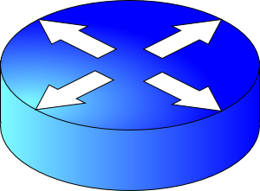
How do apps get perf guarantees?
The network core provides no guarantees on packet delivery
Transport software on the endpoint oversees implementing guarantees on top of a best-effort network
Three important kinds of guarantees
Reliability
Ordered delivery
Resource sharing in the network core
Transmission Control Protocol (TCP)

Slide 5
Reliable data delivery

Slide 6

Packet loss
Sender
Receiver
How might a sender and receiver ensure that data is delivered reliably (despite some packets being lost)?
TCP uses three mechanisms

Slide 7
Coping with packet loss: (1) ACK
Key idea: Receiver returns an acknowledgment (ACK) per packet sent
If sender receives an ACK, it knows that the receiver got the packet.
Sender
Receiver
packet
ACK
packet
ACK

Slide 8
Coping with packet corruption: (1) ACK
ACKs also work to detect packet corruption on the way to the receiver
One possibility: A receiver could send a negative acknowledgment, or a NAK, if it receives a corrupted packet
Q: How to detect corrupted packet?
One method: Checksum!
TCP only uses positive ACKs.
Sender
Receiver
packet
NAK
packet
ACK

Slide 9
Coping with packet loss: (2) RTO
What if a packet is dropped?
Key idea: Wait for a duration of time (called retransmission timeout or RTO) before re-sending the packet
In TCP, the onus is on the sender to retransmit lost data when ACKs are not received
Note that retransmission works also if ACKs are lost or delayed
Sender
Receiver
RTO
Retransmission
ACK

Slide 10
How should the RTO be set?
A good RTO must predict the round-trip time (RTT) between the sender and receiver
RTT: the time to send a single packet and receive a (corresponding) single ACK at the sender
Intuition: If an ACK hasn’t returned, and our (best estimate of) RTT has elapsed, the packet was likely dropped.
RTT can be measured directly at the sender. No receiver involvement needed.
Sender
Receiver
RTO
ACK

Slide 11
Coping with packet duplication
If ACKs delayed beyond the RTO, sender may retransmit the same data
Receiver wouldn’t know that it just received duplicate data from this retransmitted packet
Add some identification to each packet to help distinguish between adjacent transmissions
This is known as the sequence number
Sender
Receiver
RTO
Duplicate
packet received!
(Receiver doesn’t know…)
ACK

Slide 12
Coping with packet loss: (3) Sequence #s
A bad scenario: Suppose an ACK was delayed beyond the RTO; sender ended up retransmitting the packet.
At the receiver: sequence number helps disambiguate a fresh transmission from a retransmission
Sequence number same as earlier: retransmission
Fresh sequence number: fresh data
Sender
Receiver
0
RTO
0
ACK

Slide 13
Coping with packet loss: (3) Sequence #s
A good scenario: packet successfully received and ACK returned within RTO
Sequence numbers of successively transmitted packets are different
Sender
Receiver
SEQ 0
Receiver knows these are not duplicate, because sequence numbers are different
RTO
ACK
SEQ 1
RTO

Slide 14
Coping with packet loss: (3) Sequence #s
A good scenario: packet successfully received and ACK returned within RTO
Sequence numbers of successively transmitted packets are different
Further, the receiver informs the sender which packet was ACK’ed using an ACK sequence number
Sender
Receiver
SEQ 0
Receiver knows these are not duplicate, because sequence numbers are different
RTO
ACK
ACK 0
SEQ 1
RTO
ACK 1

Slide 15
Q: What is the seq# of third packet?
Goal: Avoid ambiguity on which packet was received/ACK’ed from both the sender and receiver’s perspective
One possibility: keep incrementing the seq #: 2, 3, …
Alternative: since seq # 0 was successfully ACK’ed earlier, it is OK to reuse seq #0 for next transmission.
Seq #s reused if enough time elapsed
Sender
Receiver
SEQ 0
RTO
ACK 0
SEQ 1
RTO
ACK 1
???

Slide 16
Summary: Stop-and-Wait Reliability
Sender sends a single packet, then waits for an ACK to know the packet was successfully received. Then the sender transmits the next packet.
If ACK is not received until a timeout (RTO), sender retransmits the packet
Disambiguate duplicate vs. fresh packets using sequence numbers that change on “adjacent” packets
Sender
Receiver
SEQ 0
ACK 0
RTT
SEQ 1
RTO
Retransmit

Slide 18
CS 352 Reliability: TCP Metadata
CS 352, Lecture 9.2
http://www.cs.rutgers.edu/~sn624/352
Srinivas Narayana

Slide 19
Review: Stop-and-Wait Reliability
Sender sends a single packet, then waits for an ACK to know the packet was successfully received. Then the sender transmits the next packet.
If ACK is not received until a timeout (RTO), sender retransmits the packet
Disambiguate duplicate vs. fresh packets using sequence numbers that change on “adjacent” packets
Sender
Receiver
SEQ 0
ACK 0
RTT
SEQ 1
RTO
Retransmit

Slide 20
Q1: Where are seq & ACK #s written to?
Naturally, in the packet header!

Slide 21
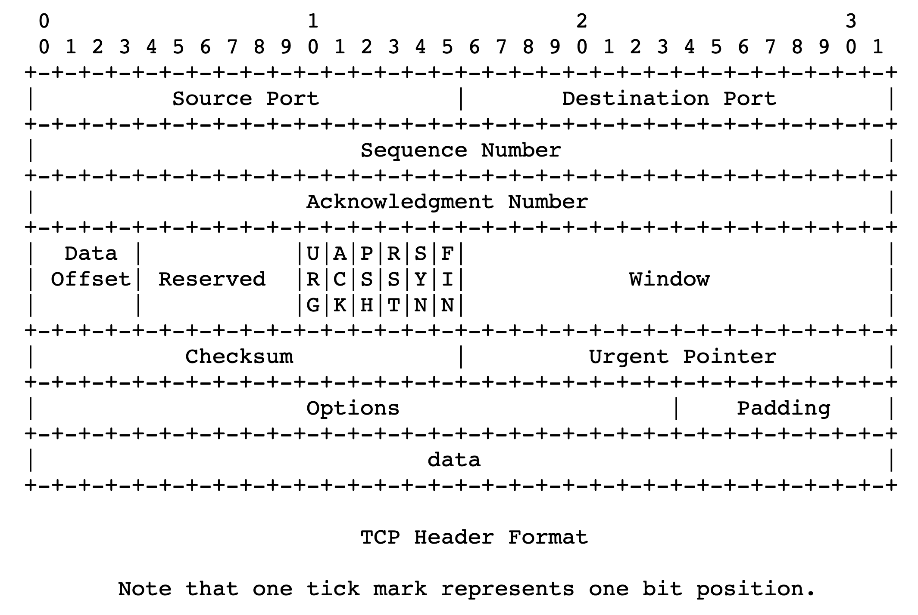
TCP header structure
Source port, destination port (connection demultiplexing)
Size of the TCP header (in 32-bit words)
Basic error detection through checksums (similar to UDP)

Slide 22
TCP header structure
Identifies data in the packet from sender’s perspective
TCP uses byte seq #s
Identifies the data being ACKed from the receiver’s perspective.
TCP uses next seq # that the receiver is expecting.

Slide 23
A TCP exchange
A small demo

