Slide 1

CS 352 Reliability: Sliding Windows
CS 352, Lecture 10.1
http://www.cs.rutgers.edu/~sn624/352
Srinivas Narayana

Slide 2


Transport
Application
HTTPS
FTP
HTTP
SMTP
DNS
Transport
TCP
UDP
Network
IP
Host-to-Net
X.25
…
802.11
ATM

Slide 3
Modularity through layering
Apps: useful user-level functions
HTTP
FTP
NV
TFTP
Transport: provide guarantees to apps
TCP
UDP
IP
Network: best-effort global pkt delivery
Ether
ATM
…
WiFi
Link: best-effort local pkt delivery

Slide 4

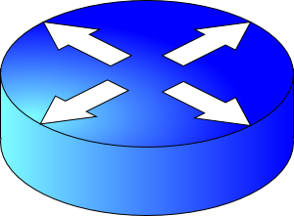
How do apps get perf guarantees?
The network core provides no guarantees on packet delivery
Transport software on the endpoint oversees implementing guarantees on top of a best-effort network
Three important kinds of guarantees
Reliability
Ordered delivery
Resource sharing in the network core
Transmission Control Protocol (TCP)

Slide 5
Review: Stop-and-Wait Reliability
Stop and wait: sender waits for an ACK/RTO before sending another packet
Suppose no packets are dropped
RTT = RTO = 100 milliseconds
Packet size: 12 Kbit (1 K = 10³)
Link rate: 12 Mbit/s (1 M = 10⁶)
Rate of data transmission?
one packet per RTT = 12Kbits / 100ms = 120 Kbit/s
Sender
Receiver
RTT
RTO
120 Kilobit/s == 1% of link rate

Slide 6
Making reliable transmissions efficient
Terminology: unACKed data / packets in flight
Data that has been sent, but not known (by the sender) to be received
With just one packet in flight, the data rate is limited by the packet delay (RTT) rather than available bandwidth (link rate)
Larger the delay, slower the data rate, regardless of link rate
Idea: Keep many packets in flight!
More packets in flight improves throughput
We say such protocols implement pipelined reliability

Slide 7
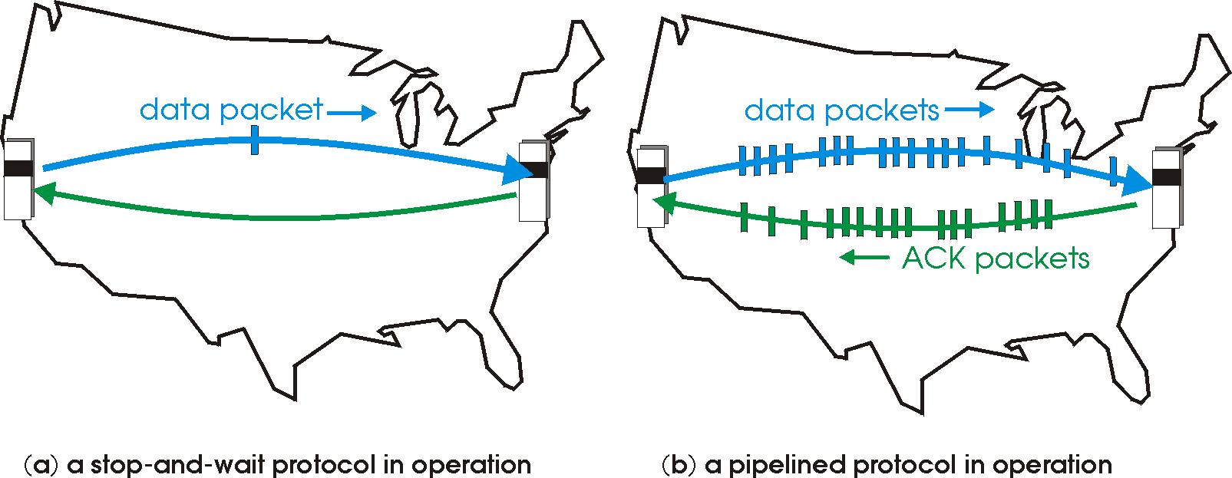
Why does pipelined reliability help?
Suppose sender has multiple, in-flight (yet-to-be-acknowledged) packets
New packets transmitted concurrently with in-flight packets
Packets and ACKs (of prior packets) are concurrently transmitted
➔ More data and ACKs transmitted within the same duration

Slide 8

Tracking packets in flight
If there are N packets in flight, throughput improves by N times relative to stop-and-wait.
Stop and wait: send 1 packet per RTT
Pipelined: send N packets per RTT
We term the in-flight data the window
We term the amount of in-flight data the window size
Sender
Receiver
RTT
RTO

Slide 9
Sliding Windows

Slide 10
Window
Window: Sequence numbers of in-flight data
Window size: The amount of in-flight data (unACKed)
Sequence numbers restart from 0 beyond a point (finite space on header)
Window size = 3
Sender’s point of view:
0
1
2
3
4
5
6
7
0
1
0
7
1
6
2
Last seq # known to be received at receiver (ACK’ed)
Last sequence # sent
5
3
4
Transmissions later in time

Slide 11
Sliding window (sender side)
Suppose sequence number 2 is acknowledged by the receiver
Sender can transmit sequence # 5
The window “slides” forward
Window size = 3
Sender’s point of view:
0
1
2
3
4
5
6
7
0
1
0
7
1
6
2
Last seq # known to be received at receiver (ACK’ed)
Last sequence # sent
5
3
4

Slide 12
Sliding window (sender side)
Suppose sequence number 2 is acknowledged by the receiver
Sender can transmit sequence # 5
The window “slides” forward
Window size = 3
Sender’s point of view:
0
1
2
3
4
5
6
7
0
1
0
7
1
6
2
Last seq # known to be received at receiver (ACK’ed)
Last sequence # sent
5
3
4

Slide 13
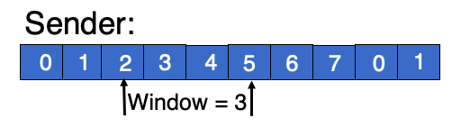
Sliding window (receiver side)
Window of in-flight packets can look different between sender and the receiver: receiver has more recent info of in-flight
Receiver only accepts sequence #s as allowed by the current receiver window
Window size = 3
Receiver will not accept this seq #. Packet dropped
Receiver’s point of view:
0
1
2
3
4
5
6
7
0
1
Last seq # received and ACK’ed by receiver
Highest sequence # accepted

Slide 14
Summary of sliding windows
Sender and receiver can keep several packets of in-flight data
Book-keep the sequence numbers using the window
Windows slide forward as packets are ACKed (at receiver) and ACKs are received (at sender)
Common case: Improve throughput by sending and ACKing more packets in the same duration
Key challenge: how should the sender and receiver collaboratively track the packets that must be retransmitted?

Slide 16
CS 352 Making Retransmissions Efficient
CS 352, Lecture 10.2
http://www.cs.rutgers.edu/~sn624/352
Srinivas Narayana

Slide 17
Pipelined Reliability
If there are N packets in flight, throughput improves by N times relative to stop-and-wait.
Stop and wait: send 1 packet per RTT
Pipelined: send N packets per RTT
Q1: how should sender efficiently identify which pkts were dropped and (hence) retransmitted?
Q2: how much data to keep in flight (i.e., what is N?) to reduce drops/retransmits?
Sender
Receiver
RTT
RTO

Slide 18
Q1. Identifying the Dropped Packets

Slide 19
Q1: Identifying dropped packets
Suppose 4 packets were sent, but one was dropped. How does sender know which one(s) were dropped?
Recall: Receiver writes sequence numbers on the ACK
Sender infers which bytes were received successfully using the ACK #s
Q1.1: Should receivers ACK subsequent packets upon detecting data loss?
Q1.2: If so, what sequence number should receiver put on the ACK?
Sender
Receiver
SEQ 1
SEQ 2
SEQ 3
SEQ 4
RTT
ACK 2
ACK 3
Should this ACK exist ???
ACK ??
RTO

Slide 20
Receiver strategies upon packet loss
Sender
Receiver
ACK subsequent pkts?
1
No
Yes
2
3
4
Go-back-N
Selective Repeat
What seq # on ACK?
5
Last pkt in order
Cumulative ACK
Seq # ranges received so far
Selective ACK
TCP’s default

Slide 21
Sliding Window with Go Back N
When the receiver notices a missing or erroneous frame:
It simply discards all frames with greater sequence numbers
The receiver will send no ACK
The sender will eventually time out and retransmit all the frames in its sending window

Slide 22
Go back N
RTO
Sender
0
1
2
3
4
2
3
4
5
6
Maximum
window size = 8
ACK 1
ACK 2
ACK 3
ACK 4
ACK 5
ACK 6
ACK 7
Receiver
0
1
E
D
D
2
3
4
5
6
Maximum
window size = 8
Discarded by
receiver
Frame with
error
Time

Slide 23
Go back N
Go Back N can recover from erroneous or missing frames.
But it is wasteful.
If there are errors, the sender will spend time and network bandwidth retransmitting data the receiver has already seen.

Slide 24
Selective repeat with cumulative ACK
Idea: sender should only retransmit dropped/corrupted segments.
The receiver stores all the correct frames that arrive following the bad one. (Note that the receiver requires a memory buffer for each sequence number in its receiver window.)
When the receiver notices a skipped sequence number, it keeps acknowledging the first in-order sequence number it wants to receive. This is what we mean by cumulative ACK.
When the sender times out waiting for an acknowledgement, it just retransmits the first unacknowledged packet, not all its successors.
Note that the RTO applies independently to each sequence #

Slide 25
Selective repeat with cumulative ACK
RTO
Sender
0
1
2
3
4
2
5
6
Maximum
window size = 8
ACK 2
ACK 2
ACK 1
ACK 2
ACK 5
ACK 6
ACK 7
Receiver
0
1
E
3
4
2
5
6
Maximum
window size = 8
Buffered by
receiver
Frame with
error
Time

Slide 26
Selective repeat with selective ACK
RTO
Sender
0
1
2
3
4
2
5
6
ACK 2
SACK 0--1, 3
Maximum
window size = 8
ACK 2
SACK 0,--1, 3--4
ACK 1
ACK 2
ACK 5
ACK 6
ACK 7
Receiver
0
1
E
3
4
2
5
6
Maximum
window size = 8
Buffered by
receiver
Frame with
error
Time

Slide 27
TCP: Cumulative & Selective ACKs
Sender retransmits the seq #s it thinks aren’t received successfully yet
Pros & cons: selective vs. cumulative ACKs
Precision of info available to sender
Redundancy of retransmissions
Packet header space
Complexity (and bugs) in transport software
On modern OSes, TCP uses selective ACKs by default
Sender
Receiver
1
2
3
4
2
3
4
5
5

Slide 28
Memory Buffers in the Transport Layer

Slide 29
Receiver-side sockets need memory buffers
Since TCP uses selective repeat, the receiver must buffer data that is received out of order:
e.g., hold packets so that only the “holes” (due to drops) need to be filled in later, without having to retransmit packets that were received successfully
Apps read from the receive-side socket buffer when you do a recv() call.
Even if data reliably received in order, applications may not always read the data immediately
What if you invoked recv() in your socket program infrequently (or never)?
For the same reason, UDP sockets also have buffers

Slide 30
Sender-side sockets need memory buffers
The possibility of packet retransmission in the future means that data can’t be immediately discarded from the sender once transmitted.
Transport layer must wait for ACK of a piece of data before reclaiming the memory for that data.

Slide 31
Q2. How much data to keep in flight?

Slide 32
Q2: How much data to keep in flight?
Challenging question! We want to increase throughput. But:
The receiving app must keep up: otherwise, receiver socket buffer will fill up. Once full, subsequent packets are dropped.
Even if receiving app is fast, there must be sufficient buffering for selective repeat, if some data is dropped/corrupted
The network path must be able to keep up.
We don’t want window to be so large that pkts dropped anyway
Challenge: The sender must figure out where the bottleneck is: receiving app? Socket buffer? A link along the network path?
Flow control and congestion control

Slide 33
Inspecting TCP stack parameters
A small demo

Slide 34
Info on (tuning) TCP stack parameters
https://www.ibm.com/support/knowledgecenter/linuxonibm/liaag/wkvm/wkvm_c_tune_tcpip.htm
https://cloud.google.com/solutions/tcp-optimization-for-network-performance-in-gcp-and-hybrid

