Slide 1

Virtual Memory

Slide 2
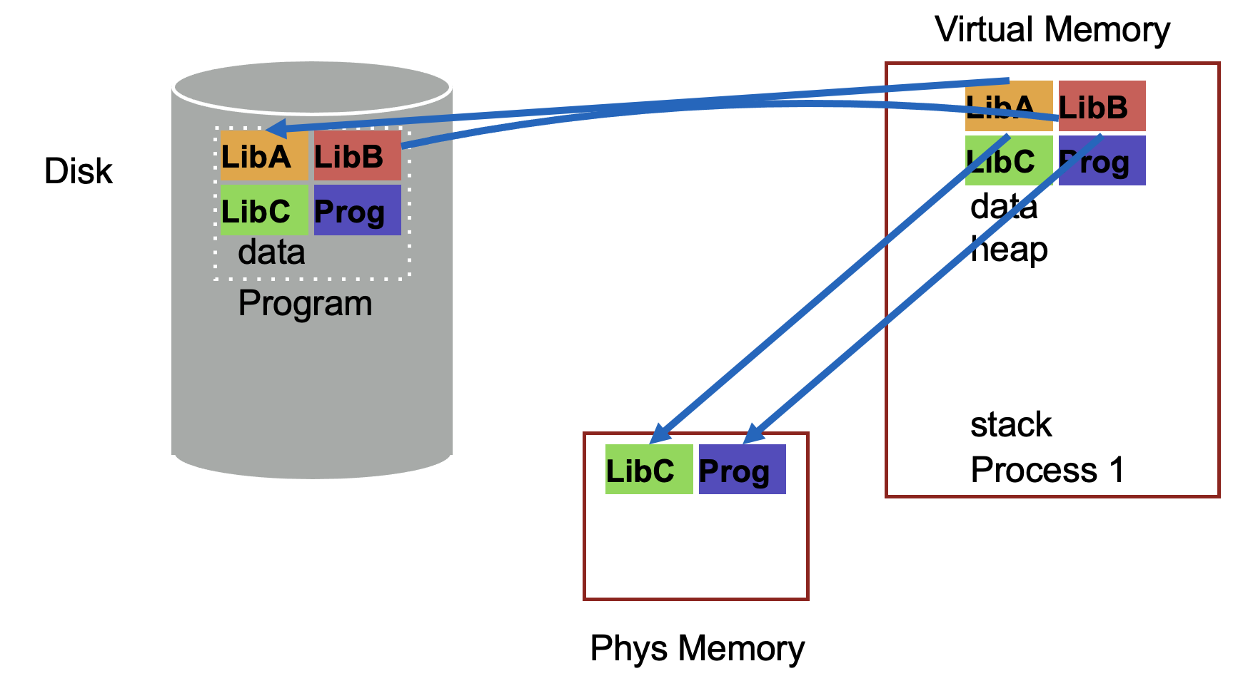
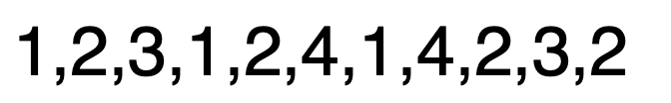
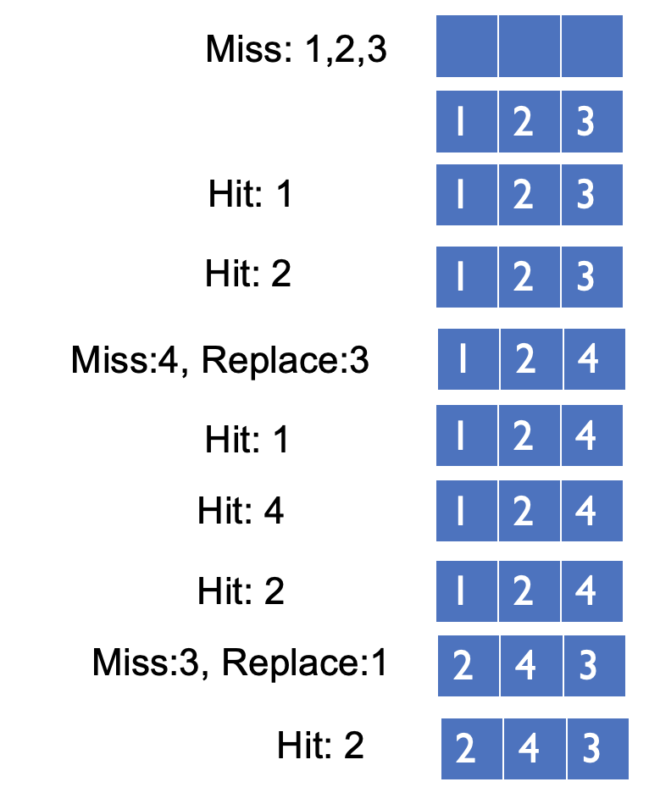
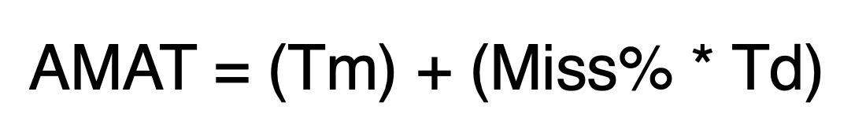
Page Selection
Page Replacement
OPT
FIFO
LRU

Slide 3
Page Replacement Comparison
Add more physical memory, what happens to performance?
LRU, OPT: Add more memory, guaranteed to have fewer (or same number of) page faults
Smaller memory sizes are guaranteed to contain a subset of larger memory sizes
Stack property: smaller cache a subset of bigger cache
FIFO: Add more memory, usually have fewer page faults
Belady’s anomaly: but there are cases where we have more page faults!

Slide 4
Fifo Performance may Decrease!
Consider access stream: 1, 2, 3, 4, 1, 2, 5, 1, 2, 3, 4, 5
Consider physical memory size: 3 pages vs. 4 pages
How many misses with FIFO?
3 pages: 9 misses
4 pages: 10 misses

Slide 5
Problems with LRU-based Replacement
LRU does not consider frequency of accesses
Is a page accessed once in the past equal to one accessed N times?
Common workload problem:
Scan (sequential read, never used again) one large data region flushes memory
Solution: Track frequency of accesses to page
Pure LFU (Least-frequently-used) replacement
Problem: LFU can never forget pages from the far past

Slide 6
Implementing LRU
Perfect LRU on Software
OS maintains ordered list of physical pages by reference time
When page is referenced: Move page to front of list
When need victim: Pick page at back of list
Trade-off: Slow on memory reference, fast on replacement
Perfect LRU on Hardware
Associate timestamp with each page (e.g., PTE)
When page is referenced: Associate current system timestamp with page
When need victim: Scan through PTEs to find oldest timestamp
Trade-off: Fast on memory reference, slow on replacement (especially as size of memory grows)
In practice, do not implement Perfect LRU
LRU is an approximation anyway, so approximate more
Goal: Find an old page, but not necessarily the oldest

Slide 7
Clock Algorithm
Hardware
Keep use (or reference) bit for each page frame
When page is referenced: set use bit
Operating System
Page replacement: Look for page with use bit cleared (has not been referenced for a while)
Implementation:
Keep pointer to last examined page frame (“clock hand”)
Traverse pages in circular fashion (like a clock)
Clear use bits as you search
Stop when find page with already cleared use bit, replace this page

Slide 8
Clock: Look For a Page
use=1
use=1
use=0
use=1
0
1
2
3
…
Physical Mem:
clock hand

Slide 9
Clock: Look For a Page
use=0
use=1
use=0
use=1
0
1
2
3
…
Physical Mem:
clock hand

Slide 10
Clock: Look For a Page
use=0
use=0
use=0
use=1
0
1
2
3
…
Physical Mem:
clock hand

Slide 11
Clock: Look For a Page
use=0
use=0
use=0
use=1
0
1
2
3
…
Physical Mem:
clock hand
evict page 2 because it has not been recently used

Slide 12
Clock: Look For a Page
use=0
use=0
use=0
use=1
0
1
2
3
…
Physical Mem:
clock hand
page 0 is accessed…

Slide 13
Clock: Look For a Page
use=1
use=0
use=0
use=1
0
1
2
3
…
Physical Mem:
clock hand

Slide 14
Clock: Look For a Page
use=1
use=0
use=0
use=1
0
1
2
3
…
Physical Mem:
clock hand

Slide 15
Clock: Look For a Page
use=1
use=0
use=0
use=1
0
1
2
3
…
Physical Mem:
clock hand

Slide 16
Clock: Look For a Page
use=1
use=0
use=0
use=0
0
1
2
3
…
Physical Mem:
clock hand

Slide 17
Clock: Look For a Page
use=0
use=0
use=0
use=0
0
1
2
3
…
Physical Mem:
clock hand

Slide 18
Clock: Look For a Page
use=0
use=0
use=0
use=0
0
1
2
3
…
Physical Mem:
clock hand
evict page 1 because it has not been recently used

Slide 19
Clock Extensions
Use modified (“dirty”) bit to prefer to retain modified pages in memory
Intuition: More expensive to replace dirty pages
Modified pages must be written to disk, clean pages do not have to be
First replace pages that have use bit and modified bit cleared
Replace multiple pages at once
Intuition: Expensive to run replacement algorithm and to write single block to disk
Find multiple victims each time and track free list
Add software counter (“chance”) to track use frequency
Intuition: Want to differentiate pages by how much they are accessed
Increment software counter if use bit is 0
Replace when chance exceeds some specified limit

Slide 20
What if no hardware support?
What can the OS do if hardware does not have use bit (or dirty bit)?
Can the OS “emulate” these bits?
Think about this question:
Can the OS get control (i.e., generate a trap) every time use bit should be set? (i.e., when the page is accessed?)

Slide 21
Conclusion
Illusion of virtual memory: Processes can run when the sum of virtual address spaces is larger than physical memory
Mechanism:
Extend page table entry with “present” bit
OS handles page faults (or page misses) by reading in the desired page from disk
Policy:
Page selection – demand paging, prefetching, hints
Page replacement – OPT, FIFO, LRU, others
Implementations (clock) approximate LRU

Slide 22
Concurrency

Slide 23
Concurrency
Questions answered:
Why is concurrency useful?
What is a thread and how does it differ from processes?
What can go wrong if scheduling of critical sections is not atomic?

Slide 24
Motivation for concurrency: Blocking
Operations proceeding at the same time: blocking for I/O, while doing other useful work
Example: web server
Serve the first request by reading a file from disk
Serve a second request by running computation

Slide 25
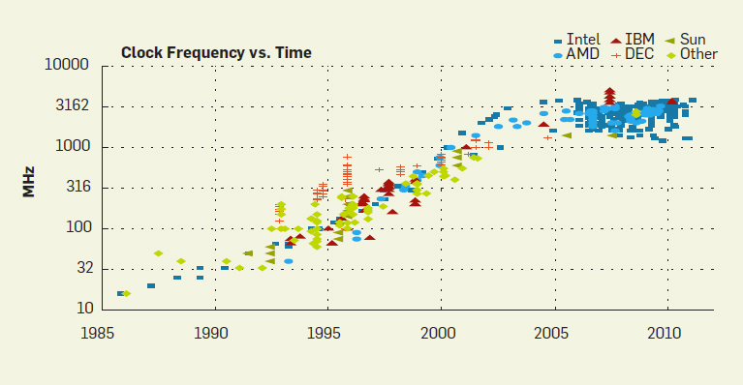
Motivation for Concurrency: Parallelism
http://cacm.acm.org/magazines/2012/4/147359-cpu-db-recording-microprocessor-history/fulltext

Slide 26
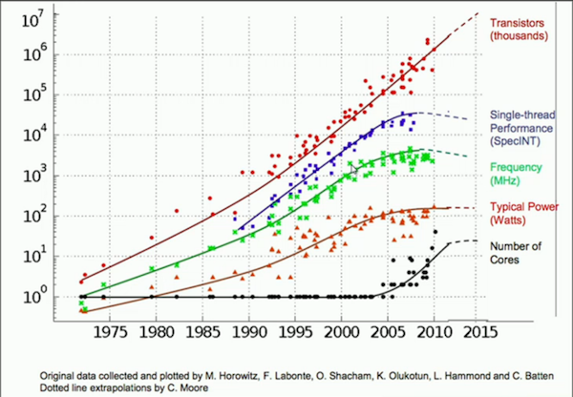
Motivation for Concurrency: Parallelism

Slide 27
Motivation
CPU Trend: Same speed, but multiple cores
Goal: Write applications that fully utilize many cores
Option 1: Build apps from many communicating processes
Example: Chrome (process per tab)
Communicate via pipe() or similar
Pros?
Don’t need new abstractions; good for security
Cons?
Cumbersome programming
High communication overheads
Expensive context switching (why expensive?)

Slide 28
Concurrency: Option 2
New abstraction: thread
Threads are like processes, except: multiple threads of same process share an address space
Divide large task across several cooperative threads
Communicate through shared address space

Slide 29
Common Programming Models
Multi-threaded programs tend to be structured as:
Producer/consumer Multiple producer threads create data (or work) that is handled by one of the multiple consumer threads
Pipeline Task is divided into series of subtasks, each of which is handled in series by a different thread
Defer work with background thread One thread performs non-critical work in the background (when CPU idle)

Slide 30
CPU 1
CPU 2
RAM
running
thread 1
running
thread 2
What state do threads share?

Slide 31
CPU 1
CPU 2
RAM
running
thread 1
running
thread 2
PageDir A
PageDir B
…
What threads share page directories?

Slide 32
CPU 1
CPU 2
RAM
running
thread 1
running
thread 2
PageDir A
PageDir B
PTBR
PTBR
…

Slide 33
CPU 1
CPU 2
RAM
running
thread 1
running
thread 2
PageDir A
PageDir B
PTBR
PTBR
…

Slide 34
CPU 1
CPU 2
RAM
running
thread 1
running
thread 2
PageDir A
PageDir B
PTBR
PTBR
…
IP
IP
Do threads share Instruction Pointer?

Slide 35
CPU 1
CPU 2
RAM
running
thread 1
running
thread 2
PageDir A
PageDir B
PTBR
PTBR
…
IP
IP
Virt Mem
(PageDir A)
CODE
HEAP
…

Slide 36
CPU 1
CPU 2
RAM
running
thread 1
running
thread 2
PageDir A
PageDir B
PTBR
PTBR
…
IP
IP
Virt Mem
(PageDir A)
CODE
HEAP
…
Share code, but each thread may be executing
different code at the same time
→ Different Instruction Pointers

Slide 37
CPU 1
CPU 2
RAM
running
thread 1
running
thread 2
PageDir A
PageDir B
PTBR
PTBR
…
IP
IP
Virt Mem
(PageDir A)
CODE
HEAP
…

Slide 38
CPU 1
CPU 2
RAM
running
thread 1
running
thread 2
PageDir A
PageDir B
PTBR
PTBR
…
IP
SP
IP
SP
Virt Mem
(PageDir A)
CODE
HEAP
…
Do threads share stack pointer?

Slide 39
CPU 1
CPU 2
RAM
running
thread 1
running
thread 2
PageDir A
PageDir B
PTBR
PTBR
…
IP
SP
IP
SP
Virt Mem
(PageDir A)
CODE
HEAP
STACK 1
STACK 2

Slide 40
CPU 1
CPU 2
RAM
running
thread 1
running
thread 2
PageDir A
PageDir B
PTBR
PTBR
…
IP
SP
IP
SP
Virt Mem
(PageDir A)
CODE
HEAP
STACK 1
STACK 2
threads executing different functions need different stacks

Slide 41
THREAD VS. Process
Multiple threads within a single process share:
Process ID (PID)
Address space
Code (instructions)
Most data (heap)
Open file descriptors
Current working directory
User and group id
Each thread has its own
Thread ID (TID)
Set of registers, including Program counter and Stack pointer
Stack for local variables and return addresses (in same address space)

Slide 42
THREAD API
Variety of thread systems exist
POSIX Pthreads
Common thread operations
Create
Exit
Join (instead of wait() for processes)

Slide 43
OS Support: Approach 1
User-level threads: Many-to-one thread mapping
Implemented by user-level runtime libraries
Create, schedule, synchronize threads at user-level
OS is not aware of user-level threads
OS thinks each process contains only a single thread of control
Advantages
Does not require OS support; Portable
Can tune scheduling policy to meet application demands
Lower overhead thread operations since no system call
Disadvantages?
Cannot leverage multiprocessors
Entire process blocks when one thread blocks

Slide 44
OS Support: Approach 2
Kernel-level threads: One-to-one thread mapping
OS provides each user-level thread with a kernel thread
Each kernel thread scheduled independently
Thread operations (creation, scheduling, synchronization) performed by OS
Advantages
Each kernel-level thread can run in parallel on a multiprocessor
When one thread blocks, other threads from process can be scheduled
Disadvantages
Higher overhead for thread operations
OS must scale well with increasing number of threads

Slide 45
Thread Schedule #1
balance = balance + 1; balance at 0x9cd4
Thread 1
Thread 2
State:
0x9cd4: 100
%eax: ?
%rip = 0x195
process
control
blocks:
%eax: ?
%rip: 0x195
%eax: ?
%rip: 0x195
T1
0x195 mov 0x9cd4, %eax
0x19a add $0x1, %eax
0x19d mov %eax, 0x9cd4

Slide 46
Thread Schedule #1
Thread 1
Thread 2
State:
0x9cd4: 100
%eax: 100
%rip = 0x19a
process
control
blocks:
%eax: ?
%rip: 0x195
%eax: ?
%rip: 0x195
0x195 mov 0x9cd4, %eax
0x19a add $0x1, %eax
0x19d mov %eax, 0x9cd4
T1

Slide 47
Thread Schedule #1
Thread 1
Thread 2
State:
0x9cd4: 100
%eax: 101
%rip = 0x19d
process
control
blocks:
%eax: ?
%rip: 0x195
%eax: ?
%rip: 0x195
0x195 mov 0x9cd4, %eax
0x19a add $0x1, %eax
0x19d mov %eax, 0x9cd4
T1

Slide 48
Thread Schedule #1
Thread 1
Thread 2
State:
0x9cd4: 101
%eax: 101
%rip = 0x1a2
process
control
blocks:
%eax: ?
%rip: 0x195
%eax: ?
%rip: 0x195
0x195 mov 0x9cd4, %eax
0x19a add $0x1, %eax
0x19d mov %eax, 0x9cd4
T1

Slide 49
Thread Schedule #1
Thread 1
Thread 2
State:
0x9cd4: 101
%eax: 101
%rip = 0x1a2
process
control
blocks:
%eax: ?
%rip: 0x195
%eax: ?
%rip: 0x195
0x195 mov 0x9cd4, %eax
0x19a add $0x1, %eax
0x19d mov %eax, 0x9cd4
T1
Thread Context Switch

Slide 50
Thread Schedule #1
Thread 1
Thread 2
State:
0x9cd4: 101
%eax: ?
%rip = 0x195
process
control
blocks:
%eax: 101
%rip: 0x1a2
%eax: ?
%rip: 0x195
T2
0x195 mov 0x9cd4, %eax
0x19a add $0x1, %eax
0x19d mov %eax, 0x9cd4

Slide 51
Thread Schedule #1
Thread 1
Thread 2
State:
0x9cd4: 101
%eax: 101
%rip = 0x19a
process
control
blocks:
%eax: 101
%rip: 0x1a2
%eax: ?
%rip: 0x195
0x195 mov 0x9cd4, %eax
0x19a add $0x1, %eax
0x19d mov %eax, 0x9cd4
T2

Slide 52
Thread Schedule #1
Thread 1
Thread 2
State:
0x9cd4: 101
%eax: 102
%rip = 0x19d
process
control
blocks:
%eax: 101
%rip: 0x1a2
%eax: ?
%rip: 0x195
0x195 mov 0x9cd4, %eax
0x19a add $0x1, %eax
0x19d mov %eax, 0x9cd4
T2

Slide 53
Thread Schedule #1
Thread 1
Thread 2
State:
0x9cd4: 102
%eax: 102
%rip = 0x1a2
process
control
blocks:
%eax: 101
%rip: 0x1a2
%eax: ?
%rip: 0x195
0x195 mov 0x9cd4, %eax
0x19a add $0x1, %eax
0x19d mov %eax, 0x9cd4
T2

Slide 54
Thread Schedule #1
Thread 1
Thread 2
State:
0x9cd4: 102
%eax: 102
%rip = 0x1a2
process
control
blocks:
%eax: 101
%rip: 0x1a2
%eax: ?
%rip: 0x195
0x195 mov 0x9cd4, %eax
0x19a add $0x1, %eax
0x19d mov %eax, 0x9cd4
T2
Desired Result!

Slide 55
Let’s consider another schedule…

Slide 56
Thread Schedule #2
Thread 1
Thread 2
State:
0x9cd4: 100
%eax: ?
%rip = 0x195
process
control
blocks:
%eax: ?
%rip: 0x195
%eax: ?
%rip: 0x195
T1
0x195 mov 0x9cd4, %eax
0x19a add $0x1, %eax
0x19d mov %eax, 0x9cd4

Slide 57
Thread Schedule #2
Thread 1
Thread 2
State:
0x9cd4: 100
%eax: 100
%rip = 0x19a
process
control
blocks:
%eax: ?
%rip: 0x195
%eax: ?
%rip: 0x195
0x195 mov 0x9cd4, %eax
0x19a add $0x1, %eax
0x19d mov %eax, 0x9cd4
T1

Slide 58
Thread Schedule #2
Thread 1
Thread 2
State:
0x9cd4: 100
%eax: 101
%rip = 0x19d
process
control
blocks:
%eax: ?
%rip: 0x195
%eax: ?
%rip: 0x195
0x195 mov 0x9cd4, %eax
0x19a add $0x1, %eax
0x19d mov %eax, 0x9cd4
T1
Thread Context Switch

Slide 59
Thread Schedule #2
Thread 1
Thread 2
State:
0x9cd4: 100
%eax: ?
%rip = 0x195
process
control
blocks:
%eax: 101
%rip: 0x19d
%eax: ?
%rip: 0x195
T2
0x195 mov 0x9cd4, %eax
0x19a add $0x1, %eax
0x19d mov %eax, 0x9cd4

Slide 60
Thread Schedule #2
Thread 1
Thread 2
State:
0x9cd4: 100
%eax: 100
%rip = 0x19a
process
control
blocks:
%eax: 101
%rip: 0x19d
%eax: ?
%rip: 0x195
0x195 mov 0x9cd4, %eax
0x19a add $0x1, %eax
0x19d mov %eax, 0x9cd4
T2

Slide 61
Thread Schedule #2
Thread 1
Thread 2
State:
0x9cd4: 100
%eax: 101
%rip = 0x19d
process
control
blocks:
%eax: 101
%rip: 0x19d
%eax: ?
%rip: 0x195
0x195 mov 0x9cd4, %eax
0x19a add $0x1, %eax
0x19d mov %eax, 0x9cd4
T2

Slide 62
Thread Schedule #2
Thread 1
Thread 2
State:
0x9cd4: 101
%eax: 101
%rip = 0x1a2
process
control
blocks:
%eax: 101
%rip: 0x19d
%eax: ?
%rip: 0x195
0x195 mov 0x9cd4, %eax
0x19a add $0x1, %eax
0x19d mov %eax, 0x9cd4
T2

Slide 63
Thread Schedule #2
Thread 1
Thread 2
State:
0x9cd4: 101
%eax: 101
%rip = 0x1a2
process
control
blocks:
%eax: 101
%rip: 0x19d
%eax: ?
%rip: 0x195
0x195 mov 0x9cd4, %eax
0x19a add $0x1, %eax
0x19d mov %eax, 0x9cd4
T2
Thread Context Switch

Slide 64
Thread Schedule #2
Thread 1
Thread 2
State:
0x9cd4: 101
%eax: 101
%rip = 0x19d
process
control
blocks:
%eax: 101
%rip: 0x19d
%eax: 101
%rip: 0x1a2
0x195 mov 0x9cd4, %eax
0x19a add $0x1, %eax
0x19d mov %eax, 0x9cd4
T1
Thread Context Switch

Slide 65
Thread Schedule #2
Thread 1
Thread 2
State:
0x9cd4: 101
%eax: 101
%rip = 0x1a2
process
control
blocks:
%eax: 101
%rip: 0x1a2
%eax: 101
%rip: 0x1a2
0x195 mov 0x9cd4, %eax
0x19a add $0x1, %eax
0x19d mov %eax, 0x9cd4
T1

Slide 66
Thread Schedule #2
Thread 1
Thread 2
State:
0x9cd4: 101
%eax: 101
%rip = 0x1a2
process
control
blocks:
%eax: 101
%rip: 0x1a2
%eax: 101
%rip: 0x1a2
0x195 mov 0x9cd4, %eax
0x19a add $0x1, %eax
0x19d mov %eax, 0x9cd4
T1
WRONG Result! Final value of balance is 101

Slide 67
Timeline View
Thread 1 Thread 2
mov 0x123, %eax
add %0x1, %eax
mov %eax, 0x123
mov 0x123, %eax
add %0x2, %eax
mov %eax, 0x123
How much is added to shared variable?
3: correct!

Slide 68
Timeline View
Thread 1 Thread 2
mov 0x123, %eax
add %0x1, %eax
mov 0x123, %eax
mov %eax, 0x123
add %0x2, %eax
mov %eax, 0x123
How much is added?
2: incorrect!

Slide 69
Timeline View
Thread 1 Thread 2
mov 0x123, %eax
mov 0x123, %eax
add %0x2, %eax
add %0x1, %eax
mov %eax, 0x123
mov %eax, 0x123
How much is added?
1: incorrect!

Slide 70
Timeline View
Thread 1 Thread 2
mov 0x123, %eax
add %0x2, %eax
mov %eax, 0x123
mov 0x123, %eax
add %0x1, %eax
mov %eax, 0x123
How much is added?
3: correct!

Slide 71
Timeline View
Thread 1 Thread 2
mov 0x123, %eax
add %0x2, %eax
mov 0x123, %eax
add %0x1, %eax
mov %eax, 0x123
mov %eax, 0x123
How much is added?
2: incorrect!

Slide 72
Non-Determinism
Concurrency leads to non-deterministic results
Not deterministic result: different results even with same inputs
race conditions: results depend on execution timing
Whether bug manifests depends on CPU schedule!
Passing tests means little
How to program: imagine scheduler is malicious
Assume scheduler will pick bad ordering at some point…

Slide 73
What do we want?
Want 3 instructions to execute as an uninterruptable group
That is, we want them to be atomic
mov 0x123, %eax
add %0x1, %eax
mov %eax, 0x123
critical section
More general:
Need mutual exclusion for critical sections
if process A is in critical section C, process B can’t
(okay if other processes do unrelated work)

Slide 74
Synchronization
Build higher-level synchronization primitives in OS
Operations that ensure correct ordering of instructions across threads
Why is this an OS (rather than app) concern?
Motivation: Build them once and get them right
Monitors
Semaphores
Locks
Condition Variables
Loads
Test&Set
Stores
Disable Interrupts

Slide 75
Locks
Goal: Provide mutual exclusion (mutex)
Three common operations:
Allocate and Initialize
Pthread_mutex_t mylock = PTHREAD_MUTEX_INITIALIZER;
Acquire
Acquire exclusion access to lock;
Wait if lock is not available (some other process in critical section)
Spin or block (relinquish CPU) while waiting
Pthread_mutex_lock(&mylock);
Release
Release exclusive access to lock; let another process enter critical section
Pthread_mutex_unlock(&mylock);

Slide 76
Other Examples
Consider multi-threaded applications that do more than increment shared balance
Multi-threaded application with shared linked-list
All concurrent:
Thread A inserting element a
Thread B inserting element b
Thread C looking up element c

Slide 77
Shared Linked List
typedef struct __node_t {
int key;
struct __node_t *next;
} node_t;
Typedef struct __list_t {
node_t *head;
} list_t;
Void List_Init(list_t *L) {
L->head = NULL;
}
n2
n3
head

Slide 78
Shared Linked List
Void List_Insert(list_t *L, int key) {
node_t *new = malloc(sizeof(node_t));
assert(new);
new->key = key;
new->next = L->head;
L->head = new;
}
n2
n3
n4
head
int List_Lookup(list_t *L, int key) {
node_t *tmp = L->head; while (tmp) {
if (tmp->key == key) return 1;
tmp = tmp->next;
}
return 0;
}
What can go wrong?
Find a schedule that leads to problem?

Slide 79
Linked-List Race
Thread 1 Thread 2
new->key = key
new->next = L->head

Slide 80
Linked-List Race
T1’s
n1
n2
n3
n4
head
…

Slide 81
Linked-List Race
Thread 1 Thread 2
new->key = key
new->next = L->head
Cntxt_Switch() new->key = key
new->next = L->head
L->head = new

Slide 82
Linked-List Race
T1’s
n1
n2
n3
n4
…
T2’s
n5
head

Slide 83
Linked-List Race
Thread 1 Thread 2
new->key = key
new->next = L->head
Cntxt_Switch() new->key = key
new->next = L->head
L->head = new Cntxt_Switch() L->head = new
Both entries point to old head
Only one entry (which one?) can be the new head.

Slide 84
Resulting Linked List
head
T1’s
n1
n2
n3
n4
…
T2’s
n5
[orphan node]

Slide 85
Locking Linked Lists
Void List_Insert(list_t *L, int key) {
node_t *new =
malloc(sizeof(node_t));
assert(new);
new->key = key;
new->next = L->head;
L->head = new;
}
int List_Lookup(list_t *L, int key) {
node_t *tmp = L->head; while (tmp) {
if (tmp->key == key) return 1;
tmp = tmp->next;
}
return 0;
}
typedef struct __node_t {
int key;
struct __node_t *next;
} node_t;
Typedef struct __list_t {
node_t *head;
} list_t;
Void List_Init(list_t *L) {
L->head = NULL;
}
How to add locks?

Slide 86
Locking Linked Lists
typedef struct __node_t {
int key;
struct __node_t *next;
} node_t;
Typedef struct __list_t {
node_t *head;
} list_t;
Void List_Init(list_t *L) {
L->head = NULL;
}
typedef struct __node_t {
int key;
struct __node_t *next;
} node_t;
Typedef struct __list_t {
node_t *head;
pthread_mutex_t lock;
} list_t;
Void List_Init(list_t *L) {
L->head = NULL;
pthread_mutex_init(&L->lock, NULL);
}
How to add locks?
pthread_mutex_t lock;
One lock per list

Slide 87
Locking Linked Lists : Approach #1
Void List_Insert(list_t *L, int key) {
node_t *new = malloc(sizeof(node_t));
assert(new);
new->key = key;
new->next = L->head;
L->head = new;
}
int List_Lookup(list_t *L, int key) {
node_t *tmp = L->head; while (tmp) {
if (tmp->key == key) return 1;
tmp = tmp->next;
}
return 0;
}
Consider everything critical section
Pthread_mutex_lock(&L->lock);
Pthread_mutex_unlock(&L->lock);
Pthread_mutex_lock(&L->lock);
Pthread_mutex_unlock(&L->lock);

Slide 88
Locking Linked Lists : Approach #2
Void List_Insert(list_t *L, int key) {
node_t *new = malloc(sizeof(node_t));
assert(new);
new->key = key;
new->next = L->head;
L->head = new;
}
int List_Lookup(list_t *L, int key) {
node_t *tmp = L->head; while (tmp) {
if (tmp->key == key) return 1;
tmp = tmp->next;
}
return 0;
}
Can critical section be smaller?
Pthread_mutex_lock(&L->lock);
Pthread_mutex_unlock(&L->lock);
Pthread_mutex_lock(&L->lock);
Pthread_mutex_unlock(&L->lock);

Slide 89
Locking Linked Lists : Approach #2
Void List_Insert(list_t *L, int key) {
node_t *new = malloc(sizeof(node_t));
assert(new);
new->key = key;
new->next = L->head;
L->head = new;
}
int List_Lookup(list_t *L, int key) {
node_t *tmp = L->head; while (tmp) {
if (tmp->key == key) return 1;
tmp = tmp->next;
}
return 0;
}
Can critical section be smaller?
Pthread_mutex_lock(&L->lock);
Pthread_mutex_unlock(&L->lock);
Pthread_mutex_lock(&L->lock);
Pthread_mutex_unlock(&L->lock);

Slide 90
Locking Linked Lists : Approach #3
Void List_Insert(list_t *L, int key) {
node_t *new = malloc(sizeof(node_t));
assert(new);
new->key = key;
new->next = L->head;
L->head = new;
}
int List_Lookup(list_t *L, int key) {
node_t *tmp = L->head; while (tmp) {
if (tmp->key == key) return 1;
tmp = tmp->next;
}
return 0;
}
Can critical section be smaller?
Pthread_mutex_lock(&L->lock);
Pthread_mutex_unlock(&L->lock);
Pthread_mutex_lock(&L->lock);
If no List_Delete(), locks not needed
Pthread_mutex_unlock(&L->lock);

Slide 91
Implementing Synchronization
Build higher-level synchronization primitives in OS
Operations that ensure correct ordering of instructions across threads
Motivation: Build them once and get them right
Monitors
Semaphores
Locks
Condition Variables
Loads
Test&Set
Stores
Disable Interrupts

Slide 92
Lock Implementation Goals
Correctness
Mutual exclusion
Only one thread in critical section at a time
Progress (deadlock-free)
If several simultaneous requests, must allow one to proceed
Bounded (starvation-free)
Must eventually allow each waiting thread to enter
Fairness
Each thread waits for same amount of time
Performance
CPU is not used unnecessarily (e.g., spinning)

Slide 94
Implementing Synchronization
To implement, need atomic operations
Atomic operation: No other instructions can be interleaved
Examples of atomic operations
Code between interrupts on uniprocessors
Disable timer interrupts, don’t do any I/O
Loads and stores of words
Load r1, B
Store r1, A
Special hw instructions
Test&Set
Compare&Swap

Slide 95
Implementing Locks: W/ Interrupts
Turn off interrupts for critical sections
Prevent dispatcher from running another thread
Code between interrupts executes atomically
Void acquire(lockT *l) { disableInterrupts(); }
Void release(lockT *l) { enableInterrupts(); }
Disadvantages??
Only works on uniprocessors
Process can keep control of CPU for arbitrary length
Cannot perform other necessary work

Slide 96
Implementing LOCKS: w/ Load+Store
Code uses a single shared lock variable
Boolean lock = false; // shared variable
Void acquire(Boolean *lock) {
while (*lock) /* wait */ ;
*lock = true;
}
Void release(Boolean *lock) {
*lock = false;
}
Why doesn’t this work? Example schedule that fails with 2 threads?

Slide 97
Race Condition with LOAD and STORE
*lock == 0 initially
Thread 1 Thread 2
while(*lock == 1);
while(*lock == 1);
*lock = 1
*lock = 1
Both threads grab lock!
Problem: Testing lock and setting lock are not atomic

Slide 98
xchg: atomic exchange, or test-and-set
// xchg(int *addr, int newval) // return what was pointed to by addr // at the same time, store newval into addr
int xchg(int *addr, int newval) { int old = *addr; *addr = newval; return old; }
static inline uint xchg(volatile unsigned int *addr, unsigned int newval) {
uint result;
asm volatile("lock; xchgl %0, %1" :
"+m" (*addr), "=a" (result) :
"1" (newval) : "cc");
return result;
}

Slide 99
LOCK Implementation with XCHG
typedef struct __lock_t {
int flag;
} lock_t;
void init(lock_t *lock) {
lock->flag = ??;
}
void acquire(lock_t *lock) {
????;
// spin-wait (do nothing)
}
void release(lock_t *lock) {
lock->flag = ??;
}
int xchg(int *addr, int newval)

Slide 100
XCHG Implementation
typedef struct __lock_t {
int flag;
} lock_t;
void init(lock_t *lock) {
lock->flag = 0;
}
void acquire(lock_t *lock) {
while(xchg(&lock->flag, 1) == 1) ;
// spin-wait (do nothing)
}
void release(lock_t *lock) {
lock->flag = 0;
}

Slide 101
Other Atomic HW Instructions
int CompareAndSwap(int *addr, int expected, int new) { int actual = *addr; if (actual == expected) *addr = new; return actual; }
void acquire(lock_t *lock) {
while(CompareAndSwap(&lock->flag, ?, ?) == ?) ;
// spin-wait (do nothing)
}

Slide 102
Other Atomic HW Instructions
int CompareAndSwap(int *ptr, int expected, int new) { int actual = *addr; if (actual == expected) *addr = new; return actual; }
void acquire(lock_t *lock) {
while(CompareAndSwap(&lock->flag, 0, 1) == 1) ;
// spin-wait (do nothing)
}

Slide 103
Basic Spinlocks are Unfair
unlock
lock
unlock
lock
unlock
lock
unlock
lock
lock
spin
spin
spin
spin
A
B
A
B
A
B
A
B
0
20
40
60
80
100
120
140
160
Scheduler is independent of locks/unlocks

Slide 104
Fairness: Ticket Locks
Idea: reserve each thread’s turn to use a lock.
Each thread spins until their turn.
Use new atomic primitive, fetch-and-add:
int FetchAndAdd(int *ptr) {
int old = *ptr;
*ptr = old + 1;
return old;
}
Acquire: Grab ticket; Spin while not thread’s ticket != turn
Release: Advance to next turn

Slide 105
Ticket Lock Example
A lock():
B lock():
C lock():
A unlock():
B runs
A lock():
B unlock():
C runs
C unlock():
A runs
A unlock():
C lock():
Ticket
Turn
0
1
2
3
4
5
6
7

Slide 106
Ticket Lock ExampLE
A lock(): gets ticket 0, spins until turn = 0 →runs
B lock(): gets ticket 1, spins until turn=1
C lock(): gets ticket 2, spins until turn=2
A unlock(): turn++ (turn = 1)
B runs
A lock(): gets ticket 3, spins until turn=3
B unlock(): turn++ (turn = 2)
C runs
C unlock(): turn++ (turn = 3)
A runs
A unlock(): turn++ (turn = 4)
C lock(): gets ticket 4, runs
0
1
2
3
4
5
6
7

Slide 107
Ticket Lock Implementation
typedef struct __lock_t {
int ticket;
int turn;
}
void lock_init(lock_t *lock) {
lock->ticket = 0;
lock->turn = 0;
}
void acquire(lock_t *lock) {
int myturn = FAA(&lock->ticket);
while (lock->turn != myturn); // spin
}
void release (lock_t *lock) {
FAA(&lock->turn);
}

Slide 108
Spinlock Performance
Fast when…
- many CPUs
- locks held a short time
- advantage: avoid context switch
Slow when…
- one CPU
- locks held a long time
- disadvantage: spinning is wasteful

Slide 109
CPU Scheduler is Ignorant
lock
unlock
lock
spin
spin
spin
spin
spin
A
B
C
D
A
B
C
D
0
20
40
60
80
100
120
140
160
CPU scheduler may run B instead of A
even though B is waiting for A

Slide 110
Ticket Lock with Yield()
typedef struct __lock_t {
int ticket;
int turn;
}
void lock_init(lock_t *lock) {
lock->ticket = 0;
lock->turn = 0;
}
void acquire(lock_t *lock) {
int myturn = FAA(&lock->ticket);
while(lock->turn != myturn)
yield();
}
void release (lock_t *lock) {
FAA(&lock->turn);
}

Slide 111
Yield Instead of Spin
lock
unlock
lock
spin
spin
spin
spin
spin
A
B
C
D
A
B
C
D
no yield:
0
20
40
60
80
100
120
140
160
lock
unlock
lock
A
A
B
yield:
0
20
40
60
80
100
120
140
160

Slide 112
Spinlock Performance
Waste…
Without yield: O(threads * time_slice)
With yield: O(threads * context_switch)
So even with yield, spinning is slow with high thread contention
Next improvement: Block and put thread on waiting queue instead of spinning
Disclaimer: Materials derived, reused, and modified from OSTEP book and lectures of Prof. Andrea and Remzi Arpaci-Dusseau and Prof. Yojip Won

Slide 113
Concurrency Objectives
Mutual exclusion (e.g., A and B don’t run at same time)
- solved with locks
Ordering (e.g., B runs after A does something)
- solved with condition variables and semaphores

Slide 114
Condition Variables
wait(cond_t *cv, mutex_t *lock)
- assumes the lock is held when wait() is called
- puts caller to sleep + releases the lock (atomically)
- when awoken, reacquires lock before returning
signal(cond_t *cv)
- wake a single waiting thread (if >= 1 thread is waiting)
- if there is no waiting thread, just return, doing nothing

Slide 115
Join Implementation: Correct
Parent:
Child:
void thread_join() {
Mutex_lock(&m); // w
if (done == 0) // x
Cond_wait(&c, &m); // y
Mutex_unlock(&m); // z
}
void thread_exit() {
Mutex_lock(&m); // a
done = 1; // b
Cond_signal(&c); // c
Mutex_unlock(&m); // d
}
Note: Cond_wait also releases mutex before waiting provided
condition is not met yet
Parent: w x y z
Child: a b c d
Use mutex to ensure no race between interacting with state and wait/signal

Slide 116
Producer/Consumer Problem
Producers generate data (like pipe writers)
Consumers grab data and process it (like pipe readers)
Use condition variables to:
make producers wait when buffers are full
make consumers wait when there is nothing to consume

Slide 117
Broken Implementation of Producer Consumer
void *producer(void *arg) {
for (int i=0; i<loops; i++) {
Mutex_lock(&m); // p1
while(numfull == max) //p2
Cond_wait(&cond, &m); //p3
do_fill(i); // p4
Cond_signal(&cond); //p5
Mutex_unlock(&m); //p6
}
}
void *consumer(void *arg) {
while(1) {
Mutex_lock(&m); // c1
while(numfull == 0) // c2
Cond_wait(&cond, &m); // c3
int tmp = do_get(); // c4
Cond_signal(&cond); // c5
Mutex_unlock(&m); // c6
printf(“%d\n”, tmp); // c7
}
}
wait()
wait()
signal()
wait()
signal()
Producer: p1 p2 p4 p5 p6 p1 p2 p3
Consumer1: c1 c2 c3
Consumer2: c1 c2 c3 c2 c4 c5
does last signal wake producer or consumer2?

Slide 118
Producer/Consumer: Two CVs
void *producer(void *arg) {
for (int i = 0; i < loops; i++) {
Mutex_lock(&m); // p1
if (numfull == max) // p2
Cond_wait(&empty, &m); // p3
do_fill(i); // p4
Cond_signal(&fill); // p5
Mutex_unlock(&m); //p6
}
}
void *consumer(void *arg) {
while (1) {
Mutex_lock(&m); // c1
if (numfull == 0) // c2
Cond_wait(&fill, &m); // c3
int tmp = do_get(); // c4
Cond_signal(&empty); // c5
Mutex_unlock(&m); // c6
}
}
Is this correct? Can you find a bad schedule?
1. consumer1 waits because numfull == 0
2. producer increments numfull, wakes consumer1
3. before consumer1 runs, consumer2 runs, grabs entry, sets numfull=0.
4. consumer1 then reads bad data.
Producer: p1 p2 p4 p5 p6
Consumer1: c1 c2 c3 c4! ERROR
Consumer2: c1 c2 c4 c5 c6

Slide 119
CV Rule of Thumb 3
Whenever a lock is acquired, recheck assumptions about state!
Use “while” intead of “if”
Possible for another thread to grab lock between signal and wakeup from wait
Difference between Mesa (practical implementation) and Hoare (theoretical) semantics
Signal() simply makes a thread runnable, does not guarantee thread run next
Note that some libraries also have “spurious wakeups”
May wake multiple waiting threads at signal or at any time

Slide 120
Producer/Consumer: Two CVs and WHILE
void *producer(void *arg) {
for (int i = 0; i < loops; i++) {
Mutex_lock(&m); // p1
while (numfull == max) // p2
Cond_wait(&empty, &m); // p3
do_fill(i); // p4
Cond_signal(&fill); // p5
Mutex_unlock(&m); //p6
}
}
void *consumer(void *arg) {
while (1) {
Mutex_lock(&m);
while (numfull == 0)
Cond_wait(&fill, &m);
int tmp = do_get();
Cond_signal(&empty);
Mutex_unlock(&m);
}
}
Is this correct? Can you find a bad schedule?
Correct!
- no concurrent access to shared state
- every time lock is acquired, assumptions are reevaluated
- a consumer will get to run after every do_fill()
- a producer will get to run after every do_get()

Slide 121
Summary: rules of thumb for CVs
Keep state in addition to CV’s
Always do wait/signal with lock held
Whenever thread wakes from waiting, recheck state

Slide 122
Conclusions
Concurrency is needed to obtain high performance by utilizing multiple cores
Threads are multiple execution streams within a single process or address space (share PID and address space, own registers and stack)
Context switches within a critical section can lead to non-deterministic bugs (race conditions)
Use locks to provide mutual exclusion
Improving performance requires reducing critical section cost

