Slide 1

Network

Slide 2
OpenVSwitch: Requirements
Support large and complex policies
Support updates in such policies, e.g., VM migration, new customers, …
Don’t take up too much resources (CPU must do useful work, not just policy processing)
Process packets with high performance
High throughput and low delay

Slide 3
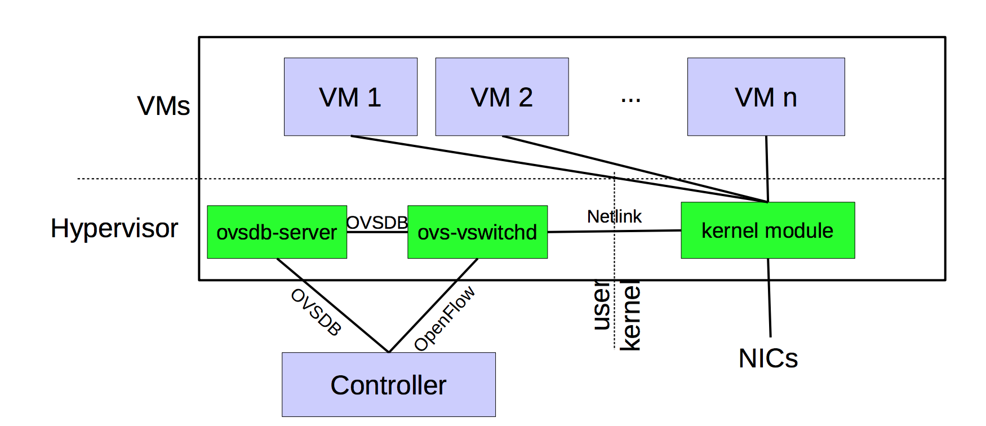
OVS design

Slide 4
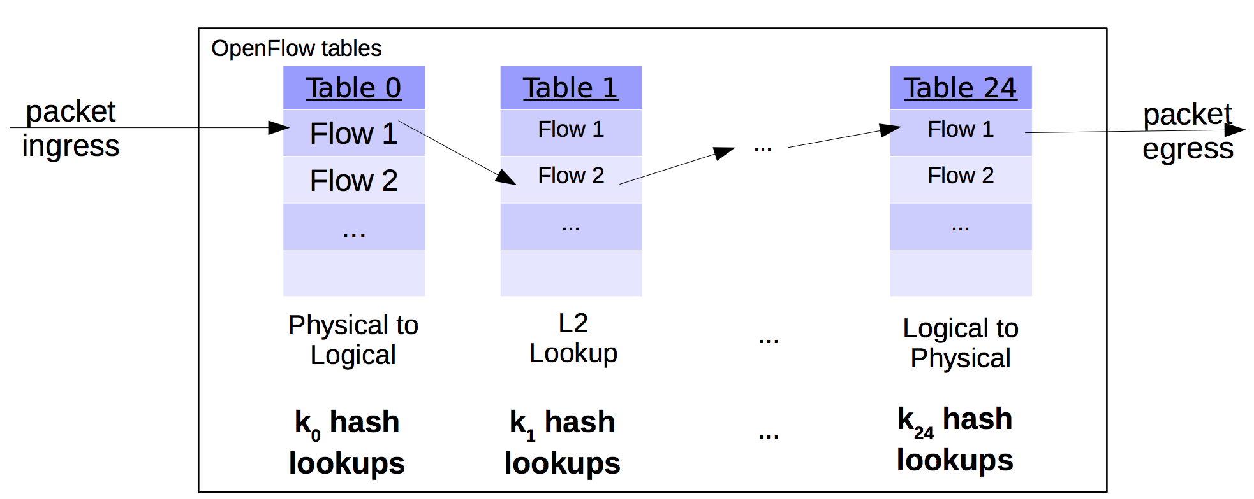
First design: put OF tables in the kernel
Large policies: Low performance with 100+ lookups per packet
Merging policies is problematic: cross-product explosion
Complex logic in kernel: rules with wildcards require complex algoriths

Slide 5
Idea 1: Microflow cache
Microflow: complete set of packet headers with action
Example: srcIP, dstIP, IP TTL, srcMAC, dstMAC
Same insight as tuple space search; attempt to do one memory lookup per packet
Hit
Microflow cache in the kernel
Use a large hash table
Openflow table in user space
Miss

Slide 6
Problems with micro-flows
Too many micro-flows: e.g., each TCP port
Many micro-flows may be short lived
Poor cache-hit rate for memory lookup
Can we cache the outcome of rule lookup directly?
Naive approach: Cross-product explosion!
Example: Table 1 on source IP, table 2 on destination IP
Recurring theme: avoid up-front (proactive) costs

Slide 7
Idea 2: Mega-flow cache
Build the cache of rules lazily using just the fields accessed
Ex: contain just src/dst IP combinations that appeared in packets
Hit
Megaflow cache in the kernel
Use tuple space search
Miss
Openflow table in user space

Slide 8
Outlook: fast packet processing
Get rid of needless software if you can
Specialization to app can bring significant benefits
IDS (hyperscan), caching in switches & load balancers
Algorithms can be as important as the frameworks
Software changes
Application-kernel interface: application must be modified
Device drivers must often be modified
Multitenancy: think about implications to weakening fault isolation
Can we get isolation with efficiency?

Slide 9
Going beyond one (software) box
Safe & efficient composition of middleboxes
Share or shard state
Failover and migration
Placement and routing
Scaling and compaction

Slide 10
Distributed Control Planes
Acknowledgment: Jennifer Rexford

Slide 11

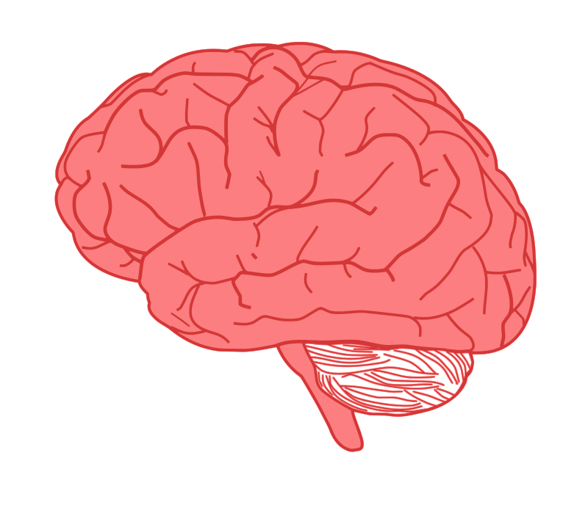


Per-router control plane
Distributed control plane: Components in every router interact with other components to produce a routing outcome.
Routing
Algorithm
control
plane
data
plane
Routing protocol
Data plane
per-packet processing, moving packet from input port to output port
Q1. What info exchanged?
0111
1
3
2
values in arriving
packet header,
i.e, destination IP address
Q2. What computation?

Slide 12
Routing protocols enable FT computation
What does the protocol compute?
Spanning tree, shortest path, local policy, arbitrary end-to-end paths
What algorithm does the protocol run?
Information exchange + computation
Spanning-tree construction, distance vector, link-state routing, path-vector routing, source routing, end-to-end signaling
How do routers learn end-host locations?
Learning/flooding, injecting into the routing protocol, dissemination using a different protocol, and directory server

Slide 13
Goals of Routing Protocols #1
Determine good paths from source to destination
“Good” = least cost
Least propagation delay
Least cost per unit bandwidth (e.g., $ per Gbit/s)
Least congested (workload-driven)
“Good” = policy compliant
“Path” = a sequence of router ports (links)

Slide 14


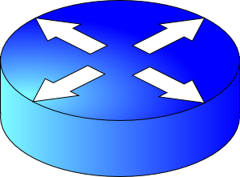
Goals of Routing Protocols #2
Make networks resilient to failures
Routers & links can fail without taking down the entire network
Entire subsets can be unreachable; rest still reachable
Hence, the protocol must be distributed

Slide 15
What does the protocol compute?
(the outcome, not the computation)

Slide 16
Different ways to represent paths
Trade-offs
State required to represent the paths
Efficiency of the resulting paths
Ability to support multiple paths
Complexity of computing the paths
Which nodes are “in charge”
Applied in different settings
LAN, intra-domain, inter-domain

Slide 17
Spanning tree (Ethernet)
One tree that reaches every node
Single path between each pair of nodes
No loops, so can support broadcast easily
Disadvantages
Paths are sometimes long
Some links are not used at all

Slide 18
Shortest paths (OSPF/IS-IS)
Set by network administrator
Shortest path(s) between each pair of nodes
Separate shortest-path tree rooted at each node
Minimum hop count or minimum sum of edge weights
Disadvantages
All nodes need to agree on the link metrics
Multipath routing is limited to Equal cost multiPath

Slide 19
Local policy at each hop (BGP)
Locally best path
Local policy: each node picks the path it likes best
… among the paths chosen by its neighbors
Disadvantages
More complicated to configure and model
2 1 d
2 d
3 2 d
3 4 d
2
2 1 d
2 d
3 2 d
3 4 d
2
3
1
1 d
1 2 d
3
1
1 d
1 2 d
4 d
4 d
5 4 d
4
5 4 d
4
5
5
6 4 d
6 5 4 d
d
6 4 d
6 5 4 d
d
6
6

Slide 20
End-to-end path selection (IP src route)
End-to-end path selection
Each node picks its own end to end paths
… independent of what other paths other nodes use
Disadvantages
More state and complexity in the nodes
Hop-by-hop destination-based forwarding is not enough

Slide 21
How to compute paths?

Slide 22
Spanning tree algorithm (Ethernet)
Elect a root
The switch with the smallest identifier
And form a tree from there
Algorithm
Repeatedly talk to neighbors
“I think node Y is the root”
“My distance from Y is d”
Update information based on neighbors
Smaller id as the root
Smaller distance d+1
Don’t use interfaces not in the path
root
One hop
Three hops

Slide 23
Spanning tree example: switch #4
Switch #4 thinks it is the root
Sends (4, 0) message to 2 and 7
Switch #4 hears from #2
Receives (2, 0) message from 2
… and thinks that #2 is the root
And realizes it is just one hop away
Switch #4 hears from #7
Receives (2, 1) from 7
And realizes this is a longer path
So, prefers its own one-hop path
And removes 4-7 link from the tree
1
3
5
2
4
6
7

Slide 24
Shortest-path problem
Compute: path costs to all nodes
From a given source u to all other nodes
Cost of the path through each outgoing link
Next hop along the least-cost path to s
2
3
1
1
4
u
2
1
5
4
3
6
s

Slide 25
The graph abstraction
Routing algorithms work over an abstract representation of a network: the graph abstraction
Each router is a node in a graph
Each link is an edge in the graph
Edges have weights (also called link metrics). Set by netadmin
Ex: Rutgers campus
u: Computer Science
v: School of Engineering
…
5
v
3
w
2
5
u
2
1
z
3
1
2
x
y
1

Slide 26
The graph abstraction
Routing algorithms work over an abstract representation of a network: the graph abstraction
G = (N, E)
N = {u, v, w, x, y, z}
E = { (u,v), (u,x), (v,x), (v,w), (x,w), (x,y), (w,y), (w,z), (y,z) }
Ex: Rutgers campus
u: Computer Science
v: School of Engineering
…
5
v
3
w
2
5
u
2
1
z
3
1
2
x
y
1

Slide 27
The graph abstraction
5
Cost of an edge: c(x, y)
Examples: c(u, v) = 2, c(u, w) = 5
Cost of a path = sum of edge costs
c(path x → w → y → z) = 3 + 1 + 2 = 6
Outcome of routing: each node should determine the least cost path to every other node
Q1: What information should nodes exchange with each other to enable this computation?
Q2: What algorithm should each node run to compute the least cost path to every node?
v
3
w
2
5
u
2
1
z
3
1
2
x
y
1

Slide 28
Q1: Information exchange
Link state flooding: the process by which neighborhood information of each network router is transmitted to all other routers
Each router sends a link state advertisement (LSA) to each of its neighbors
LSA contains the router ID, the IP prefix owned by the router, the router’s neighbors, and link cost to those neighbors
Upon receiving an LSA, a router forwards it to each of its neighbors: flooding
5
v
3
w
2
5
u
2
1
z
3
1
2
x
y
1

Slide 29
Q1: Information exchange
Eventually, the entire network receives LSAs originated by each router
LSAs put into a link state database
LSAs occur periodically and whenever the graph changes
Example: if a link fails
Example: if a new link or router is added
The routing algorithm running at each router can use the entire network’s graph to compute least cost paths
5
v
3
w
2
5
u
2
1
z
3
1
2
x
y
1

Slide 30
Q2: The algorithm
Dijkstra’s algorithm
Given a network graph, the algorithm computes the least cost paths from one node (source) to all other nodes
This can then be used to compute the forwarding table at that node
Iterative algorithm: maintain estimates of least costs to reach every other node. After k iterations, each node definitively knows the least cost path to k destinations
Notation:
c(x,y): link cost from node x to y; = ∞ if not direct neighbors
D(v): current estimate of cost of path from source to destination v
p(v): (predecessor node) the last node before v on the path from source to v
N': set of nodes whose least cost path is definitively known

Slide 31
Dijsktra’s Algorithm
1 Initialization:
2 N' = {u}
3 for all nodes v
4 if v adjacent to u
5 then D(v) = c(u,v)
6 else D(v) = ∞
7
8 Loop
9 find w not in N' such that D(w) is a minimum
10 add w to N'
11 update D(v) for all v adjacent to w and not in N' :
12 D(v) = min( D(v), D(w) + c(w,v) )
13 /* new cost to v is either old cost to v or known
14 shortest path cost to w plus cost from w to v */
15 until all nodes in N'
Initial estimates of distances are just the link costs of neighbors.
Least cost node among all estimates. This cost cannot decrease further.
Relaxation

Slide 32
Visualization
min cost in N \ N’
N \ N’
Nodes with estimated least path costs, not definitively known to be smallest possible
N’
nodes whose least cost paths from u are definitively known
W should move to N’.
w
c(w, v)
D(w)
v
Relaxation: for each v in N \ N’, is the cost of the path via w smaller than known least cost path to v?
If so, update D(v)
Predecessor of v is w.
D(v)
v’
u
v’’
Cost of path via w: D(w) + c(w,v)
Cost of known best path: D(v)

Slide 33
Dijkstra’s algorithm: example
Step
0
1
2
3
4
5
N'
u
ux
uxy
uxyv
uxyvw
uxyvwz
D(v),p(v)
2,u
2,u
2,u
D(w),p(w)
5,u
4,x
3,y
3,y
D(x),p(x)
1,u
D(y),p(y)
∞
2,x
D(z),p(z)
∞
∞
4,y
4,y
4,y
5
v
3
w
2
5
u
2
1
z
3
1
2
x
y
1

Slide 34
Constructing the forwarding table
To find the router port to use for a given destination (router), find the predecessor of the node iteratively until reaching an immediate neighbor of the source u
The port connecting u to this neighbor is the output port for this destination

Slide 35
Constructing the forwarding table
5
Suppose we want forwarding entry for z.
v
3
w
2
5
u
2
1
z
3
1
2
x
y
1
D(v),p(v)
2,u
D(w),p(w)
3,y
D(x),p(x)
1,u
D(y),p(y)
2,x
D(z),p(z)
4,y
z: p(z) = y
y: p(y) = x
x: p(x) = u
x is an immediate
neighbor of u
Forwarding table at u:
destination
link
z
(u,x)

Slide 36
Link-state: Shortest-path tree
Shortest-path tree from u
Forwarding table at u
v
2
y
link
3
1
1
x
4
v
(u,v)
u
z
2
1
w
(u,w)
5
t
x
(u,w)
w
4
3
y
(u,v)
s
z
(u,v)
Counter-intuitive: Operators may set the link metric to achieve certain shortest-path trees with the protocol
s
(u,w)
t
(u,w)

Slide 37

Path-vector routing (BGP)
Key idea: advertise the entire path
Distance vector: send distance metric per dest d
Path vector: send the entire path for each dest d
“d: path (2,1)”
“d: path (1)”
3
2
1
data traffic
data traffic
d

Slide 38
Path-vector: Fast loop detection
Node can easily detect a loop
Look for its own node identifier in the path
E.g., node 1 sees itself in the path “3, 2, 1”
Node can simply discard paths with loops
“d: path (2,1)”
“d: path (1)”
3
2
1
“d: path (3,2,1)”

Slide 39
Path-vector: Flexible policies
Each node can apply local policies
Path selection: Which path to use?
Path export: Which paths to advertise?
Examples
Node 2 may prefer the path “2, 3, 1” over “2, 1”
Node 1 may not let node 3 hear the path “1, 2”
2
3
2
3
1
1

Slide 40
Learning the locations of the endpoints

Slide 41
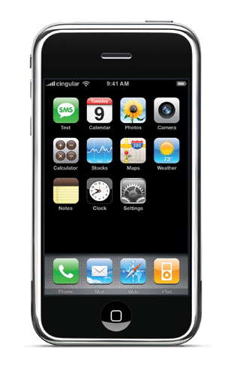

Finding the endpoints
Computing the forwarding table
Still must figure out where the endpoints are
How to find the endpoints?
Learning/flooding (Ethernet)
Injecting into the routing protocol
Dissemination using a different protocol
Central directory service
Ways to curb scaling challenges
E.g., spanning tree per VLAN for endpoint flooding

Slide 42
Learning and Flooding
When the frame has an unfamiliar destination
Forward out all interfaces
… except for the one where the frame arrived
When a frame arrives
Inspect the source address
Associate address with the incoming interface
B
B
A
C
A
C
Switch learns how to reach A.
When in doubt, shout!
D
D
Used in Ethernet LANs

Slide 43
Inject into Routing Protocol
Treat the end host (or subnet) as a node
And disseminate in the routing protocol
E.g., flood information about where addresses attach
2
3
1
1
4
u
2
1
5
4
3
6
s
Used in OSPF and IS-IS, especially in enterprise networks
. . .

Slide 44
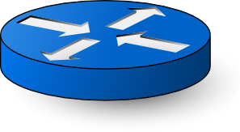
Disseminate with another protocol
One router learns the route
… and shares the information with other routers
disseminate route to other routers
learn a route to d
(e.g., via BGP)
Internal BGP (iBGP) used in backbone networks

Slide 45
Directory Service
Contact a service to learn the location
Lookup the end-host or subnet address
… and learn the label to put on the packet
… to get the traffic to the right egress point
directory
e
“Host d is at egress e”
d
i
Used in some data centers.
s
Encapsulate packet to send to egress e.

Slide 46
Conclusion
Routing is a distributed computation
With challenges in scalability and handling dynamics
Different solutions for different environments
Ethernet LAN: spanning tree, MAC learning, flooding
Enterprise: link-state routing, injecting subnet addresses
Backbone: link-state routing inside, path-vector routing with neighboring domains, and iBGP dissemination
Data centers: many different solutions, still in flux
An active research area…

