Slide 1

Packet Scheduling
Srinivas Narayana
Fall 2020

Slide 2




Are endpoint algorithms alone enough?
What if an endpoint is malicious or buggy?
Want the network core to do something more about resource allocation than best effort

Slide 3



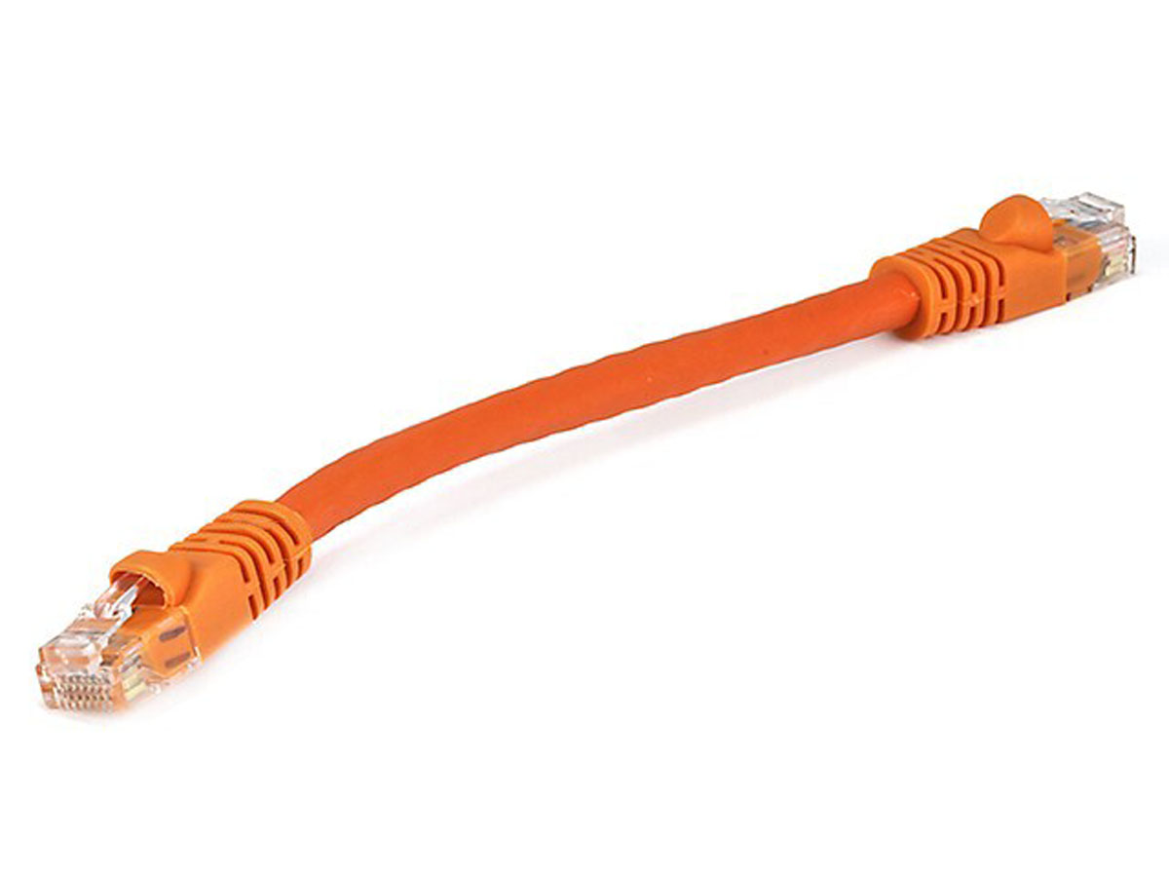
Network model
Queuing delay
Bottleneck queue
(max size B)
Link rate
Flows
Packet-switched core network

Slide 4

First-in first-out (FIFO) queue + tail-drop
Buffer size
2
1
b
2
a
1
a
b
Dropped packets

Slide 5
First-in first-out (FIFO) queue + tail-drop
6
Head of line blocking (HOL)
5
4
Buffer size
3
2
1
6
a
4
3
2
5
1
a
b
b
Can you guess what happens in the next round-trip time interval?
Dropped packets

Slide 6
ACK-clocking makes it worse: lucky case
13
12
11
10
Buffer size
9
8
7
12
11
10
9
8
b
7
b
13
c
Dropped packets

Slide 7
ACK-clocking makes it worse: unlucky case
13
12
11
10
Buffer size
9
8
7
13
12
11
10
9
8
7
b
b
c
Dropped packets

Slide 8
Network monopolized by “bad” endpoints
An ACK signals the source of a free router buffer slot
Further, ACK clocking means that the source transmits again
Contending packet arrivals may not be random enough
Blue flow can’t capture buffer space for a few round-trips
Sources which sent successfully earlier get to send again
A FIFO tail-drop queue incentivizes sources to misbehave!

Slide 9
Packet scheduling on routers
We will discuss packet scheduling algorithms implemented on routers in detail later in this course.
Goal: Achieve a predetermined resource allocation regardless of endpoint behavior
How to make such allocation “efficient”?
Implement on routers at high speeds and low cost
Achieve equitable sharing of network bandwidth & queues
Use available bandwidth effectively

