Slide 1

The Network Layer: Protocols DHCP, ICMP, NAT, IPv6
CS 352, Lecture 14, Spring 2020
http://www.cs.rutgers.edu/~sn624/352
Srinivas Narayana

Slide 2
Course announcements
Quiz 5 due Tuesday
Will be released later today
Recording of Wednesday’s lecture available
See Piazza for details
We are working on converting video into a format that’s more accessible than WebEx’s ARF… stay tuned

Slide 3
Where we are: The network layer
Application
HTTPS
FTP
HTTP
SMTP
DNS
Transport
TCP
UDP
Network
IP
Host-to-Net
X.25
…
802.11
ATM
The network layer exists on every endpoint and router.

Slide 4
Review of concepts
Router components
Input port: line termination, forwarding function
Forwarding: based on IP destination.
Longest-prefix matching
Switching fabric: memory, bus, crossbar
Output port: buffer management and scheduling
route
processor
high-speed
switching
fabric
router input ports
router output ports

Slide 5
Poll #1
If an ISP X owns two prefixes 128.0.0.0/16 and 128.1.0.0/16, which IP prefix can the rest of the Internet use in its forwarding rules to route data towards X?
(a) 128.0.0.0/8
(b) 128.0.0.0/24
(c) 128.0.0.0/15
(d) None of the above

Slide 6
Poll #2
Suppose a router has two forwarding rules. Which port should pkt with destination IP 192.168.0.56 go out of?
192.168.0.0/16 -> port 1
192.168.0.0/24 -> port 2
(a) port 1
(b) port 2
(c) neither port
(d) both ports

Slide 7
The Internet Protocol (IP)

Slide 8
IP datagram format
IP protocol version
number
32 bits
total datagram
length (bytes)
header length
(bytes)
head.
len
type of
service
ver
length
for
fragmentation/
reassembly
“type” of data
flgs
fragment
offset
16-bit identifier
max number
remaining hops
(decremented at
each router)
time to
live
upper
layer
header
checksum
32 bit source IP address
upper layer protocol
to deliver payload to
32 bit destination IP address
Options (if any)
E.g. timestamp,
record route
taken, specify
list of routers
to visit.
how much overhead with TCP?
20 bytes of TCP
20 bytes of IP
= 40 bytes + app layer overhead
data
(variable length,
typically a TCP
or UDP segment)

Slide 9
IP Fragmentation & Reassembly
network links have MTU (max.transfer size) - largest possible link-level frame.
different link types, different MTUs
large IP datagram divided (“fragmented”) within net
one datagram becomes several datagrams
reassembled only at the destination, at the IP layer
IP header bits used to identify, order related fragments
fragmentation:
in: one large datagram
out: 3 smaller datagrams
reassembly

Slide 10
IP Fragmentation and Reassembly
length
=4000
ID
=x
fragflag
=0
offset
=0
Example
4000 byte datagram
MTU = 1500 bytes
(includes IP headers)
One large datagram becomes
several smaller datagrams
length
=1500
ID
=x
fragflag
=1
offset
=0
1480 bytes in data field
length
=1500
ID
=x
fragflag
=1
offset
=185
offset =
1480/8
length
=1040
ID
=x
fragflag
=0
offset
=370

Slide 11
Poll #3
Which header does the IP source and destination live in?
(a) TCP header
(b) IP header
(c) Application-layer header
(d) None of the above

Slide 12
Dynamic Host Configuration
How does an endpoint get its IP address?

Slide 13
IP addresses: how to get one?
Q: How does a host get IP address?
Hard-coded by system admin in a file
UNIX: /etc/network/interfaces
Windows: controlpanel -> network -> configuration -> tcp/ip -> properties
DHCP: Dynamic Host Configuration Protocol: dynamically get address from as server
“plug-and-play”

Slide 14
Similar bootstrapping problems
How does a host get its IP address?
How does a host know its local DNS server?
How does a host know its subnet mask?
How does a host know which router is its “gateway” to other networks?

Slide 15
DHCP: Dynamic Host Configuration Protocol
goal: allow host to dynamically obtain its IP address from network server when it joins network
can renew its lease on address in use
allows reuse of addresses (only hold address while connected/“on”)
support for mobile users who want to join network
DHCP overview:
host broadcasts “DHCP discover” msg [optional]
DHCP server responds with “DHCP offer” msg [optional]
host requests IP address: “DHCP request” msg
DHCP server sends address: “DHCP ack” msg

Slide 16



DHCP client-server scenario
DHCP
server
223.1.1.0/24
223.1.1.1
223.1.2.1
223.1.1.2
arriving DHCP
client needs
address in this
network
223.1.1.4
223.1.2.9
223.1.3.27
223.1.2.2
223.1.1.3
223.1.2.0/24
223.1.3.1
223.1.3.2
223.1.3.0/24

Slide 17
DHCP client-server scenario
DHCP server: 223.1.2.5
DHCP discover
arriving
client
src : 0.0.0.0, 68
dest.: 255.255.255.255,67
yiaddr: 0.0.0.0
transaction ID: 654
Broadcast: is there a DHCP server out there?
DHCP offer
src: 223.1.2.5, 67
dest: 255.255.255.255, 68
yiaddrr: 223.1.2.4
transaction ID: 654
lifetime: 3600 secs
Broadcast: I’m a DHCP server! Here’s an IP address you can use
DHCP request
src: 0.0.0.0, 68
dest:: 255.255.255.255, 67
yiaddrr: 223.1.2.4
transaction ID: 655
lifetime: 3600 secs
Broadcast: OK. I’ll take that IP address!
DHCP ACK
src: 223.1.2.5, 67
dest: 255.255.255.255, 68
yiaddrr: 223.1.2.4
transaction ID: 655
lifetime: 3600 secs
Broadcast: OK. You’ve got that IP address!

Slide 18
DHCP Protocol
Server 1
Client
Server 2
DHCPDISCOVER
DHCPDISCOVER
DHCPOFFER
DHCPOFFER
Collects replies
Selects server 2
DHCPREQUEST
DHCPREQUEST
DHCPACK

Slide 19
DHCP: more than IP addresses
DHCP can return more than just allocated IP address on subnet:
address of first-hop router for client to reach other subnets
Also called the gateway router
name and IP address of the local DNS server
subnet mask of the IP network the host is on
Useful to know whether other endpoint is inside or outside the current IP network

Slide 20
DHCP Relay Agents
DHCP relay agents allow DHCP servers to handle requests from other subnets
Client
DHCP
Relay
Agent
IP
Gateway
Router
IP
Gateway
Router
DHCP
Server

Slide 21


DHCP: An example
connecting laptop needs its IP address, addr of first-hop router, addr of DNS server: use DHCP
DHCP
DHCP
UDP
IP
Eth
Phy
DHCP
DHCP
DHCP request encapsulated in UDP, encapsulated in IP, encapsulated in 802.1 Ethernet
DHCP
DHCP
Ethernet frame broadcast (dest: FFFFFFFFFFFF) on LAN, received at router running DHCP server
DHCP
DHCP
UDP
IP
Eth
Phy
168.1.1.1
DHCP
DHCP
DHCP
DHCP
router with DHCP
server built into
router
Ethernet demuxed to IP demuxed, UDP demuxed to DHCP

Slide 22
DHCP: An example
DHCP server formulates DHCP ACK containing client’s IP address, subnet mask, IP address of first-hop router for client, name & IP address of DNS server
DHCP
DHCP
UDP
IP
Eth
Phy
DHCP
DHCP
DHCP
DHCP
encapsulation of DHCP server, frame forwarded to client, demuxing up to DHCP at client
DHCP
DHCP
UDP
IP
Eth
Phy
168.1.1.1
DHCP
DHCP
DHCP
client now knows its IP address, name and IP address of DNS server, IP address of its first-hop router
DHCP
router with DHCP
server built into
router

Slide 23
Poll #4
What functions does the DHCP protocol serve?
(a) discovering a usable IP address when a host joins
(b) discovering the local DNS server address
(c) discovering the gateway router of the local IP network
(d) all of the above

Slide 24
Poll #5
When a host joins a new network, how does it know the IP address of the DHCP server?
(1) this is a static configuration on all endpoints
(2) it broadcasts a message to discover DHCP servers
(3) neither of the above

Slide 25
Summary
IP addresses don’t have to be manually configured into hosts
DHCP allows “ignorant” hosts to receive IP addresses (and more) at start-up time
DHCP solves important bootstrapping problems in attaching new hosts to a network

Slide 26
Internet Control Message Protocol (ICMP)

Slide 27
ICMP
Protocol for error detection and reporting
tightly coupled with IP, unreliable
ICMP messages delivered in IP packets
ICMP functions:
Announce reachability and network errors
Announce “time exceeded” errors for IP packets
Announce network congestion
ICMP assists network troubleshooting in general

Slide 28
ICMP message
IP header
Source, Destination Address, TTL, ...
ICMP MSG
Message type, Code, Checksum,
Data

Slide 29
ICMP: Internet Control Message Protocol
Type Code description
0 0 echo reply (ping)
3 0 dest. network unreachable
3 1 dest host unreachable
3 2 dest protocol unreachable
3 3 dest port unreachable
3 6 dest network unknown
3 7 dest host unknown
4 0 source quench (congestion
control - not used)
8 0 echo request (ping)
9 0 route advertisement
10 0 router discovery
11 0 TTL expired
12 0 bad IP header
Time for an activity!

Slide 30
Specific uses of ICMP
Echo request reply
Can be used to check if a host is alive
Destination unreachable
Invalid address and/or port
TTL expired
Routing loops, or too far away

Slide 31
Ping
Uses ICMP echo request/reply
Source sends ICMP echo request message to the destination address
Destination replies with an ICMP echo reply message containing the data in the original echo request message
Source can calculate round trip time (RTT) of packets
If no echo reply comes back, then the destination is unreachable

Slide 32
Ping (cont’d)
A
R1
R2
R3
B
Echo request
Time
Echo reply

Slide 33
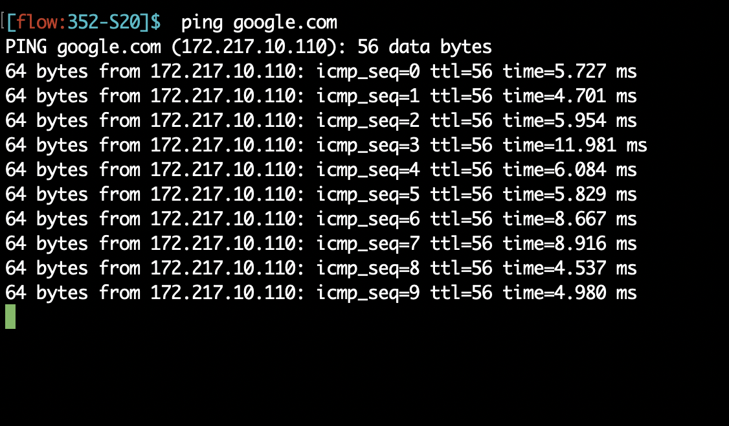
Ping example

Slide 34
Traceroute
Traceroute records the route that packets take
A clever use of the IP TTL (time to live) field
In general, when a router receives a packet, it decrements the TTL on that packet
If TTL=0, router sends an ICMP time exceeded message back to sender
traceroute progressively increases TTL of the packets it sends out
Every time an ICMP time exceeded message is received, record the sender’s (router’s) address
Repeat until the destination host is reached or an error message occurs
If packet reaches the destination, the dest host usually sends an ICMP port unreachable

Slide 35
Traceroute (cont’d)
Te = Time exceeded
Pu = Port unreachable
A
R1
R2
R3
B
TTL=1, Dest = B,
port = invalid
Te (R1)
TTL=2, Dest = B
Time
Te (R2)
TTL=3, Dest = B
Te (R3)
TTL=4, Dest = B
Pu (B)

Slide 36
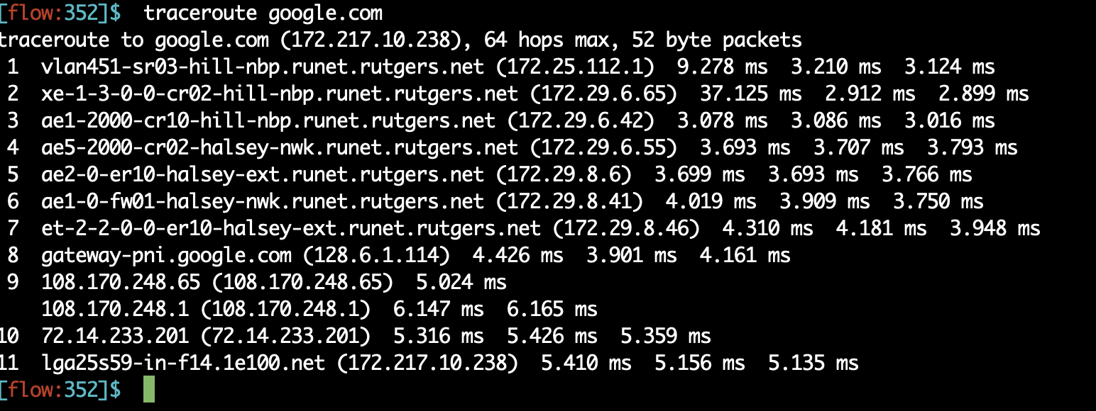
Traceroute example

Slide 37
Poll #6
What’s the IP header field that traceroute changes for each packet that it sends out to a given destination?
(1) IP source address
(2) IP source port
(3) IP TTL
(4) IP length

Slide 38
Network Address Translation (NAT)
How do you survive in a society where names are scarce?

Slide 39
NAT: Network Address Translation
rest of
Internet
local network
(e.g., home network)
10.0.0/24
10.0.0.1
10.0.0.4
10.0.0.2
138.76.29.7
10.0.0.3
All datagrams leaving local
network have same source IP address: 138.76.29.7, with
different source IP port numbers

Slide 40
NAT: Network Address Translation
NAT translation table
WAN side addr LAN side addr
1: host 10.0.0.1
sends datagram to
128.119.40.186, 80
2: NAT router
changes datagram
source addr from
10.0.0.1, 3345 to
138.76.29.7, 5001,
updates table
138.76.29.7, 5001 10.0.0.1, 3345
…… ……
S: 10.0.0.1, 3345
D: 128.119.40.186, 80
10.0.0.1
1
2
S: 138.76.29.7, 5001
D: 128.119.40.186, 80
10.0.0.4
10.0.0.2
138.76.29.7
S: 128.119.40.186, 80
D: 10.0.0.1, 3345
4
S: 128.119.40.186, 80
D: 138.76.29.7, 5001
3
10.0.0.3
4: NAT router
changes datagram
dest addr from
138.76.29.7, 5001 to 10.0.0.1, 3345
3: Reply arrives
dest. address:
138.76.29.7, 5001

Slide 41
NAT: Network Address Translation
Features: local network uses just one IP address as far as outside world is concerned:
range of addresses not needed from ISP: just one IP address for all devices
can change addresses of devices in local network without notifying outside world
can change ISP without changing addresses of devices in local network
Devices inside local network not explicitly addressable
Devices inside local network invisible to the outside world (a security plus) unless the device inside connects first.
Your home WiFi router uses NATs.
If you’re home, you’re behind a NAT right now.

Slide 42
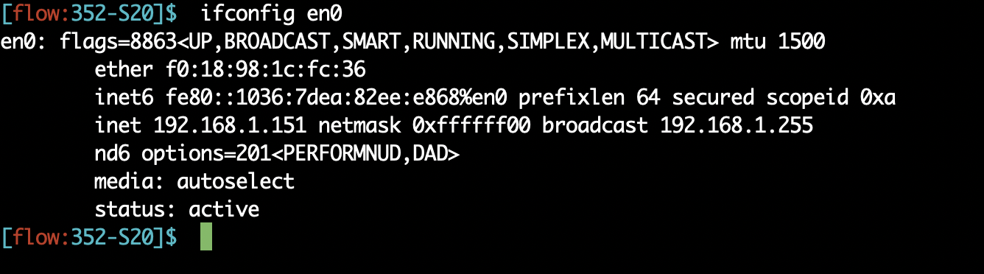
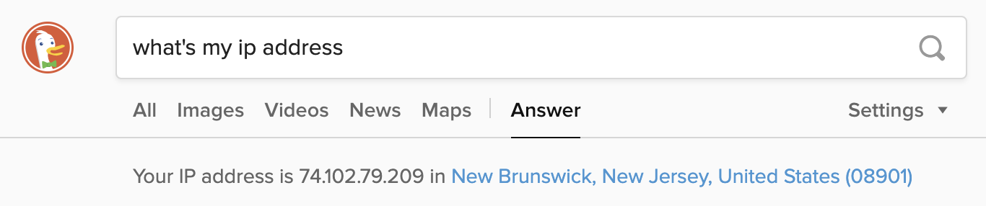
The impact of NATs

Slide 43
NAT: Network Address Translation
16-bit port-number field:
60,000 simultaneous connections with a single LAN-side address!
NAT is controversial:
Routers should only work upto the network layer, not transport ports!
violates “end-to-end argument”
NAT must be taken into account by app designers
e.g., P2P applications like skype
Purists: address shortage should instead be solved by IPv6

Slide 44
Think about…
How do the hosts inside the home network get their IP addresses?
How does your home router get its externally visible IP address?

Slide 45
Poll #7
The translation table at the NAT router contains
(1) Local IP address
(2) Local IP port
(3) Remote IP address
(4) Remote IP port
(5) All of the above

Slide 46
Poll #8
Network Address Translation
(1) reduces the demand for fresh IPv4 addresses
(2) keeps internal IP addresses hidden from the outside world
(3) requires support from the NAT gateway router
(4) all of the above

Slide 47
Internet Protocol v6 (IPv6)

Slide 48
Recent Developments: IPv6
IPv4 has limited address space (32 bits) and is running out of addresses. 32 bits are not enough!
More devices: phones, watches, your refrigerator(!), …
Real-time traffic and mobile users are also becoming more common
IP version 6

Slide 49
IPv6: Main changes from IPv4
Large address space:
128-bit addresses (16 bytes)
Allows up to 340,282,366,920,938,463,463,374,607,431,768,211,456 unique addresses (3.4 x 10 ³⁸ )
Fixed length headers (40 bytes)
Improves the speed of packet processing in routers
IPv6 “options” processing happens through a separate mechanism

Slide 50
IPv6 datagram format
priority: identify priority among datagrams in flow
flow Label: identify datagrams in same “flow”
(concept of“flow” left undefined)
next header: identify upper layer protocol for data
ver
pri
flow label
payload len
next hdr
hop limit
source address
(128 bits)
destination address
(128 bits)
data
32 bits

Slide 51
Other changes from IPv4
checksum: removed entirely to reduce processing time at each hop
options: allowed, but outside of header, indicated by “Next Header” field
ICMPv6: new version of ICMP
additional message types, e.g. “Packet Too Big”
multicast group management functions

Slide 52
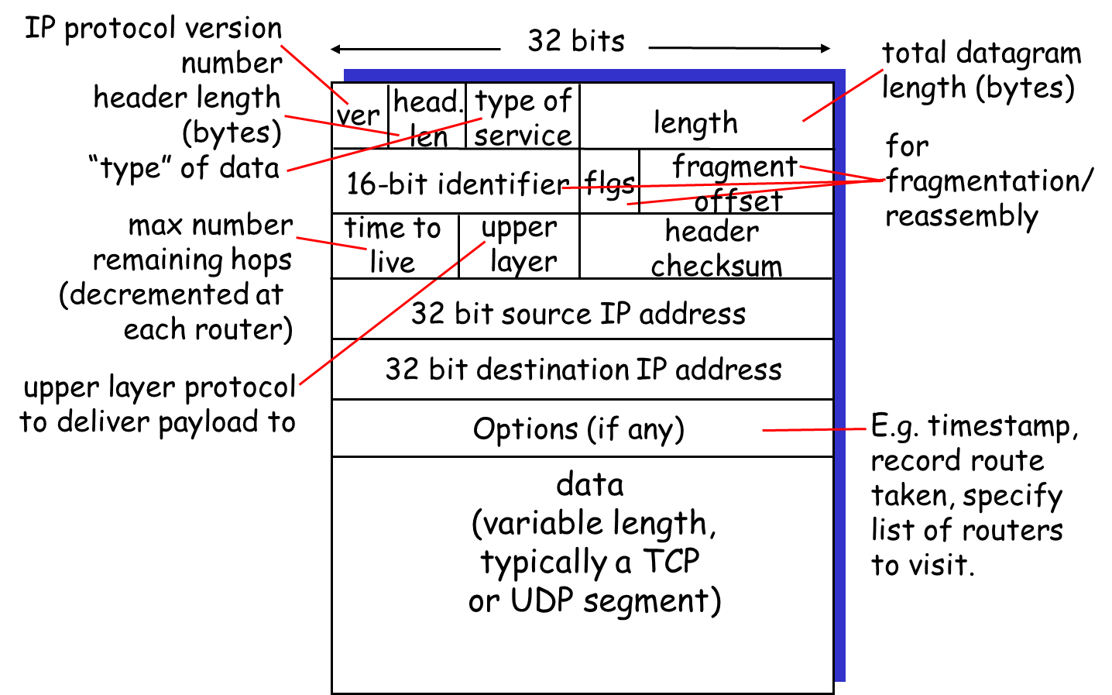
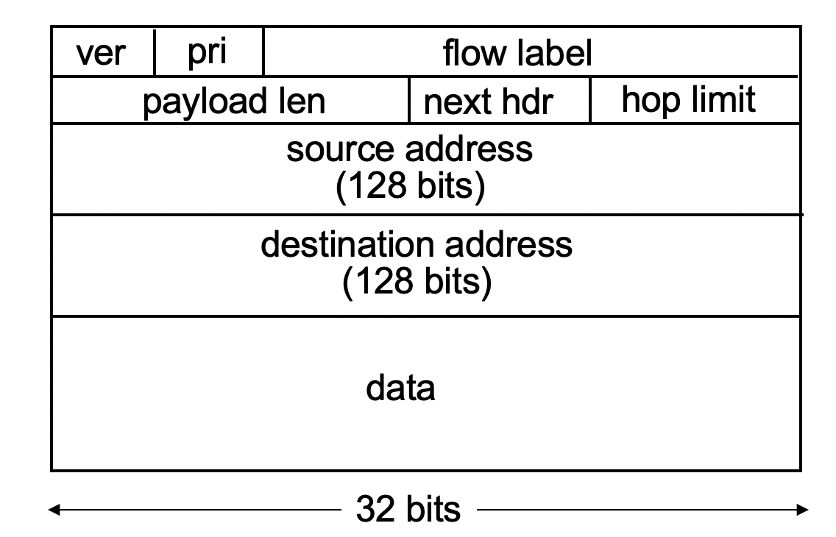
IPv4 vs IPv6: Can you tell the differences?

Slide 53
IPv6 Flows
Support for “flows”
Flows help support real-time service in the Internet
A “flow” is a number in the IPv6 header that can be used by routers to see which packets belong to the same stream
Guarantees can then be assigned to certain flows
Example:
Packets from flow 10 should receive rapid delivery
Packets from flow 12 should receive reliable delivery

Slide 54
IPv6 Addresses
Classless addressing/routing (similar to CIDR)
Notation: xx:xx:xx:xx:xx:xx:xx:xx
x = 4-bit hex number
contiguous 0s are compressed: 47CD::A456:0124
IPv6 compatible IPv4 address: ::128.64.18.87
First 96 bits are 0
Global unicast addresses start with 001….
2000::/3 prefix

Slide 55
IPv6: Adoption
Google: 8% of clients access services via IPv6
NIST: 1/3 of all US government domains are IPv6 capable
Long (long!) time for deployment, use
20 years and counting!
Think of application-level changes in last 20 years: WWW, Facebook, streaming media, Skype, …
Why?

