Slide 1

Distributed Systems: Consensus
Lecture 12b
Srinivas Narayana
http://www.cs.rutgers.edu/~sn624/553-S25

Slide 2

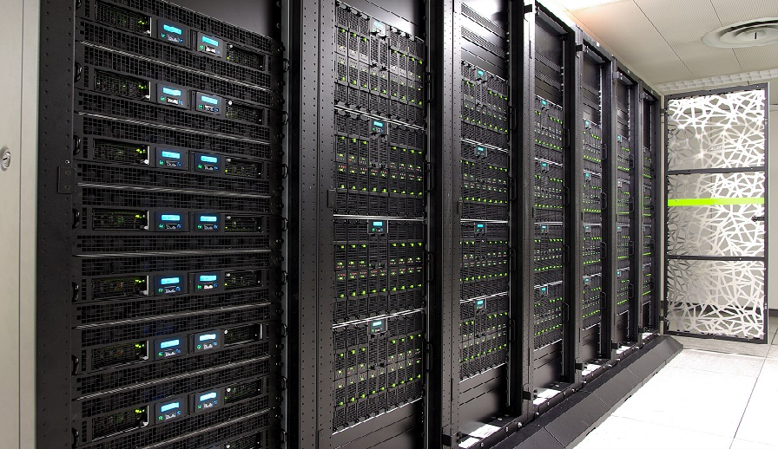





Distributed Systems in Internet Services
Coordination services
Distributed storage
Distributed consensus
Load management

Slide 3

Distribution & its consequences
=
Need replication to tackle machine failures and unavailability
Q: How to make data consistent across replicas?
One option: weak consistency models
Example: eventually consistent
Complex mental models: e.g., read, write, read
Some data is too critical to be out of sync, e.g., Kubernetes cluster state
Don’t sacrifice correctness at any point, e.g., financial systems
Strong consistency: all reads (e.g., clients) return the same value
Operations ordered globally; each read returns the result of the latest write

Slide 4

CAP Theorem
consistency
availability
(Strong) consistency: each read receives the most recent write
Availability: read to any non-failed node returns a response
Partition tolerance: continue to operate despite arbitrary message failure between nodes
CAP theorem: Can’t get all three: Pick 2
You really can’t choose CA in a practical system
Network partitions will happen; design systems to tolerate them
Result: give up either strong consistency or availability

Slide 5


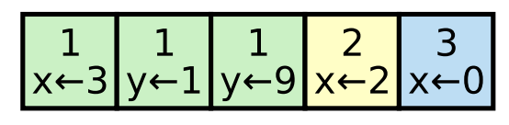
Primitives to build Distributed Systems
Agreement on (meta)data that is distributed: Consensus
Clients may contact any replica or a distinguished replica
Replicated state machines
Replicated configuration and data stores (e.g., etcd)
Leader election
Distributed coordination & locking
e.g., barriers between different computation phases (workflow)
Reliable distributed queueing and messaging
barrier
barrier

Slide 6

Simple solutions distributed consensus?
Simple timeouts to determine a primary?
“Split brain” problem: data corruption
Data unavailable if conservative
Problem amplified in clusters
Disagreement in group membership
Data corruption with separate leaders per group
Network unavailability is common
Slow network
Some messages being dropped
Messages throttled in one direction

Slide 7
Setup: Agree on one value forever
Suppose we have N = 2f + 1 nodes
Want to agree on one value across the distributed system
Assume no clock synchronization (clocks can drift)
Asynchronous: the network can delay or drop messages
Crash recovery
Nodes execute correctly (not Byzantine)
Assume a majority of the nodes can reach each other (quorum)
Agree on the same value even as nodes crash and recover
N = 2f + 1
With f failures (unavailable), the rest is consistent and available

Slide 8
Simple Agreement: Prepare and Accept
Proposer
Single designated acceptor?
That acceptor node can fail
Multiple acceptors?
If a majority accept, agreement!
Problems?
Accept
Acceptors
Prepare(v)

Slide 9

Some problems
Multiple proposers
Each proposer may propose different values
Each acceptor may hear multiple proposals
Acceptors may disagree
Acceptors don’t know if other acceptors agreeing to the same proposal
Acceptor may hear a different proposal after it accepted one
Should it keep its acceptance or change its mind?
Proposer
Proposer
Acceptor
Acceptor

Slide 10
Properties we want: Safety
If a majority of nodes have agreed on one value, that value cannot change in the future
e.g., using a different majority or the same majority
We call this value the chosen value

Slide 11
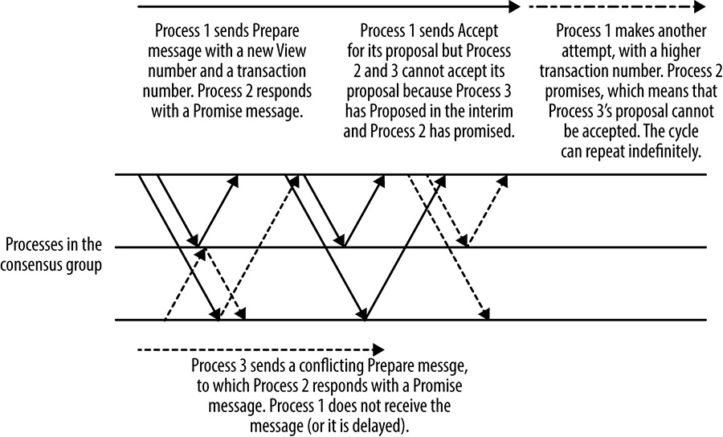
Properties we want: Liveness
Liveness: majority of nodes must eventually choose a value
FLP’s impossibility result: Deterministic algorithms cannot guarantee liveness under arbitrary network asynchrony (delay and loss)
Good news: Realistic networks are not that adversarial (practically live protocols can be designed!)

Slide 12
Basic Paxos (1/3)
Simple operation: a single proposer and (pure) acceptors
P1: If only one value were proposed, it must be chosen
An acceptor must accept the first proposal it receives
If an acceptor fails, and two proposals were each accepted by roughly half the acceptors, the cluster cannot determine the chosen value
Hence, want acceptors to be able to accept multiple proposals
Proposals include transaction numbers (n); assume unique & increasing
P2: If a proposal with value v is chosen, every other chosen proposal must have the same value v
“Agree on some value, not necessarily my value”. P2 guarantees safety

Slide 13
Basic Paxos (2/3)
P2a: One way to satisfy P2 is for acceptors to only accept proposals with the same value v once v is chosen
P2b: One way to satisfy P2a for proposers to only propose proposals with the same value v that was chosen earlier
P2c: One way to satisfy P2b is for any proposer to ask a set of acceptors (at least a majority responding) which proposal # and values accepted so far
These are called promises

Slide 14
Basic Paxos (3/3)
Acceptor agrees not to accept any proposal < n
Proposer must use the value from the highest-numbered proposal accepted from the responses, or use its own value if no existing proposals were accepted
Acceptor can only accept if not promised any proposal > n
If a majority of acceptors promise, at least one acceptor must have responded with the chosen value and chosen proposal # (inductive argument)
Subtle: Write information that must not be reneged into persistent storage (disk) for use after crash recovery

Slide 15
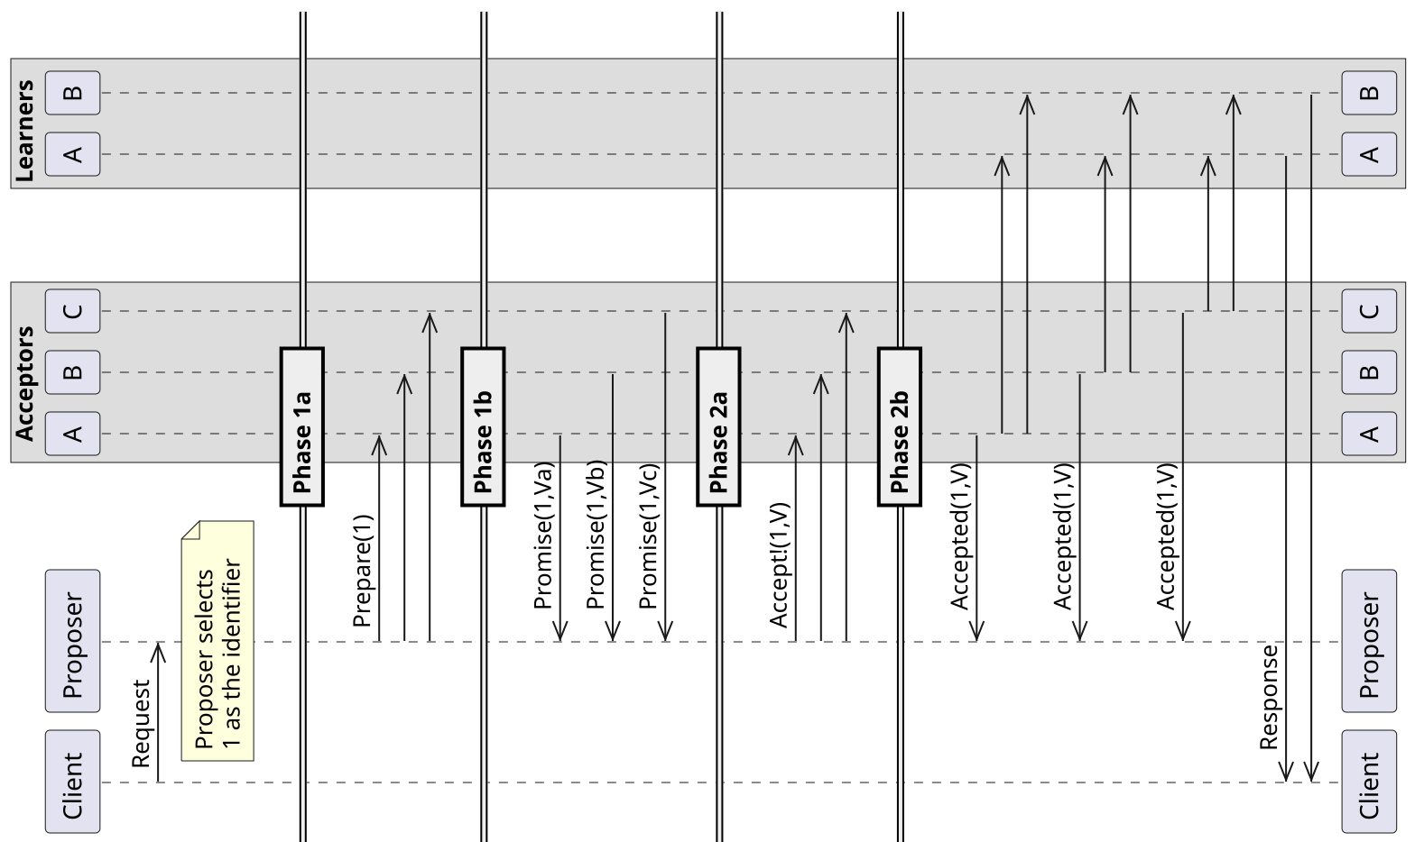
Notes:
https://en.wikipedia.org/wiki/Paxos_(computer_science)#/media/File:Basic_Paxos_without_failures.svg

Slide 16
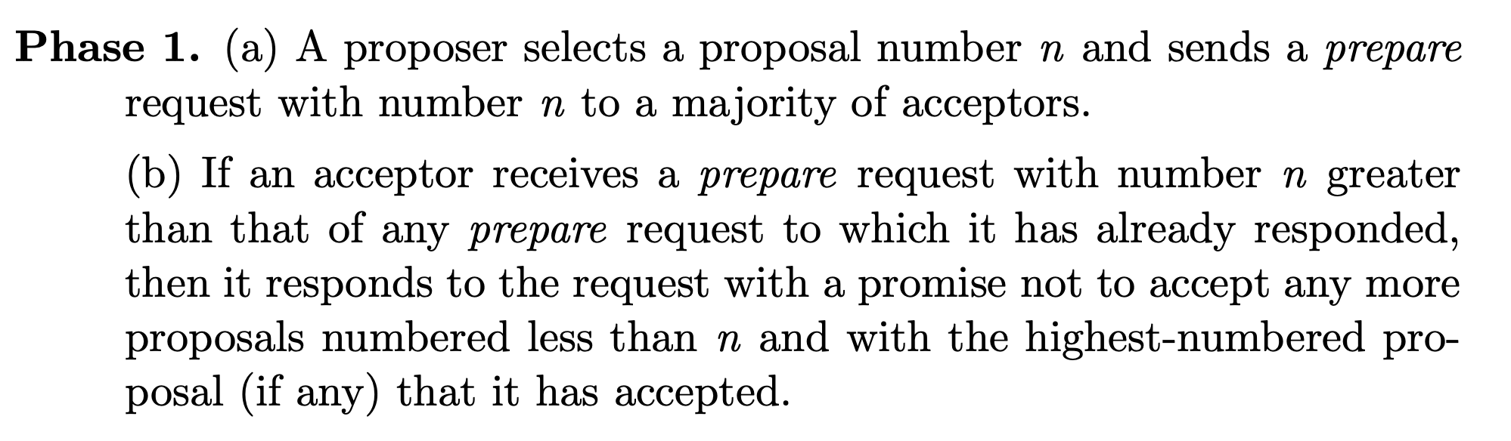
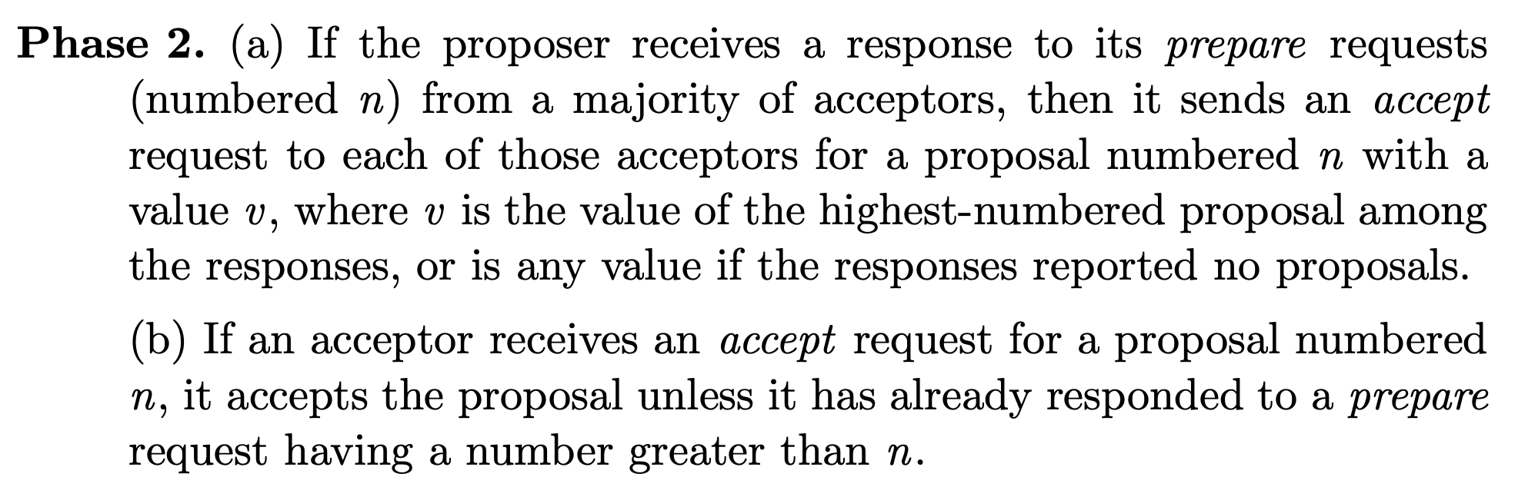
Notes:
https://lamport.azurewebsites.net/pubs/paxos-simple.pdf

Slide 17
Learning the chosen value
Read-only consensus: A majority of nodes must respond with a specific accepted value
e.g., a client sends a message to all nodes
Read from a replica guaranteed to be up to date, e.g., leader
Quorum leases: a set of nodes hold a time-bound lease on a value. Updates must be acknowledged by all of these machines (reduced write performance)

Slide 18
Implementing primitives atop Paxos
Leader election: The chosen value is the leader
Replicated State Machines:
Agree on each command through Paxos: one Paxos instance for each ”slot” in the ordered log of commands
Once all slots up to slot j chosen, can compute state up to log slot j
Locking, configuration store, etc. can be similarly implemented

Slide 19
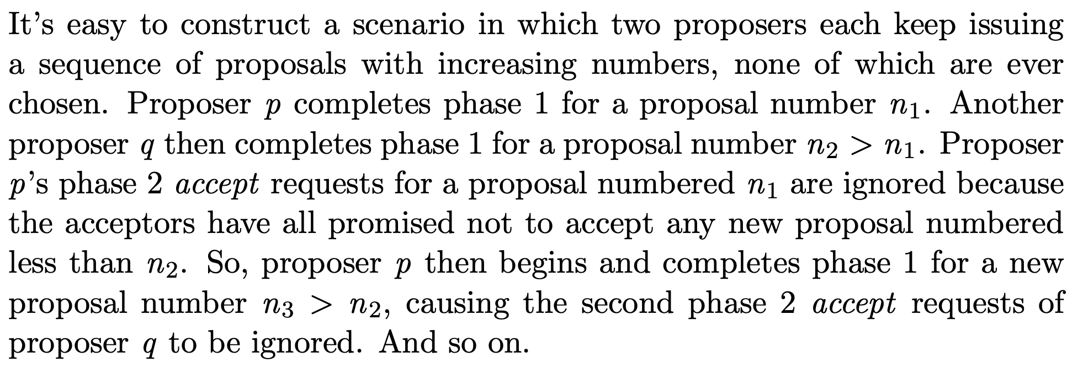
Paxos does not guarantee liveness
One solution: pre-determine or elect a distinguished leader

Slide 20
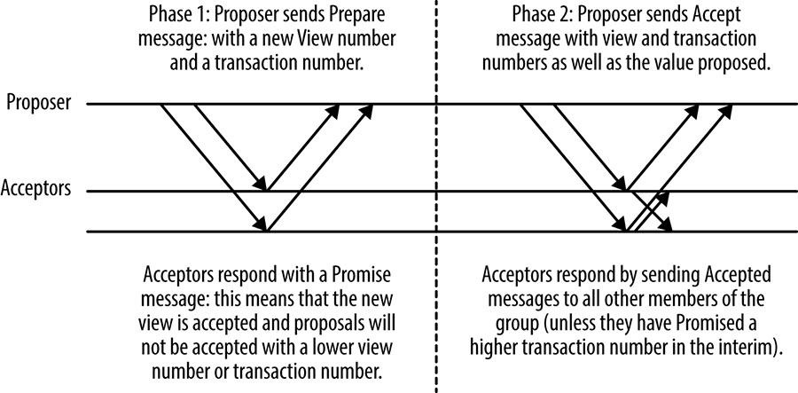
Improvements and Considerations
Agreeing on multiple values and ordering
e.g., multi-paxos: Elect a distinguished node (leader)
only execute phase 2 afterwards until failure
Other protocols
Epaxos, Mencius, RAFT

Slide 21
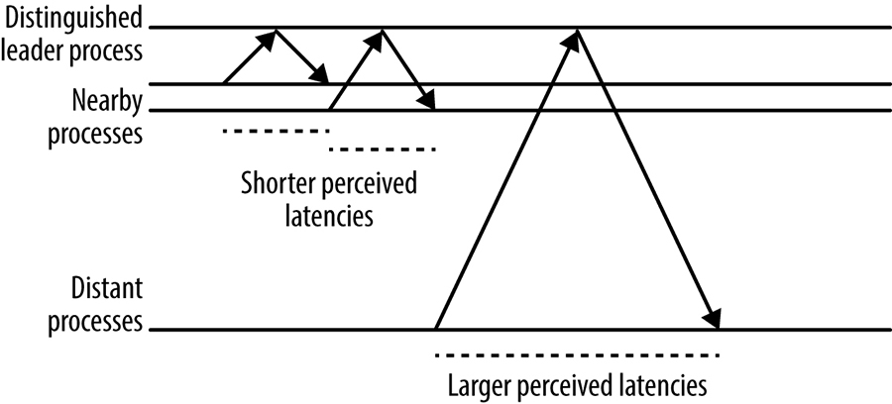

Improvements and Considerations
Disk latency vs. Network latency
Uneven network latencies and choosing leaders

