Slide 1

Transport Security
Lecture 12, Computer Networks (198:552)
Fall 2019
Notes:
Slide material heavily adapted courtesy of Albert Greenberg, Changhoon Kim, Mohammad Alizadeh.

Slide 2
Why security?
Malicious people share your network
People who want to snoop, corrupt, destroy, pretend, steal, …
Problem made more severe as Internet becomes more commercialized
Active and passive attacks

Slide 3
Key aspects of network security
confidentiality: only sender, intended receiver should “understand” message contents
sender encrypts message
receiver decrypts message
integrity: sender, receiver want to ensure message not altered (in transit, or afterwards) without detection
authentication: sender, receiver want to confirm identity of each other
non-repudiation: Once someone sends a message, or conducts a transaction, she can’t later deny the contents of that message

Slide 4



Friends and enemies: Alice, Bob, Trudy
well-known in network security world
Bob and Alice want to communicate “securely”
Trudy (intruder) may intercept, delete, add messages
Alice
Bob
channel
data, control messages
secure
sender
s
data
secure
receiver
data
Trudy

Slide 5
Who might Bob and Alice be?
Real humans ☺
Web browser/server for electronic transactions (e.g., on-line purchases)
on-line banking client/server
DNS servers
routers exchanging routing table updates

Slide 6
What can bad actors do?
A lot!
eavesdrop: intercept messages
actively insert messages into connection
impersonation: can fake (spoof) source address in packet (or any field in packet)
hijacking: “take over” ongoing connection by removing sender or receiver, inserting itself in place
denial of service: prevent service from being used by others (e.g., by overloading resources)

Slide 7
Confidentiality
Cryptography: preventing adversaries from reading private messages

Slide 8
Cryptography: Terminology
Alice’s
encryption
key
Bob’s
decryption
key
K
K
A
B
plaintext, m
encryption
algorithm
ciphertext
decryption
algorithm
plaintext
En/decryption algorithms are also called ciphers.
m plaintext message
c = K_{A}(m), K_{A}(m) ciphertext, encrypted with key K_{A}
m’ = K_{B}(c), K_{B}(c) decrypted plaintext with key K_{B}
Want: m = K_{B}(K_{A}(m))
Want: K_{A}(m) to be uncorrelated with m

Slide 9
Cryptography: Algorithms and Keys
Cryptography requires both an en-/decryption algorithm and keys
Key is a string known only to Alice and Bob, which controls how algorithm works
Algorithm should be public and known to all
Inspires trust that the algorithm works
Keys
Should be long enough to prevent easy breaking of the encryption
Should be short enough to keep algorithm efficient
Typical key lengths: 56-bit, 128-bit, 256-bit, 512-bit

Slide 10
Symmetric key cryptography
K
K
S
S
plaintext
message, m
encryption
algorithm
ciphertext
decryption
algorithm
plaintext
K_{S}(m)
m = K_{S}(K_{S}(m))
Symmetric keys: Bob and Alice share same (symmetric) key: S
Main techniques of symmetric key cryptography:
Substitution and Permutation
Q: how do Bob and Alice agree on key value?

Slide 11
How to agree on a shared secret key?
In reality: two parties may meet in person or communicate “out of band” to exchange shared key
But communicating parties may never meet in person
Example: An online retailer and customer
Much more common for a network ☺
What if the shared secret is stolen?
All secret communications can now be decrypted and are visible
Including earlier ones that were encrypted using that secret
How to communicate without necessitating key exchange?
Public key cryptography

Slide 12
Public Key Cryptography
Sender and receiver do not share secret key
public encryption key known to all
private decryption key known only to the receiver

Slide 13
Public key cryptography (eg: RSA)
+
Bob’s public
key
K
B
-
Bob’s private
key
K
B
plaintext
message, m
encryption
algorithm
ciphertext
decryption
algorithm
plaintext
message
+
K (m)
-
+
B
m = K (K (m))
B
B

Slide 14
Diffie Hellman Merkle key exchange
Alice and Bob agree on a modulus p and base g
Alice chooses secret a, sends bob A = gª mod p
Bob chooses secret b, sends bob B = g^{b} mob p
Alice computes Bª mod p
Bob computes A^{b} mod p
Is the common key computed by Alice and Bob the same?
In what sense is D-H-M key exchange secure?

Slide 15
Public vs. Symmetric key crypto
Public key crypto
Expensive to encrypt using just modular exponentiation operations
No need to exchange keys
Symmetric key crypto
Encryption and decryption are fast
But need to solve the key exchange problem

Slide 16
Crypto in practice: session keys
Use public key crypto or key exchange to agree on a symmetric session key
Use symmetric key to protect the rest of the session efficiently
E_{Kpub,Jeff}(Sally,R_{Sally})
E_{Kpub,Sally}(R_{Sally}, R_{Jeff}, K_{S})
Sally
Jeff
E_{KS}(R_{Jeff})

Slide 17
Integrity
Did messages get across without tampering?

Slide 18
Message digests
large
message
m
H: Hash
Function
Can we ensure that a receiver can detect message tampering?
Idea: fixed-length, easy- to-compute digital “fingerprint” of a message
apply hash function H to m, get fixed size message digest, H(m).
H(m)
Cryptographic hash function properties:
Easy to calculate
Produces fixed-size msg digest (fingerprint)
Hard to reverse: given msg digest x,
computationally infeasible to find m such that x = H(m)
Or another m’ such that H(m) = H(m’)

Slide 19
Using message digests for integrity
s
s = shared secret
s
message
message
message
H( )
Internet
H( )
compare
Verifies message integrity
Requires a secret shared key
No encryption

Slide 20
Message digest algorithms
You’ll see the term “MAC” or Message Authentication Codes
I find it confusing (medium access); I will avoid using it.
MD5 hash function widely used (RFC 1321)
computes 128-bit message digest in 4-step process.
arbitrary 128-bit string x, appears difficult to construct msg m whose MD5 hash is equal to x
SHA-1 is also used
US standard [NIST, FIPS PUB 180-1]
160-bit message digest

Slide 21
Digital signatures
Cryptographic technique analogous to handwritten signatures:
sender (Bob) digitally signs document, establishing he is document owner/creator.
verifiable, nonforgeable: recipient (Alice) can prove to someone that Bob, and no one else (including Alice), must have signed document

Slide 22
Digital signatures
simple digital signature for message m:
Bob signs m by encrypting with his private key K_{B}, creating “signed” message, K_{B}(m)
-
-
Bob’s message, m
-
Bob’s private
key
-
K
m,K
(m)
B
B
Dear Alice
Oh, how I have missed you. I think of you all the time! …(blah blah blah)
Bob
Bob’s message, m, signed (encrypted) with his private key
Public key
encryption
algorithm

Slide 23
Authentication
How do I know you are who you say you are?

Slide 24
Authentication using public key crypto
Idea: Use nonce and public key cryptography
“I am Alice”
Bob computes
+
-
R
K
(K (R)) = R
-
A
A
K (R)
and knows only Alice could have the private key, that encrypted R such that
A
“send me your public key”
+
K
A
+
-
K
(K (R)) = R
A
A

Slide 25
Security hole -- if you ask for public keys!
man (or woman) in the middle attack: Trudy poses as Alice (to Bob) and as Bob (to Alice)
I am Alice
I am Alice
R
-
K (R)
T
R
-
Send me your public key
K (R)
+
A
K
T
Send me your public key
+
K
A
+
K (m)
Trudy gets
T
-
+
+
m = K (K (m))
K (m)
T
T
-
A
sends m to Alice encrypted with Alice’s public key
+
m = K (K (m))
A
A

Slide 26
Certification authorities
certification authority (CA): binds public key to particular entity, E.
E (person, router) registers its public key with CA.
E provides “proof of identity” to CA.
CA creates certificate binding E to its public key.
certificate containing E’s public key digitally signed by CA – CA says “this is E’s public key”
Bob’s
public
key
digital
signature
(encrypt)
+
K
+
B
K
B
CA
private
key
certificate for Bob’s public key, signed by CA
-
Bob’s
identifying information
K
CA

Slide 27
Certification authorities
When Alice wants Bob’s public key:
gets Bob’s certificate (from Bob or elsewhere).
apply CA’s public key to Bob’s certificate, get Bob’s public key
+
digital
signature
(decrypt)
Bob’s
public
key
K
B
+
K
B
CA
public
key
+
K
CA

Slide 28
Transport Layer Security (TLS)
Providing security properties in a practical protocol

Slide 29
Goals of TLS
Confidentiality
Message integrity
Server authentication (optionally, client authentication)
Must work in the context of the existing network protocol stack

Slide 30
TLS/SSL and the rest of the protocol stack
Application
Application
TLS/SSL
TCP
TCP
IP
IP
normal application
application with TLS/SSL
TLS/SSL provides application programming interface (API) to applications
C and Java libraries/classes readily available
Ex: OpenSSL
30

Slide 31
Step (1): a simple handshake
Client hello
Server public key certificate
K_{B}⁺(MS) = EMS
MS: master secret
EMS: encrypted master secret
Q: What all might the “master secret” be used for?

Slide 32
Step (2): key derivation
considered bad to use same key for more than one cryptographic operation
use different keys for message integrity and encryption
four keys:
K_{c} = encryption key for data sent from client to server
M_{c} = integrity digest key for data sent from client to server
K_{s} = encryption key for data sent from server to client
M_{s} = integrity digest key for data sent from server to client
keys derived from key derivation function (KDF)
Takes master secret and (possibly) some additional random data and creates the keys

Slide 33
Step (3): Data records
why not encrypt data in constant stream as we write it to TCP?
where would we put the message digest? If at end, no message integrity until all data processed.
e.g., with instant messaging, how can we do integrity check over all bytes sent before displaying?
instead, break stream in series of records
each record carries a message digest
receiver can act on each record as it arrives
How does receiver distinguish the digest from data within a record?
want to use variable-length records
length
data
Message digest

Slide 34
TLS/SSL “Cipher Suite”
Cipher suite
public-key algorithm
symmetric encryption algorithm
Integrity hashing algorithm
TLS/SSL supports several cipher suites
Negotiation: client, server agree on cipher suite
client offers choices
server picks one
Common symmetric ciphers
AES – Advanced Encryption Standard
DES – Data Encryption Standard: block
3DES – Triple strength: block
ChaCha: stream
RC4 – Rivest Cipher 4: stream
SSL Public key encryption
RSA with DH
Integrity hashing algorithms
HMAC-MD5 and others

Slide 35
Improved Handshake with Negotiation
server authentication
negotiation: agree on cipher suite
establish necessary keys
client authentication (optional)
All this takes a few round trip times to accomplish!
35

Slide 36
QUIC handshake
Adding security in one shot to a handshake

Slide 37
Goals of QUIC handshake
Reduce round-trip times to get set up with secure connection
Initial handshake takes 1 RTT, starting from the first byte received from the client, before server can send data
Later, server can send data immediately upon receiving the first byte from the client (“0-RTT” handshake)

Slide 38
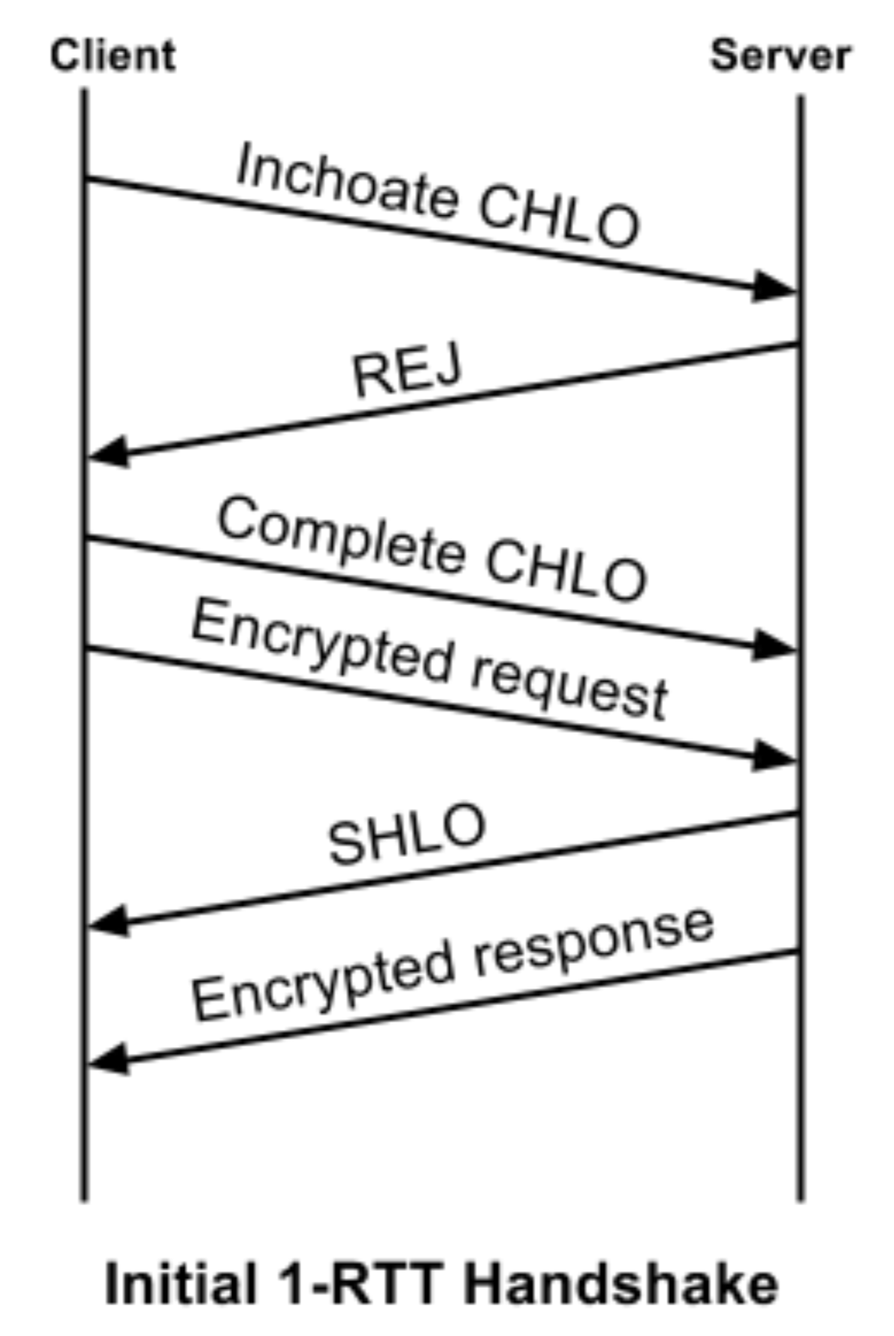
Initial 1-RTT handshake
Client first sends an “inchoate” (incomplete) client hello message
Server REJ message contains:
server’s long-term DHM public value
Certificate chain authenticating the server
Signature of DHM public value using the certified (private) key
Client source address token signed by server
What properties does each of these (help) establish?

Slide 39
Initial 1–RTT handshake
Finish the handshake
Client sends its ephemeral DHM public value to server in a complete CHLO.
Server then responds with its ephemeral DHM public value.
Ephemeral DH values provide forward secrecy

Slide 40
Other handshake details
In later handshakes, client optimistically sends its source address token to the server
Optimistic version negotiation: client proposes a cipher suite and encrypts first request with that cipher suite
If server can’t speak that cipher suite, it forces version renegotiation, similar to TLS
Both techniques optimize the common case when clients speak to a known server with an agreed-upon cipher suite

