Slide 1

Video
Lecture 10
http://www.cs.rutgers.edu/~sn624/352-F24
Srinivas Narayana

Slide 2

Quick recap of concepts
Multimedia
Spatial coding
Video Bitrate
Bits played out per second
(can vary over video’s lifetime)
Temporal coding
variable
network
delay
Stall
Constant bitrate video
transmitted @ server
Cumulative data
Reality
Buffer at the client to hold frames initially until playout delay t_{p}
Ideal @ client
Smooth playout
time

Slide 3

Client-side buffering, playout
buffer fill level, B(t)
variable fill
rate, x(t)
playout rate,
e.g., CBR r
video server
Client’s
buffer, size B_{max}
client
Most video is broken up in time into multiple segments
Client downloads video segment by segment
For example: a segment might be 4 seconds worth of video.

Slide 4
Client-side buffering, playout
buffer fill level, B(t)
variable fill
rate, x(t)
playout rate,
e.g., CBR r
video server
Client’s
buffer, size B_{max}
client
1. Initial fill of buffer until playout begins at t_{p}
2. playout begins at t_{p}
3. buffer fill level varies over time as fill rate x(t) varies (assume playout rate r is constant)

Slide 5
Client-side buffering, playout
buffer fill level, B(t)
variable fill
rate, x(t)
playout rate,
e.g., CBR r
video server
Client’s
buffer, size B_{max}
playout buffering: average fill rate (x), playout rate (r):
x < r: buffer eventually empties for a sufficiently long video.
Stall and rebuffering
x > r: buffer will not empty, provided the initial playout delay is large enough to absorb variability in x(t)
initial playout delay tradeoff: buffer starvation less likely with larger delay, but also incur a larger delay for the user to begin watching

Slide 6
Client-side buffering, playout
buffer fill level, B(t)
variable fill
rate, x(t)
playout rate,
e.g., CBR r
video server
Client’s
buffer, size B_{max}
playout buffering: average fill rate (x), playout rate (r):
is x < r or x > r for a given network connection?
It can be hard to control x or even predict it in general
Best-effort network inflicts long queues, low bandwidth, loss, etc.
How to set the playout rate r?
Too low a bit-rate r: video has poorer quality than needed
Too high a bit-rate r: buffer might empty out. Stall/rebuffering

Slide 7
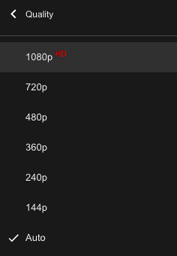
Adaptive bit–rate video
Motivation: Want to provide high quality video experience, without stalls
Observations:
Videos come in different qualities (average bit rates)
Versions of the video for different quality levels readily available
Different segments of video can be downloaded separately
Adapt bit rate per segment through collaboration between the video client (e.g., your browser) and the server (e.g., @ Netflix)
Adaptive bit-rate (ABR) video: change the bit-rate (quality) of next video segment based on network and client conditions
A typical strategy: Buffer-based rate adaptation

Slide 8
Buffer-based bit-rate adaptation
Key idea: If there is a large stored buffer of video at the client, optimize for video quality, i.e., high bit rates
Else (i.e., client video buffer has low occupancy), avoid stalls by being conservative and asking for a lower quality (bit-rate)
The hope: the lower bandwidth requirement of a lower-quality stream is more easily met; stalls averted
Buffer is measured in seconds of playout left before stalling

Slide 9
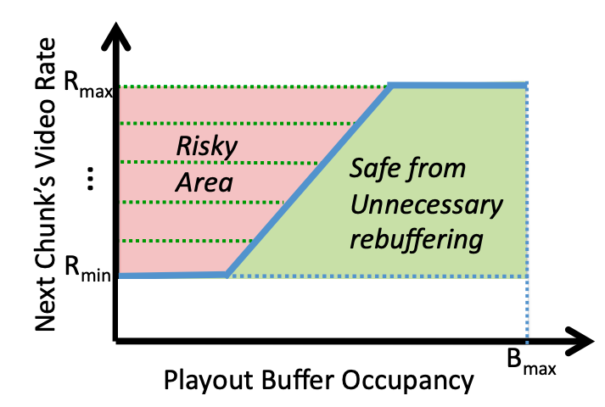
Buffer-based bit-rate adaptation
Provide high video quality overall despite variable and intermittently poor
network conditions.
http://yuba.stanford.edu/~nickm/papers/sigcomm2014-video.pdf
A Buffer-Based Approach to Rate Adaptation
(used by Netflix)

Slide 10
Dynamic Adaptive Streaming over HTTP (DASH)

Slide 11
Streaming multimedia with HTTP
Early video: basic UDP
Problems: reliability, blocking
Today: repurpose web infrastructure and protocols for video
DASH: Dynamic Adaptive Streaming over HTTP
Used by Netflix, YouTube, and other video streaming services

Slide 12
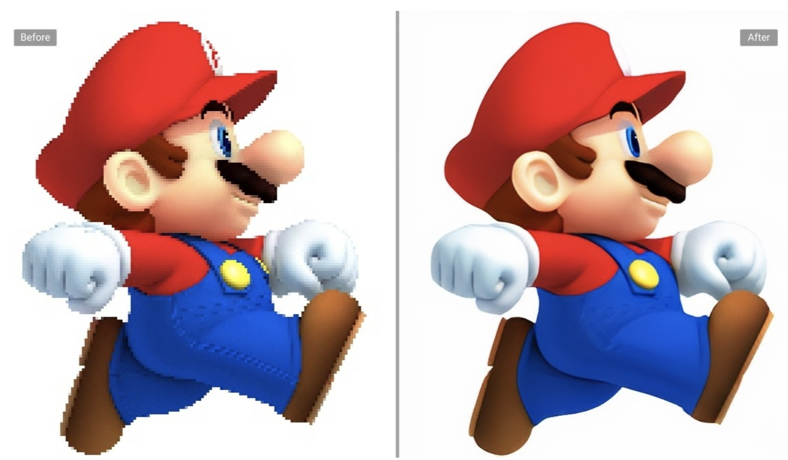
DASH: Key ideas
Web Browser
Or Video Client
Content (video, audio, transcript, etc.) divided into segments (time)
Algorithms to determine and request varying attributes (e.g., bitrate, language) for each segment
Goal: ensure good quality of service, match user prefs, etc.
HTTP
client
Media
player
Issue requests on time. Pick attributes for each segment of content
Media Presentation
Description (manifest)
Video
Server
Audio
Transcripts

Slide 13
Streaming multimedia with HTTP
Dividing up a video into multiple segments enables a few things
Possible to decide the quality per segment
Enables bit rate adaptation
Typically done on the client, but possible on the server (with feedback)
Change language, receive sub-titles, etc. mid-stream
Retrieve segments of a single video from multiple sources
DASH video server is just a standard HTTP server
Client issue HTTP GET requests (typically with the Range request header)
Leverage existing web infrastructure (CDN, DNS)
Send different clients to different video sources (CDN)

Slide 14
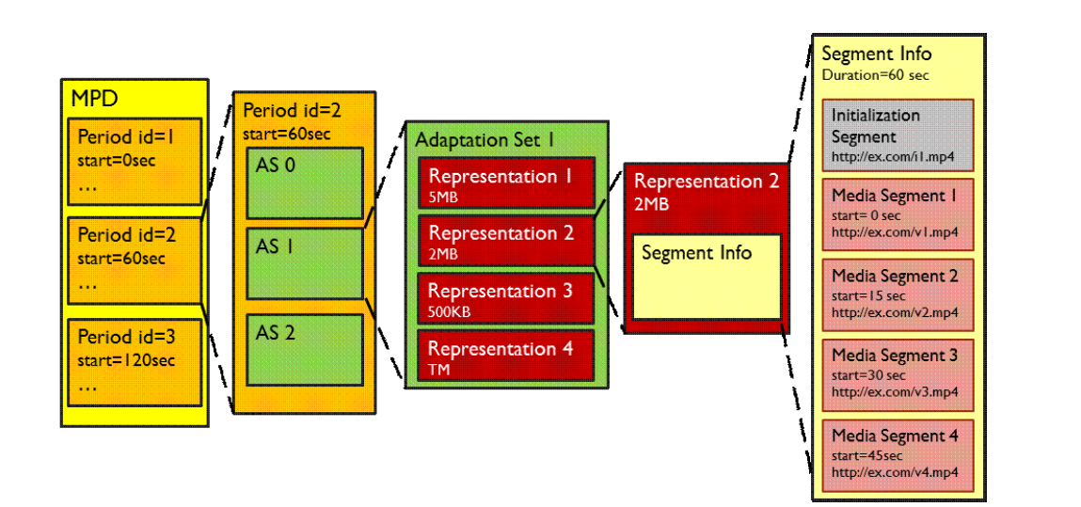
What does the manifest contain?
Representation sets (RS): codecs, bit rates, resolutions, etc.
Functionally equivalent: RSes of given AS
Functionally different: different ASes
Adaptation sets: each AS includes functionally different content (e.g., video, audio, transcript)
Periods:
Durations of content
Multiple segments per representation
URL for each RS/segment
If URL per RS, byte ranges per segment (HTTP header for a range request)
Source: Stockhammer, MMSys.
https://www.w3.org/2010/11/web-and-tv/papers/webtv2_submission_64.pdf

Slide 15
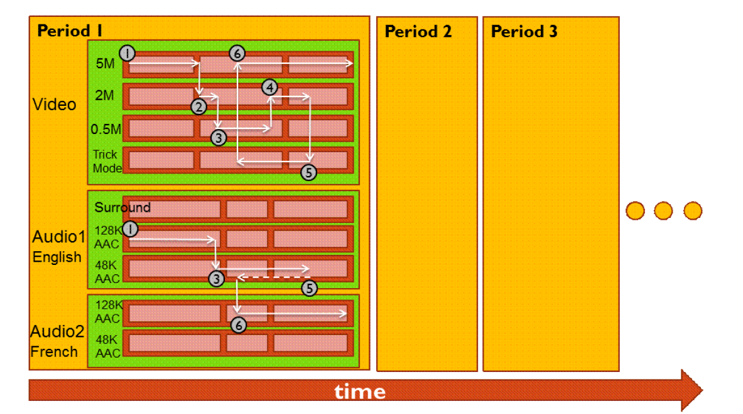
Adaptive changes in quality

Slide 16




Dynamic server selection based on client
Just an HTTP request for an HTTP object
CDN DNS points user to best CDN server
3. HTTP GET request
for URLs
1. HTTP GET request for video URL
CDN servers caching the video
Internet
YouTube origin servers
2. HTTP reply containing html to construct the web page, manifest, with URLs for video content
4. HTTP reply
with cached resources at those URLs
User

Slide 17
DASH reference player
https://reference.dashif.org/dash.js/latest/samples/dash-if-reference-player/index.html

Slide 18
DASH Summary
Piggyback video on HTTP: widely used
Enables independent HTTP requests per segment
Works well with CDNs
Adapt quality with time, location per client, possibly location over time
May use HTTP range requests to ask byte ranges in a segment URL
Fetch segments from locations other than the origin server
More resources on DASH
https://www.w3.org/2010/11/web-and-tv/papers/webtv2_submission_64.pdf
https://www.youtube.com/watch?v=xgowGnH5kUE

Slide 19


Application Layer: Wrap-up
Name resolution, the web, video
Protocols built over the socket() abstraction
Simple designs go a long way
Plain text protocols, header-based evolution
Infrastructure for functionality & performance
CDNs, web proxies
Fit your apps to run on browsers: run almost anywhere (e.g. video)
Apps are ultimately what users and most engineers care about
But, if you don’t understand what’s under the hood, you risk bad design and poor performance in Internet applications
App layer
App layer

