Slide 1

Persistence

Slide 2
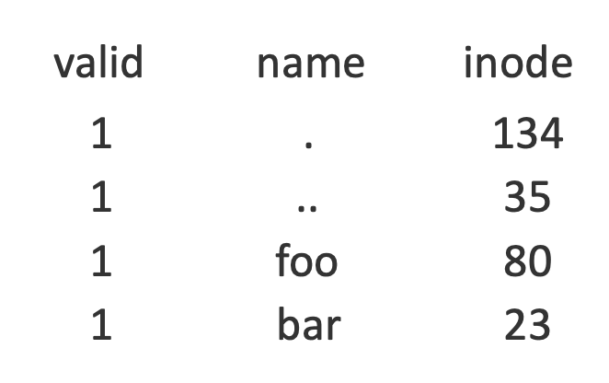
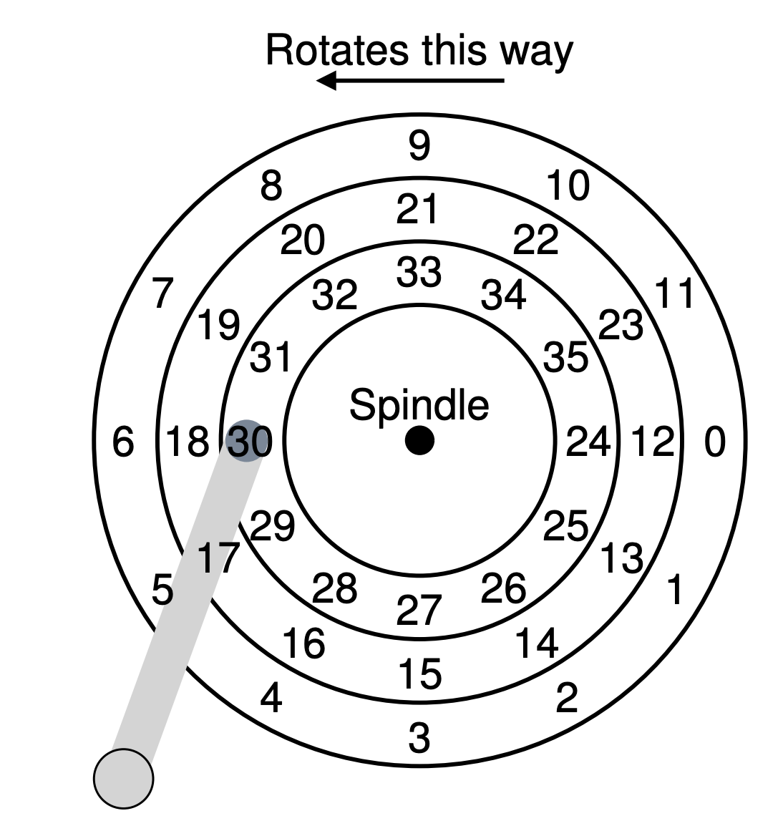
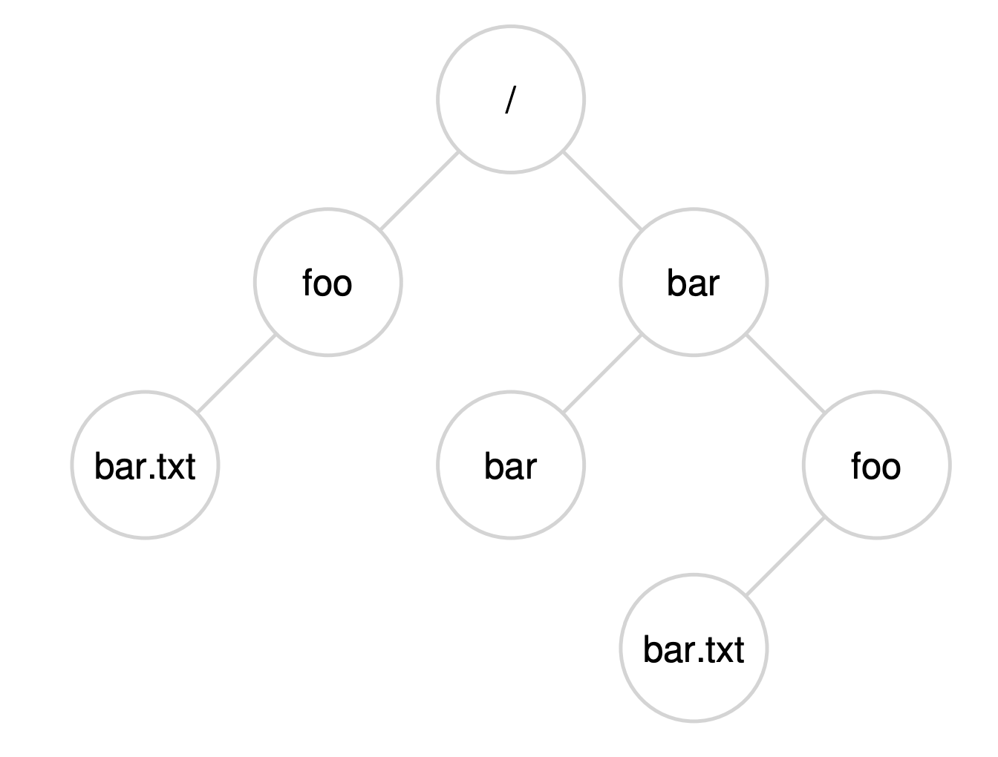
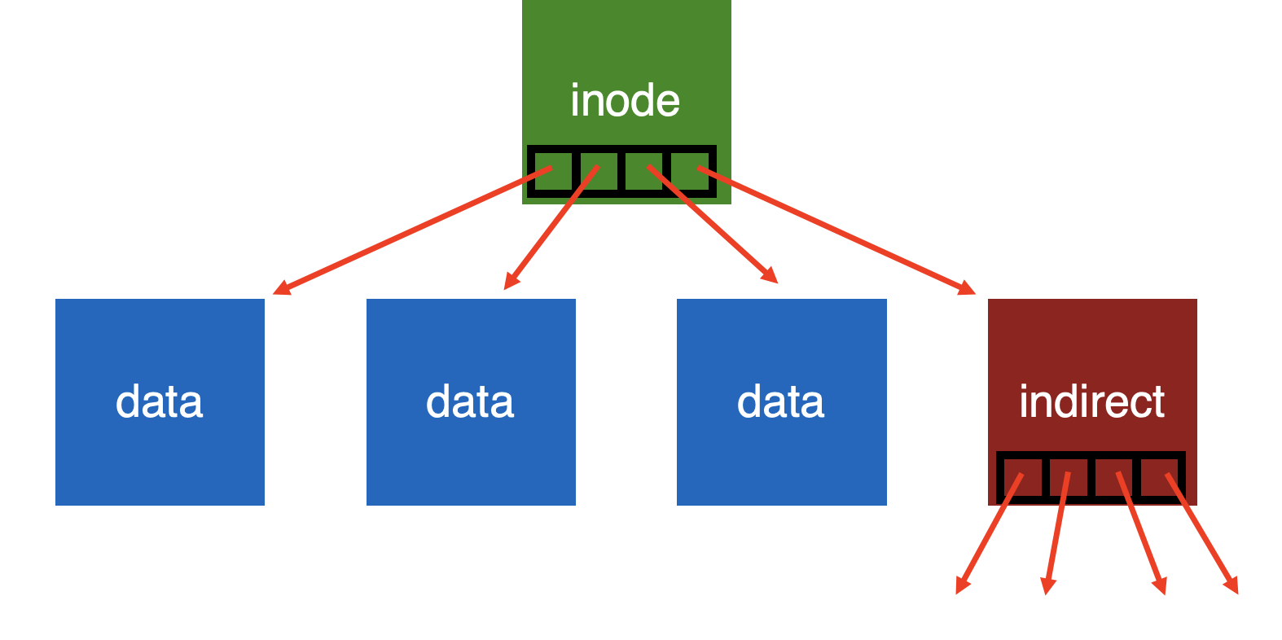
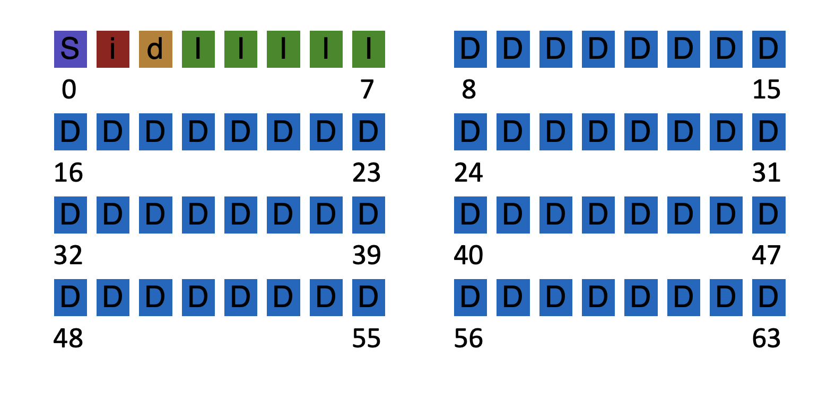
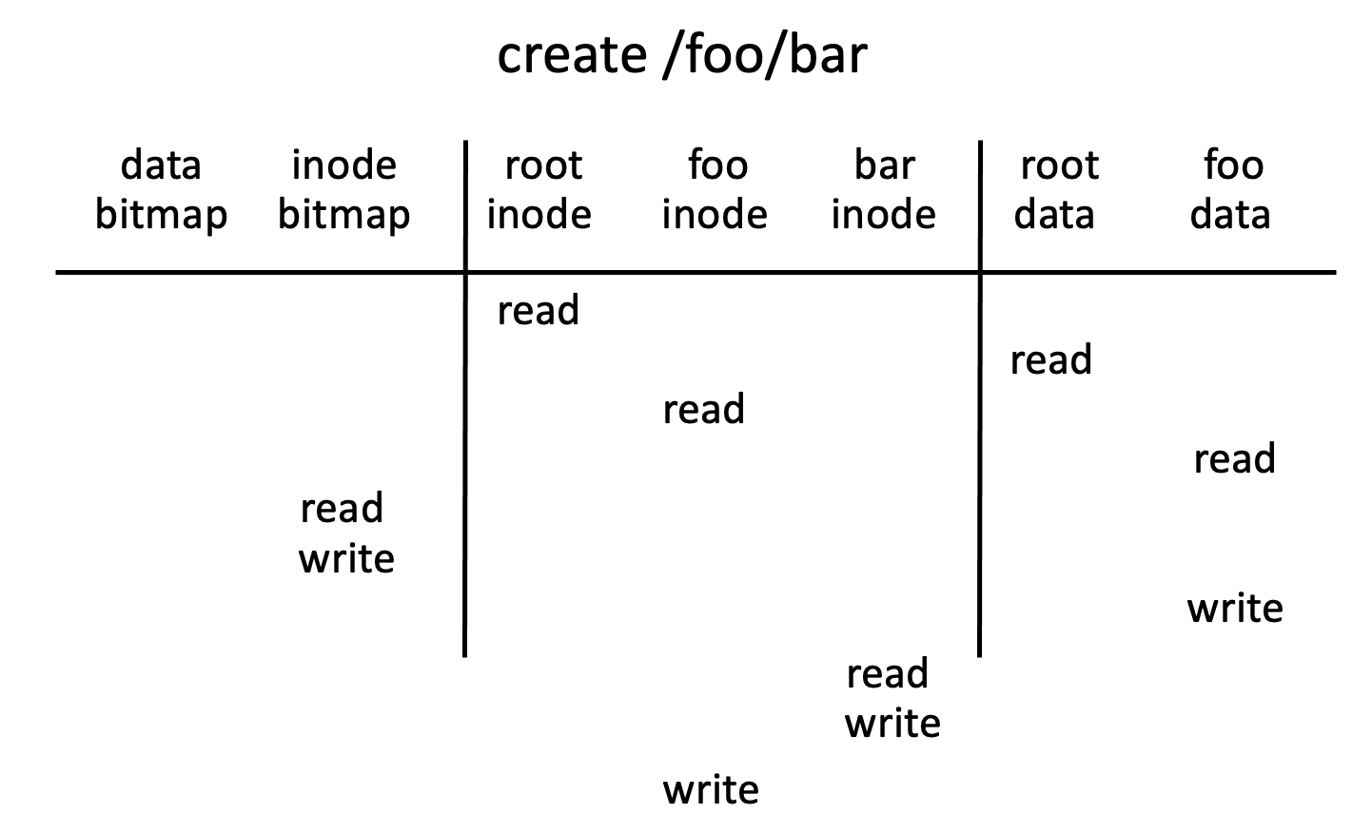

Slide 3
Efficiency
How can we avoid this excessive I/O for basic ops?
Cache for:
- reads
- write buffering

Slide 4
Write Buffering
Why does procrastination help?
Overwrites, deletes, scheduling
Shared structs (e.g., bitmaps+dirs) often overwritten.
We decide: how much to buffer, how long to buffer…
- tradeoff durability vs. performance

Slide 5
How to allocate file data to disk blocks?

Slide 6
Disk layout of data matters!
Why?
Positioning latency: disk rotation; seek
Sequential reads are faster than random reads

Slide 7
Allocation Strategies
Many different approaches
Contiguous
Extent-based
Linked
File-allocation Tables
Indexed
Multi-level Indexed
Questions
Amount of fragmentation (internal and external) – free space that can’t be used
Ability to grow file over time?
Performance of sequential accesses (contiguous layout)?
Speed to find data blocks for random accesses?
Wasted space for meta-data overhead (everything that isn’t data)?
Meta-data must be stored persistently too!

Slide 8
Contiguous Allocation
Allocate each file to contiguous sectors on disk
Meta-data:
OS allocates by finding sufficient free space
Must predict future size of file; Should space be reserved?
Example: IBM OS/360
Starting block and size of file
A
A
A
B
B
B
B
C
C
C
Fragmentation (internal and external)?
Ability to grow file over time?
Seek cost for sequential accesses?
Speed to calculate random accesses?
Wasted space for meta-data?
- Horrible external frag (needs periodic compaction)
- May not be able to without moving
+ Excellent performance
+ Simple calculation
+ Little overhead for meta-data

Slide 9
Small # of Extents
Allocate multiple contiguous regions (extents) per file
Meta-data:
Small array (2-6) designating each extent
Each entry: starting block and size
A
A
A
B
B
B
B
C
C
C
D
D
A
A
A
D
B
B
B
B
C
C
C
B
B
Fragmentation (internal and external)?
Ability to grow file over time?
Seek cost for sequential accesses?
Speed to calculate random accesses?
Wasted space for meta-data?
- Helps external fragmentation
- Can grow (until run out of extents)
+ Still good performance
+ Still simple calculation
+ Still small overhead for meta-data

Slide 10
Linked Allocation
Allocate linked-list of fixed-sized blocks (multiple sectors)
Meta-data:
Examples: TOPS-10, Alto
Location of first block of file
Each block also contains pointer to next block
D
D
A
A
A
D
B
B
B
B
C
C
C
B
B
D
B
D
Fragmentation (internal and external)?
Ability to grow file over time?
Seek cost for sequential accesses?
Speed to calculate random accesses?
Wasted space for meta-data?
+ No external frag (use any block);
+ Can grow easily
+/- Depends on data layout
- Ridiculously poor
- Waste pointer per block
Notes:
Larger --> ??
Smaller --> ??

Slide 11
File-Allocation Table (FAT)
Variation of Linked allocation
Keep linked-list information for all files in on-disk FAT table
Meta-data: Location of first block of file
And, FAT table itself
D
D
A
A
A
D
B
B
B
B
C
C
C
B
B
D
B
D
Draw corresponding FAT Table?

Slide 12
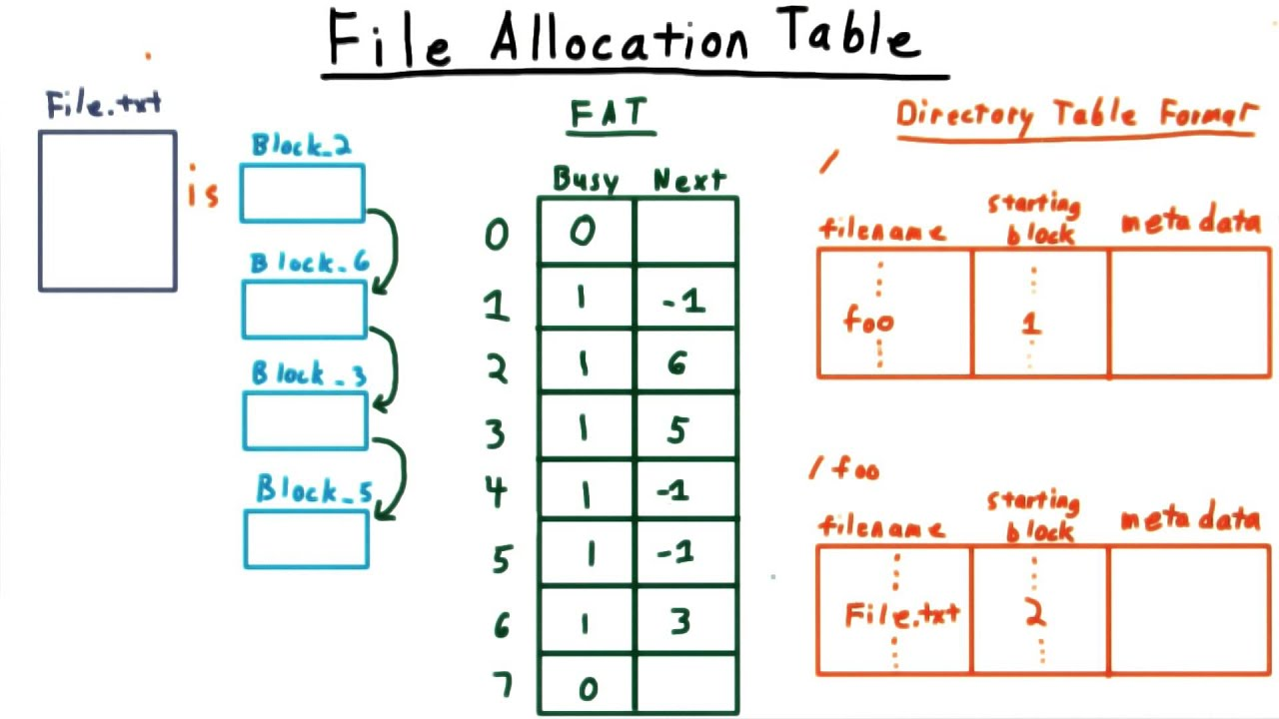
Example of a FAT
https://www.youtube.com/watch?v=mgQtlXBxH0c

Slide 13
File-Allocation Table (FAT)
Variation of Linked allocation
Keep linked-list information for all files in on-disk FAT table
Meta-data: Location of first block of file
And, FAT table itself
D
D
A
A
A
D
B
B
B
B
C
C
C
B
B
D
B
D
Draw corresponding FAT Table?
Comparison to Linked Allocation
Same basic advantages and disadvantages
Disadvantage: Read from two disk locations for every data read
Optimization: Cache FAT in main memory
Advantage: Greatly improves random accesses
What portions should be cached? Scale with larger file systems?

Slide 14
Indexed Allocation
Allocate fixed-sized blocks for each file
Meta-data:
Allocate space for pointers at file creation time
Fixed-sized array of block pointers
D
D
A
A
A
D
B
B
B
B
C
C
C
B
B
D
B
D
Advantages
No external fragmentation
Files can be easily grown up to max file size
Supports random access
Disadvantages
Large overhead for meta-data:
Wastes space for unneeded pointers (most files are small!)

Slide 15
Multi-Level Indexing
Variation of Indexed Allocation
Dynamically allocate hierarchy of pointers to blocks as needed
Meta-data: Small number of pointers allocated statically
Additional pointers to blocks of pointers
Examples: UNIX FFS-based file systems, ext2, ext3
double indirect
indirect
indirect
triple indirect
Comparison to Indexed Allocation
Advantage: Does not waste space for unneeded pointers
Still fast access for small files
Can grow to what size?
Disadvantage: Need to read indirect blocks of pointers to calculate addresses (extra disk read)
Keep indirect blocks cached in main memory

Slide 16
Flexible # of Extents
Modern file systems: Dynamic multiple contiguous regions (extents) per file
Organize extents into multi-level tree structure
Each leaf node: starting block and contiguous size
Minimizes meta-data overhead when have few extents
Allows growth beyond fixed number of extents
Fragmentation (internal and external)?
Ability to grow file over time?
Seek cost for sequential accesses?
Speed to calculate random accesses?
Wasted space for meta-data?
+ Both reasonable
+ Can grow
+ Still good performance
+/- Some calculations depending on size
+ Relatively small overhead

Slide 17
Assume Multi-Level Indexing
Simple approach
More complex file systems build from these basic data structures

Slide 18
Summary/Future
We’ve described a very simple FS.
- basic on-disk structures
- the basic ops
Future questions:
- how to handle crashes?

Slide 19
Crash Consistency
Questions answered:
What benefits and complexities exist because of data redundancy?
What can go wrong if disk blocks are not updated consistently?
How can file system be checked and fixed after crash?
How can journaling be used to obtain atomic updates?
How can the performance of journaling be improved?

Slide 20
Data Redundancy
Definition: if A and B are two pieces of data, and knowing A eliminates some or all values B could be, there is redundancy between A and B
File system examples:
Superblock: field contains total blocks in FS
Inodes: field contains pointer to data block
Is there redundancy between these two types of fields? Why or why not?

Slide 21
File System Redundancy Example
Superblock: field contains total number of blocks in FS
DATA = N
Inode: field contains pointer to data block; possible DATA?
DATA in {0, 1, 2, …, N - 1}
Pointers to block N or after are invalid!
Total-blocks field has redundancy with inode pointers

Slide 22
Pros and CONs of Redundancy
Redundancy may improve:
- reliability
Superblocks in FFS
- performance
bitmaps
But Redundancy could hurt!
- capacity
- consistency
Redundancy implies certain combinations of values are (possibly) illegal
Illegal combinations: inconsistency

Slide 23
Consistency Examples
Assumptions:
Superblock: field contains total blocks in FS.
DATA = 1024
Inode: field contains pointer to data block.
DATA in {0, 1, 2, …, 1023}
Scenario 1: Consistent or not?
Superblock: field contains total blocks in FS.
DATA = 1024
Inode: field contains pointer to data block.
DATA = 241
Consistent
Scenario 2: Consistent or not?
Superblock: field contains total blocks in FS.
DATA = 1024
node: field contains pointer to data block.
DATA = 2345
Inconsistent

Slide 24
Why is consistency challenging?
File system may perform several disk writes to redundant blocks
If file system is interrupted between writes, may leave data in inconsistent state
What can interrupt write operations?
- power loss
- kernel panic
- reboot
Bad things that can happen: inconsistency, garbage data, data loss,

Slide 25
Question for You…
File system is appending to a file and must update:
- inode
- data bitmap
- data block
What happens if crash after only updating some blocks?
a) bitmap:
b) data:
c) inode:
d) bitmap and data:
e) bitmap and inode:
f) data and inode:
lost block & data
Data loss, but otherwise OK
point to garbage (what?), another file may use
lost block & data (nothing can reach it)
point to garbage
another file may use (from bitmap)

Slide 26
How can file system fix Inconsistencies?
Solution #1:
FSCK = file system checker
Strategy:
After crash, scan whole disk for contradictions and “fix” if needed
Keep file system off-line until FSCK completes
For example, how to tell if data bitmap block is consistent?
Read every valid inode+indirect block If pointer to data block, the corresponding bit should be 1; else bit is 0

Slide 27
Fsck Checks
Hundreds of types of checks over different fields…
Do superblocks match?
Do directories contain “.” and “..”?
Do number of dir entries equal inode link counts?
Do different inodes ever point to same block?
…
How to solve problems?

Slide 28

Link Count (example 1)
Dir Entry
inode
link_count = 1
Dir Entry
How to fix to have consistent file system?

Slide 29
Link Count (example 1)
Dir Entry
inode
link_count = 2
Simple fix!
Dir Entry

Slide 30
Link Count (example 2)
inode
link_count = 1
How to fix???

Slide 31
Link Count (example 2)
Dir Entry
fix!
inode
link_count = 1
ls -l /
total 150
drwxr-xr-x 401 18432 Dec 31 1969 afs/
drwxr-xr-x. 2 4096 Nov 3 09:42 bin/
drwxr-xr-x. 5 4096 Aug 1 14:21 boot/
dr-xr-xr-x. 13 4096 Nov 3 09:41 lib/
dr-xr-xr-x. 10 12288 Nov 3 09:41 lib64/
drwx------. 2 16384 Aug 1 10:57 lost+found/
...

Slide 32
Data Bitmap
inode
link_count = 1
block
(number 123)
data bitmap
0011001100
How to fix?
for block 123

Slide 33
Data Bitmap
inode
link_count = 1
block
(number 123)
data bitmap
0011001101
Simple fix!
for block 123

Slide 34
Duplicate Pointers
inode
link_count = 1
block
(number 123)
inode
link_count = 1
How to fix????

Slide 35
Duplicate Pointers
copy
inode
link_count = 1
block
(number 123)
inode
link_count = 1
block
(number 789)

Slide 36
Duplicate Pointers
inode
link_count = 1
block
(number 123)
inode
link_count = 1
block
(number 789)
Simple fix!
But is this correct?

Slide 37
Bad Pointer
inode
link_count = 1
9999
super block
tot-blocks=8000
How to fix???

Slide 38
Bad Pointer
inode
link_count = 1
Simple fix! (But is this correct?)
super block
tot-blocks=8000

Slide 39
Problems with fsck
Problem 1:
Not always obvious how to fix file system image
Don’t know “correct” state, just a consistent one
Easy way to get consistency: reformat disk!

Slide 40
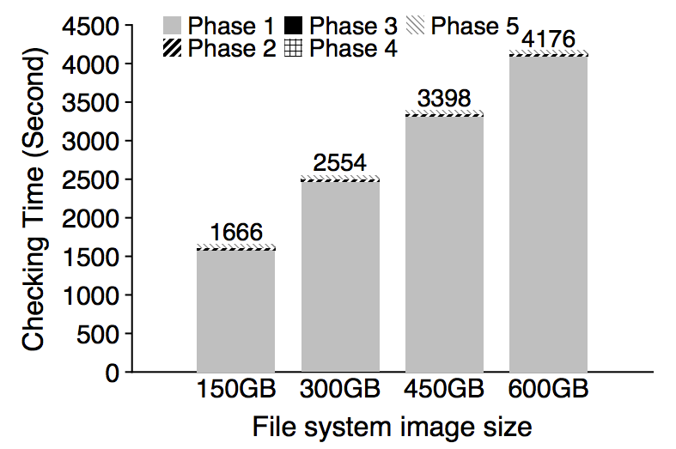
Problem 2: fsck is very slow
Checking a 600GB disk takes ~70 minutes
ffsck: The Fast File System Checker
Ao Ma, EMC Corporation and University of Wisconsin—Madison; Chris Dragga, Andrea C. Arpaci-Dusseau, and Remzi H. Arpaci-Dusseau, University of Wisconsin—Madison

Slide 41
Consistency Solution #2: Journaling
Goals
Ok to do some recovery work after crash, but not to read entire disk
Don’t move file system to just any consistent state, get correct state (in most cases)
Strategy
Atomicity
Definition of atomicity for concurrency
operations in critical sections are not interrupted by operations on related critical sections
Definition of atomicity for persistence
collections of writes are not interrupted by crashes; either (all new) or (all old) data is visible

Slide 42
Consistency vs Correctness
Say a set of writes moves the disk from state A to B
empty
all states
consistent states
A
B
fsck gives consistency
Atomicity gives A or B.

Slide 43
Journaling: General Strategy
Never delete ANY old data, until, ALL new data is safely on disk
Ironically, adding redundancy to fix the problem caused by redundancy.

Slide 44
Fight Redundancy with Redundancy
Want to replace X with Y. Original:
DISK
X
redundant
f(X)

Slide 45
Fight Redundancy with Redundancy
Want to replace X with Y. Original:
DISK
Good time to crash?
X
f(X)
Yes, good time to crash

Slide 46
Fight Redundancy with Redundancy
Want to replace X with Y. Original:
DISK
Good time to crash?
Y
f(X)
bad time to crash

Slide 47
Fight Redundancy with Redundancy
Want to replace X with Y. Original:
DISK
DISK
Good time to crash?
Y
f(Y)
good time to crash

Slide 48
Fight Redundancy with Redundancy
Want to replace X with Y. With journal:
DISK
DISK
Good time to crash?
X
f(X)
good time to crash

Slide 49
Fight Redundancy with Redundancy
Want to replace X with Y. With journal:
DISK
DISK
X
f(X)
good time to crash
Y

Slide 50
Fight Redundancy with Redundancy
Want to replace X with Y. With journal:
DISK
DISK
X
f(X)
good time to crash
Y
f(Y)

Slide 51
Fight Redundancy with Redundancy
Want to replace X with Y. With journal:
DISK
DISK
Y
f(X)
good time to crash
Y
f(Y)

Slide 52
Fight Redundancy with Redundancy
Want to replace X with Y. With journal:
DISK
Y
f(Y)
good time to crash
Y
f(Y)

Slide 53
Fight Redundancy with Redundancy
Want to replace X with Y. With journal:
DISK
DISK
Y
f(Y)
good time to crash
f(Y)

Slide 54
Fight Redundancy with Redundancy
Want to replace X with Y. With journal:
DISK
DISK
Y
f(Y)
good time to crash

Slide 55
Fight Redundancy with Redundancy
Want to replace X with Y. With journal:
DISK
DISK
Y
f(Y)
With journaling, it’s always a good time to crash!

Slide 56
Question for You…
Develop algorithm to atomically update two blocks: Write 10 to block 0; write 5 to block 1
Assume these are only blocks in file system…
Usage Scenario: Block 0 stores Alice’s bank account;
Block 1 stores Bob’s bank account; transfer $2 from Alice to Bob
Time | Block 0 | Block 1 | extra | extra | extra
1 | 12 | 3 | 0 | 0 | 0
2 | 12 | 5 | 0 | 0 | 0
3 | 10 | 5 | 0 | 0 | 0
don’t crash here!
Wrong algorithm leads to inconsistency states (non-atomic updates)

Slide 57
Initial Solution: Journal New Data
Time | Block 0 | Block 1 | J:2 | J:3 | J:valid:4
1 | 12 | 3 | 0 | 0 | 0
2 | 12 | 3 | 10 | 0 | 0
3 | 12 | 3 | 10 | 5 | 0
4 | 12 | 3 | 10 | 5 | 1
5 | 10 | 3 | 10 | 5 | 1
6 | 10 | 5 | 10 | 5 | 1
7 | 10 | 5 | 10 | 5 | 0
Crash here? → Old data
Crash here? →New data
Note: Understand behavior if crash after each write…
Usage Scenario: Block 0 stores Alice’s bank account;
Block 1 stores Bob’s bank account; transfer $2 from Alice to Bob

Slide 58
void update_accounts(int cash1, int cash2) {
write(cash1 to block 2) // Alice backup
write(cash2 to block 3) // Bob backup
write(1 to block 4) // backup is safe
write(cash1 to block 0) // Alice
write(cash2 to block 1) // Bob
write(0 to block 4) // discard backup
}
void recovery() {
if(read(block 4) == 1) {
write(read(block 2) to block 0) // restore Alice
write(read(block 3) to block 1) // restore Bob
write(0 to block 4) // discard backup
}
}

Slide 59
Terminology
Extra blocks are called a “journal”
The writes to the journal are a “journal transaction”
The last valid bit written is a “journal commit block”

Slide 63
Problem with Initial APPROACH: Journal Size
…
0
N-1
N
2N-1
2N
Disadvantages?
- slightly < half of disk space is usable
- transactions copy all the data (1/2 bandwidth!)

Slide 64
Fix #1: Small Journals
Still need to first write all new data elsewhere before overwriting new data
Goal:
Reuse small area as backup for any block
How?
Store block numbers in a transaction header

Slide 65
New Layout
journal
5,2
A
B
0
0
1
2
3
4
5
6
7
8
9
10
11
12
transaction: write A to block 5; write B to block 2

Slide 66
New Layout
journal
B
A
5,2
A
B
1
0
1
2
3
4
5
6
7
8
9
10
11
12
transaction: write A to block 5; write B to block 2
Checkpoint: Writing new data to in-place locations

Slide 67
New Layout
journal
B
A
5,2
A
B
0
0
1
2
3
4
5
6
7
8
9
10
11
12

Slide 68
New Layout
journal
journal
B
B
A
A
5,2
5,2
A
A
B
B
0
0
0
0
1
1
2
2
3
3
4
4
5
5
6
6
7
7
8
8
9
9
10
10
11
11
12
12
transaction: write C to block 4; write T to block 6

Slide 69
New Layout
journal
B
A
4,6
A
B
0
0
1
2
3
4
5
6
7
8
9
10
11
12
transaction: write C to block 4; write T to block 6

Slide 70
New Layout
journal
journal
B
A
4,6
C
B
0
0
0
1
1
2
2
3
3
4
4
5
5
6
6
7
7
8
8
9
9
10
10
11
11
12
12
transaction: write C to block 4; write T to block 6

Slide 71
New Layout
journal
journal
B
A
4,6
C
T
0
0
0
1
1
2
2
3
3
4
4
5
5
6
6
7
7
8
8
9
9
10
10
11
11
12
12
transaction: write C to block 4; write T to block 6
transaction: write C to block 4; write T to block 6

Slide 72
New Layout
journal
journal
B
C
A
T
4,6
C
T
1
0
0
0
1
1
1
2
2
2
3
3
3
4
4
4
5
5
5
6
6
6
7
7
7
8
8
8
9
9
9
10
10
10
11
11
11
12
12
12
transaction: write C to block 4; write T to block 6
transaction: write C to block 4; write T to block 6
Checkpoint: Writing new data to in-place locations

Slide 73
New Layout
journal
journal
B
C
A
T
4,6
C
T
0
0
0
0
0
1
1
1
1
2
2
2
2
3
3
3
3
4
4
4
4
5
5
5
5
6
6
6
6
7
7
7
7
8
8
8
8
9
9
9
9
10
10
10
10
11
11
11
11
12
12
12
12
transaction: write C to block 4; write T to block 6
transaction: write C to block 4; write T to block 6

Slide 74
Optimizations
1. Reuse small area for journal
2. Barriers - (fsync)
3. Checksums
4. Circular journal
5. Logical journal

Slide 75
Correctness depends on Ordering
journal
journal
journal
B
B
C
C
A
A
T
T
4,6
4,6
C
C
T
T
0
0
0
0
0
0
0
1
1
1
1
1
2
2
2
2
2
3
3
3
3
3
4
4
4
4
4
5
5
5
5
5
6
6
6
6
6
7
7
7
7
7
8
8
8
8
8
9
9
9
9
9
10
10
10
10
10
11
11
11
11
11
12
12
12
12
12
transaction: write C to block 4; write T to block 6
write order: 9, 10, 11, 12, 4, 6, 12
Enforcing total ordering is inefficient. Why?
Random writes
Instead: Use barriers w/ disk cache flush at key points (when??)

Slide 76
Ordering
journal
journal
journal
journal
B
B
B
C
C
C
A
A
A
T
T
T
4,6
4,6
4,6
C
C
C
T
T
T
0
0
0
0
0
0
0
0
0
1
1
1
1
1
1
2
2
2
2
2
2
3
3
3
3
3
3
4
4
4
4
4
4
5
5
5
5
5
5
6
6
6
6
6
6
7
7
7
7
7
7
8
8
8
8
8
8
9
9
9
9
9
9
10
10
10
10
10
10
11
11
11
11
11
11
12
12
12
12
12
12
transaction: write C to block 4; write T to block 6
transaction: write C to block 4; write T to block 6
write order: 9,10,11 | 12 | 4,6 | 12
Use barriers at key points in time: 1) Before journal commit, ensure journal transaction entries complete
2) Before checkpoint, ensure journal commit complete
3) Before free journal, ensure in-place updates complete

Slide 77
Optimizations
1. Reuse small area for journal
2. Barriers
3. Checksums
4. Circular journal
5. Logical journal

Slide 78
Checksum Optimization
journal
journal
journal
journal
journal
B
B
B
B
C
C
C
C
A
A
A
A
T
T
T
T
4,6
4,6
4,6
4,6
C
C
C
C
T
T
T
T
0
0
0
0
0
0
0
0
0
0
0
1
1
1
1
1
1
1
2
2
2
2
2
2
2
3
3
3
3
3
3
3
4
4
4
4
4
4
4
5
5
5
5
5
5
5
6
6
6
6
6
6
6
7
7
7
7
7
7
7
8
8
8
8
8
8
8
9
9
9
9
9
9
9
10
10
10
10
10
10
10
11
11
11
11
11
11
11
12
12
12
12
12
12
12
write order: 9,10,11 | 12 | 4,6 | 12
write order: 9,10,11 | 12 | 4,6 | 12
How can we get rid of barrier between (9, 10, 11) and 12 ???

Slide 79
Checksum Optimization
journal
B
C
A
T
4,6
C
T
(ck)
0
1
2
3
4
5
6
7
8
9
10
11
12
write order: 9,10,11,12 | 4,6 | 12
In last transaction block, store checksum of rest of transaction
12 = Cksum(9, 10, 11)
During recovery: If checksum does not match transaction, treat as not valid

Slide 80
Optimizations
1. Reuse small area for journal
2. Barriers
3. Checksums
4. Circular journal
5. Logical journal

Slide 81
Write Buffering Optimization
Note: after journal write, there is no rush to checkpoint
If system crashes, still have persistent copy of written data!
Journaling is sequential, checkpointing is random
Solution? Delay checkpointing for some time
Difficulty: need to reuse journal space
Solution: keep many transactions for un-checkpointed data

Slide 82
Circular Buffer
T1
T2
T3
T4
Journal:
0
128 MB
Keep data also in memory until checkpointed on disk

Slide 83
Circular Buffer
T2
T3
T4
Journal:
0
128 MB
checkpoint and cleanup

Slide 84
Circular Buffer
T5
T2
T3
T4
Journal:
0
128 MB
transaction!

Slide 85
Circular Buffer
T5
T3
T4
Journal:
0
128 MB
checkpoint and cleanup

Slide 86
Optimizations
1. Reuse small area for journal
2. Barriers
3. Checksums
4. Circular journal
5. Logical journal

Slide 87
Physical Journal
TxB
length=3
blks=4,6,1
0000000000
0000000000
0000000000
0000100000
inode
…
addr[?]=521
data block
TxE
(checksum)

Slide 88
Physical Journal
TxB
length=3
blks=4,6,1
0000000000
0000000000
0000000000
0000100000
inode
…
addr[?]=521
data block
TxE
(checksum)
Actual changed data is much smaller!

Slide 89
Logical Journal
TxB
length=1
list of
changes
TxE
(checksum)
Logical journals record changes to bytes, not contents of new blocks
On recovery: Need to read existing contents of in-place data and (re-)apply changes

Slide 90
Optimizations
1. Reuse small area for journal
2. Barriers
3. Checksums
4. Circular journal
5. Logical journal

Slide 91
File System Integration
FS
Journal
Scheduler
Disk

Slide 92
How to avoid writing all disk blocks Twice?
Observation: some blocks (e.g., user data) are less important
Strategy: journal all metadata, including:
superblock, bitmaps, inodes, indirects, directories
For regular data, write it back whenever convenient. Of course, files may contain garbage.

Slide 93
Writeback Journal
journal
journal
journal
B
I
?
0
0
1
2
3
4
5
6
7
8
9
10
11
12
transaction: append to inode I

Slide 94
Writeback Journal
journal
journal
journal
B
I
?
TxB
B’
I’
0
0
0
0
0
1
1
1
1
2
2
2
2
3
3
3
3
4
4
4
4
5
5
5
5
6
6
6
6
7
7
7
7
8
8
8
8
9
9
9
9
10
10
10
10
11
11
11
11
12
12
12
12
transaction: append to inode I

Slide 95
Writeback Journal
journal
B
I
?
TxB
B’
I’
TxE
0
0
0
0
0
1
1
1
1
1
2
2
2
2
2
3
3
3
3
3
4
4
4
4
4
5
5
5
5
5
6
6
6
6
6
7
7
7
7
7
8
8
8
8
8
9
9
9
9
9
10
10
10
10
10
11
11
11
11
11
12
12
12
12
12
transaction: append to inode I

Slide 96
Writeback Journal
journal
journal
journal
B
I’
?
TxB
B’
I’
TxE
0
0
0
0
1
1
1
1
2
2
2
2
3
3
3
3
4
4
4
4
5
5
5
5
6
6
6
6
7
7
7
7
8
8
8
8
9
9
9
9
10
10
10
10
11
11
11
11
12
12
12
12
transaction: append to inode I

Slide 97
Writeback Journal
journal
journal
journal
B’
I’
?
TxB
B’
I’
TxE
0
0
0
0
1
1
1
1
2
2
2
2
3
3
3
3
4
4
4
4
5
5
5
5
6
6
6
6
7
7
7
7
8
8
8
8
9
9
9
9
10
10
10
10
11
11
11
11
12
12
12
12
transaction: append to inode I
what if we crash now? Solutions?

Slide 98
Ordered Journaling
Still only journal metadata
But write data before the transaction
No leaks of sensitive data!

Slide 99
Ordered Journal
journal
journal
B
I
?
0
0
0
0
1
1
1
2
2
2
3
3
3
4
4
4
5
5
5
6
6
6
7
7
7
8
8
8
9
9
9
10
10
10
11
11
11
12
12
12
transaction: append to inode I

Slide 100
Ordered Journal
journal
journal
B
I
D
0
0
0
0
1
1
1
2
2
2
3
3
3
4
4
4
5
5
5
6
6
6
7
7
7
8
8
8
9
9
9
10
10
10
11
11
11
12
12
12
transaction: append to inode I
What happens if crash now?
B indicates D currently free, I does not point to D;
Lose D, but that might be acceptable

Slide 101
Ordered Journal
journal
journal
B
I
D
TxB
I’
B’
0
0
0
1
1
2
2
3
3
4
4
5
5
6
6
7
7
8
8
9
9
10
10
11
11
12
12
transaction: append to inode I

Slide 102
Ordered Journal
journal
journal
B
I
D
TxB
I’
B’
TxE
0
0
1
1
2
2
3
3
4
4
5
5
6
6
7
7
8
8
9
9
10
10
11
11
12
12
transaction: append to inode I

Slide 103
Ordered Journal
journal
B
I’
D
TxB
I’
B’
TxE
0
0
1
1
2
2
3
3
4
4
5
5
6
6
7
7
8
8
9
9
10
10
11
11
12
12
transaction: append to inode I

Slide 104
Ordered Journal
journal
B’
I’
D
TxB
I’
B’
TxE
0
1
2
3
4
5
6
7
8
9
10
11
12
transaction: append to inode I

Slide 105
Conclusion
Most modern file systems use journals
ordered-mode for meta-data is popular
FSCK is still useful for weird cases
- bit flips
- FS bugs
Some file systems don’t use journals, but still (usually) write new data before deleting old (copy-on-write file systems)

