Slide 1

552: Computer Networks
Srinivas Narayana
Fall 2020

Slide 2












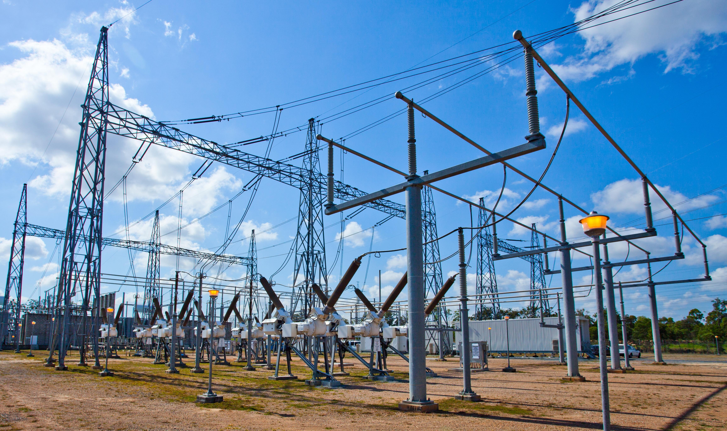
The Internet is an exciting place

Slide 3
The Internet is an exciting place
A research experiment that escaped the lab
... to become a global communication infrastructure
Ever-expanding reach
Now: > 3B people online
Future: Still potential for more users, machines, and applications
Consistent innovation with low barriers
Apps: streaming video, smart grids, telesurgery, …
Technologies: Ethernet, cellular, optics, human-body (!), …

Slide 4
The Internet has transformed everything
How we communicate with other humans
How we learn and acquire knowledge
How we transact and do business
How we entertain ourselves
How we govern ourselves
How warfare is conducted (!)
Computer Networking is the study of how the Internet (and other inter-networks) are designed

Slide 5




What is a network, anyway?
Carrier of information between two or more entities
Entities may be hosts: your laptop, cell phone, etc.
Entities may also be devices in the middle of the network
For example, your WiFi router
In this course, we will typically refer to communicating entities as endpoints
The interconnection between entities is any physical medium capable of carrying information
copper wire, lasers (over optic fibre), microwave, cable (coax), satellite link, wireless link (cellular, 802.11, bluetooth)

Slide 6
Why should we study networking?
Utility: tangible real-world impact
Easy to measure and build things
Artifacts can go a long way
You can build something that you want to use
… that other people then build on
Examples
BitTorrent: a student at University of Buffalo
World wide web (WWW): one researcher at CERN
Bitcoin: no one knows with certainty who created it

Slide 7
Why should we study networking?
Intellectual rewards: interdisciplinary & evolving problems
So much to learn and apply from other fields
Many principles to contribute to other fields
Examples
Convex optimization: flow of traffic through an ISP network
Formal verification: ensure admin intent is reliably implemented
End to end argument: many computer systems use this principle

Slide 8
Why should we study networking?
Academic impact: a young and relatively immature field
You get to decide what the field looks like in a few years!
Several highly cited CS papers are networking papers
At least 2 Turing awards (Cerf&Kahn’04, Berners-Lee’16)
Significant opportunities lie ahead!
Define the most interesting problems
Build your ideas using freely and openly available software
Deploy your ideas and technology over cheap platforms!

Slide 9
So, how should we study networking?
You may be familiar with some of the usual ways…

Slide 10
So, how should we study networking?
The soup of acronyms? IP, TCP, HTTP, RSVP, …

Slide 11
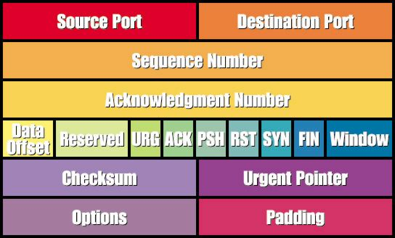

So, how should we study networking?
The soup of acronyms? IP, TCP, HTTP, RSVP, …
The stack of layers and headers? port, option, flags, …

Slide 12
So, how should we study networking?
The soup of acronyms? IP, TCP, HTTP, RSVP, …
The stack of layers and headers? port, option, flags, …
The suite of tools? ping, traceroute, wireshark, …
The wire protocols? SCTP, DNS, SSH, ...
The middle boxes? CDN, firewall, NAT, proxy, ...

Slide 13
What we will study in this course
Principles used to build computer networks and services
How to design network software and hardware
… to effectively meet user, application, and operator goals
… in ways that compose well
How to partition functionality
Among machines: end points, switches, middleboxes, ...)
Among modules inside a machine: OS, apps, hardware, ...
Among entities: ISPs (“core”), users (“edge”), …
Discuss a mix of classic and recent research
Build real software through a programming project

