Slide 1

The Application Layer: SMTP
CS 352, Lecture 5, Spring 2020
http://www.cs.rutgers.edu/~sn624/352
Srinivas Narayana

Slide 2
Course announcements
Project 1 will be released on Friday
Find a partner if you don’t have one
Quiz 1 completed yesterday
Quiz 2 will go up on Friday
Due next Tuesday

Slide 3



Review of concepts
Application-layer protocols: DNS, HTTP
HyperText Transfer Protocol:
Client-server model: requests and responses
Request methods: GET, POST, HEAD, PUT, DELETE
And response codes
Persistent vs. non-persistent HTTP connection
Remembering HTTP users via cookies
Common features of DNS, HTTP:
“Plain” text
Command line tools to directly speak the protocol
Caching

Slide 4
Caching in HTTP

Slide 5
Web caches
Web caches: Machines that remember web responses for a network
Why cache web responses?
Reduce response time for client requests
Reduce traffic on an institution’s access link
Caches can be implemented in the form of a proxy server

Slide 6

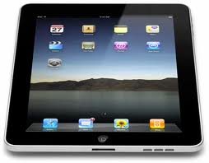
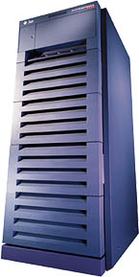
Web caching using a proxy server
You can configure a HTTP proxy on your laptop’s network settings.
If you do, your browser sends all HTTP requests to the proxy (cache).
Hit: cache returns object
Miss:
Proxy requests object from original HTTP server (called origin server)
Proxy caches object locally
Proxy returns object to client
Clients
GET foo.html
GET foo.html
The Internet
HTTP Server
Proxy Server
Store foo.html
on receiving response

Slide 7
Web Caches: how does it look on HTTP?
cache
server
Conditional GET guarantees cache content is up-to-date while still saves traffic and response time whenever possible
Date in the cache’s request is the last time the server provided in its response header “last modified”
HTTP request msg
If-modified-since: <date>
object
not
modified
HTTP response
HTTP/1.0
304 Not Modified
HTTP request msg
If-modified-since: <date>
object
modified
HTTP response
HTTP/1.0 200 OK
<data>

Slide 8
Content Distribution Networks (CDN)
A global network of web caches
Provisioned by ISPs and network operators
Or content providers, like Netflix, Google, …
Uses
Improve response time to user for a service
Reduce bandwidth requirements
Both on content provider and on a network (e.g., Rutgers)
Reduce $$ to provision and maintain origin servers

Slide 9
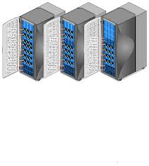
Without CDN
DOMAIN NAME | IP ADDRESS
www.google.com | 98.138.253.109
cs.rutgers.edu | 128.6.4.2
www.yahoo.com | 74.125.225.243
www.princeton.edu | 128.112.132.86
Cluster with Google’s origin servers
Huge bandwidth requirements
Large propagation delays to reach users
So, distribute content to geographically distributed cache servers
Often, use DNS to redirect request to users to copies of content
98.138.253.109

Slide 10
CDN terms
Origin server
Server that holds the authoritative copy of the content
CDN server
A replica server owned by the CDN provider
We called this proxy in our earlier example
CDN name server
A DNS server used for redirection
Client

Slide 11
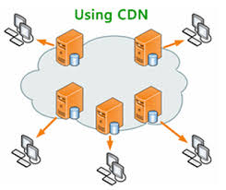
With CDN
DOMAIN NAME | IP ADDRESS
www.google.com | 124.8.9.8 (NS of CDN)
cs.rutgers.edu | 128.6.4.2
www.yahoo.com | 74.125.225.243
www.princeton.edu | 128.112.132.86
Scale a service through indirection to CDN name server.
Typically, custom logic to map one domain name to one of many IP addresses
Policies may depend on location of requesting client, load at the different origin servers, apart from other things.
CDN Name Server (124.8.9.8)
DOMAIN NAME | IP ADDRESS
www.google.com | 12.1.2.3
www.google.com | 12.1.2.4
www.google.com | 12.1.2.5
www.google.com | 12.1.2.6
12.1.2.3
12.1.2.4
CDN servers
12.1.2.6
12.1.2.5
98.138.253.109
Origin server
Client

Slide 12
SMTP
Simple Mail Transfer Protocol

Slide 13
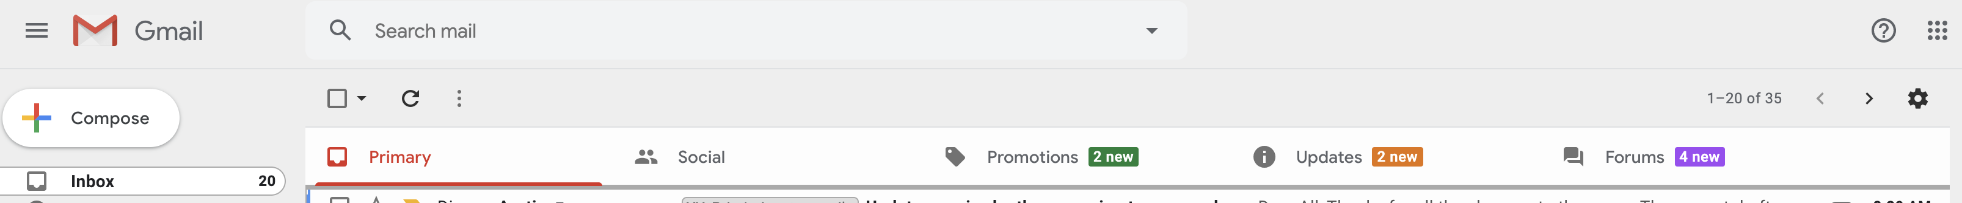
What we’re familiar with

Slide 14
Electronic Mail
outgoing
message queue
user mailbox
Three major components:
User agents
a.k.a. “mail reader”
e.g., Applemail, Outlook
Web-based user agents (ex: gmail)
user
agent
mail
server
user
agent
SMTP
mail
server
user
agent
SMTP
SMTP
mail
server
user
agent
user
agent
user
agent

Slide 15
Electronic Mail: Mail servers
Mail Servers
Mailbox contains incoming messages for user
Message queue of outgoing (to be sent) mail messages
Sender mail server makes connection to Receiver mail server
IP address, port 25
SMTP protocol
Used to send messages
Client: sending user agent or sending mail server
server: receiving mail server
user
agent
mail
server
user
agent
SMTP
mail
server
user
agent
SMTP
SMTP
mail
server
user
agent
user
agent
user
agent

Slide 16


Scenario: Alice sends message to Bob
1) Alice uses UA to compose message and “to” bob@someschool.edu
2) Alice’s UA sends message to her mail server; message placed in outgoing message queue
3) Client side of SMTP opens TCP connection with Bob’s mail server
4) SMTP client sends Alice’s message over the TCP connection
5) Bob’s mail server places the message in Bob’s incoming mailbox
6) Bob invokes his user agent to read message
1
mail
server
mail
server
user
agent
user
agent
2
3
6
4
5

Slide 17
Sample SMTP interaction
220 hill.com SMTP service ready
HELO town.com
250 hill.com Hello town.com, pleased to meet you
MAIL FROM: <jack@town.com>
250 <jack@town.com>… Sender ok
RCPT TO: <jill@hill.com>
250 <jill@hill.com>… Recipient ok
DATA
354 Enter mail, end with “.” on a line by itself
Jill, I’m not feeling up to hiking today. Will you please fetch me a pail of water?
.
250 message accepted
QUIT
221 hill.com closing connection

Slide 18
MAIL command response codes

Slide 19
Mail message (stored on server) format
SMTP: protocol for exchanging email msgs
RFC 822: standard for text message format:
header lines, e.g.,
To:
From:
Subject:
different from SMTP commands!
(these would still be under “DATA”)
body
the “message”, ASCII characters only
header
blank
line
body

Slide 20
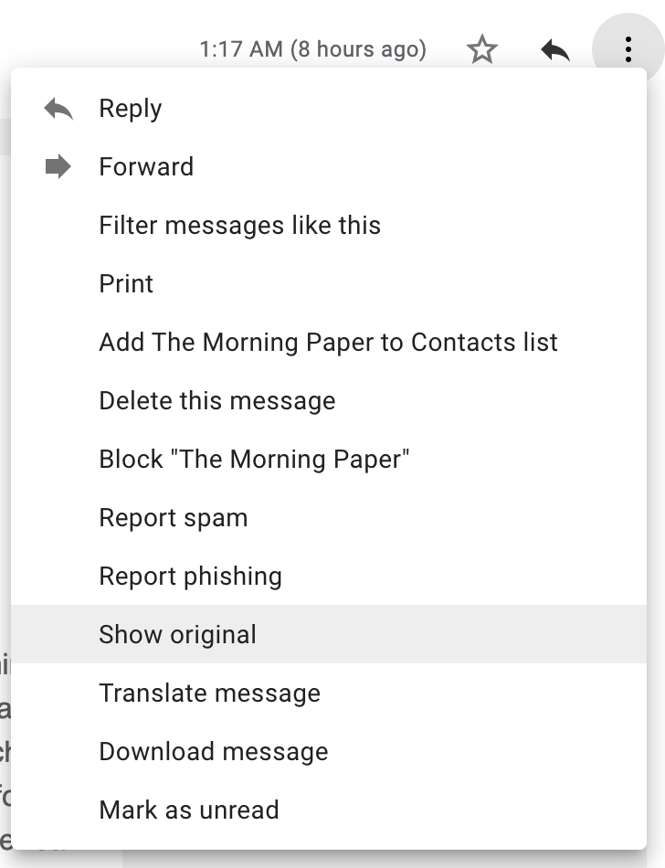
Message format: multimedia extensions
MIME: multimedia mail extension, RFC 2045, 2056
additional lines in msg header declare MIME content type
From: alice@crepes.fr
To: bob@hamburger.edu
Subject: Picture of yummy crepe.
MIME-Version: 1.0
Content-Transfer-Encoding: base64
Content-Type: image/jpeg
base64 encoded data .....
.........................
......base64 encoded data
MIME version
method used
to encode data
multimedia data
type, subtype,
parameter declaration
encoded data

Slide 21
Mail access protocols
POP3 or IMAP4
SMTP
SMTP
access
protocol
user
agent
user
agent
sender’s mail
server
receiver’s mail
server
Why not use SMTP here?
SMTP: delivery/storage to receiver’s server
Mail access protocol: retrieval from server
POP: Post Office Protocol [RFC 1939]
Client connects to POP3 server on TCP port 110
IMAP: Internet Mail Access Protocol [RFC 1730]
Client connects to TCP port 143
HTTP: gmail, Yahoo! Mail, etc.
Why do we need a sender side mail server?

Slide 22
POP vs IMAP
POP3
Stateless server
UA-heavy processing
UA retrieves email from server, then typically deleted from server
Latest changes are at the UA
Simple protocol (list, retr, del within a POP session)
IMAP4
Stateful server
UA and server processing
Server sees folders, etc. which are visible to UAs
Changes visible at the server
Complex protocol

Slide 23
What about web-based email?
Connect to mail servers via web browser
Ex: gmail, outlook, etc.
Browsers speak HTTP
Email servers speak SMTP
Need a bridge to retrieve email using HTTP

Slide 24
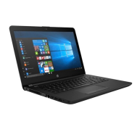


Web based email
HTTP
HTTP
HTTP server
HTTP
server
SMTP
Client
SMTP server
Internet

Slide 25
Comparing SMTP with HTTP
HTTP: pull
SMTP: push
both have ASCII command/response interaction, status codes
HTTP: each object encapsulated in its own response msg
SMTP: multiple objects sent in multipart msg
HTTP: can put non-ASCII data directly in response
SMTP: need ASCII-based encoding

Slide 26
Try an SMTP interaction

Slide 27
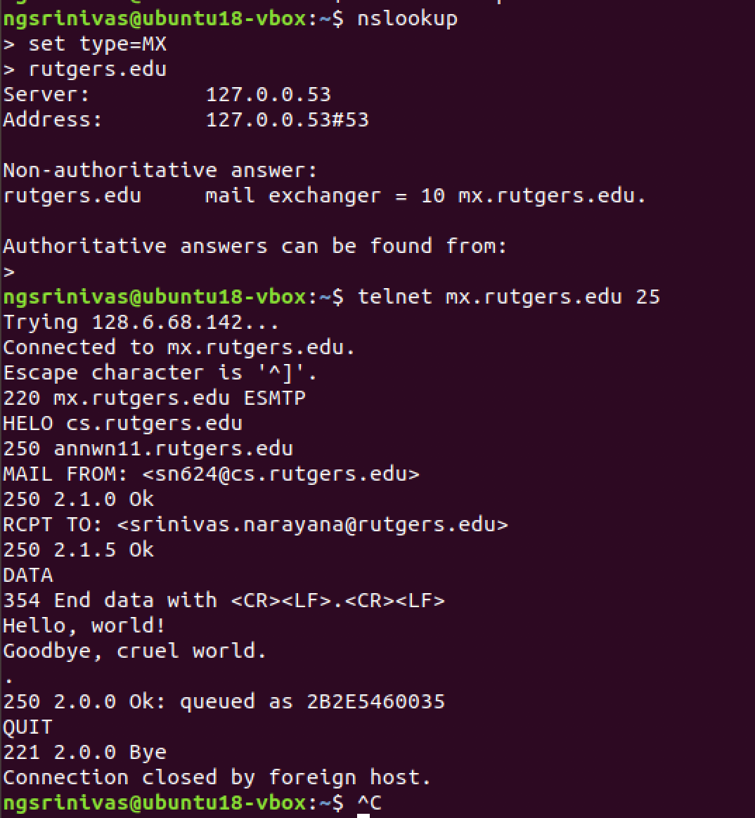

Slide 28
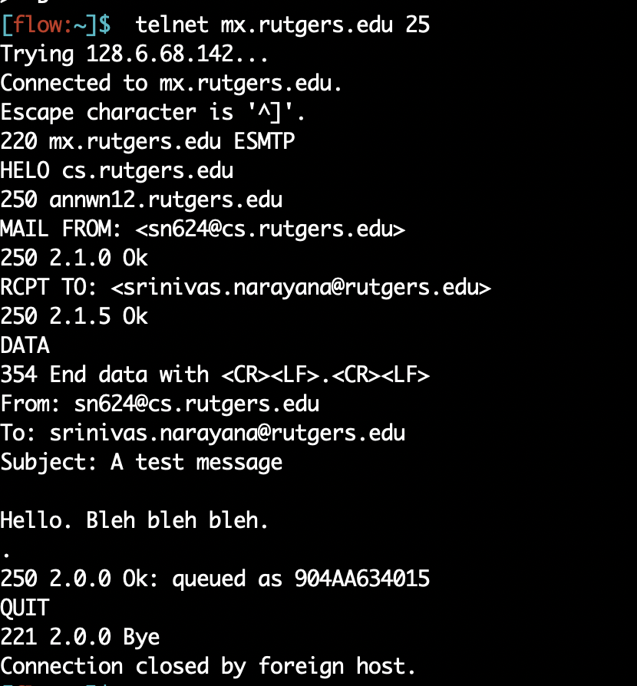

Slide 29
More themes from app-layer protocols
Separation of concerns. Examples:
Content rendering for users (browser, UA) separate from protocol operations (mail server)
Reliable mail sending and receiving: mail UA doesn’t need to be “always on” to send or receive email reliably
In-band vs. out-of-band control:
In-band: headers determine the actions of all the parties of the protocol
There are protocols with out-of-band control, e.g., FTP
Keep it simple until you really need complexity
ASCII-based design; stateless servers. Then introduce:
Cookies for HTTP state
IMAP for email organization
Security extensions
Different methods to set up and use underlying connections, etc.

Slide 31
FTP
File Transfer Protocol

Slide 32
Client server connection
DNS
Host name
IP Address
IP Address, port 21
ftp commands
Data transfer, port 20

Slide 33
FTP: the file transfer protocol
FTP
user
interface
file transfer
FTP
client
FTP
server
user
at host
local file
system
remote file
system
transfer file to/from remote host
client/server model
client: side that initiates transfer (either to/from remote)
server: remote host
ftp: RFC 959
ftp server: port 21, port 20 (data connection)

Slide 34
FTP: separate control & data connections
“out of band” control
Control connection:
Authorization
Directory browse
Commands
Data connection
Transfer files
FTP server maintains “state”: current directory, earlier authentication
TCP control connection
port 21
FTP
client
TCP data connection
port 20
FTP
server

Slide 35
FTP commands, responses
Sample commands
sent as ASCII text over control channel
USER username
PASS password
LIST return list of file in current directory
RETR filename retrieves (gets) file
STOR filename stores (puts) file onto remote host
Sample return codes
status code and phrase (as in HTTP)
331 Username OK, password required
125 data connection already open; transfer starting
425 Can’t open data connection
452 Error writing file

Slide 36
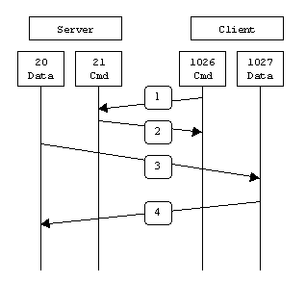
FTP Active connection
Data connection initiated from the server
Client opens a connection from port x for sending commands to server port 21
Server opens a connection from port 20 to send data at port x+1

Slide 37
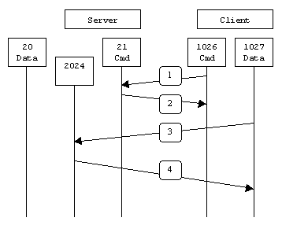
FTP passive connection (always client initiated)
Connections always initiated from the client
Client opens a connection from port x for sending commands to server port 21
Client sends a request for PASSIVE connection with PASV command
Server replies with a new port number S_{p} on which it is listening
Client opens a connection from port x+1 to server port S_{p}

Slide 38
Problems with FTP
Sends passwords in plain ASCII text
Eavesdropper can recover passwords
Fatal flaw, turned off at a lot of sites
Replaced with scp, sftp instead

Slide 39
Recall the Internet protocol stack…
Application
HTTPS
FTP
HTTP
SMTP
DNS
Transport
TCP
UDP
Network
IP
Host-to-Net
X.25
…
802.11
ATM

Slide 40
Next: Transport
Application
HTTPS
FTP
HTTP
SMTP
DNS
Transport
TCP
UDP
Network
IP
Host-to-Net
X.25
…
802.11
ATM

