Slide 1

The Application Layer: HTTP: Introduction
CS 352, Lecture 4.1 http://www.cs.rutgers.edu/~sn624/352
Srinivas Narayana

Slide 2


Review of concepts
Application
HTTPS
FTP
HTTP
SIP
RTSP
Transport
Layering and modularity; application layer
4-tuple (IP_{s}, port_{s}, IP_{d}, port_{d}), socket
Client-server, peer to peer architectures
TCP
UDP
Network
IP
Host-to-Net
X.25
…
802.11
ATM

Slide 3
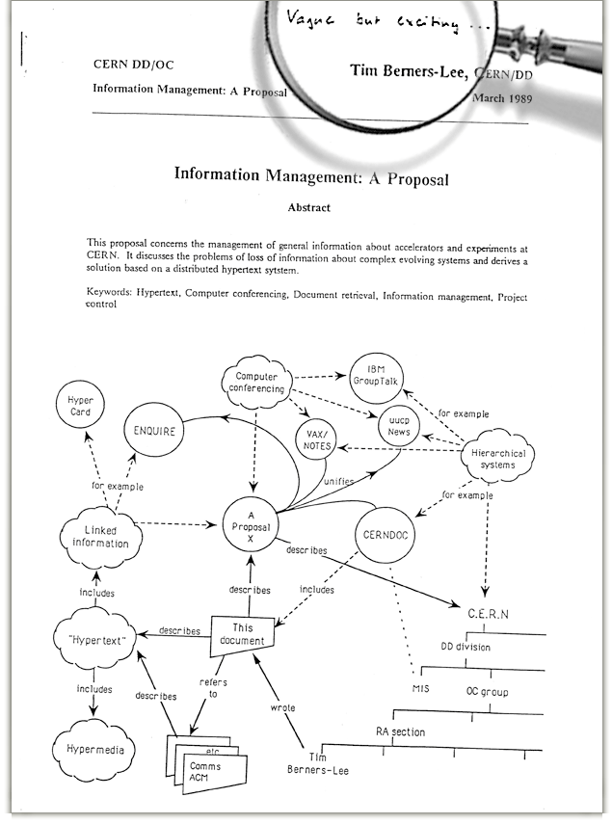
The Web: Humble origins
Tim Berners-Lee: a way to manage and access documents at CERN research lab
Info containing links to other info, accessible remotely, through a standardized mechanism.
His boss is said to have written on his proposal:
“vague, but exciting”

Slide 4
Web and HTTP: Some terms
HTTP stands for “HyperText Transfer Protocol”
A web page consists of many objects
Object can be HTML file, JPEG image, video stream chunk, audio file,…
Web page consists of base HTML-file which includes several referenced objects.
Each object is addressable by a uniform resource locator (URL)
sometimes also referred to as uniform resource identifier (URI)
Example URL:
www.cs.rutgers.edu/~sn624/index.html
host name
path name

Slide 5
HTTP Protocol Overview

Slide 6
HTTP overview
HTTP: hypertext transfer protocol
Client/server model
Client: browser that requests, receives, “displays” Web objects
Server: Web server sends objects in response to requests
HTTP 1.0: RFC 1945
HTTP 1.1: RFC 2068
HTTP request
PC running
Chrome
HTTP response
HTTP request
HTTP response
Web Server
e.g., Apache HTTP
server, nginx, etc.
Mac running
Safari

Slide 7
Client server connection
DNS
Hostname | IP address
Cs.Rutgers.edu | 10.0.1.2
Host name
IP Address
HTTP application typically associated with port 80
IP Address, 80
HTTP request
HTTP response
HTTP messages

Slide 8
HTTP messages: request message
ASCII (human-readable format)
request line
(GET, POST,
HEAD commands)
GET /352/syllabus.html HTTP/1.1
Host: www.cs.rutgers.edu
User-agent: Mozilla/4.0
Connection: close
Accept-language:en
(extra carriage return, line feed)
Header lines
Carriage return,
line feed
indicates end
of message

Slide 9
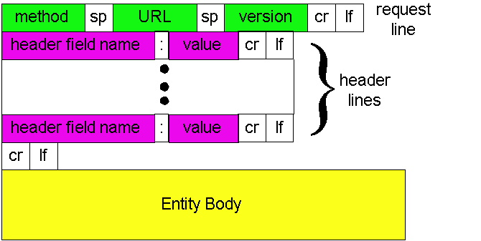
HTTP Request: General format
http://www.w3.org/Protocols/rfc2616/rfc2616-sec14.html#sec14

Slide 10
HTTP method types
GET
Get the resource specified in the requested URL. URL may refer to a data-handling process
POST
Send entities (specified in the entity body) to a data-handling process at the requested URL
HEAD
Asks server to leave requested object out of response, but send the rest of the response
PUT
Update a resource at the requested URL with the new entity specified in the entity body
DELETE
Deletes file specified in the URL
... and other methods.

Slide 11
Difference between POST and PUT
POST: the URL of the request identifies the resource that processes the entity body
PUT: the URL of the request identifies the resource that is contained in the entity body
https://tools.ietf.org/html/rfc2616

Slide 12
Difference between HEAD and GET
GET: return the requested resource in the entity body of the response along with response headers (we’ll see these shortly)
HEAD: return all the response headers in the GET response, but without the resource in the entity body
https://tools.ietf.org/html/rfc2616

Slide 13
Uploading form input: GET and POST
POST method:
Web page often includes form input
Input is uploaded to server in entity body
Posted content not visible in the URL
Free form content (ex: images) can be posted since entity body interpreted as data bytes
GET method:
Entity body is empty
Input is uploaded in URL field of request line
Example:
http://site.com/form?first=jane&last=austen

Slide 14
Observing HTTP GET and POST
A small demo

Slide 15
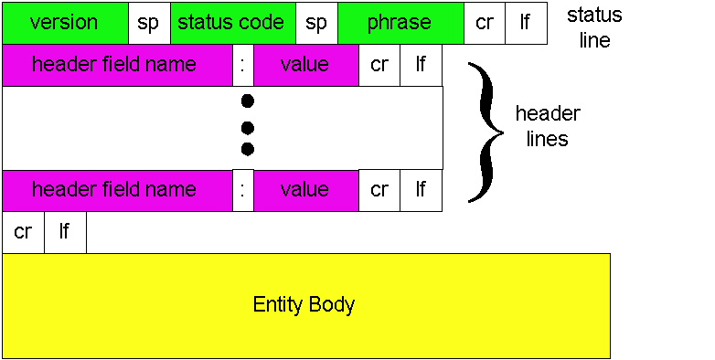
HTTP Response: General format
Unlike HTTP request, No method name

Slide 16
HTTP message: response message
status line
(protocol
status code
status phrase)
HTTP/1.1 200 OK
Connection: close
Date: Thu, 06 Aug 1998 12:00:15 GMT
Server: Apache/1.3.0 (Unix)
Last-Modified: Mon, 22 Jun 1998 …...
Content-Length: 6821
Content-Type: text/html
data data data data data ...
response
header
lines
data, e.g., requested
HTML file in entity body

Slide 17
HTTP response status codes
In first line in server->client response message.
A few sample codes:
200 OK
request succeeded, requested object later in this message
301 Moved Permanently
requested object moved, new location specified later in this message (Location:)
403 Forbidden
Insufficient permissions to access the resource
404 Not Found
requested document not found on this server
505 HTTP Version Not Supported

Slide 18
Try sending a HTTP request yourself!
1. Telnet to your favorite Web server:
Opens TCP connection to port 80
(default HTTP server port).
Anything typed in sent
to port 80 at web.mit.edu
telnet web.mit.edu 80
2. Type in a GET HTTP request:
By typing this in (hit carriage
return twice), you send
this minimal (but complete)
GET request to HTTP server
GET / HTTP/1.1
Host: web.mit.edu
3. Look at response message sent by HTTP server!

Slide 20
HTTP: Persistence, Cookies, and Caching
CS 352, Lecture 4.2
http://www.cs.rutgers.edu/~sn624/352
Srinivas Narayana

Slide 21
Additional details about HTTP
Persistent vs. Nonpersistent HTTP connections
Cookies (User-server state)
Web caches

Slide 22
Non/Persistent HTTP

Slide 23
HTTP connections
Non-persistent HTTP
At most one object is sent over a TCP connection.
HTTP/1.0 uses nonpersistent HTTP
Persistent HTTP
Multiple objects can be sent over single TCP connection between client and server.
HTTP/1.1 uses persistent connections in default mode
TCP is a kind of reliable communication service provided by the transport layer. It requires the connection to be “set up” before data communication.

Slide 24


Non-persistent HTTP
1a. HTTP client initiates TCP connection to HTTP server
1b. HTTP server at host “accepts” connection, notifying client
Suppose user visits a page with text and 10 images.
2. HTTP client sends HTTP request message
3. HTTP server receives request message, replies with response message containing requested object
time

Slide 25
Non-persistent HTTP (contd.)
4. HTTP server closes TCP connection.
5. HTTP client receives response message containing html file, displays html. Parsing html file, finds 10 referenced jpeg objects
time
6. Steps 1-5 repeated for each of 10 jpeg objects

Slide 26
Non-Persistent HTTP’s Response time
Round Trip Time (RTT): time to send a packet from client to server and back.
Sum of propagation, transmission, and queueing delays along both directions.
Response time:
One RTT to initiate TCP connection
One RTT for HTTP request and first few bytes of HTTP response to return
File transmission time
total = 2RTT + file transmission time
initiate TCP
connection
RTT
request
file
RTT
time to
transmit
file
file
received
time
time

Slide 27
Persistent HTTP: jumping to steps 4/5
4. HTTP server sends a response.
Server keeps the TCP connection alive.
5. HTTP client receives response message containing html file, displays html. Parsing html file, finds 10 referenced jpeg objects
time
The 10 objects can be requested over the same TCP connection.
i.e., save an RTT trying to open a new TCP connection per object.

Slide 28
Persistent vs. Non-persistent
Non-persistent HTTP requires at least 2 RTTs per object.
For each object: Open TCP connection; send HTTP request & receive response
Persistent HTTP: since server leaves connection open after sending response, subsequent HTTP messages between same client/server sent over the open connection
Save one RTT per object relative to non-persistent HTTP
In both cases, browsers have a choice of opening multiple parallel connections.

Slide 29
Remembering HTTP users

Slide 30
HTTP: User data on servers?
So far, HTTP is “stateless”
The server maintains no memory about past client requests
But state, i.e., memory, about the user at the server is very useful!
authorization
shopping carts
recommendations
In general, user session state

Slide 31
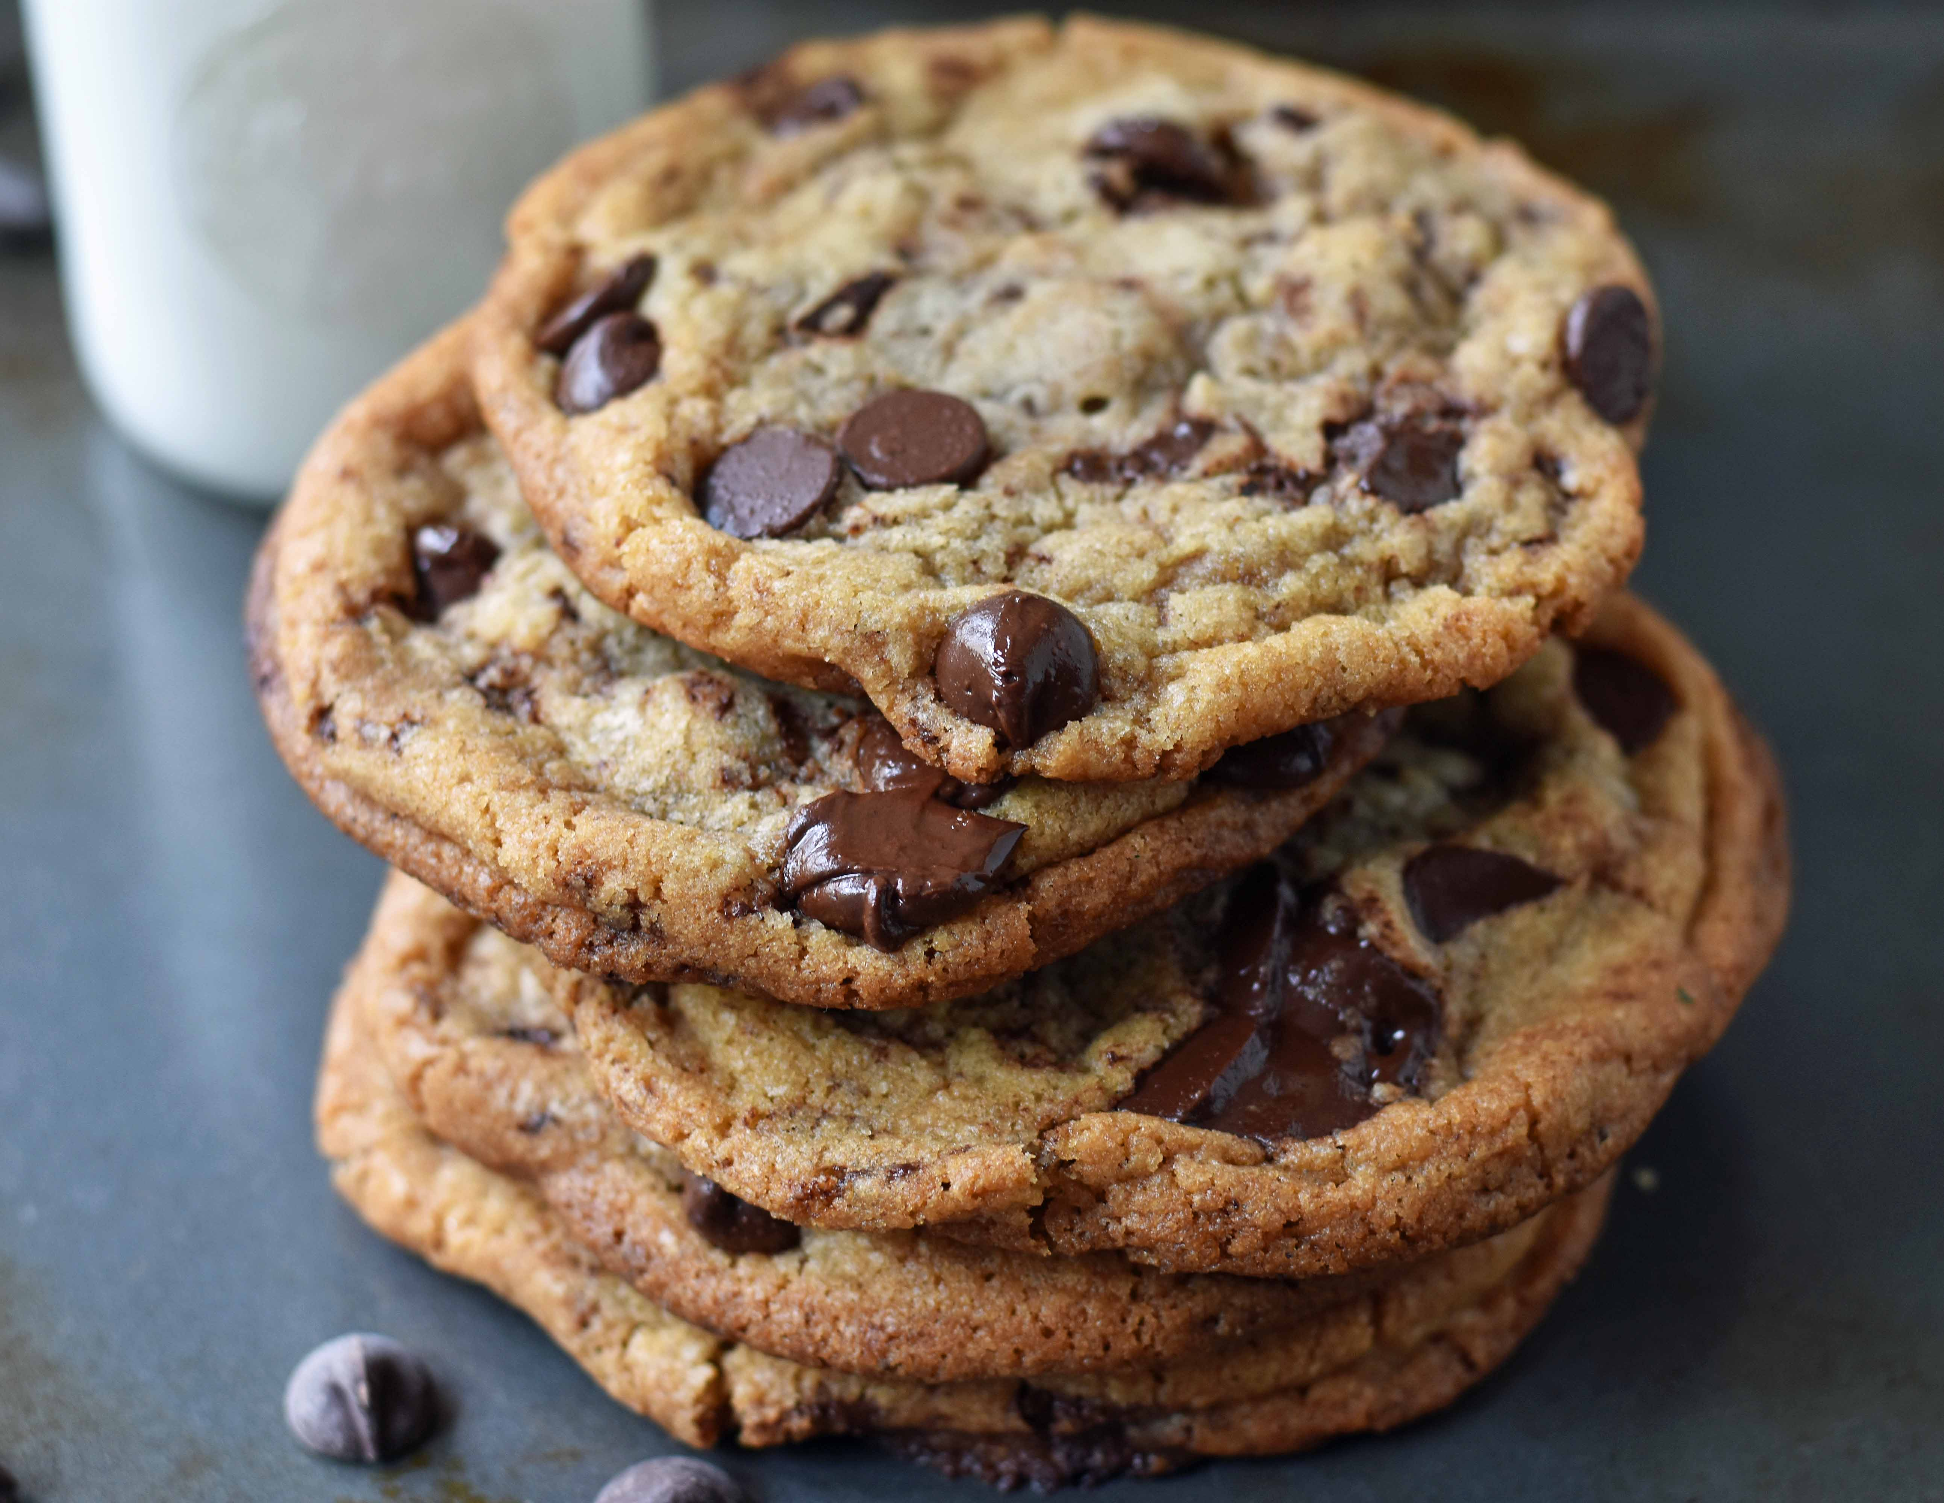
Cookies: Keeping user memory
client
server
Cookie file
http request msg + auth
server
creates ID
1678 for user
Netflix: 436
Amazon: 1678
http response +
Set-cookie: 1678
entry in backend
database
Cookie file
http request (no auth)
cookie: 1678
Netflix: 436
cookie-
specific
action
access
Amazon: 1678
Personalized http response
one week later:
access
Cookie file
http request (no auth)
cookie: 1678
cookie-
specific
action
Netflix: 436
Amazon: 1678
Personalized http response

Slide 32
How cookies work
Four components:
cookie header line of HTTP response message
cookie header line in HTTP request message
cookie file kept on user endpoint, managed by user’s browser
back-end database maps cookie to user data at Web endpoint
Client and server collaboratively track and remember the user’s state.

Slide 33

PSA: Cookies and Privacy
The Internet would be unusable without cookies.
However, cookies permit sites to learn a lot about you, from your behaviors.
E.g., which products, topics, images, etc. are you most interested in?
What demographic do you belong to? Where?
What kinds of ads will you likely click on?
Tracking networks correlate this info across sites
You might reasonably be concerned about your privacy when online.
Disable and delete unnecessary cookies by default
Use privacy-conscious browsers, websites, tools: DuckDuckGo, Brave, AdBlock Plus.

Slide 34
Caching in HTTP

Slide 35
Web caches
Web caches: Machines that remember web responses for a network
Why cache web responses?
Reduce response time for client requests
Reduce traffic on an institution’s access link
Caches can be implemented in the form of a proxy server

Slide 36

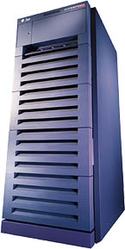
Web caching using a proxy server
You can configure a HTTP proxy on your laptop’s network settings.
If you do, your browser sends all HTTP requests to the proxy (cache).
Hit: cache returns object
Miss:
cache requests object from origin server
caches it locally
and returns it to client
Clients
Web Server
(also called origin server in this context)
GET foo.html
GET foo.html
The Internet
Proxy Server
Store foo.html
on receiving response

Slide 37
Web Caches: how does it look on HTTP?
cache
server
Conditional GET guarantees cache content is up-to-date while still saves traffic and response time whenever possible
Date in the cache’s request is the last time the server provided in its response header “last modified”
HTTP request msg
If-modified-since: <date>
object
not
modified
HTTP response
HTTP/1.0
304 Not Modified
HTTP request msg
If-modified-since: <date>
object
modified
HTTP response
HTTP/1.0 200 OK
<data>

Slide 38
Content Distribution Networks (CDN)
A global network of web caches
Provisioned by ISPs and network operators
Or content providers, like Netflix, Google, etc.
Uses
Reduce bandwidth requirements on content provider
Reduce $$ to maintain origin servers
Reduce traffic on a network’s Internet connection, e.g., Rutgers
Improve response time to user for a service

Slide 39
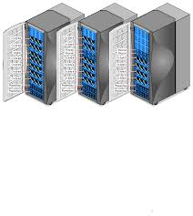
Without CDN
DOMAIN NAME | IP ADDRESS
www.yahoo.com | 98.138.253.109
cs.rutgers.edu | 128.6.4.2
www.google.com | 74.125.225.243
www.princeton.edu | 128.112.132.86
Cluster with Rutgers CS origin servers
128.6.4.2
Huge bandwidth requirements for Rutgers
Large propagation delays to reach users
So, distribute content to geographically distributed cache servers.
Often, use DNS to redirect request to users to copies of content

Slide 40
CDN terms
Origin server
Server that holds the authoritative copy of the content
CDN server
A replica server owned by the CDN provider
CDN name server
A DNS like name server used for redirection
Client

Slide 41
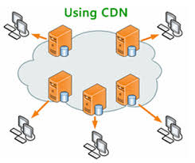
With CDN
DOMAIN NAME | IP ADDRESS
www.yahoo.com | 98.138.253.109
cs.rutgers.edu | 124.8.9.8 (NS of CDN)
www.google.com | 74.125.225.243
www.princeton.edu | 128.112.132.86
Implement DNS delegation to the CDN name server.
“layer of indirection”
CDN Name Server (124.8.9.8)
Custom logic to map ONE domain name to one of many IP addresses!
DOMAIN NAME | IP ADDRESS
www.yahoo.com | 12.1.2.3
www.yahoo.com | 12.1.2.4
www.yahoo.com | 12.1.2.5
www.yahoo.com | 12.1.2.6
12.1.2.3
12.1.2.4
CDN servers
12.1.2.6
12.1.2.5
128.6.4.2
Origin server
Client
Most requests go to CDN servers (caches).
Only the remainder go to the origin server.

Slide 42
Themes from HTTP
Request/response nature of the protocol
Special HTTP headers to customize actions of the protocol
ASCII-based message structures
Improve performance using caching
Scale using a layer of indirection
Simple, highly-customizable protocol, permitting efficient implementations and flexible functionality.
The basis of why we enjoy the web today.

