Slide 1

CS 352 Simple Mail Transfer Protocol
CS 352, Lecture 5.1
http://www.cs.rutgers.edu/~sn624/352
Srinivas Narayana

Slide 2
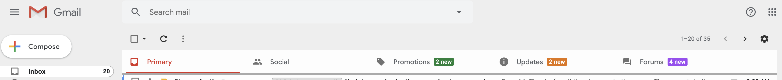
We’re all familiar with email. How does it work?

Slide 3
Electronic Mail
outgoing
message queue
user mailbox
Three major components:
User agents
a.k.a. “mail reader”
e.g., Applemail, Outlook
Web-based user agents (ex: gmail)
user
agent
mail
server
user
agent
SMTP
mail
server
user
agent
SMTP
SMTP
mail
server
user
agent
user
agent
user
agent

Slide 4
Electronic Mail: Mail servers
Mail Servers
Mailbox contains incoming messages for user
Message queue of outgoing (to be sent) mail messages
Sender mail server makes connection to Receiver mail server
IP address, port 25
SMTP protocol
Used to send messages
Client: sending user agent or sending mail server
server: receiving mail server
user
agent
mail
server
user
agent
SMTP
mail
server
user
agent
SMTP
SMTP
mail
server
user
agent
user
agent
user
agent

Slide 5
Scenario: Alice sends message to Bob
1) Alice (alice@rutgers.edu) uses UA to compose message to bob@nyu.edu
2) Alice’s UA sends message to her mail server; message placed in outgoing message queue
3) Client side of SMTP opens TCP connection with Bob’s mail server
4) SMTP client sends Alice’s message over the TCP connection
5) Bob’s mail server places the message in Bob’s incoming mailbox
6) Sometime later, Bob invokes his user agent to read message
1
mail
server
mail
server
user
agent
user
agent
Alice
2
Bob
3
4
6
5
Rutgers mail server
NYU mail server

Slide 6
Observations on these exchanges
Mail servers are useful “always on” endpoints
Receiving the email on behalf of Bob, should Bob’s machine be turned off
Retrying the delivery of the email to Bob on behalf of Alice, should Bob’s mail server be unavailable in the first attempt
The same machine can act as client and server based on context
Rutgers’s mail server is the server when Alice sends the mail
It is the client when it sends mail to Bob’s mail server
SMTP is push-heavy: info is pushed from client to server
Contrast to HTTP or DNS where info is pulled from the server

Slide 7
Sample SMTP interaction
A small demo

Slide 8
Sample SMTP interaction
220 hill.com SMTP service ready
HELO town.com
250 hill.com Hello town.com, pleased to meet you
MAIL FROM: <jack@town.com>
250 <jack@town.com>… Sender ok
RCPT TO: <jill@hill.com>
250 <jill@hill.com>… Recipient ok
DATA
354 Enter mail, end with “.” on a line by itself
Jill, I’m not feeling up to hiking today. Will you please fetch me a pail of water?
.
250 message accepted
QUIT
221 hill.com closing connection

Slide 9
MAIL command response codes
220: Service ready
250: Request command complete
354: Start mail input
421: Service not available

Slide 10
Mail message (stored on server) format
SMTP: protocol for exchanging email msgs
RFC 822: standard for text message format:
header lines, e.g.,
To:
From:
Subject:
different from SMTP commands!
(these would still be under “DATA”)
body
the “message”, ASCII characters only
header
blank
line
body

Slide 11
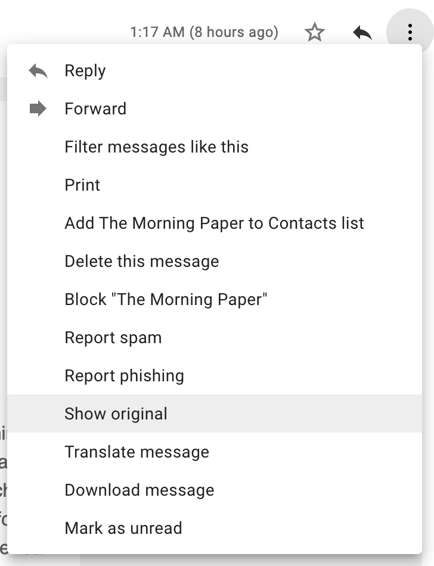
Message format: multimedia extensions
MIME: multimedia mail extension, RFC 2045, 2056
additional lines in msg header declare MIME content type
From: alice@crepes.fr
To: bob@hamburger.edu
Subject: Picture of yummy crepe.
MIME-Version: 1.0
Content-Transfer-Encoding: base64
Content-Type: image/jpeg
base64 encoded data .....
.........................
......base64 encoded data
MIME version
method used
to encode data
multimedia data
type, subtype,
parameter declaration
encoded data

Slide 12
CS 352 Mail: Access Protocols
CS 352, Lecture 5.2
http://www.cs.rutgers.edu/~sn624/352
Srinivas Narayana

Slide 13
Mail access protocols
POP3 or IMAP4
SMTP
SMTP
access
protocol
user
agent
user
agent
Bob
Alice
sender’s mail
server
receiver’s mail
server
SMTP: delivery/storage to receiver’s server
Mail access protocol: retrieval from server
POP: Post Office Protocol [RFC 1939]
Client connects to POP3 server on TCP port 110
IMAP: Internet Mail Access Protocol [RFC 1730]
Client connects to TCP port 143
HTTP: gmail, outlook, etc.

Slide 14
POP vs IMAP
POP3
Stateless server
UA-heavy processing
UA retrieves email from server, then typically deleted from server
Latest changes are at the UA
Simple protocol (list, retr, del within a POP session)
IMAP4
Stateful server
UA and server processing
Server sees folders, etc. which are visible to UAs
Changes visible at the server
Complex protocol

Slide 15
What about web-based email?
Connect to mail servers via web browser
Ex: gmail, outlook, etc.
Browsers speak HTTP
Email servers speak SMTP
Need a bridge to retrieve email using HTTP

Slide 16
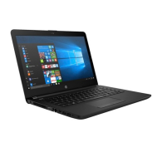

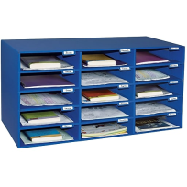
Web based email
HTTP
HTTP
HTTP server
HTTP
server
SMTP
Client
SMTP server
Internet

Slide 17
Comparing SMTP with HTTP
HTTP: pull
SMTP: push
both have ASCII command/response interaction, status codes
HTTP: each object encapsulated in its own response msg
SMTP: multiple objects sent in multipart msg
HTTP: can put non-ASCII data directly in response
SMTP: need ASCII-based encoding

Slide 18
More themes from app-layer protocols
Separation of concerns. Examples:
Content rendering for users (browser, UA) separate from protocol operations (mail server)
Reliable mail sending and receiving: mail UA doesn’t need to be “always on” to send or receive email reliably
In-band vs. out-of-band control:
In-band: headers determine the actions of all the parties of the protocol
There are protocols with out-of-band control, e.g., FTP
Keep it simple until you really need complexity
ASCII-based design; stateless servers. Then introduce:
Cookies for HTTP state
IMAP for email organization
Security extensions (e.g., TLS)
Different methods to set up and use underlying connections (e.g., persistence)

