Slide 1

CS 352 Multimedia Data Representations
Lecture 6.1
http://www.cs.rutgers.edu/~sn624/352
Srinivas Narayana

Slide 2




Multimedia networking
Many applications on the Internet use audio or video
IP video traffic will be 82 percent of all IP traffic […] by 2022, up from 75 percent in 2017
CCTV traffic over the Internet will increase sevenfold between 2017 to 2022
Internet video to TV will increase threefold between 2017 to 2022.
Consumer Video-on-Demand (VoD) traffic will nearly double by 2022
Source: Cisco visual networking index 2017--22
2

Slide 3
What’s different about these applications?
Traditional applications (HTTP(S), SMTP)
Delay tolerant but not loss tolerant
Data used after transfer complete
Multimedia applications are often real time
Data delivery time during transfer matters for user experience
Video/audio streaming
Delay-sensitive
Real-time audio and video
Delays > 400 ms for audio is a bad user experience
Somewhat loss tolerant
3

Slide 4
Digital representation of audio and video

Slide 5
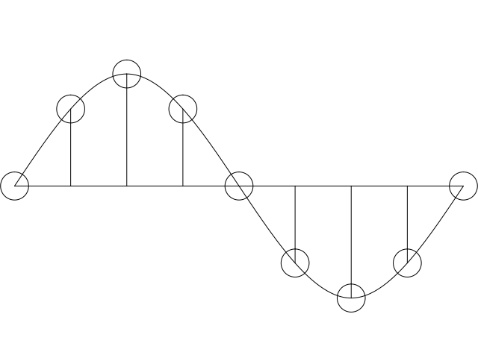
Digital representation of audio
Must convert analog signal to digital representation
Sample
How many times (twice the max frequency in the signal)
Quantize
How many levels or bits to represent each sample
More levels ➔ more accuracy
More levels ➔ more bits to store & more bandwidth to transmit
Compress
Compact representation of quantized values
5

Slide 6
Audio representation
analog audio signal sampled at constant rate
telephone: 8,000 samples/sec
CD music: 44,100 samples/sec
each sample quantized, i.e., rounded
e.g., 2⁸=256 possible quantized values
each quantized value represented by bits, e.g., 8 bits for 256 values
quantization error
quantized value of
analog value
analog
signal
audio signal amplitude
time
sampling rate
(N sample/sec)

Slide 7
Audio representation
example: 8,000 samples/sec, 256 quantized values
Bandwidth needed: 64,000 bps
receiver converts bits back to analog signal:
some quality reduction
Example rates
CD: 1.411 Mbps
MP3: 96, 128, 160 Kbps
Internet telephony: 5.3 Kbps and up
quantization error
quantized value of
analog value
analog
signal
audio signal amplitude
time
sampling rate
(N sample/sec)

Slide 8

Video representation
Video: sequence of images displayed at constant rate
e.g., 30 images/sec
Appear continuous due to “persistence of vision”/stroboscopic effect.
frame i
frame i+1

Slide 9
Video representation
spatial coding example: instead of sending N values of same color (all purple), send only two values: color value (purple) and number of repeated values (N)
Digital image: array of pixels
each pixel represented by bits
Coding: use redundancy within and between images to decrease # bits used to encode image
spatial (within image)
temporal (from one image to next)
Coding/decoding algorithm often called a codec
……………………...…
……………………...…
frame i
temporal coding example: instead of sending complete frame at i+1, send only differences from frame i
frame i+1

Slide 10
Video representation
Video bit rate: effective number of bits per second of the video after encoding
Depends on quality of each image. More pixels, more detail per pixel = more bits
Depends on effectiveness of compression in the codec
Video bit rate is typically correlated with quality.
CBR: (constant bit rate): fixed bit-rate video
VBR: (variable bit rate): different parts of the video have different bit rates, e.g., changes in color, motion, etc.
Examples of average video bit-rates:
MPEG 1 (CD-ROM) 1.5 Mbps. MPEG2 (DVD) 3-6 Mbps
MPEG4 (often used in Internet, < 1 Mbps)
In general, one Internet video stream takes up a few Mbit/s (that’s it.)

Slide 11
Multimedia networking: 3 application types
streaming, stored audio, video
streaming: can begin playout before downloading entire file
stored (at server): can transmit faster than audio/video will be rendered (implies storing/buffering at client)
e.g., Spotify, YouTube, Netflix
conversational voice/video over IP
interactive nature of human-to-human conversation limits delay tolerance
e.g., Zoom
streaming live audio, video
e.g., live sporting event (e.g., superbowl)

Slide 13
CS 352 Video Streaming
Lecture 6.2
http://www.cs.rutgers.edu/~sn624/352
Srinivas Narayana

Slide 14
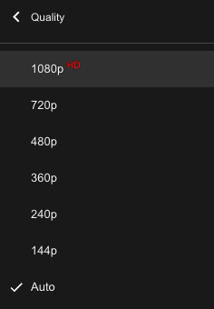
Streaming stored video
Media is prerecorded at different qualities
Client downloads an initial portion and starts viewing
Rest downloaded as time progresses
No need to wait for entire content to be downloaded
Can change content sites mid-stream based on network conditions

Slide 15


Streaming stored video
Cumulative data
2. video
sent
video
recorded (e.g., 30 frames/sec)
3. video received,
played out at client
(30 frames/sec)
network delay
(fixed in this example)
time
streaming: at this time, client
playing out early part of video,
while server still sending later
part of video

Slide 16
Streaming stored video: challenges
continuous playout constraint: once client playout begins, playback must match original timing
… but network delays are variable (jitter), so will need client-side buffer to match playout requirements
other challenges:
client interactivity: pause, fast-forward, rewind, jump through video
video packets may be lost, retransmitted

Slide 17
Scenario 1: Constant bit-rate video
constant bit
rate video
transmission
client video
reception
constant bit
rate video
playout at client
Cumulative data
variable
network
delay
buffered
video
client playout
delay
time
client-side buffering and playout delay: compensate for network-added delay, delay jitter

Slide 18

Client-side buffering, playout
buffer fill level, B(t)
variable fill
rate, x(t)
playout rate,
e.g., CBR r
video server
client application
buffer, size B_{max}
client
Video is downloaded chunk by chunk (typically using the HTTP protocol)
For example: a chunk might be 4 seconds worth of video.

Slide 19
Client-side buffering, playout
buffer fill level, B(t)
variable fill
rate, x(t)
playout rate,
e.g., CBR r
video server
client application
buffer, size B_{max}
client
1. Initial fill of buffer until playout begins at t_{p}
2. playout begins at t_{p,}
3. buffer fill level varies over time as fill rate x(t) varies and playout rate r is constant

Slide 20
Client-side buffering, playout
buffer fill level, Q(t)
variable fill
rate, x(t)
playout rate,
e.g., CBR r
video server
client application
buffer, size B
playout buffering: average fill rate (x), playout rate (r):
x < r: buffer eventually empties (causing freezing of video playout until next chunk downloaded). Rebuffering event
x > r: buffer will not empty, provided initial playout delay is large enough to absorb variability in x(t)
initial playout delay tradeoff: buffer starvation less likely with larger delay, but larger delay until user begins watching

Slide 21
Client-side buffering, playout
buffer fill level, Q(t)
variable fill
rate, x(t)
playout rate,
e.g., CBR r
video server
client application
buffer, size B
playout buffering: average fill rate (x), playout rate (r):
is x < r or x > r for a given network connection?
It is hard to predict this in general. How to set r?
Too low a bit-rate r: video has poorer quality than needed
Too high a bit-rate r: buffer might empty out. Rebuffering!

Slide 22
Scenario 2: Adaptive bit–rate video
Motivation: Want to provide high quality video experience, without rebuffering
Adapt bit rate collaboratively between the video client (e.g., YouTube player on your browser) and the server
Adaptive bit-rate (ABR) video: change the bit-rate (quality) of next chunk, based on network and client conditions.
A typical strategy: Buffer-based rate adaptation

Slide 23
Buffer-based Rate Adaptation
Key idea: If there is a large stored buffer of video, optimize aggressively for video quality, i.e., high bit rates
Conversely, if there is a small stored buffer of video, be conservative and ask for a lower quality
The hope is that the lower bandwidth requirement can be satisfied by the connection more easily.

Slide 24
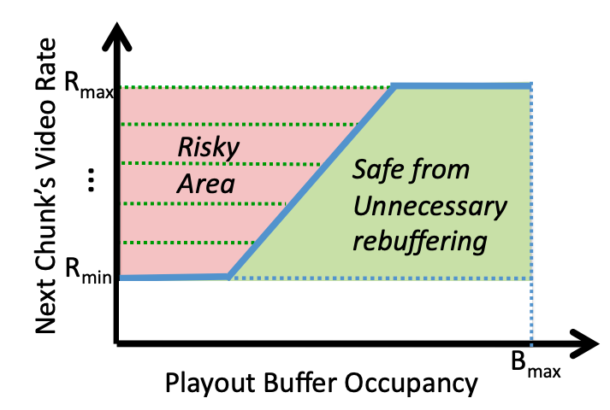
Buffer-based bit-rate adaptation
A highly effective method to provide high video quality despite variable and intermittently poor
network conditions.
Used by Netflix.
http://yuba.stanford.edu/~nickm/papers/sigcomm2014-video.pdf
A Buffer-Based Approach to Rate Adaptation

