Slide 1

CS 352 Network Service Guarantees
CS 352, Lecture 20.1
http://www.cs.rutgers.edu/~sn624/352
Srinivas Narayana

Slide 2


Network
Application
HTTPS
FTP
HTTP
SMTP
DNS
Transport
TCP
UDP
Network
IP
Host-to-Net
X.25
…
802.11
ATM
The network layer moves packets from one place to another.
The network will put in its best effort but makes no guarantees.

Slide 3
Network support for applications
A best effort Internet architecture does not offer any guarantees on delay, bandwidth, and loss
Network may drop, reorder, corrupt packets
Network may treat traffic randomly regardless of their “importance”
However, many apps require special treatment & guarantees
E.g., voice over IP (phone calls) require strict delay guarantees
E.g., HD video requires a reasonable minimum bandwidth
E.g., remote surgery with 3D-vision requires strict sync & latency
Q: How to provide quality of service (QoS) for apps?

Slide 4


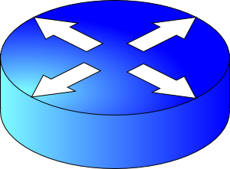
Why best effort isn’t enough: Contention
Conf call: Requires low latency
High delay
Packet drops
Resource contention occurs in the core of the network
Congestion control will react, but may be too little & too late:
Congestion control can’t prevent packet drops “now”
Congestion control won’t prevent high-sending-rate flows from inflicting large delays or recurring drops
BitTorrent: Requires high throughput
FIFO queue

Slide 5
Can networks help improve the quality of service for applications?
Yes, but networks must become
better than best-effort.

Slide 6
Approach 1: Provision more capacity
If you’re an ISP (e.g., AT&T), you might deploy enough capacity so that contention doesn’t occur any more
Low complexity: can use current “best effort” network
However, this approach incurs high costs (e.g., bandwidth)
A key challenge: estimating how much bandwidth is enough
Need to estimate demand over time
Network operators can do this quite well usually
But there are exceptional circumstances: pandemics, Superbowl, etc.

Slide 7
Approach 2: Classes of service
Have the network treat different traffic differently
Also called traffic differentiation
Analogy: lines at an airport (e.g., first class vs. economy)
Partition traffic into classes and offer service guarantees per class and across classes
Classes may be indicated using the IP type of service header bits
Classes may be inferred from IP & transport headers (e.g., src/dst/ports)
Packet classification: assigning packets to classes
(Not in scope: we won’t discuss packet classification)

Slide 8
Kinds of Service Guarantees

Slide 9

(1) Strict prioritization
Transmitted immediately regardless of HTTP packets
Conf call
H3
H1
R1
R2
H4
HTTP
H2
1.5 Mbps link
Suppose a 1Mbps interactive flow and an HTTP connection share a 1.5 Mbps link.
A network operator (e.g., Rutgers admin) might choose to prioritize the interactive app strictly over the HTTP flow.

Slide 10
(2) Rate limiting
Rate limited to 1 Mbit/s
What if a flow doesn’t respect its allocation?
Example: Say, conf call flow goes beyond 1 Mbit/s
Don’t want to starve HTTP flow!
An operator might want to limit a flow to a certain max rate
Isolation: HTTP should not be impacted by the conf call
Conf call
H3
H1
R1
R2
H4
HTTP
H2
1.5 Mbps link

Slide 11
(3) Weighted fair sharing
Allocated 2/3rd of the link
An operator might want to partition the link’s rate C into separate allocations for each class
Partitions may have weights w (example: 2, 1)
Usually, class i gets the illusion of traversing a logical link of rate
w_{i} * C / ∑_{j} w_{j}
w=2
Conf call
H3
H1
R1
R2
H4
w=1
HTTP
H2
Allocated 1/3rd of the link

Slide 12
(3) Weighted fair sharing
Class 1
Customary to think of different classes as belonging to different queues
For this reason, weighted fair sharing is also called weighted fair queueing (WFQ)
Each queue is first-in-first-out (FIFO)
The link multiplexes among these queues
Intuitively, packets of one queue should not influence the behavior of other queues
Hence, fair queueing is also a form of isolation across traffic classes
Class 2
Link
Class 3

Slide 13
(3) Weighted fair sharing
Class 1
But what if one class doesn’t use its share?
Can other classes use the spare capacity?
Yes! WFQ is work-conserving: a router implementing WFQ will allow other classes to use the unused capacity
Work conservation makes WFQ different from rate limits applied separately to each class
Class i’s usage can exceed w_{i} * C / ∑_{j} w_{j}
(only if spare capacity is available, of course.)
Class 2
Link
Class 3

Slide 14
Q: Where are guarantees enforced?
We’ve seen three kinds of service guarantees: prioritization, rate limiting, and fair sharing
Common goal: allocate the bottleneck link capacity across packets from traffic classes
This allocation occurs in the packet scheduler in the bottleneck router
Recall: scheduling is the task of choosing the packet (among buffered packets) which is transmitted over the output link
A router is said to implement packet scheduling policies

Slide 15
Why care about service guarantees?
Influences how packets are treated at contentious resources in the core of the network
Regardless of the endpoint transport
Service guarantees: prioritization, rate limiting, fair sharing
Implementations of scheduling (QoS) within large networks have implications for debates on network neutrality
Scheduling is a fundamental problem in computer networks
Next lecture: a deeper look at mechanisms for one kind of service guarantee

Slide 17
CS 352 Rate Limiting
CS 352, Lecture 20.2
http://www.cs.rutgers.edu/~sn624/352
Srinivas Narayana

Slide 18
Review
Packet drops
High delay
Conf call
H3
H1
FIFO queue
H4
HTTP
H2
1.5 Mbps link
Best-effort network isn’t enough
Applications might require more guarantees
3 mechanisms: prioritization, rate limiting, and fair sharing
This module: implementation of rate limiting

Slide 19
Measures of transmission rate
Long-term/average rate: data rate transmitted per unit time, over a long period
Crucial question: what is the time interval over which rate is measured?
Average and instantaneous behaviors can be very different
Same average rate
Rate
Measurement duration
Rate
Measurement duration
Time
Time

Slide 20
Measures of transmission rate
Peak rate: largest instantaneous rate that is transmitted
Measurement duration is typically very small
Burst size: maximum amount of data sent consecutively without any intervening idle periods
Measurement duration
peak rate
Rate
Time

Slide 21
Rate enforcement
There are two kinds of rate enforcement policies:
shaping and policing
Two specific mechanisms to implement those:
leaky buckets and token buckets

Slide 22
Shaping
vs. Policing
Enforces rate by queueing excess packets in a buffer
Drop only if buffer is full
Requires memory to buffer packets
Can inflate round-trip time (queueing in shaping buffer)
Enforces rate by dropping excess packets immediately
Can result in high loss rates
Does not require a memory buffer
No additional inflation in round-trip times

Slide 23
Leaky bucket shaper

Slide 24
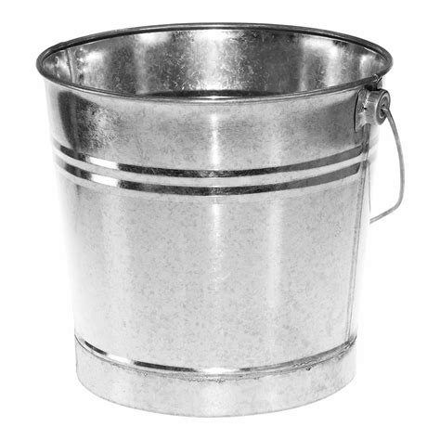

Intuition: release packets at steady rate
Packets from source
Bucket
leaking water
at a steady
rate
Leaky
Bucket
Shaper
Shaping buffer
Timed release mechanism for packets
Packets leaving at steady rate

Slide 25
Leaky Bucket Shaper
Packets may enter in a bursty manner
However, once they pass through the leaky bucket, they are evenly spaced
The shaping buffer holds packets up to a certain point
If the buffer is full, packets are dropped (true of any shaper)
Setting the rate is a policy concern
Assume an admin provides us the rate
Shapers may be used in the core of a network to limit bandwidth use, or at the edge to pace packets entering the network in the first place

Slide 26
Leaky Bucket Shaper
For a leaky bucket shaper, assume average rate == peak rate
However, many Internet transfers just have a few packets
For example, web requests and responses
Enforcing rate limit for those can significantly delay completion
We often wish to have peak rate higher than avg rate
If so, use a token bucket: burst-tolerant version of a leaky bucket

Slide 27
Token bucket shaper

Slide 28
Token bucket shaper
Fill at rate r
Limits traffic class to a specified average rate r and burst size B
Tokens are filled in at rate r
The token bucket can hold a maximum of B tokens. Further tokens dropped
Note: distinct from shaping buffer size
Suppose a packet is at the head of the shaping buffer
If a token exists in the bucket, remove token, and transmit the packet
If not, wait.
Bucket size B
Packets
Remove token
Transmit
Shaping buffer

Slide 29
Token bucket shaper
Fill at rate r
In time t, the maximum number of packets that depart the shaper is (r * t) + B
A full bucket of tokens would allow small flows to go through unaffected
A maximum burst of B packets
Longer flows have average rate r
Bucket emptied initially, the rest of the flow must respect the token fill rate
As t → ∞, the average rate approaches r
That is, (1/t) * (r*t + B) → r
Bucket size B
Packets
Remove token
Transmit
Shaping buffer

Slide 30
Token bucket policers

Slide 31
Token bucket policer
Fill at rate r
A token bucket policer is just a token bucket shaper without the shaping buffer
No place for packets to wait if there are no tokens
If token exists, packet transmitted.
If not, packet dropped
Simple and efficient to implement.
The internet has tons of token bucket policers
Bucket size B
Packets
Remove token
Transmit
Shaping buffer

Slide 32
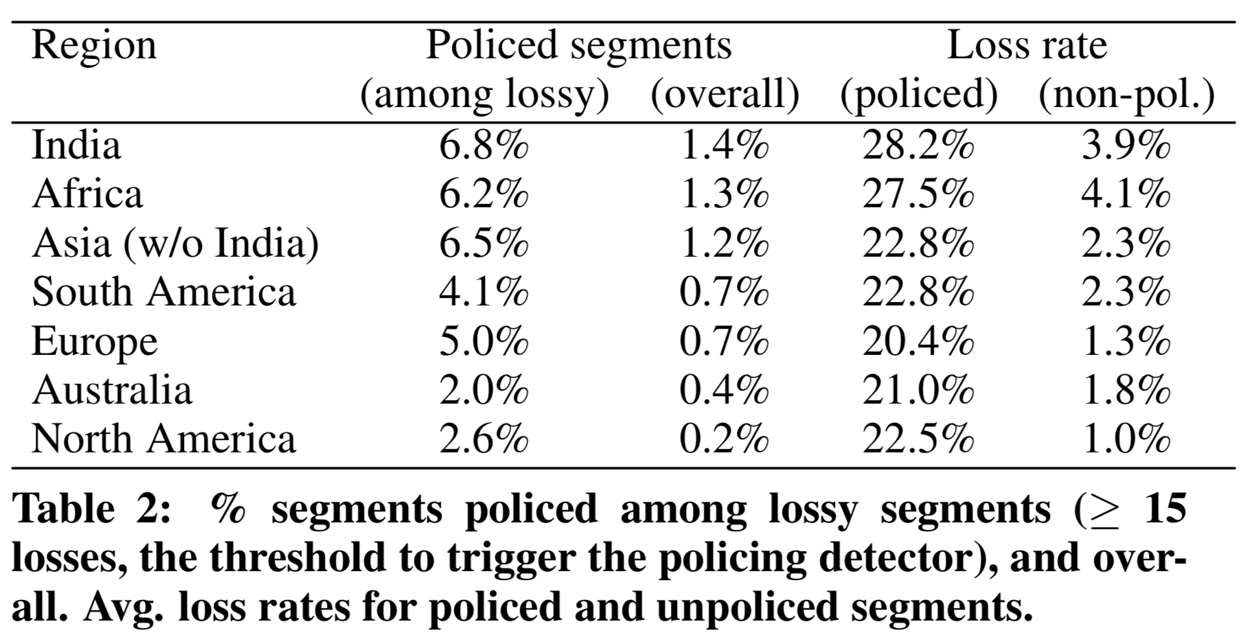
Google study from 2016
Small but non-trivial fraction of policed links
Significant impact on packet loss rate
Flach et al., An Internet-Wide Analysis of Traffic Policing, SIGCOMM 2016

Slide 33
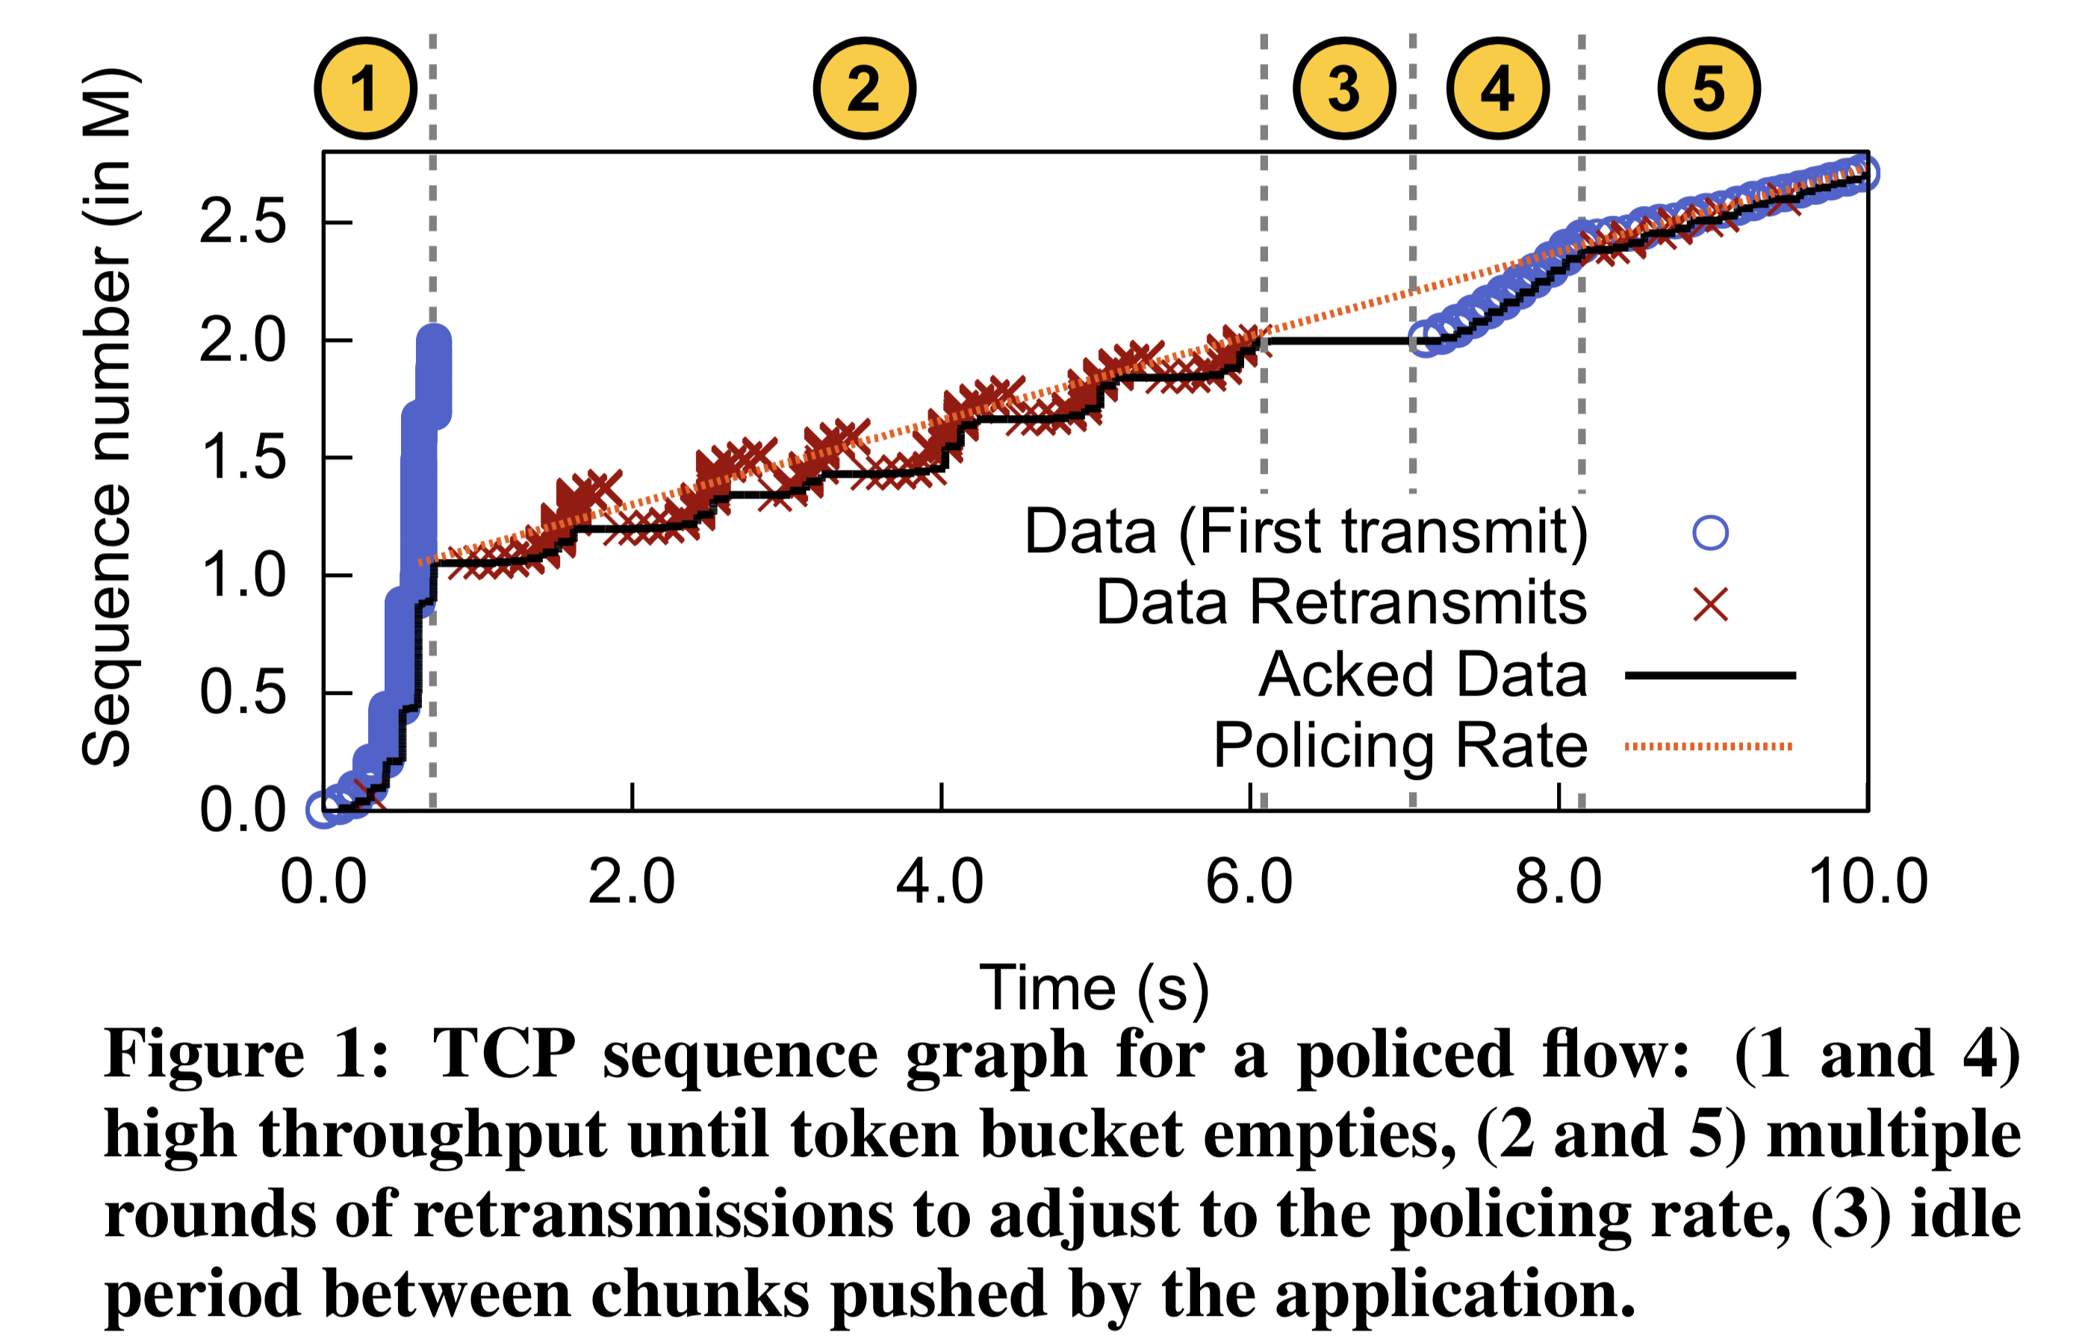
Impact on TCP
Policers drop multiple packets in a burst: causing RTOs and retransmissions after emptying of token bucket
Slow start period: burst allowed with a full bucket of tokens

Slide 34
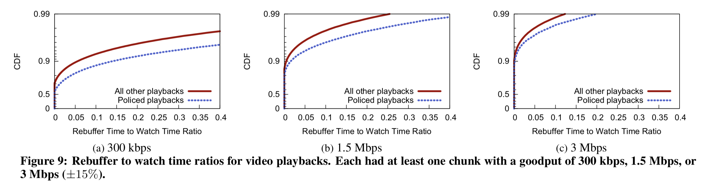
Effect on actual apps: YouTube
Video rebuffer rate: rebuffer time / overall watch time

Slide 35
Summary of rate limiting
Rate limiting is a useful mechanism to isolate traffic classes from each other
Two strategies: policing and shaping
Leaky bucket and token bucket
The Internet has a lot of token bucket policers, causing real impact on TCP connections and app performance

