Slide 1

CS 352 Router Design
CS 352, Lecture 15.1
http://www.cs.rutgers.edu/~sn624/352
Srinivas Narayana

Slide 2


Network
Application
HTTPS
FTP
HTTP
SMTP
DNS
Transport
TCP
UDP
Network
IP
Host-to-Net
X.25
…
802.11
ATM
The main function of the network layer is to
move packets from one endpoint to another.
The network will make its best effort to deliver packets
but doesn’t guarantee anything.

Slide 3
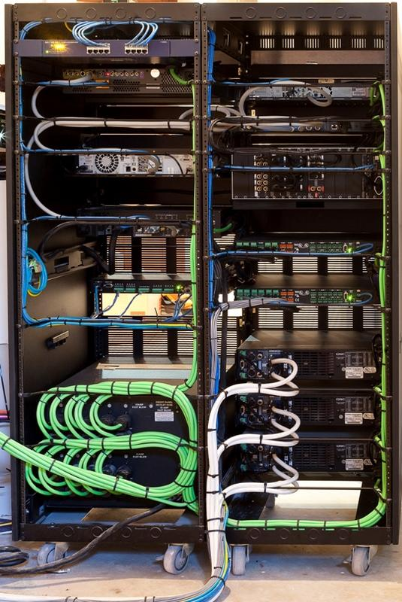
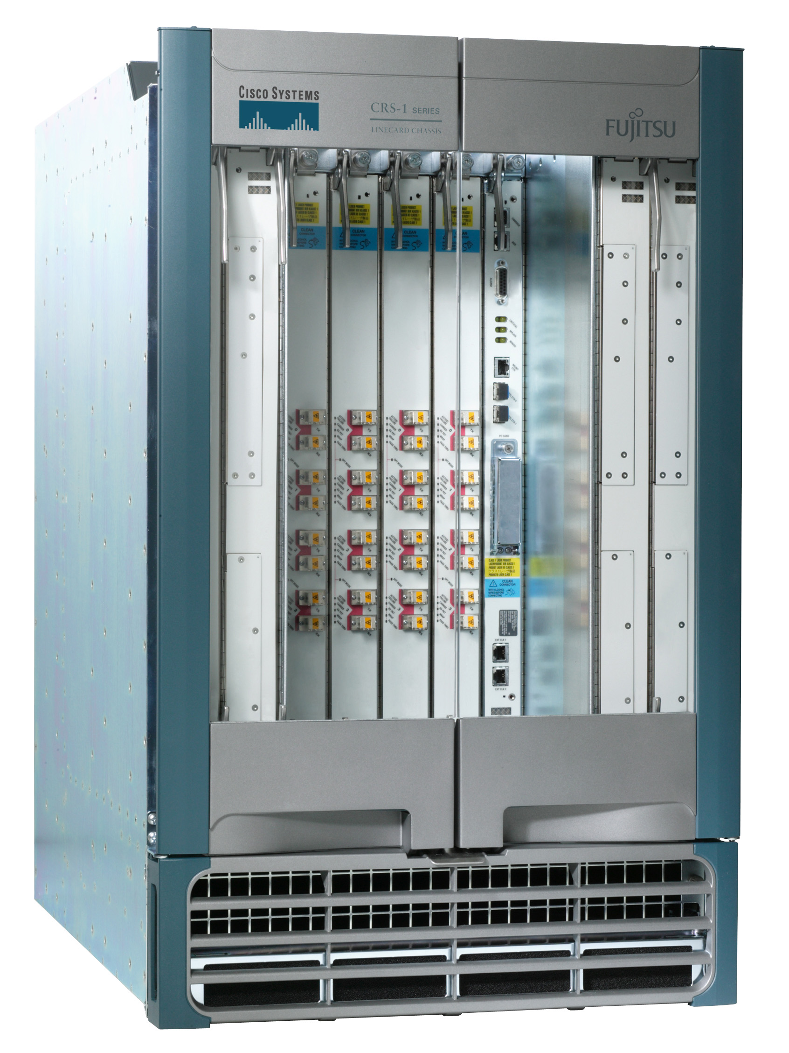
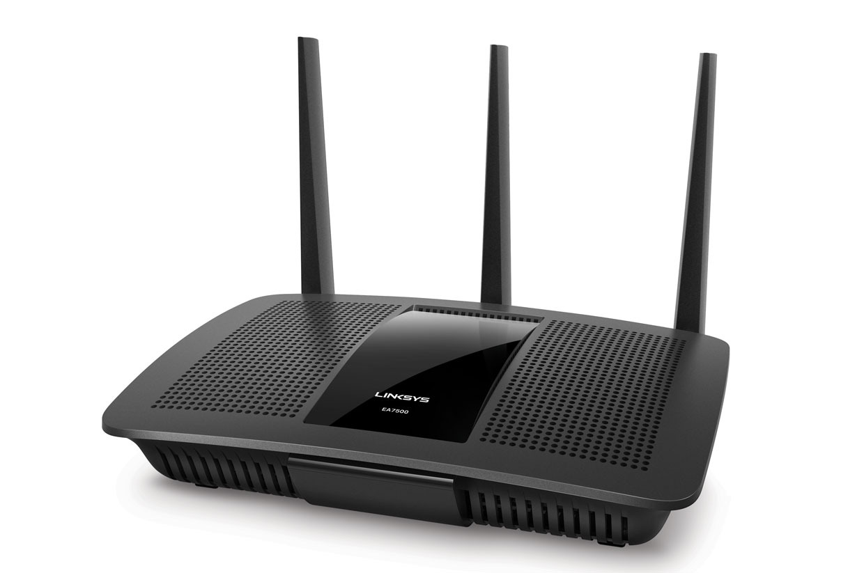
This lecture is about routers
Access routers
Core router
Data center top-of-rack switch

Slide 4
What’s inside a router?

Slide 5
Router architecture overview
Review: assuming distributed routing, routing function: decide which ports packets need to exit
route
processor
Control plane
Data plane
Review: Forwarding function: move packets from one input port to another.
high-speed
switching
fabric
router input ports
router output ports

Slide 6
Different and evolving designs
There are different kinds of routers, with their own designs
Access routers (e.g., home WiFi), chassis/core routers, top-of-rack switches
Router designs have also evolved significantly over time
For simplicity and concreteness, we will learn about one high-speed router design from the early 2000s.
Called the MGR (multi-gigabit router). It could support an aggregate rate of 50 Gbit/s (1 G = 10⁹)
Today’s single-chip routers can support aggregate rates of ~10 Tbit/s (1 T = 10¹²)

Slide 7
Input port functions
Input port
Output port
Input port
Switching fabric
Output port
Line termination: receives physical (analog) signals and turns them into digital signals.
Speed of data on a single network interface termed line speed or line rate (e.g., 100 Mbit/s)
Link layer: performs medium access control functions (e.g., Ethernet): more on this much later.
…
…
Input port
Output port
Per-output
Queues
Line
Term
Link
Layer
/ MAC
(receive)
Route
lookup
switching
fabric

Slide 8
Input port functions
Input port
Output port
Input port
Switching fabric
Output port
Route lookup: high-speed lookup of which output port the packet is destined to
Goal: must complete this processing at the line rate
Queueing: packets may wait in per-output-port queues if packets are arriving too fast for the switching fabric to send them to the output port
…
…
Input port
Output port
Per-output
Queues
Line
Term
Link
Layer
/ MAC
(receive)
Route
lookup
switching
fabric

Slide 9

Route lookups
Route
lookup
Per-output
Queues
Line
Term
Link
Layer
Packet forwarding in the Internet is based on the destination IP address on the packet.
Example: if dst IP on packet is 65.45.145.34, it matches the forwarding table prefix 65.0.0.0/8.
The packet is forwarded out port 3.
Parse
Transport
Extract destination IP address
Network
Link layer
Route Lookup Data Structure
Outgoing Port
Forwarding Table
Dst-network
Port
65.0.0.0/8
3
128.9.0.0/16
1
149.12.0.0/19
7

Slide 10
Route lookups
Route
lookup
Per-output
Queues
Line
Term
Link
Layer
Number of entries in the forwarding table matters.
Fitting into router memory
Designing hardware and software for fast lookups
Parse
Transport
Extract destination IP address
Network
Link layer
Route Lookup Data Structure
Outgoing Port
Forwarding Table
Dst-network
Port
65.0.0.0/8
3
128.9.0.0/16
1
149.12.0.0/19
7

Slide 11
Route lookups
Route
lookup
Per-output
Queues
Line
Term
Link
Layer
Recall: IP addresses can be aggregated based on shared prefixes.
The number of table entries in a router is proportional to the number of prefixes, NOT the number of endpoints.
Today: ~ 1 million prefixes.
Parse
Transport
Extract destination IP address
Network
Link layer
Route Lookup Data Structure
Outgoing Port
Forwarding Table
Dst-network
Port
65.0.0.0/8
3
128.9.0.0/16
1
149.12.0.0/19
7

Slide 12
Route lookups
Route
lookup
Per-output
Queues
Line
Term
Link
Layer
Destination-IP-based forwarding has consequences.
Forwarding behavior is independent of the source: legitimate source vs. malicious attack traffic
Forwarding behavior is independent of the application: web traffic vs. file download vs. video
IP-based packet processing is “baked into” router hardware: evolving the IP protocol faces tall deployment hurdles
Parse
Transport
Extract destination IP address
Network
Link layer
Route Lookup Data Structure
Outgoing Port
Forwarding Table
Dst-network
Port
65.0.0.0/8
3
128.9.0.0/16
1
149.12.0.0/19
7

Slide 13
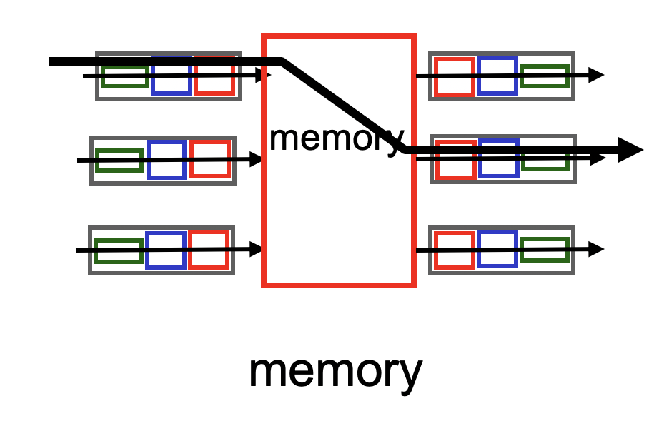
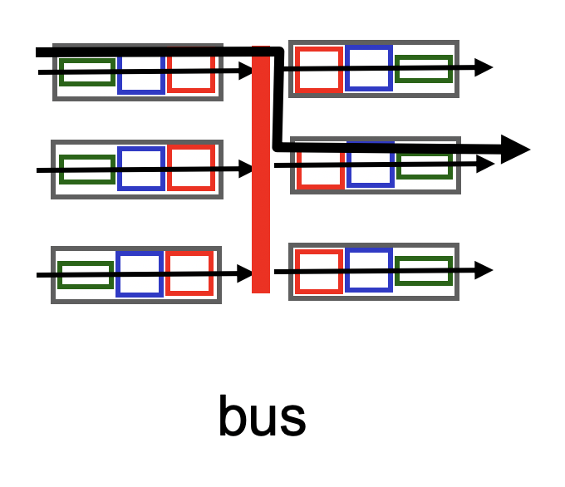
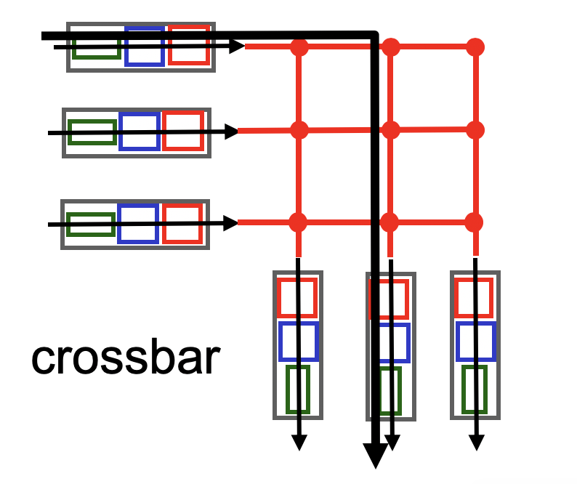
Types of fabrics
Input port
Output port
Input port
Switching fabric
Output port
…
…
Input port
Output port
Input port writes packets into shared memory.
Output port reads the packet when output link ready to transmit.
Single shared channel to move data from input to output port.
Easy to build buses; technology is quite mature.
Each input port has a physical data path to every output port.
Switch at the cross-over points turns on to connect pairs of ports.

Slide 14
Types of fabrics
Input port
Output port
Input port
Switching fabric
Output port
…
…
Input port
Output port
Crossbars can get expensive as the number of ports grows (N² connections for N ports)
MGR uses a crossbar and schedules (in,out) port pairs.
Modern high-speed routers use highly optimized shared-memory-based interconnects.

Slide 15
Fabrics
Input port
Output port
Input port
Switching fabric
Output port
…
…
Input port
Output port
High-speed switching fabrics designed to be nonblocking:
If an output port is “available”, an input port can always transmit to it without being blocked by the switching fabric itself
Crossbars are nonblocking by design
Shared memory can be designed to be nonblocking if memory is optimized to be fast enough for the access pattern

Slide 16
Fabrics
Input port
Output port
Input port
Switching fabric
Output port
…
…
Input port
Output port
With a nonblocking fabric, queues aren’t formed due to the switching fabric.
i.e., there are no queues due to inefficiencies at the input port or the switching fabric
Queues only form due to contention for the output port

Slide 17
Fabrics
Input port
Output port
Input port
Switching fabric
Output port
…
…
Input port
Output port
With a nonblocking fabric, queues aren’t formed due to the switching fabric.
i.e., there are no queues due to inefficiencies at the input port or the switching fabric
Queues only form due to contention for the output port
Typically, these (per-output-port) queues form on the output side
But queues can also form on the input side if the fabric can’t even move packets to the output port’s buffer (ie: if output-side buffer filled up)

Slide 18
Output port functions
Input port
Output port
Input port
Switching fabric
Output port
Components in reverse order of those in the input port
This is where most routers have the bulk of their packet buffers
Recall our discussions regarding router buffer sizes in the transport layer
MGR uses per-port output buffers, but modern routers have shared memory buffers
More efficient use of memory under varying demands
…
…
Input port
Output port
Queues
Link
Layer
/ MAC
(transmit)
Line
Termination
Switching
fabric
To output link

Slide 19
Output port functions
Input port
Output port
Input port
Switching fabric
Output port
Two important policy decisions
Scheduling: which among the waiting packets gets to be transmitted out the link?
Ex: First-In-First-Out (FIFO)
Buffer management: which among the packets arriving from the fabric get space in the packet buffer?
Ex: Tail drop: later packets dropped first
…
…
Input port
Output port
Queues
Link
Layer
/ MAC
(transmit)
Line
Termination
Switching
fabric
To output link

Slide 20
Control (plane) processor
A general-purpose processor that “programs” the data plane:
Forwarding table
Scheduling and buffer management policy
Implements the routing algorithm by processing routing protocol messages
Mechanism by which routers collectively solve the Internet routing problem
More on this soon.
Control Processor
Input port
Output port
Input port
Switching fabric
Output port
…
…
Input port
Output port

Slide 21

Router design: the bigger picture
Control plane
Traditional distributed routing: per route-change processing
(~ a few tens of seconds)
Routing
Algorithm
control
plane
data
plane
Data plane
per-packet processing
(~ tens of nanoseconds)
0111
1
3
2
values in arriving
packet header, i.e, destination IP address

Slide 23
CS 352 Longest Prefix Matching
CS 352, Lecture 15.2
http://www.cs.rutgers.edu/~sn624/352
Srinivas Narayana

Slide 24
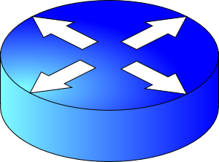
Review: Route lookup
Table lookup matches a packet against an IP prefix
Ex: 65.12.45.2 matches 65.0.0.0/8
Prefixes are allocated to organizations by Internet registries
But organizations can reallocate a subset of their IP address allocation to other orgs
Parse
Transport
Extract destination IP address
Network
Link layer
Route Lookup Data Structure
Outgoing Port
Forwarding Table
Dst-network
Port
65.0.0.0/8
3
128.9.0.0/16
1
149.12.0.0/19
7

Slide 25
Example of IP block reallocation
Dst IP Prefix | Output port
65.0.0.0/8 | 3
128.9.0.0/16 | 1
… | …
200.23.16.0/20 | 7 (towards A)
Suppose ISP A reallocates a part of its IP block to orgs 1… 8
ISP A owns the IP block 200.23.16.0/20.
Organization 1
200.23.16.0/23
Organization 2
200.23.18.0/23
Send me pkts for
200.23.16.0/20
Organization 3
200.23.20.0/23
.
ISP A
.
.
.
.
Internet
.
Organization 8
200.23.30.0/23
There is an announcement mechanism (BGP) by which ISP A can inform the rest of the Internet about the prefixes it owns.
It is enough to announce a coarse-grained prefix 200.23.16.0/20 rather than 8 separate sub-prefixes.

Slide 26
Example of IP block reallocation
Dst IP Prefix | Output port
65.0.0.0/8 | 3
128.9.0.0/16 | 1
… | …
200.23.16.0/20 | 7 (towards A)
Suppose ISP A reallocates a part of its IP block to orgs 1… 8
ISP A owns the IP block 200.23.16.0/20.
Organization 1
200.23.16.0/23
Organization 2
200.23.18.0/23
Send me pkts for
200.23.16.0/20
Organization 3
200.23.20.0/23
.
ISP A
.
.
.
.
Internet
.
Organization 8
200.23.30.0/23
Now suppose one of these organizations chooses to connect to a different ISP for its Internet service.
It is possible for this organization to retain its assigned IP block.

Slide 27
Example of IP block reallocation
Dst IP Prefix | Output port
65.0.0.0/8 | 3
128.9.0.0/16 | 1
… | …
200.23.16.0/20 | 7 (towards A)
Suppose ISP A reallocates a part of its IP block to orgs 1… 8
ISP A owns the IP block 200.23.16.0/20.
Organization 1
200.23.16.0/23
Organization 2
200.23.18.0/23
Send me pkts for
200.23.16.0/20
Organization 3
200.23.20.0/23
.
ISP A
.
.
.
.
Internet
.
Organization 8
200.23.30.0/23
ISP B
Announce 200.23.18.0/23
(besides other IP blocks)
Organization 2
200.23.18.0/23

Slide 28
Example of IP block reallocation
Dst IP Prefix | Output port
65.0.0.0/8 | 3
128.9.0.0/16 | 1
200.23.18.0/23 | 4 (towards B)
200.23.16.0/20 | 7 (towards A)
Suppose ISP A reallocates a part of its IP block to orgs 1… 8
ISP A owns the IP block 200.23.16.0/20.
Organization 1
200.23.16.0/23
Organization 2
200.23.18.0/23
Send me pkts for
200.23.16.0/20
Organization 3
200.23.20.0/23
.
ISP A
.
.
.
.
Internet
.
Organization 8
200.23.30.0/23
ISP B
Announce 200.23.18.0/23
(besides other IP blocks)
Organization 2
200.23.18.0/23

Slide 29
A closer look at the forwarding table
200.23.18.0/23 is inside 200.23.16.0/20
A packet with destination IP address 200.23.18.xx is in both prefixes
i.e., both entries match
Q: How should the router choose to forward the packet?
Clearly, towards ISP B
Dst IP Prefix | Output port
65.0.0.0/8 | 3
128.9.0.0/16 | 1
200.23.18.0/23 | 4 (towards B)
200.23.16.0/20 | 7 (towards A)
200.23.16.0/20

Slide 30
Longest Prefix Matching (LPM)
Use the longest matching prefix, i.e., the most specific route, among all prefixes that match the packet.
Policy borne out of the Internet’s IP allocation model: prefixes and sub-prefixes are handed out
Internet routers use longest prefix matching.
Very interesting algorithmic problems
Challenges in designing efficient software and hardware
Dst IP Prefix | Output port
65.0.0.0/8 | 3
128.9.0.0/16 | 1
200.23.18.0/23 | 4 (towards B)
200.23.16.0/20 | 7 (towards A)
200.23.16.0/20

