Slide 1

CS 352 Bandwidth-Delay Product
CS 352, Lecture 13.1
http://www.cs.rutgers.edu/~sn624/352
Srinivas Narayana

Slide 2


Transport
Application
HTTPS
FTP
HTTP
SMTP
DNS
Transport
TCP
UDP
Network
IP
Host-to-Net
X.25
…
802.11
ATM

Slide 3

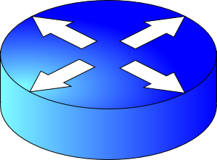
How do apps get perf guarantees?
The network core provides no guarantees on packet delivery
Transport software on the endpoint oversees implementing guarantees on top of a best-effort network
Three important kinds of guarantees
Reliability
Ordered delivery
Resource sharing in the network core
Transmission Control Protocol (TCP)

Slide 4
Review: Congestion control so far
Algorithm by which multiple endpoints efficiently and fairly share bottleneck link
So far, we’ve looked at just efficiency.
Steady state: ACK clocking (keep the pipe full, but don’t congest it)
Getting to steady state:
Slow start: exponential increase
TCP New Reno: Additive increase
TCP BBR: gain cycling & filters
TCP congestion control algorithm
Signals:
ACKs
Loss (RTOs), etc.
Knobs:
Sending rate
Congestion window
Bottleneck link

Slide 5
Goal of steady state operation
(2) Keep transmissions over the bottleneck link back to back
Send packet burst (as allowed by window)
Receive data packet
(1) Keep transmissions ACK-clocked: Send new data on ACK
Data
Sender
Receiver
Receive ACK
Send ACK
ACKs

Slide 6
Steady state cwnd for a single flow
Suppose the bottleneck link has rate C
Suppose the propagation round-trip delay (propRTT) between sender and receiver is T
Ignore transmission delays for this example;
Assume steady state: highest sending rate with no bottleneck congestion
Q: how much data is in flight over a single RTT?
C * T data i.e., amount of data unACKed at any point in time
ACKs take time T to arrive (without any queueing). In the meantime, sender is transmitting at rate C

Slide 7
The Bandwidth-Delay Product
C * T = bandwidth-delay product:
The amount of data in flight for a sender transmitting at the ideal rate during the ideal round-trip delay of a packet
Note: this is just the amount of data “on the pipe”
Data
C * T

Slide 8
The Bandwidth-Delay Product
Q: What happens if cwnd > C * T?
i.e., where are the rest of the in-flight packets?
A: Waiting at the bottleneck router queues
Data
C * T

Slide 9
Router buffers and the max cwnd
Router buffer memory is finite: queues can only be so long
If the router buffer size is B, there is at most B data waiting in the queue
If cwnd increases beyond C * T + B, data is dropped!
B
Data
C * T

Slide 10
Summary
Bandwidth-Delay Product (BDP) governs the window size of a single flow at steady state
The bottleneck router buffer size governs how much the cwnd can exceed the BDP before packet drops occur

Slide 12
CS 352 Detecting & Reacting to Losses
CS 352, Lecture 13.2
http://www.cs.rutgers.edu/~sn624/352
Srinivas Narayana

Slide 13
Detecting packet loss
So far, all the algorithms we’ve studied have a coarse loss detection mechanism: RTO timer expiration
Let the RTO expire, drop cwnd all the way to 1 MSS
Analogy: you’re driving a car
You’re waiting until the next car in front is super close to you (RTO) and then hitting the brakes really hard (set cwnd := 1)
Q: Can you see obstacles from afar and slow down proportionately?
That is, can the sender see packet loss coming in advance?
And reduce cwnd more gently?

Slide 14
Can we detect loss earlier than RTO?
Key idea: use the information in the ACKs. How?
Suppose successive (cumulative) ACKs contain the same ACK#
Also called duplicate ACKs
Occur when network is reordering packets, or one (but not most) packets in the window were lost
Reduce cwnd when you see many duplicate ACKs
Consider many dup ACKs a strong indication that packet was lost
Default threshold: 3 dup ACKs, i.e., triple duplicate ACK
Make cwnd reduction gentler than setting cwnd = 1; recover faster

Slide 15
Fast Retransmit & Fast Recovery

Slide 16
Distinction: In-flight versus window
So far, window and in-flight referred to the same data
Fast retransmit & fast recovery differentiate the two notions
cwnd = 6
inflight = 3
Sender’s view:
0
1
2
3
4
5
6
7
0
1
0
1
2
3
4
5
6
7
0
1
Triple duplicate ACKs
(assume subsequent 3 pieces of data were successfully received)
Last cumulative
ACK’ed seq #
Last transmitted
seq #
cwnd is the interval between the last cumulatively ACK’ed seq# and the last transmitted seq#
inflight is the data currently believed to be in flight.

Slide 17
TCP fast retransmit (RFC 2581)
The fact that ACKs are coming means that data is getting delivered to the receiver, albeit with some loss.
Note: Before the dup ACKs arrive, we assume inflight = cwnd
TCP sender does two actions with fast retransmit

Slide 18
TCP fast retransmit (RFC 2581)
(1) Reduce the cwnd and in-flight gently
Don’t drop cwnd all the way down to 1 MSS
Reduce the amount of in-flight data multiplicatively
Set inflight → inflight / 2
That is, set cwnd = (inflight / 2) + 3MSS
This step is called multiplicative decrease
Algorithm also sets ssthresh to inflight / 2

Slide 19
TCP fast retransmit (RFC 2581)
Example: Suppose cwnd and inflight (before triple dup ACK) were both 8 MSS.
After triple dup ACK, reduce inflight to 4 MSS
Assume 3 of those 8 MSS no longer in flight; set cwnd = 7 MSS
inflight = 4
cwnd = 7
cwnd = inflight = 8
0
1
2
3
4
5
6
7
0
1
2
3
4
5
6
7
0
1
5
Last cumulative
ACK’ed seq #
Assumed not in flight (dup ACK)

Slide 20
TCP fast retransmit (RFC 2581)
(2) The seq# from dup ACKs is immediately retransmitted
That is, don’t wait for an RTO if there is sufficiently strong evidence that a packet was lost

Slide 21
TCP fast recovery (RFC 2581)
Sender keeps the reduced inflight until a new ACK arrives
New ACK: an ACK for the seq# that was just retransmitted
May also include the (three or more) pieces of data that were subsequently delivered to generate the duplicate ACKs
Conserve packets in flight: transmit some data over lossy periods (rather than no data, which would happen if cwnd := 1)

Slide 22
TCP fast recovery (RFC 2581)
Keep incrementing cwnd by 1 MSS for each dup ACK
cwnd = 6
inflight = 3
0
1
2
3
4
5
6
7
0
1
2
3
4
5
6
7
0
1
5
Last cumulative
ACK’ed seq #
Assumed not in flight (dup ACK)

Slide 23
TCP fast recovery (RFC 2581)
Keep incrementing cwnd by 1 MSS for each dup ACK
cwnd = 7
inflight = 3
0
1
2
3
4
5
6
7
0
1
2
3
4
5
6
7
0
1
Last cumulative
ACK’ed seq #
Assumed not in flight (dup ACK)

Slide 24
TCP fast recovery (RFC 2581)
Keep incrementing cwnd by 1 MSS for each dup ACK
cwnd = 8
inflight = 3
0
1
2
3
4
5
6
7
0
1
2
3
4
5
6
7
0
1
Last cumulative
ACK’ed seq #
Assumed not in flight (dup ACK)

Slide 25
TCP fast recovery (RFC 2581)
Eventually a new ACK arrives, acknowledging the retransmitted data and all data in between
Deflate cwnd to half of cwnd before fast retransmit.
cwnd and inflight are aligned and equal once again
Perform additive increase from this point!
cwnd = 3
inflight = 3
0
1
2
3
4
5
6
7
0
1
2
3
4
5
6
7
0
1
Last cumulative
ACK’ed seq #
New ACK acknowledged this data

Slide 26
Additive Increase/Multiplicative Decrease
Say MSS = 1 KByte
Default ssthresh = 64KB = 64 MSS
Triple duplicate ACK
Perceived loss occurs at cwnd = 80K
Switch to additive increase at cwnd = ssthresh = 64K
New ACK
RTO
Multiplicative decrease
In-flight data
Additive increase
Additive increase
RTO: window drops all the way to 1 MSS
Slow start
(2) Set inflight = ssthresh = 40K
Fast retransmit: (1) retransmit dup-ACKed segment
Fast recovery keeps inflight stable until new ACK
1K
Time

Slide 27
TCP New Reno performs additive increase and multiplicative decrease of its congestion window.
In short, we often refer to this as AIMD.
Multiplicative decrease is a part of all TCP algorithms, including BBR.
[It is necessary for fairness across TCP flows.]

Slide 28
Summary of TCP loss detection
Don’t wait for an RTO and then set the cwnd to 1 MSS
Tantamount to waiting to get super close to the car in front and then jamming the brakes really hard
Instead, react proportionately by sensing pkt loss in advance
Fast Retransmit
Triple dup ACK: sufficiently strong signal that network has dropped data, before RTO
Immediately retransmit data
Multiplicatively decrease in-flight data to half of its value
Fast Recovery
Maintain this reduced amount of in-flight data as long as dup ACKs arrive
Data is successfully getting delivered
When new ACK arrives, do additive increase from there on

Slide 30
CS 352 Computing the Retransmit Timeout
CS 352, Lecture 13.3
http://www.cs.rutgers.edu/~sn624/352
Srinivas Narayana

Slide 31
TCP timeout (RTO)
Useful for reliable delivery and congestion control
How to pick the RTO value?
Too long: slow reaction to loss
Too short: premature retransmissions which are wasteful
Want: RTO must predict the upper bound of RTTs resulting from a successful packet + ACK
Intuition: somehow use the observed RTT (sampleRTT)
Can we just directly set the latest RTT as the RTO?
No. RTT can vary significantly!
Intermittent congestion, path changes, signal quality changes on wireless channel, etc.

Slide 32
Estimate an “average” RTT
Exponential weighted moving average (typical alpha = 1/8)
EstimatedRTT = (1 - α)*EstimatedRTT + α*SampleRTT
RTT: gaia.cs.umass.edu to fantasia.eurecom.fr
RTT (milliseconds)
sampleRTT
EstimatedRTT

Slide 33
Accounting for RTT variance
RTT samples can have a large variance
Use a safety margin in the RTO estimate to account for variance

Slide 34

TCP timeout computation
DevRTT = (1-β)*DevRTT +
β*|SampleRTT-EstimatedRTT|
(typically, β = 0.25)
RTO = EstimatedRTT + 4*DevRTT
average RTT
safety margin
Conceptually, there is an RTO timer for each seq #.

Slide 35
Too many timers?
Timers are expensive – we don’t want one per sequence #
Interrupts, OS data structures, and book-keeping
The TCP stack maintains just one “real” timer per connection
When a packet is transmitted, its transmission time is recorded
The only real timer in the system is the RTO for the first unACK’ed segment
Expiration interval: RTO
If ACK before RTO fires: set timer for next unACK’ed segment, based on recorded transmission time of that segment
If RTO fires: retransmit the segment, restart RTO timer

Slide 36
Retransmission ambiguity

Slide 37

Real RTT of a retransmitted segment?
Sender
Receiver
RTO
Retransmission ambiguity
RTT?
RTT?
Aside: problem would go away if packets had a flag to indicate retransmission, or a field to uniquely identify each transmission and its ACK
(TCP has neither)
ACK arrives

Slide 38
How to estimate RTT/RTO despite retxmit?
One solution: Never update RTT measurements based on ACKs from retransmitted packets
Problem: Sudden change in RTT, coupled with many retransmissions, can cause system to update RTT very late
Ex: Primary path failure leads to a high-RTT secondary path
If RTT estimates are not updated, the RTO estimate isn’t, and that leads to a host of other problems.
Ex: Unnecessary retransmissions since RTOs needlessly expire

Slide 39
Karn’s algorithm
Use back-off as part of the sampleRTT computation
Whenever packet loss (RTO), RTO is increased by a factor
Conservatively assume that RTT may have increased since the last unambiguous RTTsamples were obtained
Use this increased RTO as RTO estimate for the next segment
Don’t use the estimatedRTT from stale sampleRTT
Only after an ACK is received for a successful transmission is the RTO timer set to a value obtained from EstimatedRTT

Slide 40
Summary
RTO computation is an important part of TCP’s behavior under loss
TCP uses both an average RTT as well as the variance to obtain a safe prediction of an upper bound of a successful RTT
Resolve retransmission ambiguity under path changes by avoiding sampleRTT measurements and multiplicatively increasing the RTO each time

Slide 42
CS 352 TCP Connection Management
CS 352, Lecture 13.4
http://www.cs.rutgers.edu/~sn624/352
Srinivas Narayana

Slide 43
TCP connections need lots of bookkeeping
Socket buffer memory
Entries in connection lookup tables
Data structures and parameters (e.g., sequence numbers) in the operating system kernel
These resources can get expensive on machines running many connections, e.g., web servers

Slide 44
Handshake
Client app
Server app
Before starting data transmission, TCP client and server perform a handshake and agree on parameters
TCP is bidirectional: independent set of sequence numbers for each direction
Sequence numbers start from a random initial value
Specific TCP flags indicate connection initiation and acceptance
accept()
connect()
Client
Server
SYN
Client → server seq #
SYN / ACK
Server → client seq #

Slide 45
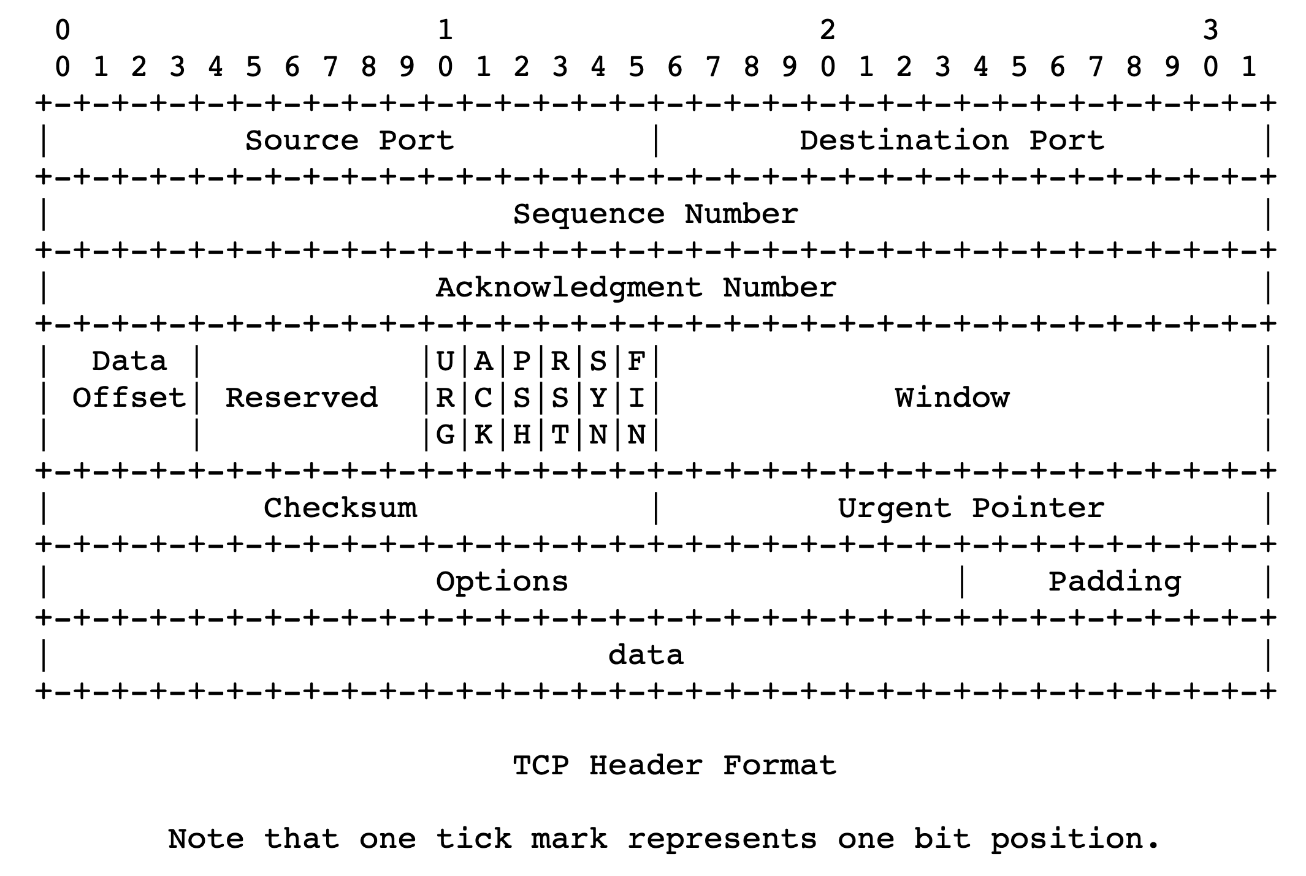
TCP flags in the header

Slide 46

2-way handshake not enough
Client app
Server app
Suppose the server receives the first SYN packet and decides to allocate all the resources needed for the connection.
What happens if a malicious client sends a ton of SYN packets?
Asymmetric work: client doesn’t need to allocate any resources of its own
Just have to send a well-crafted packet
However, server’s resources exhausted!
SYN flood attack: a form of denial of service
accept()
connect()
Client
Server
SYN
SYN
SYN
SYN
SYN

Slide 47
Consequences
Client app
Server app
The server should not allocate resources upon receiving the first client message (SYN)
The server cannot carry any application data in SYN/ACK
Server hasn’t yet allocated all necessary resources
Client cannot send any data in the SYN packet
Recall: HTTP requires an RTT for the handshake before sending HTTP request
accept()
connect()
Client
Server
SYN
SYN
SYN
SYN
SYN

Slide 48
Mitigating the denial of service problem
Key idea: Make the client do more work before allocating server resources
The client should send at least one more packet, responding to the data in the server’s SYN/ACK, before the server decides to call the connection established
That is, before all required server resources like buffers are allocated
Result: 3-way handshake
Per-connection finite state machine tracks this process

Slide 49
TCP 3-way handshake
Client
Server
connect()
bind()
listen()
CLOSED
CLOSED
accept()
SYN
Send SYN
SYN-SENT
LISTEN
Upon receiving SYN
Send SYN/ACK
SYN/ACK
ESTAB
Upon receiving SYN/ACK
SYN-RCVD
Send ACK
Return from
connect()
ACK
ESTAB
Upon receiving ACK
This packet can contain application data!
Server
resources
only allocated
at this point
Return from
accept()

Slide 50
TCP: Closing a connection
Client, server each close their side of connection
send TCP segment with FIN bit = 1
In general, TCP is full-duplex: both sides can send
However, FIN is unidirectional: stop one side of the communication
Respond to received FIN with ACK
On receiving FIN, ACK can be combined with own FIN
Simultaneous FIN exchanges can be handled

Slide 51
Summary of TCP connection management
TCP connections have associated resources: managing them requires book-keeping the establishment of a connection carefully
Simple 2-way handshakes suffer from denial of service vulnerability
Moral: don’t allocate resources on the first client message
3-way handshake mitigates this issue by making client work harder
Client must send ACK to server’s SYN/ACK before server can handle data
The cost: increased time before sending application data from client

