Slide 1

The Link Layer: Wireless LANs
CS 352, Lecture 21, Spring 2020
http://www.cs.rutgers.edu/~sn624/352
Srinivas Narayana

Slide 2
Course announcements
Quiz grades:
Drop 2 lowest scores
Final exam
All multiple choice
One or more correct: scored as #right - #wrong options

Slide 3


Review of concepts
Link layer
Application
HTTPS
FTP
HTTP
SMTP
DNS
Transport
TCP
UDP
Network
IP
Link layer
802.3
…
802.11
ATM
Ethernet

Slide 4
Review of concepts
Link layer: medium access control
Want: efficiency, fairness, simplicity, distribution
Channel partitioning: TDMA, FDMA
Random access
Slotted ALOHA
Pure ALOHA
Carrier sensing
Collision Detection
Ethernet CSMA/CD: Exponential back-off
Turn-taking
Randomly contending is too inefficient (pure ALOHA is 18% asymptotically efficient)
Listen before speaking, and as you speak
One of the most fundamental and reused ideas in all of computer systems

Slide 5
Wireless and Mobile Networks
Background:
# wireless (mobile) phone subscribers now far exceeds # wired phone subscribers
# wireless Internet-connected devices far exceeds # wireline Internet-connected devices
laptops, Internet-enabled phones promise anytime untethered Internet access
Your refrigerator, microwave, and car are connected
two important (but different) challenges
wireless: communication over wireless link
mobility: handling the mobile user who changes point of attachment to network

Slide 6



















Elements of a wireless network
network
infrastructure

Slide 7
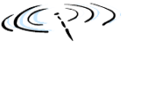


Elements of a wireless network
wireless hosts
laptop, smartphone
run applications
may be stationary (non-mobile) or mobile
wireless does not always mean mobility
network
infrastructure

Slide 8

Elements of a wireless network
base station
typically connected to wired network
relay - responsible for sending packets between wired network and wireless host(s) in its “area”
e.g., cell towers, 802.11 access points
network
infrastructure

Slide 9
Elements of a wireless network
wireless link
typically used to connect mobile(s) to base station
also used as backbone link
multiple access protocol coordinates link access
various data rates, transmission distance
network
infrastructure

Slide 10
Wireless network taxonomy
single hop
multiple hops
host connects to
base station (WiFi,
WiMAX, cellular)
which connects to
larger Internet
host may have to
relay through several
wireless nodes to
connect to larger
Internet: mesh net
infrastructure
(e.g., APs)
no base station, no
connection to larger
Internet. May have to
relay to reach
a given wireless node
MANET, VANET
no
infrastructure
no base station, no
connection to larger
Internet (Bluetooth,
ad hoc nets)

Slide 11
Wireless network characteristics

Slide 12
Wireless Link Characteristics (1)
important differences from wired link ….
decreased signal strength: radio signal attenuates as it propagates through matter (path loss)
interference from other sources: standardized wireless network frequencies (e.g., 2.4 GHz) shared by other devices (e.g., phone); devices interfere
multipath propagation: radio signal reflects off objects ground, arriving at destination at slightly different times
…. make communication across (even a point to point) wireless link much more challenging

Slide 13
Wireless Link Characteristics (2)
SNR: signal-to-noise ratio
larger SNR – easier to extract signal from noise (a “good thing”)
SNR versus BER tradeoffs
given physical layer: increase power -> increase SNR->decrease BER
given SNR: choose physical layer that meets BER requirement, giving highest thruput
SNR may change with mobility: dynamically adapt physical layer (modulation technique, rate)
10⁻¹
10⁻²
10⁻³
BER
10⁻⁴
10⁻⁵
10⁻⁶
10⁻⁷
10
20
30
40
SNR(dB)
QAM256 (8 Mbps)
QAM16 (4 Mbps)
BPSK (1 Mbps)

Slide 14

Wireless network characteristics
Multiple wireless senders and receivers create additional problems (beyond multiple access):
A
B
C
C
A’s signal
strength
C’s signal
strength
B
A
Hidden terminal problem
B, A hear each other
B, C hear each other
A, C can not hear each other means A, C unaware of their interference at B
space
Signal attenuation:
B, A hear each other
B, C hear each other
A, C can not hear each other interfering at B

Slide 15
IEEE 802.11 Wireless LAN
802.11b
2.4-5 GHz unlicensed spectrum
up to 11 Mbps
802.11a
5-6 GHz range
up to 54 Mbps
802.11g
2.4-5 GHz range
up to 54 Mbps
802.11n: multiple antennae
2.4-5 GHz range
up to 200 Mbps
all use CSMA/CA for multiple access
all have base-station and ad-hoc network versions

Slide 16
802.11: Channels, association
802.11b: 2.4GHz-2.485GHz spectrum divided into 11 channels at different frequencies
AP admin chooses frequency for AP
interference possible: channel can be same as that chosen by neighboring AP!
host: must associate with an AP
scans channels, listening for beacon frames containing AP’s name (SSID) and MAC address
selects AP to associate with
may perform authentication
will typically run DHCP to get IP address in AP’s subnet

Slide 17
WiFi (802.11) multiple access
CSMA/CA

Slide 18
Review: MAC protocols: Taxonomy
three broad classes:
channel partitioning
divide channel into smaller “pieces” (time slots, frequency, code)
allocate piece to node for exclusive use
random access
channel not divided, allow collisions
“recover” from collisions
“taking turns”
nodes take turns, but nodes with more to send can take more or longer turns

Slide 19
Review: Ethernet CSMA/CD algorithm
1. NIC receives datagram from network layer, creates frame
2. If NIC senses channel idle, starts frame transmission. If NIC senses channel busy, waits until channel idle, then transmits.
3. If NIC transmits entire frame without detecting another transmission, NIC is done with frame !
4. If NIC detects another transmission while transmitting, aborts and sends jam signal
5. After aborting, NIC enters binary (exponential) backoff:
after mth collision, NIC chooses K at random from {0,1,2, …, 2^{m}-1}. NIC waits K·512 bit times, returns to Step 2
longer backoff interval with more collisions

Slide 20




IEEE 802.11: multiple access
avoid collisions: 2⁺ nodes transmitting at same time
802.11: CSMA - sense before transmitting
don’t collide with ongoing transmission by other node
802.11: no collision detection!
difficult to receive (sense collisions) when transmitting due to weak received signals (fading)
can’t sense all collisions in any case: hidden terminal, fading
goal: avoid collisions: CSMA/C(ollision)A(voidance)
A
B
C
C
B
A’s signal
strength
C’s signal
strength
A
space

Slide 21
IEEE 802.11 MAC Protocol: CSMA/CA
802.11 sender
1 if sense channel idle for DIFS then
transmit entire frame (no CD)
2 if sense channel busy then
start random backoff time
timer counts down while channel idle
transmit when timer expires
if no ACK, increase random backoff interval, repeat 2
802.11 receiver
- if frame received OK
return ACK after SIFS (ACK needed due to hidden terminal problem)
sender
receiver
DIFS
data
SIFS
ACK
SIFS < DIFS

Slide 22
Avoiding collisions (more)
idea: allow sender to “reserve” channel rather than random access of data frames: avoid collisions of long data frames
sender first transmits small request-to-send (RTS) packets to BS using CSMA
RTSs may still collide with each other (but they’re short)
BS broadcasts clear-to-send CTS in response to RTS
CTS heard by all nodes
sender transmits data frame
other stations defer transmissions
avoid data frame collisions completely
using small reservation packets!

Slide 23

Collision Avoidance: RTS-CTS exchange
A
B
AP
RTS(B)
RTS(A)
reservation collision
RTS(A)
CTS(A)
CTS(A)
DATA (A)
defer
time
ACK(A)
ACK(A)

Slide 24
Wireless multiple access
Code Division Multiple Access (CDMA)

Slide 25
Code Division Multiple Access (CDMA)
unique “code” assigned to each user; i.e., code set partitioning
all users share same frequency, but each user has own “chipping” sequence (i.e., code) to encode data
allows multiple users to “coexist” and transmit simultaneously with minimal interference (if codes are “orthogonal”)
encoded signal = (original data) X (chipping sequence)
decoding: inner-product of encoded signal and chipping sequence

Slide 26
CDMA encode/decode
channel output Z_{i,m}
Z_{i,m}= d_{i}.c_{m}
data
bits
d₀ = 1
1
1
1
1
1
d₁ = -1
1
1
1
-
-
-
-
1
-
-
-
1
-
1
1
1
1
1
sender
1
1
slot 1
channel
output
slot 0
channel
output
1
1
1
1
1
code
1
1
-
-
-
1
-
1
1
1
-
-
-
1
-
1
1
1
slot 1
slot 0
M
D_{i} = S Z_{i,m}.c_{m}
m=1
M
received
input
1
1
1
1
1
1
1
1
d₀ = 1
-
-
-
-
1
-
-
-
1
-
1
1
1
1
1
1
d₁ = -1
1
slot 1
channel
output
slot 0
channel
output
1
1
1
1
1
code
1
1
-
-
-
1
-
1
1
1
-
-
-
1
-
1
1
1
receiver
slot 1
slot 0

Slide 27
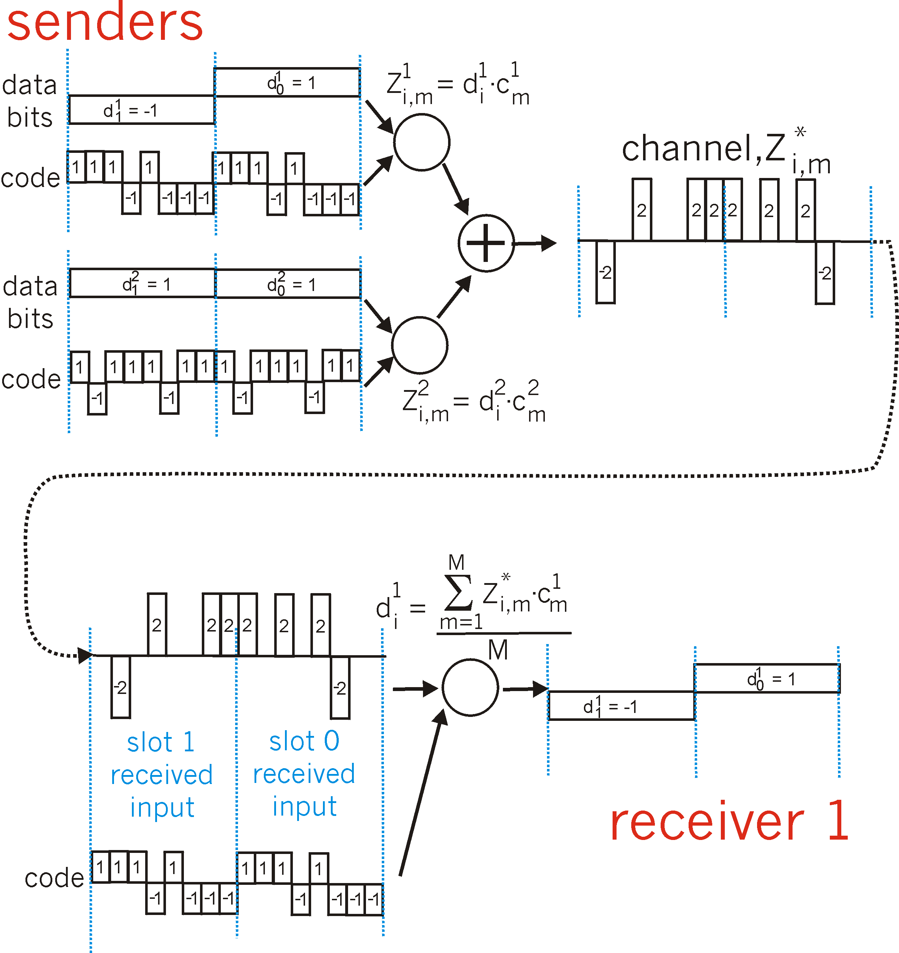
CDMA: two-sender interference
channel sums together transmissions by sender 1 and 2
Sender 1
Sender 2
using same code as sender 1, receiver recovers sender 1’s original data from summed channel data!

Slide 28
Summary of the wireless link layer
Wireless medium is very different from wired
Signal attenuation (“fading”) much more important to handle
Hidden terminal problem
Consequences of differences:
Link-layer ACKs
Transmission delays to control contention: SIFS, DIFS
Link reservation (RTS/CTS)
Conservative backoff timer (count down only when idle)
Medium access control
Frequency division multiple access (AP channels in WiFi)
Random access (CSMA/CA for transmitting to/from WiFi AP)
Code division multiple access (simultaneous transmission in cellular networks)

