Slide 1

The Network Layer: Quality of Service
CS 352, Lecture 18, Spring 2020
http://www.cs.rutgers.edu/~sn624/352
Srinivas Narayana

Slide 2
Course announcements
Quiz 6 due on Tuesday at 10 PM
Covers lectures 17 and 18
Project 2 due later today
Project 3 will go out this weekend
Start early

Slide 3
Review of concepts
Border Gateway Protocol: a path-vector protocol
Announce paths to specific destinations through prefix + attributes
AS Path, next hop
Business relationships influence route export and selection
BGP paths get propagated inside ASes using iBGP
Used together with intra-domain routing to compute forwarding table
Two tables used together (BGP next hop, intra-domain lookup)
Intra- and inter-AS routing protocols address different concerns
Policy vs. performance
Quality of service within the network
… when best-effort isn’t enough for apps (e.g., robotic surgery over the net)
Traffic identified using packet marking; now how to arbitrate traffic?

Slide 4
Quality of Service
How can the network make application performance better?

Slide 5

Multiple classes of service: scenario
H1
H3
R1
R2
H4
H2
R1 output
interface
queue
1.5 Mbps link
example: 1Mbps VoIP, HTTP share 1.5 Mbps link.
HTTP bursts can congest router, cause audio loss
want to give priority to audio over HTTP

Slide 6
Principles for QOS guarantees
what if applications misbehave (VoIP sends higher than declared rate)
policing: force source adherence to bandwidth allocations
marking, policing at network edge
1 Mbps
phone
R1
R2
1.5 Mbps link
packet marking and policing
Principle 1: Isolation
Provide protection for one class from others

Slide 7
Principles for QoS guarantees
allocating fixed (non-sharable) bandwidth to flow: inefficient use of bandwidth if flows doesn’t use its allocation
1 Mbps
phone
1 Mbps logical link
R1
R2
1.5 Mbps link
0.5 Mbps logical link
Principle 2: Work conservation
While providing isolation, use resources as efficiently as possible

Slide 8
Poll #1
Where does contention between different traffic classes (e.g., resulting in long queues) typically occur within routers?
(a) switch fabric
(b) input line termination
(c) output port buffers
(d) forwarding table

Slide 9
Poll #2
What router mechanisms might you use to implement quality of service mechanisms?
(a) forwarding
(b) scheduling
(c) buffer management
(d) switching

Slide 10
Packet scheduling for QoS
Shaping and policing

Slide 11
Why care about packet scheduling?
Significantly influences how packets are treated regardless of the endpoint transport
Implementations of Quality of Service (QoS) within large networks
Implications for net neutrality debates
Intellectually interesting, foundational problem that a network solves
Classic Demers et al paper on scheduling (WFQ) has ~ 1500 citations
Important connections to other literature (e.g., job scheduling)
Scheduling algorithms influence many daily life decisions ☺

Slide 12
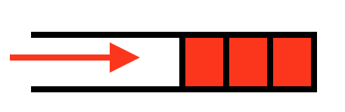
Scheduling vs. Buffer Management
How packets enter vs. how packets leave the switch buffer
Common architecture: shared-buffer switches, where buffer memory is shared between different output ports
Typical buffer management strategy: tail-drop
How should buffer memory be partitioned across ports?
Static partitioning?
Inefficient: even if port 1 has nothing to send, might drop port 2
Also want fair sharing of buffer
If output port 1 is congested, why should port 2 traffic suffer?
State of the art: demand-aware buffer sharing algos

Slide 13
Packet scheduling for QoS
Choose next queued packet to send on outgoing link
Common scheduling disciplines
first come first served (FIFO)
simple multi-class priority
round robin
weighted fair queueing (WFQ)
Rate limiting
All except rate-limiting are
work-conserving
packet
arrivals
packet
departures
queue
(waiting area)
link
(server)
Class 1
Class 2
link
(server)
Class 3

Slide 14
Poll #3
When cars from two lanes on a congested freeway take turns to merge into one lane, what scheduling discipline is being implemented?
(a) priority-queueing
(b) weighted fair queueing
(c) rate limiting
(d) none of the above

Slide 15
Isolation by Rate Limits

Slide 16
Providing Isolation through Rate Limiting
Three commonly used terms:
(long term) average rate: how many pkts can be sent per unit time (in the long run)
crucial question: what is the interval length? 100 packets per sec or 6000 packets per min have same average! Instantaneous behaviors of the two may look very different.
peak rate: e.g., 6000 pkts per min (ppm) avg.; 1500 ppm peak rate
(max.) burst size: max number of pkts sent consecutively (with no intervening idle)

Slide 17
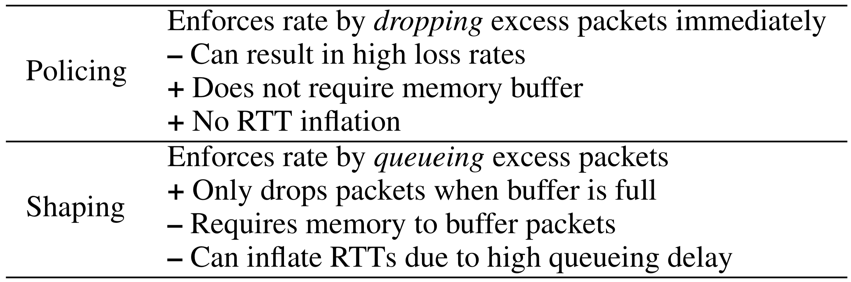
Shaping and Policing

Slide 18
Mechanism (1): Leaky Bucket Shaper
Packets from source
Leaky
Bucket
Leaky
Bucket
Packets leaving leaky bucket

Slide 19
Mechanism (1): Leaky Bucket Shaper
Packets may be generated in a bursty manner, but after they pass through the leaky bucket, they enter the network evenly spaced
The “bucket” buffers packets up to a certain point
If the bucket is full, packets are dropped.
May be used in conjunction with resource reservation to police the host’s resource use
E.g., at the host-network interface, allow packets into the network at a constant rate
May be used in the core of a network to limit bandwidth use

Slide 20
Shaping traffic with leaky buckets
The leaky bucket is a traffic shaper: It changes the downstream arrival times & characteristics of packets passing through it
Traffic shaping makes traffic more manageable and more predictable downstream (e.g., always under a certain rate)
Usually, a system/network administrator would set the rate at which packets may be sent through the leaky bucket
Administrator also sets up policies to map any connection that started up to a leaky bucket (and rate) of its own

Slide 21
Issues with a leaky bucket
Many short transfers just have a few packets
E.g., web requests and responses
Enforcing rate limit for those can significantly delay completion
For a leaky bucket shaper, average rate == peak rate
Sometimes, we wish to have peak rate higher than avg rate
For this purpose we use a token bucket, which is a burst-tolerant version of a leaky bucket

Slide 22
Token buckets

Slide 23
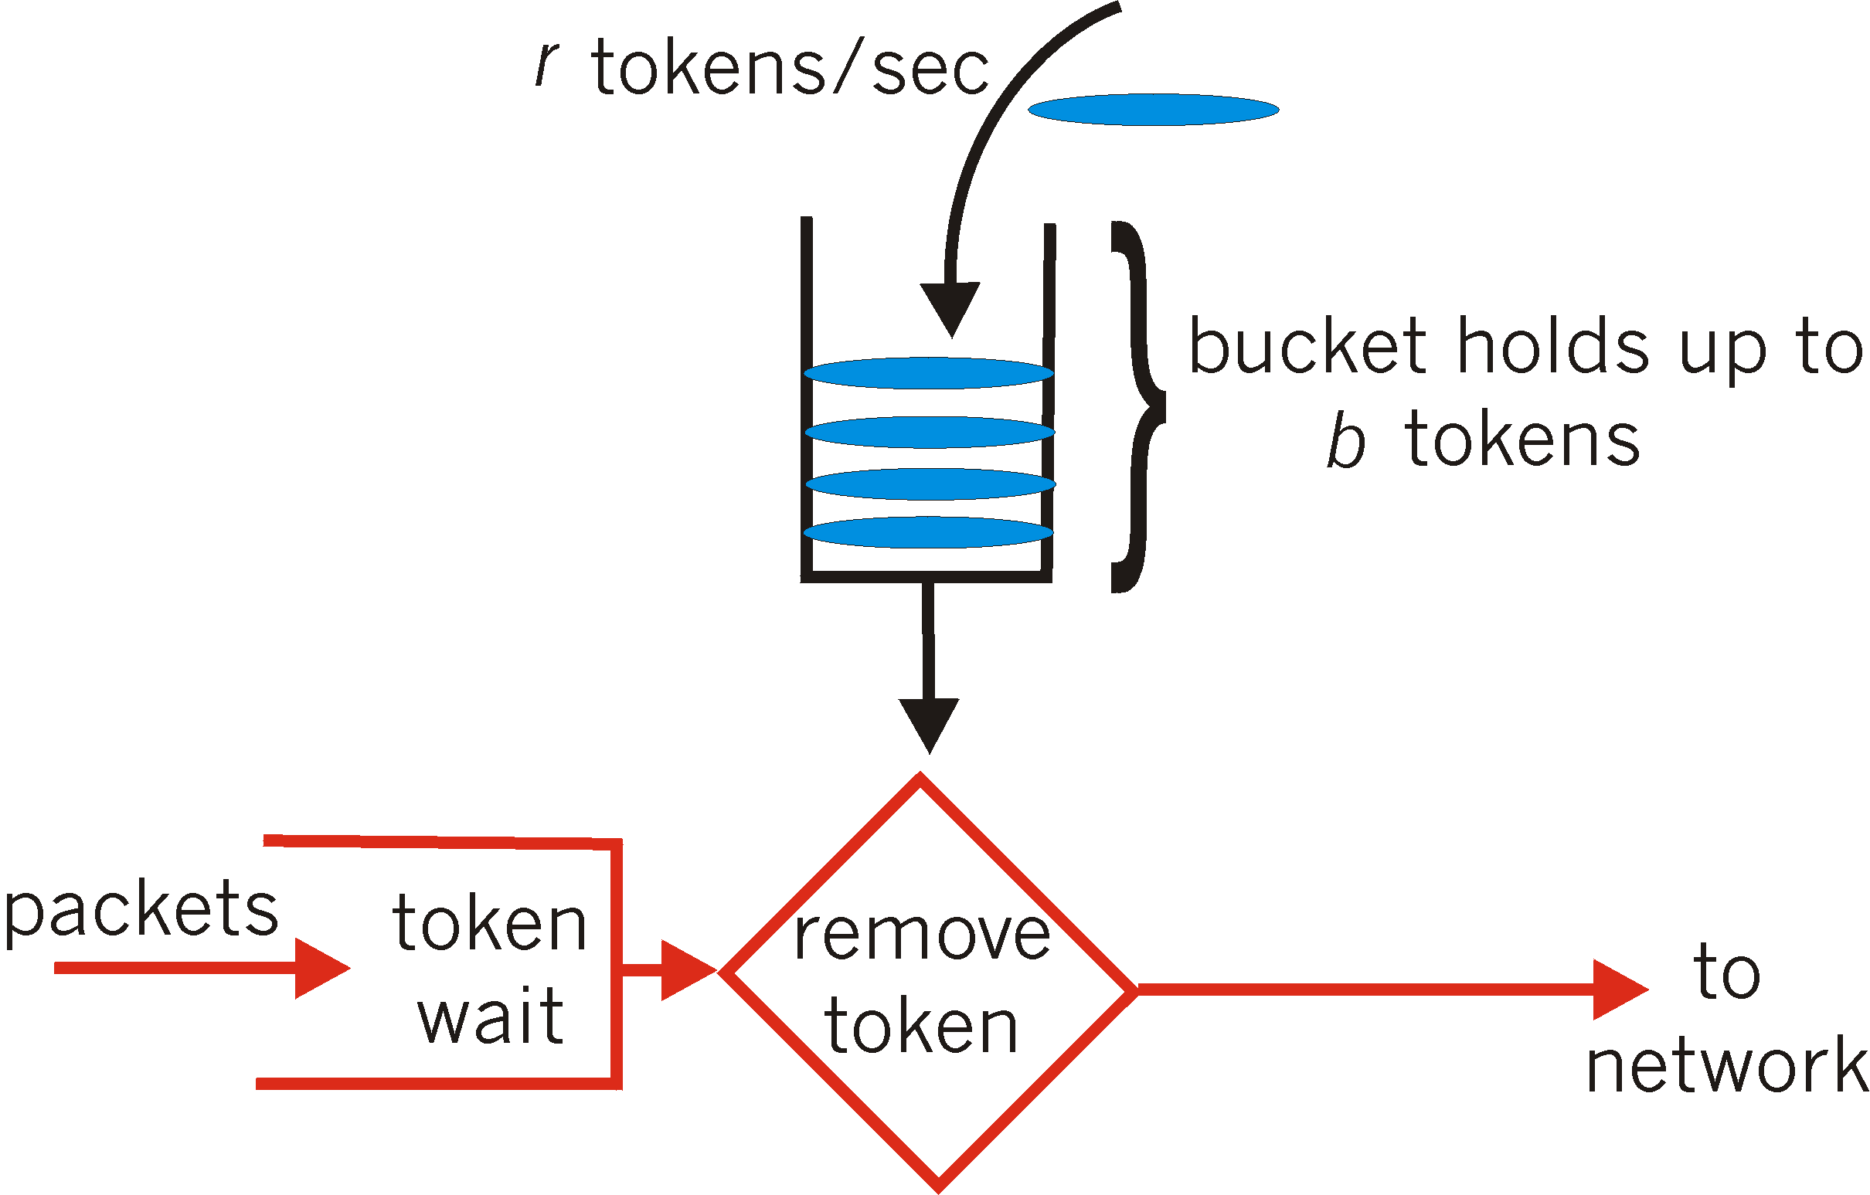
Mechanism (2): Token Bucket Shaper
token bucket: limit input to specified burst size and average rate
Tokens generated at rate r tokens/sec, put into bucket
Bucket can hold b tokens. Tokens are dropped if bucket is full
A packet can leave as long as a token is available
Over interval of time t: number of packets that leave the token bucket is less than or equal to (r * t + b)

Slide 24
Token Bucket Shaper
There is a bucket for tokens and a packet buffer for packets
Packets will be dropped if the associated packet buffer is full
A token bucket policer doesn’t contain a packet buffer: any packet arriving without a token is immediately dropped
Bucket of tokens enables small bursts to go through unscathed
Short flows can exceed rate limit r, since they use up the reserve in the bucket
Long flows will fit into the rate limit r over longer periods of time, since once they use up the reserve, they are limited by the token-fill rate r

Slide 25
Token Bucket vs. Leaky Bucket
Case 1: Small burst of packet arrivals
Arrival time at bucket
0
1
2
3
4
5
6
Departure time from a leaky bucket shaper
Leaky bucket rate = 1 packet in 2 time units
Assume packet buffer size is very large
0
1
2
3
4
5
6
Departure time from a token bucket
Token bucket fill rate = 1 tokens in 2 time units
Token bucket size = 2 tokens
Assume packet buffer size is very large
0
1
2
3
4
5
6

Slide 26
Token Bucket vs. Leaky Bucket
Case 2: Large burst of packet arrivals
Arrival time at bucket
0
1
2
3
4
5
6
Departure time from a leaky bucket shaper
Leaky bucket rate = 1 packet in 2 time units
Assume packet buffer size is very large
0
1
2
3
4
5
6
Departure time from a token bucket shaper
Token bucket fill rate = 1 token in 2 time units
Token bucket size = 2 tokens
Assume packet buffer size is very large
0
1
2
3
4
5
6
??
Departure time from a token bucket policer
Token bucket fill rate = 1 token in 2 time units
Token bucket size = 2 tokens

Slide 27
Poll #4
Suppose the packets above arrived at a token bucket policer with a fill rate of 1 token per 2 time units, and a token bucket size of 2 tokens. What happens to packet 3 above as it arrives?
(a) Buffered into the packet buffer
(b) Transmitted out of the token bucket
(c) Packet is dropped
(d) None of the above
Arrival time at bucket
0
1
2
3
4
5
6

Slide 28
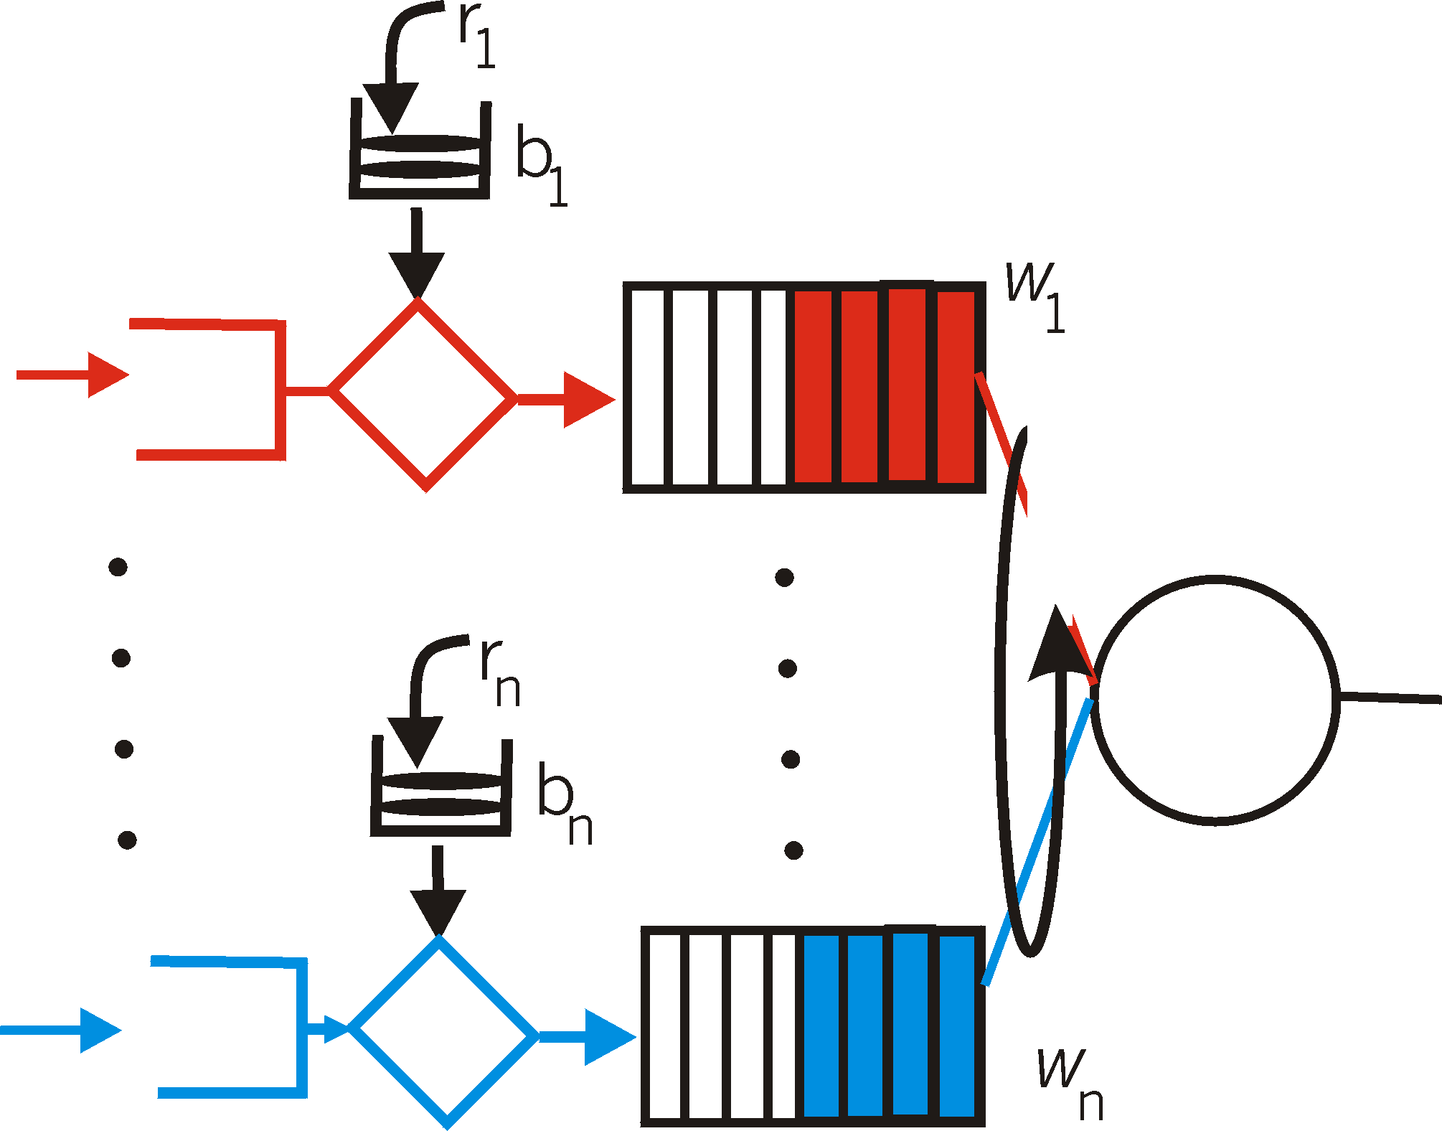
Token buckets can be used to provide delay QoS guarantees
token bucket + WFQ combine to provide a guaranteed upper bound on delay
arriving
traffic
token rate, r
bucket size, b
per-flow
rate, R
WFQ
D = b/R
arriving
traffic
max

Slide 29
Impact of Token Bucket Policers
The Internet has tons of them, and they affect application performance

Slide 30
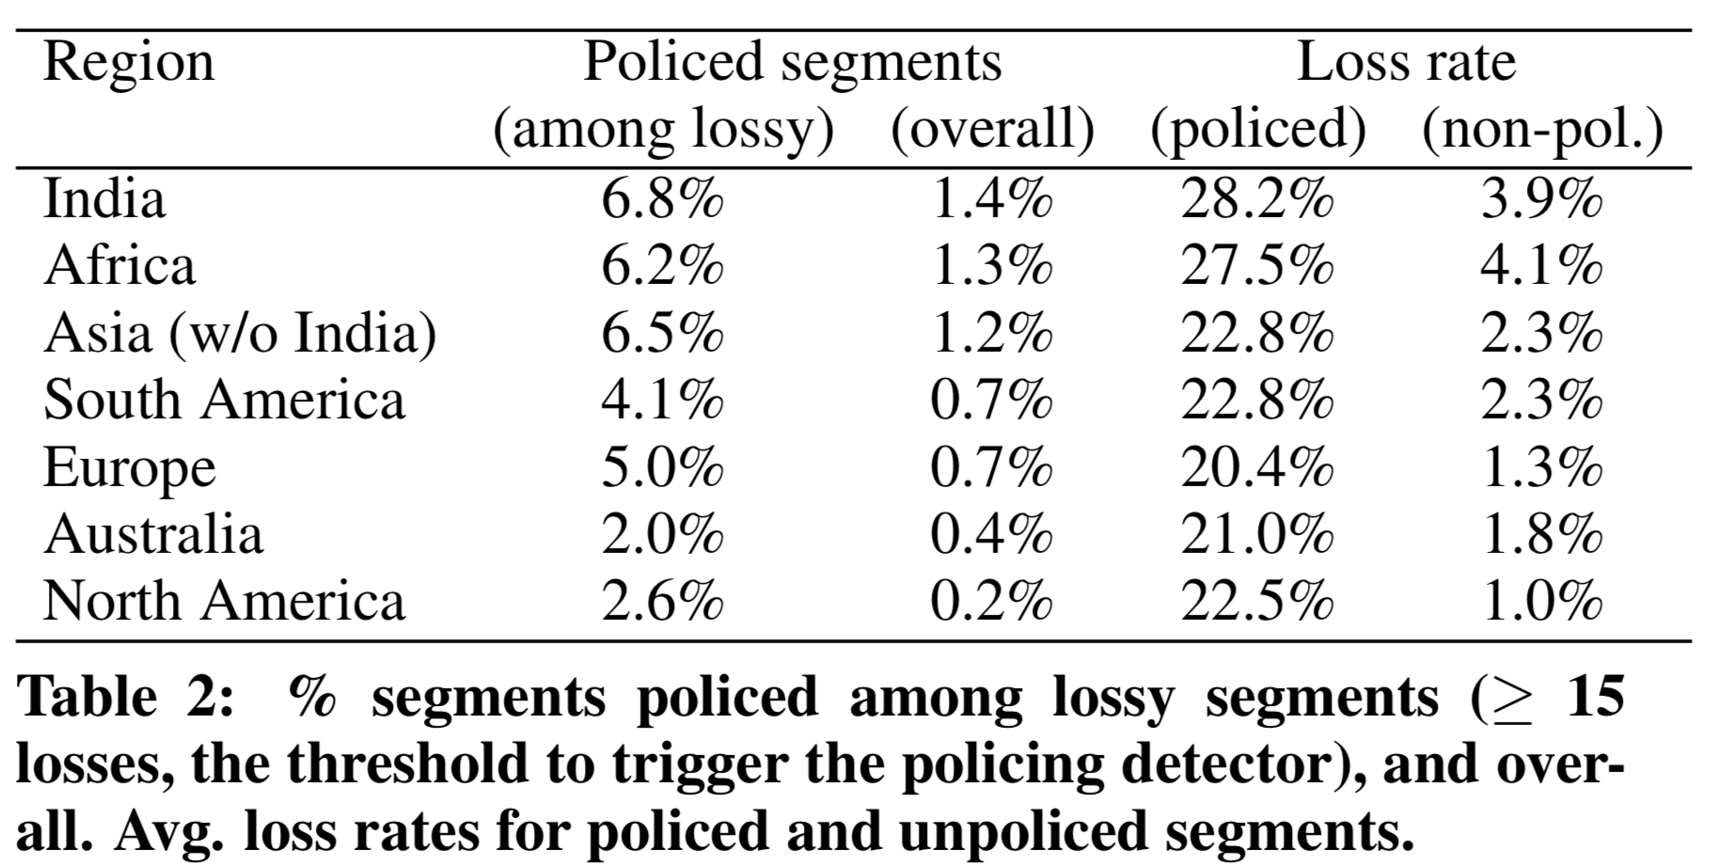
Google study from 2016
Flach et al., An Internet-Wide Analysis of Traffic Policing, SIGCOMM 2016

Slide 31
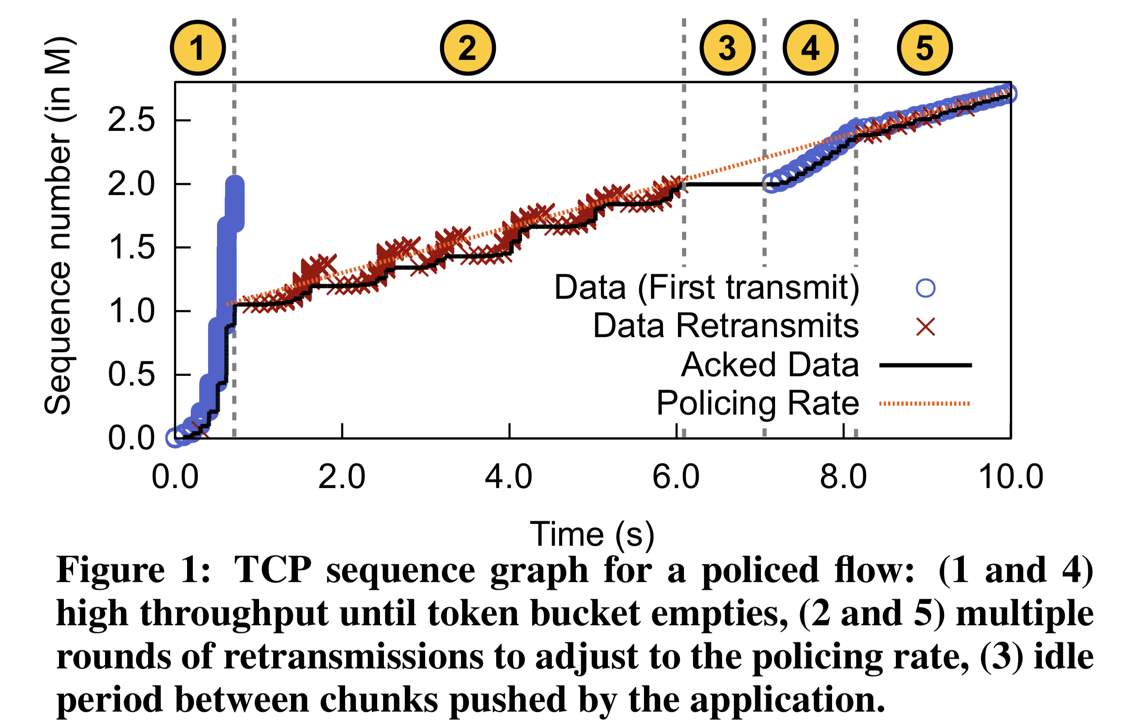
Impact on TCP

Slide 32
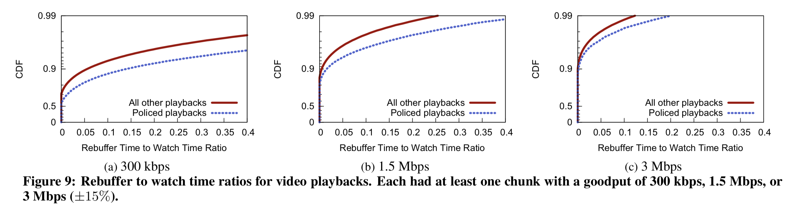
Policing losses impact applications
Video rebuffer rate: rebuffer time / overall watch time

