Slide 1

Virtual Memory

Slide 2
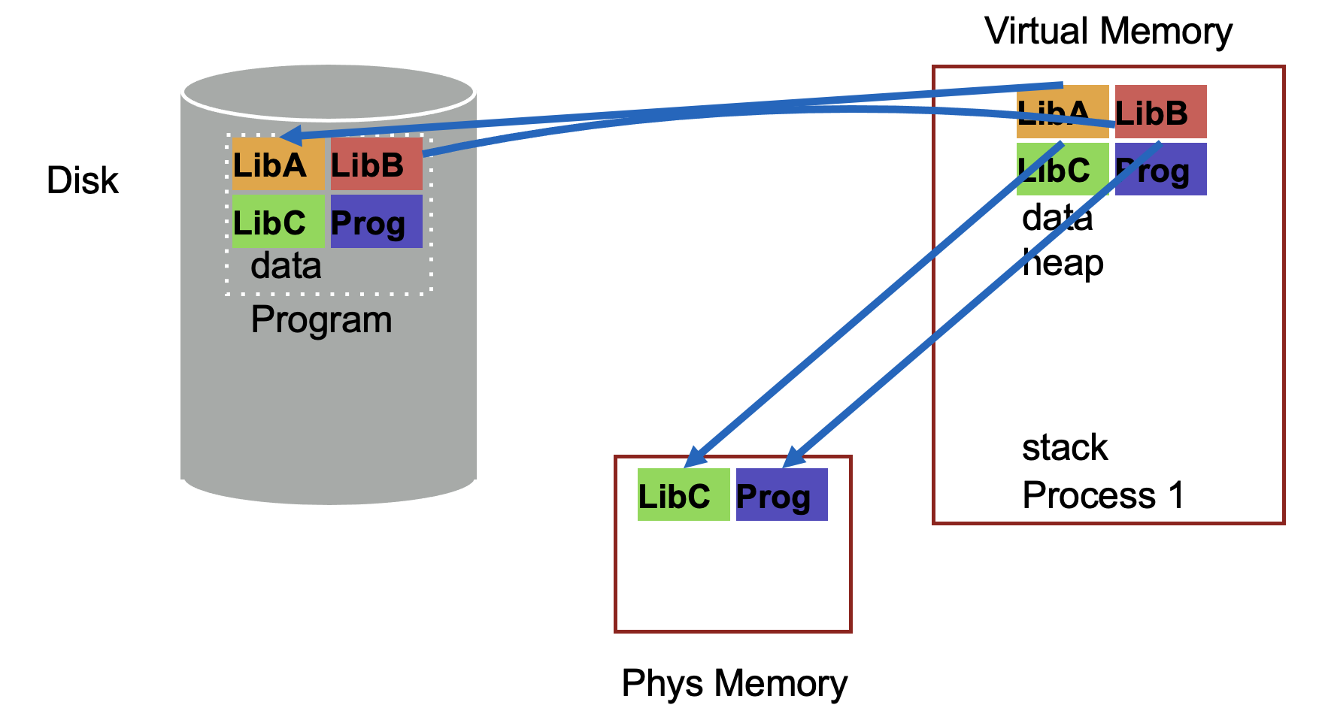
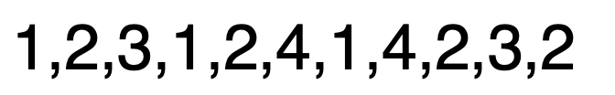
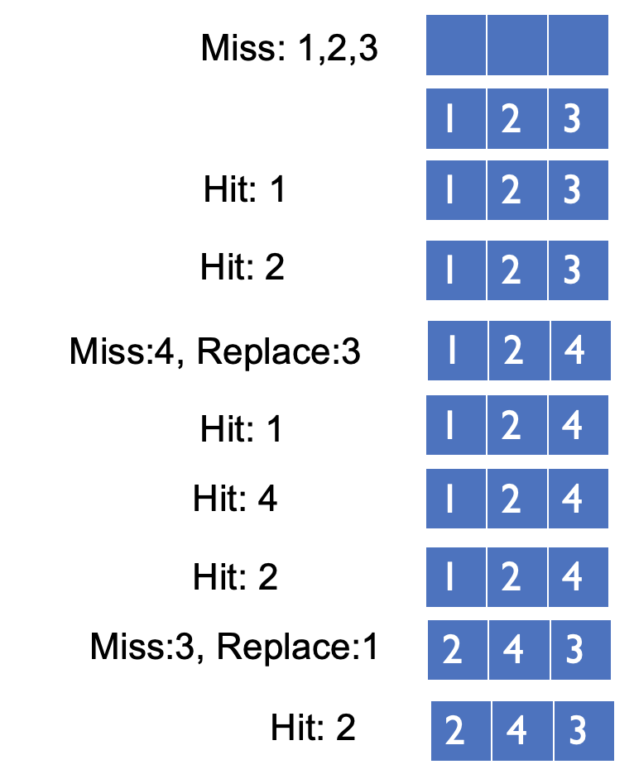
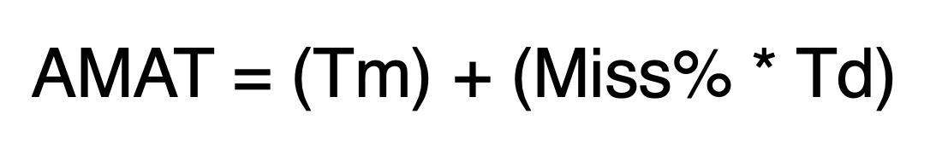
Page Selection
Page Replacement
OPT
FIFO
LRU

Slide 3
Page Replacement Comparison
Add more physical memory, what happens to performance?
LRU, OPT: Add more memory, guaranteed to have fewer (or same number of) page faults
Smaller memory sizes are guaranteed to contain a subset of larger memory sizes
Stack property: smaller cache a subset of bigger cache
FIFO: Add more memory, usually have fewer page faults
Belady’s anomaly: but there are cases where we have more page faults!

Slide 4
Fifo Performance may Decrease!
Consider access stream: 1, 2, 3, 4, 1, 2, 5, 1, 2, 3, 4, 5
Consider physical memory size: 3 pages vs. 4 pages
How many misses with FIFO?
3 pages: 9 misses
4 pages: 10 misses

Slide 5
Problems with LRU-based Replacement
LRU does not consider frequency of accesses
Is a page accessed once in the past equal to one accessed N times?
Common workload problem:
Scan (sequential read, never used again) one large data region flushes memory
Solution: Track frequency of accesses to page
Pure LFU (Least-frequently-used) replacement
Problem: LFU can never forget pages from the far past

Slide 6
Implementing LRU
Perfect LRU on Software
OS maintains ordered list of physical pages by reference time
When page is referenced: Move page to front of list
When need victim: Pick page at back of list
Trade-off: Slow on memory reference, fast on replacement
Perfect LRU on Hardware
Associate timestamp with each page (e.g., PTE)
When page is referenced: Associate current system timestamp with page
When need victim: Scan through PTEs to find oldest timestamp
Trade-off: Fast on memory reference, slow on replacement (especially as size of memory grows)
In practice, do not implement Perfect LRU
LRU is an approximation anyway, so approximate more
Goal: Find an old page, but not necessarily the oldest

Slide 7
Clock Algorithm
Hardware
Keep use (or reference) bit for each page frame
When page is referenced: set use bit
Operating System
Page replacement: Look for page with use bit cleared (has not been referenced for a while)
Implementation:
Keep pointer to last examined page frame (“clock hand”)
Traverse pages in circular fashion (like a clock)
Clear use bits as you search
Stop when find page with already cleared use bit, replace this page

Slide 8
Clock: Look For a Page
use=1
use=1
use=0
use=1
0
1
2
3
…
Physical Mem:
clock hand

Slide 9
Clock: Look For a Page
use=0
use=1
use=0
use=1
0
1
2
3
…
Physical Mem:
clock hand

Slide 10
Clock: Look For a Page
use=0
use=0
use=0
use=1
0
1
2
3
…
Physical Mem:
clock hand

Slide 11
Clock: Look For a Page
use=0
use=0
use=0
use=1
0
1
2
3
…
Physical Mem:
clock hand
evict page 2 because it has not been recently used

Slide 12
Clock: Look For a Page
use=0
use=0
use=0
use=1
0
1
2
3
…
Physical Mem:
clock hand
page 0 is accessed…

Slide 13
Clock: Look For a Page
use=1
use=0
use=0
use=1
0
1
2
3
…
Physical Mem:
clock hand

Slide 14
Clock: Look For a Page
use=1
use=0
use=0
use=1
0
1
2
3
…
Physical Mem:
clock hand

Slide 15
Clock: Look For a Page
use=1
use=0
use=0
use=1
0
1
2
3
…
Physical Mem:
clock hand

Slide 16
Clock: Look For a Page
use=1
use=0
use=0
use=0
0
1
2
3
…
Physical Mem:
clock hand

Slide 17
Clock: Look For a Page
use=0
use=0
use=0
use=0
0
1
2
3
…
Physical Mem:
clock hand

Slide 18
Clock: Look For a Page
use=0
use=0
use=0
use=0
0
1
2
3
…
Physical Mem:
clock hand
evict page 1 because it has not been recently used

Slide 19
Clock Extensions
Use modified (“dirty”) bit to prefer to retain modified pages in memory
Intuition: More expensive to replace dirty pages
Modified pages must be written to disk, clean pages do not have to be
First replace pages that have use bit and modified bit cleared
Replace multiple pages at once
Intuition: Expensive to run replacement algorithm and to write single block to disk
Find multiple victims each time and track free list
Add software counter (“chance”) to track use frequency
Intuition: Want to differentiate pages by how much they are accessed
Increment software counter if use bit is 0
Replace when chance exceeds some specified limit

Slide 20
What if no hardware support?
What can the OS do if hardware does not have use bit (or dirty bit)?
Can the OS “emulate” these bits?
Think about this question:
Can the OS get control (i.e., generate a trap) every time use bit should be set? (i.e., when the page is accessed?)

Slide 21
Conclusion
Illusion of virtual memory: Processes can run when the sum of virtual address spaces is larger than physical memory
Mechanism:
Extend page table entry with “present” bit
OS handles page faults (or page misses) by reading in the desired page from disk
Policy:
Page selection – demand paging, prefetching, hints
Page replacement – OPT, FIFO, LRU, others
Implementations (clock) approximate LRU

Slide 22
Concurrency

Slide 23
Concurrency
Questions answered:
Why is concurrency useful?
What is a thread and how does it differ from processes?
What can go wrong if scheduling of critical sections is not atomic?

Slide 24
Motivation for concurrency: Blocking
Operations proceeding at the same time: blocking for I/O, while doing other useful work
Example: web server
Serve the first request by reading a file from disk
Serve a second request by running computation

Slide 25
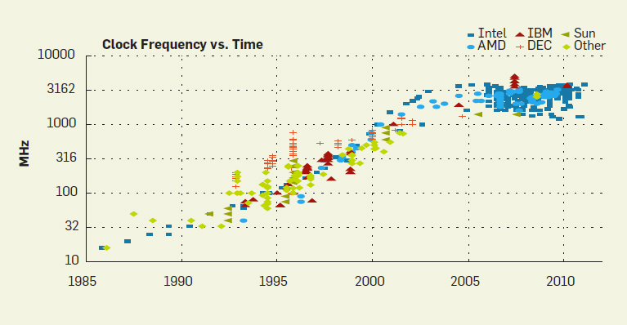
Motivation for Concurrency: Parallelism
http://cacm.acm.org/magazines/2012/4/147359-cpu-db-recording-microprocessor-history/fulltext

Slide 26
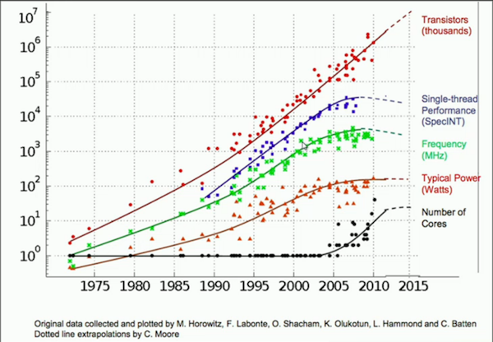
Motivation for Concurrency: Parallelism

Slide 27
Motivation
CPU Trend: Same speed, but multiple cores
Goal: Write applications that fully utilize many cores
Option 1: Build apps from many communicating processes
Example: Chrome (process per tab)
Communicate via pipe() or similar
Pros?
Don’t need new abstractions; good for security
Cons?
Cumbersome programming
High communication overheads
Expensive context switching (why expensive?)

Slide 28
Concurrency: Option 2
New abstraction: thread
Threads are like processes, except: multiple threads of same process share an address space
Divide large task across several cooperative threads
Communicate through shared address space

Slide 29
Common Programming Models
Multi-threaded programs tend to be structured as:
Producer/consumer Multiple producer threads create data (or work) that is handled by one of the multiple consumer threads
Pipeline Task is divided into series of subtasks, each of which is handled in series by a different thread
Defer work with background thread One thread performs non-critical work in the background (when CPU idle)

Slide 30
CPU 1
CPU 2
RAM
running
thread 1
running
thread 2
What state do threads share?

Slide 31
CPU 1
CPU 2
RAM
running
thread 1
running
thread 2
PageDir A
PageDir B
…
What threads share page directories?

Slide 32
CPU 1
CPU 2
RAM
running
thread 1
running
thread 2
PageDir A
PageDir B
PTBR
PTBR
…

Slide 33
CPU 1
CPU 2
RAM
running
thread 1
running
thread 2
PageDir A
PageDir B
PTBR
PTBR
…

Slide 34
CPU 1
CPU 2
RAM
running
thread 1
running
thread 2
PageDir A
PageDir B
PTBR
PTBR
…
IP
IP
Do threads share Instruction Pointer?

Slide 35
CPU 1
CPU 2
RAM
running
thread 1
running
thread 2
PageDir A
PageDir B
PTBR
PTBR
…
IP
IP
Virt Mem
(PageDir A)
CODE
HEAP
…

Slide 36
CPU 1
CPU 2
RAM
running
thread 1
running
thread 2
PageDir A
PageDir B
PTBR
PTBR
…
IP
IP
Virt Mem
(PageDir A)
CODE
HEAP
…
Share code, but each thread may be executing
different code at the same time
→ Different Instruction Pointers

Slide 37
CPU 1
CPU 2
RAM
running
thread 1
running
thread 2
PageDir A
PageDir B
PTBR
PTBR
…
IP
IP
Virt Mem
(PageDir A)
CODE
HEAP
…

Slide 38
CPU 1
CPU 2
RAM
running
thread 1
running
thread 2
PageDir A
PageDir B
PTBR
PTBR
…
IP
SP
IP
SP
Virt Mem
(PageDir A)
CODE
HEAP
…
Do threads share stack pointer?

Slide 39
CPU 1
CPU 2
RAM
running
thread 1
running
thread 2
PageDir A
PageDir B
PTBR
PTBR
…
IP
SP
IP
SP
Virt Mem
(PageDir A)
CODE
HEAP
STACK 1
STACK 2

Slide 40
CPU 1
CPU 2
RAM
running
thread 1
running
thread 2
PageDir A
PageDir B
PTBR
PTBR
…
IP
SP
IP
SP
Virt Mem
(PageDir A)
CODE
HEAP
STACK 1
STACK 2
threads executing different functions need different stacks

Slide 41
THREAD VS. Process
Multiple threads within a single process share:
Process ID (PID)
Address space
Code (instructions)
Most data (heap)
Open file descriptors
Current working directory
User and group id
Each thread has its own
Thread ID (TID)
Set of registers, including Program counter and Stack pointer
Stack for local variables and return addresses (in same address space)

Slide 42
THREAD API
Variety of thread systems exist
POSIX Pthreads
Common thread operations
Create
Exit
Join (instead of wait() for processes)

Slide 43
OS Support: Approach 1
User-level threads: Many-to-one thread mapping
Implemented by user-level runtime libraries
Create, schedule, synchronize threads at user-level
OS is not aware of user-level threads
OS thinks each process contains only a single thread of control
Advantages
Does not require OS support; Portable
Can tune scheduling policy to meet application demands
Lower overhead thread operations since no system call
Disadvantages?
Cannot leverage multiprocessors
Entire process blocks when one thread blocks

Slide 44
OS Support: Approach 2
Kernel-level threads: One-to-one thread mapping
OS provides each user-level thread with a kernel thread
Each kernel thread scheduled independently
Thread operations (creation, scheduling, synchronization) performed by OS
Advantages
Each kernel-level thread can run in parallel on a multiprocessor
When one thread blocks, other threads from process can be scheduled
Disadvantages
Higher overhead for thread operations
OS must scale well with increasing number of threads

Slide 45
Thread Schedule #1
balance = balance + 1; balance at 0x9cd4
Thread 1
Thread 2
State:
0x9cd4: 100
%eax: ?
%rip = 0x195
process
control
blocks:
%eax: ?
%rip: 0x195
%eax: ?
%rip: 0x195
T1
0x195 mov 0x9cd4, %eax
0x19a add $0x1, %eax
0x19d mov %eax, 0x9cd4

Slide 46
Thread Schedule #1
Thread 1
Thread 2
State:
0x9cd4: 100
%eax: 100
%rip = 0x19a
process
control
blocks:
%eax: ?
%rip: 0x195
%eax: ?
%rip: 0x195
0x195 mov 0x9cd4, %eax
0x19a add $0x1, %eax
0x19d mov %eax, 0x9cd4
T1

Slide 47
Thread Schedule #1
Thread 1
Thread 2
State:
0x9cd4: 100
%eax: 101
%rip = 0x19d
process
control
blocks:
%eax: ?
%rip: 0x195
%eax: ?
%rip: 0x195
0x195 mov 0x9cd4, %eax
0x19a add $0x1, %eax
0x19d mov %eax, 0x9cd4
T1

Slide 48
Thread Schedule #1
Thread 1
Thread 2
State:
0x9cd4: 101
%eax: 101
%rip = 0x1a2
process
control
blocks:
%eax: ?
%rip: 0x195
%eax: ?
%rip: 0x195
0x195 mov 0x9cd4, %eax
0x19a add $0x1, %eax
0x19d mov %eax, 0x9cd4
T1

Slide 49
Thread Schedule #1
Thread 1
Thread 2
State:
0x9cd4: 101
%eax: 101
%rip = 0x1a2
process
control
blocks:
%eax: ?
%rip: 0x195
%eax: ?
%rip: 0x195
0x195 mov 0x9cd4, %eax
0x19a add $0x1, %eax
0x19d mov %eax, 0x9cd4
T1
Thread Context Switch

Slide 50
Thread Schedule #1
Thread 1
Thread 2
State:
0x9cd4: 101
%eax: ?
%rip = 0x195
process
control
blocks:
%eax: 101
%rip: 0x1a2
%eax: ?
%rip: 0x195
T2
0x195 mov 0x9cd4, %eax
0x19a add $0x1, %eax
0x19d mov %eax, 0x9cd4

Slide 51
Thread Schedule #1
Thread 1
Thread 2
State:
0x9cd4: 101
%eax: 101
%rip = 0x19a
process
control
blocks:
%eax: 101
%rip: 0x1a2
%eax: ?
%rip: 0x195
0x195 mov 0x9cd4, %eax
0x19a add $0x1, %eax
0x19d mov %eax, 0x9cd4
T2

Slide 52
Thread Schedule #1
Thread 1
Thread 2
State:
0x9cd4: 101
%eax: 102
%rip = 0x19d
process
control
blocks:
%eax: 101
%rip: 0x1a2
%eax: ?
%rip: 0x195
0x195 mov 0x9cd4, %eax
0x19a add $0x1, %eax
0x19d mov %eax, 0x9cd4
T2

Slide 53
Thread Schedule #1
Thread 1
Thread 2
State:
0x9cd4: 102
%eax: 102
%rip = 0x1a2
process
control
blocks:
%eax: 101
%rip: 0x1a2
%eax: ?
%rip: 0x195
0x195 mov 0x9cd4, %eax
0x19a add $0x1, %eax
0x19d mov %eax, 0x9cd4
T2

Slide 54
Thread Schedule #1
Thread 1
Thread 2
State:
0x9cd4: 102
%eax: 102
%rip = 0x1a2
process
control
blocks:
%eax: 101
%rip: 0x1a2
%eax: ?
%rip: 0x195
0x195 mov 0x9cd4, %eax
0x19a add $0x1, %eax
0x19d mov %eax, 0x9cd4
T2
Desired Result!

Slide 55
Let’s consider another schedule…

Slide 56
Thread Schedule #2
Thread 1
Thread 2
State:
0x9cd4: 100
%eax: ?
%rip = 0x195
process
control
blocks:
%eax: ?
%rip: 0x195
%eax: ?
%rip: 0x195
T1
0x195 mov 0x9cd4, %eax
0x19a add $0x1, %eax
0x19d mov %eax, 0x9cd4

Slide 57
Thread Schedule #2
Thread 1
Thread 2
State:
0x9cd4: 100
%eax: 100
%rip = 0x19a
process
control
blocks:
%eax: ?
%rip: 0x195
%eax: ?
%rip: 0x195
0x195 mov 0x9cd4, %eax
0x19a add $0x1, %eax
0x19d mov %eax, 0x9cd4
T1

Slide 58
Thread Schedule #2
Thread 1
Thread 2
State:
0x9cd4: 100
%eax: 101
%rip = 0x19d
process
control
blocks:
%eax: ?
%rip: 0x195
%eax: ?
%rip: 0x195
0x195 mov 0x9cd4, %eax
0x19a add $0x1, %eax
0x19d mov %eax, 0x9cd4
T1
Thread Context Switch

Slide 59
Thread Schedule #2
Thread 1
Thread 2
State:
0x9cd4: 100
%eax: ?
%rip = 0x195
process
control
blocks:
%eax: 101
%rip: 0x19d
%eax: ?
%rip: 0x195
T2
0x195 mov 0x9cd4, %eax
0x19a add $0x1, %eax
0x19d mov %eax, 0x9cd4

Slide 60
Thread Schedule #2
Thread 1
Thread 2
State:
0x9cd4: 100
%eax: 100
%rip = 0x19a
process
control
blocks:
%eax: 101
%rip: 0x19d
%eax: ?
%rip: 0x195
0x195 mov 0x9cd4, %eax
0x19a add $0x1, %eax
0x19d mov %eax, 0x9cd4
T2

Slide 61
Thread Schedule #2
Thread 1
Thread 2
State:
0x9cd4: 100
%eax: 101
%rip = 0x19d
process
control
blocks:
%eax: 101
%rip: 0x19d
%eax: ?
%rip: 0x195
0x195 mov 0x9cd4, %eax
0x19a add $0x1, %eax
0x19d mov %eax, 0x9cd4
T2

Slide 62
Thread Schedule #2
Thread 1
Thread 2
State:
0x9cd4: 101
%eax: 101
%rip = 0x1a2
process
control
blocks:
%eax: 101
%rip: 0x19d
%eax: ?
%rip: 0x195
0x195 mov 0x9cd4, %eax
0x19a add $0x1, %eax
0x19d mov %eax, 0x9cd4
T2

Slide 63
Thread Schedule #2
Thread 1
Thread 2
State:
0x9cd4: 101
%eax: 101
%rip = 0x1a2
process
control
blocks:
%eax: 101
%rip: 0x19d
%eax: ?
%rip: 0x195
0x195 mov 0x9cd4, %eax
0x19a add $0x1, %eax
0x19d mov %eax, 0x9cd4
T2
Thread Context Switch

Slide 64
Thread Schedule #2
Thread 1
Thread 2
State:
0x9cd4: 101
%eax: 101
%rip = 0x19d
process
control
blocks:
%eax: 101
%rip: 0x19d
%eax: 101
%rip: 0x1a2
0x195 mov 0x9cd4, %eax
0x19a add $0x1, %eax
0x19d mov %eax, 0x9cd4
T1
Thread Context Switch

Slide 65
Thread Schedule #2
Thread 1
Thread 2
State:
0x9cd4: 101
%eax: 101
%rip = 0x1a2
process
control
blocks:
%eax: 101
%rip: 0x1a2
%eax: 101
%rip: 0x1a2
0x195 mov 0x9cd4, %eax
0x19a add $0x1, %eax
0x19d mov %eax, 0x9cd4
T1

Slide 66
Thread Schedule #2
Thread 1
Thread 2
State:
0x9cd4: 101
%eax: 101
%rip = 0x1a2
process
control
blocks:
%eax: 101
%rip: 0x1a2
%eax: 101
%rip: 0x1a2
0x195 mov 0x9cd4, %eax
0x19a add $0x1, %eax
0x19d mov %eax, 0x9cd4
T1
WRONG Result! Final value of balance is 101

Slide 67
Timeline View
Thread 1 Thread 2
mov 0x123, %eax
add %0x1, %eax
mov %eax, 0x123
mov 0x123, %eax
add %0x2, %eax
mov %eax, 0x123
How much is added to shared variable?
3: correct!

Slide 68
Timeline View
Thread 1 Thread 2
mov 0x123, %eax
add %0x1, %eax
mov 0x123, %eax
mov %eax, 0x123
add %0x2, %eax
mov %eax, 0x123
How much is added?
2: incorrect!

Slide 69
Timeline View
Thread 1 Thread 2
mov 0x123, %eax
mov 0x123, %eax
add %0x2, %eax
add %0x1, %eax
mov %eax, 0x123
mov %eax, 0x123
How much is added?
1: incorrect!

Slide 70
Timeline View
Thread 1 Thread 2
mov 0x123, %eax
add %0x2, %eax
mov %eax, 0x123
mov 0x123, %eax
add %0x1, %eax
mov %eax, 0x123
How much is added?
3: correct!

Slide 71
Timeline View
Thread 1 Thread 2
mov 0x123, %eax
add %0x2, %eax
mov 0x123, %eax
add %0x1, %eax
mov %eax, 0x123
mov %eax, 0x123
How much is added?
2: incorrect!

Slide 72
Non-Determinism
Concurrency leads to non-deterministic results
Not deterministic result: different results even with same inputs
race conditions: results depend on execution timing
Whether bug manifests depends on CPU schedule!
Passing tests means little
How to program: imagine scheduler is malicious
Assume scheduler will pick bad ordering at some point…

Slide 73
What do we want?
Want 3 instructions to execute as an uninterruptable group
That is, we want them to be atomic
mov 0x123, %eax
add %0x1, %eax
mov %eax, 0x123
critical section
More general:
Need mutual exclusion for critical sections
if process A is in critical section C, process B can’t
(okay if other processes do unrelated work)

Slide 74
Synchronization
Build higher-level synchronization primitives in OS
Operations that ensure correct ordering of instructions across threads
Why is this an OS (rather than app) concern?
Motivation: Build them once and get them right
Monitors
Semaphores
Locks
Condition Variables
Loads
Test&Set
Stores
Disable Interrupts

Slide 75
Locks
Goal: Provide mutual exclusion (mutex)
Three common operations:
Allocate and Initialize
Pthread_mutex_t mylock = PTHREAD_MUTEX_INITIALIZER;
Acquire
Acquire exclusion access to lock;
Wait if lock is not available (some other process in critical section)
Spin or block (relinquish CPU) while waiting
Pthread_mutex_lock(&mylock);
Release
Release exclusive access to lock; let another process enter critical section
Pthread_mutex_unlock(&mylock);

