Slide 1

CS 352 Video Streaming (Part 2)
Lecture 9
http://www.cs.rutgers.edu/~sn624/352-F22
Srinivas Narayana

Slide 2

Quick recap of concepts
Multimedia
Spatial coding
Video Bitrate
Bits played out per second
(can vary over video’s lifetime)
Temporal coding
variable
network
delay
Stall
Constant bitrate video
transmitted @ server
Cumulative data
Reality
Buffer at the client to hold frames initially until playout delay t_{p}
Ideal @ client
Smooth playout
time

Slide 3
Client-side buffering, playout
buffer fill level, B(t)
variable fill
rate, x(t)
playout rate,
e.g., CBR r
video server
Client’s
buffer, size B_{max}
playout buffering: average fill rate (x), playout rate (r):
is x < r or x > r for a given network connection?
It is hard to predict this in general!
Best effort network suffers long queues, paths with low bandwidth, …
How to set playout rate r?
Too low a bit-rate r: video has poorer quality than needed
Too high a bit-rate r: buffer might empty out. Stall/rebuffering!

Slide 4
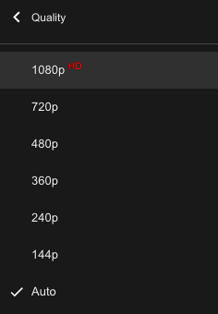
Adaptive bit–rate video
Motivation: Want to provide high quality video experience, without stalls
Observations:
Videos come in different qualities (average bit rates)
Versions of the video for different quality levels readily available
Different segments of video can be downloaded separately
Adapt bit rate per segment through collaboration between the video client (e.g., your browser) and the server (e.g., @ Netflix)
Adaptive bit-rate (ABR) video: change the bit-rate (quality) of next video segment based on network and client conditions
A typical strategy: Buffer-based rate adaptation

Slide 5
Buffer-based bit-rate adaptation
Key idea: If there is a large stored buffer of video, optimize aggressively for video quality, i.e., high bit rates
Else (i.e., buffer has low occupancy), avoid stalls by being conservative and ask for a lower quality (bit-rate)
Hope: lower bandwidth requirement of a lower quality stream is satisfiable more easily

Slide 6
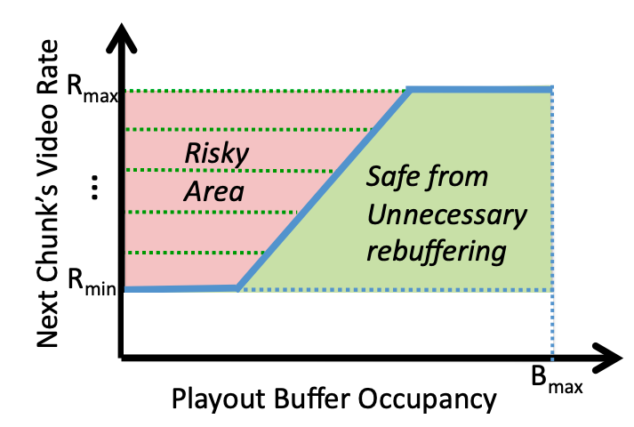
Buffer-based bit-rate adaptation
A highly effective method to provide high video quality despite variable and intermittently poor
network conditions.
Used by Netflix.
http://yuba.stanford.edu/~nickm/papers/sigcomm2014-video.pdf
A Buffer-Based Approach to Rate Adaptation

Slide 7
Dynamic Adaptive Streaming over HTTP (DASH)

Slide 8
Streaming multimedia with DASH
Dynamic Adaptive Streaming over HTTP
Used by Netflix and most popular video streaming services
Adaptive: Perform video bit rate adaptation
It can be done on the client, or the server (with client feedback)
Dynamic: Retrieve a single video from multiple sources
The DASH video server is just a standard HTTP server
Provides video/audio content in multiple formats and encodings
Leverage existing web-based infrastructure
DNS
CDNs!

Slide 9
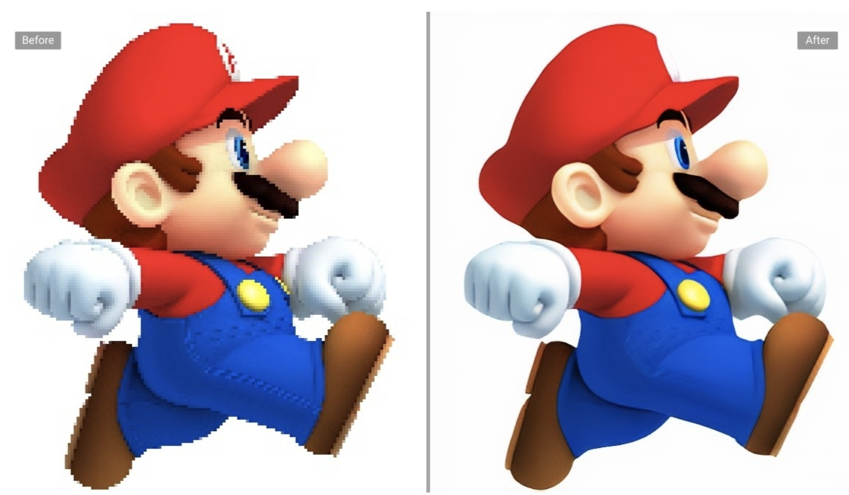
DASH: Key ideas
Web Browser
Or Video Client
Content (video, audio, transcript, etc.) divided into segments (time)
Algorithms to determine and request varying attributes (e.g., bitrate, language) for each segment
Goal: ensure good quality of service, match user prefs, etc.
HTTP
client
Media
player
Issue requests on time. Pick attributes for each segment of content
Media Presentation
Description (manifest)
Video
Server
Audio
Transcripts

Slide 10
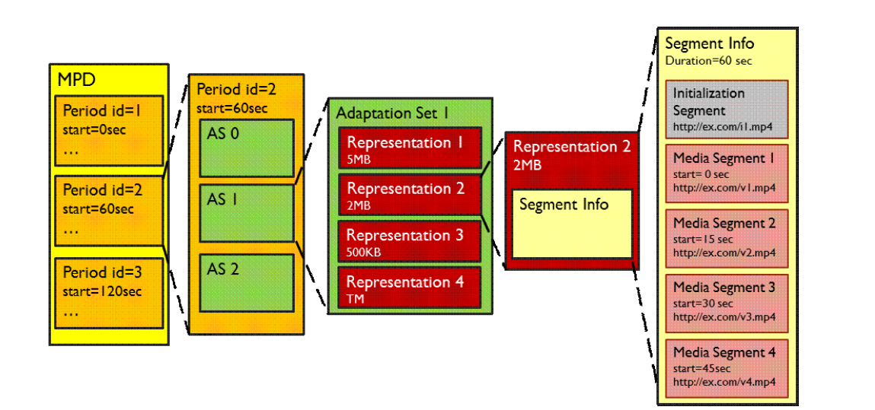
What does the manifest contain?
Functionally equivalent: RSes of given AS
Functionally different: different ASes
Adaptation set: functionally equivalent content
Representations: codecs, bit rates, etc.
Periods:
Durations of content
Multiple segments per representation
URL available for each segment
Byte ranges per segment (HTTP header for a range request)
Source: Stockhammer, MMSys.
https://www.w3.org/2010/11/web-and-tv/papers/webtv2_submission_64.pdf

Slide 11
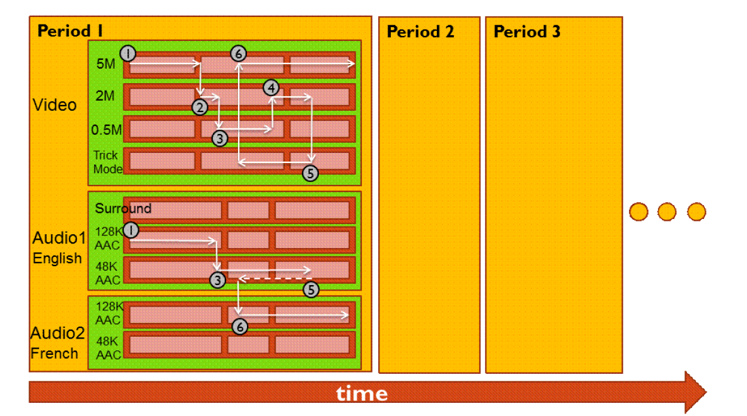
Dynamic changes in stream quality

Slide 12


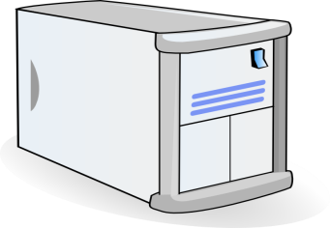

Dynamic changes in stream location
Just an HTTP request for an HTTP object
CDN DNS points user to best CDN server
3. HTTP GET request
for URLs
1. HTTP GET request for video URL
CDN servers caching the video
Internet
YouTube origin servers
Subtle: DNS granularity is per (sub)domain.
Content from different (sub)domains can go to different CDN servers or origin
2. HTTP reply containing html to construct the web page, manifest, with URLs for video content
4. HTTP reply
with cached resources at those URLs
User

Slide 13
DASH reference player
https://reference.dashif.org/dash.js/latest/samples/dash-if-reference-player/index.html

Slide 14
DASH Summary
Piggyback video on HTTP: widely used
Enables independent HTTP requests per segment
Choose dynamic quality & preferences over time
Independent HTTP byte ranges
Works well with CDNs
Fetch segments from locations other than the origin server
Fetch different segments from possibly different locations
More resources on DASH
https://www.w3.org/2010/11/web-and-tv/papers/webtv2_submission_64.pdf
https://www.youtube.com/watch?v=xgowGnH5kUE

Slide 15


Application Layer: Wrap-up
Name resolution, the web, mail, video
Protocols built over the socket() abstraction
Simple designs go a long way
Plain text protocols, header-based evolution, …
Infrastructure for functionality, performance, …
Mail servers, CDNs, proxies, …
Fit your apps to run on browsers: run almost anywhere (e.g. video)
Apps are ultimately what users and most engineers care about
BUT: if you don’t understand what’s under the hood, you risk bad design and poor performance for your Internet-facing applications
App layer
App layer

Slide 16
Transport

Slide 17
Transport
Application
HTTPS
FTP
HTTP
SMTP
DNS
Transport
TCP
UDP
Tp layer
Network
IP
Host-to-Net
X.25
…
802.11
ATM

Slide 18

Transport services and protocols
application
transport
network
data link
physical
Provide a communication abstraction between application processes
Transport protocols run @ endpoints
send side: transport breaks app messages into segments, passes to network layer
recv side: reassembles segments into messages, passes to app layer
Multiple transport protocols available to apps
Very popular in the Internet: TCP and UDP
application
transport
network
data link
physical

Slide 19






Transport vs. network layer
Household analogy:
3 kids sending letters to 3 kids
endpoints = houses
processes = kids
app messages = letters in envelopes
transport protocol = Alice and Bob who de/mux to in-house siblings
network-layer protocol = postal service
Network layer: abstraction to communicate between endpoints. Network layer provides best effort packet delivery to a remote endpoint.
Transport layer: communication abstraction between processes. Delivers packets to the process.
Alice
Bob

Slide 20
Identifying a single conversation
Application connections are identified by 4-tuple:
Source IP address
Source port
Destination IP address
Destination port
In this analogy,
Source address: the address of the first house
Source port: name of a kid in the first house
Destination address: the address of the second house
Destination port: name of a kid in the second house

Slide 21
Demultiplexing Packets

Slide 22
Two popular transports
Transmission Control Protocol (TCP)
Connection-based: the application remembers the other process talking to it.
Suitable for longer-term, contextual data transfers, like HTTP, file transfers, etc.
Guarantees: reliability, ordering, congestion control
User Datagram Protocol (UDP)
Connectionless: app doesn’t remember the last process or source that talked to it.
Suitable for single req/resp flows, like DNS.
Guarantees: basic error detection

