Slide 1

CS 352 Reliability: Pipelined Delivery
Lecture 12
http://www.cs.rutgers.edu/~sn624/352-F22
Srinivas Narayana

Slide 2



Quick recap of concepts
UDP
Connectionless
TCP
Connection-oriented
Tp layer
Detecting errors is insufficient.
Need to correct errors.
Also, data may simply be lost.
(checksum is also lost)
Need better mechanisms for reliable data delivery!
TCP uses 3 simple ideas
Error detection
Sender
Receiver
f(.)
f(.)
Checksum
Checksum
Compare*
Note: actual impl more nuanced

Slide 3
Review:
Sender sends a single packet, then waits for an ACK to know the packet was successfully received. Then the sender transmits the next packet.
If ACK is not received until a timeout (RTO), sender retransmits the packet
How to set the RTO?
Bad RTO: retransmit too early or too late
Sender
Receiver
RTT
ACK delayed
ACK dropped
Pkt dropped
Pkt corrupted
RTO
Retransmit

Slide 4
How should the RTO be set?
A good RTO must predict the round-trip time (RTT) between the sender and receiver
RTT: the time to send a single packet and receive a (corresponding) single ACK at the sender
Intuition: If an ACK hasn’t returned, and our (best estimate of) RTT has elapsed, the packet was likely dropped.
RTT can be measured directly at the sender. No receiver or router help needed.
Sender
Receiver
RTO
ACK

Slide 5
Coping with packet duplication
If ACKs delayed beyond the RTO, sender may retransmit the same data
Receiver wouldn’t know that it just received duplicate data from this retransmitted packet
Add some identification to each packet to help distinguish between adjacent transmissions
This is known as the sequence number
Sender
Receiver
RTO
Duplicate
packet received!
(Receiver doesn’t know…)
ACK

Slide 6
Coping with packet loss: (3) Sequence #s
A bad scenario: Suppose an ACK was delayed beyond the RTO; sender ended up retransmitting the packet.
At the receiver: sequence number helps disambiguate a fresh transmission from a retransmission
Sequence number same as earlier: retransmission
Fresh sequence number: fresh data
Sender
Receiver
0
RTO
0
ACK

Slide 7
Coping with packet loss: (3) Sequence #s
A good scenario: packet successfully received and ACK returned within RTO
Sequence numbers of successively transmitted packets are different
Sender
Receiver
SEQ 0
Receiver knows these are not duplicate, because sequence numbers are different
RTO
ACK
SEQ 1
RTO

Slide 8
Coping with packet loss: (3) Sequence #s
A good scenario: packet successfully received and ACK returned within RTO
Sequence numbers of successively transmitted packets are different
Sender
Receiver
SEQ 0
Receiver knows these are not duplicate, because sequence numbers are different
RTO
ACK
ACK
SEQ 1
RTO
ACK

Slide 9
Q: What is the seq# of third packet?
Goal: Avoid ambiguity on which packet was received/ACK’ed from both the sender and receiver’s perspective
One option: increment seq#: 2, 3, …
Alternative: since seq # 0 was successfully ACK’ed earlier, it is OK to reuse seq #0 for next transmission.
Seq #s reusable if older packets with those seq #s known to be delivered
Sender
Receiver
SEQ 0
RTO
ACK
SEQ 1
RTO
ACK
???

Slide 10
Stop-and-Wait Reliability
Sender sends a single packet, then waits for an ACK to know the packet was successfully received. Then the sender transmits the next packet.
If ACK is not received until a timeout (RTO), sender retransmits the packet
Disambiguate duplicate vs. fresh packets using sequence numbers that change on “adjacent” packets
Sender
Receiver
SEQ 0
ACK
RTT
SEQ 1
RTO
Retransmit

Slide 11
In principle, these three ideas are sufficient to implement reliable data delivery!

Slide 12
Making reliable data transfer efficient

Slide 13
Efficiency problem with stop-and-wait
Sender sends one packet, waits for an ACK (or RTO) before transmitting next one
Unfortunately, too slow ☹
Suppose RTO = RTT = 100 milliseconds
Packet size (bytes in 1 packet) = 12,000 bits
Bandwidth of links from sender to receiver = 12 Mbit/s (1 M = 10⁶)
Rate of data transfer = data size / time
Sender
Receiver
RTT
RTO
120 Kilobit/s == 1% of bw!

Slide 14
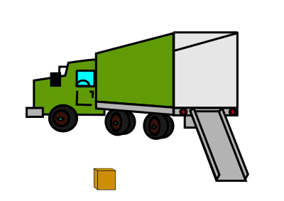
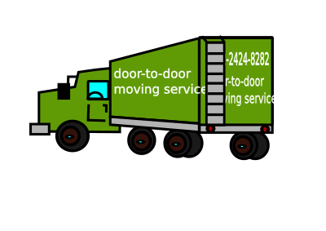


Sending one packet per RTT makes the data transfer rate limited by the time between the endpoints, rather than the bandwidth.
Ensure you got the (one) box safely; make N trips
Ensure you get N boxes safely; make just 1 trip!
Keep many packets in flight

Slide 15
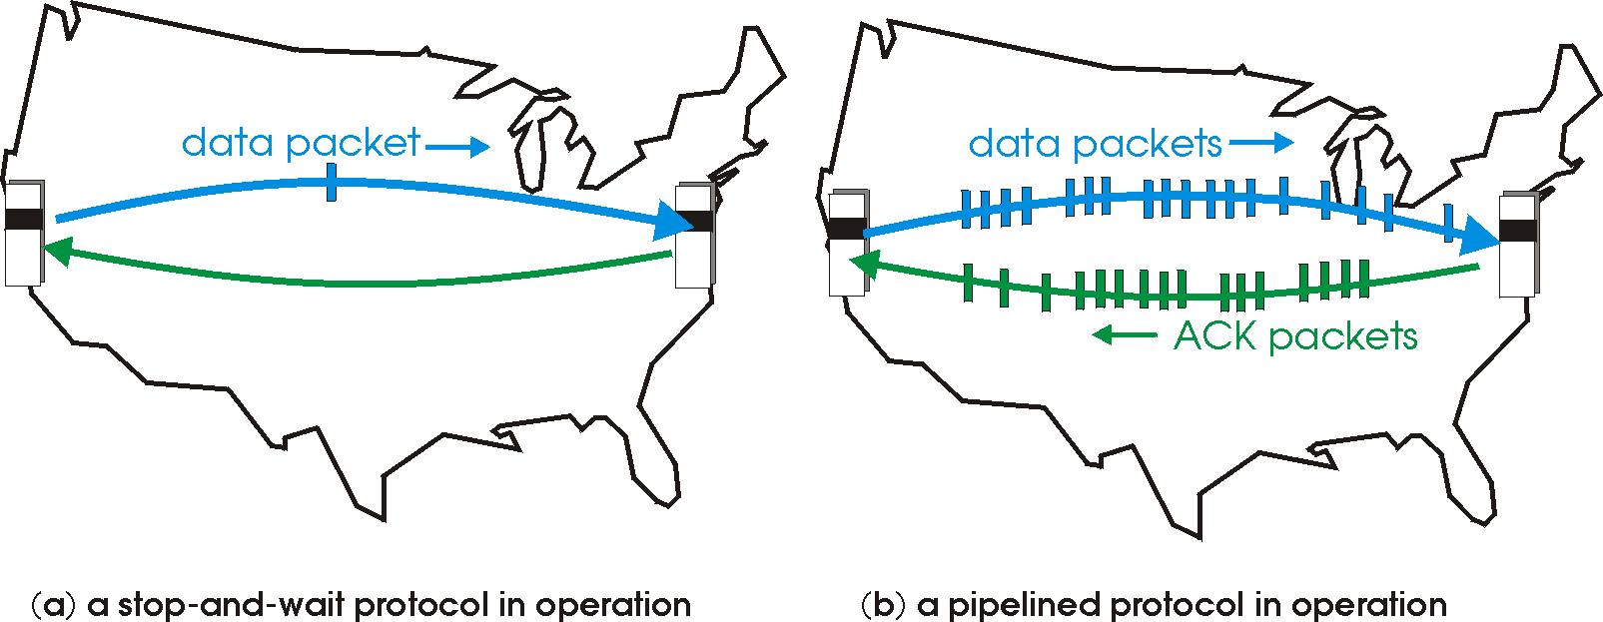
Pipelined reliability
Data in flight: data that has been sent, but sender hasn’t yet received ACKs from the receiver
Note: can refer to packets in flight or bytes in flight
New packets sent at the same time as older ones still in flight
New packets sent at the same time as ACKs are returning
More data moving in same time!
Improves throughput
Rate of data transfer

Slide 16

Pipelined reliability
Stop and wait: send 1 packet per RTT
Pipelined: send N packets per RTT
If there are N packets in flight, throughput improves by N times compared to stop-and-wait!
Sender
Receiver
RTT
RTO

Slide 17
Pipelining makes reliable data transfer efficient.
However, pipelining also makes it more complex.
Which packets are currently in flight?
Which packets were successfully delivered?
Which packets should the sender retransmit?

Slide 18
Sliding Windows

Slide 19
Setup
Sender
Receiver
Assume packets are labeled by sequence numbers
Increasing from 0, …, N-1, then roll back to 0
Assume ACKs indicate the sequence numbers of data that was received
Note: Didn’t need this for stop-and-wait
Convention: ACK#s carry the next sequence number expected
Used in TCP.
SEQ 0
SEQ 1
ACK 1
ACK 2
…
SEQ N-1
SEQ 0

Slide 20
Sliding window (sender side)
Window: Sequence numbers of in-flight data
Window size: The amount of in-flight data (unACKed)
Sequence numbers restart from 0 beyond a point (finite space on header)
Window size = 3
Sender’s point of view:
0
1
2
3
4
5
6
7
0
1
0
7
1
6
2
Last seq # known to be received (ACK recv’d at sender)
Last sequence # sent
5
3
4
Transmissions later in time

Slide 21
Sliding window (sender side)
Suppose sequence number 2 is acknowledged by the receiver
Sender receives the ACK. Sender can transmit sequence # 5
The window “slides” forward
Window size = 3
Sender’s point of view:
0
1
2
3
4
5
6
7
0
1
0
7
1
6
2
Last seq # known to be received (ACK recv’d at sender)
Last sequence # sent
5
3
4

Slide 22
Sliding window (sender side)
Suppose sequence number 2 is acknowledged by the receiver
Sender receives the ACK. Sender can transmit sequence # 5
The window “slides” forward
Window size = 3
Sender’s point of view:
0
1
2
3
4
5
6
7
0
1
0
7
1
6
2
Last seq # known to be received (ACK recv’d at sender)
Last sequence # sent
5
3
4

Slide 23
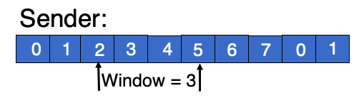
Sliding window (receiver side)
Window of in-flight packets can look different between sender and the receiver
Receiver only accepts sequence #s allowed by the current receiver window
Window size = 3
Receiver will not accept this seq #. Packet dropped
Receiver’s point of view:
0
1
2
3
4
5
6
7
0
1
Last seq # received and ACK’ed by receiver
Highest sequence # accepted

Slide 24
Summary of sliding windows
Sender and receiver can keep several packets of in-flight data
Book-keep the sequence numbers using the window
Windows slide forward as packets are ACKed (at receiver) and ACKs are received (at sender)
Common case: Improve throughput by sending and ACKing more packets in the same duration

Slide 25
Pipelining makes reliable data transfer efficient.
However, pipelining also makes it more complex.
Which packets are currently in flight?
Which packets were successfully delivered?
Which packets should the sender retransmit?

Slide 26
Which packets to retransmit?

Slide 27
Pipelined Reliability
If there are N packets in flight, throughput improves by N times relative to stop-and-wait.
Stop and wait: send 1 packet per RTT
Pipelined: send N packets per RTT
Q1: how should sender efficiently identify which pkts were dropped and (hence) retransmitted?
Q2: how much data to keep in flight (i.e., what is N?) to reduce drops/retransmits?
Sender
Receiver
RTT
RTO

Slide 28
How to identify dropped packets?
Suppose 4 packets sent, but 1 dropped. How does sender know which one(s) dropped?
Recall: Receiver writes sequence numbers on the ACK indicating successful reception
Key idea: Sender can infer which data was received successfully using the ACK #s!
Hence, sender can know which data to retransmit
Q1: Should receivers ACK subsequent packets upon detecting data loss?
Q2: If so, what sequence number should receiver put on the ACK?
Sender
Receiver
SEQ 1
SEQ 2
SEQ 3
SEQ 4
RTT
ACK 2
ACK 3
Should this ACK exist ???
ACK ??
RTO

Slide 29
Receiver strategies upon packet loss
Sender
Receiver
ACK pkts after a drop?
1
No
Yes
2
3
4
Go-back-N
Selective Repeat
What # on ACK?
5
Last seq# in order
Cumulative ACK
Seq# ranges received so far
Selective ACK
TCP’s default

Slide 30
Sliding Window with Go Back N
When the receiver notices missing data:
It simply discards all data with greater sequence numbers
i.e.: the receiver will send no further ACKs
The sender will eventually time out (RTO) and retransmit all the data in its sending window
Subtle: conceptually, separate timer per byte to infer RTO

Slide 31
Go back N
RTO
Sender
0
1
2
3
4
2
3
4
5
6
Maximum
window size = 8
ACK 1
ACK 2
ACK 3
ACK 4
ACK 5
ACK 6
ACK 7
Receiver
0
1
E
D
D
2
3
4
5
6
Maximum
window size = 8
Discarded by
receiver
Dropped packet
(or) Packet with
error
Time

Slide 32
Go back N
Go Back N can recover from erroneous or missing packets.
But it is wasteful.
If there are errors, the sender will spend time and network bandwidth retransmitting data the receiver has already seen.

Slide 33
Selective repeat with cumulative ACK
Idea: sender should only retransmit dropped/corrupted data.
The receiver stores all the correct frames that arrive following the bad one. (Note that the receiver requires memory to hold data for each sequence number in the receiver window.)
When the receiver notices a skipped sequence number, it keeps acknowledging the first in-order sequence number it wants to receive. This is termed cumulative ACK.
When the sender times out waiting for an acknowledgement, it just retransmits the first unacknowledged data, not all its successors.
Recall that RTO applies independently to each sequence #

Slide 34
Selective repeat with cumulative ACK
RTO
Sender
0
1
2
3
4
2
5
6
Maximum
window size = 8
ACK 2
ACK 2
ACK 1
ACK 2
ACK 5
ACK 6
ACK 7
Receiver
0
1
E
3
4
2
5
6
Maximum
window size = 8
Buffered by
receiver in
its memory
Packet with
error (or)
dropped packet
Time

Slide 35
Selective repeat with selective ACK
RTO
Sender
0
1
2
3
4
2
5
6
ACK 2
SACK 0--1, 3
Maximum
window size = 8
ACK 2
SACK 0,--1, 3--4
ACK 1
ACK 2
ACK 5
ACK 6
ACK 7
Receiver
0
1
E
3
4
2
5
6
Maximum
window size = 8
Buffered by
receiver in
its memory
Frame with
error
Time

Slide 36
TCP: Cumulative & Selective ACKs
Sender retransmits the seq #s it thinks aren’t received successfully yet
Pros & cons: selective vs. cumulative ACKs
Precision of info available to sender
Redundancy of retransmissions
Packet header space
Complexity (and bugs) in transport software
On modern Linux, TCP uses selective ACKs by default
Sender
Receiver
1
2
3
4
2
3
4
5
5

