Slide 1

CS 352 Flow Control; Congestion Control
Lecture 15
http://www.cs.rutgers.edu/~sn624/352-F22
Srinivas Narayana

Slide 2

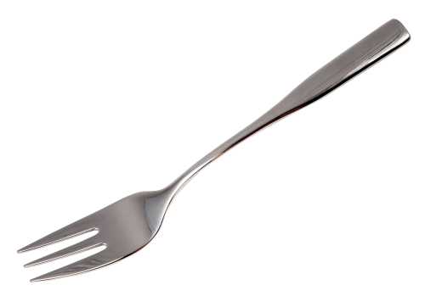
Quick recap of concepts
TCP:
Reliability
Ordering
Reordering degrades connection throughput. Apps can’t recv().
Packets may even be dropped due to insufficient buffering.
Tp layer
recv()
SEQ 0
Packet boundaries
SEQ 1
SEQ 2
SEQ 3
RTT
ACK 1
ACK 2
ACK 3
ACK 4
How much data to keep in flight?
Sequence numbers
Stream-Oriented Transport

Slide 3
How much data to keep in flight?
= window size
Proportional to throughput
SEQ 0
SEQ 1
SEQ 2
Stop and Wait
SEQ 3
SEQ 0
RTT
ACK 1
ACK 2
ACK 3
ACK 4
RTT
ACK
SEQ 1
Pipelined Reliability
RTO
Retransmit

Slide 4



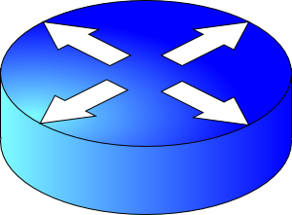
We want to increase throughput, but …
Multiple locations for bottlenecks
sender
application
process
recv()
TCP socket
receiver buffers
Flow Control
What’s the bottleneck? How to adapt how much data to keep in flight?
TCP
code
Congestion Control
from sender
receiver

Slide 5
How much data to keep in flight?
Challenging question! We want to increase throughput. But:
The receiving app must keep up: otherwise, receiver socket buffer will fill up. Once full, subsequent packets are dropped.
Even if receiving app is fast, there must be sufficient buffering for selective repeat, if some data is dropped/corrupted
The network path must be able to keep up.
We don’t want window to be so large that pkts dropped anyway
Challenge: The sender must figure out where the bottleneck is: receiving app? Socket buffer? A link along the network path?
Flow control and congestion control

Slide 6
Flow Control

Slide 7
Socket buffers can become full
application
process
Applications may read data slower than the sender is pushing data in
Example: what if an app infrequently or never calls recv()?
There may be too much reordering or packet loss in the network
What if the first few bytes of a window are lost or delayed?
Receivers can only buffer so much before dropping subsequent data
TCP socket
receiver buffers
TCP
code
from sender
TCP receiver

Slide 8
Goal: avoid drops due to buffer fill
application
process
Have a TCP sender only send as much as the free buffer space available at the receiver.
Amount of free buffer varies over time!
TCP implements flow control
Receiver’s ACK contains the amount of data the sender can transmit without running out the receiver’s socket buffer
This number is called the advertised window size
TCP socket
receiver buffers
TCP
code
from sender
TCP receiver

Slide 9
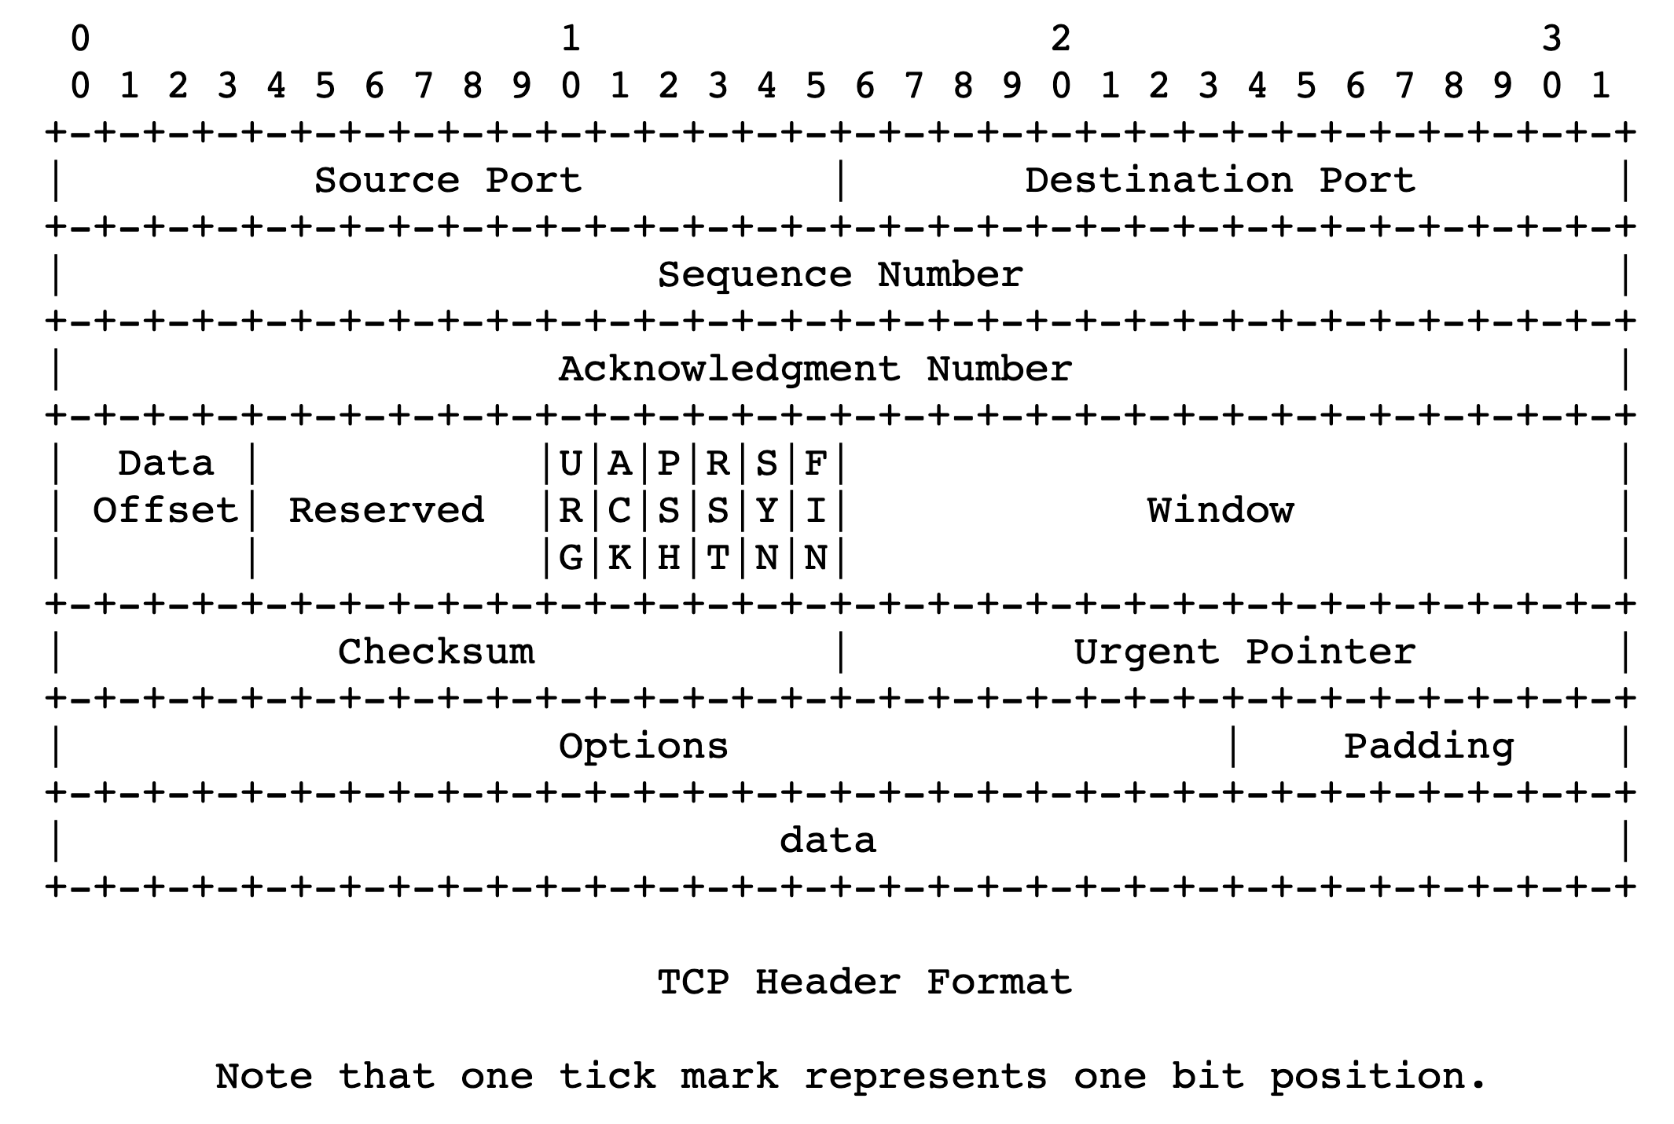
Flow control in TCP headers

Slide 10
TCP flow control
Receiver advertises to sender (in the ACK) how much free buffer is available
Sender
Receiver
1
2
3
4
1
2
3
4
5

Slide 11
TCP flow control
Subsequently, the sender’s sliding window cannot be larger than this value
Restriction on new sequence numbers that can be transmitted
== restriction on sending rate!
Sender
Receiver
1
2
3
4
1
2
3
Window <= Advertised window
4
5
Sender’s view:
0
1
2
3
4
5
6
7
0
1
Last cumulative
ACK’ed seq #
Last transmitted
seq #

Slide 12
TCP flow control
If receiver app is too slow reading data:
receiver socket buffer fills up
So, advertised window shrinks
So, sender’s window shrinks
So, sender’s sending rate reduces
Sender
Receiver
1
2
3
4
1
2
3
Window <= Advertised window
4
5
Sender’s view:
0
1
2
3
4
5
6
7
0
1
Last cumulative
ACK’ed seq #
Last transmitted
seq #

Slide 13
TCP flow control
Flow control matches the sender’s write speed to the receiver’s read speed.
Sender
Receiver
1
2
3
4
1
2
3
Window <= Advertised window
4
5
Sender’s view:
0
1
2
3
4
5
6
7
0
1
Last cumulative
ACK’ed seq #
Last transmitted
seq #

Slide 14
Sizing the receiver’s socket buffer
Operating systems have a default receiver socket buffer size
Listed among sysctl –a | grep net.inet.tcp on MAC
Listed among sysctl –a | grep net.ipv4.tcp on Linux
If socket buffer is too small, sender can’t keep too many packets in flight ➔ lower throughput
If socket buffer is too large, too much memory consumed per socket
How big should the receiver socket buffer be?

Slide 15
Q: how large a receiver socket buffer?
Case 1: Suppose the receiving app is reading data too slowly:
no amount of receiver buffer can prevent low sender throughput if the connection is long-lived!

Slide 16
Q: how large a receiver socket buffer?
Case 2: Suppose the receiving app reads sufficiently fast on average to match the sender’s writing speed.
Assume the sender has a window of size W.
The receiver must use a buffer of size at least W. Why?
Captures two cases:
(1) When the first sequence #s in the window are dropped
Selective repeat: data in window buffered until the ACKs of delivered data (within window) reach sender. Adv. win reduces sender’s window
(2) When the sender sends a burst of data of size W
Receiver may not match the instantaneous rate of the sender

Slide 17
Summary of flow control
Keep memory buffers available at the receiver whenever the sender transmits data
Buffers needed to hold for selective repeat and reassemble data in order
Inform the sender on an on-going basis (each ACK)
Function: match sender speed to receiver speed
Correct socket buffer sizing is important for TCP throughput

Slide 18
Info on (tuning) TCP stack parameters
https://www.ibm.com/support/knowledgecenter/linuxonibm/liaag/wkvm/wkvm_c_tune_tcpip.htm
https://cloud.google.com/solutions/tcp-optimization-for-network-performance-in-gcp-and-hybrid

Slide 19
Congestion Control

Slide 20

Congestion
Routers have buffers which accommodate queued packets.
∞
Max amount of useful data that link can support, ~ link rate
Packets get dropped beyond max buffer
Too many retransmissions due to packet drops!
Amount of useful (fresh) data plummets.
Congestion collapse
Amount of useful data that gets across to the receiver
Queueing delay
~100%
~100%
Link load
Fraction of link used (link load)
https://en.wikipedia.org/wiki/Network_congestion#Congestive_collapse

Slide 21
How should multiple endpoints share net?
It is difficult to know where the bottleneck link is
It is difficult to know how many other endpoints are using that link
Endpoints may join and leave at any time
Network paths may change over time, leading to different bottleneck links (with different link rates) over time

Slide 22
The approach that the Internet takes is to use a distributed algorithm to converge to an efficient and fair outcome.

Slide 23
The approach that the Internet takes is to use a distributed algorithm to converge to an efficient and fair outcome.
No one can centrally view or control all the endpoints and bottlenecks in the Internet.
Every endpoint must try to reach a globally good outcome by itself: i.e., in a distributed fashion.
This also puts a lot of trust in endpoints.

Slide 24
The approach that the Internet takes is to use a distributed algorithm to converge to an efficient and fair outcome.
If there is spare capacity in the bottleneck link, the endpoints should use it.

Slide 25
The approach that the Internet takes is to use a distributed algorithm to converge to an efficient and fair outcome.
If there are N endpoints sharing a bottleneck link, they should be able to get equitable shares of the link’s capacity.
For example: 1/N’th of the link capacity.

Slide 26
Flow Control vs. Congestion Control
Avoid overwhelming the receiving application
Sender is managing the receiver’s socket buffer
Avoid overwhelming the bottleneck network link
Sender is managing the bottleneck link capacity and bottleneck router buffers

Slide 27
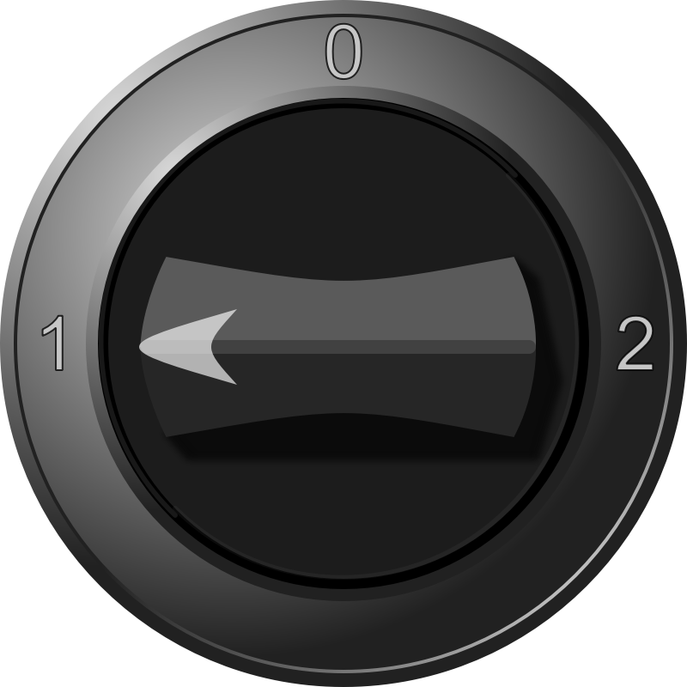


The approach that the Internet takes is to use a distributed algorithm to converge to an efficient and fair outcome.
H
C
How to achieve this?
Approach: sense and react
Example: taking a shower
Use a feedback loop with signals and knobs

Slide 28
Signals and Knobs in Congestion Control
Signals
Packets being ACK’ed
Packets being dropped (e.g. RTO fires)
Packets being delayed (RTT)
Rate of incoming ACKs
Knobs
What can you change to “probe” the available bottleneck capacity?
Suppose receiver buffer is unbounded:
Increase window/sending rate: e.g., add x or multiply by a factor of x
Decrease window/sending rate: e.g., subtract x or reduce by a factor of x
Implicit feedback signals measured directly at sender.
(There are also explicit signals that the network might provide.)

Slide 29
Sense and react, sure…but how?
H
Where do you want to be?
The steady state
How do you get there?
Congestion control algorithms
Sense accurately
React proportionately
C

Slide 30
Subsequent modules/lectures
Feedback loops used by 2 important TCPs
TCP New Reno and TCP BBR
Strategies to react “proportionately” to network signals like loss
Fast retransmit and fast recovery
Strategies to measure loss accurately
How to predict the RTT of a packet successfully received (in the future)?

Slide 31
The Steady State
Efficiency of a single TCP conversation

Slide 32
What does efficiency look like?
Suppose we want to achieve an efficient outcome for one TCP conversation by observing network signals from the endpoint
Q: How should the endpoint behave at steady state?
Challenge: bottleneck link is remotely located

Slide 33
Steady state: Ideal goal
High sending rate: Use the full capacity of the bottleneck link
Low delay: Minimize the overall delay of packets to get to the receiver
Overall delay = propagation + queueing + transmission
Assume propagation and transmission components fixed
“Low delay” reduces to low queueing delay
i.e., don’t push so much data into the network that packets have to wait in queues
Key question: When to send the next packet?

Slide 34
When to send the next packet?
T
Fast link
Bottleneck link
1. Send packet burst (as allowed by window)
Inter-packet delay T
2. Receive data packet
5. Send data packet on ACK
Data
Sender
T
T
Receiver
T
4. Receive ACK
3. Send ACK
ACKs

Slide 35
Rationale
When the sender receives an ACK, that’s a signal that the previous packet has left the bottleneck link (and the rest of the network)
Hence, it must be safe to send another packet without congesting the bottleneck link
Such transmissions are said to follow packet conservation
ACK clocking: “Clock” of ACKs governs packet transmissions

Slide 36
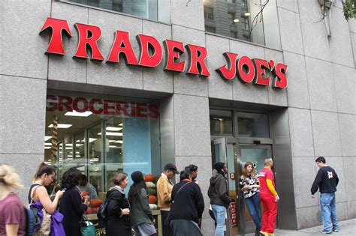
ACK clocking: analogy
How to avoid crowding a grocery store?
Strategy: Send the next waiting customer exactly when a customer exits the store
However, this strategy alone can lead to inefficient use of resources…

Slide 37
ACK clocking alone can be inefficient
Sender pushing data slowly
T
Large delay T
Send data packet on ACK
Data
Sender
T
T
Receiver
T
ACKs

Slide 38
ACK clocking alone can be inefficient
Sender pushing data slowly
T
Large delay T
Send data packet on ACK
Data
Sender
Receiver
The sending rate should be high enough to keep the “pipe” full
Analogy: a grocery store with only 1 customer in entire store
If the store isn’t “full”, you’re using store space inefficiently

Slide 39
Steady State of Congestion Control
Send at the highest rate possible (to keep the pipe full)
while being ACK-clocked (to avoid congesting the pipe)
So, how to get to steady state?

