Slide 1

Flow Control
Lecture 14 http://www.cs.rutgers.edu/~sn624/352-S22
Srinivas Narayana

Slide 2

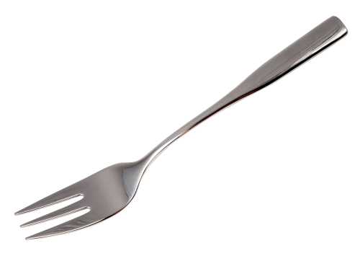
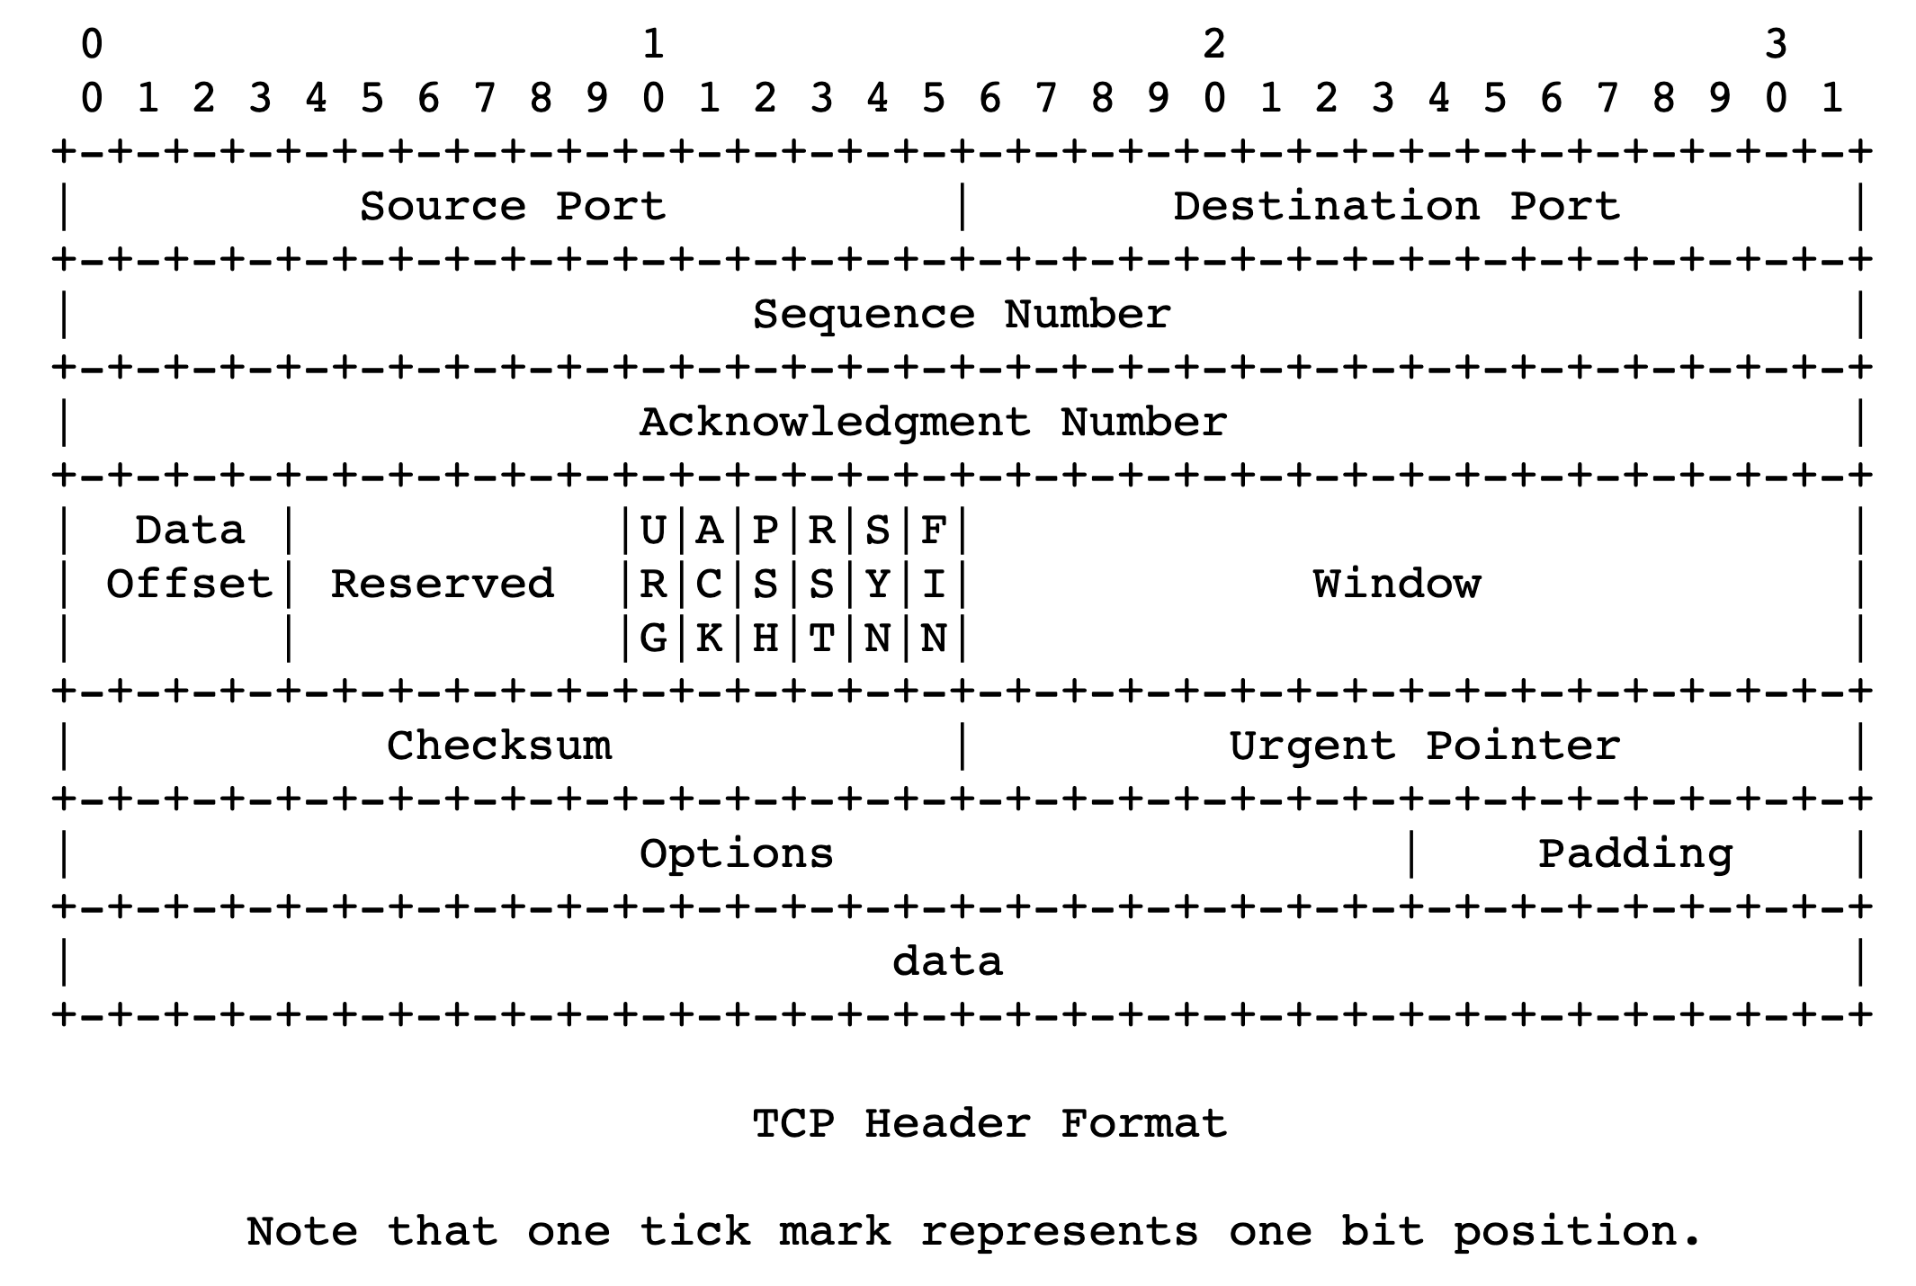

Quick recap of concepts
Selective repeat
TCP:
Connection-oriented
Cumulative ACK
Selective ACK
ACK x
ACK x
SACK x1-x2,x3-x4,x5-x6
Tp layer
application
process
Precision of info:
<
recv()
Cumulative ACK
Selective ACK
Retransmissions
>
TCP socket
receiver buffers
Complexity, bugs, …
<
Ordering
Reassembly
App
TCP
code
recv()
from sender
1
2
3
4
receiver TCP interaction
Data with sequence #

Slide 3
Implications of ordered delivery
Packets cannot be delivered to the application if there is an in-order packet missing from the receiver’s buffer
The receiver can only buffer so much out-of-order data
Subsequent out-of-order packets dropped
It won’t matter that those packets successfully arrive at the receiver from the sender over the network
TCP application-level throughput will suffer if there is too much packet reordering in the network
Data may have reached the receiver but won’t be delivered to apps upon a recv() (...or may not even be buffered!)

Slide 4
Stream-Oriented Data Transfer

Slide 5
Sequence numbers in the app’s stream
Data written by application over time
e.g., send() call
…
100
150
180
240
273
310
…
packet
packet
packet
packet
packet
Increasing sequence #s
TCP uses byte sequence numbers

Slide 6
Sequence numbers in the app’s stream
Data written by application over time
e.g., send() call
…
100
150
180
240
273
310
…
packet
packet
packet
packet
packet
Increasing sequence #s
Packet boundaries aren’t important for TCP software
TCP is a stream-oriented protocol
(We use SOCK_STREAM when creating sockets)

Slide 7
Sequence numbers in the app’s stream
Data written by application over time
e.g., send() call
…
…
1st recv()
2nd recv()
3rd recv()
4th recv()
A recv() call may return a part of a packet, a full packet, or multiple packets together.
App does a recv()

Slide 8
How much data to keep in flight?
= window size
Proportional to throughput
SEQ 0
SEQ 1
SEQ 2
Stop and Wait
SEQ 3
SEQ 0
RTT
ACK 1
ACK 2
ACK 3
ACK 4
RTT
ACK
SEQ 1
Pipelined Reliability
RTO
Retransmit

Slide 9


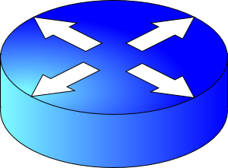
We want to increase throughput, but …
Multiple locations for bottlenecks
sender
application
process
recv()
TCP socket
receiver buffers
Flow Control
What’s the bottleneck? How to adapt how much data to keep in flight?
TCP
code
Congestion Control
from sender
receiver

Slide 10
How much data to keep in flight?
Challenging question! We want to increase throughput. But:
The receiving app must keep up: otherwise, receiver socket buffer will fill up. Once full, subsequent packets are dropped.
Even if receiving app is fast, there must be sufficient buffering for selective repeat, if some data is dropped/corrupted
The network path must be able to keep up.
We don’t want window to be so large that pkts dropped anyway
Challenge: The sender must figure out where the bottleneck is: receiving app? Socket buffer? A link along the network path?
Flow control and congestion control

Slide 11
Flow Control

Slide 12
Socket buffers can become full
application
process
Applications may read data slower than the sender is pushing data in
Example: what if an app infrequently or never calls recv()?
There may be too much reordering or packet loss in the network
What if the first few bytes of a window are lost or delayed?
Receivers can only buffer so much before dropping subsequent data
TCP socket
receiver buffers
TCP
code
from sender
TCP receiver

Slide 13
Goal: avoid drops due to buffer fill
application
process
Have a TCP sender only send as much as the free buffer space available at the receiver.
Amount of free buffer varies over time!
TCP implements flow control
Receiver’s ACK contains the amount of data the sender can transmit without running out the receiver’s socket buffer
This number is called the advertised window size
TCP socket
receiver buffers
TCP
code
from sender
receiver protocol stack

Slide 14
Flow control in TCP headers

Slide 15
TCP flow control
Receiver advertises to sender (in the ACK) how much free buffer is available
Sender
Receiver
1
2
3
4
1
2
3
4
5

Slide 16
TCP flow control
Subsequently, the sender’s sliding window cannot be larger than this value
Restriction on new sequence numbers that can be transmitted
== restriction on sending rate!
Sender
Receiver
1
2
3
4
1
2
3
Window <= Advertised window
4
5
Sender’s view:
0
1
2
3
4
5
6
7
0
1
Last cumulative
ACK’ed seq #
Last transmitted
seq #

Slide 17
TCP flow control
If receiver app is too slow reading data:
receiver socket buffer fills up
So, advertised window shrinks
So, sender’s window shrinks
So, sender’s sending rate reduces
Sender
Receiver
1
2
3
4
1
2
3
Window <= Advertised window
4
5
Sender’s view:
0
1
2
3
4
5
6
7
0
1
Last cumulative
ACK’ed seq #
Last transmitted
seq #

Slide 18
TCP flow control
Flow control matches the sender’s write speed to the receiver’s read speed.
Sender
Receiver
1
2
3
4
1
2
3
Window <= Advertised window
4
5
Sender’s view:
0
1
2
3
4
5
6
7
0
1
Last cumulative
ACK’ed seq #
Last transmitted
seq #

Slide 19
Sizing the receiver’s socket buffer
Operating systems have a default receiver socket buffer size
Listed among sysctl –a | grep net.inet.tcp on MAC
Listed among sysctl –a | grep net.ipv4.tcp on Linux
If socket buffer is too small, sender can’t keep too many packets in flight ➔ lower throughput
If socket buffer is too large, too much memory consumed per socket
How big should the receiver socket buffer be?

Slide 20
Sizing the receiver’s socket buffer
Case 1: Suppose the receiving app is reading data too slowly:
no amount of receiver buffer can prevent low sender throughput if the connection is long-lived!

Slide 21
Sizing the receiver’s socket buffer
Case 2: Suppose the receiving app reads sufficiently fast on average to match the sender’s writing speed.
Assume the sender has a window of size W.
The receiver must use a buffer of size at least W. Why?
Captures two cases:
(1) When the first sequence #s in the window are dropped
Selective repeat: data in window buffered until the ACKs of delivered data (within window) reach sender. Adv. win reduces sender’s window
(2) When the sender sends a burst of data of size W
Receiver may not match the instantaneous rate of the sender

Slide 22
Summary of flow control
Keep memory buffers available at the receiver whenever the sender transmits data
Inform the sender on an on-going basis (each ACK)
Function #1: match sender speed to receiver speed
Function #2: reassemble data in order and hold for selective repeat
Correct socket buffer sizing is important for TCP throughput

Slide 23
Info on (tuning) TCP stack parameters
https://www.ibm.com/support/knowledgecenter/linuxonibm/liaag/wkvm/wkvm_c_tune_tcpip.htm
https://cloud.google.com/solutions/tcp-optimization-for-network-performance-in-gcp-and-hybrid

