Slide 1

Backbone Traffic Engineering
Lecture 20, Computer Networks (198:552)

Slide 2
Do IP Networks Manage Themselves?
In some sense, yes:
TCP senders send less traffic during congestion
Routing protocols adapt to topology changes
But, does the network run efficiently?
Congested link when idle paths exist?
High-delay path when a low-delay path exists?
How should routing adapt to the traffic?
Avoiding congested links in the network
Satisfying application requirements (e.g., delay)
… these are the essential questions of traffic engineering

Slide 3
Routing With “Static” Link Weights
Routers flood information to learn topology
Determine “next hop” to reach other routers…
Compute shortest paths based on link weights
Link weights configured by network operator
2
3
1
1
3
2
1
5
4
3

Slide 4
Setting the Link Weights
How to set the weights
Inversely proportional to link capacity?
Proportional to propagation delay?
Network-wide optimization based on traffic?
2
3
1
1
3
2
3
1
5
4
3

Slide 5
Measure, Model, and Control
Network-wide
“what if” model
Topology/
Configuration
Offered
traffic
Changes to
the network
measure
control
Operational network

Slide 6
Key Ingredients
Measurement
Topology: monitoring of the routing protocols
Traffic matrix: passive traffic measurement
Network-wide models
Representations of topology and traffic
“What-if” models of shortest-path routing
Network optimization
Efficient algorithms to find good configurations
Operational experience to identify constraints

Slide 7
Optimization Problem
Input: graph G(R,L)
R is the set of routers
L is the set of unidirectional links
c_{l} is the capacity of link l
Input: traffic matrix
M_{i,j} is traffic load from router i to j
Output: setting of the link weights
w_{l} is weight on unidirectional link l
P_{i,j,l} is fraction of traffic from i to j traversing link l

Slide 8
Equal-Cost Multipath (ECMP)
0.25
0.25
0.5
1.0
1.0
0.25
0.25
0.5
0.5
0.5
Values of P_{i,j,l}

Slide 9
Objective Function
Computing the link utilization
Link load: u_{l} = Σ_{i,j} M_{i,j} P_{i,j,l}
Utilization: u_{l}/c_{l}
Objective functions
min(max_{l}(u_{l}/c_{l}))
min(Σ_{l} f(u_{l}/c_{l}))
f(x)
x

Slide 10
Complexity of Optimization Problem
NP-complete optimization problem
No efficient algorithm to find the link weights
Even for simple objective functions
What are the implications?
Have to resort to searching through weight settings
Clearly suboptimal, but effective in practice
Fast computation of the link weights
Good performance, compared to “optimal” solution

Slide 11
Incorporating Operational Realities
Minimize number of changes to the network
Changing just 1 or 2 link weights is often enough
Tolerate failure of network equipment
Weights settings usually remain good after failure
… or can be fixed by changing one or two weights
Limit dependence on measurement accuracy
Good weights remain good, despite random noise
Limit frequency of changes to the weights
Joint optimization for day & night traffic matrices

Slide 12
Central Control over Distributed Routing
Stefano Visicchio et al., ACM SIGCOMM’15

Slide 13
Context: Scalable & robust backbone TE
Traditional IGPs perform distributed computations
Scalable
Robust to link and node failures
But not flexible in terms of expressed paths
SDNs perform (logically) centralized path computations
Highly flexible
But handling large networks is challenging
Handling topology updates is challenging
Could we combine the best of both worlds?

Slide 14
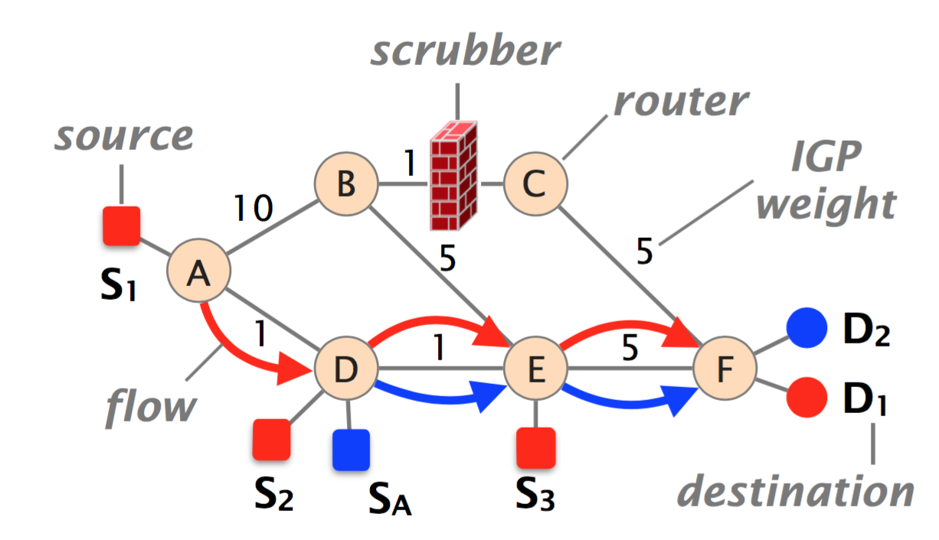
An example

Slide 15
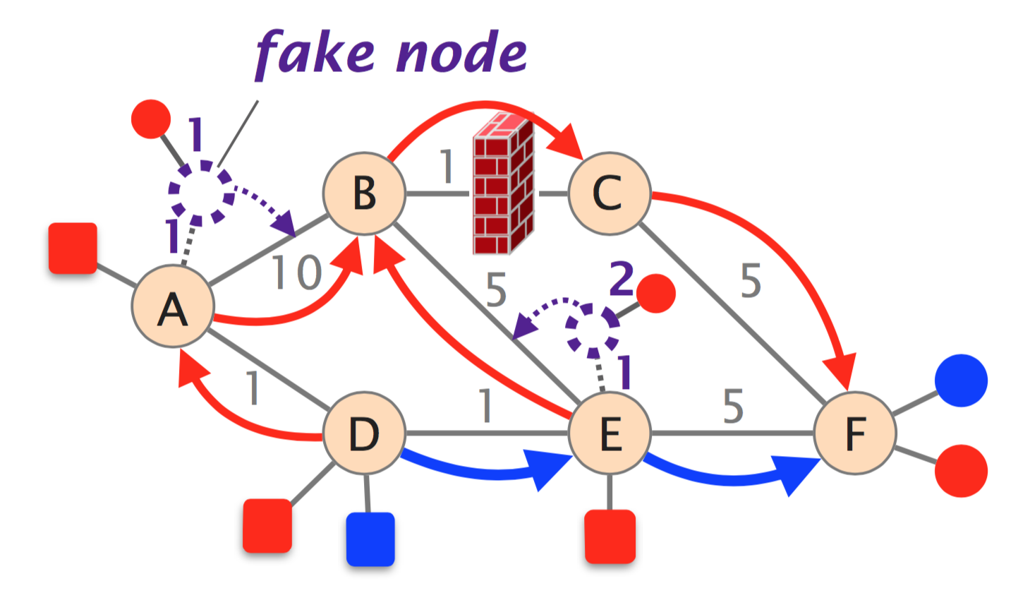
Key idea: Lies to the routers

Slide 16
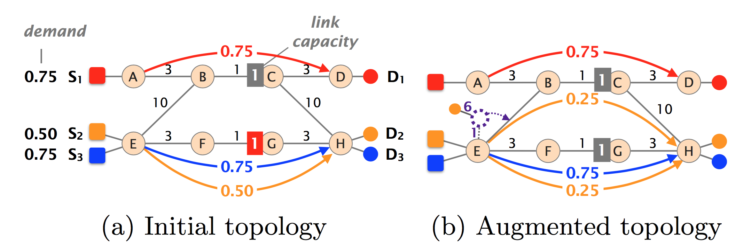
Another example

Slide 17
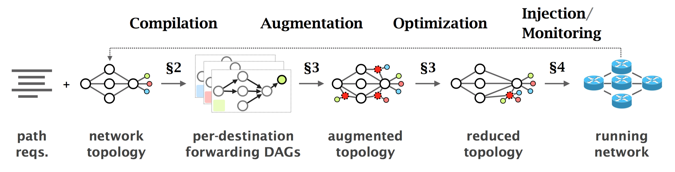
Workflow

Slide 18
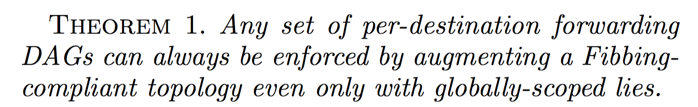
Fibbing: Expressiveness

Slide 19
Key primitives required
Initial setting of static routing weights: “Fibbing-compliance”
Local and global scoping of IGP announcements
Forwarding traffic to fake nodes on any desired link

Slide 20
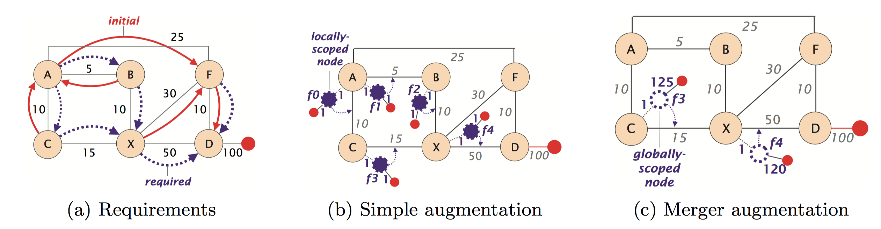
Augmentation algorithms

Slide 21
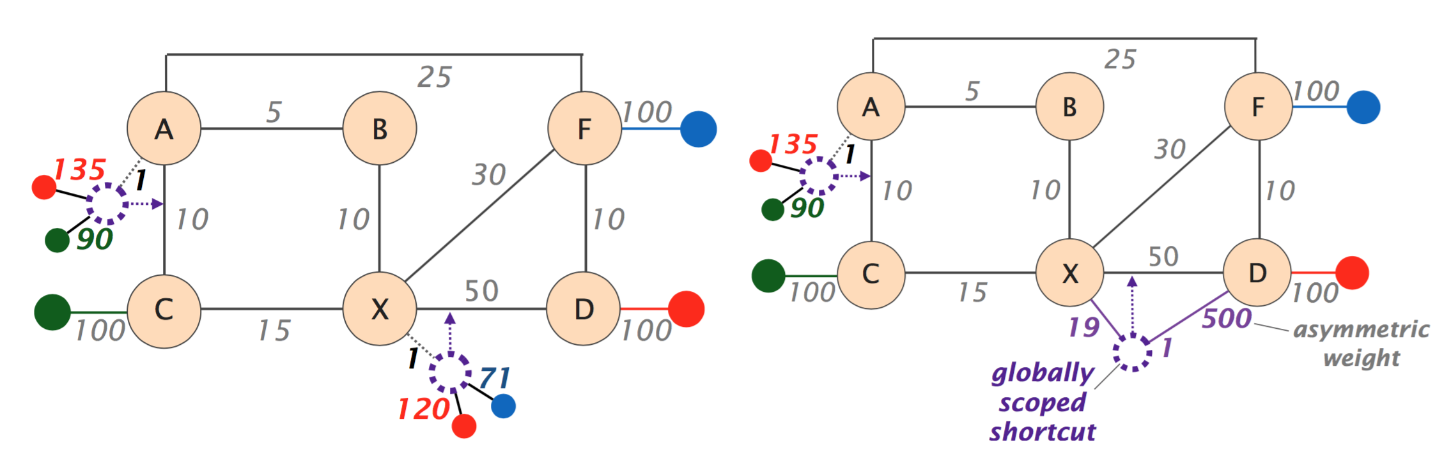
Cross-destination optimization

Slide 22
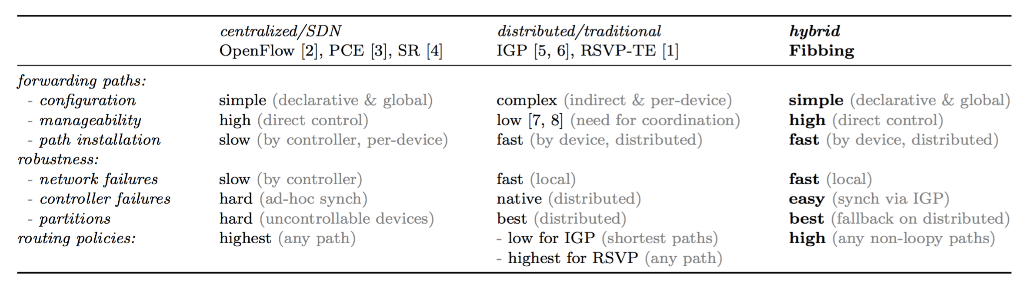
A comparison of approaches

Slide 23
Acknowledgment
Slides heavily adapted from material by Jennifer Rexford and Stefano Visicchio

