Slide 1

Web
Lecture 23, Computer Networks (198:552)

Slide 2
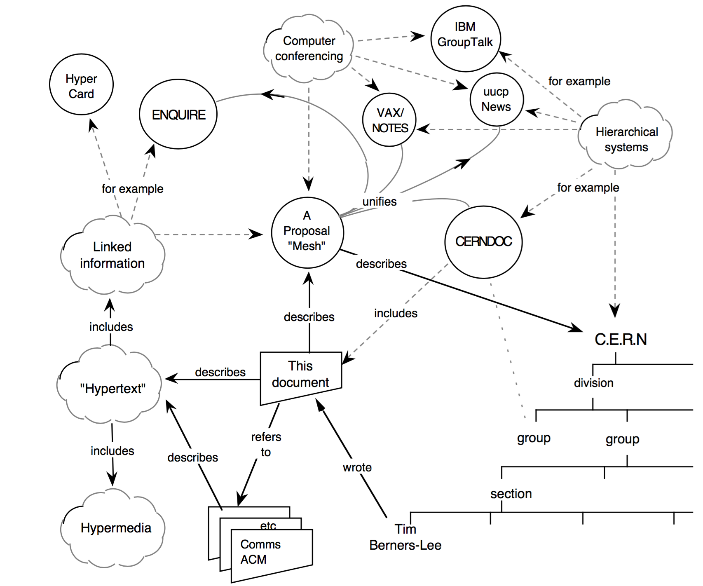
Information management: A proposal
Sir Tim Berners-Lee
https://cds.cern.ch/record/369245/files/dd-89-001.pdf

Slide 3
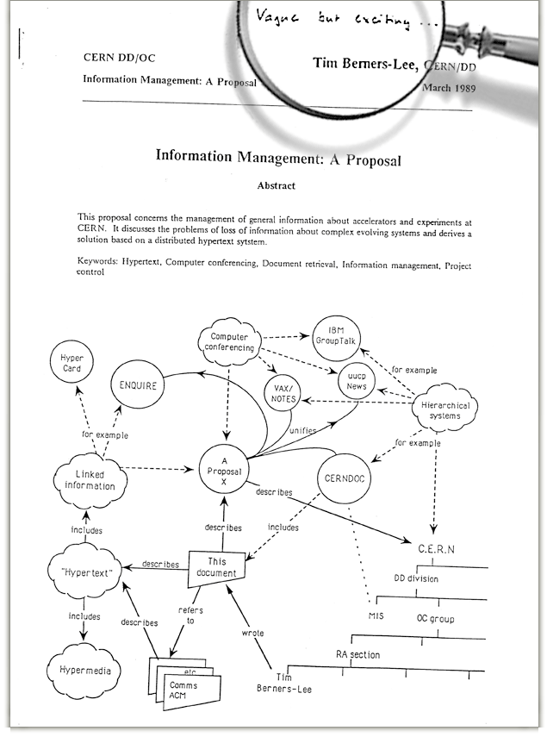
Information management: A proposal
“Vague, but exciting”

Slide 4
Prescient ideas in the original proposal
A distributed system linking content together
Non-linear text navigation (“hypertext”)
Access from different kinds of systems
Access to different kinds of data and media
The possibility of automated search and analysis
Highly dynamic content and live links

Slide 5

Structure of a web page: Rendered

Slide 6
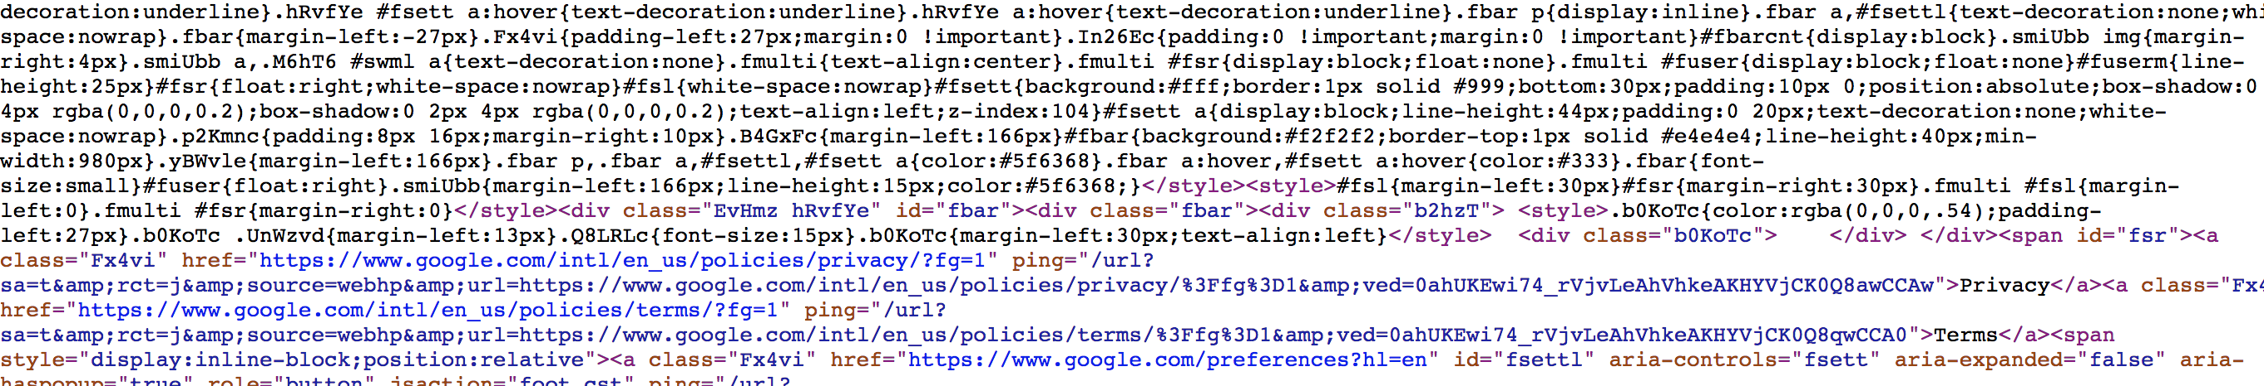
Structure of a web page: Source code
HTML: text content and (basic) formatting
<a href=“…”>link text</a>
JavaScript: content rendering
document.getElementById(“x”)
CSS: styling of an entire page
link { color: red }
Media: images, videos, etc.

Slide 7
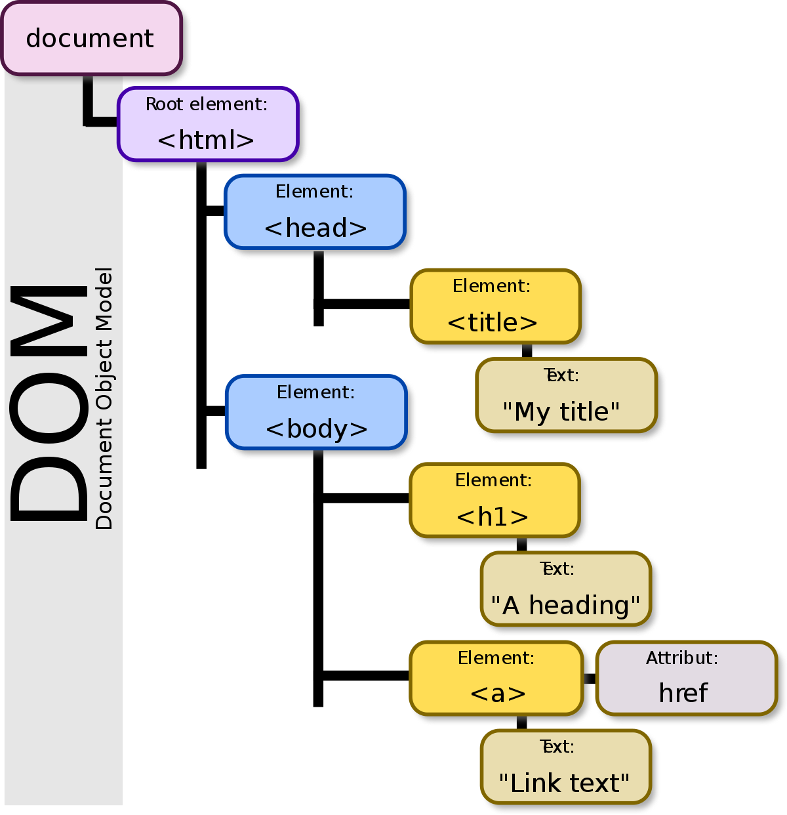
Structure of a web page: DOM
Document object model
Hierarchical representation of elements
Lexical dependencies
Interface for processing, not rendering
Common language for content specification (HTML) and formatting (JS, CSS)

Slide 8
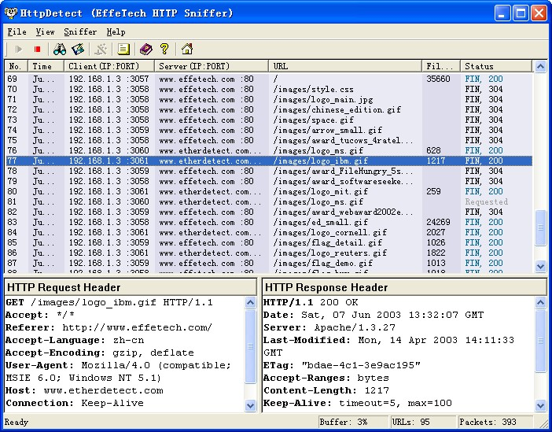
Structure of a web page: The network
Client (browser)
Origin/Server (google.com)
HTTP requests
HTTP response

Slide 9
Structure of a web page: The network
Client (browser)
Origin/Server (google.com)
HTTP requests
HTTP response
Requests based on DOM or JS (xmlHttpRequest/AJAX)

Slide 10
Polaris: Faster Page Loads using Fine-Grained Dependency Tracking
Ravi Netravali et al., NSDI ‘16
(ACK: Material by Ravi Netravali)

