Slide 1

Ordering & Flow Control
Lecture 15
http://www.cs.rutgers.edu/~sn624/352-F24
Srinivas Narayana

Slide 2
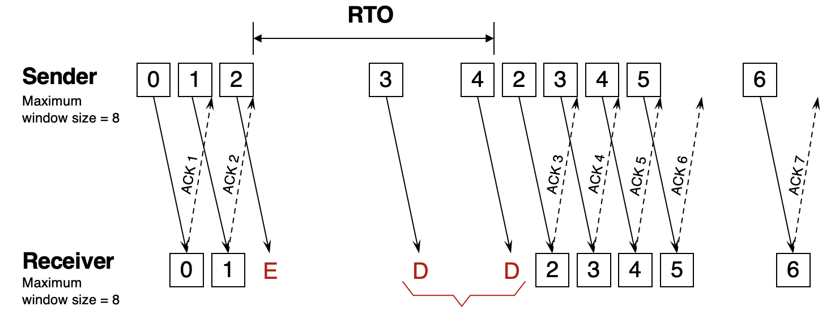
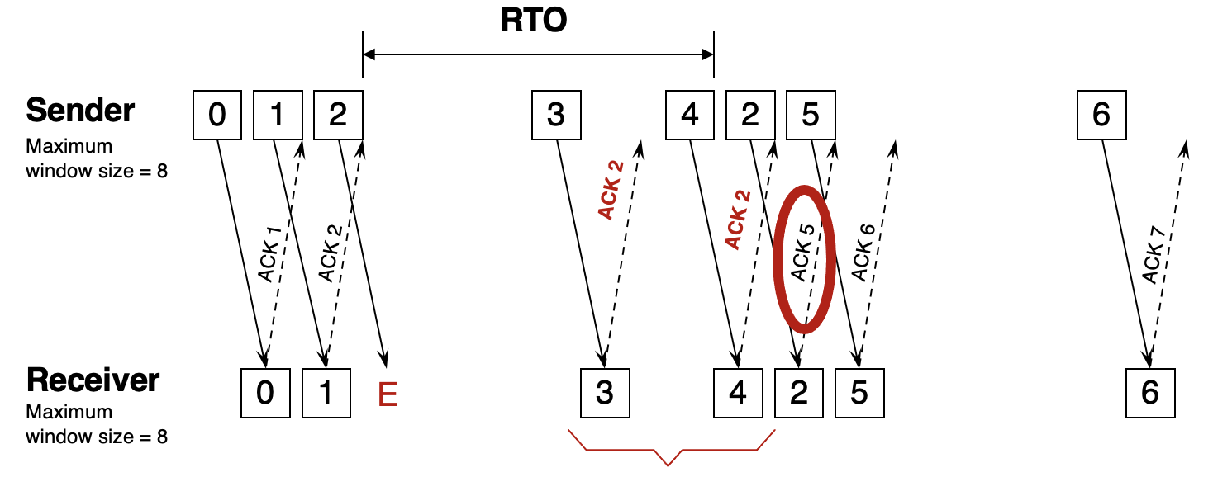
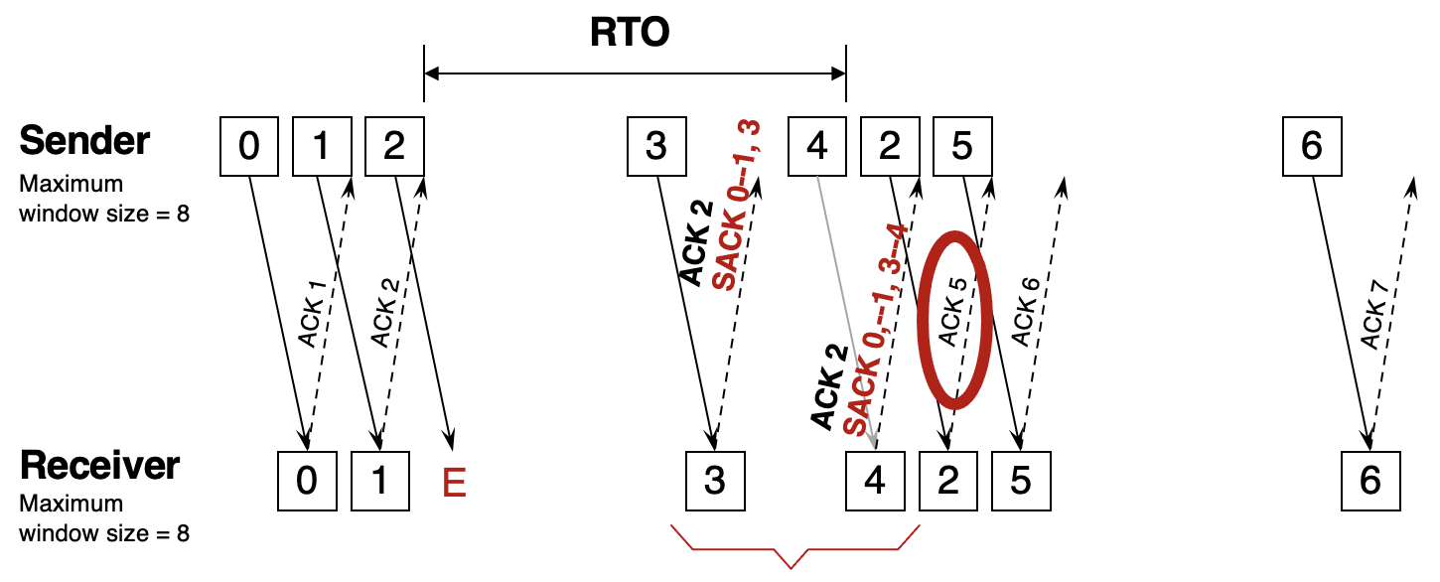
Review: Reliability
ACK pkts after a drop?
No
Yes
Go-back-N
Selective repeat
Stop and Wait
Cumulative ACK
Selective ACK
SEQ 0
SEQ 0
RTT
SEQ 1
throughput
SEQ 2
ACK
SEQ 3
SEQ 1
RTT
ACK 1
ACK 2
RTO
ACK 3
Retransmit
ACK 4
Pipelined Reliability

Slide 3
TCP reliability metadata
Where are reliability metadata (seq and ack numbers) stored?

Slide 4
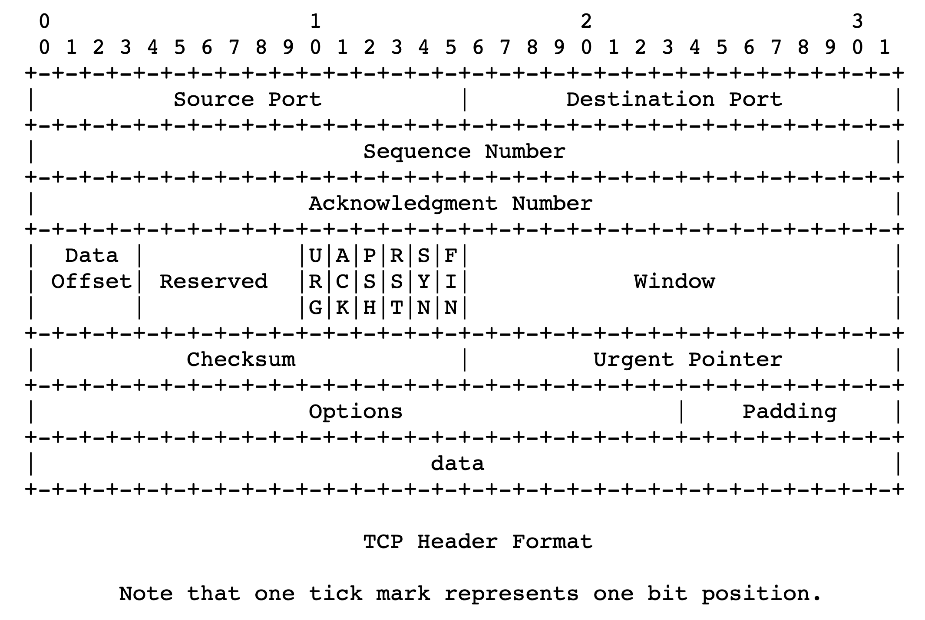
TCP header structure
Source port, destination port (connection demultiplexing)
Size of the TCP header (in 32-bit words)
Basic error detection through checksums (similar to UDP)

Slide 5
TCP header structure
Identifies data in the packet from the application stream
TCP uses byte seq #s
TCP acks the next seq # that the receiver expects.
(cumulative ACK)
Selective ACKs are written into the options field

Slide 6
Observing a TCP exchange
sudo tcpdump -i eno1 tcp portrange 56000-56010
curl --local-port 56000-56010 https://www.google.com > output.html
Bonus: Try crafting TCP packets with scapy!

Slide 7
TCP Stream-Oriented Data Transfer

Slide 8
Sequence numbers in the app’s stream
Data written by application over time
e.g., send() call
…
100
150
180
240
273
310
…
packet
packet
packet
packet
packet
Increasing sequence #s
TCP uses byte sequence numbers

Slide 9
Sequence numbers in the app’s stream
Data written by application over time
e.g., send() call
…
100
150
180
240
273
310
…
packet
packet
packet
packet
packet
Increasing sequence #s
Packet boundaries aren’t important for TCP software
TCP is a stream-oriented protocol
(We use SOCK_STREAM when creating sockets)

Slide 10
Sequence numbers in the app’s stream
Data written by application over time
e.g., send() call
…
…
1st recv()
2nd recv()
3rd recv()
4th recv()
A recv() call may return a part of a packet, a full packet, or parts of multiple packets (in order).
App does a recv()

Slide 11
Buffering and Ordering in TCP

Slide 12
Memory Buffers at the Transport Layer

Slide 13
Sockets need receive-side memory buffers
Since TCP uses selective repeat, the receiver must buffer data that is received after loss:
e.g., hold packets so that only the “holes” (due to loss) need to be filled in later, without having to retransmit packets that were received successfully
Apps read from the receive-side socket buffer when you do a recv() call.
Even if data is always reliably received, applications may not always read the data immediately
What if you invoked recv() in your program infrequently (or never)?
For the same reason, UDP sockets also have receive-side buffers

Slide 14

Receiver app’s interaction with TCP
Upon reception of data, the receiver’s TCP stack deposits the data in the receive-side socket buffer
An app with a TCP socket reads from the TCP receive socket buffer
e.g., when you do data = sock.recv()
application
process
recv()
TCP socket
receiver buffers
TCP
code
from sender
receiver TCP interaction

Slide 15
Sockets need send-side memory buffers
The possibility of packet retransmission in the future means that data can’t be immediately discarded from the sender once transmitted.
App has issued send() and moved on; TCP stack must buffer this data
Transport layer must wait for ACK of a piece of data before reclaiming (freeing) the memory for that data.
application
process
send()
TCP socket
sender buffers
TCP
code
to receiver
sender TCP interaction

Slide 16
Ordered Delivery

Slide 17

Reordering packets at the receiver side
Let’s suppose receiver gets packets 1, 2, and 4, but not 3 (dropped)
Suppose you’re trying to download a document containing a report
What would happen if transport at the receiver directly presents packets 1, 2, and 4 to the application (i.e., receiving 1,2,4 through the recv() call)?
Sender
Receiver
1
2
3
4
1
2
4
5

Slide 18
Reordering packets at the receiver side
Reordering can happen for a few reasons:
Drops
Packets taking different paths through a network
Receiver needs a general strategy to ensure that data is presented to the application in the same order that the sender pushed it. Ideas?
To implement ordered delivery, the receiver uses
Sequence numbers
Receiver socket buffer
We’ve already seen the use of these for reliability; but they can be used to order too!
Sender
Receiver
1
2
3
4
1
2
3
5
5

Slide 19
Receive-side app and TCP
TCP receiver software only releases the data from the receive-side socket buffer to the application if:
the data is in order relative to all other data already read by the application
This process is called TCP reassembly
application
process
recv()
TCP socket
receiver buffers
TCP
code
from sender
receiver protocol stack

Slide 20
TCP Reassembly
Sender/Net writes here
Application can recv() up to here
1
2
1
2
4
1
2
3
4
Socket buffer memory on the receiver

Slide 21
Implications of ordered delivery
Packets cannot be delivered to the application if there is an in-order packet missing from the receiver’s buffer
The receiver can only buffer so much out-of-order data
Subsequent out-of-order packets dropped
It won’t matter that those packets successfully arrive at the receiver from the sender over the network
TCP application-level throughput will suffer if there is too much packet reordering in the network
Data may have reached the receiver, but won’t be delivered to apps upon a recv() (...or may not even be buffered!)

Slide 22
How much data to keep in flight?
= window size
Proportional to throughput
SEQ 0
SEQ 1
SEQ 2
Stop and Wait
SEQ 3
SEQ 0
RTT
ACK 1
ACK 2
ACK 3
ACK 4
RTT
ACK
SEQ 1
Pipelined Reliability
RTO
Retransmit

Slide 23

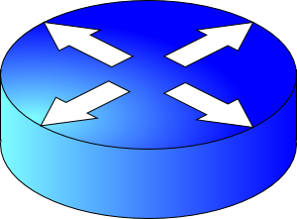
We want to increase throughput, but …
Multiple locations for bottlenecks
sender
application
process
recv()
TCP socket
receiver buffers
Flow Control
What’s the bottleneck? How to adapt how much data to keep in flight?
TCP
code
Congestion Control
from sender
receiver

Slide 24
Flow Control

Slide 25
Socket buffers can become full
application
process
Applications may read data slower than the sender is pushing data in
Example: what if an app infrequently or never calls recv()?
There may be too much reordering or packet loss in the network
What if the first few bytes of a window are lost or delayed?
Receivers can only buffer so much before dropping subsequent data
TCP socket
receiver buffers
TCP
code
from sender
TCP receiver

Slide 26
Goal: avoid drops due to buffer fill
application
process
Have a TCP sender only send as much as the free buffer space available at the receiver.
Amount of free buffer varies over time!
TCP implements flow control
Receiver’s ACK contains the amount of data the sender can transmit without running out the receiver’s socket buffer
This number is called the advertised window size
TCP socket
receiver buffers
TCP
code
from sender
receiver protocol stack

Slide 27
Flow control in TCP headers

Slide 28
TCP flow control
Receiver advertises to sender (in the ACK) how much free buffer is available
Sender
Receiver
1
2
3
4
1
2
3
4
5

Slide 29
TCP flow control
Subsequently, the sender’s sliding window cannot be larger than this value
Restriction on new sequence numbers that can be transmitted
== restriction on sending rate
Sender
Receiver
1
2
3
4
1
2
3
Window <= Advertised window
4
5
Sender’s view:
0
1
2
3
4
5
6
7
0
1
Last cumulative
ACK’ed seq #
Last transmitted
seq #

Slide 30
TCP flow control
If receiver app is too slow reading data:
receiver socket buffer fills up
=> advertised window shrinks
=> sender’s window (sending rate) reduces
=> sender’s socket buffer fills up
=> sender process put to sleep upon send()
Sender
Receiver
1
2
3
4
1
2
3
Window <= Advertised window
4
5
Sender’s view:
0
1
2
3
4
5
6
7
0
1
Last cumulative
ACK’ed seq #
Last transmitted
seq #

Slide 31
TCP flow control
Flow control matches the sending process’s write speed to the receiving process’s read speed.
Sender
Receiver
1
2
3
4
1
2
3
Window <= Advertised window
4
5
Sender’s view:
0
1
2
3
4
5
6
7
0
1
Last cumulative
ACK’ed seq #
Last transmitted
seq #

Slide 32
Sizing the receiver’s socket buffer
Operating systems have a default receiver socket buffer size
Listed among sysctl –a | grep net.inet.tcp on MAC
Listed among sysctl –a | grep net.ipv4.tcp on Linux
If socket buffer is too small, sender can’t keep too many packets in flight ➔ lower throughput
If socket buffer is too large, too much memory consumed per socket
How big should the receiver socket buffer be?

Slide 33
Sizing the receiver’s socket buffer
Case 1: Suppose the receiving app is reading data too slowly:
no amount of receiver buffer can prevent low sender throughput if the connection is long-lived!

Slide 34
Sizing the receiver’s socket buffer
Case 2: Suppose the receiving app reads sufficiently fast on average to match the sender’s writing speed.
Assume the sender has a window of size W.
The receiver must use a buffer of size at least W. Why?
Captures two cases:
(1) When the first sequence #s in the window are dropped
Selective repeat: data in window buffered until the “hole” within the window can be filled by the sender. Advertised window reduces sender’s window
(2) When the sender sends a burst of data of size W
The receiver may not keep up with the instantaneous rate of the sender
Set receiver socket buffer > desired window size

Slide 35
Summary of flow control
Keep memory buffers available at the receiver whenever the sender transmits data
Buffers needed to hold for selective repeat and reassemble data in order
Inform the sender on an on-going basis (each ACK)
Function: match sender speed to receiver speed
Correct socket buffer sizing is important for TCP throughput

Slide 36
Info on (tuning) TCP stack parameters
https://www.ibm.com/support/knowledgecenter/linuxonibm/liaag/wkvm/wkvm_c_tune_tcpip.htm
https://cloud.google.com/solutions/tcp-optimization-for-network-performance-in-gcp-and-hybrid

