Slide 1

Measurement, App Layer
Lecture 3
http://www.cs.rutgers.edu/~sn624/352-F24
Srinivas Narayana

Slide 2
Review
Switching: Circuit, Message, Packet
Layering: Modularity
Application: useful user-level functions
User space
Transport: provide guarantees to apps
Kernel space
Network: best-effort global pkt delivery
Functionality is implemented in protocols
Link: best-effort local pkt delivery

Slide 3
Protocols: The “rules” of networking
Protocols consist of two things
Message format
structure of messages exchanged with an endpoint
Actions
operations upon receiving, or not receiving, messages
Example of a Zoom conversation:
Message format: English words and sentences
Actions: when a word is heard, say “yes”; when nothing is heard for more than 3 seconds, say “can you hear me?”

Slide 4

The protocols of the Internet
Standardized by the Internet Engineering Task Force (IETF)
through documents called RFCs (“Request For Comments”)
Layering of protocols
HTTP
FTP
NV
TFTP
HTTPS
FTP
HTTP
SIP
RTSP
TCP
UDP
TCP
UDP
IP
IP
Ether
ATM
…
WiFi
X.25
…
802.11
ATM

Slide 5
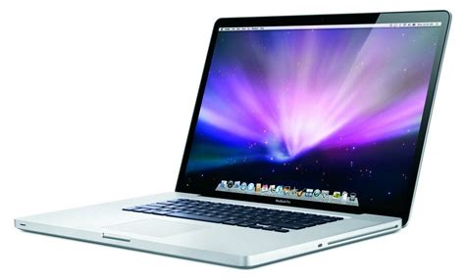
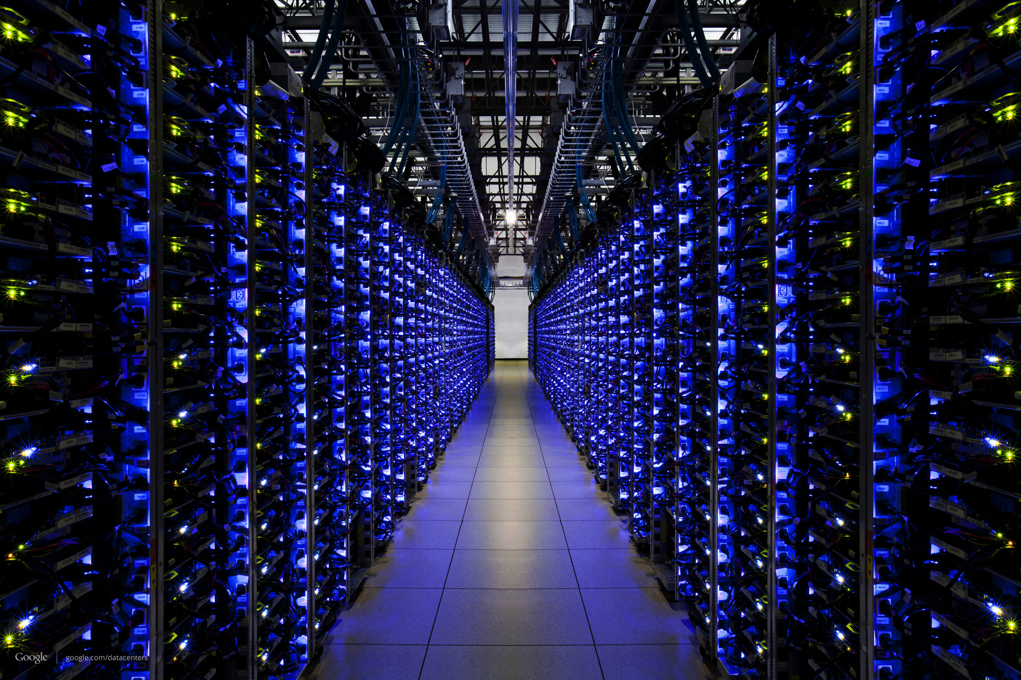
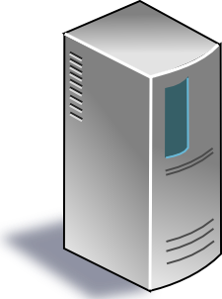

The Internet
Applications
Applications
Packet starts as an
app message
Transport
Packet takes on headers at each layer
Transport
Network
Network
Link layer
Link layer
The Internet

Slide 6

Applications
Applications
Transport
Transport
Network
Network
Network
Network
Link layer
Link layer
Link layer
Link layer

Slide 7
Applications
Applications
Routers have network and link layers too!
Transport
Transport
Network
Network
Network
Network
Link layer
Link layer
Link layer
Link layer

Slide 8
Layering
Communication over the Internet is a complex problem.
Layering simplifies understanding, testing, maintaining
Easy to improve or replace protocol at one layer without affecting others

Slide 9

This course has layers
Application
HTTPS
FTP
HTTP
SIP
RTSP
Transport
TCP
UDP
Network
IP
Host-to-Net
X.25
…
802.11
ATM

Slide 10
Measuring the Internet
Speed, by any other name

Slide 11
What exactly do we mean by speed?
A packet consists of many bits, including header and data
Packet size: length of the packet (bits or bytes) incl. header and data
Bandwidth: For a single link, amount of data it can transmit per unit time (bits/second or Bytes/second or packets/second)
Total packet delay: time from the first bit@sender to the last bit@receiver

Slide 12
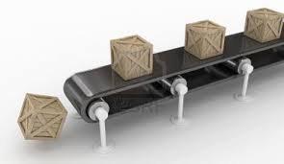
Bandwidth and delay are related but distinct
Propagation delay
Bandwidth
Total packet delay = time for a box to travel the length of the belt
Bandwidth = the number of boxes put on the belt per minute (“rate”)

Slide 13
High
Bandwidth
GPU—GPU link in an AI compute cluster
Trans-continental optic fiber
Low delay
High delay
Bluetooth link
Satellite link
(e.g., on a foggy day)
Low
Bandwidth

Slide 14
Total Packet Delay has a few pieces
Propagation delay: Time needed to move one bit across (second)
Imposed by the communication medium; depends on the link “length”
Transmission delay: Time from first bit@sender to last bit@sender
Determined by link bandwidth and packet size
Packet size / link bandwidth
Queueing delay: Time that a packet waits for transmission
Determined by contention for the link
Total packet delay = propagation delay + queueing delay + transmission delay for a single packet

Slide 15

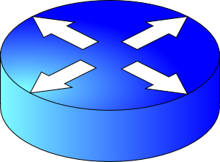
Visualizing the components of delay
Transmission delay at the first link
Propagation delay of first link
Queueing at the router
Increasing time
Transmission delay at the second link
Propagation delay of second link

Slide 16
Bandwidth and delay demo
Throughput (related to bandwidth)
iperf –s # at the destination
iperf –c <destination> # at the source,
e.g., iperf –c localhost
(total) delay
ping <destination>
e.g., ping google.com
(you can try it!)

Slide 17
Application Layer

Slide 18









App-layer communication
Internet applications reside on multiple endpoints
Need addresses to identify the communicating endpoints
E.g., Telephone network: xxx-yyy-zzzz
Internet: Internet Protocol (IP) addresses
IPv4 (32 bits) 128.6.24.78
IPv6 (128 bits) 2001:4000:A000:C000:6000:B001:412A:8000
Which app on each endpoint? Port number
IP addr
IP addr
Internet
port
port

Slide 19
How are addresses used?
Socket: abstraction (API) of the Internet for applications
IP_{A}
IP_{B}
Internet
port_{B}
port_{A}
App process
App process
User space
User space
Socket
Socket
Kernel space
Kernel space
Operating system’s network stack
Operating system’s network stack
Internet
App-layer connection is a 4-tuple: (IP_{A}, port_{A}, IP_{B}, port_{B})

Slide 20
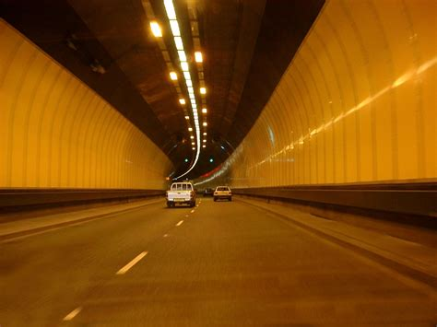



Socket system calls
Process A
(client)
connect(
IP_{B}, port_{B})
send()
Process B
(server)
bind(IPaddr_{B}, port_{B})
listen()
accept()
recv()
process
process
IP_{B} + port_{B}
socket
socket
IP_{A} + port_{A}

Slide 21
Seeing app-layer connections
netstat
ss

