Slide 1

Domain Name System
Lecture 4
http://www.cs.rutgers.edu/~sn624/352-F24
Srinivas Narayana

Slide 2



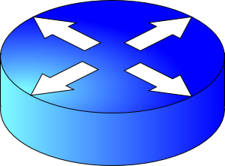

Review
Connection 4-tuple
IP_{A}
IP_{B}
port_{A}
port_{B}
Application process
Application process
Propagation
bind(IP_{B}, port_{B})
listen()
accept()
recv(data)
Transmission
connect(IP_{B}, port_{B})
send(data)
Bandwidth
Queueing
User space
Socket
Socket
Kernel space
OS network stack layers
OS network stack layers
Internet

Slide 3
Common Architectures of Applications

Slide 4
Client-server architecture
client
Server:
Always-on endpoint
Provides a “service” to the world
Typically, a permanent IP address
Hosted in clusters to scale to many users
Clients:
A “customer” of the service
Maybe intermittently connected
May have dynamic IP addresses
Typically, do not communicate directly with other clients
The web and most mobile apps use a client-server architecture
server
client

Slide 5
Peer-to-peer (P2P) architecture
peer
Peers:
Intermittently connected hosts
Directly talking to each other
Little to no reliance on always-up servers
Examples: BitTorrent
Today, many applications use a hybrid model: servers to set up connectivity, communicate directly afterward
Example: (webRTC) Google meet
peer

Slide 6
Going forward: A few app-layer protocols
Domain Name System
The web
Streaming video

Slide 7
Domain Name System

Slide 8
Domain Name System (DNS)
Problem: Humans cannot remember Internet (IP) addresses
The average human brain can remember 7 digits for a few names
On average, IP addresses have 12 digits
Solution: Use human-friendly names to refer to endpoints
Alphanumeric names (e.g. www.cs.rutgers.edu)
Called host names or domain names
A new problem! We need a directory (address book) to translate human-friendly names to IPs

Slide 9
You have a name. Can you lookup an address?

Slide 10

Directories
Directories map a name to an address
We call this process Address Resolution
Simplistic designs
Central directory
Ask everyone (flooding)
Tell everyone (e.g., push to a file like /etc/hosts)
Scalable distributed designs
Hierarchical namespace (e.g., Domain Name System (DNS))
Flat namespace (e.g., Distributed Hash Table)

Slide 11
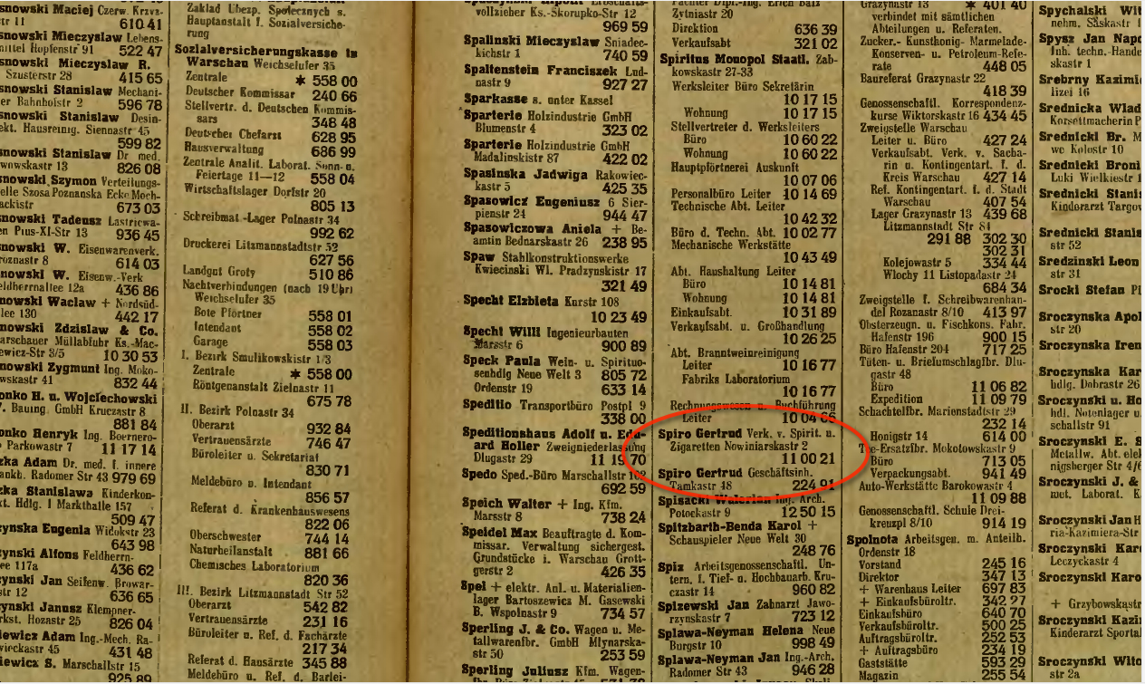
Simple DNS (“tell everyone”)
What if every endpoint has a local directory?
/etc/hosts.txt: how DNS worked in the early days of the Internet
Q: What if endpoints changed addresses? How do you keep this up to date?

Slide 12
Simple DNS
DOMAIN NAME | IP ADDRESS
spotify.com | 98.138.253.109
cs.rutgers.edu | 128.6.4.2
www.google.com | 74.125.225.243
www.princeton.edu | 128.112.132.86
<Client IP, CPort, DNS server IP, 53>
Name server
QUERY cs.rutgers.edu
<DNS server, 53, Client IP, Cport>
RESPONSE 128.6.4.2
Pre-designated DNS server port: 53
Key idea: Implement a server that looks up a table.
Would this work?
Every new (changed) host needs to be entered in this table
Performance: can the server serve billions of Internet users
Failure: what if the server or the database crashes?
How to secure this server?

Slide 13
Ideas to make DNS work for the Internet
Idea #1. Hierarchy
Organize names hierarchically so we can divide the work of resolution
Internet: some names under “.com”, others with “.org”, “.edu”, …
Called top-level domains (TLD)
TLDs may contain sub-domains, sub-sub-domains, …
Lowest level: fully qualified domain name (e.g. people.cs.rutgers.edu)
Idea #2. Distribution
Each node in the hierarchy served separately (name servers)
Lowest level: Manage changes in IP addresses of endpoints
Authoritative name server

Slide 14
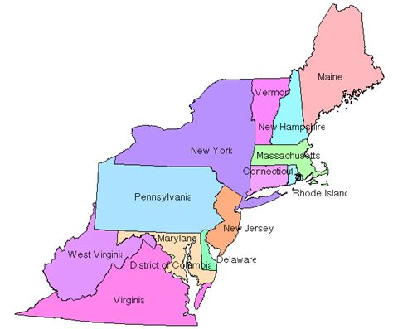
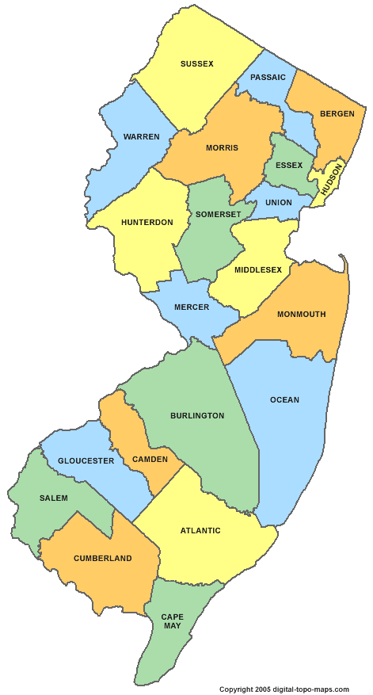

Distributed and Hierarchical database
Root DNS Servers
Top-level domain (TLD) servers
com DNS servers
org DNS servers
edu DNS servers
google.com
DNS servers
wnyc.org
DNS servers
rutgers.edu
DNS servers
umass.edu
DNS servers
amazon.com
DNS servers
cs.rutgers.edu DNS server
Authoritative name server
RFC 1034
Hierarchy
Replication

Slide 15
DNS Protocol
Client-server application
Client connects to (known) port 53 on server
For now, assume the DNS server IP is known
Two types of messages
Queries
Responses
Type of Query (OPCODE)
Standard query (0x0)
e.g., Request IP address for a given domain name
Updates (0x5)
Provide a binding of IP address to domain name

Slide 16
DNS in action
dig <domain-name>
dig +trace <domain-name>
dig @<dns-server> <domain-name>
Don’t just watch; try it!

Slide 17
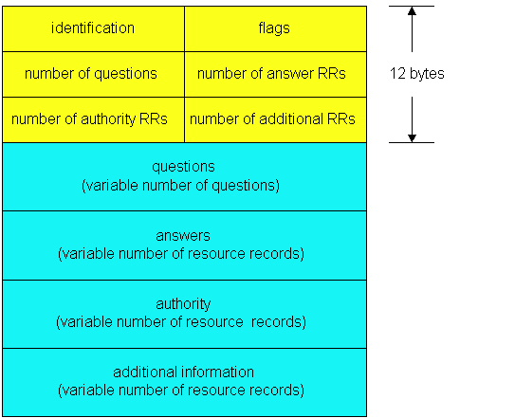
DNS protocol: Message format
DNS protocol : query and reply messages, both with same message format
QR
Opcode
Message header
QR = 0 for Query, 1 for response
Opcode= 0 standard
identification: 16 bit # for query, reply to query uses same #
flags:
Authoritative answer
recursion desired
recursion available
reply is authoritative

Slide 18
DNS protocol: Message format
QR
OPCODE
Name, class, type fields
for a query
Resource records in response to query
records for
authoritative servers
additional helpful
info that relates to the query
(but not the answer)

Slide 19

DNS Protocol: Actions
When client wants to know an IP address for a host name
Client sends a DNS query to the “local” name server in its network
If name server contains the mapping, it returns the IP address to the client
Otherwise, the name server forwards the request to the root name server
The request works its way down the DNS hierarchy until it reaches a name server with a mapping for the requested name

Slide 20
Example
root DNS server
2
Host at cs.rutgers.edu wants IP address for gaia.cs.umass.edu
Local DNS server
Root DNS server
TLD DNS server
Authoritative DNS server
3
.edu DNS server
4
5
local DNS server
dns.rutgers.edu
7
6
1
8
umass.edu DNS server
dns.umass.edu
requesting host
cs.rutgers.edu
gaia.cs.umass.edu

Slide 21
Query type
root DNS server
2
Iterative query
Contacted server replies with name of server to contact
“I don’t know this name, but ask this other server”
Queries 2,4,6 are iterative from point of view of the local DNS server
3
.edu DNS server
4
5
local DNS server
dns.rutgers.edu
7
6
1
8
umass.edu DNS server
dns.umass.edu
requesting host
cs.rutgers.edu
gaia.cs.umass.edu

Slide 22
Query type
root DNS server
Recursive query:
Puts burden of name resolution on the contacted (e.g., root) name server
Query 2 (to root DNS server) is recursive from the local server
In general, recursive is not preferred for higher levels of the DNS hierarchy
2
3
7
6
.edu DNS server
local DNS server
dns.rutgers.edu
5
4
1
8
umass.edu DNS server
dns.umass.edu
requesting host
cs.rutgers.edu
gaia.cs.umass.edu

Slide 23
Problem: Load on Higher Levels of DNS
Think about the query load on the root DNS server (regardless of recursive/iterative)
Must root server answer every DNS query?

Slide 24
DNS caching
Once (any) name server learns a name to IP address mapping, it caches the mapping
Cache entries timeout (disappear) after some time
TLD servers typically cached in local name servers
In practice, root name servers aren’t visited often!
Caching is pervasive in DNS

Slide 25
Bootstrapping DNS
How does a host contact the name server if all it has is the domain name and no (name server) IP address?
IP address of at least 1 nameserver (usually, a local name server) must be known a priori
The local name server may be bootstrapped “statically”, e.g.,
File /etc/resolv.conf in unix
Start -> settings-> control panel-> network ->TCP/IP -> properties in windows
The local name server or with another protocol!
DHCP: Dynamic Host Configuration Protocol

Slide 26




DNS may seem “basic”, low level, but …

Slide 27
DNS Resource Records

Slide 28
DNS is a distributed database
DNS stores resource records (RRs)
(Incomplete) message format for each resource record (RR):
Class, type, name, value, TTL
You can read all the gory details of the message format at https://www.iana.org/assignments/dns-parameters/dns-parameters.xhtml

Slide 29
DNS records
Type=A
name is hostname
value is IPv4 address
Type=CNAME
name is alias name for some “canonical” (the real) name
e.g., www.ibm.com is really
servereast.backup2.ibm.com
value is canonical name
Type=AAAA
name is hostname
value is IPv6 address
Type=NS
name is domain (e.g. foo.com)
value is hostname of authoritative name server for this domain
Type=MX
value is name of mailserver associated with name
More complete info at https://www.iana.org/assignments/dns-parameters/dns-parameters.xhtml

Slide 30
DNS record example
NAME | Design.cs.rutgers.edu
TYPE | A
CLASS | IN
TTL | 1 day(86400)
ADDRESS | 192.26.92.30
RRs in response
to query
records for
authoritative servers
Information about nameserver
NAME | Cs.rutgers.edu
TYPE | NS
CLASS | IN
TTL | 1 day(86400)
NSDNAME | Ns-lcsr.rutgers.edu
DNS serves as a general repository of information for the Internet!

Slide 31
DNS record types
dig –t <type> <domain-name>

Slide 32
Summary of DNS
Hostname to IP address translation via a global network of servers
Embodies several scaling principles
Partition through a hierarchy to silo query load
Replication to scale out at each level of hierarchy
Caching to reduce query load
Once you have a reliable DB, can implement many useful things on top!
Example 1: Scaling large web services, e.g., google search, by redirecting different clients to different servers (IP addresses)
Reliability, load balancing, performance optimization
Example 2: Associating certificates, keys (security info) with domain names
https://www.rfc-editor.org/rfc/rfc8162.html
https://datatracker.ietf.org/doc/draft-ietf-dnsop-svcb-https/00/

