Slide 1

Transport
Lecture 5, Computer Networks (198:552)

Slide 2
Network Core: Best effort packet delivery
Routers (typically) make no guarantees about
… whether packets get delivered
… whether packets will reach without being corrupted
… whether packets will reach the other side in order
… the app performance experienced by a user
So how are we still able to get good performance over the Internet?

Slide 3

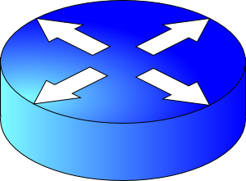
Network Edge: Application guarantees
How should endpoints provide guarantees to applications?
Transport software on the endpoint is in charge of implementing guarantees on top of an unreliable network
Reliability
Ordered delivery
Packet delay not exceeding 50 ms?

Slide 4
Modularity through layering
Protocols “stacked” in endpoint and router software/hardware
Apps: useful user-level functions
HTTP
FTP
NV
TFTP
Transport: provide guarantees to apps
TCP
UDP
IP
Network: best-effort global pkt delivery
Ether
ATM
…
WiFi
Link: best-effort local pkt delivery

Slide 5
Two Basic Transport Features
Demultiplexing: port numbers
Error detection: checksums
Server host 128.2.194.242
Service request for
128.2.194.242:80
(i.e., the Web server)
Client host
Web server
(port 80)
Client
OS
Echo server
(port 7)
IP
payload
detect corruption

Slide 6
Two Main Transport Layers
User Datagram Protocol (UDP)
Abstraction of independent messages between endpoints
Just provides demultiplexing and error detection
Header fields: port numbers, checksum, and length
Low overhead, good for query/response and multimedia
Transmission Control Protocol (TCP)
Provides support for a stream of bytes abstraction

Slide 7
Transmission Control Protocol (TCP)
Multiplexing/demultiplexing
Determine which conversation a given packet belongs to
All transports need to do this
Reliability and flow control
Ensure that data sent is delivered to the receiver application
Ensure that receiver buffer doesn’t overflow
Ordered delivery
Ensure bits pushed by sender arrive at receiver app in order
Q: why would packets ever be received out of order?
Congestion control
Ensure that data sent doesn’t overwhelm network resources
Q: which network resource?

Slide 8
Reliable data delivery

Slide 9

Packet loss
Sender
Receiver
How might a sender and receiver ensure that data is delivered reliably (despite some packets being lost)?
TCP uses two mechanisms

Slide 10
Coping with packet loss: (1) ACK
Key idea: Receiver returns an acknowledgment (ACK) per packet sent
If sender receives an ACK, it knows that the receiver got the packet.
What if a packet was lost and ACK never arrives?
Sender
Receiver
packet
ACK
packet
ACK

Slide 11
Coping with packet loss: (2) RTO
Key idea: Wait for a duration of time (called retransmission timeout or RTO) before re-sending the packet
In TCP, the onus is on the sender to retransmit lost data when ACKs are not received
Retransmission works also if ACKs are lost or delayed
Sender
Receiver
RTO
ACK

Slide 12
Sending one packet per ACK enough?
Should sender wait for an ACK before sending another packet?
Consider:
Round-trip-time: 100 milliseconds
Packet size: 12,000 bits
Link rate: 12 Mega bits/s
Suppose no packets are dropped
At what rate is the sender getting data across to the receiver?
Sender
Receiver
RTT
RTO
120 Kilo bit/s (1% of link rate)

Slide 13
Amount of “in-flight” data
We term the amount of unACKed data as data “in flight”
With just one packet in flight, the data rate is limited by the packet delay (RTT) rather than available bandwidth (link rate)
Idea: Keep many packets in flight!
More packets in flight improves throughput

Slide 14
Keeping many packets in flight
In our example before, if there are, say 4 packets in flight, throughput is 480 Kbits/s!
We just improved the throughput 4 times by keeping 4 packets in flight
Trouble: what if some packets (or ACKs) are dropped?
How should the sender retransmit?
Sender
Receiver
RTT
RTO

Slide 15
Keeping track of packets (and ACKs)
Every packet contains a sequence number
(In reality, every byte has a sequence number)
ACK echoes the sequence number of the packet that is acknowledged
If a packet is dropped, should the receiver ACK subsequent packets?
If so, with what sequence number?
Sender
Receiver
1
2
3
4
1
2
3
4
5

Slide 16
Keeping track of packets (and ACKs)
Cumulative ACKs: ACK the latest seq# up to which all packets received
Selective ACKs: return one cumulative seq# and ranges of other seq# received
Sender retransmits those packets whose sequence numbers haven’t been ACKed
What are the implications of selective vs. cumulative ACKs here?
Sender
Receiver
1
2
3
4
1
2
3
4
5

Slide 17
How should the RTO be set?
Clearly, RTO must be related to RTT
But how exactly?
Sender
Receiver
1
2
3
4
1
RTT
2
3
4
5
RTO

Slide 18
Ordered Delivery

Slide 19

Reordering packets at the receiver side
Let’s suppose receiver gets packets 1, 2, and 4, but not 3 (dropped)
Suppose you’re trying to download a Word document containing a report
What would happen if transport at the receiver directly presents packets 1, 2, and 4 to the Word application?
Sender
Receiver
1
2
3
4
1
2
4
5

Slide 20
Reordering at the receiver side
Reordering can also happen due to packets taking different paths through a network
Receiver needs a general strategy to ensure that data is presented to the application in the same order of sender side bytes pushed
Sender
Receiver
1
2
3
4
1
2
4
5
3

Slide 21
Buffering at the receiver side
Network writes here
Application can read up to here
1
2
1
2
4
1
2
3
4
Memory on the receiver machine

Slide 22
Buffering at the receiver side
The TCP receiver uses a memory buffer to hold packets until they can be read by the application in order
This process is known as TCP reassembly

Slide 23
Implications of ordered delivery
Packets cannot be delivered to the application if there is an in-order packet missing from the receiver’s buffer
TCP application throughput will suffer if there is too much packet “reordering” in the network
There is only so much the receiver can buffer before dropping subsequent packets (even if successfully arrived at receiver)
A TCP sender can only send as much as the free receiver buffer space available before packets are dropped at the receiver
This number is called the receiver window size
TCP is said to implement flow control

Slide 24
Implications of ordered delivery
The receiver can only buffer so much out-of-order data
Subsequent out-of-order packets are dropped
It doesn’t matter that the packets successfully arrive at the receiver NIC from the sender over the network
A TCP sender can only send as much as the free receiver buffer space available before packets are dropped at the receiver
This number is called the receiver window size
TCP is said to implement flow control

Slide 25
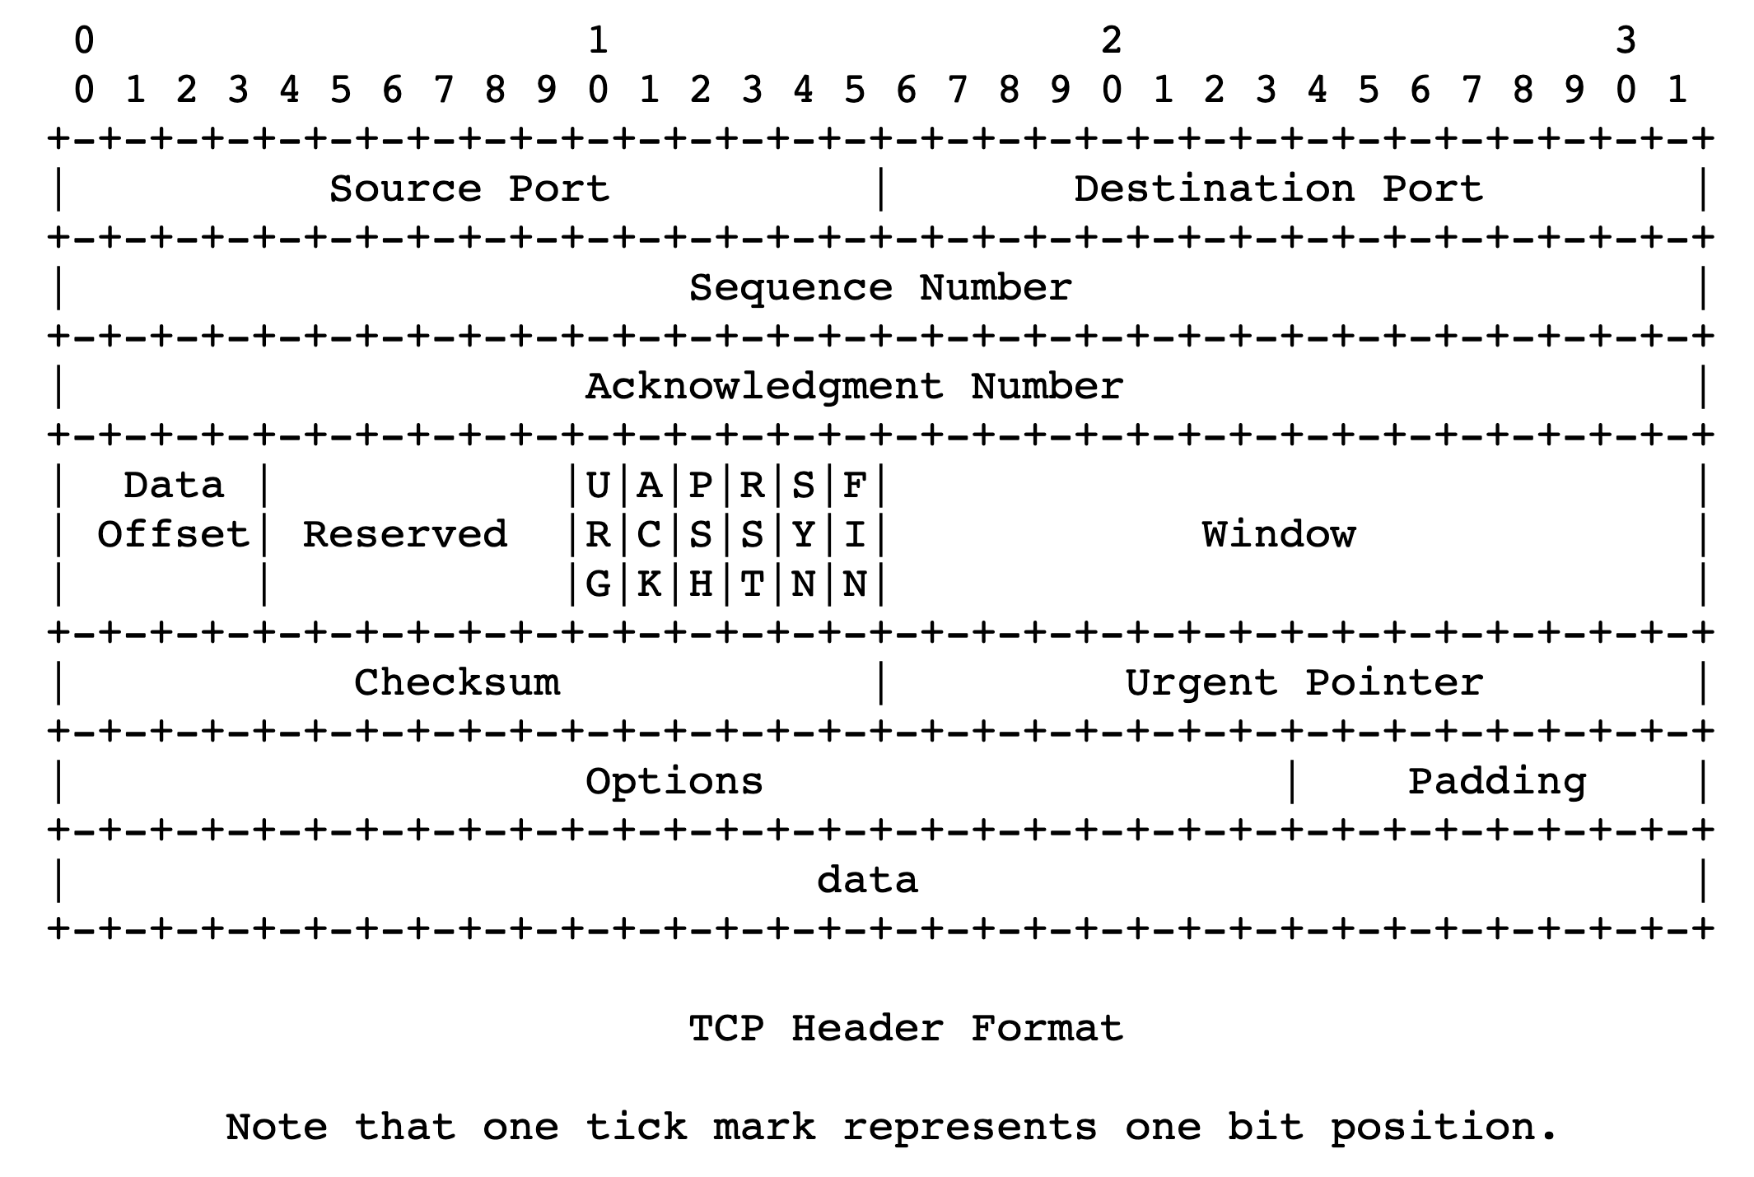
Flow control headers

Slide 26
Sizing the receiver window
How big should the receive window size be?
To ensure that data isn’t dropped due to receiver-out-of-buffer?
Bandwidth-delay product: enough data to “fill the pipe”
With this window size, can you guarantee that you will never “block” the connection due to a filled-up receiver buffer?
You can’t! If app never reads from receiver buffer, it will fill up and not allow any more data to come in.

Slide 27
Implications of ordered delivery
What if packets travel from sender to receiver over multiple paths?
Imagine a situation where one path is much faster than another
First (faster) path sends packets: 1, 3, 5, …
Second (slower) path sends packets: 2, 4, 6, …
Reassembly will require dropping the connection’s throughput to match the slower one

Slide 28
Implications of ordered delivery
Reordering and reassembly are bad for application throughput
Most network-level load balancing mechanisms avoid per-packet multi-path forwarding
Balance load at per-flow or per-flowlet (burst) granularity
Multi-path TCP variants exist, but all need to solve the path scheduling problem:
Schedule multipath packet transmissions so that the packets arrive at the receiver (roughly) in order

Slide 29
Congestion control

Slide 30
How should multiple endpoints share net?
It is difficult to know where the bottleneck link is
It is difficult to know how many other endpoints are using that link
Endpoints may join and leave at any time
Network paths may change over time, leading to different bottleneck links (with different link rates) over time

Slide 31
The approach that the Internet takes is to use a distributed algorithm to converge to an efficient and fair outcome.

Slide 32
The approach that the Internet takes is to use a distributed algorithm to converge to an efficient and fair outcome.
No one can centrally view or control all the endpoints and bottlenecks in the Internet.
Every endpoint must try to reach a globally good outcome by itself: i.e., in a distributed fashion.

Slide 33
The approach that the Internet takes is to use a distributed algorithm to converge to an efficient and fair outcome.
If there is spare capacity in the bottleneck link, the endpoint should use it.

Slide 34
The approach that the Internet takes is to use a distributed algorithm to converge to an efficient and fair outcome.
If there are N endpoints sharing a bottleneck link, they should be able to get equitable shares of the link’s capacity.

Slide 35
The approach that the Internet takes is to use a distributed algorithm to converge to an efficient and fair outcome.
So, how to achieve this?

Slide 36
Feedback from network offers clues…
Signals
Packets being dropped (ex, RTO fires)
Packets being delayed
Rate of incoming ACKs
Knobs
What can you change to “probe” the sending rate?
Suppose receiver buffer is unbounded:
The amount of in-flight data is called the congestion window
Increase congestion window: e.g., by x or by a factor of x
Decrease congestion window: e.g., by x or by a factor of x
“Implicit” feedback signals
(more on explicit signals later)

Slide 37
Time for an activity

Slide 38
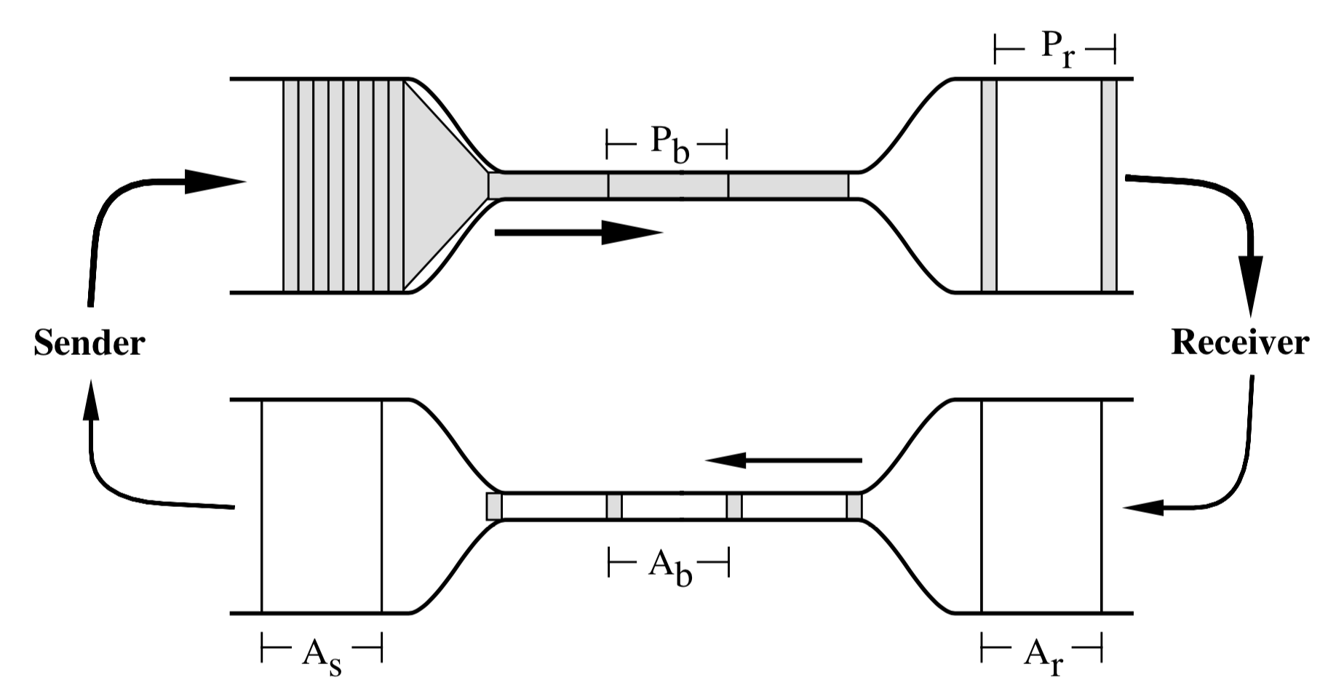
ACK clocking: steady state behavior

Slide 39
But how to get to steady state?
Slow start?
Additive increase, multiplicative decrease (AIMD)
Loss
Congestion
Window
halved
time

Slide 40
Why AIMD?
fairness
line
Converges to fairness
Converges to efficiency
Increments to rate smaller as fairness increases
(x₁,x₂)
(b_{D}x₁+a_{I}, b_{D}x₂+a_{I})
User 2: x₂
(b_{D}x₁,b_{D}x₂)
efficiency
line
User 1: x₁

Slide 41
Packet Scheduling

Slide 42

Are endpoint algorithms alone enough?
What if an endpoint is malicious or buggy?
Want the network core to do something more about resource allocation than best effort

Slide 43
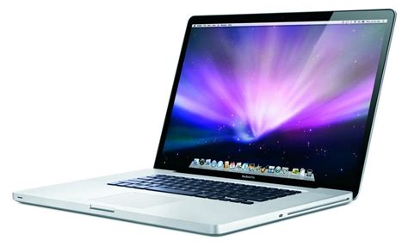

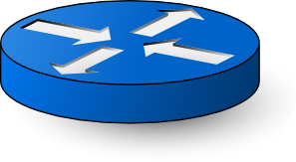
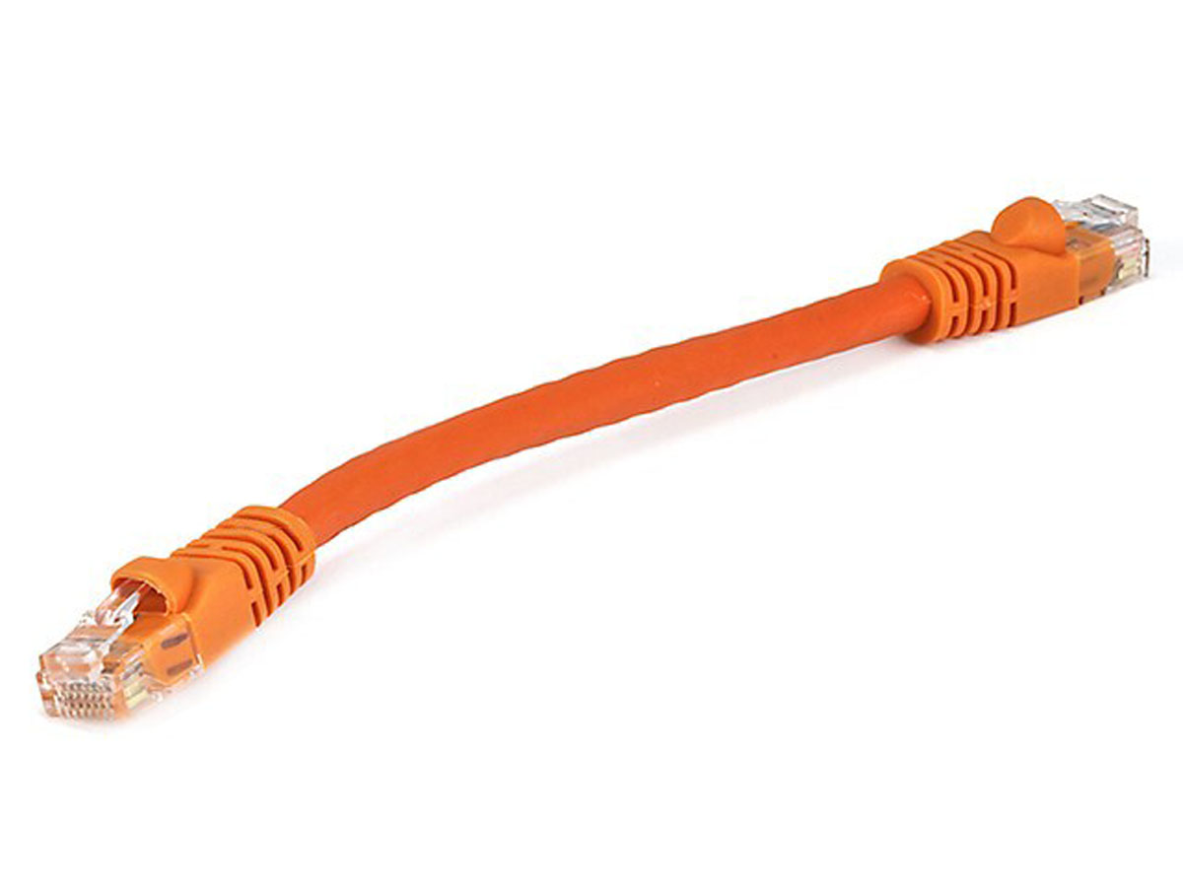
Network model
Queuing delay
Bottleneck queue
(max size B)
Link rate
Flows
Packet-switched core network

Slide 44

First-in first-out (FIFO) queue + tail-drop
Buffer size
2
1
b
2
a
1
a
b
Dropped packets

Slide 45
First-in first-out (FIFO) queue + tail-drop
6
Head of line blocking (HOL)
5
4
Buffer size
3
2
1
6
a
4
3
2
5
1
a
b
b
Can you guess what happens in the next round-trip time interval?
Dropped packets

Slide 46
ACK-clocking makes it worse: lucky case
13
12
11
10
Buffer size
9
8
7
12
11
10
9
8
b
7
b
13
c
Dropped packets

Slide 47
ACK-clocking makes it worse: unlucky case
13
12
11
10
Buffer size
9
8
7
13
12
11
10
9
8
7
b
b
c
Dropped packets

Slide 48
Network monopolized by “bad” endpoints
An ACK signals the source of a free router buffer slot
Further, ACK clocking means that the source transmits again
Contending packet arrivals may not be random enough
Blue flow can’t capture buffer space for a few round-trips
Sources which sent successfully earlier get to send again
A FIFO tail-drop queue incentivizes sources to misbehave!

Slide 49
Packet scheduling on routers
We will discuss packet scheduling algorithms implemented on routers in detail later in this course.
Goal: Achieve a predetermined resource allocation regardless of endpoint behavior
How to make such allocation “efficient”?
Implement on routers at high speeds
Achieve equitable sharing of network bandwidth & queues
Use available bandwidth effectively

