Slide 1

CS 352 Ordered Delivery
CS 352, Lecture 11.1
http://www.cs.rutgers.edu/~sn624/352
Srinivas Narayana

Slide 2


Transport
Application
HTTPS
FTP
HTTP
SMTP
DNS
Transport
TCP
UDP
Network
IP
Host-to-Net
X.25
…
802.11
ATM

Slide 3
Modularity through layering
Apps: useful user-level functions
HTTP
FTP
NV
TFTP
Transport: provide guarantees to apps
TCP
UDP
IP
Network: best-effort global pkt delivery
Ether
ATM
…
WiFi
Link: best-effort local pkt delivery

Slide 4

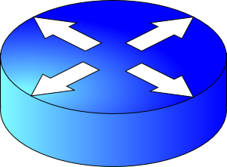
How do apps get perf guarantees?
The network core provides no guarantees on packet delivery
Transport software on the endpoint oversees implementing guarantees on top of a best-effort network
Three important kinds of guarantees
Reliability
Ordered delivery
Resource sharing in the network core
Transmission Control Protocol (TCP)

Slide 5

Reordering packets at the receiver side
Let’s suppose receiver gets packets 1, 2, and 4, but not 3 (dropped)
Suppose you’re trying to download a Word document containing a report
What would happen if transport at the receiver directly presents packets 1, 2, and 4 to the Word application?
Sender
Receiver
1
2
3
4
1
2
4
5

Slide 6
Reordering at the receiver side
Reordering can happen for a few reasons:
Drops
Packets taking different paths through a network
Receiver needs a general strategy to ensure that data is presented to the application in the same order that the sender side pushed it
Receiver uses two mechanisms:
Sequence numbers
Receiver socket buffer
We’ve already seen the use of both of these for reliability
Sender
Receiver
1
2
3
4
1
2
4
5
3

Slide 7

Interaction between apps and TCP
Sender deposits data in receiver socket buffer
An app with a TCP socket reads from the TCP receive socket buffer
e.g., when you do data = sock.recv()
TCP receiver software only releases this data to the application if the data is in order relative to all other data already read by the application
This process is called TCP reassembly
application
process
recv()
TCP socket
receiver buffers
TCP
code
from sender
receiver protocol stack

Slide 8
TCP Reassembly
Sender/Net writes here
Application can read up to here
1
2
1
2
4
1
2
3
4
Socket buffer memory on the receiver

Slide 9
Sequence numbers in the app’s stream
Data written by application over time
e.g., send() call
…
100
150
180
240
273
310
…
packet
packet
packet
packet
packet
Increasing sequence #s
TCP uses byte sequence numbers

Slide 10
Sequence numbers in the app’s stream
Data written by application over time
e.g., send() call
…
100
150
180
240
273
310
…
packet
packet
packet
packet
packet
Increasing sequence #s
Packet boundaries aren’t important for TCP software
TCP is a stream-oriented protocol
(We use SOCK_STREAM when creating sockets)

Slide 11
Sequence numbers in the app’s stream
Data written by application over time
e.g., send() call
…
…
1st recv()
2nd recv()
3rd recv()
4th recv()
A recv() call may return a part of a packet, a full packet, or multiple packets together.
App does a recv()

Slide 12
Implications of ordered delivery
Packets cannot be delivered to the application if there is an in-order packet missing from the receiver’s buffer
The receiver can only buffer so much out-of-order data
Subsequent out-of-order packets dropped (it doesn’t matter that those packets successfully arrive at the receiver from the sender over the network)
TCP application-level throughput will suffer if there is too much packet reordering in the network
Data may reach the receiver
But won’t be delivered to apps upon a recv()

Slide 13
Summary of TCP ordered delivery
In-order delivery accomplished through socket buffer and TCP reassembly at receiver
TCP is a stream-oriented protocol, where the boundaries between packets aren’t important
Significant packet reordering reduces TCP application throughput

Slide 15
CS 352 Flow Control
CS 352, Lecture 11.2
http://www.cs.rutgers.edu/~sn624/352
Srinivas Narayana

Slide 16
Review: app and socket buffer interaction
Sender deposits data in receiver socket buffer
An app with a TCP socket reads from the TCP receive socket buffer
e.g., when you do data = sock.recv()
Buffers used for ordering & reliability
Ordering: only release data to app when data in order with everything else app has read previously
Reliability: avoid wasteful sender retransmissions using selective repeat
application
process
recv()
TCP socket
receiver buffers
TCP
code
from sender
receiver protocol stack

Slide 17
But socket buffers can get full…
application
process
Applications may read data slower than the sender is pushing data in
Example: what if an app infrequently or never calls recv()?
There may be too much reordering or packet loss in the network
What if the first few bytes of a window are lost or delayed?
Receivers can only buffer so much before dropping subsequent data
TCP socket
receiver buffers
TCP
code
from sender
receiver protocol stack

Slide 18
Goal: avoid drops due to buffer fill
application
process
Have a TCP sender only send as much as the free buffer space available at the receiver.
Amount of free buffer varies over time
TCP implements flow control
Receiver’s ACK contains the amount of data the sender can transmit without running out the receiver’s socket buffer
This number is called the advertised window size
TCP socket
receiver buffers
TCP
code
from sender
receiver protocol stack

Slide 19
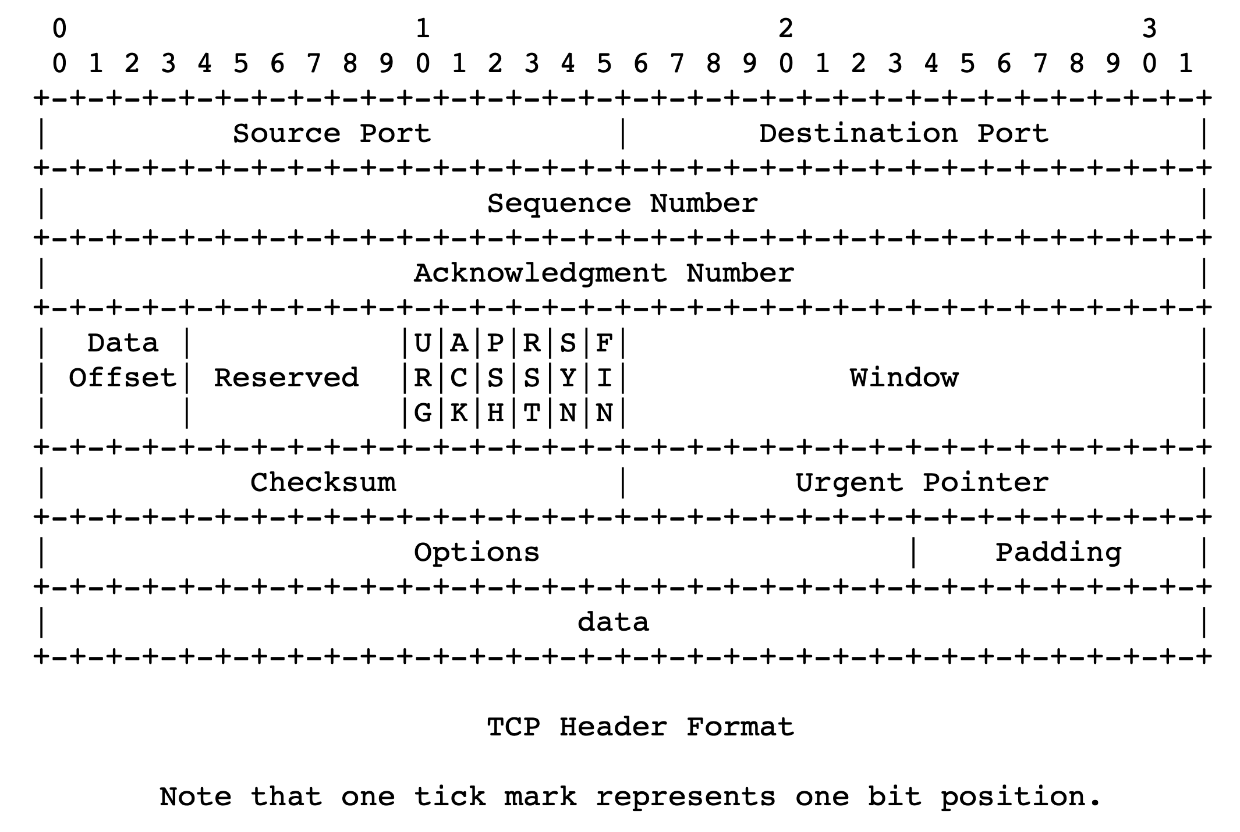
Flow control in TCP headers

Slide 20
TCP flow control
Receiver advertises to sender (in the ACK) how much free buffer is available
Sender
Receiver
1
2
3
4
1
2
3
4
5

Slide 21
TCP flow control
Subsequently, the sender’s sliding window cannot be larger than this value
Restriction on new sequence numbers that can be transmitted
Restriction on TCP sending rate
Sender
Receiver
1
2
3
4
1
2
3
Window <= Advertised window
4
5
Sender’s view:
0
1
2
3
4
5
6
7
0
1
Last cumulative
ACK’ed seq #
Last transmitted
seq #

Slide 22
TCP flow control
If receiver app is too slow reading data:
receiver socket buffer fills up
So, advertised window shrinks
So, sender’s window shrinks
So, sender’s sending rate reduces
Sender
Receiver
1
2
3
4
1
2
3
Window <= Advertised window
4
5
Sender’s view:
0
1
2
3
4
5
6
7
0
1
Last cumulative
ACK’ed seq #
Last transmitted
seq #

Slide 23
TCP flow control
Flow control matches the sender’s write speed to the receiver’s read speed.
Sender
Receiver
1
2
3
4
1
2
3
Window <= Advertised window
4
5
Sender’s view:
0
1
2
3
4
5
6
7
0
1
Last cumulative
ACK’ed seq #
Last transmitted
seq #

Slide 24
Sizing the receiver’s socket buffer
Operating systems have a default receiver socket buffer size
Listed among the parameters in sysctl –a | grep net.inet.tcp on MAC, sysctl –a | grep net.ipv4.tcp on Linux
If socket buffer is too small, sender can’t keep too many packets in flight ➔ lower throughput
If socket buffer is too large, too much memory consumed per socket
How big should the receiver socket buffer be?

Slide 25
Sizing the receiver’s socket buffer
Case 1: Suppose the receiving app is reading data too slowly:
no amount of receiver buffer can prevent low sender throughput if the connection is long-lived

Slide 26
Sizing the receiver’s socket buffer
Case 2: Suppose the receiving app reads sufficiently fast on average to match the sender’s writing speed.
Assume the sender has a window of size W.
The receiver must use a buffer of size at least W. Why?
Captures two cases:
(1) When the first sequence #s in the window are dropped
The rest of the window must be buffered until the ACKs (of the rest of the window) reach sender. Adv. window in ACKs reduces sender’s window
(2) When the sender sends a burst of data of size W
Receiver may not match the instantaneous rate of the sender

Slide 27
Summary of flow control
A mechanism to keep buffers available at the receiver whenever the sender transmits data
Main function: match sender speed to receiver speed
Socket buffer sizing is important for throughput

Slide 29
CS 352 Congestion Control: Intro
CS 352, Lecture 11.3
http://www.cs.rutgers.edu/~sn624/352
Srinivas Narayana

Slide 30
How do apps get perf guarantees?
The network core provides no guarantees on packet delivery
Transport software on the endpoint oversees implementing guarantees on top of a best-effort network
Three important kinds of guarantees
Reliability
Ordered delivery
Resource sharing in the network core
Transmission Control Protocol (TCP)

Slide 31
Congestion
Max amount of useful data that link can support, ~ link rate
∞
Packets get dropped beyond max buffer
Too many retransmissions due to packet drops!
Amount of useful (fresh) data plummets.
Congestion collapse
Amount of useful data that gets across to the receiver
Queueing delay
~100%
~100%
Link load
Link load

Slide 32
How should multiple endpoints share net?
It is difficult to know where the bottleneck link is
It is difficult to know how many other endpoints are using that link
Endpoints may join and leave at any time
Network paths may change over time, leading to different bottleneck links (with different link rates) over time

Slide 33
The approach that the Internet takes is to use a distributed algorithm to converge to an efficient and fair outcome.

Slide 34
The approach that the Internet takes is to use a distributed algorithm to converge to an efficient and fair outcome.
No one can centrally view or control all the endpoints and bottlenecks in the Internet.
Every endpoint must try to reach a globally good outcome by itself: i.e., in a distributed fashion.
This also puts a lot of trust in endpoints.

Slide 35
The approach that the Internet takes is to use a distributed algorithm to converge to an efficient and fair outcome.
If there is spare capacity in the bottleneck link, the endpoints should use it.

Slide 36
The approach that the Internet takes is to use a distributed algorithm to converge to an efficient and fair outcome.
If there are N endpoints sharing a bottleneck link, they should be able to get equitable shares of the link’s capacity.
For example: 1/N’th of the link capacity.

Slide 37
Flow Control vs. Congestion Control
Avoid overwhelming the receiving application
Sender is managing the receiver’s socket buffer
Avoid overwhelming the bottleneck network link
Sender is managing the bottleneck link capacity and bottleneck router buffers

Slide 38
The approach that the Internet takes is to use a distributed algorithm to converge to an efficient and fair outcome.
How to achieve this?
Approach: sense and react
Example: taking a shower
Use a feedback loop with signals and knobs

Slide 39
Signals and Knobs in Congestion Control
Signals
Packets being ACK’ed
Packets being dropped (e.g. RTO fires)
Packets being delayed (RTT)
Rate of incoming ACKs
Knobs
What can you change to “probe” the available bottleneck capacity?
Suppose receiver buffer is unbounded:
Increase window/sending rate: e.g., add x or multiply by a factor of x
Decrease window/sending rate: e.g., subtract x or reduce by a factor of x
Implicit feedback signals measured directly at sender.
(There are also explicit signals that the network might provide.)

Slide 40
Subsequent lectures
Feedback loops used by 2 important TCPs
TCP New Reno and TCP BBR
Strategies to react “proportionately” to network signals like loss
Fast retransmit and fast recovery
Strategies to measure loss accurately
How to predict the RTT of a packet successfully received (in the future)?

