Slide 1

Routing (part 2)
Lecture 24
http://www.cs.rutgers.edu/~sn624/352-F24
Srinivas Narayana

Slide 2

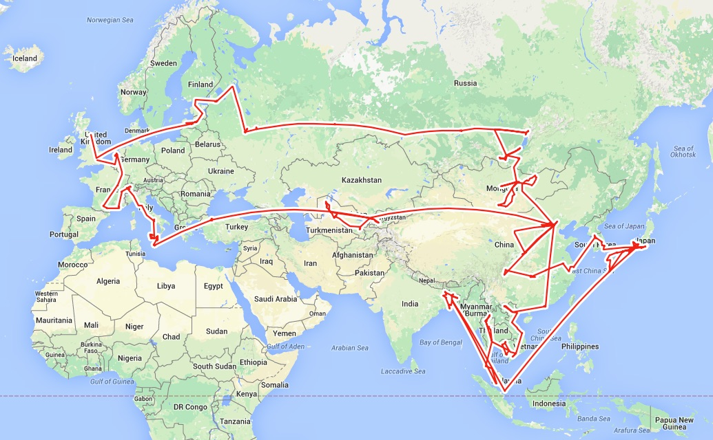

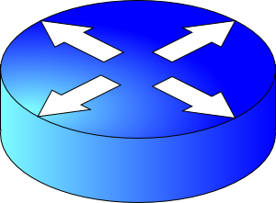


Goals of routing:
#1 Good paths
#2 Failure resilience
Routing: Google Maps for the Internet?
Routing protocols
Flooding
Dijkstra’s algorithm
Relaxation
5
Link state
protocols
Distance vector protocols
3
w
c(w, v)
v
w
D(w),
known least
2
5
Q1. What info exchanged?
u
2
1
z
v
3
1
2
x
y
D(v),
estimate
Q2. What computation?
1
u

Slide 3
Distance Vector Protocols

Slide 4
Distance Vector Protocol
Each router only exchanges a distance vector with its neighbors
Distance: how far the destination is
Vector: a value for each destination
DVs are only exchanged between neighbors; not flooded
Use incomplete view of graph derived from neighbors’ distance vectors to compute the shortest paths
Routing protocols
Q1. What info exchanged?
Q2. What computation?
Link state
protocols
Distance vector protocols

Slide 5
Q1: Distance Vectors
D_{x}(y) = estimate of least cost from x to y
Distance vector: D_{x} = [D_{x}(y): y є N ]
Node x knows cost of edge to each neighbor v: c(x,v)
Node x maintains D_{x}
Node x also maintains its neighbors’ distance vectors
For each neighbor v, x maintains D_{v} = [D_{v}(y): y є N ]
Nodes exchange distance vector periodically and whenever the local distance vector changes (e.g., link failure, cost changes)
Notes:
At each node we need
- an array (known as DV) that lists the current least costs to reach all known destinations
- also need to maintain the next-hop along the least cost path
- the DV’s from all neighbors

Slide 6
Q2: Algorithm
Bellman-Ford algorithm
Each node initializes its own distance vector (DV) to edge costs
Each node sends its DVs to its neighbors
When a node x receives new DV from a neighbor v, it updates its own DV using the Bellman-Ford equation:
Given d_{x}(y) := estimated cost of the least-cost path from x to y
Update d_{x}(y) = min_{v} {c(x,v) + d_{v}(y) }
cost of path from neighbor v to destination y
minimum taken over
all neighbors v of x
cost to reach neighbor v directly from x

Slide 7
Visualization
Neighbor v sends its distance vector to x.
Which neighbor v offers the current best path from x to y?
Path through neighbor v has cost c(x,v) + d_{v}(y)
Choose min-cost neighbor
Remember min-cost neighbor as the one used to reach node y
This neighbor determines the output port!
v
c(x,v)
v’
x
d_{v}(y)
v’’
y
v’’’
Use v’’ and link (x,v’’) to reach y.

Slide 8
D_{x}(y) = min{c(x,y) + D_{y}(y), c(x,z) + D_{z}(y)} = min{2+0 , 7+1} = 2
D_{x}(z) = min{c(x,y) + D_{y}(z),
c(x,z) + D_{z}(z)}
= min{2+1 , 7+0} = 3
node x table
cost to
cost to
cost to
x y z
x y z
x y z
x
0 2 7
x
0 2 3
x
0 2 3
from
y
∞
∞
∞
from
y
2 0 1
from
y
2 0 1
z
∞
∞
∞
z
7 1 0
z
3 1 0
node y table
cost to
cost to
cost to
x y z
x y z
x y z
y
x
∞
∞
∞
x
0 2 7
2
1
2 0 1
x
0 2 3
x
z
from
y
from
y
2 0 1
from
y
2 0 1
7
z
∞
∞
∞
z
7 1 0
z
3 1 0
node z table
cost to
cost to
cost to
x y z
x y z
x y z
x
∞ ∞ ∞
x
0 2 7
x
0 2 3
from
y
from
y
2 0 1
from
y
2 0 1
∞
∞
∞
z
z
3 1 0
z
3 1 0
7
1
0
time
Notes:
This example assumes that nodes are computing routes in a lock-step fashion.

Slide 9
Good news travels fast
Suppose the link cost reduces or a new better path becomes available in a network.
The immediate neighbors of the change detect the better path immediately
Since their DV changed, these nodes notify their neighbors immediately.
And those neighbors notify still more neighbors
… until the entire network knows to use the better path
Good news travels fast through the network
This is despite messages only being exchanged among neighbors
1
y
4
1
x
z
2

Slide 10
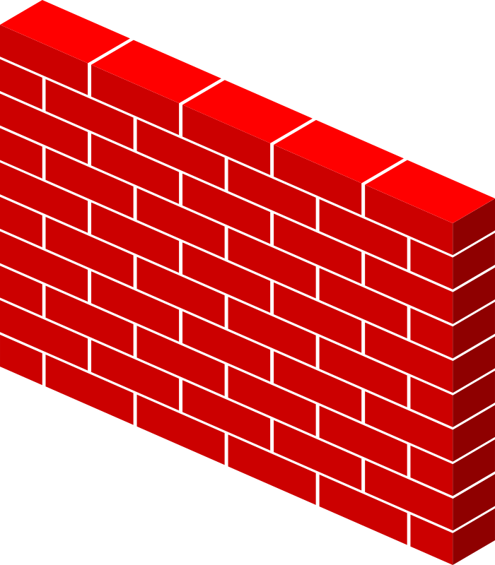
Bad news travels slowly
If router goes down, could be a while before network realizes it.
B still thinks it can reach A through C… bad!
A
B
C
D
E
1
2
3
4
Initially
C thinks it can reach A through B… worse!
3
2
3
4
After 1 exchange
3
4
3
4
After 2 exchanges
B, D think they can reach A through C… ugly!
5
4
5
4
After 3 exchanges
5
6
5
6
After 4 exchanges
Count to infinity problem
7
6
7
6
After 5 exchanges
etc… to infinity

Slide 11
Bad news travels slowly
Reacting appropriately to bad news requires information that only other routers have. DV does not exchange sufficient info.
B needs to know that C has no other path to A other than via B.
DV does not exchange paths; just distances!
Poisoned reverse: if X gets its route to Y via Z, then X will announce d_{X}(Y) = ∞ in its message to Z
Effect: Z won’t use X to route to Y
However, this won’t solve the problem in general (think why.)
A
B
C
D
E

Slide 12
Summary: Comparison of LS and DV
Link State Algorithms
Distance Vector Algorithms
Nodes have full visibility into the network’s graph
Copious message exchange: each LSA is flooded over the whole network
Robust to network changes and failures
Only distances and neighbors are visible
Sparse message exchange: DVs are exchanged among neighbors only
Brittle to router failures. Incorrect info may propagate all over net
OSPF
Open Shortest Path First
(v2 RFC 2328)
EIGRP
Enhanced Interior Gateway Routing Protocol
(RFC 7868)

Slide 13
Routing protocols
Link state
protocols
Distance vector protocols
Every router is aware of the existence of every other router.
Messages reveal information on the full network (graph) structure.
Message exchange and forwarding tables scale with network size.
These assumptions/settings cannot work on the Internet.

Slide 14
Internet Routing

Slide 15



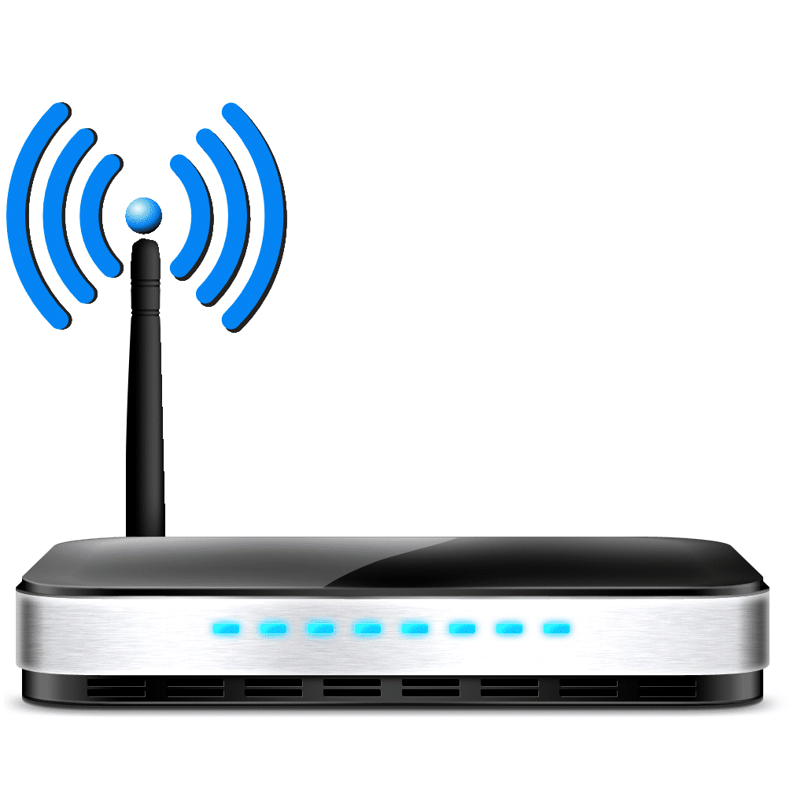

The Internet is a large federated network
AT&T
Comcast
Verizon

Slide 16
The Internet is a large federated network
Several autonomously run organizations: No one “boss”
Organizations cooperate, but also compete
AT&T
Comcast
e.g., AT&T has little commercial interest in revealing its internal network structure to Verizon.
Verizon

Slide 17
The Internet is a large federated network
Several autonomously run organizations: No one “boss”
Organizations cooperate, but also compete
AT&T
Message exchanges must
not reveal internal network details.
Comcast
Verizon
Algorithm must work with “incomplete” information about its neighbors’ internal topology.

Slide 18
The Internet is a large federated network
Internet today: > 70,000 unique autonomous networks
Internet routers: > 800,000 forwarding table entries
AT&T
Keep messages & tables as small as possible. Don’t flood
Comcast
Verizon
Algorithm must be incremental: don’t recompute the whole table on every message exchanged.

