Slide 1

Routing (part 3)
Lecture 25
http://www.cs.rutgers.edu/~sn624/352-F24
Srinivas Narayana

Slide 2

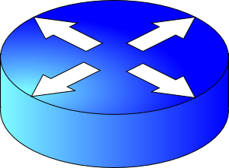


The network layer enables reachability.
We’ll see protocols that solve subproblems.
How does an endpoint get an address?
How does an endpoint talk to another outside its network?
Debugging?
ICMP
Routing protocols
OSPF, RIP, BGP
DHCP
How does an endpoint talk to another within the same network?
ARP
Gateways
NAT

Slide 3
Routing protocols
Link state
protocols
Distance vector protocols
Every router is aware of the existence of every other router.
Messages reveal information on the full network (graph) structure.
Message exchange and forwarding tables scale with network size.
These assumptions/settings cannot work on the Internet.

Slide 4

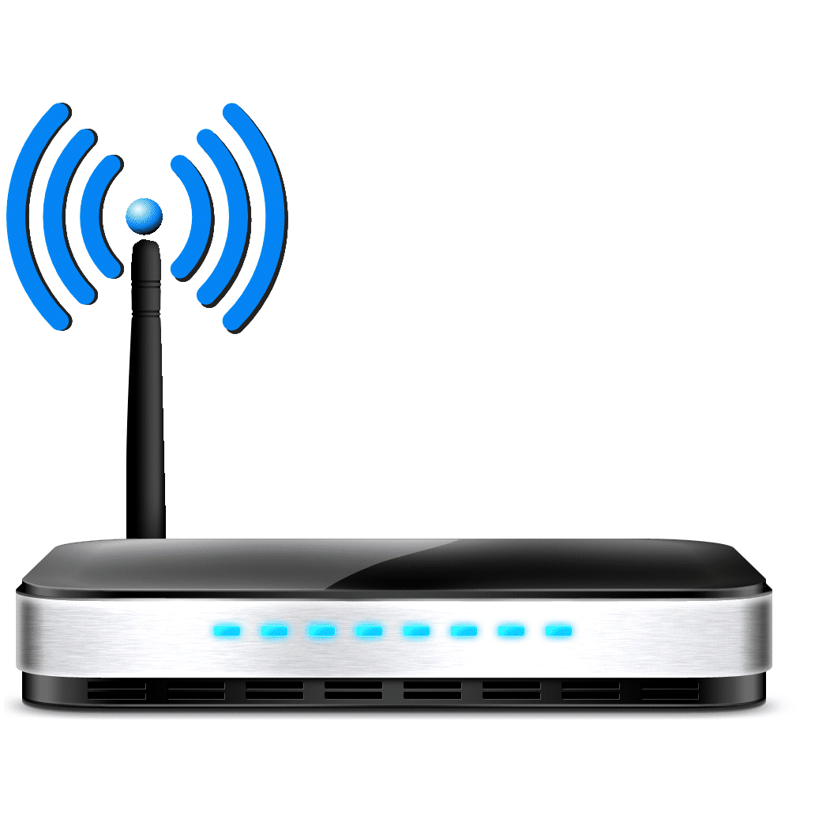
The Internet is a large federated network
Several autonomously run organizations: No one “boss”
Organizations cooperate, but also compete
AT&T
Comcast
e.g., AT&T has little commercial interest in revealing its internal network structure to Verizon.
Verizon

Slide 5


The Internet is a large federated network
Several autonomously run organizations: No one “boss”
Organizations cooperate, but also compete
AT&T
Message exchanges must
not reveal internal network details.
Comcast
Verizon
Algorithm must work with “incomplete” information about its neighbors’ internal topology.

Slide 6
The Internet is a large federated network
Internet today: > 70,000 unique autonomous networks
Internet routers: > 800,000 forwarding table entries
AT&T
Keep messages & tables as small as possible. Don’t flood
Comcast
Verizon
Algorithm must be incremental: don’t recompute the whole table on every message exchanged.

Slide 7
Inter-domain Routing
Routing approaches so far (LS + DV) are applicable within one autonomous system (AS), e.g., Rutgers
Called intra-domain routing protocols
The Internet uses Border Gateway Protocol (BGP)
All AS’es speak BGP. It is the glue that holds the Internet together
BGP is a path vector protocol
Routing protocols
Link state
protocols
Distance vector protocols
Path vector protocols
Messages?
Algorithm?

Slide 8
Q1. BGP Messages
Loop detection is easy
(no “count to infinity”)
Exchange paths: path vector
Routing Announcements or Advertisements
“I am here” or “I can reach here”
Occur over a TCP connection (BGP session) between routers
Route announcement = destination + attributes
Destination: IP prefix
Route Attributes:
AS-level path
Next hop
Several others: origin, MED, community, etc.
An AS promises to use advertised path to reach destination
Only route changes are advertised after BGP session established
No link metrics, distances!
“I am here.”
Dst: 128.1.2.0/24
AS path: X
1b
“I can reach X”
Dst: 128.1.2.0/24
AS path: AS2, X
AS 2
1a
1c
2b
1d
2a
2c
X
2d

Slide 9
Q1. Next Hop
Next hop conceptually denotes the first router interface that begins the AS-level path
The meaning of this attribute is context-dependent
In an announcement arriving from a different AS (eBGP), next hop is the router in the next AS which sent the announcement
Example: Next Hop of the eBGP announcement reaching 1c is 2a
1b
2b
1a
1c
2a
2c
X
1d
2d
AS 1
eBGP announcement:
AS2, X
AS 2

Slide 10
Q1. Next Hop
Suppose router 1c imports the path (more on this soon)
Router 1c will propagate the announcement inside the AS using iBGP
The next hop of this (iBGP) announcement is set to 1c
In particular, the next hop is an AS1 internal address
1b
2b
1a
1c
2a
2c
X
1d
2d
AS 1
eBGP announcement:
AS2, X
AS 2

Slide 11
Q2. The algorithm
A BGP router does not consider every routing advertisement it receives by default to make routing decisions!
An import policy determines whether a route is even considered a candidate
Once imported, the router performs route selection
A BGP router does not propagate its chosen path to a destination to all other AS’es by default!
An export policy determines whether a (chosen) path can be advertised to other AS’es and routers
Programmed by network operator
Policy considerations make BGP very different from intra-domain (LS / DV) protocols

Slide 12
Policies in BGP

Slide 13
Policy arises from business relationships
Customer-provider relationships:
E.g., Rutgers is a customer of AT&T
Peer-peer relationships:
E.g., Verizon is a peer of AT&T
Business relationships depend on where connectivity occurs
“Where”, also called a “point of presence” (PoP)
e.g., customers at one PoP but peers at another
Internet-eXchange Points (IXPs) are large PoPs where ISPs come together to connect with each other (often for free)

Slide 14
BGP Export Policy
legend:
provider
B
network
X
W
A
customer
C
network:
Y
Suppose an ISP only wants to route traffic to/from its customer networks (does not want to carry transit traffic between other ISPs)
A,B,C are provider networks
X,W,Y are customers (of provider networks)
X is dual-homed: attached to two networks
policy to enforce: X does not want to route from B to C via X
So, X will not announce to B a route to C

Slide 15
BGP Export Policy
legend:
provider
B
network
X
W
A
customer
C
network:
Y
Suppose an ISP only wants to route traffic to/from its customer networks (does not want to carry transit traffic between other ISPs)
A announces path Aw to B and to C
B will not announce BAw to C:
B gets no “revenue” for routing CBAw, since none of C, A, w are B’s customers
C will route CAw (not using B) to get to w

Slide 16
BGP Import Policy
legend:
provider
B
network
X
W
A
customer
C
network:
Y
Suppose an ISP wants to minimize costs by avoiding routing through its providers when possible.
Suppose C announces path Cy to x
Further, y announces a direct path (“y”) to x
Then x may choose not to import the path Cy to y since it has a peer path (“y”) towards y

Slide 17
Q2. BGP Route Selection
When a router imports more than one route to a destination IP prefix, it selects route based on:
local preference value attribute (import policy decision -- set by network admin)
shortest AS-PATH
closest NEXT-HOP router
Several additional criteria: You can read up on the full, complex, list of criteria, e.g., at https://www.cisco.com/c/en/us/support/docs/ip/border-gateway-protocol-bgp/13753-25.html

Slide 18

Example of route selection
NA
EU
Suppose AS A and B are connected to each other both in North America (NA) and in Europe (EU)
A source in NA wants to reach a destination in EU
There are two paths available
Assume same local preference
Same AS path length
Closest next hop-router: choose path via B1 rather than B2
Dst-EU
A1
A2
AS A
B1
B2
Src-NA
AS B

Slide 19

Example of route selection
NA
EU
Choosing closest next-hop results in early exit routing
Try to exit the local AS as early as possible
Also called hot potato routing
Reduce resource use within local AS
potentially at the expense of another AS
Dst-EU
A1
A2
AS A
B1
B2
Src-NA
AS B

Slide 20
Computing the forwarding table
AS3
3b
AS1
1b
3a
3c
1a
1c
AS2
2b
3d
X
1d
2a
2c
2d
Suppose a router in AS1 wants to forward a packet destined to external prefix X.
How is the forwarding table entry for X at 1d computed?
How is the forwarding table entry for X at 1c computed?

Slide 21
eBGP and iBGP announcements
AS3
3b
AS1
1b
3a
3c
1a
1c
AS2
2b
3d
X
1d
AS3,X
AS2,AS3,X
2a
2c
2d
AS2 router 2c receives path announcement AS3,X (via eBGP) from AS3 router 3a
Based on AS2 import policy, AS2 router 2c imports and selects path AS3,X, propagates (via iBGP) to all AS2 routers
Based on AS2 export policy, AS2 router 2a announces (via eBGP) path AS2, AS3, X to AS1 router 1c

Slide 22
eBGP and iBGP announcements
AS3
3b
AS1
1b
AS3,X
3a
3c
1a
1c
AS2
2b
3d
X
1d
AS3,X
AS2,AS3,X
2a
2c
2d
A given router may learn about multiple paths to destination:
AS1 gateway router 1c learns path AS2,AS3,X from 2a (next hop 2a)
AS1 gateway router 1c learns path AS3,X from 3a (next hop 3a)
Through BGP route selection process, AS1 gateway router 1c chooses path AS3,X, and announces path within AS1 via iBGP (next hop 1c)

Slide 23
Setting forwarding table entries
AS3
3b
AS1
1b
AS3,X
3a
3c
1a
1c
2
AS2
2b
1
3d
X
3
1d
AS3,X
AS2,AS3,X
2a
2c
2d
recall: 1a, 1b, 1d learn about dest X via iBGP from next-hop 1c: “path to X goes through 1c”
1d: intra-domain routing: to get to 1c, forward over outgoing local interface 1
dest
Next-Hop
NH
interface
…
…
…
…
…
…
…
…
X
1c
1c
1
IP Dst
Out port
Forwarding table
X
1

Slide 24
Setting forwarding table entries
AS3
3b
AS1
1b
AS3,X
1
2
3a
3c
1a
1c
3
AS2
2b
3d
X
1d
AS3,X
AS2,AS3,X
2a
2c
2d
dest
Next-Hop
NH
interface
recall: 1c learns about dest X via eBGP from next-hop 3a: “path to X goes through 3a”
1c: to get to link-local neighbor 3a, forward out interface 2
…
…
…
…
…
…
…
…
X
3a
3a
2
IP Dst
Out port
Forwarding table
X
2

Slide 25
Summary: Inter-domain routing
Federation and scale introduce new requirements for routing on the Internet
BGP is the protocol that handles Internet routing
Path vector: exchange paths to a destination with attributes
Policy-based import of routes, route selection, and export

Slide 26
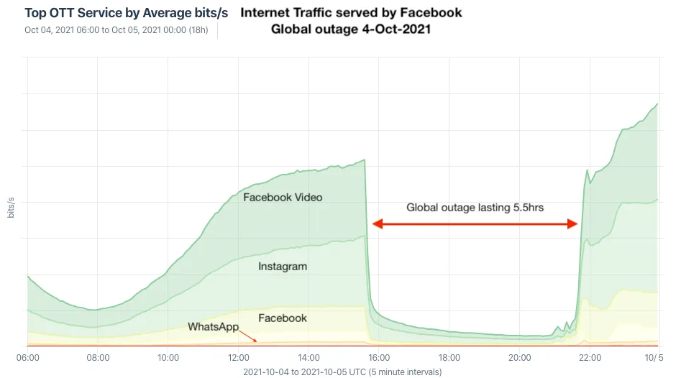
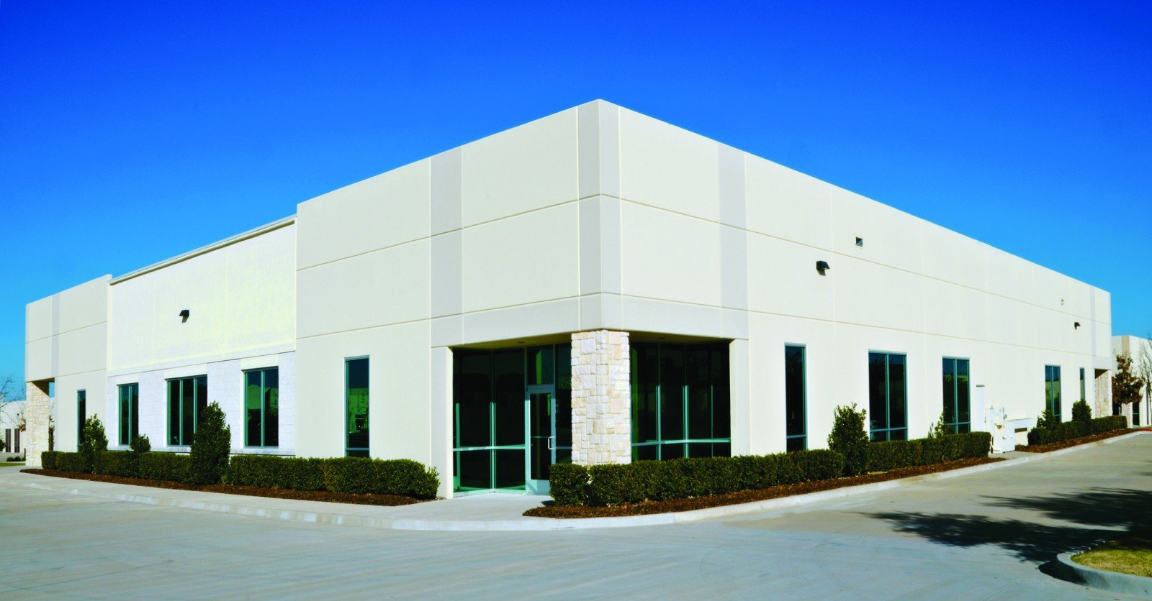

BGP’s impact: October ’21 FB++ outage
BGP route withdrawal:
“I can’t reach FB anymore”
FB network
Rest of the Internet
BGP route withdrawal: don’t use me to get to FB
FB’s DNS servers
No remote access (no more reachability due to BGP withdrawal of DC and DNS servers)
Restricted physical access (prox can’t verify, can’t access prox server)
https://engineering.fb.com/2021/10/05/networking-traffic/outage-details/
By Doug Madory - https://www.kentik.com/blog/facebooks-historic-outage-explained/, CC BY 4.0, https://commons.wikimedia.org/w/index.php?curid=110816752

Slide 27
Network Address Translation (NAT)

Slide 28
Background: The Internet’s growing pains
Networks had incompatible addressing
IPv4 versus other network-layer protocols (X.25)
Entire networks were changing their Internet Service Providers
ISPs don’t want to route directly to internal endpoints
IPv4 address exhaustion
Insufficient large IP blocks even for large networks
Rutgers (AS46) has > 130,000 publicly routable IP addresses
IIT Madras (a well-known public university in India, AS141340) has 512
(Source: ipinfo.io)

Slide 29
Network Address Translation
When a router modifies fields in an IP packet to:
Enable communication across networks with different (network-layer) addressing formats and address ranges
Allow a network to change its connectivity to the Internet en masse by modifying the source IP to a (publicly-visible) gateway IP address
Masquerade as an entire network of endpoints using (say) one publicly visible IP address
Effect: use fewer IP addresses for more endpoints!
We’ll see a standard design: “Network address and port translation” (NAPT, RFC 2663)

Slide 30
Typical NAT setup (NAPT)
rest of
the Internet
local network
10.0.0/24
10.0.0.1
10.0.0.4
10.0.0.2
138.76.29.7
Gateway router
10.0.0.3
The gateway’s IP, 138.76.29.7 is publicly visible
The local endpoint IP addresses in 10.0.0/24 are private
All datagrams leaving local network have the same source IP as the gateway

Slide 31
Typical NAT setup (NAPT)
rest of
the Internet
local network
10.0.0/24
10.0.0.1
10.0.0.4
10.0.0.2
138.76.29.7
Gateway router
10.0.0.3
That is, for the rest of the Internet, the gateway masquerades as a single endpoint representing (hiding) all the private endpoints.
The entire network just needs one (or a few) public IP addresses.

Slide 32
Typical NAT setup (NAPT)
rest of
the Internet
local network
10.0.0/24
10.0.0.1
10.0.0.4
10.0.0.2
138.76.29.7
Gateway router
10.0.0.3
The NAT gateway router accomplishes this by using a different transport port for each distinct (transport-level) conversation between the local network and the Internet.

Slide 33
Typical NAT setup (NAPT)
1: host 10.0.0.1
sends datagram to
an external host,
128.119.40.186, at port 80
2: NAT router
changes datagram
src addr, port from
10.0.0.1, 3345 to
138.76.29.7, 5001,
Updates table
Translation table
Internet-side Local side
138.76.29.7, 5001 10.0.0.1, 3345
…… ……
4: Map back
S: 10.0.0.1, 3345
D: 128.119.40.186, 80
SNAT
1
2
S: 138.76.29.7, 5001
D: 128.119.40.186, 80
10.0.0.1
S: 128.119.40.186, 80
D: 10.0.0.1, 3345
4
S: 128.119.40.186, 80
D: 138.76.29.7, 5001
3
10.0.0.2
4: NAT gateway
changes datagram
dest addr, port from
138.76.29.7, 5001 to
10.0.0.1, 3345
3: Reply arrives to
dst addr, port
138.76.29.7, 5001
138.76.29.7
10.0.0.3
DNAT

Slide 34
Features of IP-masquerading NAT
Use one or a few public IPs: You don’t need a lot of addresses from your ISP
Change addresses of devices inside the local network freely, without notifying the rest of the Internet
Change the public IP address freely independent of network-local endpoints
Devices inside the local network are not publicly visible, routable, or accessible
Most IP masquerading NATs block incoming connections originating from the Internet
Only way to communicate is if the internal host initiates the conversation

Slide 35
If you’re home, you’re likely behind NAT
Most access routers (e.g., your home WiFi router) implement network address translation
You can check this by comparing your local address (visible from ifconfig) and your externally-visible IP address (e.g., type “what’s my IP address?” on your browser search bar)

Slide 36
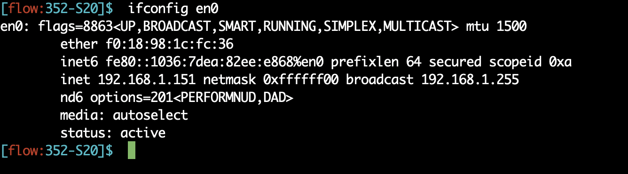
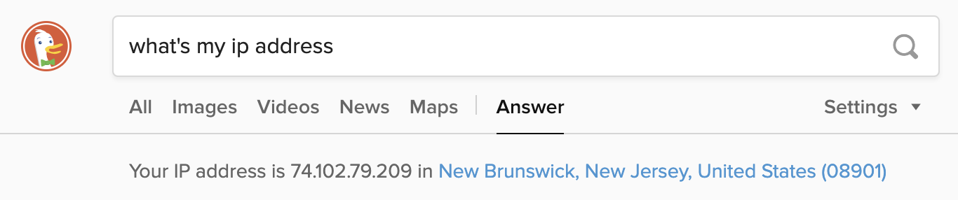
If you’re home, you’re likely behind NAT

Slide 37
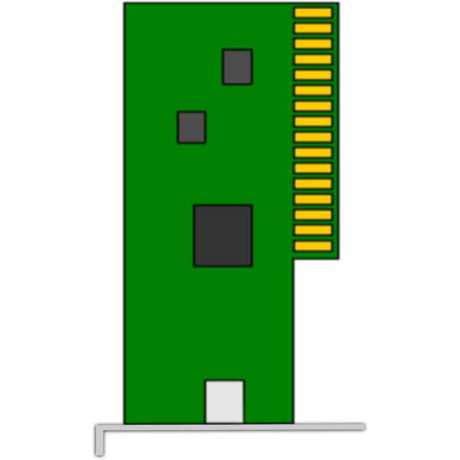
On public cloud, you’re behind NAT
VM
VM
Each VM believes it has its own (vritual) IP subnet.
Each VM believes it has its own (virtual) IP subnet.
Physical
IP subnet used
NAT
NAT
Physical Machine
Physical Machine

Slide 38
Limitations of IP-masquerading NATs
Connection limit due to 16-bit port-number field
~64K total simultaneous connections with a single public IP address
NAT can be controversial
“Routers should only manipulate headers up to the network layer, not modify headers at the transport layer!”
Application developers must take NAT into account
e.g., peer-to-peer applications
Internet “purists”: instead, solve address shortage with IPv6
32-bit IP addresses are just not enough
Esp. with more devices (your watch, your fridge, …) coming online

