Slide 1

CS 352 Reliability; Ordered Delivery
Lecture 13
http://www.cs.rutgers.edu/~sn624/352-F22
Srinivas Narayana

Slide 2


Quick recap of concepts
Pipelined Reliability
TCP: Connection-oriented
SEQ 0
Tp layer
Q1. Which packets are currently in flight?
SEQ 1
SEQ 2
Sliding windows
SEQ 3
0
1
2
3
4
5
6
7
0
RTT
ACK 1
Stop and Wait
ACK 2
ACK 3
SEQ 0
ACK 4
Latest
ACK’ed
Latest transmitted (or) acceptable
RTT
ACK pkts after a drop?
ACK
No
Q2. Which packets were successfully delivered?
Yes
SEQ 1
??
What ACK no?
Q3. Which packets should the sender retransmit?
RTO
Retransmit

Slide 3
Which packets to retransmit?

Slide 4

How to identify dropped packets?
Suppose 4 packets sent, but 1 dropped. How does sender know which one(s) dropped?
Recall: Receiver writes sequence numbers on the ACK indicating successful reception
Key idea: Sender can infer which data was received successfully using the ACK #s!
Hence, sender can know which data to retransmit
Q1: Should receivers ACK subsequent packets upon detecting data loss?
Q2: If so, what sequence number should receiver put on the ACK?
Sender
Receiver
SEQ 1
SEQ 2
SEQ 3
SEQ 4
RTT
ACK 2
ACK 3
Should this ACK exist ???
ACK ??
RTO

Slide 5
Receiver strategies upon packet loss
Sender
Receiver
ACK pkts after a drop?
1
No
Yes
2
3
4
Go-back-N
Selective Repeat
What # on ACK?
5
Last seq# in order
Cumulative ACK
Seq# ranges received so far
Selective ACK
TCP’s default

Slide 6
Sliding Window with Go Back N
When the receiver notices missing data:
It simply discards all data with greater sequence numbers
i.e.: the receiver will send no further ACKs
The sender will eventually time out (RTO) and retransmit all the data in its sending window
Subtle: conceptually, separate timer per byte to infer RTO

Slide 7
Go back N
RTO
Sender
0
1
2
3
4
2
3
4
5
6
Maximum
window size = 8
ACK 1
ACK 2
ACK 3
ACK 4
ACK 5
ACK 6
ACK 7
Receiver
0
1
E
D
D
2
3
4
5
6
Maximum
window size = 8
Discarded by
receiver
Dropped packet
(or) Packet with
error
Time

Slide 8
Go back N
Go Back N can recover from erroneous or missing packets.
But it is wasteful.
If there are errors, the sender will spend time and network bandwidth retransmitting data the receiver has already seen.

Slide 9
Selective repeat with cumulative ACK
Idea: sender should only retransmit dropped/corrupted data.
The receiver stores all the correct frames that arrive following the bad one. (Note that the receiver requires memory to hold data for each sequence number in the receiver window.)
When the receiver notices a skipped sequence number, it keeps acknowledging the first in-order sequence number it wants to receive. This is termed cumulative ACK.
When the sender times out waiting for an acknowledgement, it just retransmits the first unacknowledged data, not all its successors.
Recall that RTO applies independently to each sequence #

Slide 10
Selective repeat with cumulative ACK
RTO
Sender
0
1
2
3
4
2
5
6
Maximum
window size = 8
ACK 2
ACK 2
ACK 1
ACK 2
ACK 5
ACK 6
ACK 7
Receiver
0
1
E
3
4
2
5
6
Maximum
window size = 8
Buffered by
receiver in
its memory
Time
Packet with
error (or)
dropped packet
Subtle: Even if there were multiple drops, retransmission after an RTO only includes the first dropped sequence number. Recovering each drop will require one RTO after corresponding packet was transmitted.

Slide 11
Selective repeat with selective ACK
RTO
Sender
0
1
2
3
4
2
5
6
ACK 2
SACK 0--1, 3
Maximum
window size = 8
ACK 2
SACK 0,--1, 3--4
ACK 1
ACK 2
ACK 5
ACK 6
ACK 7
Receiver
0
1
E
3
4
2
5
6
Maximum
window size = 8
Buffered by
receiver in
its memory
Packet with
error
Time
This slide assumes retransmissions are only triggered by an RTO.
If other signals were to be used to retransmit earlier (e.g., triple dup ACK -- more on this soon),
SACK significantly reduces the number of duplicate transmissions compared to cumulative-only ACKs.

Slide 12
TCP: Cumulative & Selective ACKs
Sender retransmits the seq #s it thinks aren’t received successfully yet
Pros & cons: selective vs. cumulative ACKs
Precision of info available to sender
Redundancy of retransmissions
Packet header space
Complexity (and bugs) in transport software
On modern Linux, TCP uses selective ACKs by default
Sender
Receiver
1
2
3
4
2
3
4
5
5

Slide 13
TCP reliability metadata

Slide 14
Metadata on TCP packets for Reliability
TCP uses metadata in the form of sequence #s and ACK #s
Where are these stored? Naturally, in the packet header!

Slide 15
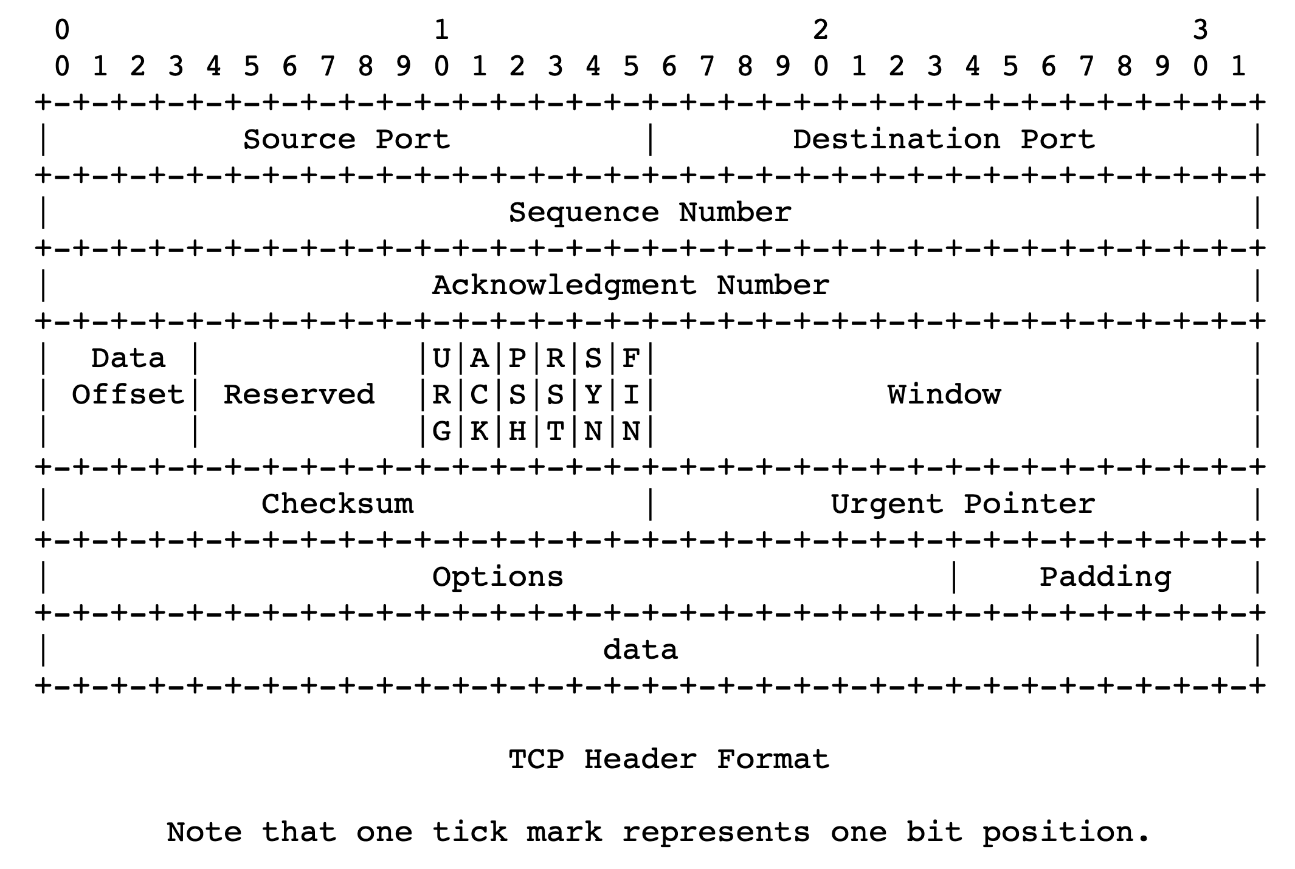
TCP header structure
Source port, destination port (connection demultiplexing)
Size of the TCP header (in 32-bit words)
Basic error detection through checksums (similar to UDP)

Slide 16
TCP header structure
Identifies data in the packet from sender’s perspective
TCP uses byte seq #s
Identifies the data being ACKed from the receiver’s perspective.
TCP uses next seq # that the receiver is expecting.

Slide 17
Observing a TCP exchange
sudo tcpdump -i eno1 tcp portrange 56000-56010
curl --local-port 56000-56010 https://www.google.com > output.html
Bonus: Try crafting TCP packets with scapy!

Slide 18
Buffering and Ordering in TCP

Slide 19
Memory Buffers at the Transport Layer

Slide 20
Sockets need receive-side memory buffers
Since TCP uses selective repeat, the receiver must buffer data that is received after loss:
e.g., hold packets so that only the “holes” (due to loss) need to be filled in later, without having to retransmit packets that were received successfully
Apps read from the receive-side socket buffer when you do a recv() call.
Even if data is always reliably received, applications may not always read the data immediately
What if you invoked recv() in your program infrequently (or never)?
For the same reason, UDP sockets also have receive-side buffers

Slide 21

Receiver app’s interaction with TCP
Upon reception of data, the receiver’s TCP stack deposits the data in the receive-side socket buffer
An app with a TCP socket reads from the TCP receive socket buffer
e.g., when you do data = sock.recv()
application
process
recv()
TCP socket
receiver buffers
TCP
code
from sender
receiver TCP interaction

Slide 22
Sockets need send-side memory buffers
The possibility of packet retransmission in the future means that data can’t be immediately discarded from the sender once transmitted.
App has issued send() and moved on; TCP stack must buffer this data
Transport layer must wait for ACK of a piece of data before reclaiming (freeing) the memory for that data.
application
process
send()
TCP socket
sender buffers
TCP
code
to receiver
sender TCP interaction

Slide 23
Ordered Delivery

Slide 24

Reordering packets at the receiver side
Let’s suppose receiver gets packets 1, 2, and 4, but not 3 (dropped)
Suppose you’re trying to download a document containing a report
What would happen if transport at the receiver directly presents packets 1, 2, and 4 to the application (i.e., receiving 1,2,4 through the recv() call)?
Sender
Receiver
1
2
3
4
1
2
4
5

Slide 25
Reordering packets at the receiver side
Reordering can happen for a few reasons:
Drops
Packets taking different paths through a network
Receiver needs a general strategy to ensure that data is presented to the application in the same order that the sender pushed it
To implement ordered delivery, the receiver uses
Sequence numbers
Receiver socket buffer
We’ve already seen the use of these for reliability; but they can be used to order too!
Sender
Receiver
1
2
3
4
1
2
3
5
5

Slide 26
Receive-side app and TCP
TCP receiver software only releases the data from the receive-side socket buffer to the application if:
the data is in order relative to all other data already read by the application
This process is called TCP reassembly
application
process
recv()
TCP socket
receiver buffers
TCP
code
from sender
receiver protocol stack

Slide 27
TCP Reassembly
Sender/Net writes here
Application can recv() up to here
1
2
1
2
4
1
2
3
4
Socket buffer memory on the receiver

Slide 28
Implications of ordered delivery
Packets cannot be delivered to the application if there is an in-order packet missing from the receiver’s buffer
The receiver can only buffer so much out-of-order data
Subsequent out-of-order packets dropped
It won’t matter that those packets successfully arrive at the receiver from the sender over the network
TCP application-level throughput will suffer if there is too much packet reordering in the network
Data may have reached the receiver, but won’t be delivered to apps upon a recv() (...or may not even be buffered!)

