Slide 1

CPU Virtualization:
Scheduling

Slide 2
Process Creation
Two ways to create a process
Build a new empty process from scratch
Copy an existing process and change it appropriately
Option 1: New process from scratch
Steps
Load specified code and data into memory; Create empty call stack
Create and initialize PCB (make it look like context-switch)
Put process on ready list
Advantages: No wasted work (compared to option 2)
Disadvantages: Difficult to express all possible options for setup, complex
Process permissions, where to write I/O, environment variables
Example: WindowsNT has call with 10 arguments

Slide 3
Process Creation
Option 2: Clone an existing process and change it
Example: Unix fork() and exec()
Fork(): Clones the calling process
Exec(char *file): Overlays file image on calling process
Fork()
Stop current process and save its state
Make copy of code, data, stack, and PCB
Add new PCB to ready list
Any changes needed to child process? Yes!
Exec(char *file)
Replace current data and code segments with those in specified file
Advantages: Flexible, clean, simple
Disadvantages: Wasteful to perform copy and then overwrite of memory

Slide 4
Unix Process Creation
Fork/exec crucial to how the user’s shell is implemented!
While (1) {
Char *cmd = getcmd();
Int retval = fork();
If (retval == 0) {
// This is the child process
// Setup the child’s process environment here
// E.g., where is standard I/O, how to handle signals?
exec(cmd);
// exec does not return if it succeeds
printf(“ERROR: Could not execute %s\n”, cmd);
exit(1);
} else {
// This is the parent process; Wait for child to finish
int pid = retval;
wait(pid);
}
}

Slide 5
Scheduling
Questions answered in this lecture: What are different scheduling policies, such as: FCFS, SJF, STCF, RR and MLFQ?
What type of workload performs well with each scheduler?
What scheduler does Linux currently use?
https://en.wikipedia.org/wiki/Completely_Fair_Scheduler
https://developer.ibm.com/tutorials/l-completely-fair-scheduler/
Chapters 7-10
Disclaimer: Materials derived, reused, and modified from OSTEP book and lectures of Prof. Andrea and Remzi Arpaci-Dusseau and Prof. Yojip Won

Slide 6
CPU Virtualization: Two Components
Dispatcher (Previous lecture)
Low-level mechanism
Performs context-switch
Switch from user mode to kernel mode
Save execution state (registers) of old process in k-stack, PCB
Insert PCB in ready queue
Load state of next process from k-stack, PCB to registers
Switch from kernel to user mode
Jump to instruction in new user process
Scheduler (Today)
Policy to determine which process gets CPU when

Slide 7
Review: Process State Transitions
Running
Ready
Descheduled
Scheduled
I/O: initiate
Blocked
I/O: done
How to transition? (“mechanism”)
When to transition? (“policy”)

Slide 8
Vocabulary
Workload: set of job descriptions (arrival time, run_time)
Job: View as current CPU burst of a process
Process alternates between CPU and I/O process moves between ready and blocked queues
Scheduler: logic that decides which ready job to run
Metric: measurement of quality of schedule

Slide 9
Scheduling Performance Metrics
Minimize turnaround time
Do not want to wait long for job to complete
Completion_time – arrival_time
Minimize response time
Schedule interactive jobs promptly so users see output quickly
Initial_schedule_time – arrival_time
Maximize throughput
Want many jobs to complete per unit of time
Maximize resource utilization
Keep expensive devices busy
Minimize overhead
Reduce number of context switches
Maximize fairness
All jobs get same amount of CPU over some time interval

Slide 10
Workload Assumptions
1. Each job runs for the same amount of time
2. All jobs arrive at the same time
3. All jobs only use the CPU (no I/O)
4. Run-time of each job is known

Slide 11
Scheduling Basics
Workloads: arrival_time run_time
Schedulers: FIFO SJF STCF RR
Metrics: turnaround_time response_time

Slide 12
Example: workload, scheduler, metric
JOB | arrival_time (s) | run_time (s)
A | ~0 | 10
B | ~0 | 10
C | ~0 | 10
FIFO: First In, First Out - also called FCFS (first come first served) - run jobs in arrival_time order
What is our turnaround? completion_time - arrival_time

Slide 13
FIFO: Event Trace
JOB | arrival_time (s) | run_time (s)
A | ~0 | 10
B | ~0 | 10
C | ~0 | 10
Time | Event
0 | A arrives
0 | B arrives
0 | C arrives
0 | run A
10 | complete A
10 | run B
20 | complete B
20 | run C
30 | complete C

Slide 14
FIFO (Identical JOBS)
JOB | arrival_time (s) | run_time (s)
A | ~0 | 10
B | ~0 | 10
C | ~0 | 10
A
B
C
0
20
40
60
80
Gantt chart: Illustrates how jobs are scheduled over time on a CPU

Slide 15
FIFO (IDENTICAL JOBS)
[A,B,C arrive]
A
B
C
0
20
40
60
80
What is the average turnaround time?
Def: turnaround_time = completion_time - arrival_time

Slide 16
FIFO (IDENTICAL Jobs)
A: 10s
B: 20s
C: 30s
0
20
40
60
80
What is the average turnaround time?
Def: turnaround_time = completion_time - arrival_time
(10 + 20 + 30) / 3 = 20s

Slide 17
Scheduling Basics
Workloads: arrival_time run_time
Schedulers: FIFO SJF STCF RR
Metrics: turnaround_time response_time

Slide 18
Workload Assumptions
1. Each job runs for the same amount of time
2. All jobs arrive at the same time
3. All jobs only use the CPU (no I/O)
4. The run-time of each job is known

Slide 19
Any Problematic Workloads for FIFO?
Workload: ?
Scheduler: FIFO
Metric: turnaround is high

Slide 20
Example: Big First Job
JOB | arrival_time (s) | run_time (s)
A | ~0 | 60
B | ~0 | 10
C | ~0 | 10
Draw Gantt chart for this workload and policy…
What is the average turnaround time?

Slide 21
Example: Big First Job
JOB | arrival_time (s) | run_time (s)
A | ~0 | 60
B | ~0 | 10
C | ~0 | 10
A: 60s
B: 70s
C: 80s
A
B
C
0
20
40
60
80
Average turnaround time: 70s

Slide 22

Convoy Effect

Slide 23
Passing the Tractor
Problem with Previous Scheduler:
FIFO: Turnaround time can suffer when short jobs must wait for long jobs
New scheduler:
SJF (Shortest Job First)
Choose job with smallest run_time

Slide 24
Shortest Job First
JOB | arrival_time (s) | run_time (s)
A | ~0 | 60
B | ~0 | 10
C | ~0 | 10
What is the average turnaround time with SJF?

Slide 25
SJF Turnaround Time
A: 80s
B: 10s
C: 20s
B
C
A
0
20
40
60
80
What is the average turnaround time with SJF?
(80 + 10 + 20) / 3 = ~36.7s
Average turnaround with FIFO: 70s
For minimizing average turnaround time (with no preemption):
SJF is provably optimal Moving shorter job before longer job improves turnaround time of short job more than it harms turnaround time of long job

Slide 26
Scheduling Basics
Workloads: arrival_time run_time
Schedulers: FIFO SJF STCF RR
Metrics: turnaround_time response_time

Slide 27
Workload Assumptions
1. Each job runs for the same amount of time
2. All jobs arrive at the same time
3. All jobs only use the CPU (no I/O)
4. The run-time of each job is known

Slide 28
Shortest Job First (Arrival Time)
JOB | arrival_time (s) | run_time (s)
A | ~0 | 60
B | ~10 | 10
C | ~10 | 10
What is the average turnaround time with SJF?

Slide 29
Stuck Behind a Tractor Again
JOB | arrival_time (s) | run_time (s)
A | ~0 | 60
B | ~10 | 10
C | ~10 | 10
[B,C arrive]
A
B
C
0
20
40
60
80
What is the average turnaround time?
(60 + (70 – 10) + (80 – 10)) / 3 = 63.3s

Slide 30
Preemptive Scheduling
Prev schedulers:
FIFO and SJF are non-preemptive
Only schedule new job when previous job voluntarily relinquishes CPU (performs I/O or exits)
New scheduler:
Preemptive: Potentially schedule different job at any point by taking CPU away from running job
STCF (Shortest Time-to-Completion First)
Always run job that will complete the quickest
(That job may change over time)

Slide 31
NON-PREEMPTIVE: SJF
JOB | arrival_time (s) | run_time (s)
A | ~0 | 60
B | ~10 | 10
C | ~10 | 10
[B,C arrive]
A
B
C
0
20
40
60
80
Average turnaround time:
(60 + (70 – 10) + (80 – 10)) / 3 = 63.3s

Slide 32
PREEMPTIVE: STCF
JOB | arrival_time (s) | run_time (s)
A | ~0 | 60
B | ~10 | 10
C | ~10 | 10
[B,C arrive]
A: 80s
B: 10s
C: 20s
A
B
C
A
0
20
40
60
80
Average turnaround time with STCF?
36.6
Average turnaround time with SJF: 63.3s

Slide 33
Scheduling Basics
Workloads: arrival_time run_time
Schedulers: FIFO SJF STCF RR
Metrics: turnaround_time response_time

Slide 34
Response Time
Sometimes we care about when job starts instead of when it finishes
New metric:
response_time = first_run_time - arrival_time

Slide 35
Response vs. Turnaround
B’s turnaround: 20s
B’s response: 10s
A
B
0
20
40
60
80
[B arrives]

Slide 36
Round-Robin Scheduler
Prev schedulers:
FIFO, SJF, and STCF can have poor response time
New scheduler: RR (Round Robin)
Alternate ready processes every fixed-length time-slice

Slide 37
FIFO vs RR
A
B
C
A
B
C
…
0
5
10
15
20
0
5
10
15
20
Avg Response Time?
(0+5+10)/3 = 5
Avg Response Time?
(0+1+2)/3 = 1
In what way is RR worse?
Ave. turn-around time with equal job lengths is horrible
Other reasons why RR could be better?
If don’t know run-time of each job, gives short jobs a chance to run and finish fast

Slide 38
Scheduling Basics
Workloads: arrival_time run_time
Schedulers: FIFO SJF STCF RR
Metrics: turnaround_time response_time

Slide 39
Review- Workload Assumptions
1. Each job runs for the same amount of time
2. All jobs arrive at the same time
3. All jobs only use the CPU (no I/O)
4. The run-time of each job is known (need smarter, fancier scheduler)

Slide 40
MLFQ (Multi-Level Feedback Queue)
Goal: general-purpose scheduling
Must support two job types with distinct goals - “interactive” programs care about response time - “batch” programs care about turnaround time
Approach: multiple levels of round-robin - each level has higher priority than lower levels and preempts them
MLFQ has a number of distinct queues.
Each queue is assigned a different priority level.

Slide 41
Priorities
Rule 1: If priority(A) > Priority(B), A runs
Rule 2: If priority(A) == Priority(B), A & B run in RR
Q3
A
[High Priority]
“Multi-level”
How to know how to set priority?
Approach 1: nice Approach 2: history “feedback”
Q2
B
Q1
Q0
C
D

Slide 42
History
Use past behavior of process to predict future behavior
Common technique in systems
Processes alternate between I/O and CPU work
Guess how CPU burst (job) will behave based on past CPU bursts (jobs) of this process

Slide 43
More MLFQ Rules
Rule 1: If priority(A) > Priority(B), A runs
Rule 2: If priority(A) == Priority(B), A & B run in RR
More rules: Rule 3: Processes start at top priority Rule 4: If job uses whole slice, demote process (longer time slices at lower priorities)

Slide 44

One Long Job (Example)
Q3
Q2
Q1
Q0
0
5
10
15
20
A four-queue scheduler with time slice 10ms
Long batch job – DNA analysis

Slide 45

An Interactive Process Joins
Q3
Q2
Q1
Q0
120
140
160
180
200
Interactive job performs quick operation and does an I/O
Interactive process never uses entire time slice, so never demoted

Slide 46
Problems with MLFQ?
Q3
Q2
Q1
Q0
120
140
160
180
200
Problems - unforgiving + starvation - gaming the system

Slide 47
Problems with MLFQ?
Q3
Q2
Q1
Q0
120
140
160
180
200
Problem: Low priority job may never get scheduled
Periodically boost priority of all jobs (or all jobs that haven’t been scheduled)

Slide 48
Prevent Gaming the Schedule
Q3
Q2
Q1
Q0
120
140
160
180
200
Problem: High priority job could trick scheduler and get more CPU by performing I/O right before time-slice ends
Fix: Account for job’s total run time at priority level (instead of just this time slice); downgrade when exceed threshold

Slide 49
Lottery Scheduling
Goal: proportional (fair) share
Sometimes we just care about fairly sharing the CPU.
Fair-share scheduler
- Guarantee that each job obtain a certain percentage of CPU time.
- Not optimized for turnaround or response time
Approach: - give processes lottery tickets - whoever wins runs - higher priority => more tickets
Amazingly simple to implement

Slide 50
Lottery Scheduling
Tickets
- Represent the share of a resource that a process should receive
- Percent of tickets represents its share of the system resource in question.
Example
- There are two processes, A and B.
- Process A has 75 tickets ➔ receive 75% of the CPU
Process B has 25 tickets ➔ receive 25% of the CPU

Slide 51
Lottery Scheduling
The scheduler picks a winning ticket.
Load the state of that winning process and runs it.
Example
There are 100 tickets
Process A has 75 tickets: 0 ~ 74
Process B has 25 tickets: 75 ~ 99
Scheduler’s winning tickets:
63 85 70 39 76 17 29 41 36 39 10 99 68 83 63
Resulting scheduler:
A
B
A
A
B
A
A
A
A
A
A
B
A
B
A
Intuition:
The longer these two jobs compete,
The more likely they are to achieve the desired percentages.

Slide 52
Lottery Code
int counter = 0; int winner = getrandom(0, totaltickets); node_t *current = head; while (current) { counter += current->tickets; if (counter > winner) break; current = current->next; } // current is the winner

Slide 53
Lottery example
int counter = 0; int winner = getrandom(0, totaltickets); node_t *current = head; while(current) { counter += current->tickets; if (counter > winner) break; current = current->next; } // current gets to run
Who runs if winner is: 50 350 0
Job A (1)
Job B (1)
Job C (100)
Job D (200)
Job E (100)
head
null

Slide 54
Other Lottery Ideas
Ticket Transfers
Ticket Currencies
Ticket Inflation
(read more in OSTEP)
Can make lottery scheduling deterministically fair, too

Slide 55
Completely Fair Scheduler
On Linux, in use since 2.6.23, has O(log N) runtime
Move from MLFQ to Weighted Fair Queuing
First major OS to use a fair scheduling algorithm
Processes ordered by the amount of CPU time they use
Gets rid of queues and linked lists in favor of a red-black tree of processes
CFS isn’t actually “completely fair”
Unfairness is bounded O(N)

Slide 56
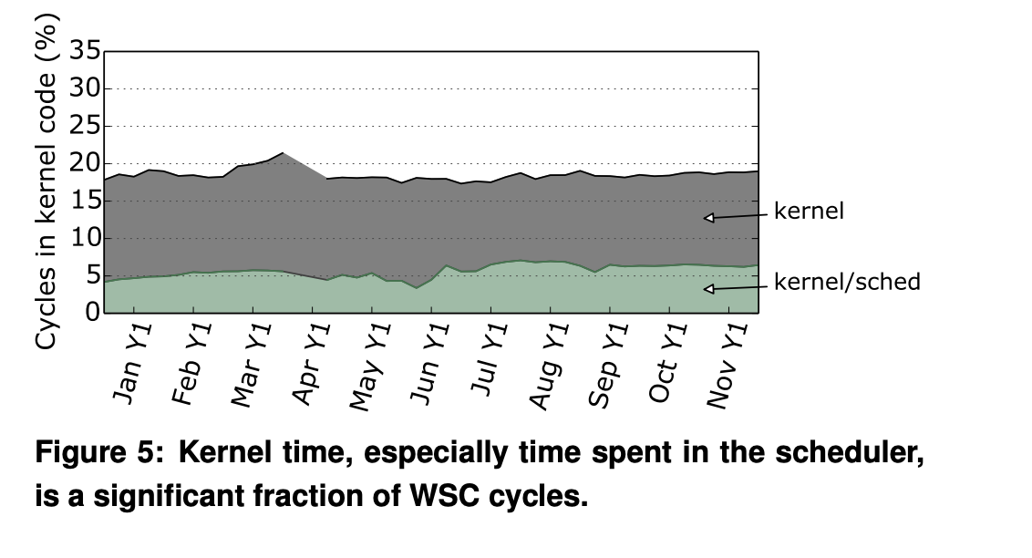
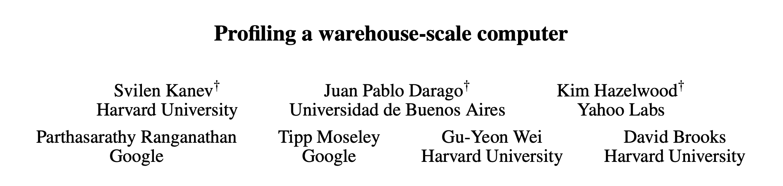
Scheduler efficiency matters!
Machines with 1000s of processes, VMs, containers, etc.

Slide 57
Completely Fair Scheduler
Tree organized according to amount of CPU time used by each process
Measured in nanoseconds, obviates the need for time slices
Left-most process has always used the least time
Scheduled next
Add the process back to the tree
Rebalance the tree
17
15
25
38
22
27

Slide 58
Completely Fair Scheduling (CFS)
CFS removes the time-slice concept as we have seen it so far
Instead, assign each process a proportion of the processor
CFS is based on a simple concept:
Model scheduling as if the system had an ideal, perfectly multitasking processor
Each process receives 1/n of the processor’s time, where n is the number of runnable processes
Would be scheduled for infinitely small durations
In any measurable period, all n processes would run for the same amount of time

Slide 59
Completely Fair Scheduling (CFS)
CFS removes the time-slice concept as we have seen it so far
Instead, assign each process a proportion of the processor
Yields constant fairness but a variable switching rate
Assume there are two processes
Unix model - run one process for 5ms and another for 5ms
Each process receives 100% of the processor
IDEAL System: Perfect multitasking processor
Run both processes simultaneously for 10 milliseconds
Each at 50% power - called “perfect multitasking”
Ideal Multiprocessor possible? Why or why not?

Slide 60
Completely Fair Scheduling (CFS)
Rank processes based on their worth and need for processor time
Processes with a higher priority run before those with a lower priority
Linux has two priority ranges
• Nice value: ranges from -20 to +19 (default is 0)
• High values of nice means lower priority
• Real-time priority: ranges from 0 to 99
• Higher values mean higher priority
• Real-time processes always executes before standard (nice) processes
ps ax -eo pid,ni,rtprio,cmd

Slide 61
Linux CFS
Rank processes based on their worth and need for processor time
Processes with a higher priority run before those with a lower priority
Linux has two priority ranges
• Nice value: ranges from -20 to +19 (default is 0)
• High values of nice means lower priority
• Real-time priority: ranges from 0 to 99
• Higher values mean higher priority
• Real-time processes always executes before standard (nice) processes
ps ax -eo pid,ni,rtprio,cmd

Slide 62
Linux CFS
Assume the targeted duration of fairness is 20 milliseconds (sched_latency)
If there are two runnable tasks at the same priority
Each will run for 10 milliseconds before preempting in favor of the other
If we have four tasks at the same priority
Each will run for 5 milliseconds
If there are 20 tasks, each will run for 1 millisecond
Problem?
As the number of runnable tasks approaches infinity, the proportion of allotted processor and the assigned timeslice approaches zero
(Solution: Run any task for a minimum of 1millisecond)

Slide 63
Linux CFS parameters
Target latency (TL)
- minimum amount of time—idealized to an infinitely small duration—required for every runnable task to get at least one turn on the processor
- Time window where every process gets some CPU
Minimum granularity (MG)
- Imposes a floor on the timeslice assigned to each process
- For example: run for 1 ms to ensure there is a ceiling on the incurred switching costs
- not perfectly fair when the number of processes grows very large

Slide 64
Linux CFS
Given for instance a target latency of 20 milliseconds
Example1: two runnable processes of equal niceness, then both processes will run for 10 milliseconds each before being pre-empted in favor of the the other process.
Example 2: If there are 10 processes of equal niceness, each runs for 2 milliseconds each.

Slide 65
Summary
Understand goals (metrics) and workload, then design scheduler around that
General purpose schedulers need to support processes with different goals
Past behavior is good predictor of future behavior
Random algorithms (lottery scheduling) can be simple to implement and avoid corner cases.
There are important scenarios we haven’t considered (multiprocessor scheduling: incorporate cache affinity & contention)

