Slide 1

CPU Virtualization

Slide 2
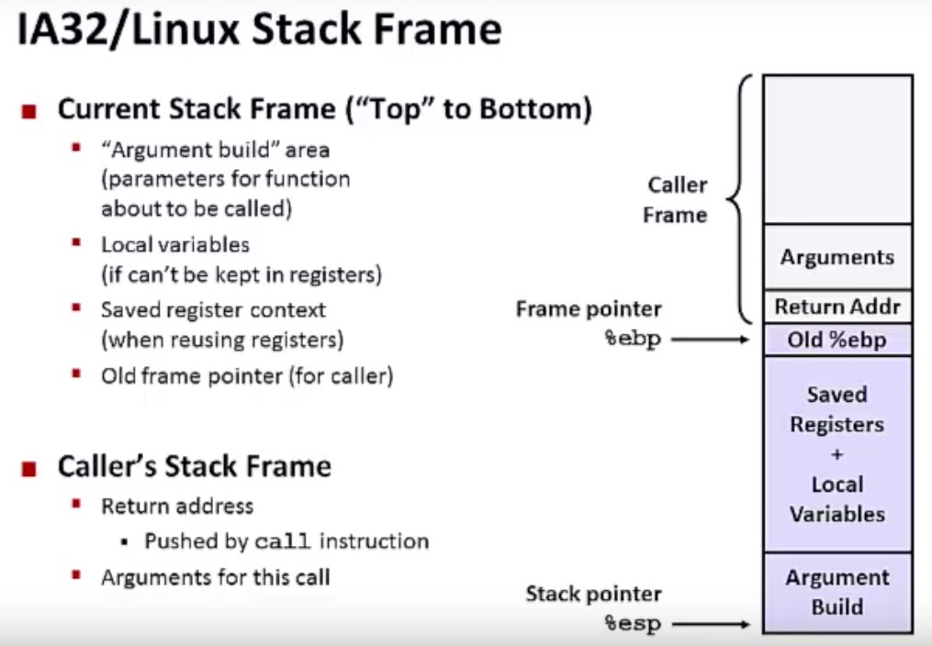
Stack Detour

Slide 3
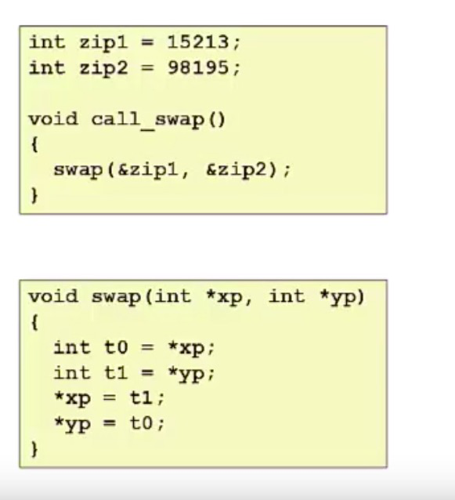
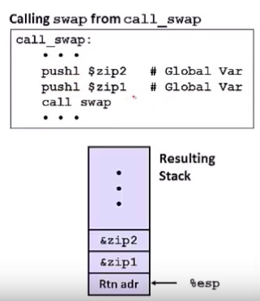
Stack Detour

Slide 4
Stack Detour

Slide 5
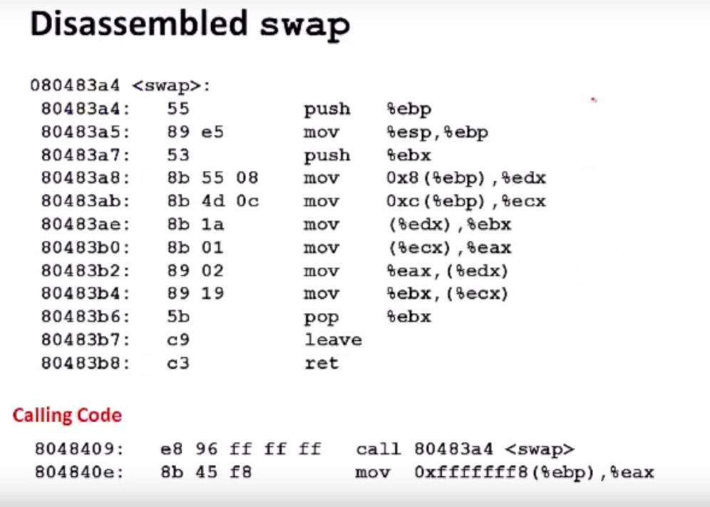
Stack Detour

Slide 6
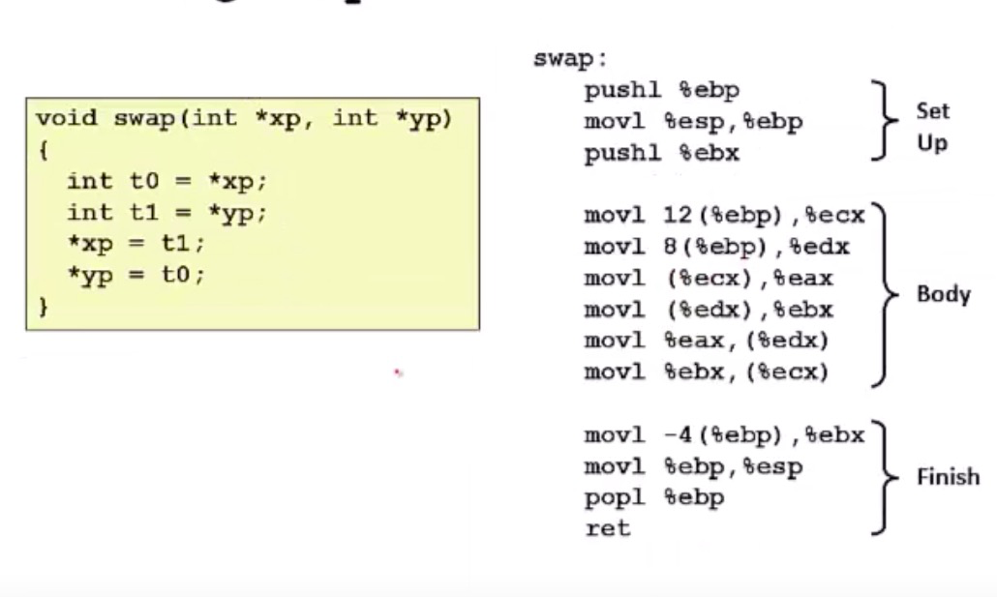
Stack Detour

Slide 7
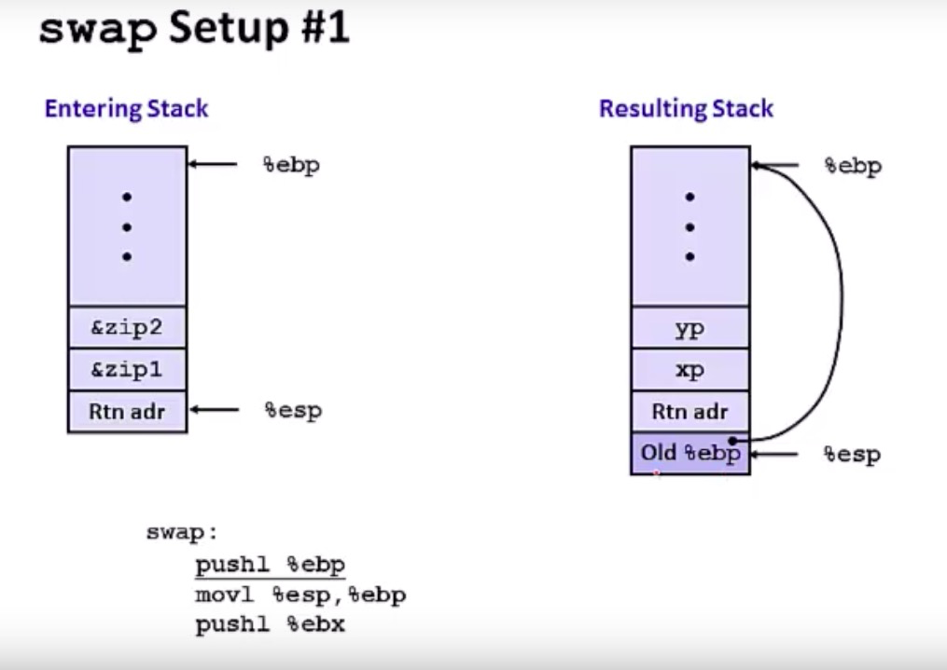
Stack Detour

Slide 8
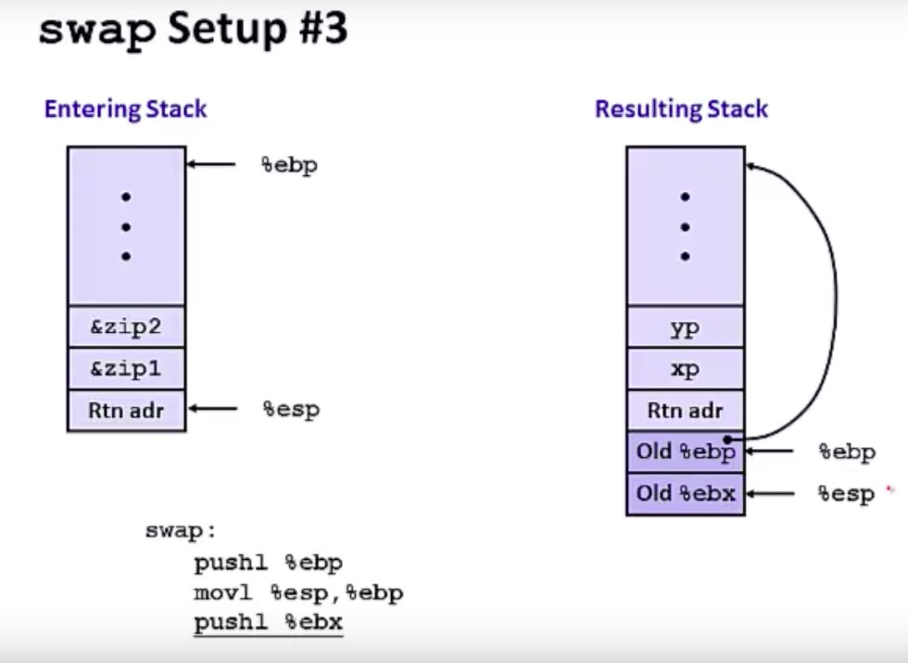
Stack Detour

Slide 9
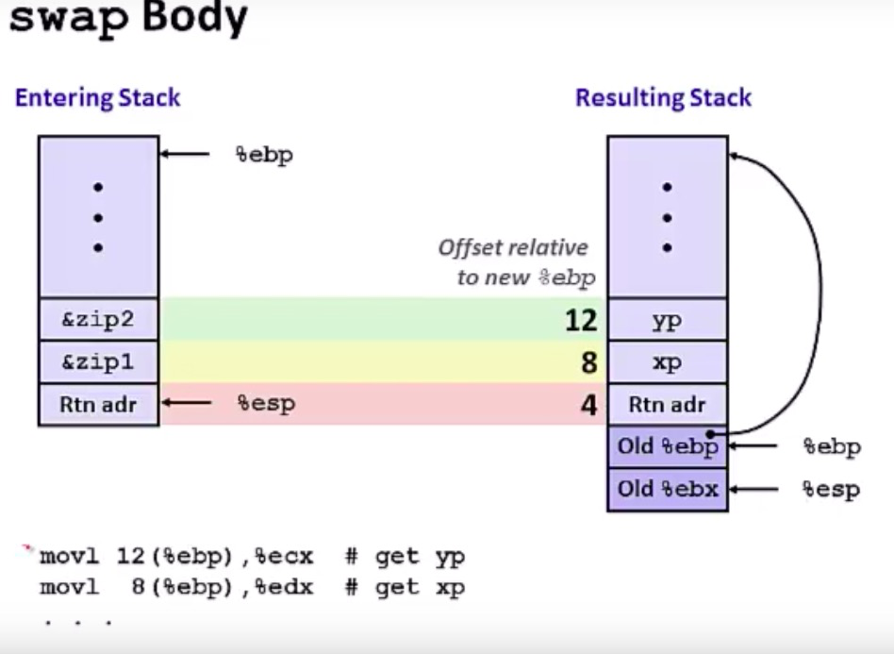
Stack Detour

Slide 10
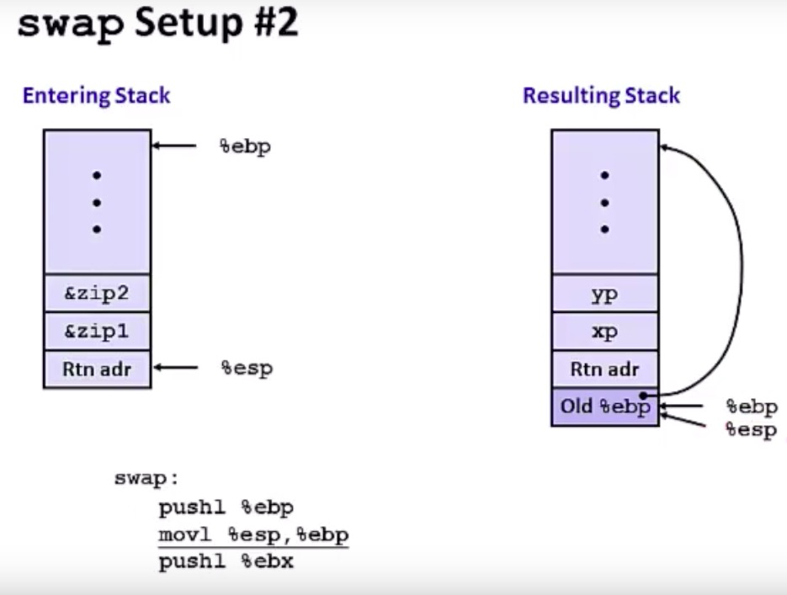
Stack Detour

Slide 11
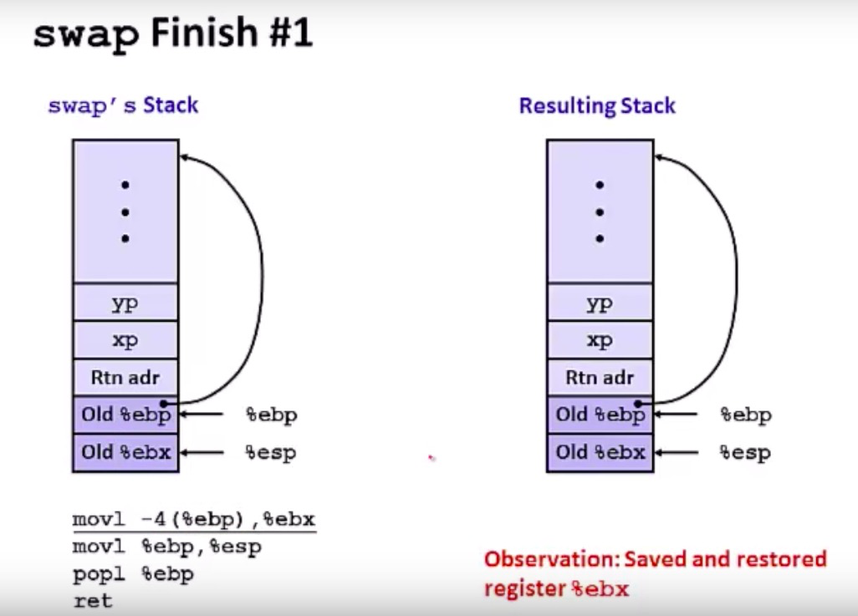
Stack Detour

Slide 12
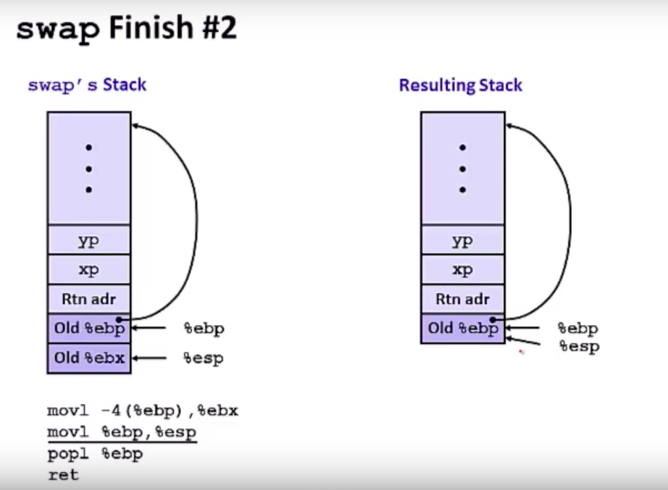
Stack Detour

Slide 13
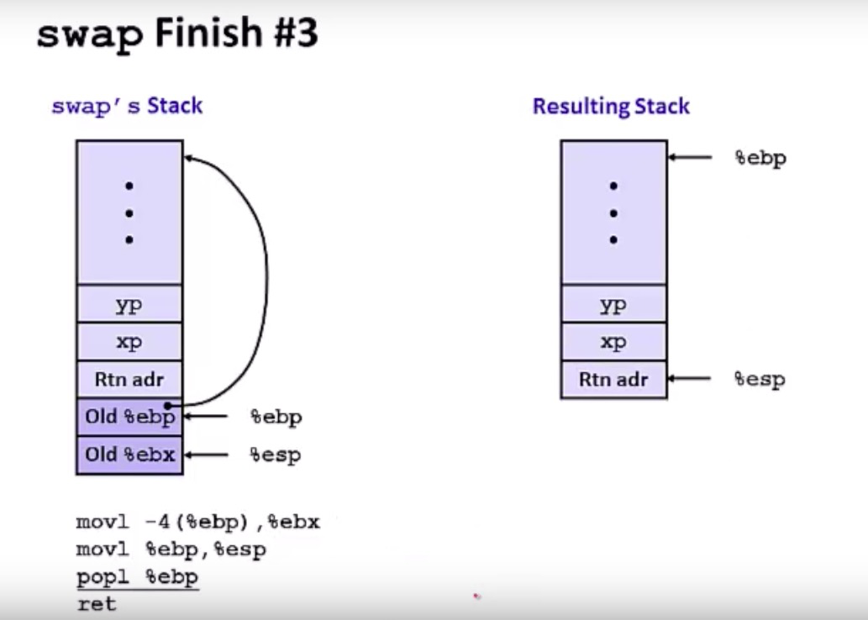
Stack Detour

Slide 14
Q4: What Context must be Saved?
// the registers will save and restore
// to stop and subsequently restart a process
struct context {
int eip; // Index pointer register
int esp; // Stack pointer register
int ebx; // Called the base register
int ecx; // Called the counter register
int edx; // Called the data register
int esi; // Source index register
int edi; // Destination index register
int ebp; // Stack base pointer register
};
// the different states a process can be in
enum proc_state { UNUSED, EMBRYO, SLEEPING,
RUNNABLE, RUNNING, ZOMBIE };

Slide 15
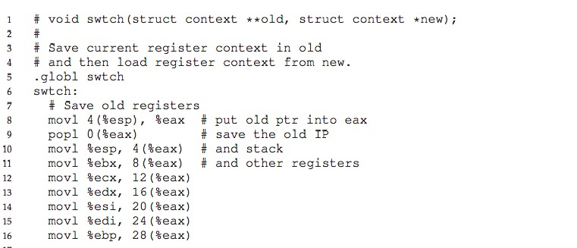
Q4: What Context must be Saved?

Slide 16
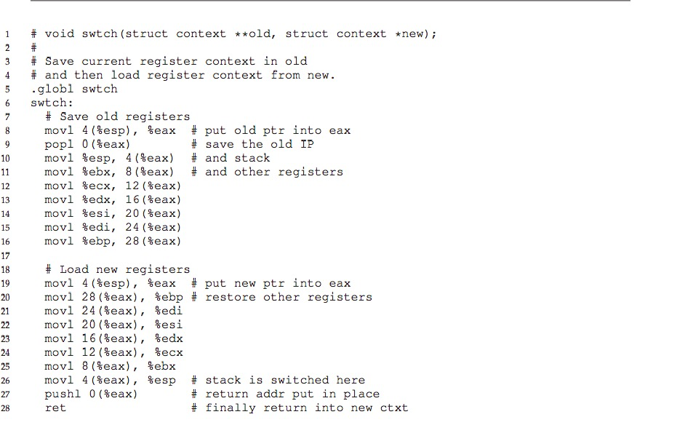
Q4: What Context must be Saved?

Slide 17
Virtualization: The CPU
RUTGERS UNIVERSITY Computer Sciences Department
CS 416 Operating Systems Design
Sudarsun Kannan
Disclaimer: Materials derived, reused, and modified from OSTEP book and lectures of Prof. Andrea and Remzi Arpaci-Dusseau and Prof. Yojip Won

