Slide 1

Pipelined Reliability
Lecture 14
http://www.cs.rutgers.edu/~sn624/352-F24
Srinivas Narayana

Slide 2
Review: Stop-and-Wait Reliability
Sender sends a single packet, then waits for an ACK to know the packet was successfully received. Then the sender transmits the next packet.
If ACK is not received until a timeout (RTO), sender retransmits the packet
Disambiguate duplicate vs. fresh packets using sequence numbers that change on “adjacent” packets
Sender
Receiver
SEQ 0
ACK
RTT
SEQ 1
RTO
Retransmit

Slide 3
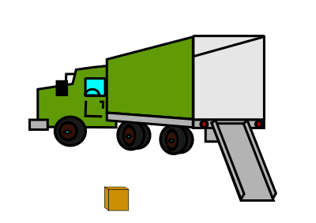



Sending one packet per RTT makes the data transfer rate limited by the time between the endpoints, rather than the bandwidth.
Ensure you got the (one) box safely; make W trips
Ensure you get W boxes safely; make just 1 trip!
Keep many packets in flight

Slide 4
Making reliable data transfer efficient

Slide 5
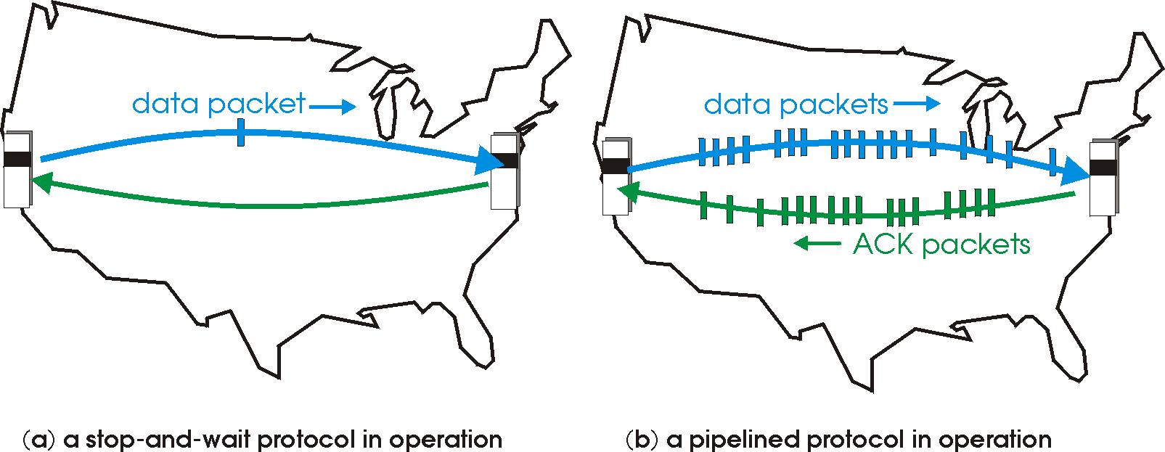
Pipelined reliability
Data in flight: data that has been sent, but sender hasn’t yet received ACKs from the receiver
Note: can refer to packets in flight or bytes in flight
New packets sent at the same time as older ones still in flight
New packets sent at the same time as ACKs are returning
More data moving in same time!
Improves throughput
Rate of data transfer

Slide 6

Pipelined reliability
Stop and wait: send 1 packet per RTT
Pipelined: send W packets per RTT
If W packets are in flight, throughput improves W times compared to stop-and-wait
For now, assume we fix W
Later: how to determine W?
Sender
Receiver
RTT
RTO

Slide 7
Pipelining makes reliable data transfer efficient.
However, pipelining also makes it more complex.
Which packets are currently in flight?
Which packets were successfully delivered?
Which packets should the sender retransmit?

Slide 8
Sliding Windows

Slide 9
Setup
Sender
Receiver
Assume packets are labeled by sequence numbers
Increasing from 0, …, N-1, then roll back to 0
Assume ACKs indicate the sequence numbers of data that was received
Note: Didn’t need this for stop-and-wait
Convention: ACK#s carry the next sequence number expected
Used in TCP
Our discussion uses packet seq #s
However, TCP uses byte seq #s
SEQ 0
SEQ 1
ACK 1
ACK 2
…
SEQ N-1
SEQ 0

Slide 10
Sliding window (sender side)
Window: Sequence numbers of in-flight data
Window size: The amount of in-flight data (unACKed)
Sequence numbers restart from 0 beyond a point (finite space on header)
Window size = 3
Sender’s point of view:
0
1
2
3
4
5
6
7
0
1
0
7
1
6
2
Last seq # known to be received (ACK recv’d at sender)
Last sequence # sent
5
3
4
Transmissions later in time

Slide 11
Sliding window (sender side)
Suppose sequence number 2 is acknowledged by the receiver
Sender receives the ACK. Sender can transmit sequence # 5
The window “slides” forward
Window size = 3
Sender’s point of view:
0
1
2
3
4
5
6
7
0
1
0
7
1
6
2
Last seq # known to be received (ACK recv’d at sender)
Last sequence # sent
5
3
4

Slide 12
Sliding window (sender side)
Suppose sequence number 2 is acknowledged by the receiver
Sender receives the ACK. Sender can transmit sequence # 5
The window “slides” forward
Window size = 3
Sender’s point of view:
0
1
2
3
4
5
6
7
0
1
0
7
1
6
2
Last seq # known to be received (ACK recv’d at sender)
Last sequence # sent
5
3
4

Slide 13
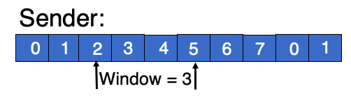
Sliding window (receiver side)
Window of in-flight packets can look different between sender and the receiver
Receiver only accepts sequence #s allowed by the current receiver window
Window size = 3
Receiver will not accept this seq #. Packet dropped
Receiver’s point of view:
0
1
2
3
4
5
6
7
0
1
Last seq # received and ACK’ed by receiver
Highest sequence # accepted

Slide 14
Summary of sliding windows
Sender and receiver can keep several packets of in-flight data
Book-keep the sequence numbers using the window
Windows slide forward as packets are ACKed (at receiver) and ACKs are received (at sender)
Common case: Improve throughput by sending and ACKing more packets in the same duration

Slide 15
Pipelining makes reliable data transfer efficient.
However, pipelining also makes it more complex.
Which packets are currently in flight?
Which packets were successfully delivered?
Which packets should the sender retransmit?

Slide 16
Which packets to retransmit?

Slide 17
How to identify dropped packets?
Suppose 4 packets sent, but 1 dropped. How does sender know which one(s) dropped?
Recall: Receiver writes sequence numbers on the ACK indicating successful reception
Key idea: Sender can infer which data was received successfully using the ACK #s
Hence, sender can know which data to retransmit
Q1: Should receivers ACK subsequent packets upon detecting data loss?
Q2: If so, what sequence number should receiver put on the ACK?
Sender
Receiver
SEQ 1
SEQ 2
SEQ 3
SEQ 4
RTT
ACK 2
ACK 3
Should this ACK exist ???
ACK ??
RTO

Slide 18
Receiver strategies upon packet loss
Sender
Receiver
ACK pkts after a drop?
1
No
Yes
2
3
4
Go-back-N
Selective Repeat
What # on ACK?
5
Last seq# in order
Cumulative ACK
Seq# ranges received so far
Selective ACK
TCP’s default

Slide 19
Sliding Window with Go Back N
When the receiver notices missing data:
It simply discards all data with greater sequence numbers
i.e.: the receiver will send no further ACKs
The sender will eventually time out (RTO) and retransmit all the data in its sending window
Subtle: conceptually, separate timer per byte to infer RTO

Slide 20
Go back N
RTO
Sender
0
1
2
3
4
2
3
4
5
6
Maximum
window size = 8
ACK 1
ACK 2
ACK 3
ACK 4
ACK 5
ACK 6
ACK 7
Receiver
0
1
E
D
D
2
3
4
5
6
Maximum
window size = 8
Discarded by
receiver
Dropped packet
(or) Packet with
error
Time

Slide 21
Go back N
Go Back N can recover from erroneous or missing packets.
But it is wasteful.
If there are errors, the sender will spend time and network bandwidth retransmitting data the receiver has already seen.

Slide 22
Selective repeat with cumulative ACK
Idea: sender should only retransmit dropped/corrupted data.
The receiver stores all the correct frames that arrive following the bad one. (Note that the receiver requires memory to hold data for each sequence number in the receiver window.)
When the receiver notices a skipped sequence number, it keeps acknowledging the first in-order sequence number it wants to receive. This is termed cumulative ACK.
When the sender times out waiting for an acknowledgement, it just retransmits the first unacknowledged data, not all its successors.
Recall that RTO applies independently to each sequence #

Slide 23
Selective repeat with cumulative ACK
RTO
Sender
0
1
2
3
4
2
5
6
Maximum
window size = 8
ACK 2
ACK 2
ACK 1
ACK 2
ACK 5
ACK 6
ACK 7
Receiver
0
1
E
3
4
2
5
6
Maximum
window size = 8
Buffered by
receiver in
its memory
Packet with
error (or)
dropped packet
Time

Slide 24
Selective repeat with selective ACK
Assume that SACKs reported alongside cumulative ACK
RTO
Sender
0
1
2
3
4
2
5
6
ACK 2
SACK 3
Maximum
window size = 8
ACK 2
SACK 3--4
ACK 1
ACK 2
ACK 5
ACK 6
ACK 7
Receiver
0
1
E
3
4
2
5
6
Maximum
window size = 8
Buffered by
receiver in
its memory
Frame with
error
Time

Slide 25
TCP: Cumulative & Selective ACKs
Sender retransmits the seq #s it thinks aren’t received successfully yet
Pros & cons: selective vs. cumulative ACKs
Precision of info available to sender
Redundancy of retransmissions
Packet header space
Complexity (and bugs) in transport software
On modern Linux, TCP uses selective ACKs by default
Sender
Receiver
1
2
3
4
2
3
4
5
5

