Slide 1

552: Directories
Srinivas Narayana
Fall 2020

Slide 2
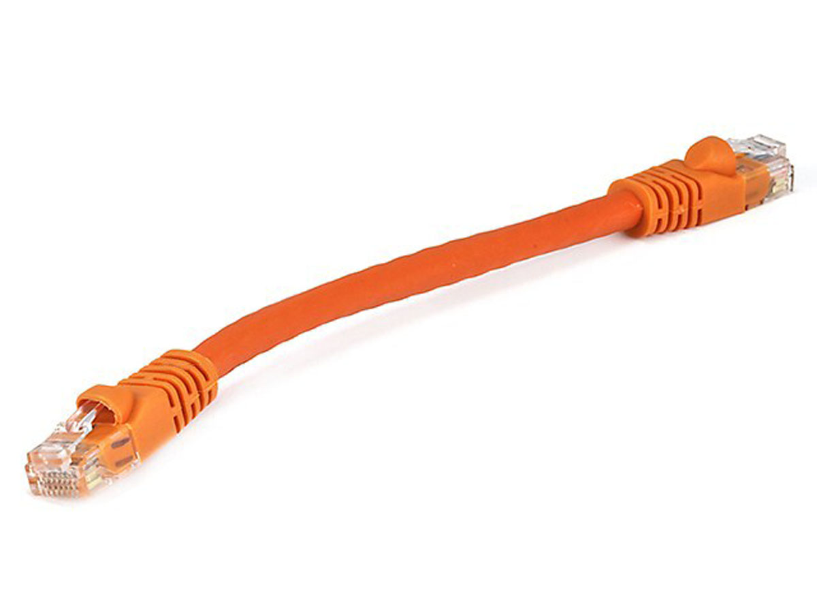


The Internet
Google’s network
Application address (URL)
Ex: mail.google.com
Transport address (port)
Ex: 4096
Network address (IP address)
Ex: 10.1.1.104
Hardware address (MAC address)
Ex: 00-15-C5-49-04-A7

Slide 3
Where do all the addresses come from?

Slide 4
Where do all the addresses come from?
You, as the user, only know the application address of your destination (google.com)
Do we need all these addresses, or can we get rid of some?
Should addresses correspond to the endpoint, or point of attachment, or to the application?
How does your laptop find all the other addresses?

Slide 5
Addresses and what they correspond to
Transport address (TCP/UDP port): app-level conversation
Network-level address (IP address): point of attachment
Link-level address (MAC address): device

Slide 6

Directories
Directories map a name to an address
Simplistic designs
Central directory
Ask everyone (e.g., flooding in ARP)
Tell everyone (e.g., pushing /etc/hosts)
Fix a value a priori (e.g., dst port 80 is typically HTTP)
Scalable distributed designs
Hierarchical namespace (e.g., Domain Name System)
Flat name space (e.g., Distributed Hash Table)

Slide 7

Domain Name System
root DNS server
Host at cis.poly.edu wants IP address for gaia.cs.umass.edu
2
3
TLD DNS server
4
local DNS server
dns.poly.edu
Q: In your home, who runs the local DNS server?
5
7
6
1
8
authoritative DNS server
dns.cs.umass.edu
requesting host
cis.poly.edu
Recursive query: #1
Iterative queries: #2, 4, 6
gaia.cs.umass.edu

Slide 8

ARP: address resolution protocol
Question: how to determine interface’s MAC address, knowing its IP address?
ARP table: each IP node (host, router) on LAN has table
ARP
137.196.7.78
IP/MAC address mappings for some LAN nodes:
< IP address; MAC address; TTL>
TTL (Time To Live): time after which address mapping will be forgotten (typically 20 min)
1A-2F-BB-76-09-AD
ARP
ARP
LAN
71-65-F7-2B-08-53
58-23-D7-FA-20-B0
137.196.7.23
137.196.7.14
ARP
0C-C4-11-6F-E3-98
137.196.7.88
ARP content credit: http://gaia.cs.umass.edu/kurose_ross/ppt.htm

Slide 9
ARP protocol in action
example: A wants to send datagram to B
B’s MAC address not in A’s ARP table, so A uses ARP to find B’s MAC address
A broadcasts ARP query, containing B's IP addr
destination MAC address = FF-FF-FF-FF-FF-FF
all nodes on LAN receive ARP query
Ethernet frame (sent to FF-FF-FF-FF-FF-FF)
1
C
Source MAC: 71-65-F7-2B-08-53
Source IP: 137.196.7.23
Target IP address: 137.196.7.14
…
TTL
A
B
1
ARP table in A
IP addr
MAC addr
TTL
71-65-F7-2B-08-53
58-23-D7-FA-20-B0
137.196.7.23
137.196.7.14
D

Slide 10
ARP protocol in action
example: A wants to send datagram to B
B’s MAC address not in A’s ARP table, so A uses ARP to find B’s MAC address
ARP message into Ethernet frame (sent to 71-65-F7-2B-08-53)
C
Target IP address: 137.196.7.14
Target MAC address:
58-23-D7-FA-20-B0
…
ARP table in A
IP addr
MAC addr
TTL
TTL
A
B
2
71-65-F7-2B-08-53
58-23-D7-FA-20-B0
137.196.7.23
137.196.7.14
2
B replies to A with ARP response, giving its MAC address
D

Slide 11
ARP protocol in action
example: A wants to send datagram to B
B’s MAC address not in A’s ARP table, so A uses ARP to find B’s MAC address
ARP uses broadcasting as a method to implement a directory service
C
ARP table in A
IP addr
MAC addr
TTL
TTL
A
B
137.196.
7.14
58-23-D7-FA-20-B0
500
71-65-F7-2B-08-53
58-23-D7-FA-20-B0
137.196.7.23
137.196.7.14
3
A receives B’s reply, adds B entry into its local ARP table
D

