Slide 1

552: Endpoint Responsibilities
Srinivas Narayana
Fall 2020

Slide 2
Network Attachment, Application Interfacing, and Resource Sharing

Slide 3

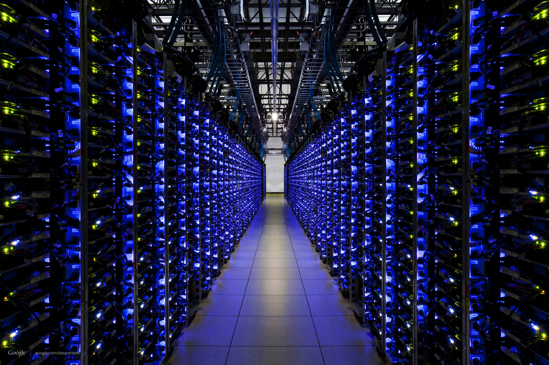



What happens when you browse?
(1) Request gmail.com for your mail
(2) Google churns on your request
(3) Receive & display the response!
The Internet
But how did the Google server and your laptop attach to the network in the first place? How did they get assigned their addresses?

Slide 4
The roles of endpoint network software
Bootstrapping the host into the network
How does the endpoint get an address?
How does the endpoint make itself known to others?
Providing an interface to networked applications
How do higher-level applications access the network?
What abstractions does the host provide to apps?
Distributed resource sharing
What roles does the host play in network resource allocation decisions?
… apart from other things.

Slide 5

(1) Bootstrapping host into network
adapter
The lowest level address is hard-wired
The network adapter (NIC) comes with MAC address
Higher-level addresses can be statically or dynamically configured
IP address
Statically configured, or dynamically with DHCP
TCP port
Pick a transient value, ex. HTTP src port
… or a value agreed upon a priori, ex. HTTP dst port such as 80
Applications
Transport
Network
Link layer

Slide 6
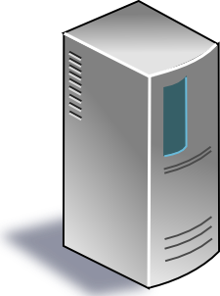
Dynamic Host Configuration Protocol
DHCP discover
(broadcast)
arriving endpoint
DHCP offer
Host learns IP address,
Subnet mask, Gateway address, DNS server(s), and a lease time.
DHCP server
DHCP request
(broadcast)
DHCP ACK

Slide 7
(2) Socket: the interface to applications
Best-effort packet delivery is a clumsy abstraction
Applications typically want higher-level abstractions
Messages, uncorrupted data, reliable in-order delivery
Applications communicate using “sockets”
Stream socket: reliable stream of bytes (like a file)
Message socket: unreliable message delivery
User process
User process
socket
socket
Operating
System
Operating
System

Slide 8
Two Basic Transport Features
Demultiplexing: port numbers
Error detection: checksums
Server host 128.2.194.242
Service request for
128.2.194.242:80
(i.e., the Web server)
Client host
Web server
(port 80)
Client
OS
Echo server
(port 7)
IP
payload
detect corruption

Slide 9
Two Main Transport Layers
User Datagram Protocol (UDP)
Just provides demultiplexing and error detection
Header fields: port numbers, checksum, and length
Low overhead, good for query/response and multimedia
Transmission Control Protocol (TCP)
Adds support for a “stream of bytes” abstraction
Retransmitting lost or corrupted data
Putting out-of-order data back in order
Preventing overflow of the receiver buffer
Adapting the sending rate to alleviate congestion
Higher overhead, good for most stateful applications

Slide 10
Socket: the interface to applications
User process
User process
A socket is associated with five pieces of information:
Source and destination IP address
Source and destination port
Kind of transport protocol (TCP/UDP)
Together referred to as the connection five-tuple
socket
socket
Operating
System
Operating
System

Slide 11
(3) Distributed sharing of the network
Best-effort network easily becomes overloaded
No mechanism to “block” excess calls
Instead excess packets are simply dropped
Examples
Shared Ethernet medium: frame collisions
Ethernet switches and IP routers: full packet buffers
Can quickly lead to congestion collapse
Increase in load that results in a decrease in useful work done.
Useful work
“congestion
collapse”
https://tools.ietf.org/html/rfc896
Load

Slide 12
Endpoints adjust to congestion
End hosts adapt their sending rates in response to network conditions
Learning that the network is congested
Shared Ethernet: carrier sense multiple access
Medium access control
IP network: observing end-to-end performance and back off
Congestion control
Adapting to network contention
Slowing down the sending rate/holding off transmitting for the greater good
too little, and don’t effectively relieve congestion
too much, and you risk losing application performance

Slide 13
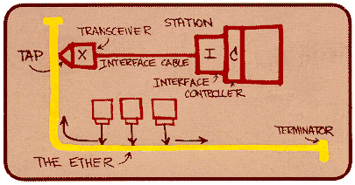
Ethernet back-off mechanism
Carrier sense: wait for link to be idle
If idle, start sending; if not, wait until idle
Collision detection: listen while transmitting
If collision: abort transmission, and send jam signal
Exponential back-off: wait before retransmitting
Wait random time, exponentially larger on each retry

Slide 14
TCP congestion control (much more later)
Additive increase, multiplicative decrease
On packet loss, divide congestion window in half
On success for last window, increase window linearly
Loss
Window
halved
time
Other mechanisms: slow start, fast retransmit vs. timeout loss, etc.

