Slide 1

552: Distributed Control Planes
Srinivas Narayana
Fall 2020

Slide 2

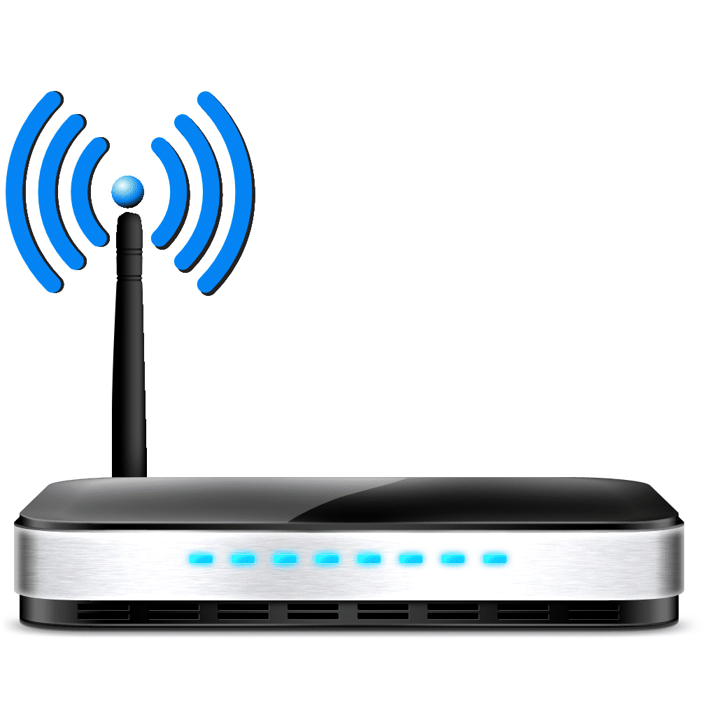
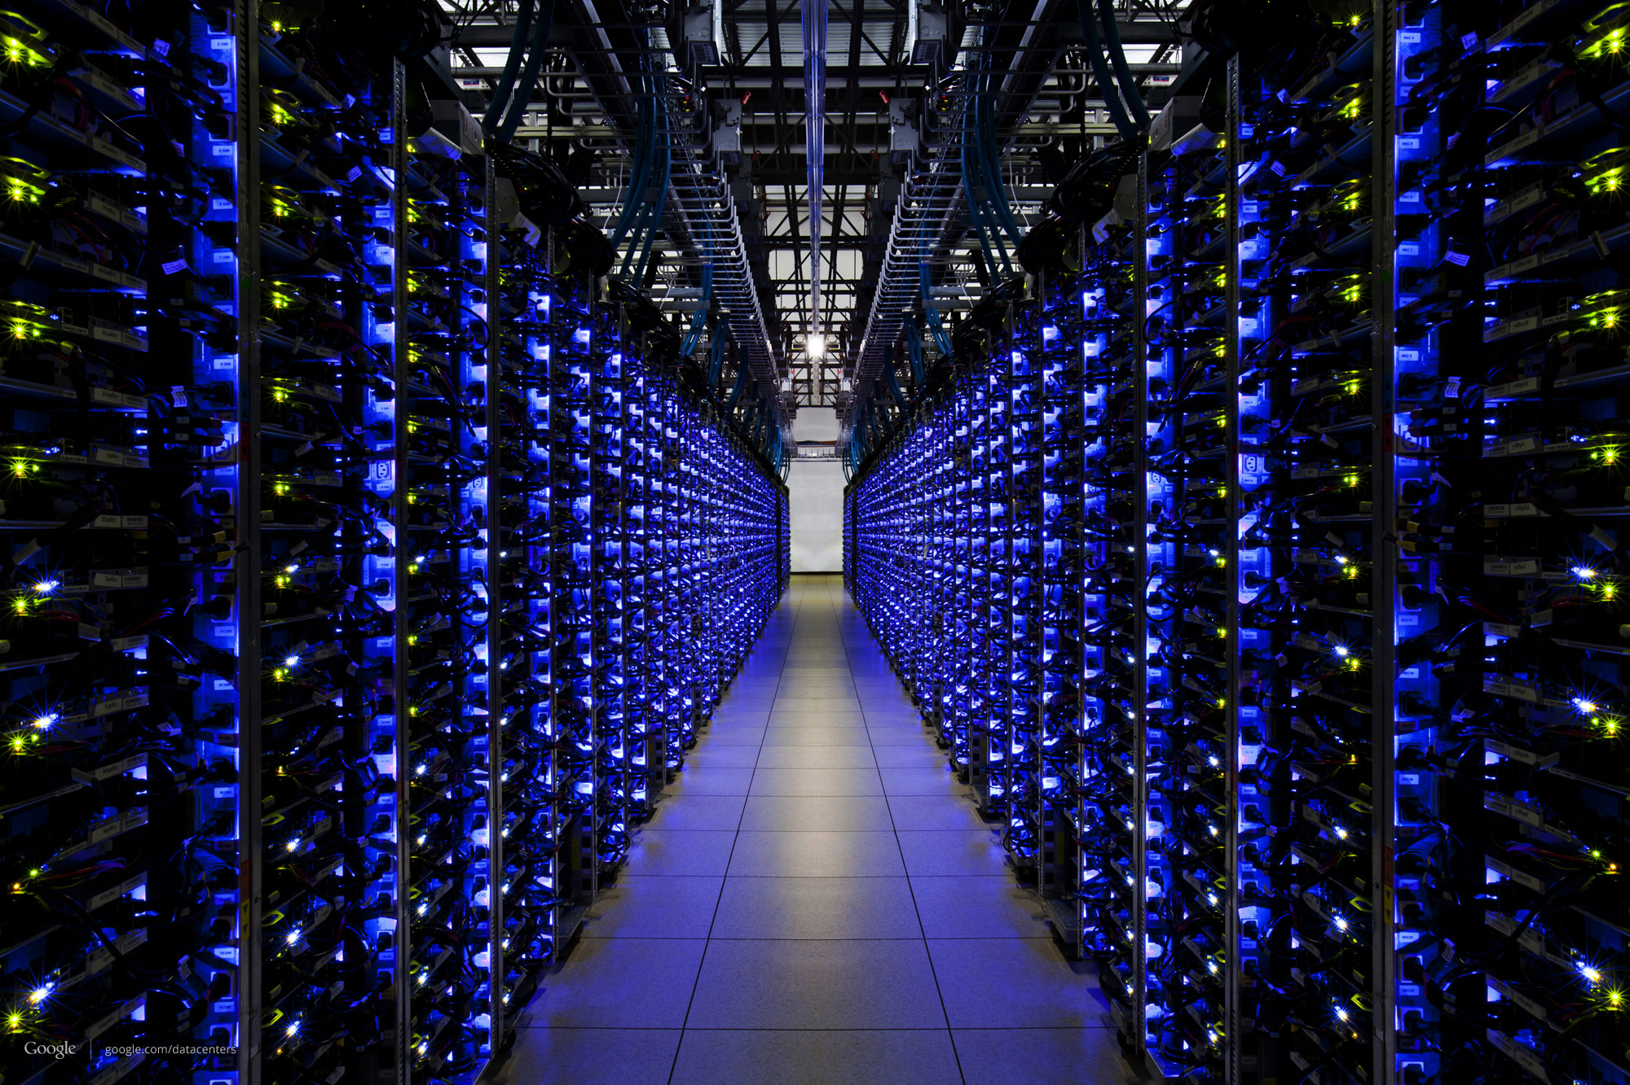
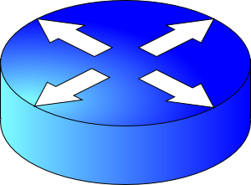
Recall…
Internet composed of many autonomously administered entities (ASes)
Routing computes paths
Verizon
AT&T
Rutgers
Sprint

Slide 3
Routing enables forwarding
Each router creates & looks packets up in its own forwarding table
But the computation of the table is itself distributed
Three aspects of a routing protocol:
What outcome it computes
What algorithm it runs
How the protocol learns the location of endpoints

Slide 4
An example: OSPF
Verizon
AT&T
Rutgers
Sprint
Open Shortest Path First (OSPF) used within an AS

Slide 5
What OSPF computes
Shortest path(s) between each pair of nodes
Separate shortest-path tree rooted at each node
Path(s) with minimum sum of link metrics
Disadvantages
All nodes need to agree on the link metrics
Multipath routing is limited to “equal cost multipath”
Edge weights set by the network administrator

Slide 6
Discovering other routers: Link State ads
Each router sends out its own address and neighborhood link costs over all of its links: link state advertisement
Each router forwards advertisements from others
A process known as link state flooding
As long as the neighboring router and the link to it are alive, the link cost is included in the flooded message
OSPF is a link state protocol: if the state of the link changes (up/down/cost change), the entire network will know

Slide 7
OSPF link-state routing algorithm
Dijkstra’s algorithm
net topology, link costs known to all nodes due to link state broadcast
all nodes have same info
Compute least cost paths from one node (‘source”) to all other nodes
Extract forwarding table for that (source) node
iterative: after k iterations, know least cost path to k dest.’s
Notation:
c(x,y): link cost from node x to y; = ∞ if not direct neighbors
D(v): current value of cost of path from source to dest. v
p(v): predecessor node along path from source to v
N': set of nodes whose least cost path definitively known

Slide 8
Dijsktra’s Algorithm
1 Initialization:
2 N' = {u}
3 for all nodes v
4 if v adjacent to u
5 then D(v) = c(u,v)
6 else D(v) = ∞
7
8 Loop
9 find w not in N' such that D(w) is a minimum
10 add w to N'
11 update D(v) for all v adjacent to w and not in N' :
12 D(v) = min( D(v), D(w) + c(w,v) )
13 /* new cost to v is either old cost to v or known
14 shortest path cost to w plus cost from w to v */
15 until all nodes in N'

Slide 9
Dijkstra’s algorithm: example
Step
0
1
2
3
4
5
N'
u
ux
uxy
uxyv
uxyvw
uxyvwz
D(v),p(v)
2,u
2,u
2,u
D(w),p(w)
5,u
4,x
3,y
3,y
D(x),p(x)
1,u
D(y),p(y)
∞
2,x
D(z),p(z)
∞
∞
4,y
4,y
4,y
5
v
3
w
2
5
u
2
1
z
3
1
2
x
y
1

Slide 10
Constructing a forwarding table
resulting shortest-path tree from u:
v
w
u
z
x
y
resulting forwarding table in u:
destination
link
v
(u,v)
x
(u,x)
y
(u,x)
w
(u,x)
z
(u,x)

Slide 11
Other Kinds of Routing Protocols
Distance Vector Protocols
Don’t flood link state throughout the network: more scalable
Exchange local vector of distances to other nodes with neighbors
RIP, IS-IS
Stability: bad router can propagate bad info to many routers
Path Vector Protocols
Exchange local vector of paths to other nodes with neighbors
BGP (Border Gateway Protocol: the glue of the Internet)
Stability issues still exist! Route hijacks, blackholing, …
Complex and prone to misconfiguration (recent CenturyLink outage)
https://www.bleepingcomputer.com/news/technology/centurylink-routing-issue-led-to-outages-on-hulu-steam-discord-more/

Slide 12
How essential is distributed route computation?
Internet-scale: ASes are managed by different entities
E.g., AT&T and Verzon
Each AS with their own policies, business arrangements, etc.
Commercial interests: ASes not willing to open proprietary details about their connectivity, topology, capabilities, …
Very hard to get operators (or equivalently, code) from 50,000+ ISPs of the Internet to compute routes together
An inter-AS protocol like BGP is fundamentally necessary for the Internet’s operation

Slide 13
How essential is distributed route computation?
Within an AS: e.g., Rutgers,
It’s conceptually possible
Rutgers NOC observes the entire network from one place
Teams within Rutgers are open and willing to collaborate
A Significant fraction of the OSPF spec is dedicated to maintenance of the distributed link state database
Path computation is just a small part of OSPF!
https://tools.ietf.org/html/rfc2328
So why not compute routes in a centralized fashion?

