Slide 1
Administrivia
Review 1 due tomorrow
Email your reviews to me
Office hours on Thursdays 10—12
MUD: Send me your top 1—3 questions on this lecture
Guest lectures next week by Prof. Richard Martin
Class slides by 10 mins (starts at 8.50 am) on both days

Slide 2

Packet Scheduling
Lecture 5, Computer Networks (198:552)

Slide 3

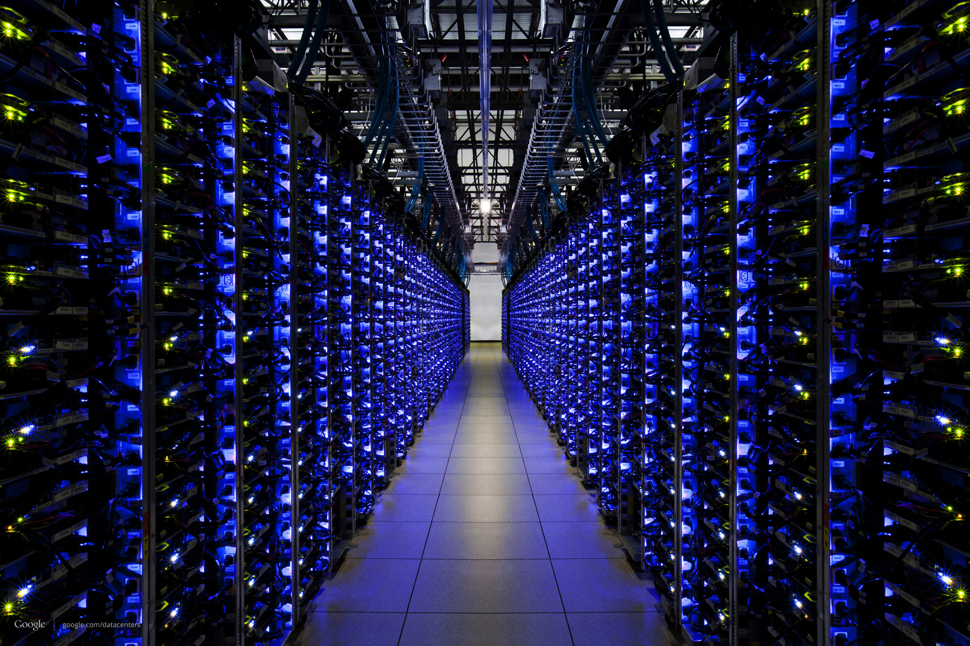
Resource allocation in the core
Edge: Run transports to provide app guarantees
Core: Transmit packets with best-effort guarantees
The Internet

Slide 4

Resource allocation in the core
Edge: Run transports to provide app guarantees
Core: Transmit packets with best-effort guarantees
But what about malicious or buggy endpoints?
The Internet

Slide 5



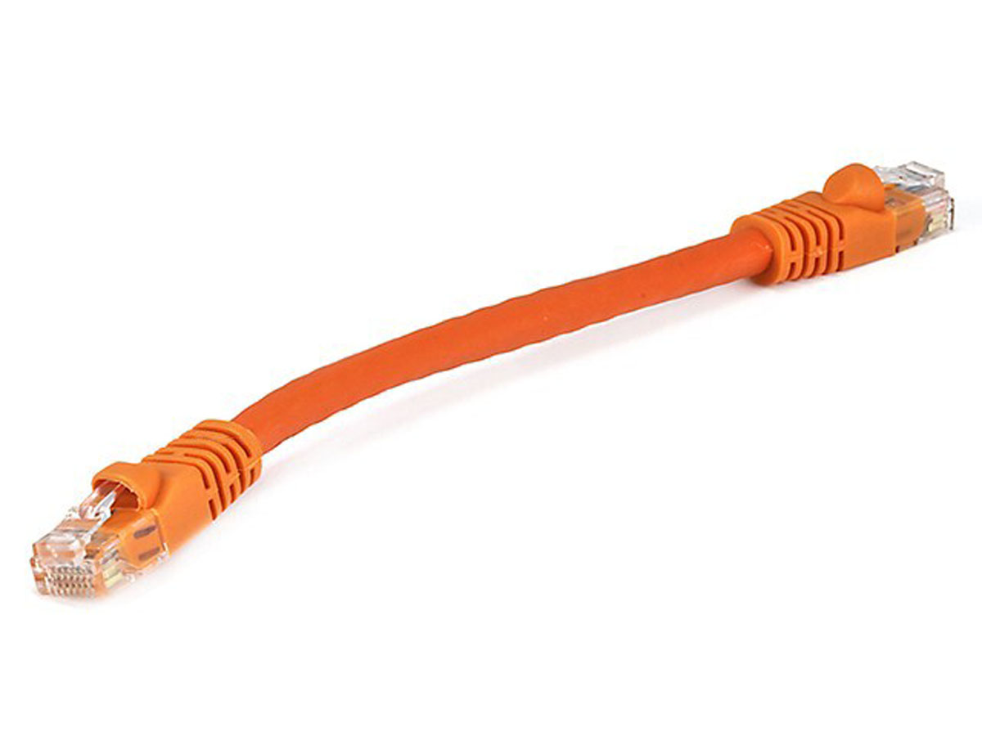
Network model
Queuing delay
Bottleneck queue
(max size B)
Link rate
Flows
Packet-switched core network

Slide 6

First-in first-out (FIFO) queue + tail-drop
Buffer size
2
1
b
2
a
1
a
b
Dropped packets

Slide 7
First-in first-out (FIFO) queue + tail-drop
6
Head of line blocking (HOL)
5
4
Buffer size
3
2
1
6
a
4
3
2
5
1
a
b
b
Dropped packets

Slide 8
What happens in the next round-trip time interval?

Slide 9
ACK-clocking makes it worse: lucky case
13
12
11
10
Buffer size
9
8
7
12
11
10
9
8
b
7
b
13
c
Dropped packets

Slide 10
ACK-clocking makes it worse: unlucky case
13
12
11
10
Buffer size
9
8
7
13
12
11
10
9
8
7
b
b
c
Dropped packets

Slide 11
Network monopolized by “bad” endpoints
An ACK signals the source of a free router buffer slot
Further, ACK clocking means that the source transmits again
Contending packet arrivals may not be random enough
Blue flow can’t capture buffer space for a few round-trips
Sources which sent successfully earlier get to send again
A FIFO tail-drop queue incentivizes sources to misbehave!

Slide 12
Goal: Better resource sharing in the core
What’s a fair resource allocation?
How to achieve a predetermined resource allocation?
… regardless of source behavior?
How to make the allocation “efficient”?
Use the available bandwidth effectively
Build routers that work at high link rates
Maybe even be a little unfair to apps to be more efficient overall

Slide 13
Fair Resource Allocation
Allocate how? among who?

Slide 14
Fair and efficient use of a resource
Suppose n users share a single resource
Like the bandwidth on a single link
E.g., 3 users sharing a 30 Gbit/s link
What is a fair allocation of bandwidth?
Suppose user demand is “elastic” (i.e., unlimited)
Allocate each a 1/n share (e.g., 10 Gbit/s each)
But, “equality” is not enough
Which allocation is best: [5, 5, 5] or [18, 6, 6]?
[5, 5, 5] is more “fair”, but [18, 6, 6] more efficient
What about [5, 5, 5] vs. [22, 4, 4]?

Slide 15
Fair use of a single resource
What if some users have inelastic demand?
E.g., 3 users where 1 user only wants 6 Gbit/s
And the total link capacity is 30 Gbit/s
Should we still do an “equal” allocation?
E.g., [6, 6, 6]
But that leaves 12 Gbps unused
Should we allocate in proportion to demand?
E.g., 1 user wants 6 Gbps, and 2 each want 20 Gbit/s
Allocate [4, 13, 13]?
Or, give the least demanding user all she wants?
E.g., allocate [6, 12, 12]?

Slide 16
Max-min fairness
Protect the less fortunate
Any attempt to increase the allocation of one user
… necessarily decreases the allocation of another user with equal or lower allocation
Fully utilize a “bottlenecked” resource
If demand exceeds capacity, the link is fully used

Slide 17
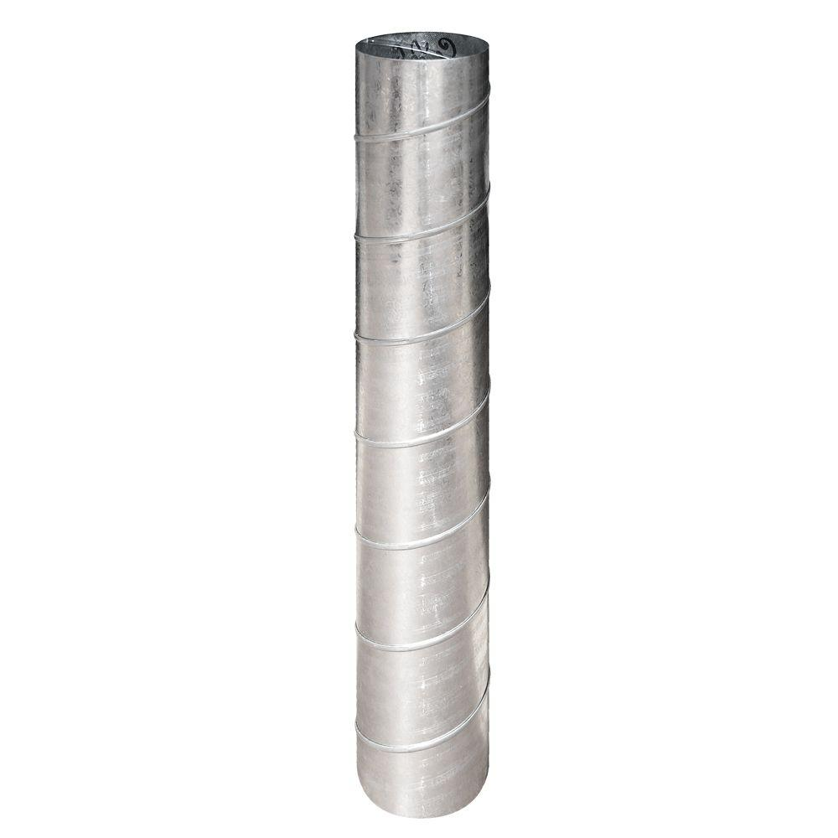
Max-min fairness
Progressive filling algorithm
Grow all rates until some users stop having demand
Continue increasing all remaining rates until link is fully utilized
If all users have elastic demands, single resource shared evenly
Link rate L/N
N elastic users
Link rate L/N
…
Link rate L
Link rate L/N

Slide 18
Resource Allocation Over Paths
A
B
Three users A, B, and C
Two 30 Gbit/s links
C
Maximum throughput: [30, 30, 0]
Total throughput of 60, but user C starves
Max-min fairness: [15, 15, 15]
Equal allocation, but throughput of just 45
Proportional fairness: [20, 20, 10]
Balance trade-off between throughput and equality
Throughput of 50, and penalize C for using 2 busy links

Slide 19
Scheduling and Buffer Management
Buffer size
Scheduling:
Allocating link bandwidth & queueing delays
(1) Which packet to send next?
(2) When to send the next packet?
12
11
10
9
8
b
7
c
Buffer management/Active Queue Management (AQM)
Allocating buffer capacity
Which packets to mark or drop?
When to mark or drop?

Slide 20
Allocate fairly among who?
Abstract entity:
a flow
Traffic sources?
Web servers, video servers, etc. need more than their fair share
Traffic destinations?
Vulnerable to malicious sources denying service to receivers
Source-destination pairs?
Can open up connections to many destinations
Application flows? (i.e., src + dst + transport ports)
Malicious app can open up many such flows
Administrative entities? (e.g., Rutgers NetID, ISP, …)
How is a router to identify packets belonging to an entity?

Slide 21
Scheduling Algorithms
Which packet to send next?
When to send the next packet?

Slide 22
A taxonomy
12
11
10
9
8
b
7
Granularity of allocation
Per-packet vs. per-flow vs bit-by-bit
Pre-emptive vs. non-pre-emptive
Do you interrupt the current packet/flow if another shows up?
Size-aware vs. unaware
Do you take into account flow or packet sizes in scheduling?
Class-based vs. shared
Are some flows strictly higher priority than others?
Work-conserving vs. non-conserving
Do you always use spare link capacity when there is demand?
How complex is the implementation?

Slide 23
Common scheduling algorithms (1/2)
FIFO over packets (example in previous slides)
Round-robin over packets of different flows
You would have seen these in the FQ & DRR papers
Shortest Remaining Processing Time (SRPT)
Flow-size-aware allocation which strictly prioritizes short flows
Flow-size-unaware variant may “predict” demand using a known flow size distribution

Slide 24
Common scheduling algorithms (2/2)
Processor sharing
Assume each flow gets a fair share of the link every unit of time
Ideal: each flow starts receiving service immediately upon arrival
Rate limiting
Non-work-conserving: flow can’t send even if more demand than limit
Class-based prioritization
Pre-determined flow classes with strict priorities over each other
Starve low priority flows if higher priority flows are always sending
There are many variants and combinations of these!

Slide 25
Exercise: When does a flow finish?
Consider a workload mix of “long” and “short” flows arriving at a Q
Ex: A flow may have as few as 2 packets or as many as 10⁵
Suppose a scheduling algorithm provides each flow:
An average per-packet delay d (e.g., 50 ms)
An average link bandwidth share t (e.g., 10 Mbit/s)
Which among d & t determines when a short flow finishes? Why?
How about a long flow?
If you don’t know the workload mix, is there an optimal sch. alg.?
If so, which one? If not, why not?

Slide 26
Analysis and Simulation of a Fair Queueing Algorithm
ACM SIGCOMM ’89
Alan Demers, Srinivasan Keshav, and Scott Shenker

Slide 27
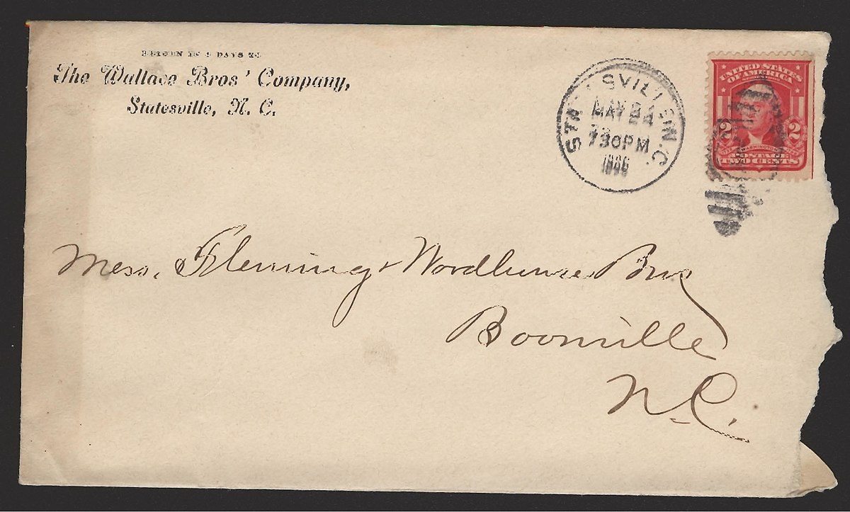
An ideal to emulate: Processor sharing
Fair-share bandwidth in the most fine-grained fashion possible
If there are N active flows, each flow gets 1/N^{th} of the link rate
“Bit by bit round robin” (BR)
Implementing BR directly on routers is unrealistic. Why?
One reason: consider the processing of the bit downstream
E.g., where to route the bit?
…

Slide 28
Emulate bit-by-bit round robin (BR)?
How about round robin over packets?
Unfair! A flow can use larger packets and gain larger bandwidth
Instead, determine when a packet would finish with BR
Depends only on packet arrival time & # of active flows
Let’s call this the “virtual finish time”
FQ: Transmit packets in the order of the virtual finish times
Buffer management: drop pkt of the flow with the largest backlog

Slide 29
How close is FQ to BR?
Total # bytes transmitted by a flow in BR and FQ aren’t different by more than the maximum packet size
Independent of the number of active flows!
Why?
A “slack” parameter, delta, used to reduce the virtual finish time for inactive flows
Doesn’t affect long-term throughput

Slide 30
Discussion of FQ
Is the slack parameter the best method to handle “delay allocation”?
What are the pros and cons of this method?
Can you think of other methods?
If there are N active flows, how much per-packet work does FQ need to do to determine the next packet to schedule?
Why does the performance of a scheduling algorithm depend on the endpoint algorithm?
What happens in a network of FQs?
Is there a variant that considers path-level resource usage?

Slide 31
Efficient Fair Queueing using Deficit Round Robin
ACM SIGCOMM ’95
M. Shreedhar and George Varghese

Slide 32
Problem: Complexity of implementing FQ
If there are N active flows, FQ needs to do O(log N) work to fetch the next packet to transmit
Reason: must maintain a sorted list of virtual finish times of at least the first packet of each active flow
Can we avoid maintaining a sorted list somehow?

Slide 33
Idea: Keep track of pkt size unfairness
Basic idea: round robin over packets of different flows
Maintain an active list of flows; hash flows to a queue
Maintain a “quantum” for each queue that is refilled every round
By the maximum packet size
Transmit as many packets as allowed by the queue’s quantum
If a packet is larger than the quantum, the flow keeps the quantum

Slide 34
Discussion of DRR
Assume N active flows
Why is the quantum added every round the maximum pkt size?
What are the throughput guarantees provided by DRR?
Short-term guarantees? Asymptotic?
Elastic demands? Inelastic demands?
What are the delay guarantees provided by DRR?
Worst case: may wait until N maximum size packets transmitted!
Combine with class-based (strict) prioritization + contracts
How would you maintain an active flow list in hardware?

Slide 35
Administrivia
Review 1 due tomorrow
Email your reviews to me
Office hours on Thursdays 10—12
MUD: Send me your top 1—3 questions on this lecture
Guest lectures next week by Prof. Richard Martin
Class slides by 10 mins (starts at 8.50 am) on both days

