Slide 1
Host-to-network layer: (a) Physical Layer
The physical layer transmits the raw bit stream between two endpoints of a physical link
Functions:
Modulation of bits over physical signals
Performing bit-serial or parallel signal transmission
Half- or Full-duplex transmission
Concerns
How many pins does the network connector have?
How is physical connectivity set up or torn down?

Slide 2
Host-to-network layer: (b) Data Link Layer
The data link layer provides the network layer with what appears to be an error-free link to the other side of the link
Functions:
Provides reliable transfer of information between two adjacent nodes
Creates frames, or packets, from bits and vice versa
Provides frame-level error control

Slide 3
Network Layer
Network layer protocols move (“route”) host data towards destination
Best effort: network will try its best, but no guarantees.
Network layer implemented differently on hosts and routers
Functions:
Responsible for routing decisions
Routing may be fixed or dynamic

Slide 4
Transport Layer
Handles host to host data transmission concerns
Almost fully implemented on hosts
Hides the details of the network from the application
Example: If we replace a point-to-point link with a satellite link, it doesn’t affect the behavior of the upper layers
Functions:
Reliable delivery: Packet retransmission upon loss
Ordered delivery: Reassemble packets in order at receiver
Flow control: Ensure that the receiving host isn’t overwhelmed
Congestion control: Ensure that routers aren’t overwhelmed

Slide 5
Application Layer
Implements application-specific communication between hosts running applications of the same “type”
Ex: between your web browser and a web server (HTTP)
Functions:
Provides session support and presentation support
Session state, encryption, encoding
Examples:
FTP, HTTP, SMTP (email), SIP (Session Initiation Protocol)

Slide 6
Hourglass Design
An artifact of the history of the Internet
Addressing a need to have diverse kinds of networks cooperate
The Internet Protocol (IP) is the “glue” connecting different physical technologies, transports, and applications
HTTPS
FTP
HTTP
SIP
RTSP
TCP
UDP
IP
NET
…
NET
1
2
NET
n

Slide 7
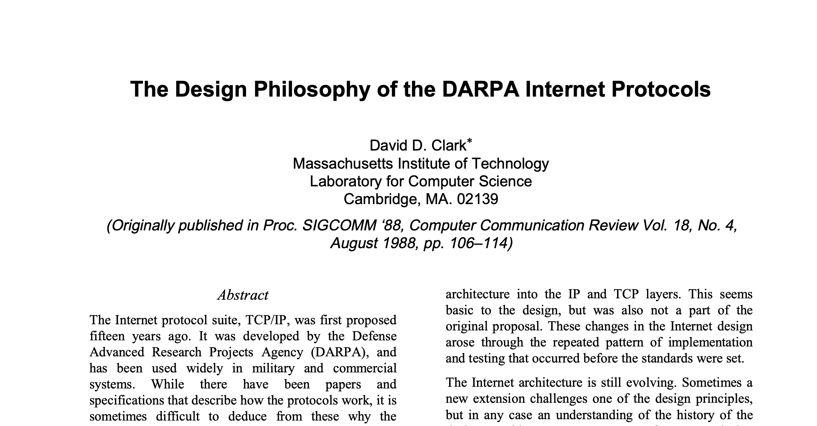
Design principles of the Internet
“multiplexed utilization of existing interconnected networks”

Slide 8
Design principles of the Internet
Accommodate heterogeneity
Interoperate with different technologies, autonomous organizations
Resilience to failure
Parts of the network must operate despite others failing
Scale
Distributed management, networks of different sizes and host types
Intelligence is at the endpoints (“the end-to-end argument”)
Much easier to engineer a network with fewer guarantees (best effort)
Hosts and applications share fate anyway

Slide 10
Backup slides

Slide 11









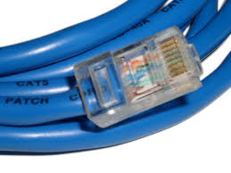


Issues at each layer
Application
Port#
Transport
End-to-end
Address
Network
Routing
Link
Access

Slide 12








functionality at each layer
Application
Port#
Transport
E-2-E
Routing
IP Address
Network
Link
Access

Slide 13
Internet Design Principles
Scale
Protocols should work in networks of all sizes and distances
Incremental deployment
New protocols need to be deployed gradually
Heterogeneity
Different technologies, autonomous organizations
End-to-end argument
Application requirements, to the extent possible should be delegated to the edges; application knows best
Encryption: Should the network provide as default or let applications or end points implement encryption on a need basis?

Slide 14
Measuring a Network’s Performance
A Brief Introduction

Slide 15
Some Definitions
Packet length: size of a packet (units = bits or bytes)
Channel speed or bandwidth: How fast the channel can transmit bits (units = bits/second or Bytes/second or packets/second)
Packet transmission time: amount of time to transmit an entire packet (units = seconds)
Propagation delay: Delay imposed by the properties of the link. Depends on the link’s distance (units = seconds)
Total transfer time =propagation delay + packet transmission time

Slide 16
Digression: Units
Bits are the units used to describe an amount of data in a network
1 kilobit (Kbit) = 1 x 10³ bits = 1,000 bits
1 megabit (Mbit) = 1 x 10⁶ bits = 1,000,000 bits
1 gigabit (Gbit) = 1 x 10⁹ bits = 1,000,000,000 bits
Seconds are the units used to measure time
1 millisecond (msec) = 1 x 10⁻³ seconds = 0.001 seconds
1 microsecond (μsec) = 1 x 10⁻⁶ seconds = 0.000001 seconds
1 nanosecond (nsec) = 1 x 10⁻⁹ seconds = 0.000000001 seconds
Bits per second are the units used to measure channel capacity/bandwidth and throughput
bit per second (bps)
kilobits per second (Kbps)
megabits per second (Mbps)
Bytes (8 bits a byte) Mega bytes, Giga bytes, Tera bytes, Peta Bytes, Exa bytes

Slide 17
Example
500 m
A
B
packet length = 1500 bytes
channel capacity = 10 Mbps
propagation delay factor = 5 μsec/km
How long does it take a single bit to travel on the link from A to B?
How long does it take A to transmit an entire packet onto the link?

Slide 18
Propagation Delay
How long does it take a single bit to travel on the link from A to B of length 500 m with a prop. delay factor = 5 μsec/km ?
Another way to ask this question:
If it takes a signal 5 μsec to travel 1 kilometer, then how long does it take a signal to travel 500 meters?
5 μsec
t
Solving for t…
t = 2.5 μsec
=
1000 m
500 m

Slide 19
Packet Transmission Time
How long does it take A to transmit an entire packet onto the link?
Relevant information: packet length = 1500 bytes
channel speed = 10 Mbps
Another way to ask this question:
If the link can transmit 10 million bits in a second, how many seconds does it take to transmit 1500 bytes (8x1500 bits)?
10 Mbits
1500 x 8 bits
Solving for t…
t = 0.0012 sec (or 1.2 msec)
=
1 sec
t

Slide 20
Message switching vs Packet switching
R1
Link speed is 1000 Bytes/sec. (ignore prop delay)
Packet size is 100 Bytes, file size is 1000 Bytes
Find total time to transfer the entire file under the two switching techniques
Msg switching
Packet switching

Slide 21
Message switching vs Packet switching
R1
Link speed is 1000 Bps. (prop delay for each link=10 msec)
Packet size is 100 bytes, file size is 1000 bytes
Find total time to transfer the entire file under the two switching techniques
Msg switching
Packet switching

Slide 22
Message switching vs Packet switching
L1
L2
L3
R1
R2
Link speed is 1000 Bytes per second . (ignore prop delay, ignore header overhead)
Packet size is 100 Bytes, file size is 1000 Bytes
Find total time to transfer the entire file under the two switching techniques

