Slide 1

Internet Architecture
Lecture 2, Computer Networks (198:552)

Slide 2
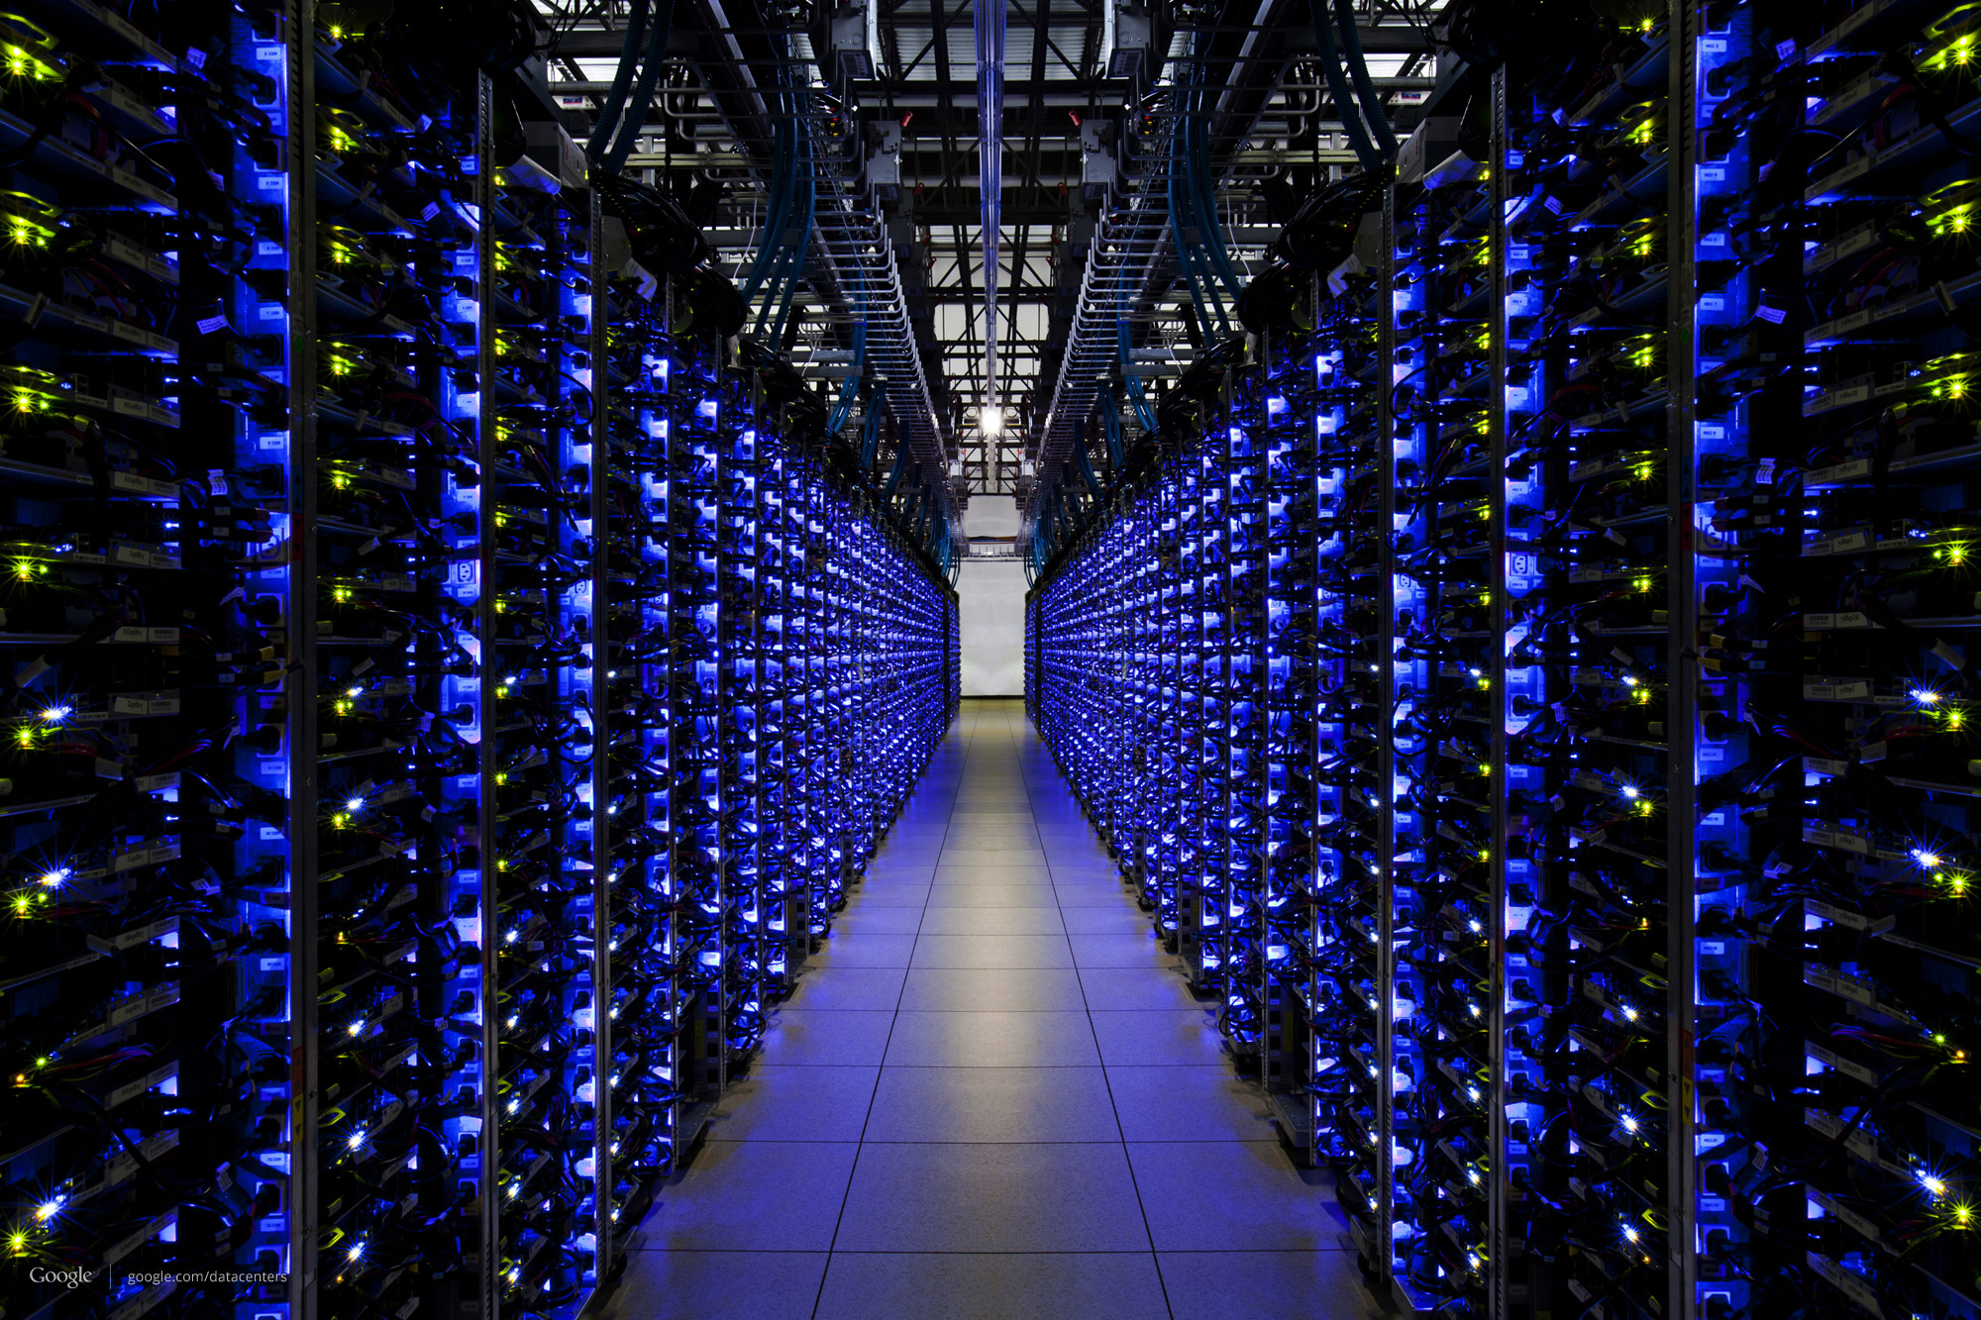

Edge vs. core division of labor
Core: the network consisting of routers
Best-effort packet delivery
Edge: the endpoints
Transport mechanisms to satisfy app needs
The Internet

Slide 3


What happens when you browse?
The Internet

Slide 4

What happens when you browse?
(1) Request gmail.com for your mail
(2) Google churns on your request
(3) Receive & display the response!
The Internet

Slide 5
But how does your laptop know how to reach gmail.com?

Slide 6
Directories!
“You know my name, now find my street address”
In networking, an address can mean many things
Both your laptop and Google’s servers have many addresses

Slide 7
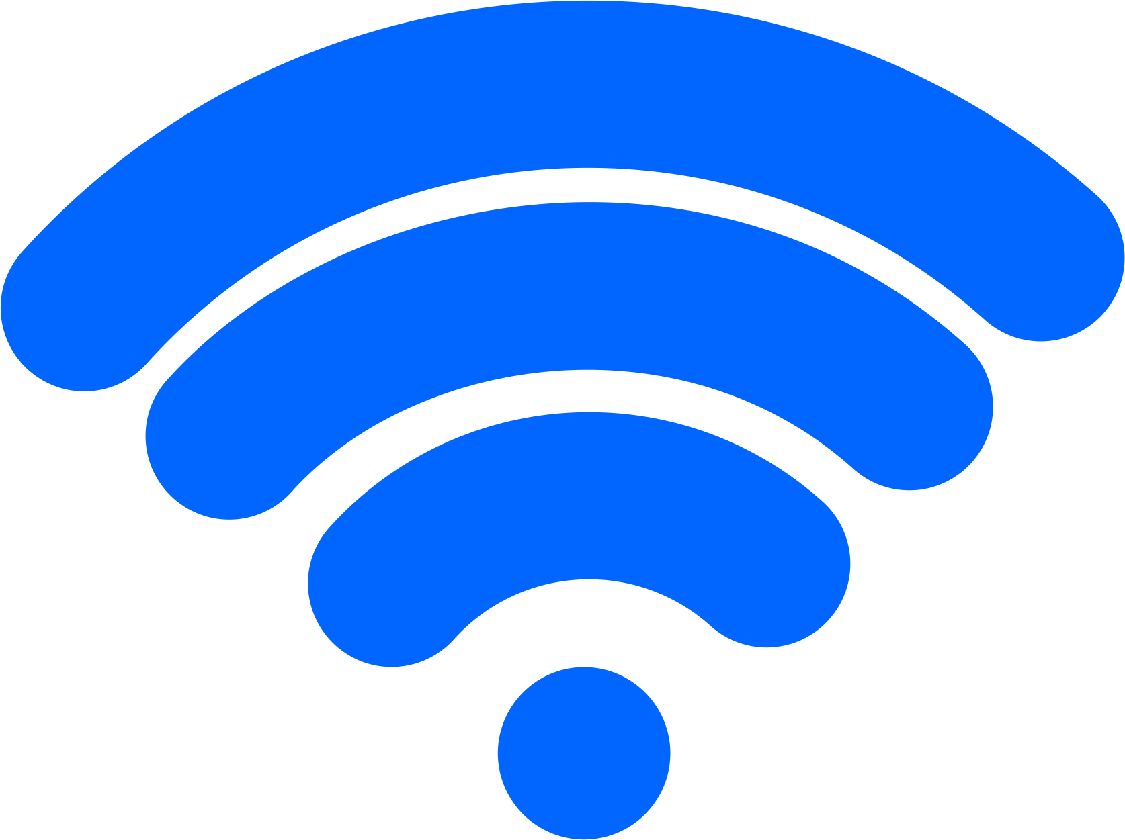

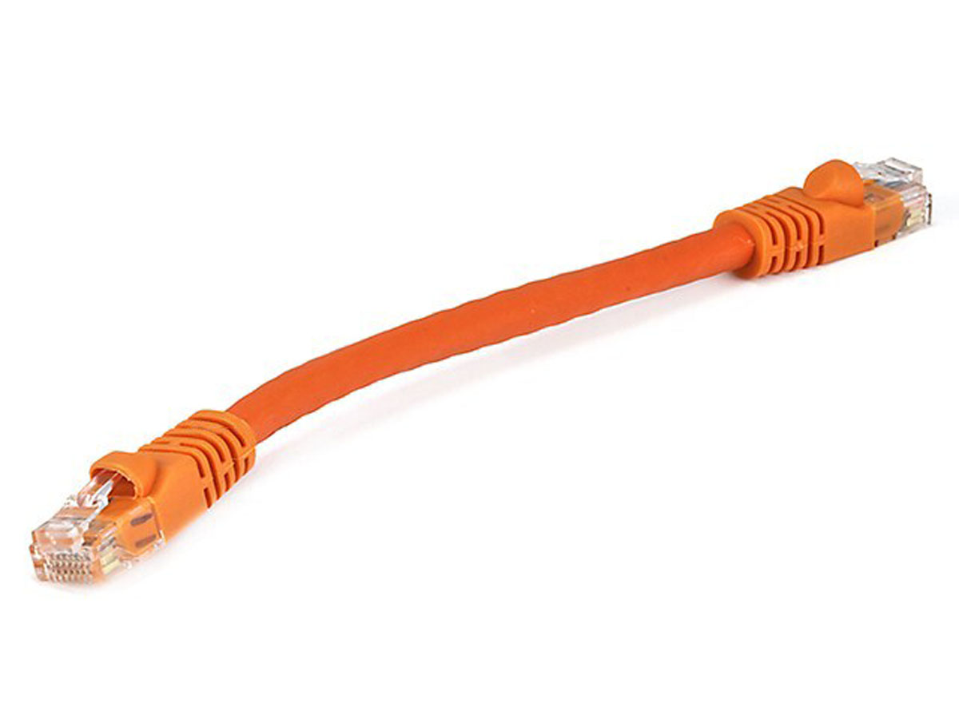
Rutgers campus network
The Internet
Transport address (port)
Ex: 64058
With which app is this conversation associated?
Network address (IP address)
Ex: 192.168.1.4
Whose network am I associated with?
Hardware address (MAC address)
Ex: 00-15-C5-49-04-A9
How do I identify my network interface (device)?

Slide 8
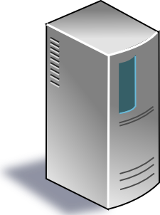
The Internet
Google’s network
Application address (URL)
Ex: mail.google.com
Transport address (port)
Ex: 4096
Network address (IP address)
Ex: 10.1.1.104
Hardware address (MAC address)
Ex: 00-15-C5-49-04-A7

Slide 9
Modularity through layering
Protocols “stacked” in endpoint and router software/hardware
Apps: useful user-level functions
HTTP
FTP
NV
TFTP
Transport: provide guarantees to apps
TCP
UDP
IP
Network: best-effort global pkt delivery
Ether
ATM
…
WiFi
Link: best-effort local pkt delivery
IP is the “thin waist” of the Internet, enabling
interoperability across apps & network media

Slide 10
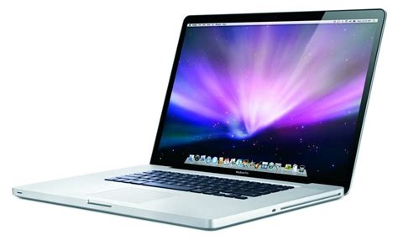
The Internet
Applications
Applications
Pkt starts as an
app “payload”
Transport
Transport
Pkt takes on info at each layer
Network
Network
Link layer
Link layer
The Internet

Slide 11
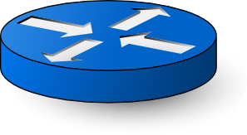
Applications
Applications
Transport
Transport
Network
Network
Network
Network
Link layer
Link layer
Link layer
Link layer

Slide 12
Applications
The core does not (usually) contain transport or app functionality.
Applications
Transport
Transport
Network
Network
Network
Network
Link layer
Link layer
Link layer
Link layer

Slide 13
How does your laptop find gmail.com?
So many network addresses…
Ideas?

Slide 14
Rutgers campus network
The Internet
Transport address (port)
With which app is this conversation associated?
Network address (IP address)
Whose network am I associated with?
Hardware address (MAC address)
How do I identify my network interface (device)?

Slide 15
Directories and Routing

Slide 16

Types of Directories
Directories map a name to an address
Simplistic designs
Central directory
Ask everyone (e.g., flooding in ARP)
Tell everyone (e.g., pushing /etc/hosts)
Scalable distributed designs
Hierarchical namespace (e.g., DNS)
Flat name space (e.g., Distributed Hash Table)

Slide 17

Path computation
“I know where you are, but how do I get there?”
End-to-end paths (e.g., source routing)
Each node picks the best end-to-end path
Spanning tree (e.g., Ethernet)
One tree that connects every pair of nodes
Shortest paths (e.g., OSPF, IS-IS, RIP)
Shortest-path tree rooted at each node
Locally optimal paths (e.g., BGP)
Each node selects the best among its neighbors

Slide 18
The role of the endpoint

Slide 19
The role of the endpoint
Network discovery and bootstrapping
How does the endpoint join the network?
How does the endpoint get an address?
Interface to networked applications
What interface to higher-level applications?
How does the host realize that abstraction?
Distributed resource sharing
What roles does the host play in network resource allocation decisions?

Slide 20
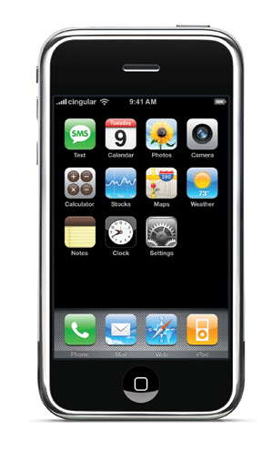

Learning a host’s address
Rutgers
campus net
me
you
adapter
adapter
Who am I?
Hard-wired: MAC address
Static configuration: IP interface configuration
Dynamically learned: IP address configured by DHCP
Who are you?
Hard-wired: IP address in a URL, or in the code
Dynamically looked up: ARP or DNS

Slide 21
Mapping between identifiers
Dynamic Host Configuration Protocol (DHCP)
Given a MAC address, assign a unique IP address
… and tell host other stuff about the Local Area Network
To automate the boot-strapping process
Address Resolution Protocol (ARP)
Given an IP address, provide the MAC address
To enable communication within the Local Area Network
Domain Name System (DNS)
Given a host name, provide the IP address
Given an IP address, provide the host name

Slide 22
Dynamic Host Configuration Protocol
DHCP discover
(broadcast)
arriving client
DHCP offer
Host learns IP address,
Subnet mask, Gateway address, DNS server(s), and a lease time.
DHCP server
DHCP request
(broadcast)
DHCP ACK

Slide 23
Address Resolution Protocol (ARP)
Every host maintains an ARP table
(IP address, MAC address) pair
Consult the table when sending a packet
Map destination IP address to destination MAC address
Encapsulate and transmit the data packet
But, what if the IP address is not in the table?
Sender broadcasts: “Who has IP address 1.2.3.156?”
Receiver responds: “MAC address 58-23-D7-FA-20-B0”
Sender caches the result in its ARP table

Slide 24

Domain Name System
root DNS server
Host at cis.poly.edu wants IP address for gaia.cs.umass.edu
2
3
TLD DNS server
4
local DNS server
dns.poly.edu
5
7
6
1
8
authoritative DNS server
dns.cs.umass.edu
requesting host
cis.poly.edu
Recursive query: #1
Iterative queries: #2, 4, 6
gaia.cs.umass.edu

Slide 25
Why so many addresses?
Can we get rid of some of these addresses? De we need all three?
Should addresses correspond to the point of attachment, or to the endpoint itself?
How do you prevent spoofing addresses?

Slide 26
Interface to Applications

Slide 27
Socket Abstraction
Best-effort packet delivery is a clumsy abstraction
Applications typically want higher-level abstractions
Messages, uncorrupted data, reliable in-order delivery
Applications communicate using “sockets”
Stream socket: reliable stream of bytes (like a file)
Message socket: unreliable message delivery
User process
User process
socket
socket
Operating
System
Operating
System

Slide 28
Two Basic Transport Features
Demultiplexing: port numbers
Error detection: checksums
Server host 128.2.194.242
Service request for
128.2.194.242:80
(i.e., the Web server)
Client host
Web server
(port 80)
Client
OS
Echo server
(port 7)
IP
payload
detect corruption

Slide 29
Two Main Transport Layers
User Datagram Protocol (UDP)
Just provides demultiplexing and error detection
Header fields: port numbers, checksum, and length
Low overhead, good for query/response and multimedia
Transmission Control Protocol (TCP)
Adds support for a “stream of bytes” abstraction
Retransmitting lost or corrupted data
Putting out-of-order data back in order
Preventing overflow of the receiver buffer
Adapting the sending rate to alleviate congestion
Higher overhead, good for most stateful applications

Slide 30
Questions
Is a socket between two IP addresses the right abstraction?
Mobile hosts?
Replicated services?
What does the network know about the traffic?
Inferring the application from the port numbers?
Is end-to-end error detection and correction the right model?
High loss environments?
Expense of retransmitting over the entire path?

Slide 31
Distributed Resource Sharing

Slide 32
Resource allocation challenges
Best-effort network easily becomes overloaded
No mechanism to “block” excess calls
Instead excess packets are simply dropped
Examples
Shared Ethernet medium: frame collisions
Ethernet switches and IP routers: full packet buffers
Quickly leads to congestion collapse
Goodput
“congestion
collapse”
Increase in load that results in a decrease in useful work done.
Load

Slide 33
Endpoints adjusting to congestion
End hosts adapt their sending rates
In response to network conditions
Learning that the network is congested
Shared Ethernet: carrier sense multiple access
Seeing your own frame collide with others
IP network: observing your end-to-end performance
Packet delay or loss over the end-to-end path
Adapting to congestion
Slowing down the sending rate, for the greater good
But, host doesn’t know how bad things might be…

Slide 34
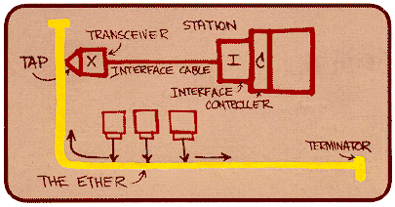
Ethernet back-off mechanism
Carrier sense: wait for link to be idle
If idle, start sending; if not, wait until idle
Collision detection: listen while transmitting
If collision: abort transmission, and send jam signal
Exponential back-off: wait before retransmitting
Wait random time, exponentially larger on each retry

Slide 35
TCP congestion control
Additive increase, multiplicative decrease
On packet loss, divide congestion window in half
On success for last window, increase window linearly
Window
Loss
halved
t
Other mechanisms: slow start, fast retransmit vs. timeout loss, etc.

Slide 36
Questions
What role should the network play in resource allocation?
Explicit feedback to the end hosts?
Enforcing an explicit rate allocation?
What is a good definition of fairness?
What about hosts who cheat to hog resources?
How to detect cheating? How to prevent/punish?
What about wireless networks?
Difficulty of detecting collisions (due to fading)
Loss caused by interference, not just congestion

Slide 37
End-to-End Arguments in System Design (ACM Trans. on Computer Systems, November 1984)
J. Saltzer, D. Reed, and D. Clark

Slide 38
End-to-end argument
Operations should occur only at the end points
… unless needed for performance optimization
2
4
3
1
5
Many things can go wrong: disk errors, software errors, hardware errors, communication errors, …

Slide 39
Trade-offs
Put functionality at each hop
All applications pay the price
End systems still need to check for errors
Place functionality only at the ends
Slower error detection
End-to-end retransmission wastes bandwidth
Compromise solution?
Reliable end-to-end transport protocol (TCP)
Plus file checksums to detect file-system errors

Slide 40
Discussion
When should the network support a function anyway?
E.g., link-layer retransmission in wireless networks?
Who’s interests are served by the e2e argument?
How does a network operator influence the network without violating the e2e argument?
Does the design of IP and TCP make it *hard* to violate the e2e argument?
E.g., middlebox functionality like NATs, firewalls, proxies
Should the e2e argument apply to routing?

Slide 41
The Design Philosophy of the DARPA Internet Protocols ACM SIGCOMM, 1988
David Clark

Slide 42
Life in the 1970s…
Multiple unconnected networks
ARPAnet, data-over-cable, packet satellite (Aloha), packet radio, …
Heterogeneous designs
Addressing, max packet size, handling of lost/corrupted data, fault detection, routing, …
ARPAnet
satellite net

Slide 43
Goals of initial Internet designers
Interconnect and multiplex resources of existing networks
Survive failures:
Must communicate so long as there is a physical path
Don’t place any state in the network core!
Support multiple types of communication service
Best-effort network: don’t impose any guarantees
Have endpoints build services with the desired guarantees
Others: distributed resource mgmt, easy host attachment, …

Slide 44
Discussion
Were the initial designers right to prioritize the goals they did?
Which goals still seem valid today, and which ones not?
Which goals were crucial to the Internet’s success?
Should network designers have resorted to best-effort?
Hard to measure: Compare to civil engineers and bridges
Accountability is hard when things go wrong
Is there a better substrate to offer multiple types of service?
What might be the associated costs?
What would you do differently today?

Slide 45
Until next time…
MUD: Send me your top 1—3 questions on this lecture
Readings for next class: 4D, ALF
Papers can take a few hours to understand, and that’s OK
Start thinking of project ideas
Discuss during office hours

