Slide 1

Network

Slide 2
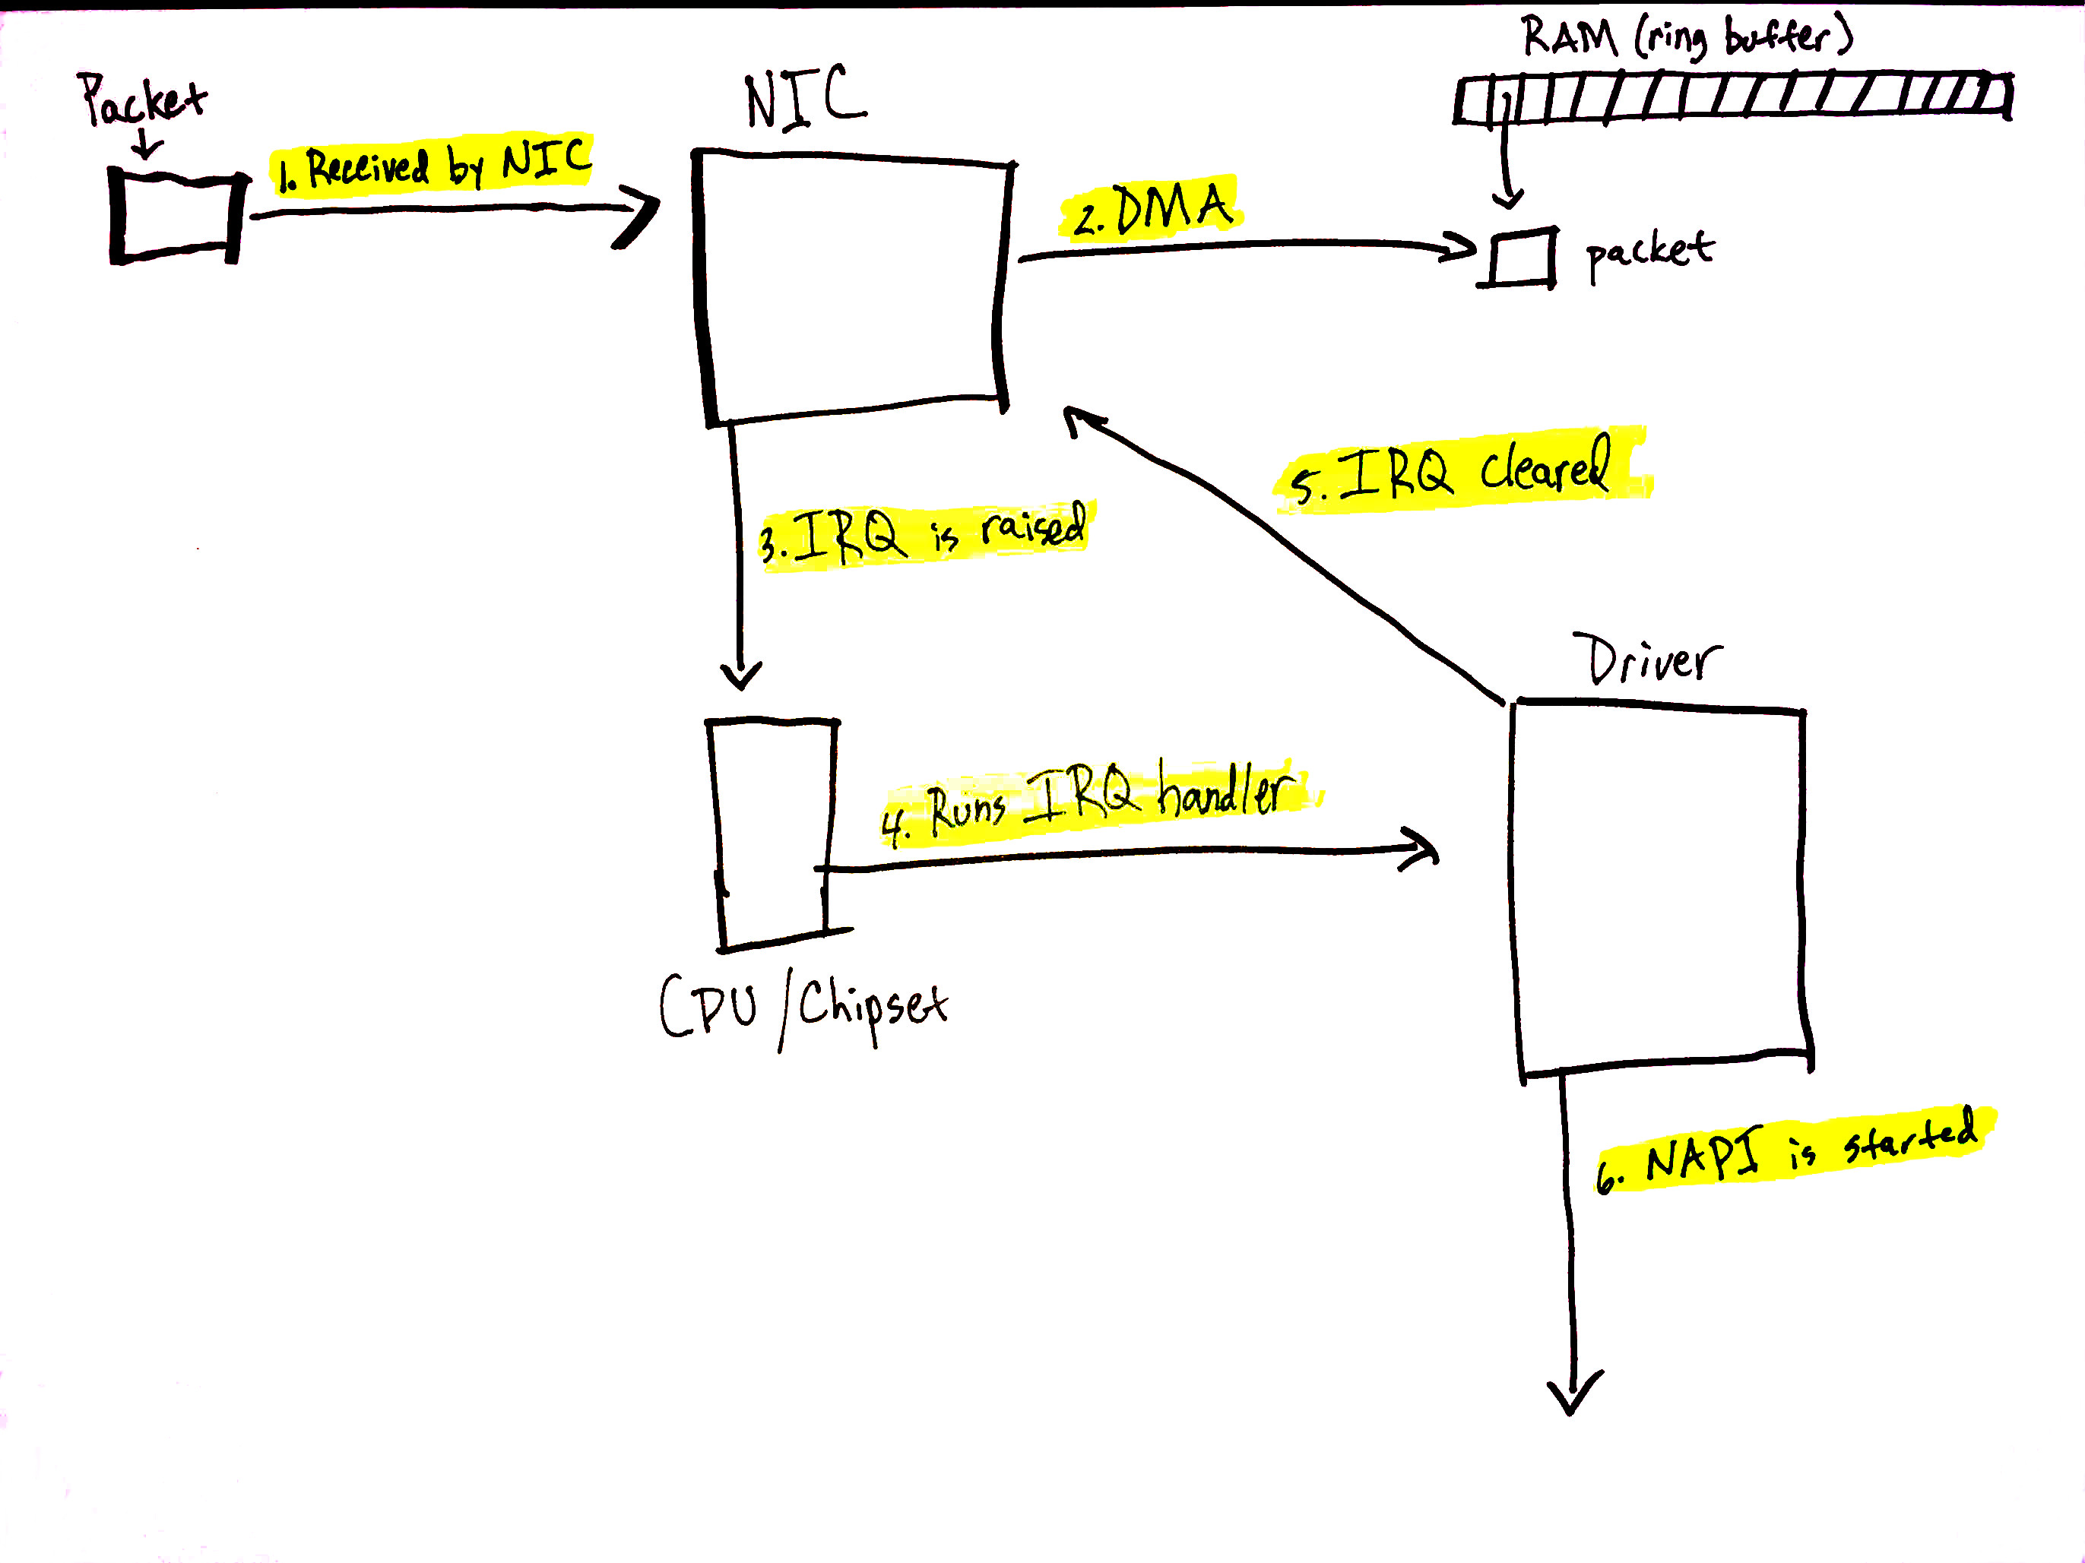
Modern NICs and architectures can also do direct cache access (DCA)
Notes:
Source: https://blog.packagecloud.io/eng/2016/10/11/monitoring-tuning-linux-networking-stack-receiving-data-illustrated/

Slide 3
Interrupt mitigation
Interrupt processing at high rate and priority prevents any other part of the system from progressing (receive livelock).
Mitigations:
(1) Interrupt coalescing:
Wait (at NIC) for more packets or a timeout until interrupting
(2) Polling to schedule the work, avoiding preemption
(3) CPU or packet quotas on polling to ensure other parts of the system (e.g. user space app) can progress
Re-enable interrupts if there is less work than allotted quota

Slide 4
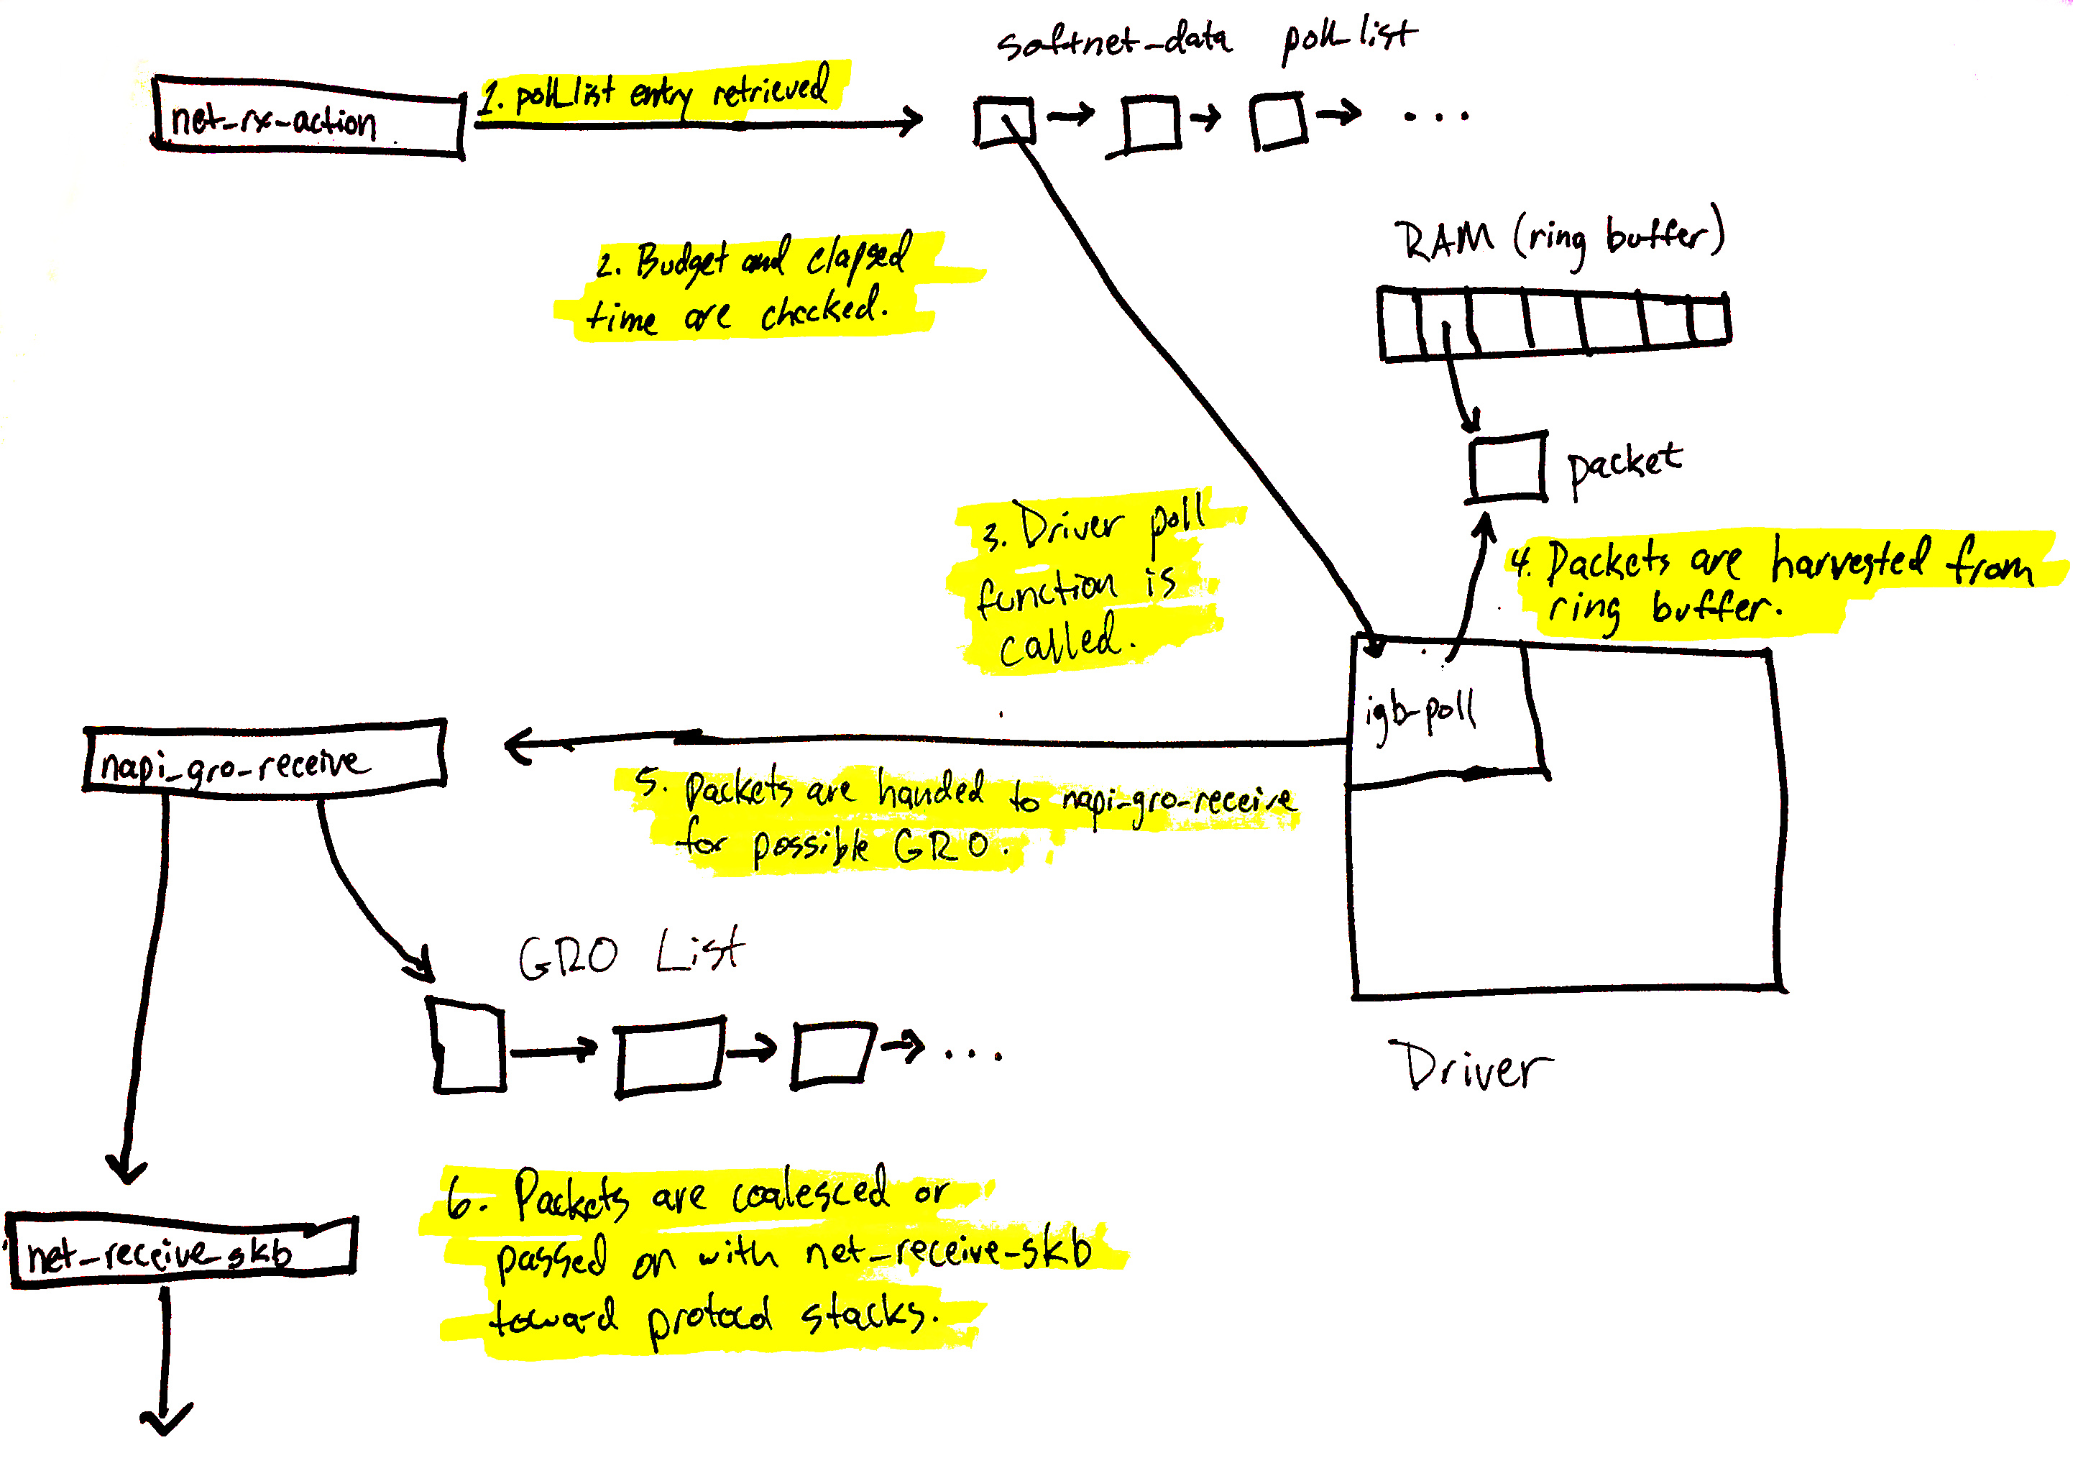
SoftIRQ
(apps cannot interrupt this processing)
Allocate packet data structures in memory (sk_buff, mbufs, …)
Optionally, steer packet to core running the application
Notes:
Source: https://blog.packagecloud.io/eng/2016/10/11/monitoring-tuning-linux-networking-stack-receiving-data-illustrated/
Linux kernel 3.13. Things have changed a bit since 4.15 with Edward Cree’s batching patch set. https://lwn.net/Articles/763056/

Slide 5
Other things that happen afterward
Netfilter: tracking TCP connection state, firewalling, NAT, tcpdump
IP protocol processing: routing
Transport processing (UDP/TCP protocol layer)
Copy into user space socket buffers
Applications use socket APIs to process the packets
Work that is independent per (group of) packets can often be handed off to the NIC. These are often referred to as NIC offload
TSO: TCP segmentation offload; LRO: Large Receive Offload
IP checksum (transmit & receive)
https://www.kernel.org/doc/html/latest/networking/segmentation-offloads.html

Slide 6
Different Kinds of Packet Steering
Receive-Side Scaling (RSS)
NIC determines which CPU to hardware interrupt (IRQ)
NICs have multiple queues, process each queue (potentially) at different CPU cores
Use a hash function over packet headers at NIC to direct to cores
Each NIC receive queue has a different associated IRQ #
IRQs can be configured to have affinity to specific CPU cores
This CPU runs the hardware interrupt handler
Receive Packet Steering (RPS)
select CPU to handle protocol processing after interrupt handling (starting from netif_receive_skb). Use inter-processor interrupts
Useful as a pure software method to distribute protocol processing

Slide 7
Different Kinds of Packet Steering
Receive Flow Steering (RFS)
Like RPS, but consider the CPU where the application is running
Improve data cache hit rates (packet read on the same CPU core that it was written to)
Pure software technique
Accelerated Receive Flow Steering (aRFS)
Implement RFS affinity in hardware
Network stack identifies which CPU is processing packets
Device driver programs the appropriate queue # into hardware
Needs hardware support

Slide 8
Socket buffers
Allocate packet data in arbitrary chunks (multiples of 64 bytes)
Support arbitrary packet sizes, fragments, deferred processing
*next
*next
*next
*prev
*prev
*prev
buffer
skb
skb
skb
…
*head
*data
*tail
*end
…
headroom
pkt data
tailroom

Slide 9
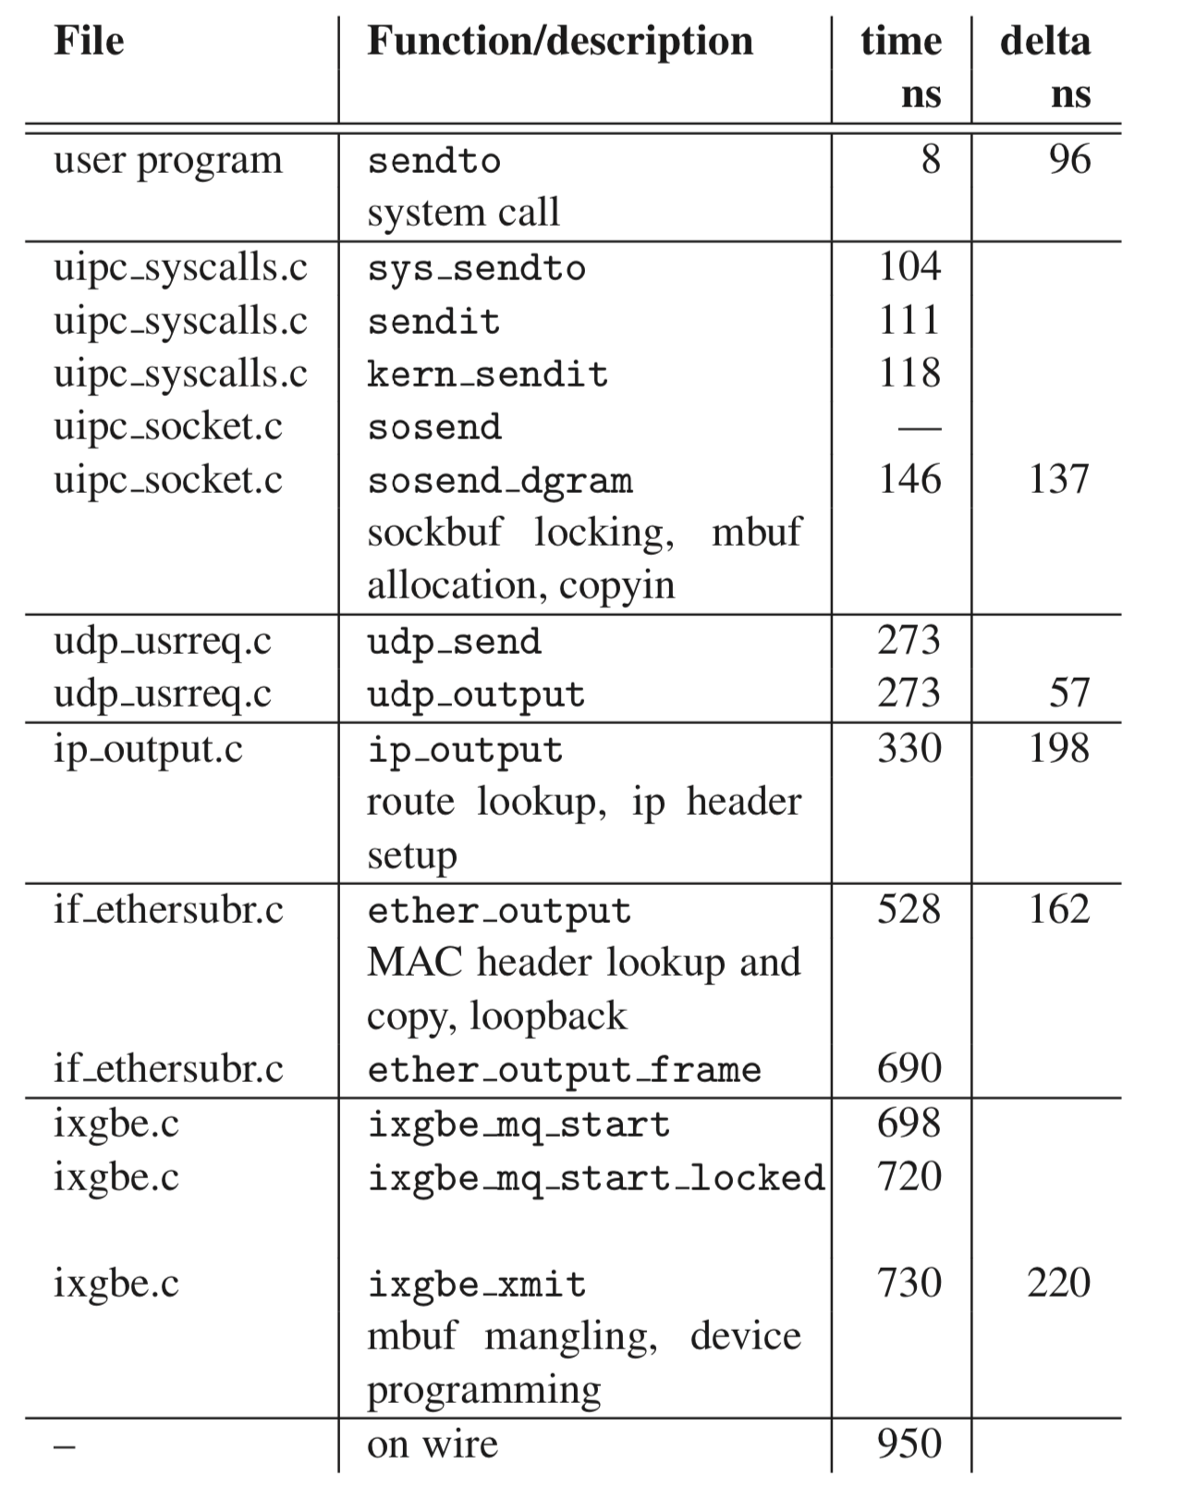
FreeBSD sendto() code path
Overheads are sprinkled throughout the packet processing stack.
Software specialization
Netmap ATC12.

Slide 10
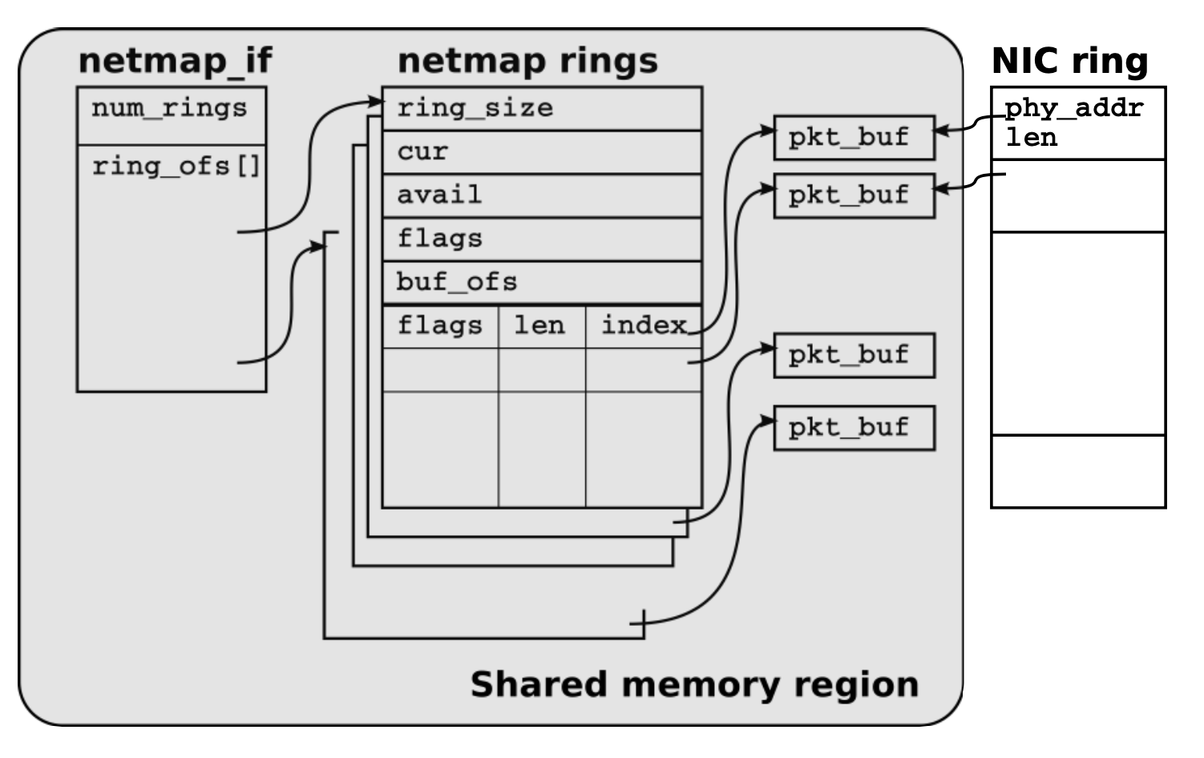
(1) Shared memory: avoid per-byte costs
Remove user-kernel data copies
Other systems use similar ideas:
Finish processing entirely within the kernel (e.g., click-kernel, eBPF)
Expressiveness
Expose NIC buffers directly to user space (PF_RING, DPDK)
Isolation

Slide 11
(2) Data representation: pre-allocated fixed size buffers and rings
Avoid per-byte costs by pre-allocating chunks of a fixed size (max packet size)
No allocation and freeing mbuf/sk_buff at run time
Exchange descriptors on ring buffers between app and NIC

Slide 12
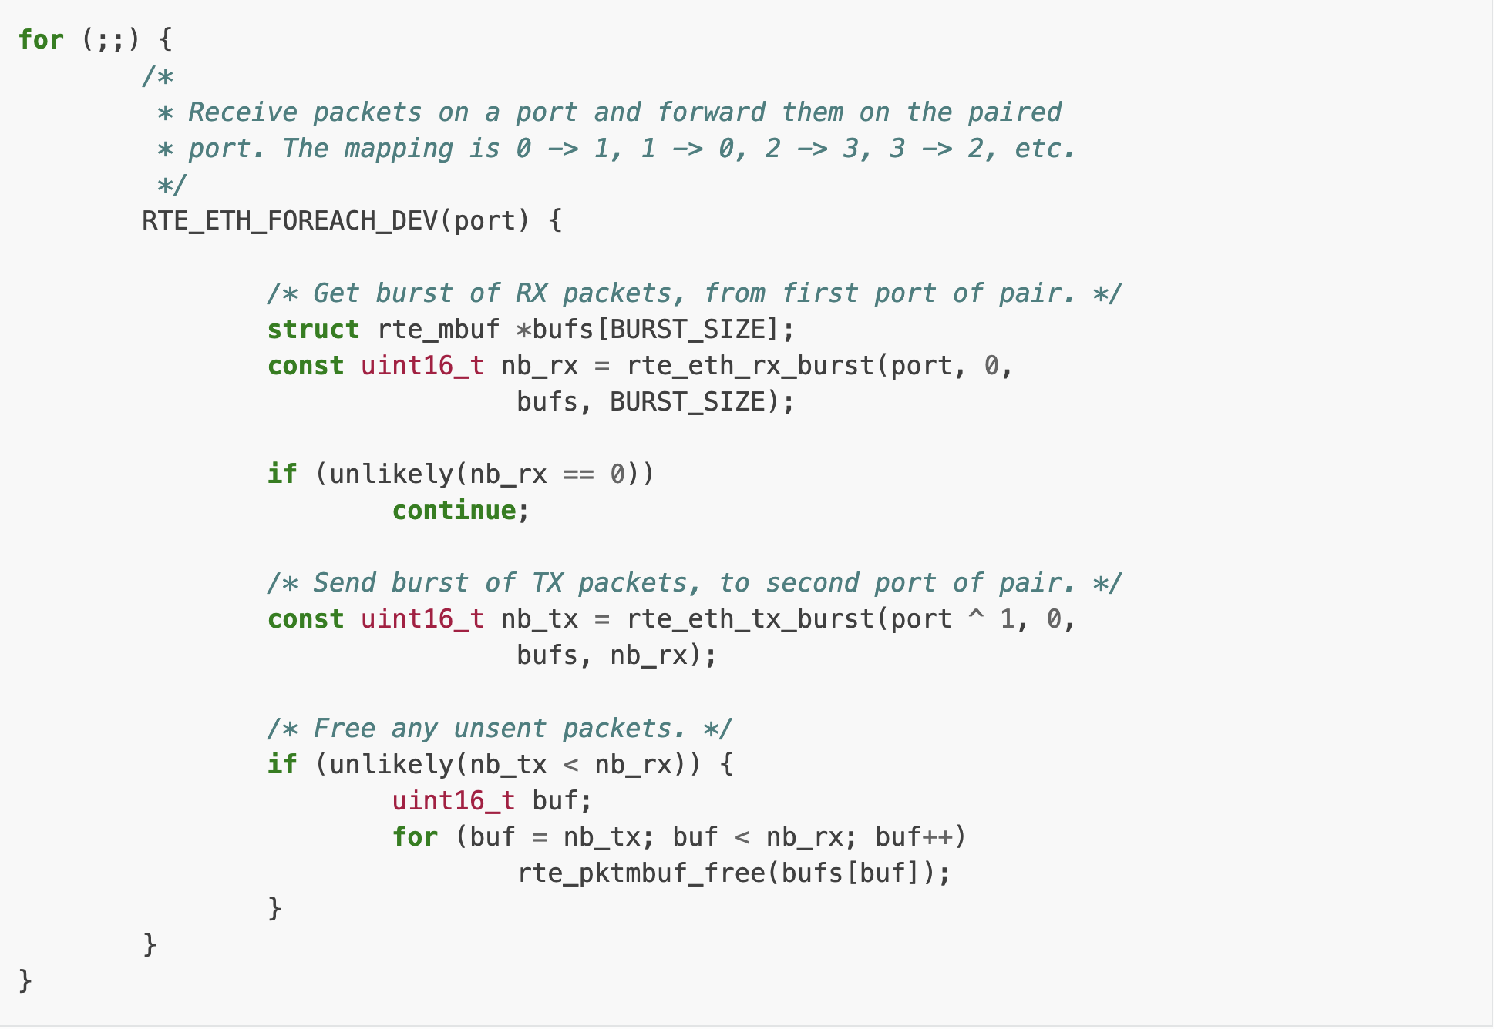
(3) Amortize operations: batching
Batch notifications to NIC for packets written for transmission or free buffers available for reception.
Process packets in batches
Effect: Better instruction cache hit rates

Slide 13
The abstraction has changed!
The techniques above (embodied into fast packet processing frameworks like netmap, DPDK, eBPF) aim to move data to applications quickly
Ideal for middleboxes and software routers
But if needed, applications must re-implement functionality that is already part of the kernel network stack (e.g. transport)
The benefit of these frameworks is less clear for application endpoints which do need transport, routing, …
Typical utilities (ping, tcpdump, etc.) may no longer work
The story becomes more complicated with virtualization

Slide 14
Case studies

Slide 15
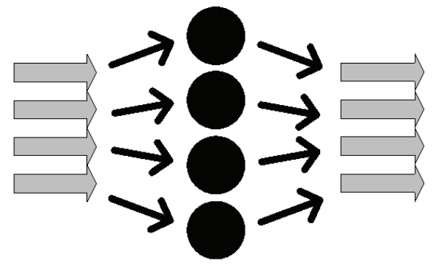
Routebricks: fast software router
Inspiration from interconnects
Fast processing on a single machine
Multi-queue NICs
Data interconnection patterns between queues and cores
Receive side scaling (RSS)

Slide 16
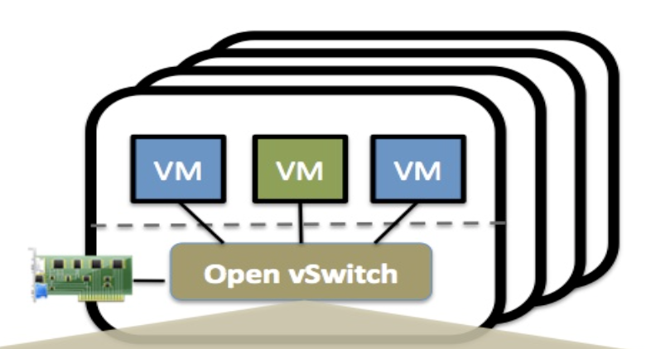
OpenVSwitch: fast virtual switch
Early roots in networking: first switches were fully in software
Until high link speeds forced everyone to make ASICs
As a tool for experimentation with SDN protocols (eg: Openflow)
Advent of virtualization
Need flexible policies (ie: flow rules) inside endpoints!
https://www.openvswitch.org/

Slide 17
Policies in virtualized switches
Tenant policies
Network virtualization: I want the physical network to look like my own, and nobody else is on it. Use own addresses
Provider policies
Traffic must follow the ACLs and paths set by the provider
Topology traversal
Use the core of the DCN as a mesh of point to point tunnels

Slide 18
Where should policies be implemented?
App
App
App
App
Virtual machine
Container
Lambda
Hypervisor (OR) orchestrator

Slide 19
OpenVSwitch: Requirements
Support large and complex policies
Support updates in such policies, e.g., VM migration, new customers, …
Don’t take up too much resources (CPU must do useful work, not just policy processing)
Process packets with high performance
High throughput and low delay

Slide 20
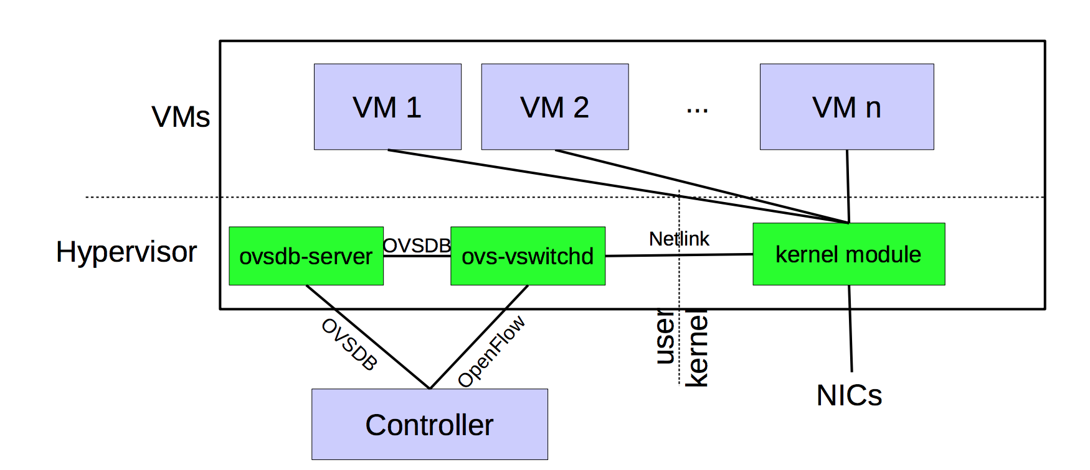
OVS design

Slide 21
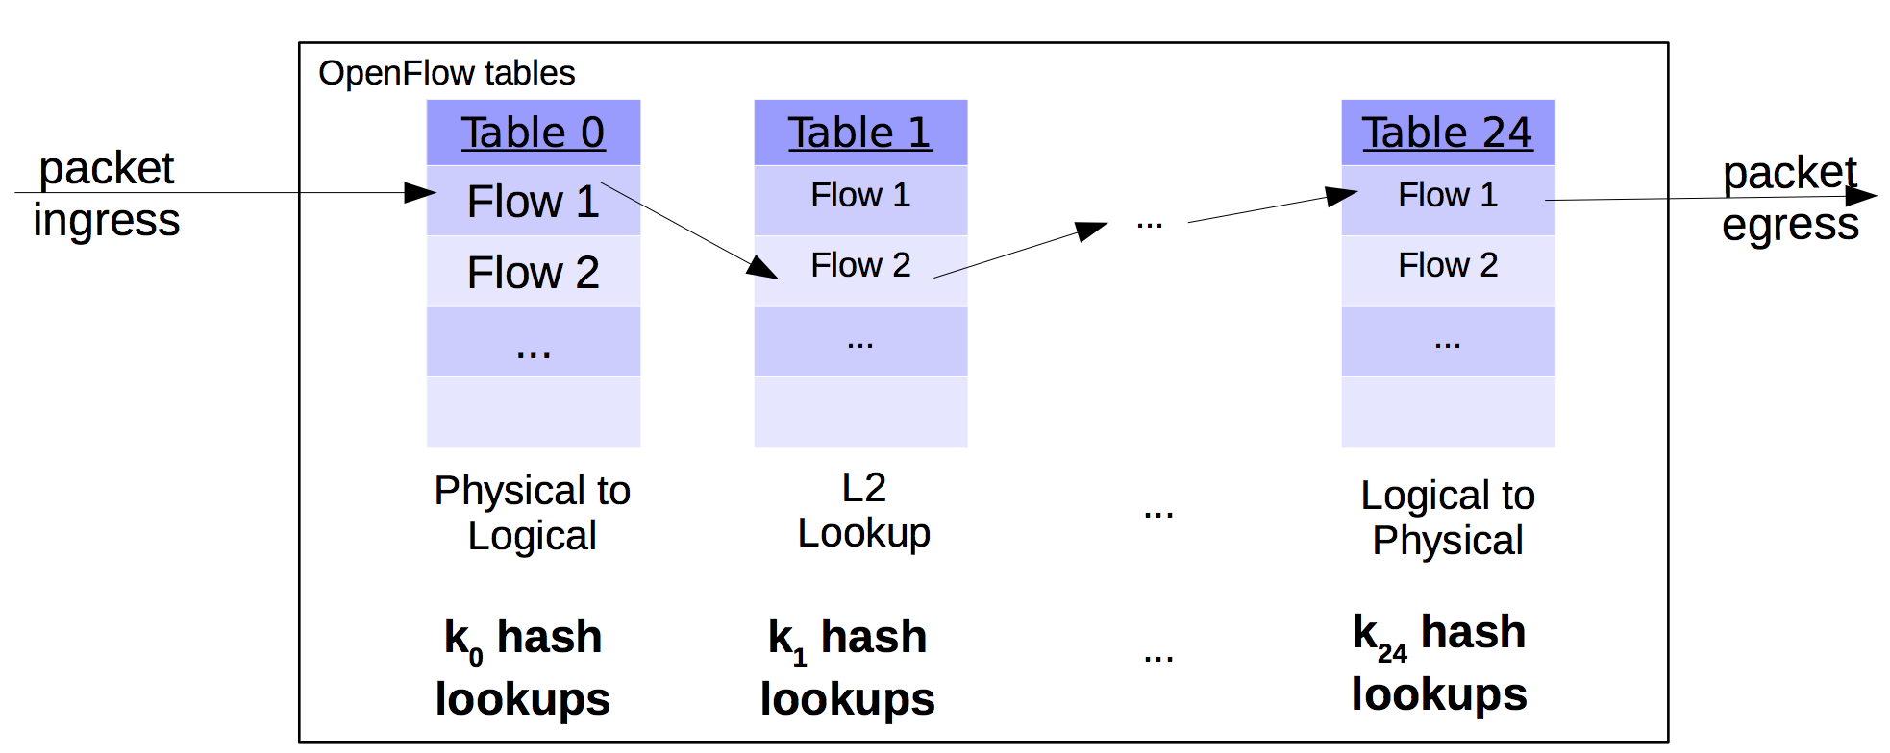
First design: put OF tables in the kernel
Large policies: Low performance with 100+ lookups per packet
Merging policies is problematic: cross-product explosion
Complex logic in kernel: rules with wildcards require complex algoriths

Slide 22
Idea 1: Microflow cache
Microflow: complete set of packet headers with action
Example: srcIP, dstIP, IP TTL, srcMAC, dstMAC
Same insight as tuple space search; attempt to do one memory lookup per packet
Hit
Microflow cache in the kernel
Use a large hash table
Openflow table in user space
Miss

Slide 23
Problems with micro-flows
Too many micro-flows: e.g., each TCP port
Many micro-flows may be short lived
Poor cache-hit rate for memory lookup
Can we cache the outcome of rule lookup directly?
Naive approach: Cross-product explosion!
Example: Table 1 on source IP, table 2 on destination IP
Recurring theme: avoid up-front (proactive) costs

Slide 24
Idea 2: Mega-flow cache
Build the cache of rules lazily using just the fields accessed
Ex: contain just src/dst IP combinations that appeared in packets
Hit
Megaflow cache in the kernel
Use tuple space search
Miss
Openflow table in user space

Slide 25
Outlook: fast packet processing
Get rid of needless software if you can
Specialization to app can bring significant benefits
IDS (hyperscan), caching in switches & load balancers
Algorithms can be as important as the frameworks
Software changes
Application-kernel interface: application must be modified
Device drivers must often be modified
Multitenancy: think about implications to weakening fault isolation
Can we get isolation with efficiency?

Slide 26
Going beyond one (software) box
Safe & efficient composition of middleboxes
Share or shard state
Failover and migration
Placement and routing
Scaling and compaction

